Slide 1
The Vulcan Chip
Analog
Ugur Yegin, Nina Parkalian, Pavithra Muralidharan, Christian Roth
Hamburg
18 September 2017

Slide 2
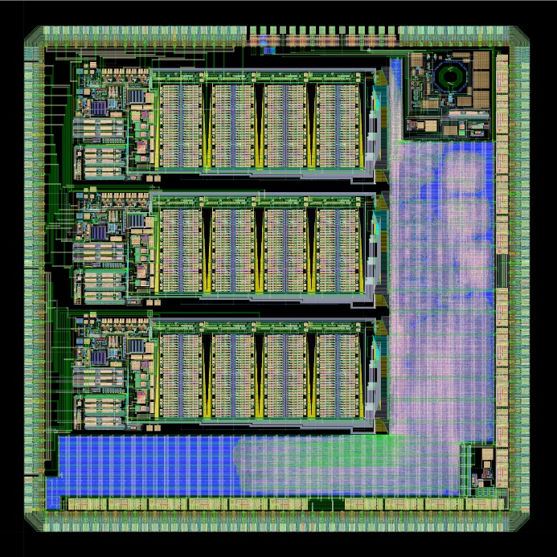
VULCAN: basics and introduction
3 identical input channels sensing different signal ranges, all independently adjustable
1 amplification stage (TIA), power supplies, DAC’s and 4 6-bit ADC’s (8-bit if combined) per channel
All clock signals provided by on chip PLL
Smart data selection by digital core, buffers available for short term storage
Data output by 16 LVDS pairs
4.7mmx4.7mm (ca 22mm²) with TSMC65 GP, QFN88 double row package
TIA, power supply, DAC‘s, TRG
Layout of second Vulcan prototype
PLL
4x6 bit ADC‘s
4.7 mm
Digital core
Digital core
LVDS

Slide 3
VULCAN: Overview of current status
1 test chip (all units as stand-alone blocks) and 2 prototypes (full signal chain) successfully tapeouted
Test chip and 1st prototype measured, verified. Christian Roth will present.
1st prototype served as platform for debugging errors, all mended before 2nd prototype
2nd prototype is production ready version, will arrive at CW 45-47
Verification plan being assembled now
Production run (dedicated mask set) due in 2018

Slide 4
Vulcan Schedule
 | 2017 |  |  |  |  |  |  |  |  |  |  |  | 2018
 | Q1 |  |  | Q2 |  |  | Q3 |  |  | Q4 |  |  | Q1 |  |  | Q2 |  |  | Q3 |  |  | Q4
Vulcan | Verification Pt1
 |  |  |  |  |  |  | FAB & Packaging
 |  |  |  |  |  |  |  |  |  |  | Verification Pt2
 |  |  |  |  |  |  |  |  |  |  |  |  |  |  |  | Fab & Packaging
 |  |  |  |  |  |  |  |  |  |  |  |  |  |  |  |  |  |  |  | TEST
07.08.2017: TO PT2
CW45-47: Silicon back
4.4.2018: Start Production
31.08.2017: Silicon back
NOW

Slide 5
VULCAN: 1st → 2nd prototype
All functional blocks already included on 1st prototype
Minor bugs preventing plug&play operation, solved by FIB
Improvements implemented on 2nd prototype
  Digital
    Timing of clocktree (for both digital circuits and ADC) and LVDS improved significantly
    Scanchain test implemented
    Power routing improved significantly
  Power
    Capless LDO‘s improved to serve different current consumption windows
    Improved power supply for TIA to match for low input impedance over bandwidth
    Optional 1-supply voltage only operation implemented
  TIA
    Improved measurability and power supply strategy for biasing
  PLL
    Improved linearity of amplitude
    Output buffer made bypassable

Slide 6
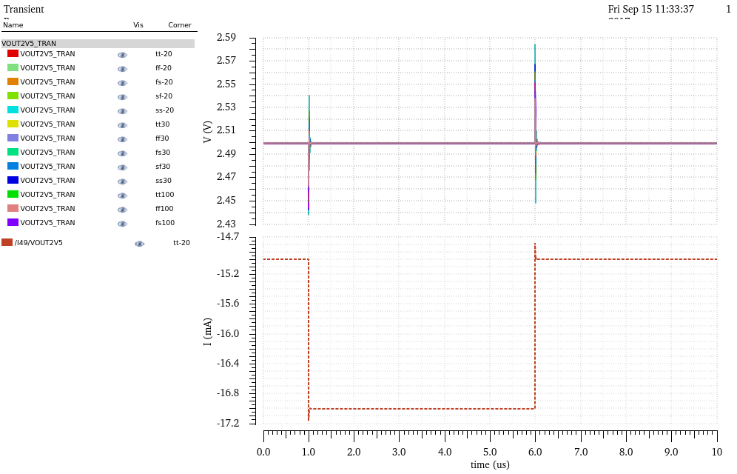
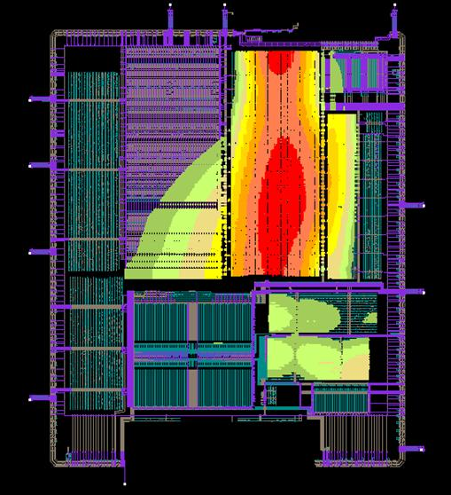
Featuring: Power management
Capless regulators to reduce risk of external component failure during long term operation
Regulators comprise of regular LDO structure assisted by NMOS diodes
Current output range adjustable (up to 50mA for LDO‘s, 200mA for linear regs)
Digital structures, LVDS cells powered by typical linear regulators
TIA stages powered by adjustable diodes for bandwidth reasons
EM&IR test conducted using Voltus
VDD_ext (3.3V or 1.8V)
VREF (1V)
Act. tr
Act. tr
Diode
Diode
AMP
VOUT_in (2.5V or 1V)

Slide 7
Featuring: Overshoot
Implemented to compensate the overshoot effect at the TIA input
Excess current generated by input bias resistor generated by OSC instead of TIA
For low gain channel, OSC performs as ADC input stage
Versatile switching structure allows OSCOUT to perform as test input for ADC

Slide 8
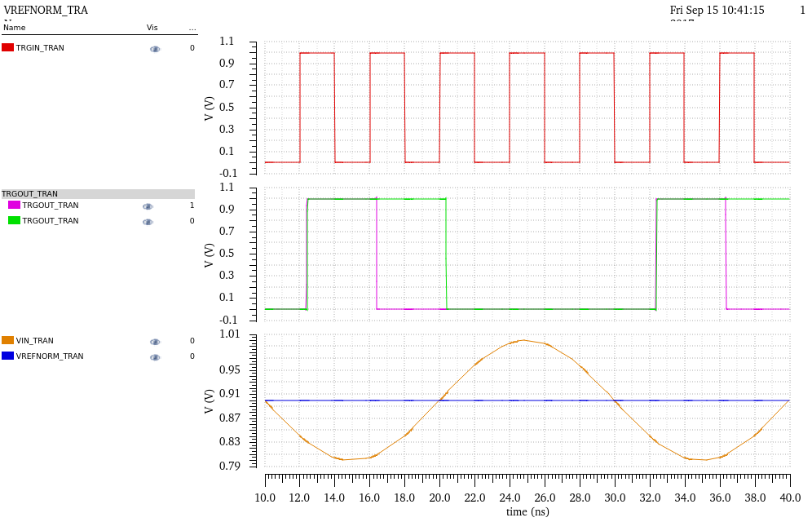
Featuring: Analog Trigger
IN
Latch
Independent trigger structure signalling events
Dedicated LVDS output to bypass ADC and digital core
Dynamic comparator with 250MHz, operable with up to 1GHz
Less than 350ps propagation delay, overall reaction time limited by operating frequency
Output single pulse or long pulse, depending on preference and external FPGA
Dyn. Comp
REF
DFF
LVDS
CLK
Delay

Slide 9
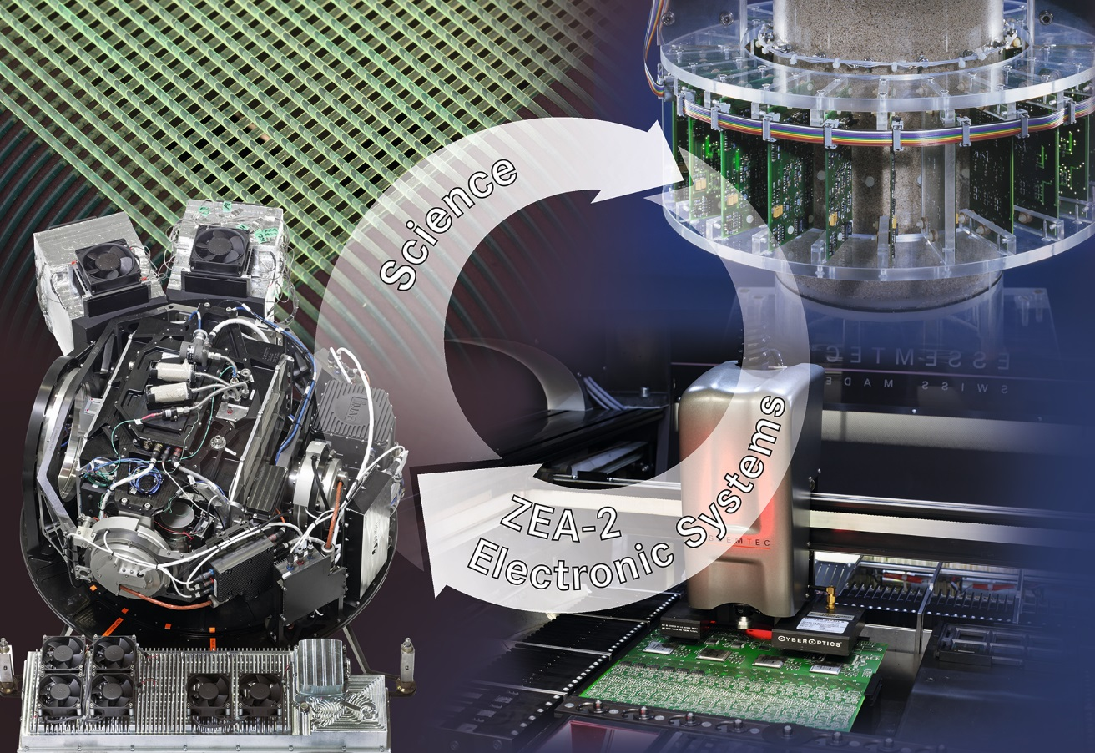
Thank you very much for your attention!

Slide 10
Backup slides

Slide 11
VULCAN: Overview of current status
Highly linear, fully integrated circuit – Vulcan
  Sampling ADC with approx. 80 dB linearity
  (3 signal chains with 3 different gains)
  No external components required
  On-chip clock generation from ref. clock
Precise signal reconstruction
  No analog delay line
  (reducing noise & distortion)
  Control loop to suppress DC variations
  Optional overshoot compensation
Further key parameters of Vulcan:
  ADC with 9.5 bit (3x 8 bit), 1 Gsample/s
  Input impedance of < 10 Ohm
  Power consumption ~ 1.2 Watt
Key Parameter of Vulcan
Process | 65 nm CMOS
Active Area | 22 mm²
Power | ~ 1.2 W
Input Impedance | < 10 Ohm
Input Bandwidth | 500 MHz
Sampling Rate | 1 Gsample/s
Dynamic Range | 80 dB
ADC Resolution | 3x 8 bit
High Gain | 0.06 p.e./bit
Medium Gain | 0.4 p.e./bit
Low Gain | 8 p.e./bit

Slide 12

Signal Modes – Small & Medium Signals
small & medium signal mode
large signal mode
First two signal chains
Parallel TIA input
Programmable gains
Combined input resistance
patent pending
$$R≈5 Ω$$

Slide 13

Signal Modes – Large Signals
small & medium signal mode
large signal mode
Third signal chain
Current > 20 mA
TIA input saturates, ESD diodes open
Voltage over diodes measured
Combined input resistance
patent pending
$$R≈5 Ω$$

Slide 14
Data Processing System
Major tasks of digital processor:
  Data selection
  (3 ADC → 1 sample)
  Meta data generation
  (ADC source, system events)
  Data buffering
  (Deal with meta data overhead)
Data suppression for noise
  Determined by threshold
  Cut off 4 MSBs
Buffer size based on
supernova simulation
Simulation in cooperation with
F. Lenz (RWTH Aachen)

Slide 15
Additional Digital Features
Dedicated Trigger Lines
Fast response on signals
  One LVDS line per ADC
Source selectable during runtime
  Analog or digital threshold trigger
  Two integral triggers
Baseline Regulation
Feedback loop to correct baseline
  Regulation only in noise mode
Configurable during runtime
  Enable
  Threshold
  Speed

Slide 16
Reliability Measures
Generally: Product failures in different phases:
  Infant mortality due to manufacturing defects
  Normal life & ware-out due to electromigration
    Electromigration covered by design & simulation
Manufacturing defects due to process variations
  Varying between wafers and with position on wafer
  Goal: Filter out all unreliable ICs, only stable survive
Extensive verification plan for product tests
  Structural scan test and IDDQ test for digital circuits
  Stress test to verify electro migration
  Functionality test and performance selection
Bathtub curve, source: Wikipedia
Strong Defects
Not operational transistors/wires
Immediate impact on functionality
Weak Defects
Weakened wire, wears out over time
Fails with stress on circuit

Slide 17
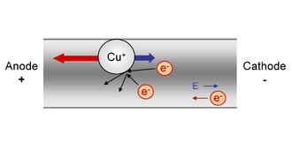
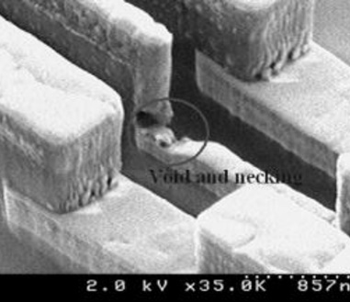
Electromigration-Aware Design
Material transport by gradual movement due to electron collisions
  Dependent on current density in the conductor
  Degradation of the metal over time
  Leads to connection faults in the design
Prevent by design methods
  Use wider/multiple conducting wires
  Use multiple vias instead of single vias
Perform electromigration studies
to estimate degradation prior tapeout
  Based on IR drop simulation
  Detailed power consumption analysis
  Critical areas are easily visible
Electromigration effect
IR drop analysis

Slide 18
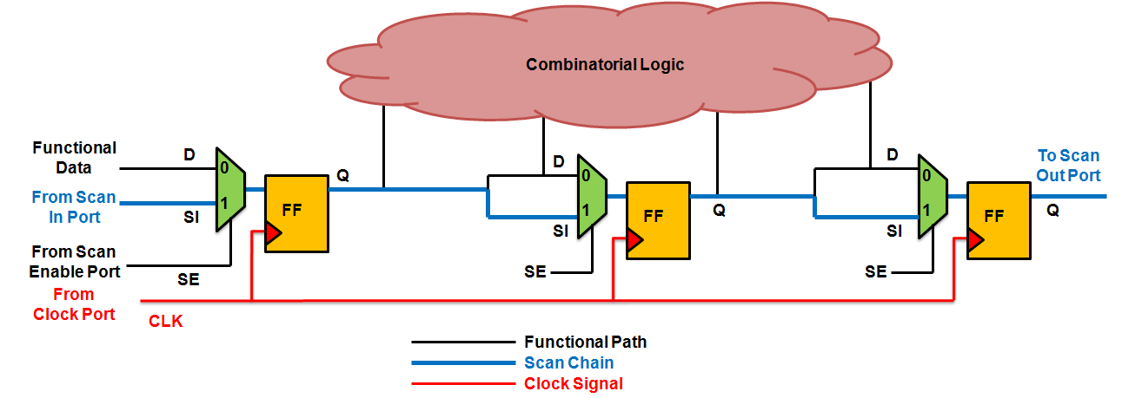
Structural Scan Tests
Digital part composed of combinatorial and sequential logic
  Goal: Test the functionality of digital gates
  Method: Include a scan chain to determine faulty gates
Flip flops (FFs) exchanged by scan FF
  Two modes for operation:
  regular and scan
  Scan data loaded through scan
  chain, representing logic state
  Data is processed through
  combinatorial logic
  Data shifted out to scan output
Scan pattern generated by ATPG tool
Detects single stuck-at-fault gates and delay faults
ATPG = automatic test pattern generator
Vulcan: 140,000 FFs

Slide 19
Vulcan Schedule
 | 2017 |  |  |  |  |  |  |  |  |  |  |  | 2018
 | Q1 |  |  | Q2 |  |  | Q3 |  |  | Q4 |  |  | Q1 |  |  | Q2 |  |  | Q3 |  |  | Q4
Vulcan | Verification Pt1
 |  |  |  |  |  |  | FAB & Packaging
 |  |  |  |  |  |  |  |  |  |  | Verification Pt2
 |  |  |  |  |  |  |  |  |  |  |  |  |  |  |  | Fab & Packaging
 |  |  |  |  |  |  |  |  |  |  |  |  |  |  |  |  |  |  |  | TEST
JUNO
07.08.2017: TO PT2
CW45-47: Silicon back
Integration Measurements:
4.4.2018: Start Production
PCU
31.08.2017: Silicon back
27.3
Base
Engineering Samples
24.4
GCU
First Samples
Mid June
15.11.2017: 2nd prototype JUNO electronics
15.1.2018: Verification Review
2.4.2018: Production Readiness Review
1.10.2018: First set of final electronics ready for potting
NOW

