Slide 1
Vulcan IC Verification
Christian Roth
Forschungszentrum Jülich GmbH
Central Institute for Engineering, Electronics and Analytics
IC Verification
18-19 September 2017

Slide 2
Verification Setup
4GHz Integer PLL Measurement Results
Digital Differential Interface
ADC Measurement Results
PMT RF Sensitivity Spectrum Measurements

Slide 3
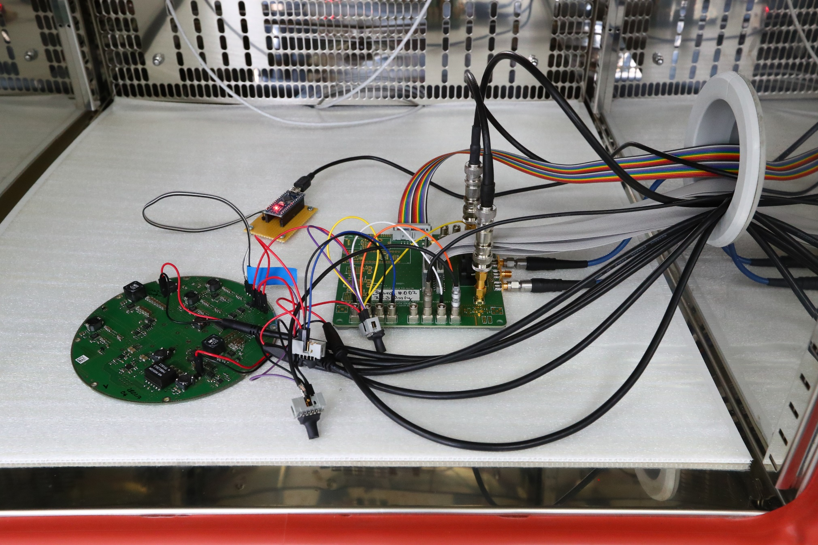
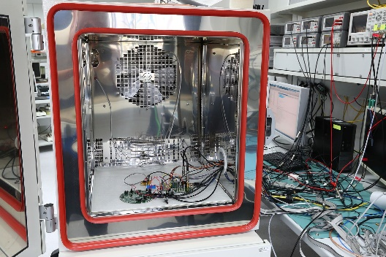
Measurement Setup
Power Board Controller
Vulcan Verification Board
Power Board

Slide 4
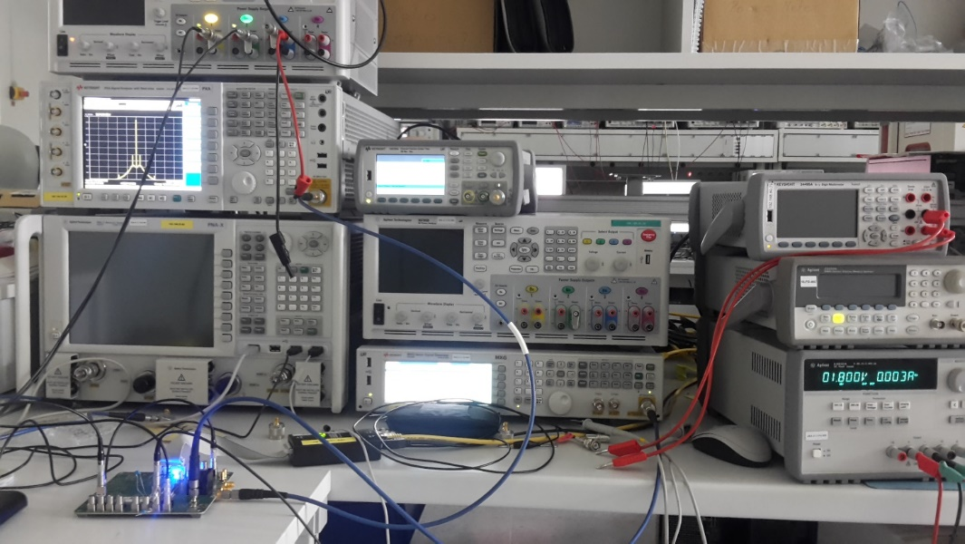
Measurement Setup

Slide 5
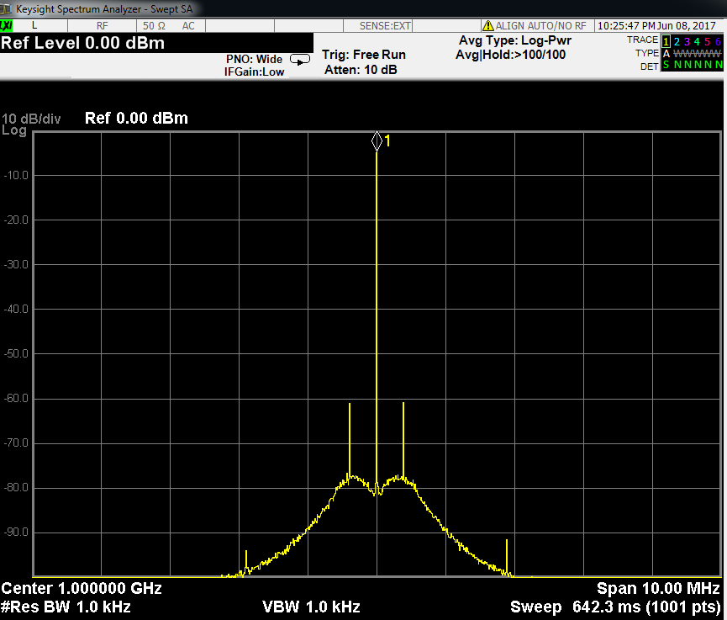
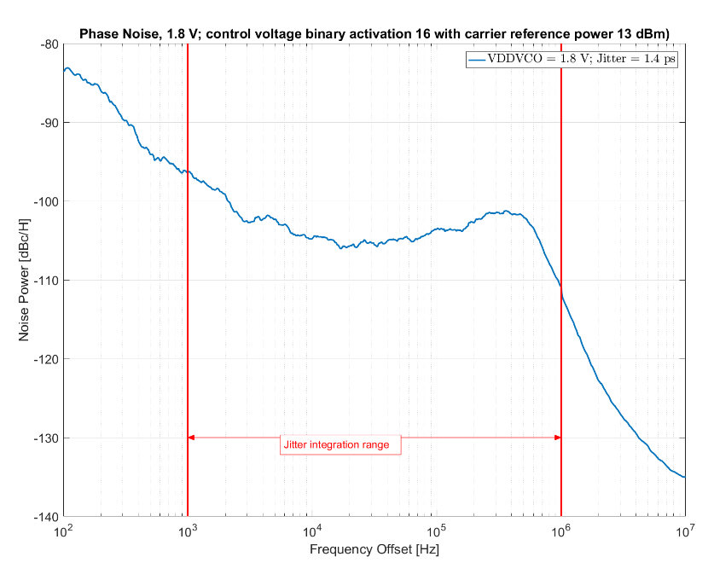
RF Spectrum of internal PLL
Phase Noise Measurement, Jitter 1.4ps

Slide 6
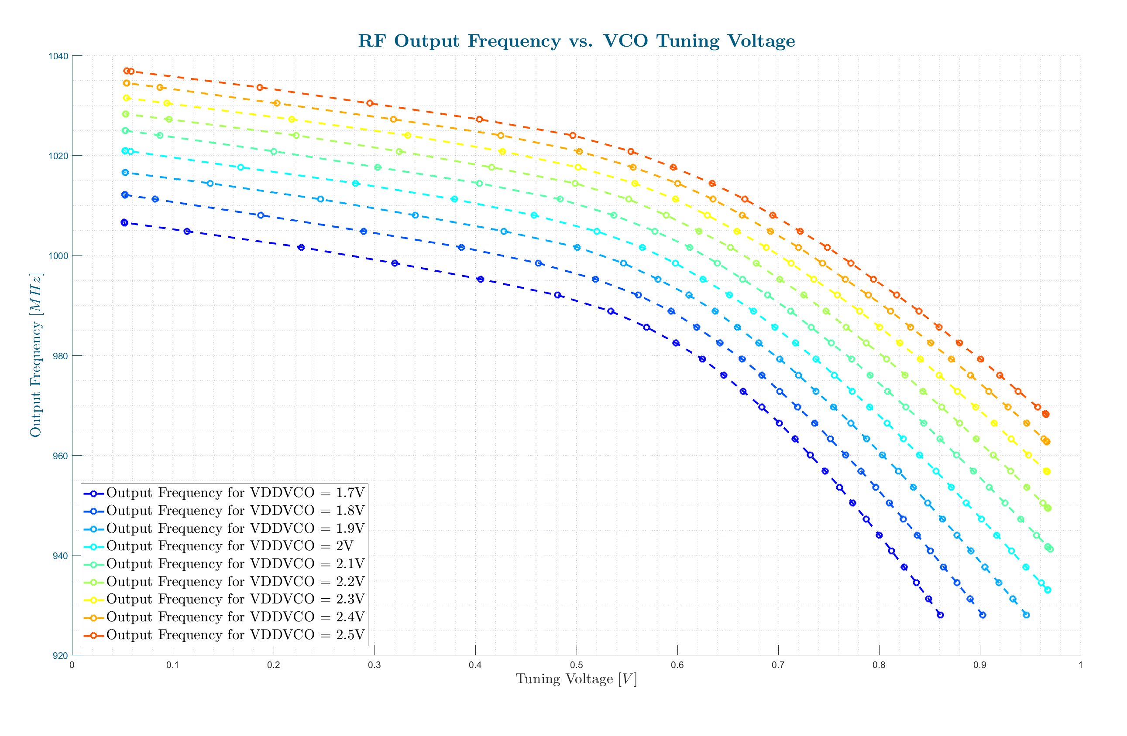
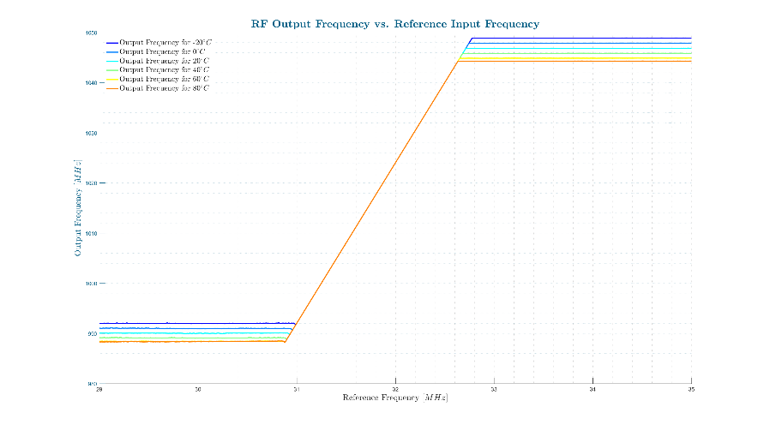
PLL Tuning/Locking Range vs. Temperature
1GHz target Frequency
1GHz target Frequency
Notes:
5,6,7 Backup 1Ghz highlight

Slide 7
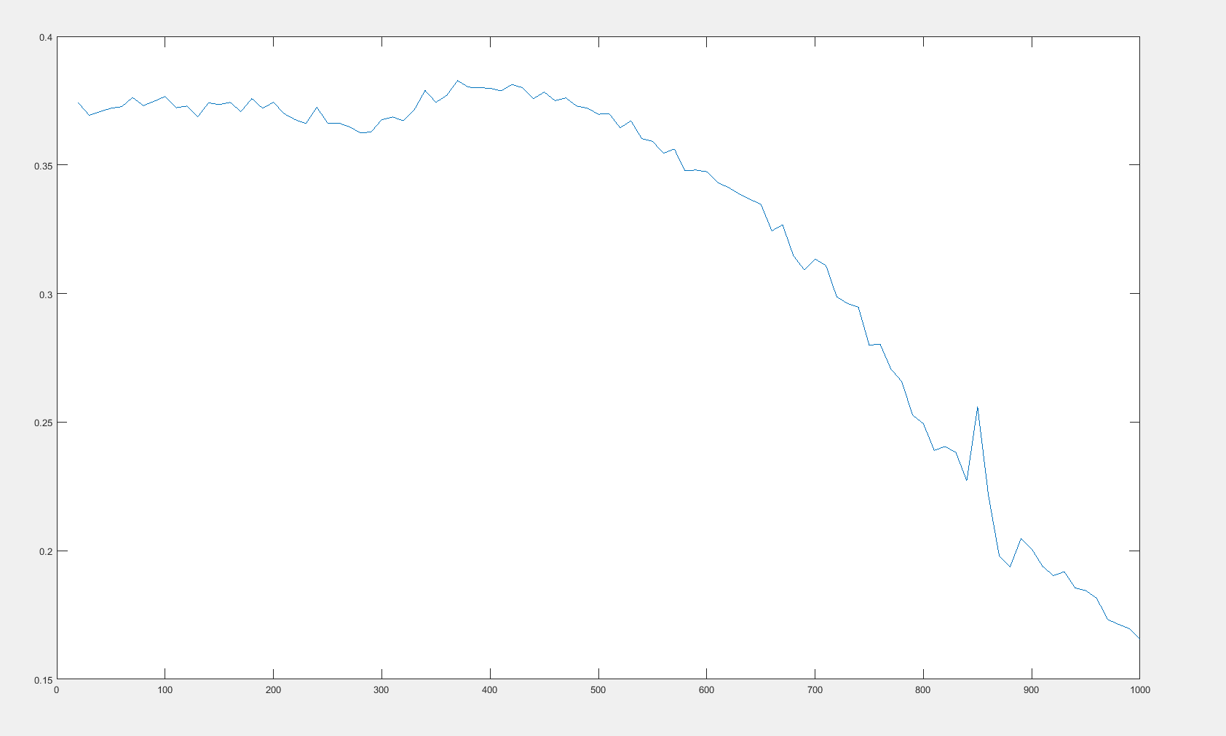
Digital Differntial Signal Level vs. Frequency
The LVDS Signal Amplitude is
decreasing above 500MHz
500MHz

Slide 8
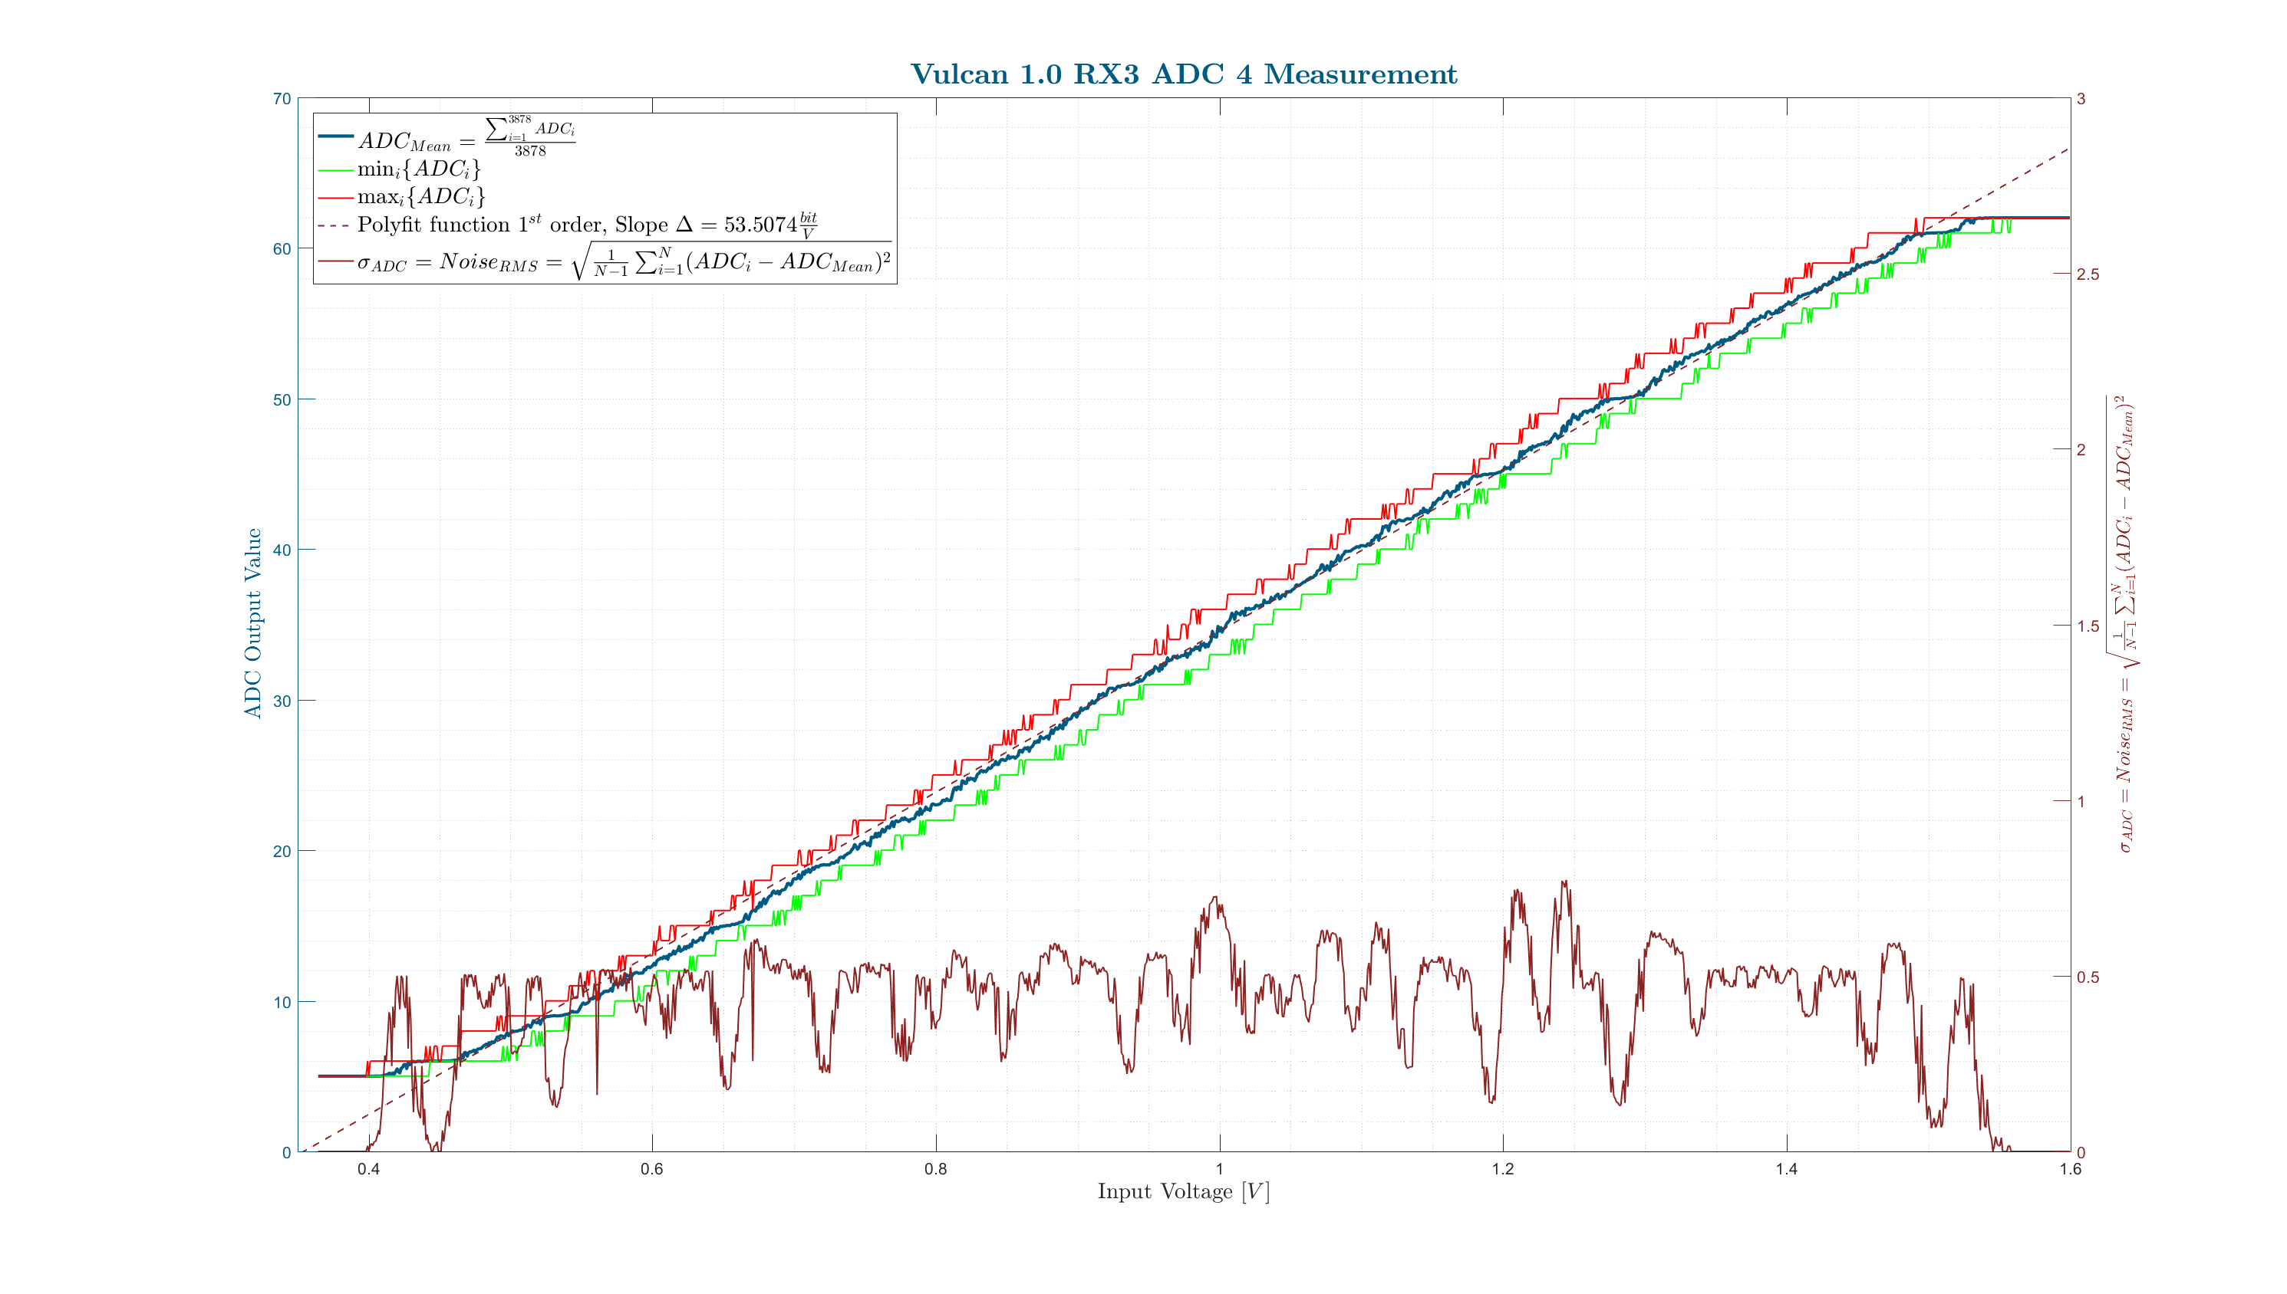
ADC Characteristic, RMS Noise, Min/Max

Slide 9
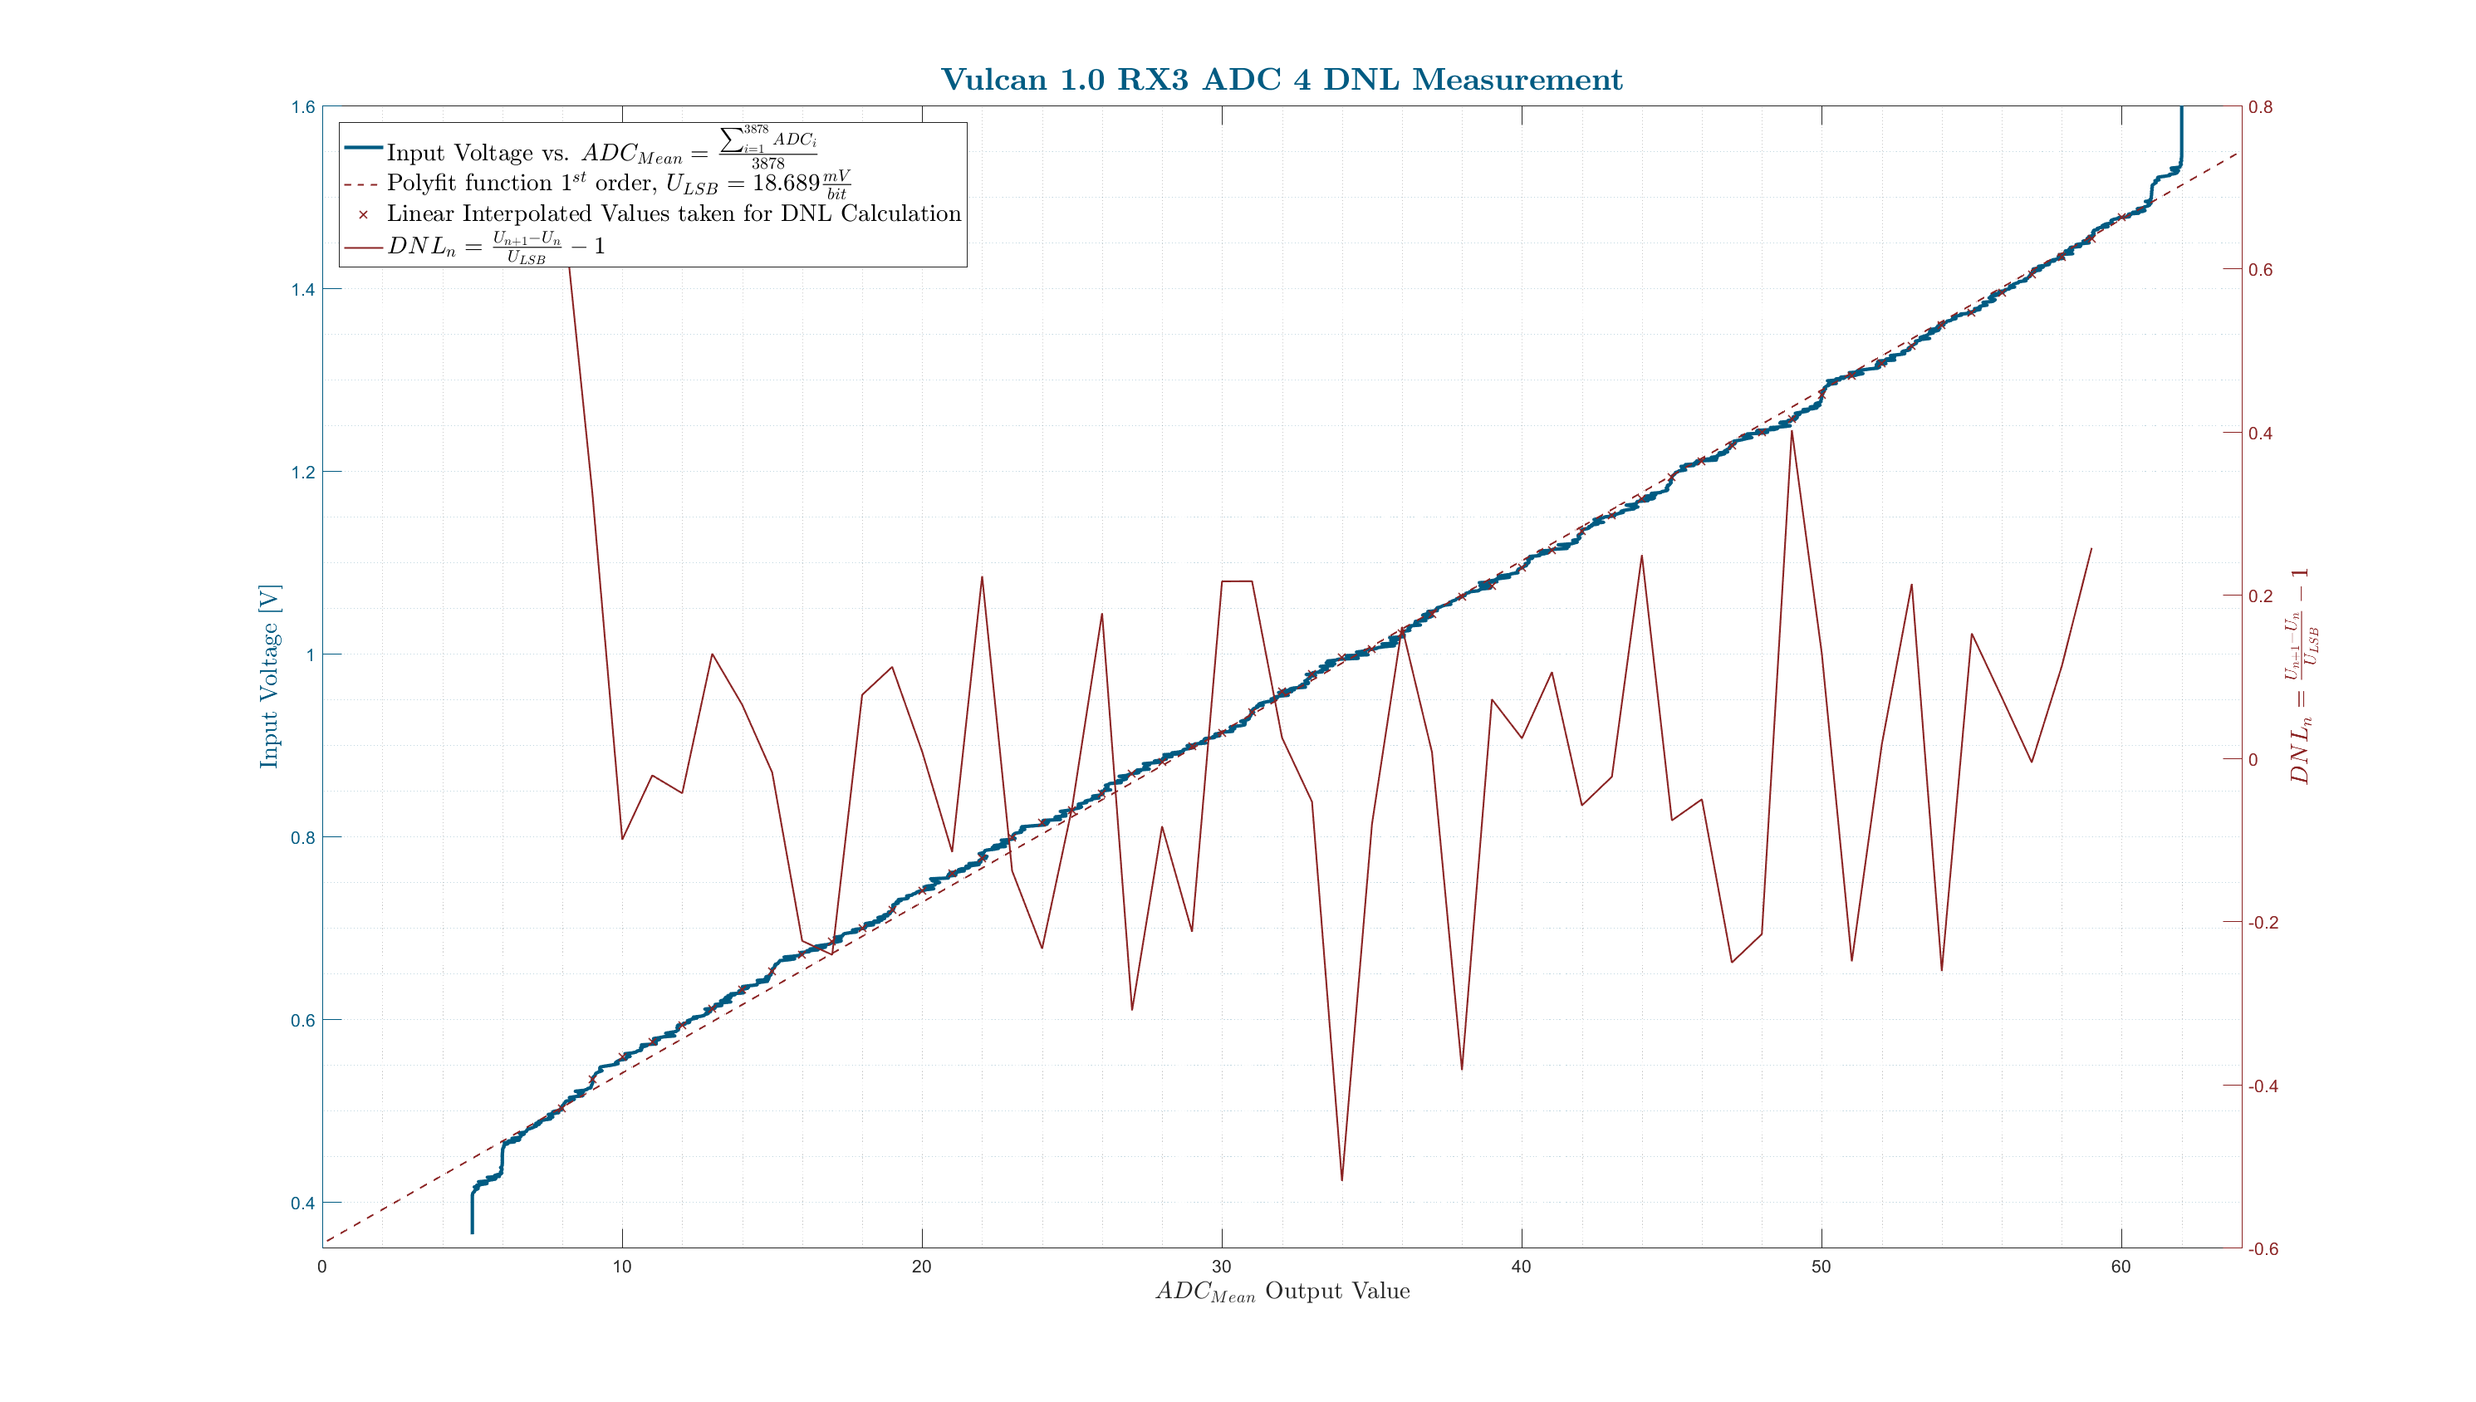
ADC DNL Measurement
Notes:
16/17 backup

Slide 10
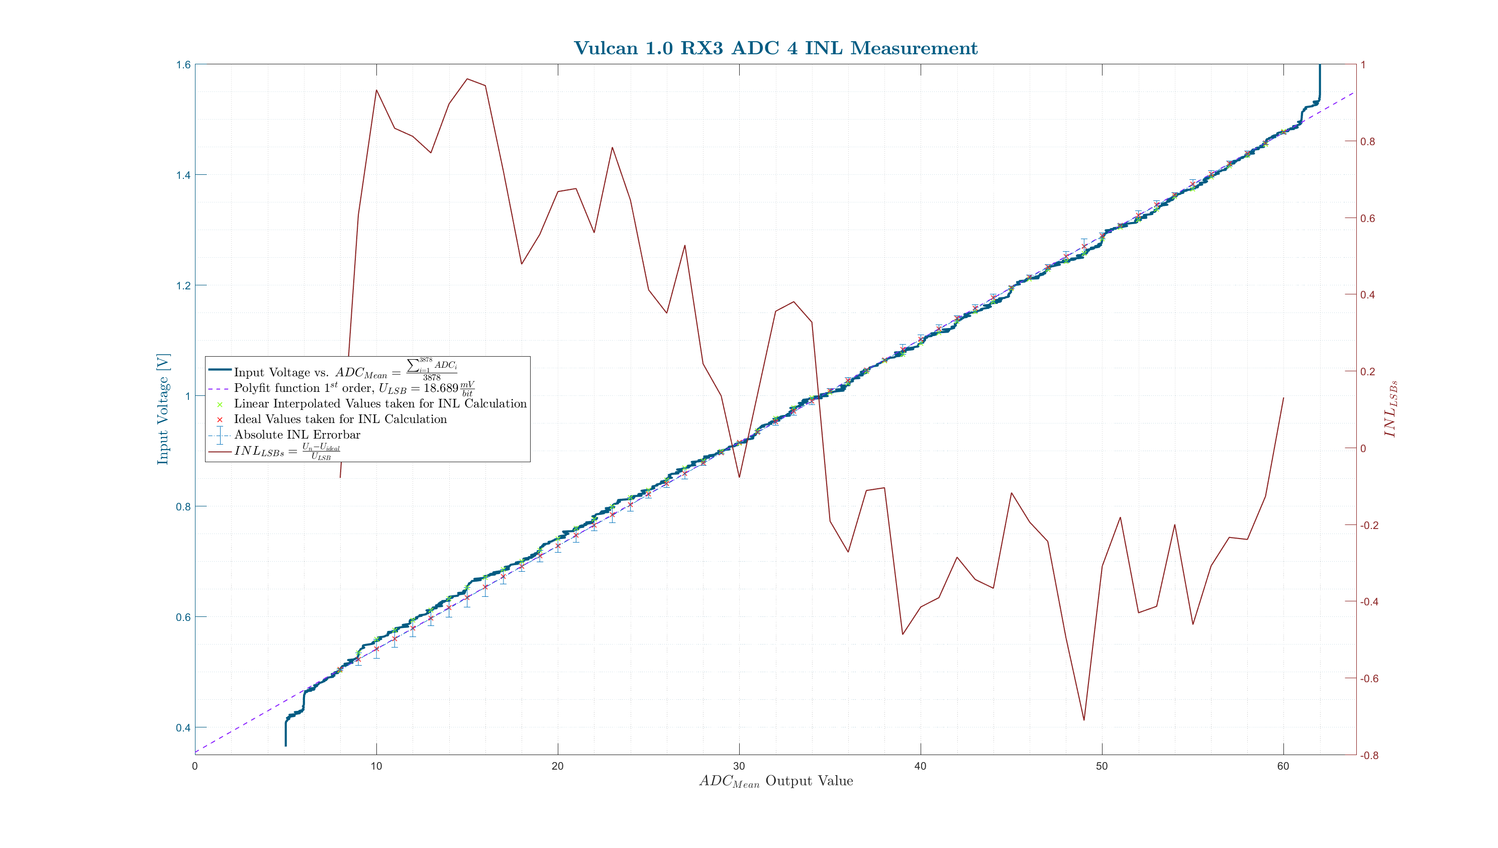
ADC INL Measurement

Slide 11
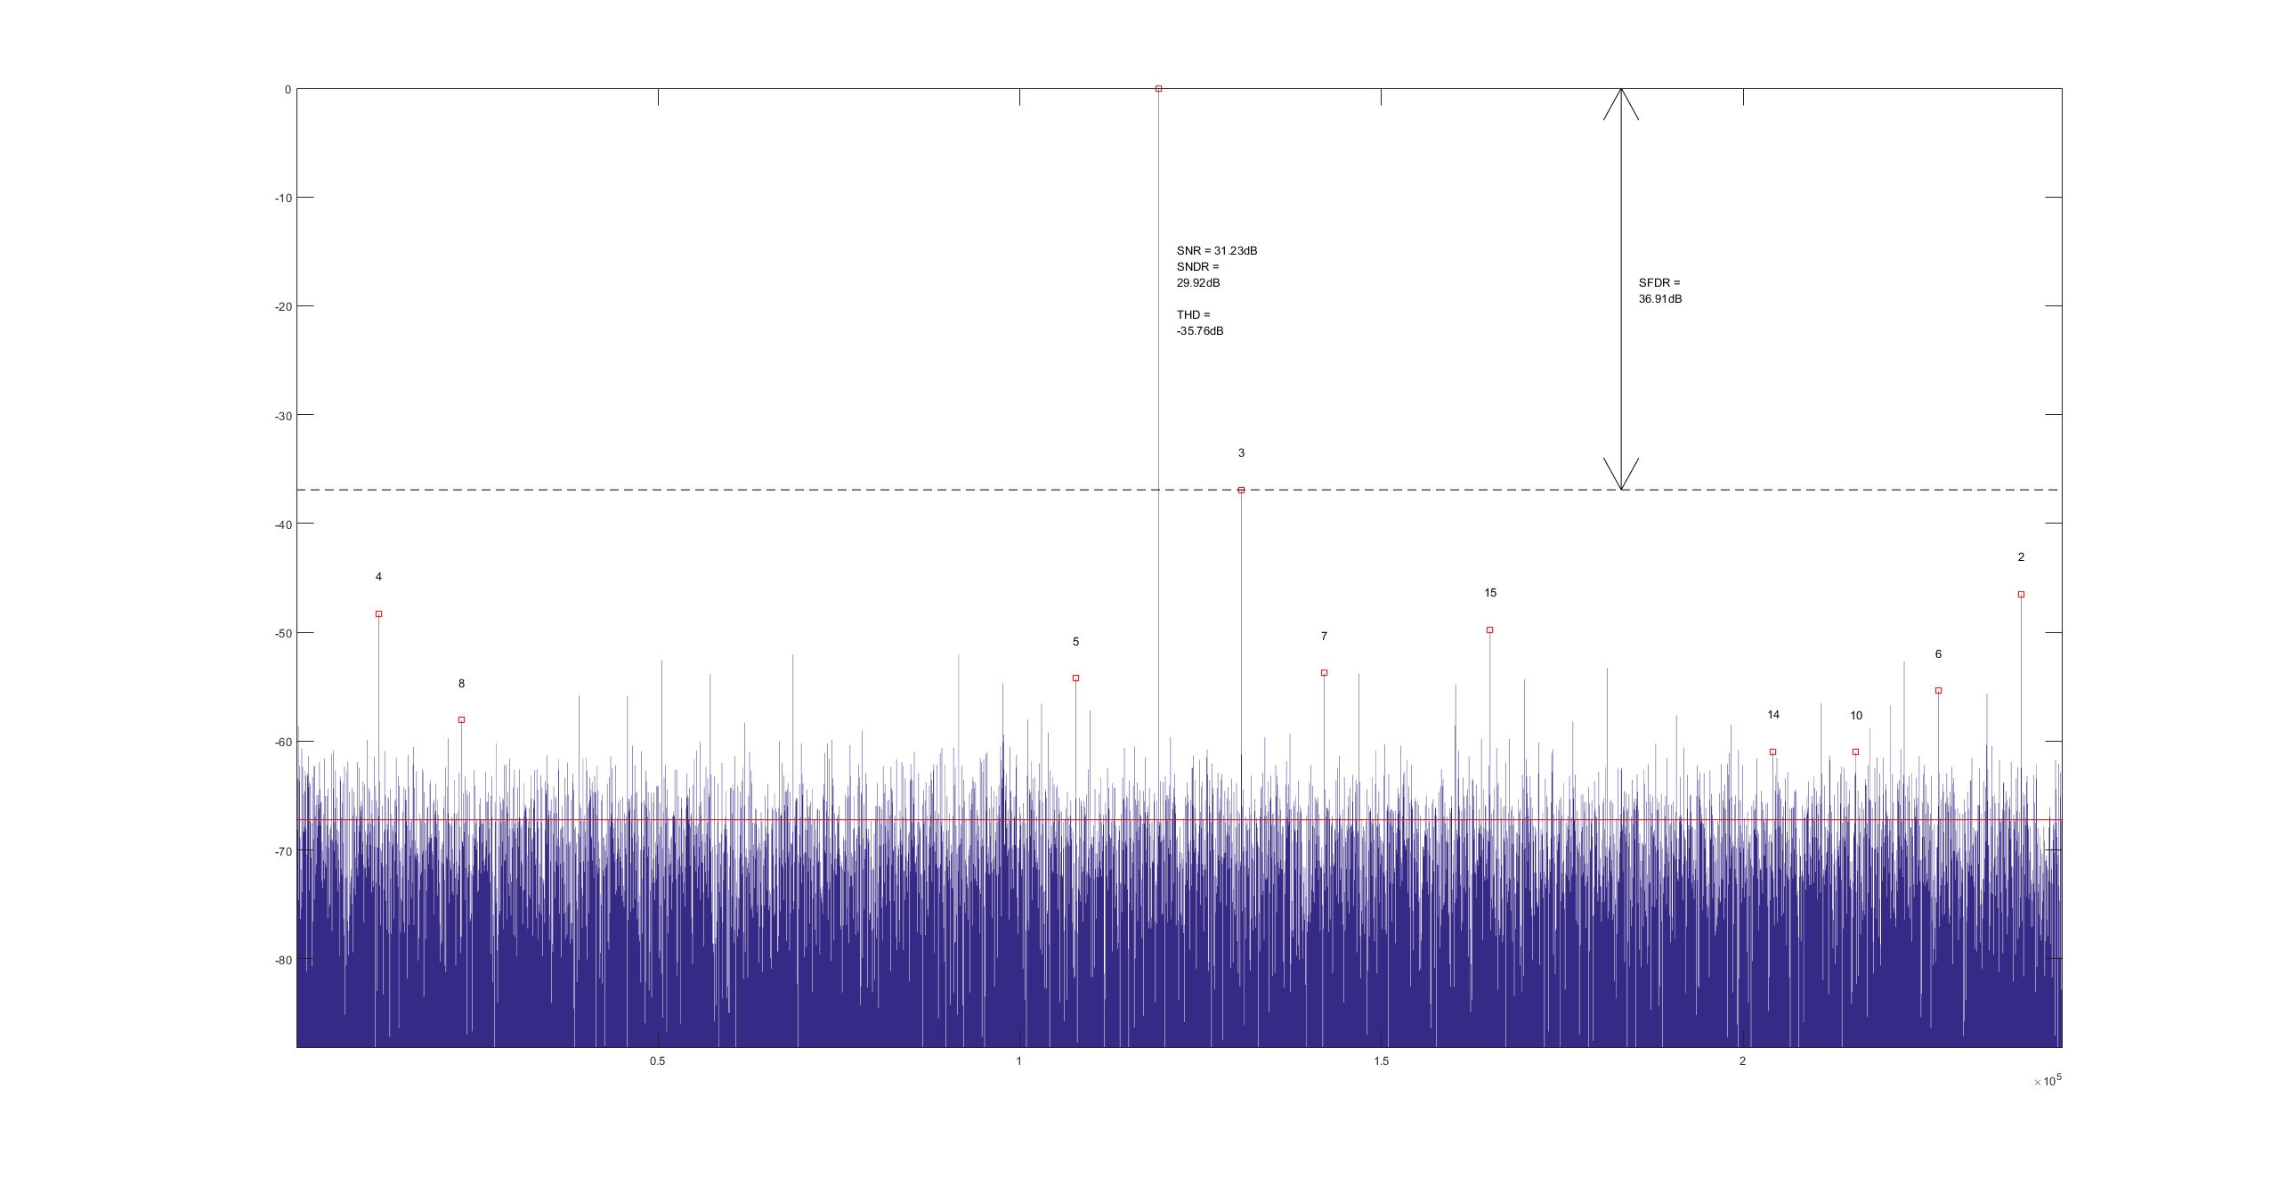
ADC SNR/ENOB Measurement
SNRD 31.23dB
ENOB = 5.25
$$ENOB=\frac{SNR−1.76+20∗log1o\left(\frac{Fullscale}{Usedscale}\right)}{6.02}$$
Carrier Frequency = 119kHz
Fullscale = 64
Usedscacle = 50
One 6 Bit ADC was measured

Slide 12
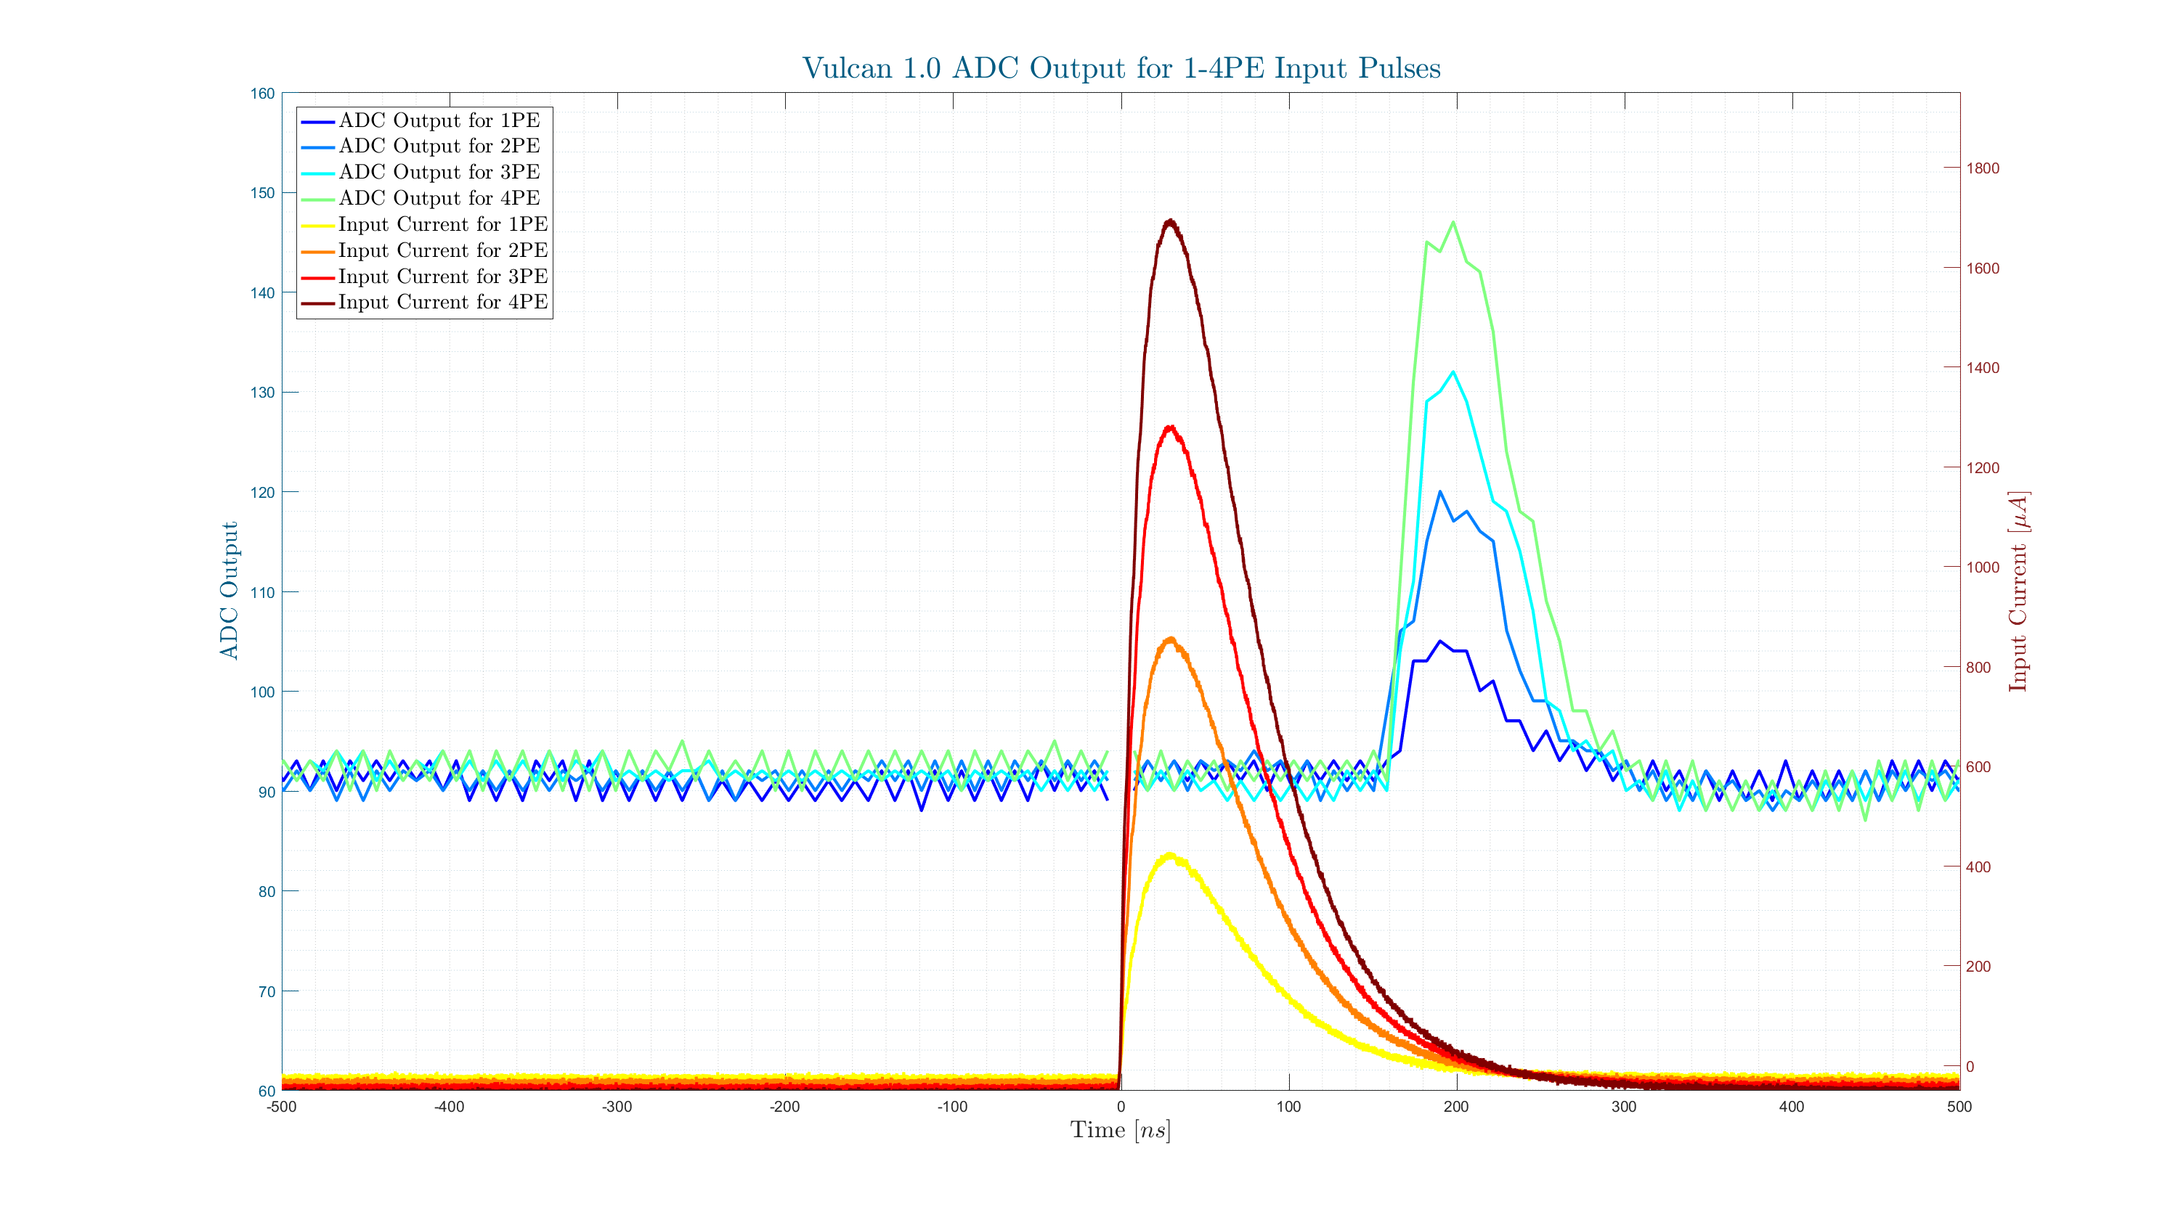
ADC PMT-shaped Pulse Measurement 1-4 PE

Slide 13
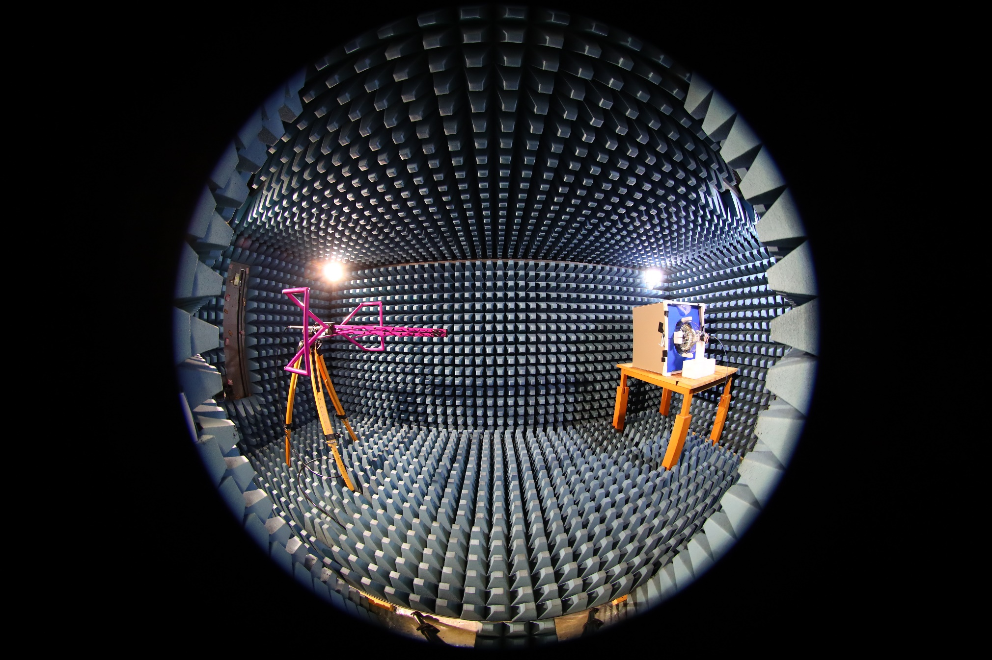
PMT RF Senitivity Measurement Setup
transmitting
antenna
PMT

Slide 14
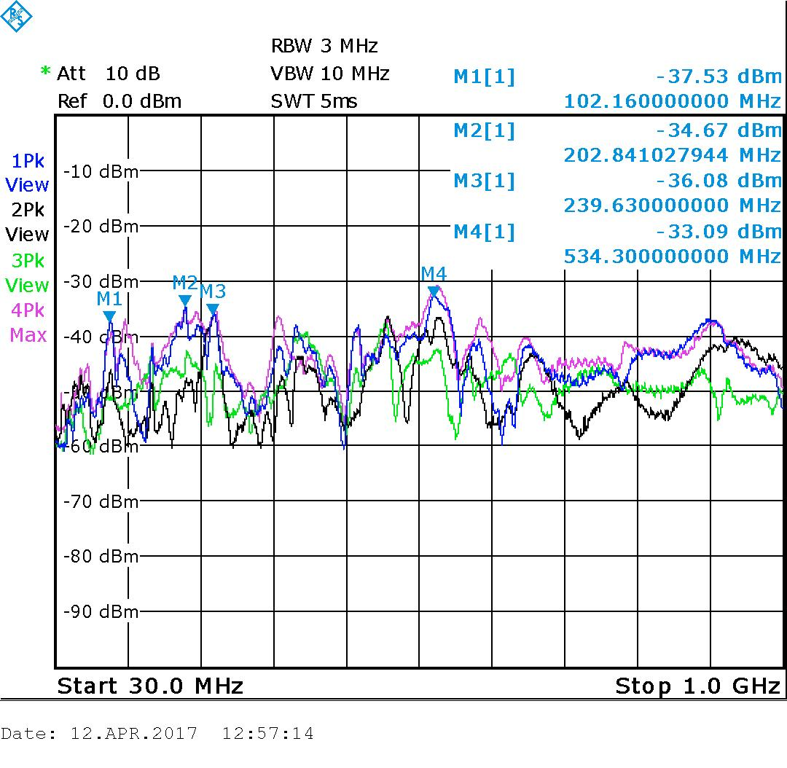
PMT RF Senitivity Spectrum
PMT Orientation
90°
45°
0°
Polarization:
Horizontal
Vertical
Antenna

Slide 15
ZEA-2 – System-house for the Science

