Slide 1
81th Section Coordination Meeting XHEXP1
28.7.2017

Slide 2
Agenda
SASE1-3 Status Updates
  Another update: Safety gear in XHEXP1
Rack review in SASE2 tunnels (XTD1 + XTD6)

Slide 3
SASE1

Slide 4
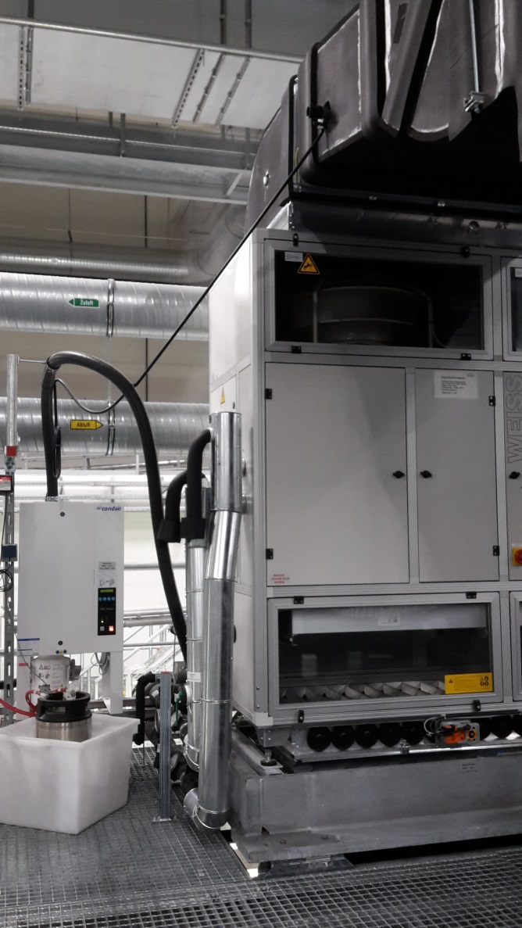
27.7.: PKG on top of D.04 malfunctioned 2x
Pipe connection of the humidifier disconnected 2
➔ hot water / steam dripping out of the disconnected hose.
➔ Please have a look in case you are nearby.
➔ If it happens again, call Alexander Kondraschew, or somebody else from TS

Slide 5
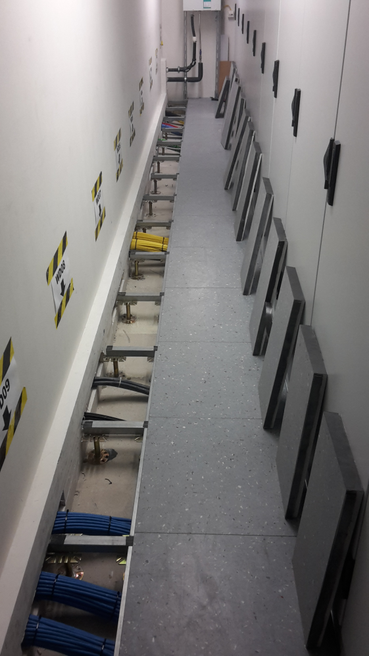
Status Update SASE1
Company svt
  is working in the rackrooms to close the cutouts.
  Smoke detection is switched off due to dust being potentially created.
  Works will be finished until 4.8.

Slide 6
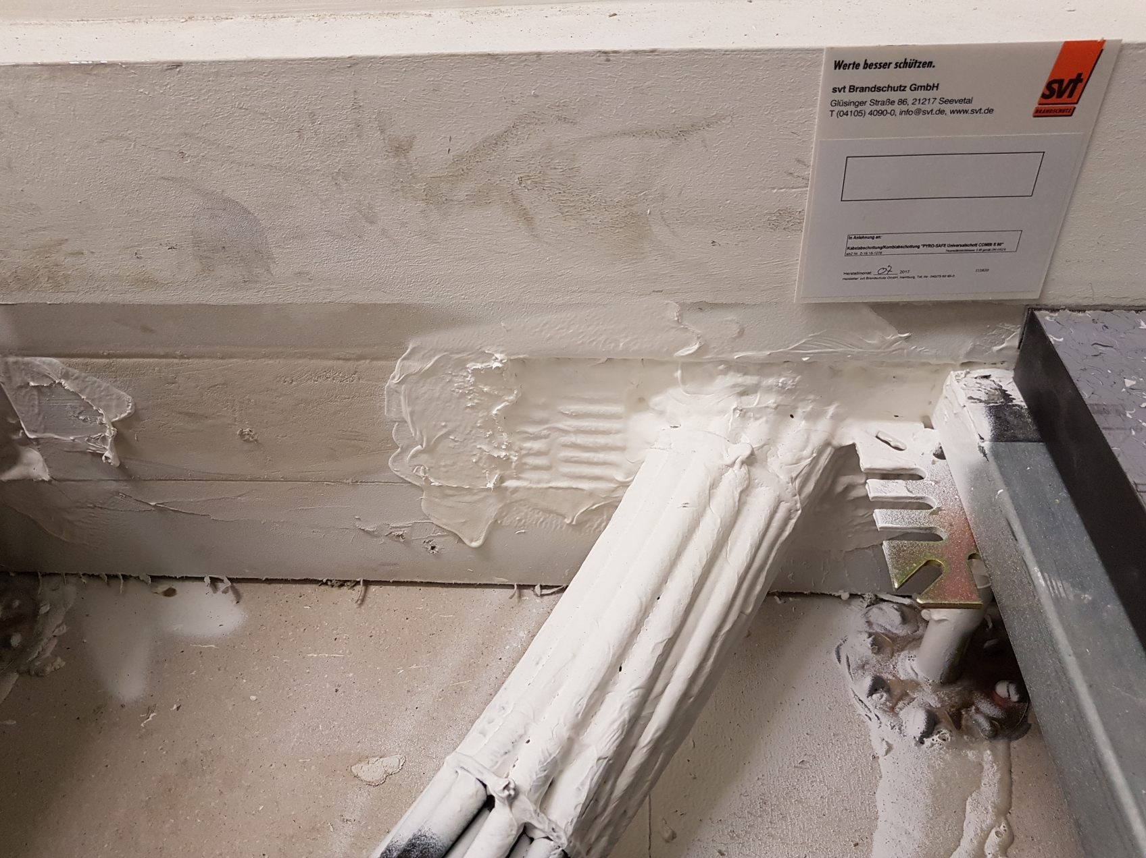
25.7.: svt progress (fire safety) – FXE-rackroom

Slide 7
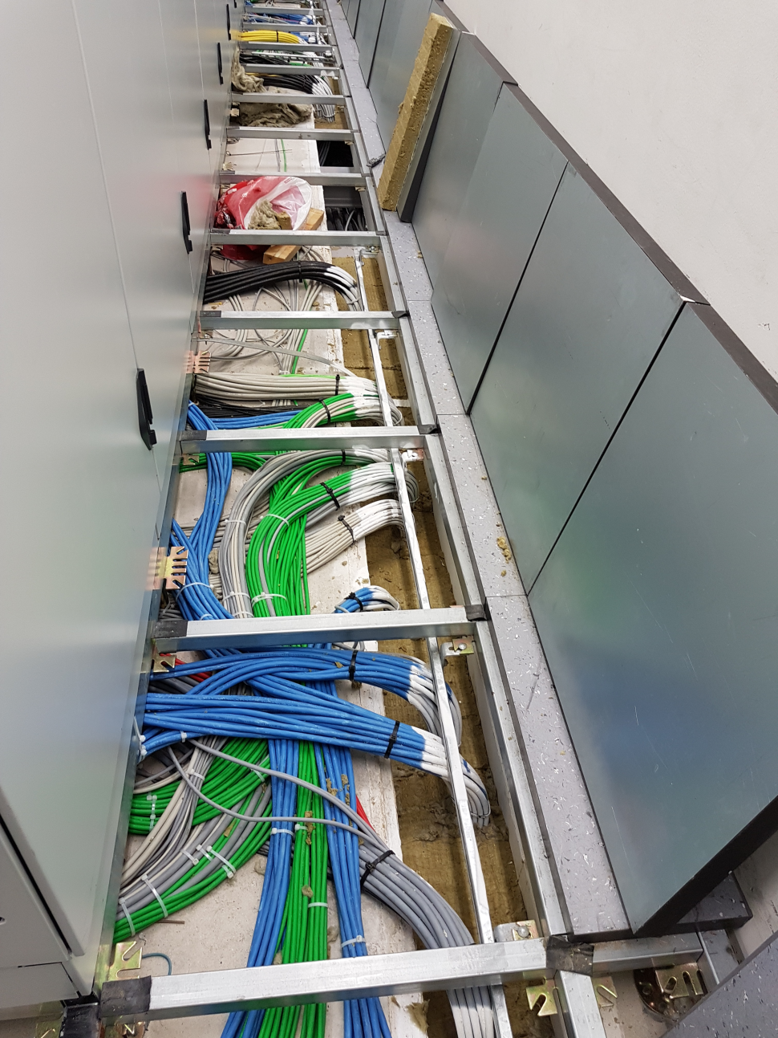
25.7.: svt progress (fire safety) – SPB-rackroom

Slide 8
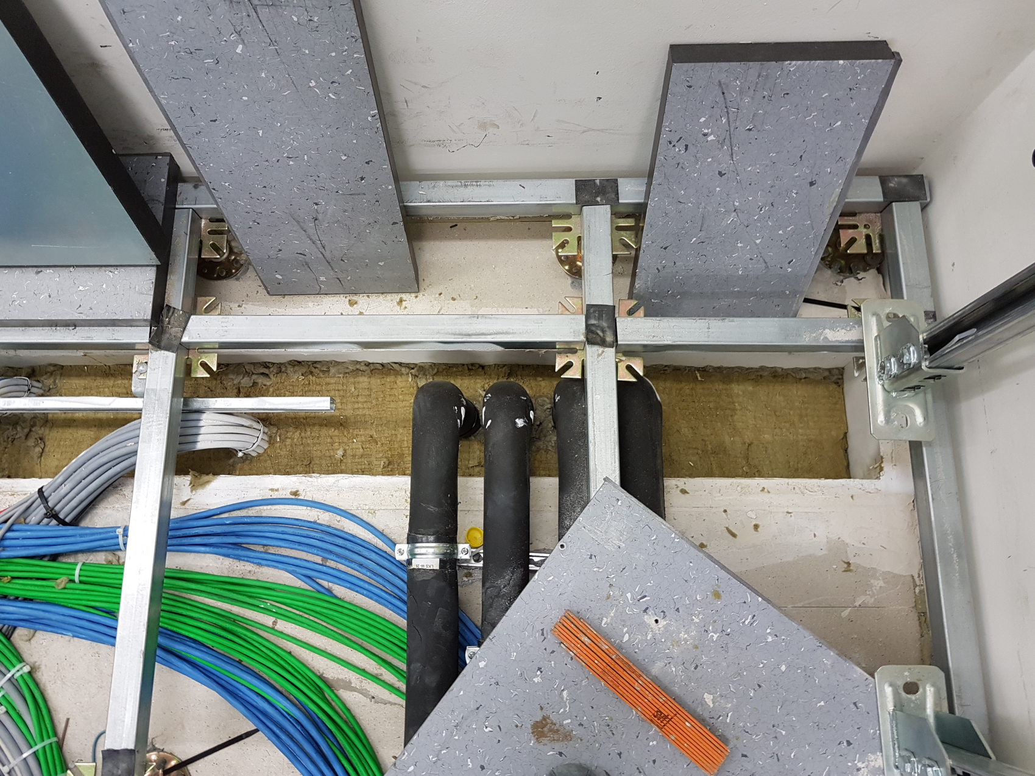
25.7.: svt progress (fire safety) – SPB-rackroom

Slide 9
SASE3

Slide 10
SASE2

Slide 11
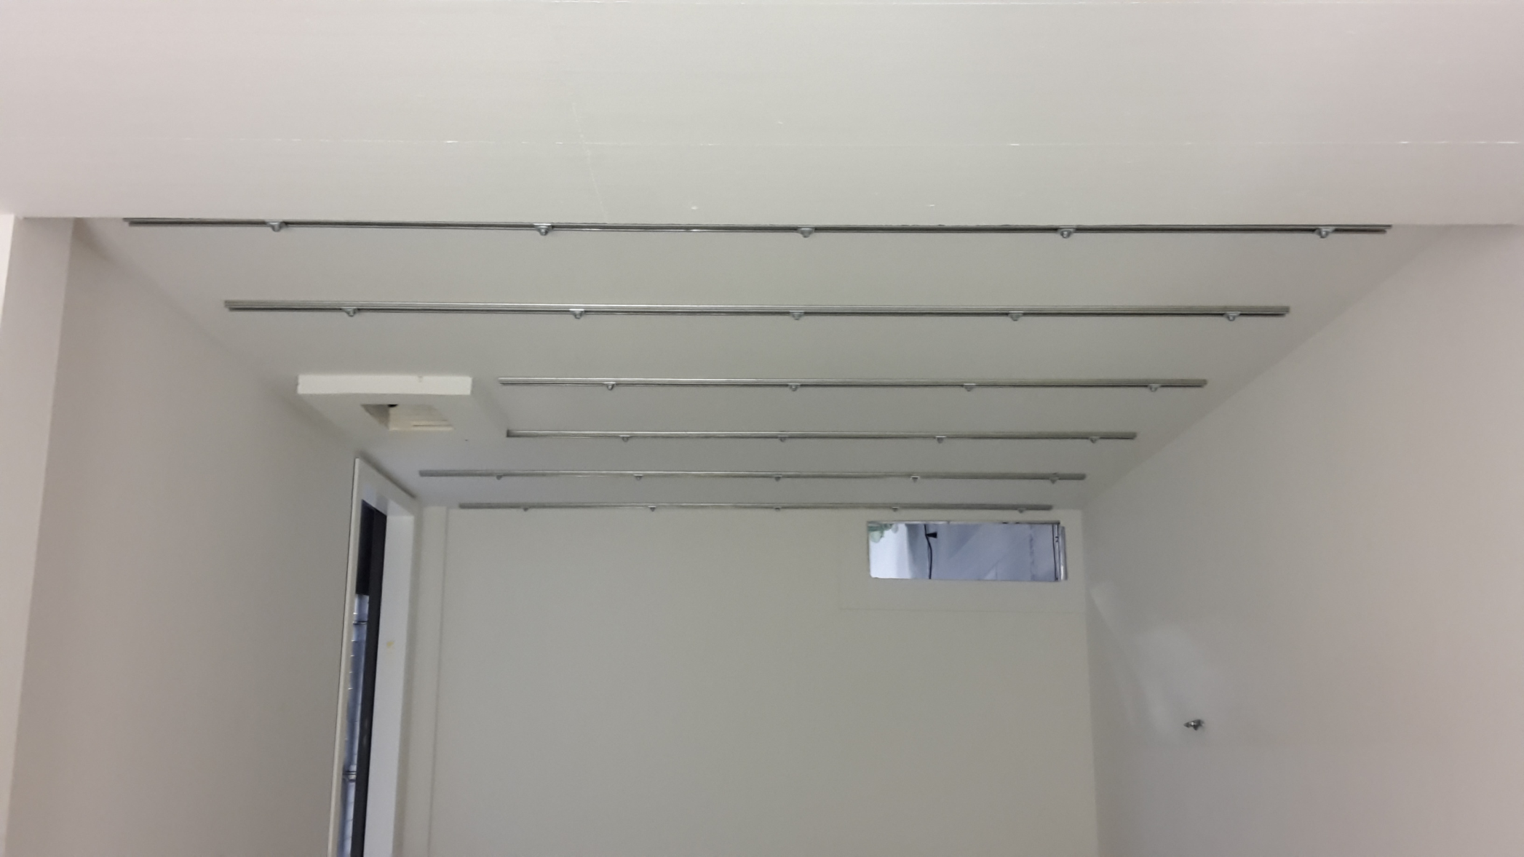
27.7.: Signs of work by Wille in SASE2 A.22

Slide 12
Status SASE3 + SASE2
Update Tender for electrotechnical installations
Company Wille has been ordered with immediate works required in SASE3 + SASE2
Four companies have been asked to provide offers for electrotechnical installations in SASE2 + SASE3
  Tenders open until 26.+27.7.
  SASE3+2: Actemium & Bohn provided offers, both seem to be 40% above our cost estimate.
  Offers will be evaluated now
  Negotiations with both companies in 2 weeks
  Signing of contract(s) in 4 weeks, hopefully.

Slide 13
Status SASE3 + SASE2
Time schedule update
Ordering of PKGs and plena:
  Plena + curtains: Ordered for SASE3 & SASE2
  Schema + sensors: Reviewed & forwarded to Engie (Do) & Caverion (Fr) ➔ T. Tietz (TS)
  PKGs: Ordered for SASE3 & SASE2, but not yet ordered @ WKT ➔ Christoph Staeps
Update Engie (SASE2):
  Plena & Curtains to be installed until Jan. 2018
  PKGs to be delivered in KW42 (16.10.)

Slide 14
Status SASE2
Actemium Phase II cabling:
  Tender documents & PR & MB-proposal are under preparation
  Tender to be started in August
  Update?

Slide 15
Safety

Slide 16
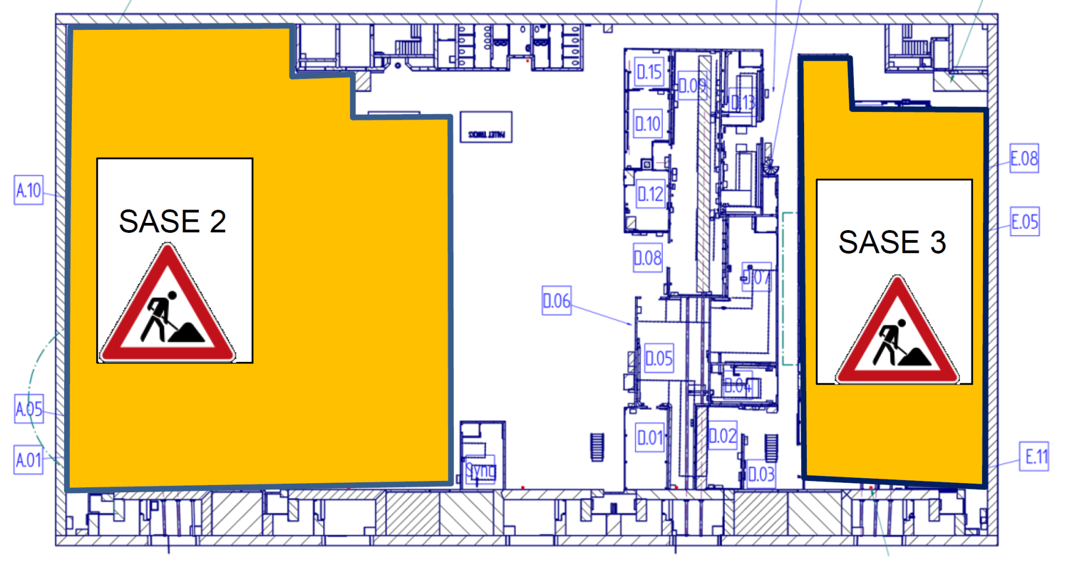
Update: Safety gear in XHEXP1
Markings + signs are still do be applied by Safety & TS.
SASE1 1st floor: You still need a helmet!
Same applies if you have to pass close to a scaffolding!

Slide 17
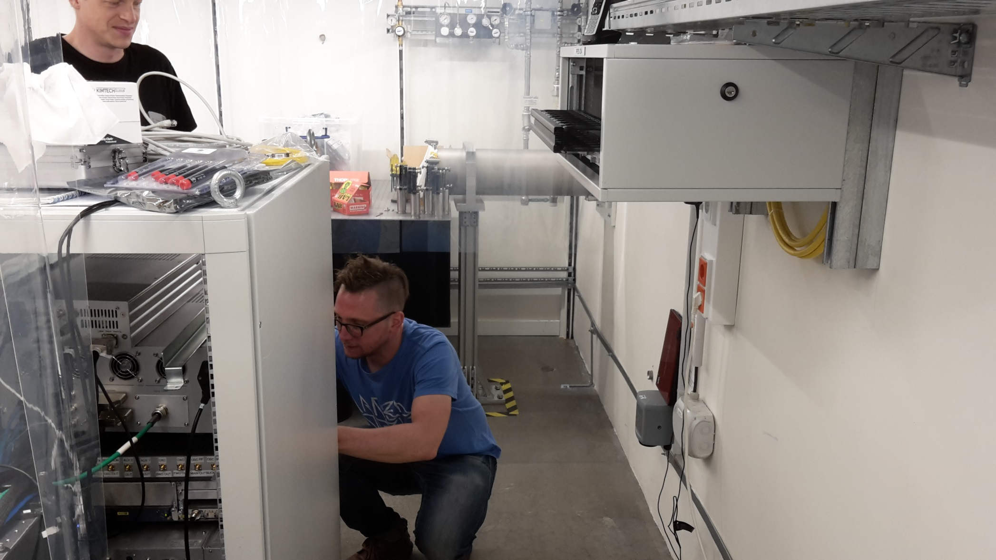
26.7.: Use-case: Bump cap!

Slide 18
Update: Safety gear in XHEXP1
For construction and installation sites the following personnel protective equipment is required.
  Safety helmet
  Safety shoes (S1P or S3)
When carrying out work in the experimental hall people must always use the compulsory personnel protective equipment e.g.
  Protective caps when carrying out work in narrowed spaces with a risk of head injuries due to sharp edges and projecting parts.
  Safety shoes when carrying out mechanical work.
Instruments should have helmets / bump caps available in the control hutches in case they are needed.

Slide 19
SASE2 rack review

Slide 20
Rack review in SASE2 tunnels (XTD1 + XTD6)
The racks in XTD1 and XTD6 are on their position. Cooling connection started last Tuesday. Power connection will start next Monday.
Racks content – Ulf Brueggmann has collected the available information from: HED, MID, WP74, WP73, Vac, ITDM, AE and prepares a 1st consolidated rack-layout, to be sent around ca. 1.8.
A PRR (Product Readiness Review) meeting to finalize the rack layout is currently planned on 12.8.
➔ expect an invitation by T. Haas ➔ ALL invited groups are expected to participate, despite the maintenance week (we try to keep it as short as possible)

Slide 21
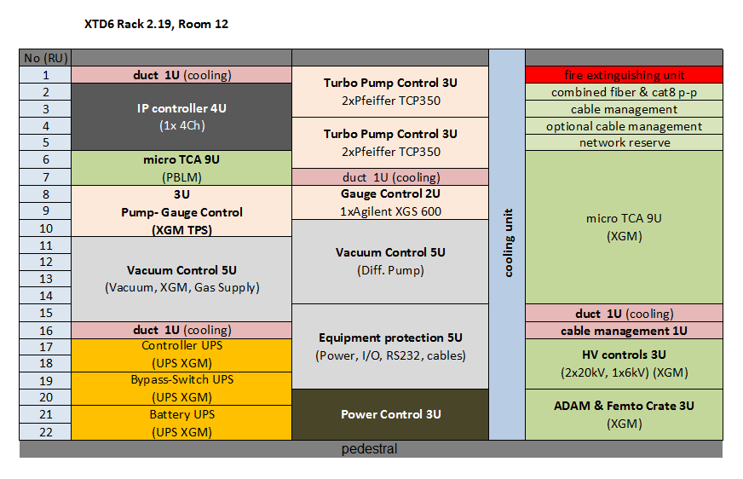
Rack review in SASE2 tunnels (XTD1 + XTD6)

Slide 22
Upcoming Dates & Meetings
Today, 9:00: SASE1+SASE3 Readiness
SASE1+SASE3 Readiness Dispatch
  Mo, 09:30 @ MCR by A. Violante
  Wed, 09:30 @ MCR by M. Areste
4.8., 8:30: No TC meeting
4.8., 9:00: No SASE1+SASE3 Readiness
11.8., 8:30: TC meeting by T. Haas.
11.8., 9:00: SASE1+SASE3 Readiness

