Slide 1
Tests on Chess 2 ASIC
Dionisio Doering, Yubo Han, Pietro Caragiulo, Larry Ruckman, Camillo Tamma, Mazin Khader, Su Dong

Slide 2
Outline
Doing the test on several pixels on board 28
-> the results is repeatable and the “hockey stick” results was back
-> still no differences between Qinj enable and Qinj disable
Change the firmware
-> add a control of Charge injection pulse inhibit completely disable the Injection pulse on the board
Doing tests with the new firmware and start to look at another board
->no longer see the “hockey stick” results on board 28
->fast-hit band started to show up (<140ns)
->differences between Qinj enable and disenable start to show up but only in lower BL value (0V~0.7V).

Slide 3
Pixel description

Slide 4
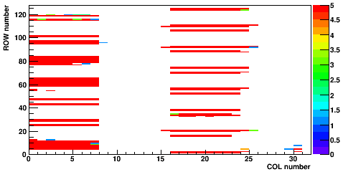
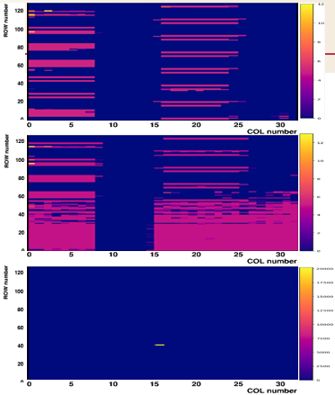
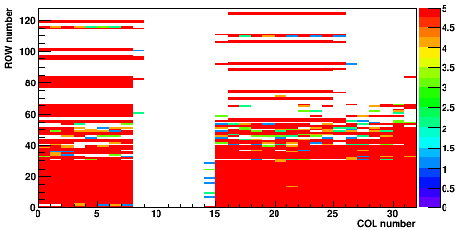
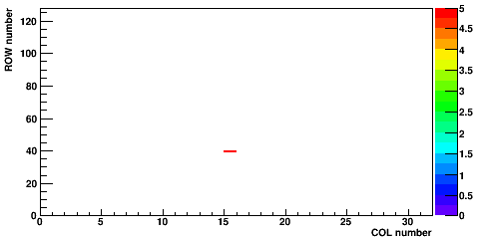
Hitmap of the 23 board
Carry Board 192.168.3.23
Daughter board: 01(regular)
Default configuration
PIXTH: 1.394V
BL: 1.15V
Matrix 0
Hot pixel on matrix 2, pixel(39,15)
Matrix 0 and Matrix 1 still have some hot pixels
all the information of Matrix2 are from pixel(39,15)
No big difference using updated configuration
Matrix 1
Matrix 2

Slide 5
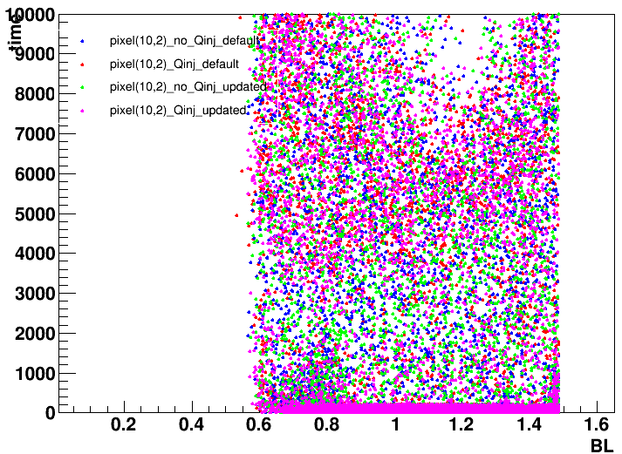
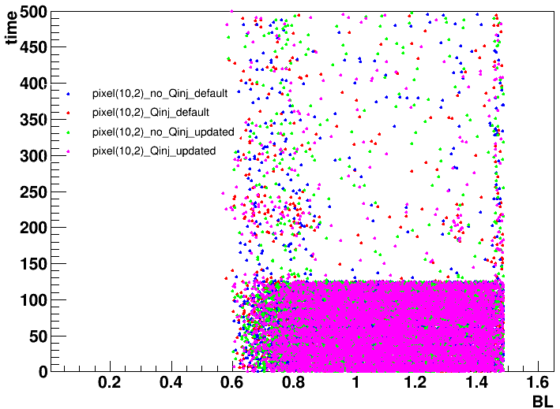
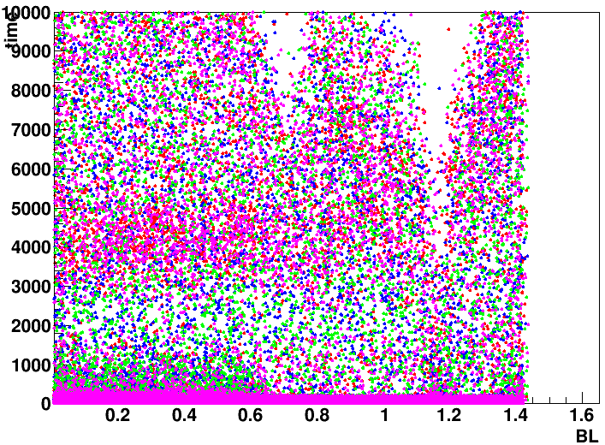
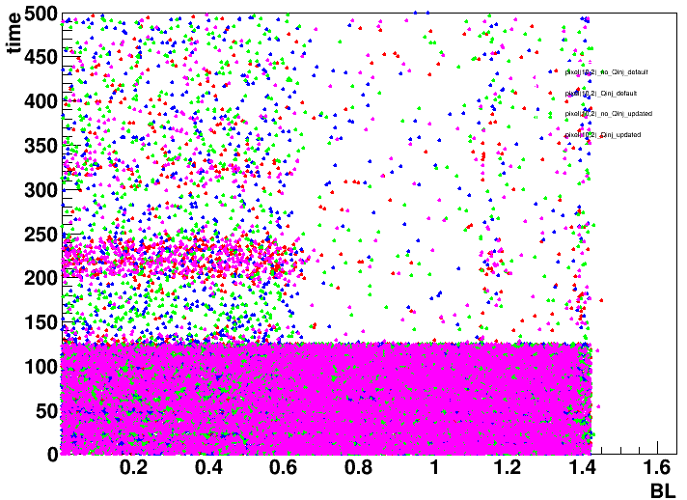
Pixel(10,2) of board 23
Carry Board 192.168.3.23
Daughter board: 01(regular)
PIXTH: 1.394V
Matrix 0
Almost every pixel has decreasing hits around BL=0.7V
Gathering around 225ns observed.
A band appeared in almost every pixels.
Matrix 1
All
Fast(time < 500ns)

Slide 6
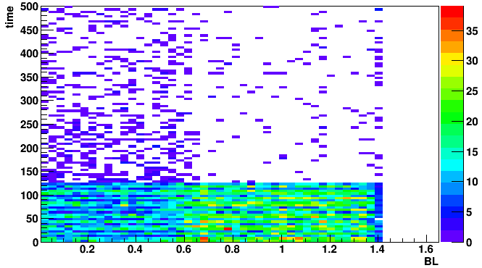
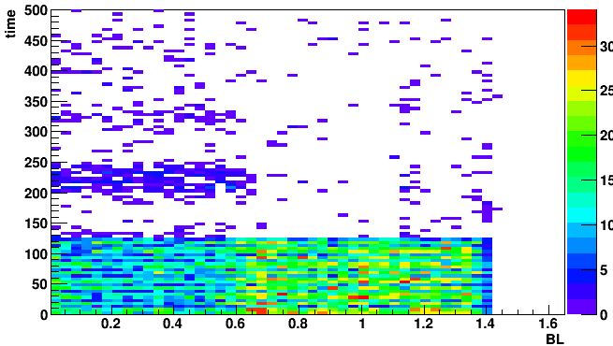
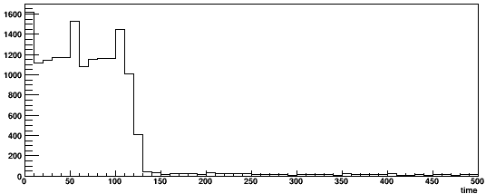
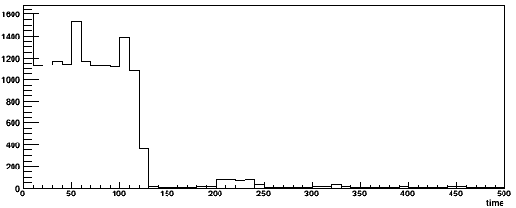
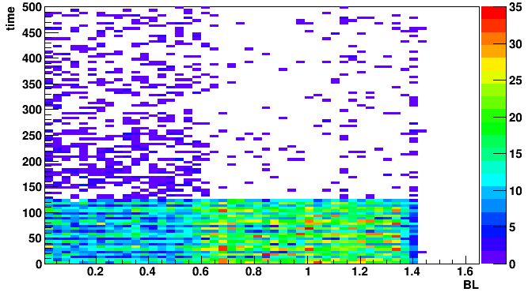
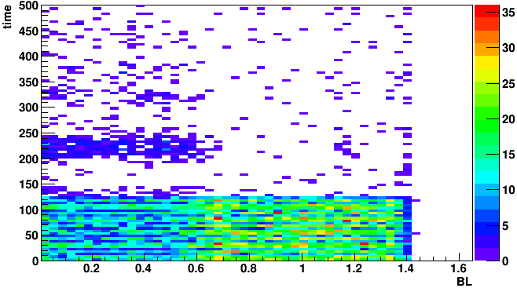
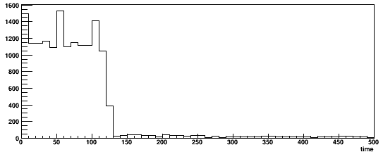
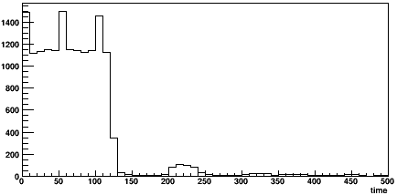
Pixel(10,2) of board 23
Carry Board 192.168.3.23
Daughter board: 01(regular)
PIXTH: 1.394V
Matrix 1
Fast hit
Default configuration
with Qinj, more hit will be obtain at around 225ns
Give a hint: maybe something at lower BL range.
Updated configuration
Qinj enabled
Qinj disabled

Slide 7
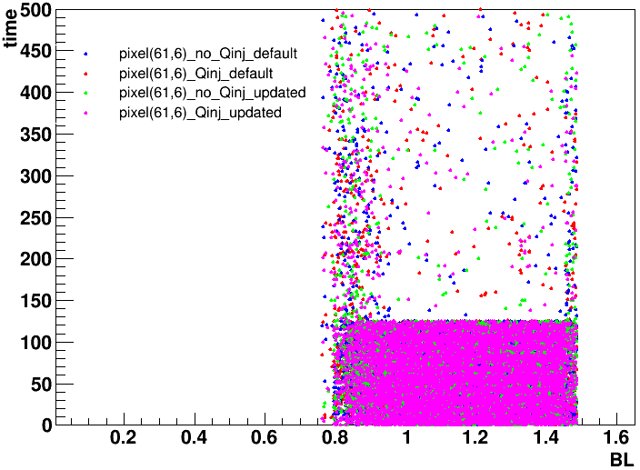
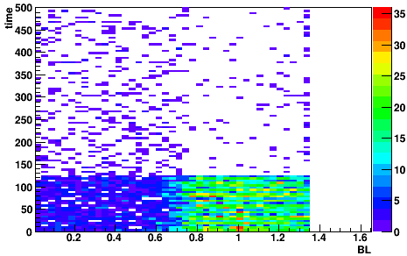
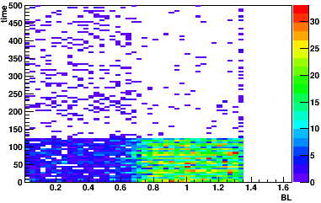
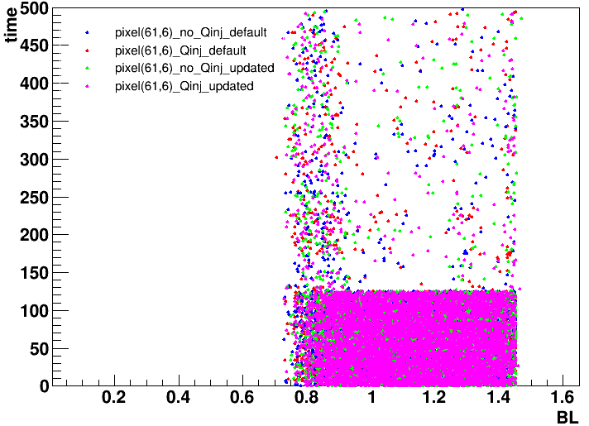
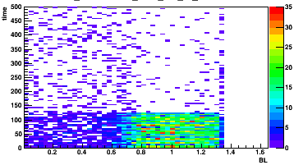
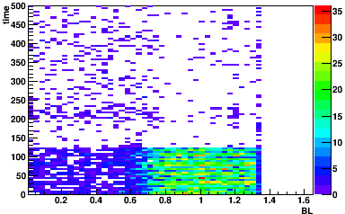
Pixel(61,6) of board 23
Carry Board 192.168.3.23
Daughter board: 01(regular)
PIXTH: 1.394V->0.5V
PIXTH=0.5V
PIXTH=1.394V
Matrix 0
Lower the PIXTH of another pixel which don’t have any the results like last one.
There was some differences observed but not that obvious
The fast-hit band is still there and still has hit even >0.5V
Matrix 1
Qinj disabled
Qinj enabled

Slide 8
Summary and Consideration
The results of the tests using new firmware on both boards are repeatable, but we can not get the “hockey stick” results any more.
Board 23-daughter board 19:
hot pixels on every Matrix.
fast-hit band (<140ns) observed all the time. ->what was that?
differences between Qinj enable and disenable start to show up but only in lower BL value (0V~0.7V)
Next:
Check the results of using updated configuration
Abandon the fast hits(<140ns)
Change the PIXTH step by step

