Slide 1
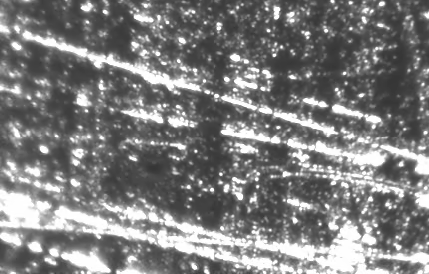
Beam damage safety tests at FXE, 10.08
30 bunches, ~260uJ/pulse, focused to ~20 um
Cu blocks 2 mm and 4 mm thickness, 30 min continuous exposure

Slide 2
Beam damage safety tests at FXE, 10.08
30 bunches, ~260uJ/pulse, focused to ~20 um
Cu blocks 2 mm and 4 mm thickness, 30 min continuous exposure

Slide 3
Beam damage safety tests at FXE, 10.08
30 bunches, ~260uJ/pulse, focused to ~20 um
B4C block 20 mm thickness, about 30 min continuous exposure
Cleaned with ethanol
As is in air

Slide 4
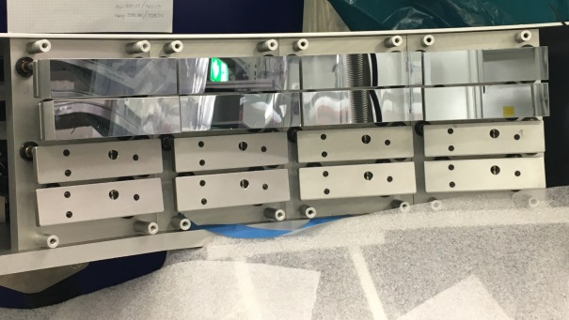
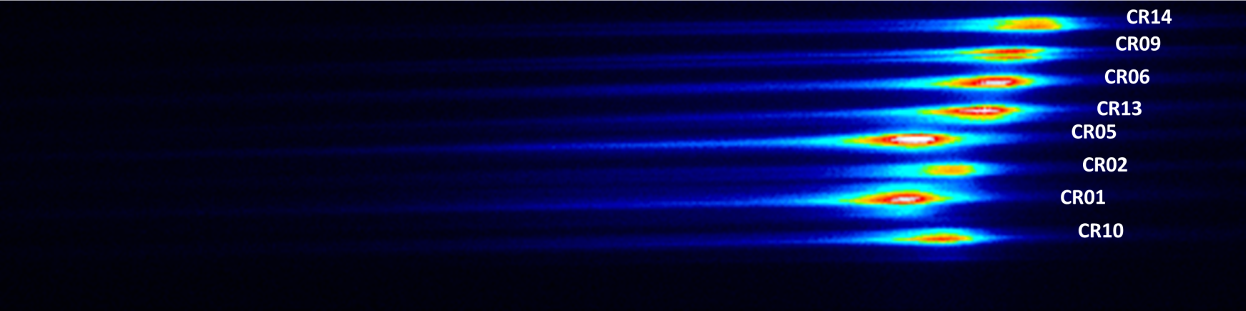
Alignment of the von Hamos XES on Fe Kbeta (Iron foil, 80um-thick)
Beam: 2 bunches, 9.16 keV, ~700uJ/pulse
8 x Si(531)
GreatEyes CCD detector

Slide 5
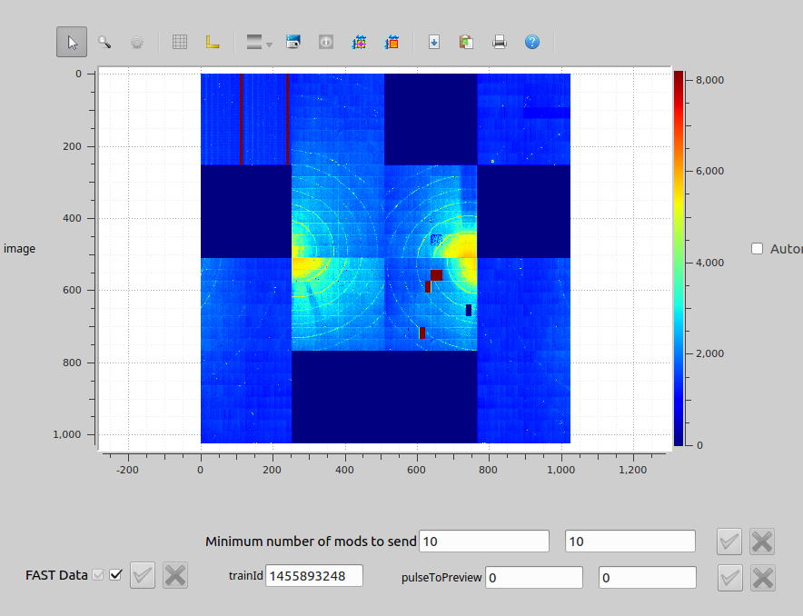
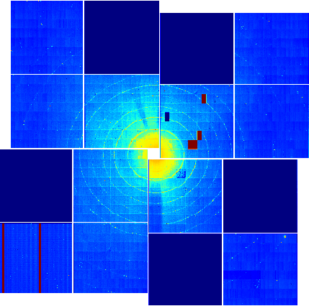
LPD tests at FXE, 12-13.08
LaB₆ calibration powder, ~140 mm to detector
LPD single shot image; per train 2 images filled, 30 are empty as should

Slide 6
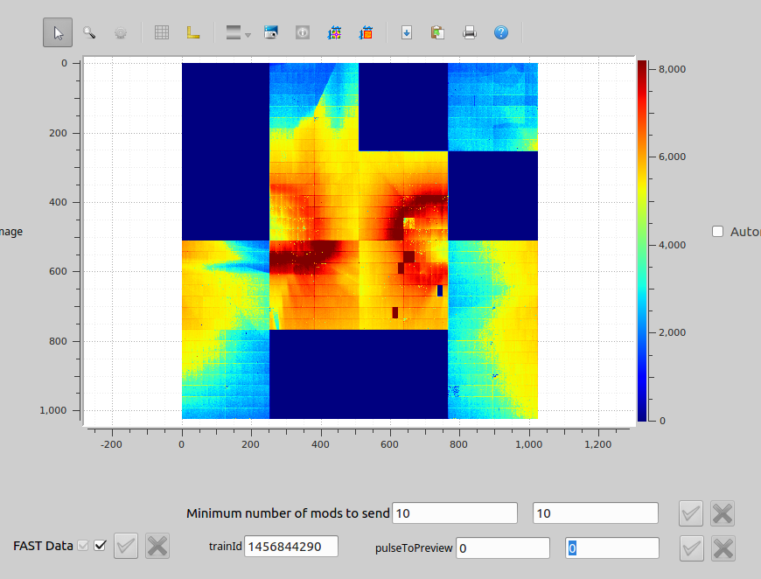
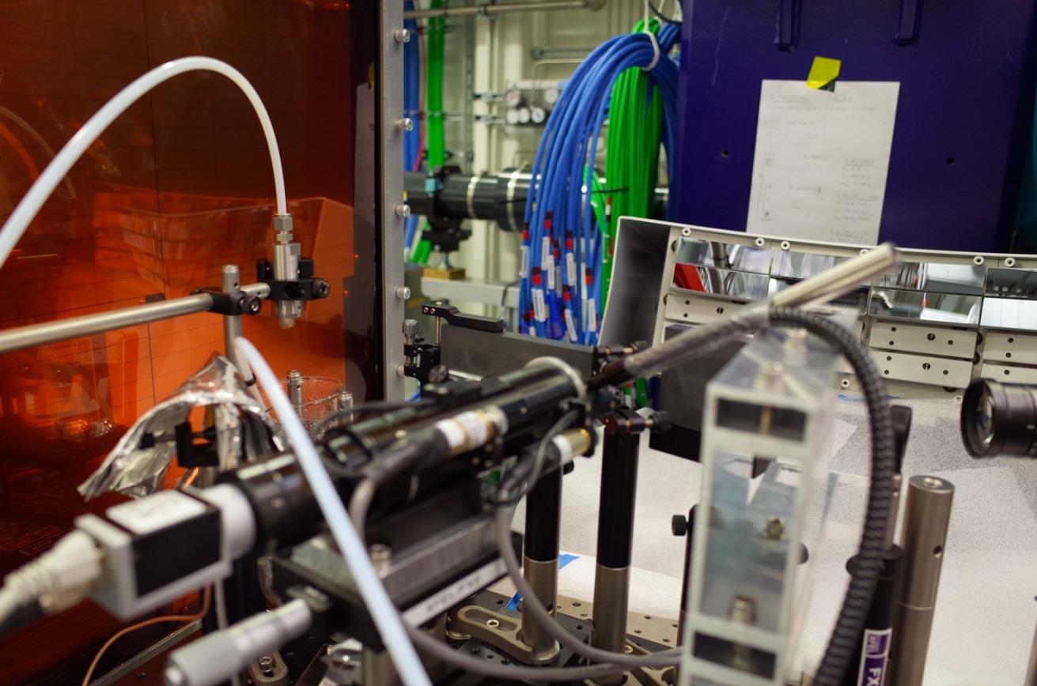
LPD tests at FXE, 12-13.08
Flat water jet, 100um, ~140 mm to detector
LPD single shot image; per train 2 images filled, 30 are empty as should

