Slide 1
Studies on H1 magnet yoke
J. Schaffran
Simulation data: K. Büsser

Slide 2
Purpose of investigations
Do we need a magnetic shield for MADMAX?
Depends on magnetic field strength in the environment
Personal safety
flying magnetic parts (limit is currently 5mT => not fixed)
For medical implants: 0.5mT (only 10 times of earth magnetic field)
Protection of cryogenic equipment (f. e. vacuum pumps) which could be destroyed
Influence on other experiments
If “yes”, could the H1 iron yoke be used as magnetic shield for the MADMAX magnet?

Slide 3
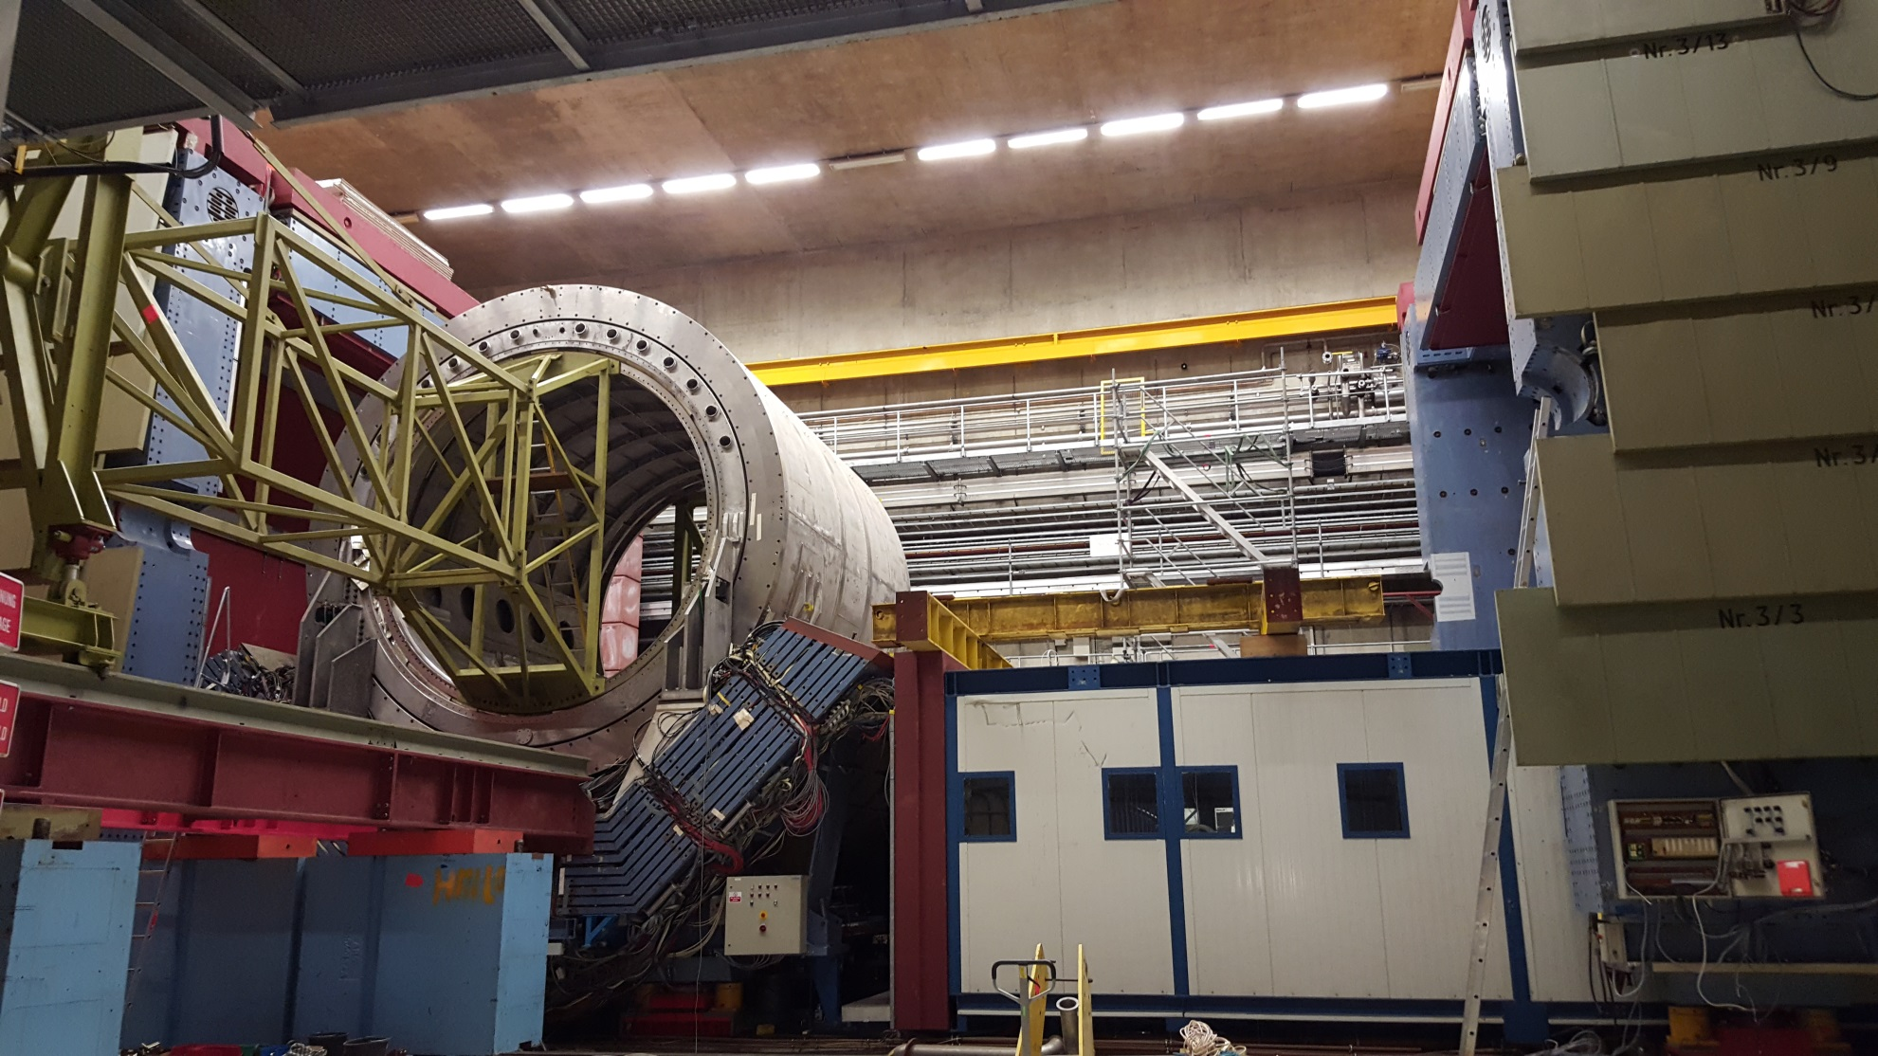
Use of existing yoke
yoke

Slide 4
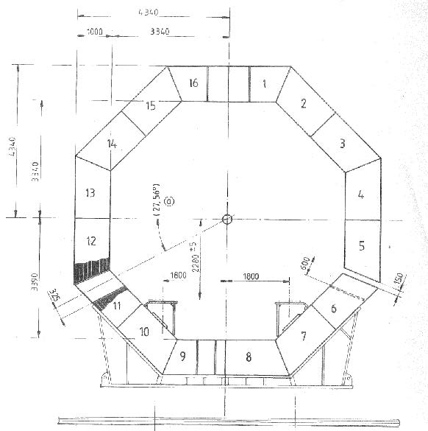
Use of existing yoke
Octagonal shield with 1m layered stainless steel plates
2 movable halves + 1 movable basis (1m/10 min)

Slide 5
Use of existing yoke
Pros | Cons
Reduced costs | Reduced space
Advantage for schedule => no time consuming uninstallation | Bad accessibility, if yoke is closed
 | Working platform at a high of 3-4m
 | Manpower for opening closing of yoke is needed
 | Limited space for transfer lines

Slide 6
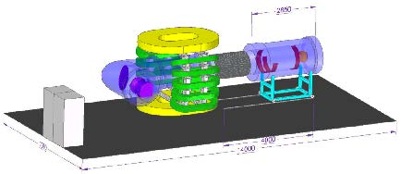
Space requirements
M. Matysek
Here: 14m x 7m
Experimental hardware needs less space!
MADMAX magnet itself needs ~7.1m x 4.5m x 3.2m (l x w x h)

Slide 7
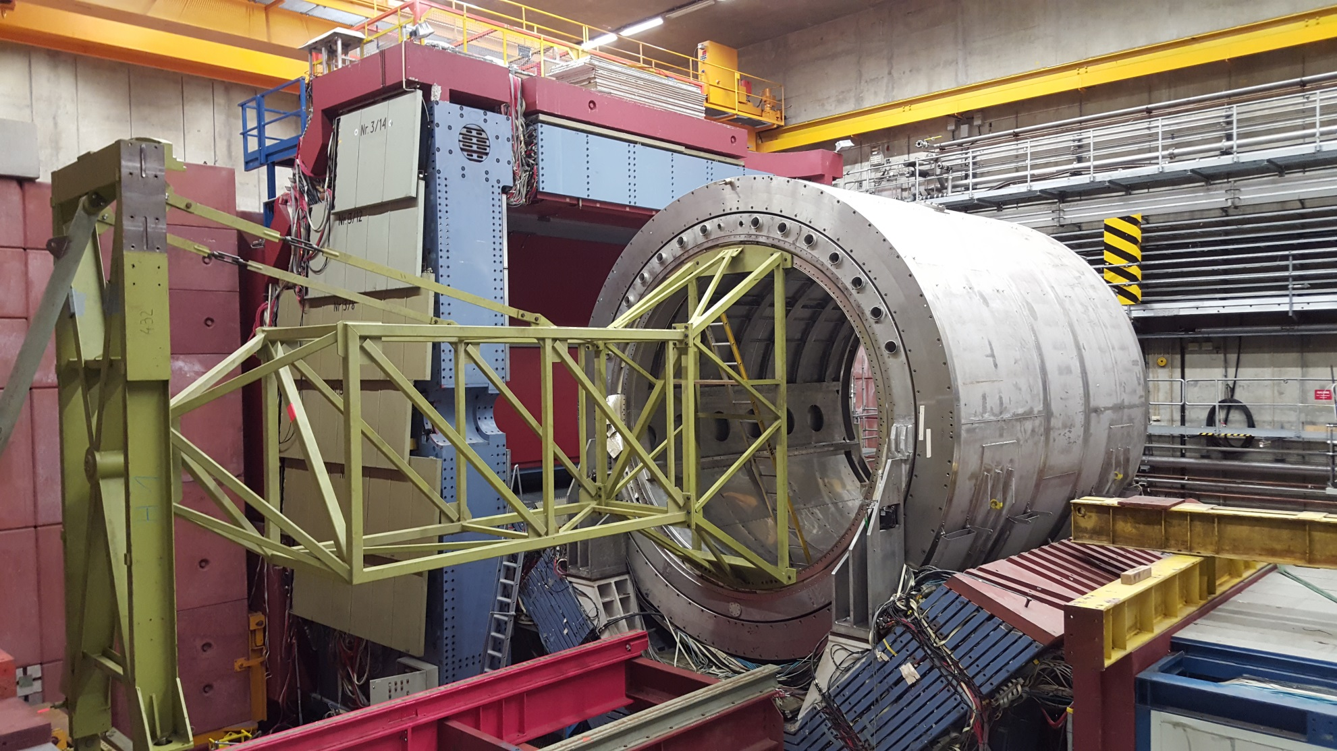
Existing space in yoke
Experimentierplatz, transfer lines
y
x
z

Slide 8
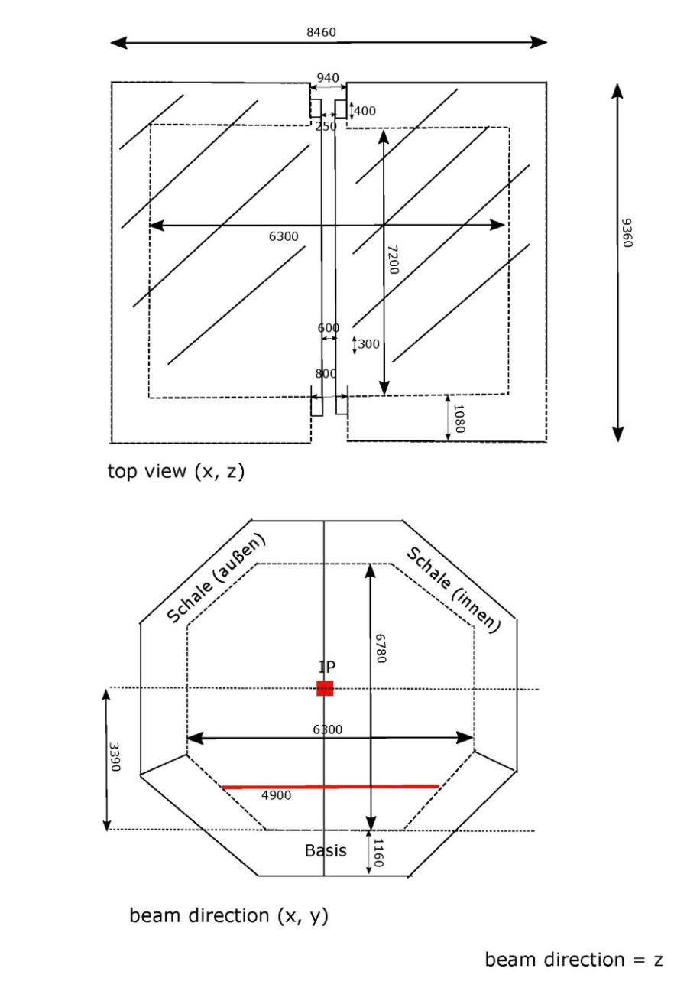
Existing space in yoke
7.2m x 6.3m x 5m
Would limit the dimensions to the modelled numbers
No reserve for realistic design

Slide 9
Result
Shielding with closed yoke is sufficient (see later)!
But: Space requirements are critical
Yoke should not completely closed
Investigation: yoke opened by 1.5m
Good accessibility when opened
But: check, if shield/half shells could be operated with this forces induced by B-field!!!

Slide 10
Use of existing yoke - closed
Pros | Cons
Reduced costs | Reduced space
Advantage for schedule => no time consuming uninstallation | Bad accessibility
 | Working platform at a high of 3-4m
 | Manpower for opening closing is needed
 | Space for transfer lines

Slide 11
Use of existing yoke - 1.5m open
Pros | Cons
Reduced costs | Reduced space
Advantage for schedule => no time consuming uninstallation | Bad accessibility
 | Working platform at a high of 3-4m
 | Manpower for opening closing is needed
 | Space for transfer lines

Slide 12
Use of existing yoke – 1.5m open
Pros | Cons
Reduced costs | Working platform at a high of 3-4m
Advantage for schedule => no time consuming uninstallation | Manpower for opening closing is needed during maintenance/ commissioning only
Good accessibility
No manpower for opening closing needed
Space for transfer lines

Slide 13
Magnetic field with open yoke
And what about the field?

Slide 14
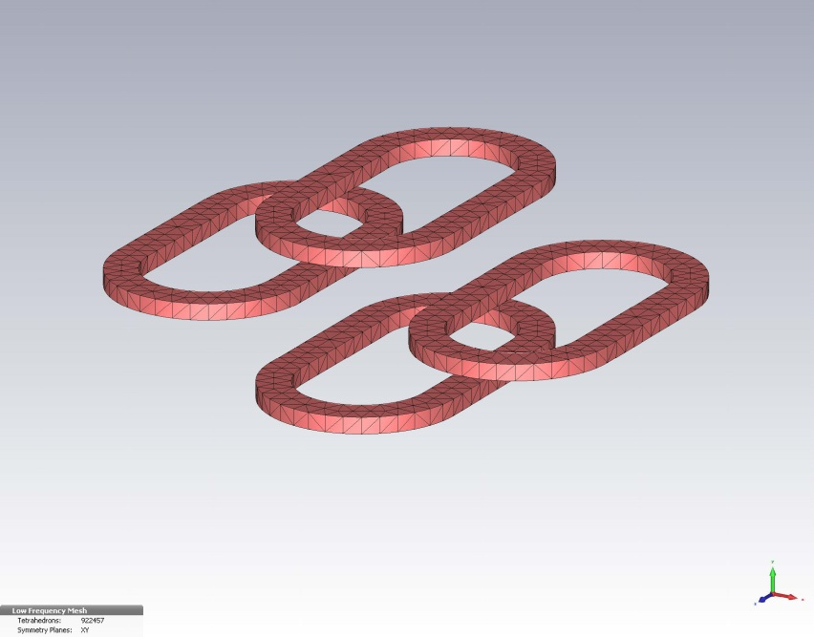
Setup for simulation – magnet
(K. Büsser)
2m long, 1x1m² space in the center
no mechanics, no check of forces, nothing…
Number of windings and current tuned to reach 10T central field
Correction („anti-Helmholtz“) coils with switched polarity
When correction coils are off, set central coils to have 1/3 higher current to recover central field of ~10T
Magnet is a simple arrangement of four „Helmholtz-like“ coils

Slide 15
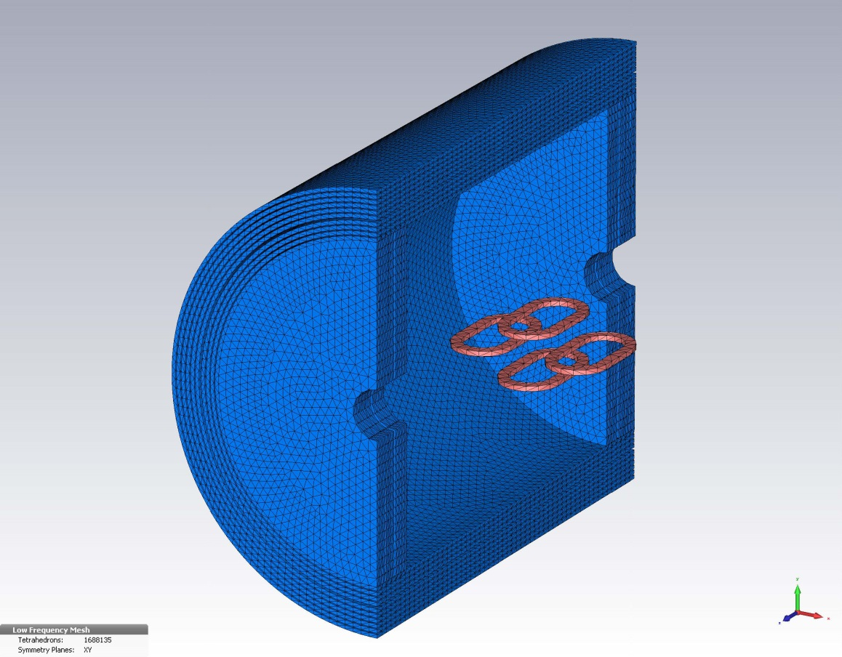
Setup for simulation – closed yoke (cross section)
Simulation use cylindrical and not the exact octagonal geometry
Existing gaps are not integrated
Cylinder: Diameter 6m
Length 7m
y
x
z
=> For open shield x and z directions are the worst cases (no direct shielding)!

Slide 16
Magnetic field in x direction (radial horiz.)
Limit (CERN experience): 5mT
Dotted vert. line for experimental area; continuous vert. line for yoke

Slide 17
Magnetic field in y direction (radial high)
Limit (CERN experience): 5mT
Gap in yoke (no material) explains bad shielding in y direction

Slide 18
Magnetic field in z direction (length)
Limit (CERN experience): 5mT

Slide 19
Influence of stray field w/o correction coil (x direction)
Limit (CERN experience): 5mT
Steps could be explained by width of meshes chose for simulation

Slide 20
Influence of stray field w/o correction coil (z direction)

Slide 21
Result
Most important direction is x (highest fringe field, influence on other experiments)
Existing shielding will reduce the magnetic fringe field below an acceptable limit
This is also valid for a slightly by 1.5m opened shield
Ambient field could be reduced significantly by the yoke (also with correction coils switched off)

Slide 22
Next steps
Simulation with more realistic magnet and shield geometry
Influence on inner magnetic field with correction coils on and off

Slide 23
Conclusion
Space requirements in HERA North are fine with yoke opened by 1.5m
Ambient field are fine with yoke (1.5m open) + simplified correction coils
Further studies with more realistic and more precise model will follow (K. Buesser)
Ambient field with yoke only looks reasonable
Study on inner magnetic field will follow

Slide 24
I like the movie, but the reality is more exciting!

Slide 25
Backup - Influence of stray field w/o correction coil (y direction)

