Slide 1
DESY status
J. Schaffran

Slide 2
Cryogenic at DESY
In overall we have 3 cryogenic strings with a capacity of ~9MW each
2 are devoted to XFEL
1 is mainly used for FLASH and AMTF
Still some free capacity of ~4MW
Connection of additional experiments to the 3rd string (f.e. MADMAX) is possible
To improve the stability and efficiency of the cryo system additional heat loads are welcome (is currently done by heaters)!!!

Slide 3
Site studies
3 different DESY sites where discussed:
New building
HERA experimental hall west
HERA experimental hall north

Slide 4
Cryo plant
Cryo. plant

Slide 5
New building
Cryo. plant
New bldg.

Slide 6
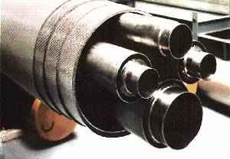
New building - connection
Cryo. plant
New bldg.

Slide 7
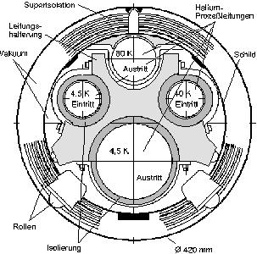
New building
Pros | Cons
Located on the DESY campus => short ways | Uncertain scheduling => availability of building not clear
Design of the building could be adapted to experimental setup | New connection to DESY cryo plant is necessary => this needs a longer shut down (~2 month) for FLASH, which has the higher priority
Operation costs are fine | High costs due to necessity of new distribution box for connection to cryo plant, transfer lines (k€5/m) and corresponding supports
 | Noise situation not clear

Slide 8
HERA hall west
Hall west
Cryo. plant
New bldg.

Slide 9
HERA hall west
Pros | Cons
Located on the DESY campus => short ways | Uncertain scheduling => home of DESY museum and detector lab => place for relocation does not exist => controlled removal will effect scheduling for MADMAX significantly
Cryogenic lines and some boxes (sub-cooling + distribution) already exist => Low investment costs
Minor operation costs
Low noise => located in underground

Slide 10
HERA hall north
Hall west
Hall north
Cryo. plant
New bldg.

Slide 11
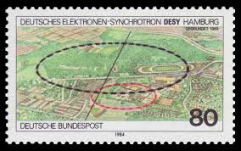
HERA hall north

Slide 12
HERA hall north
ca. 32m
Boxes for connection to HERA transfer line
ca. 25m
ALPS II

Slide 13
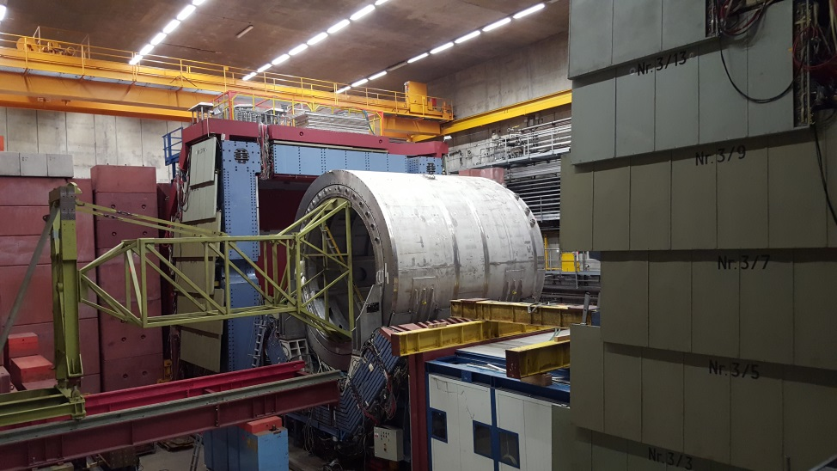
HERA hall north
Pros | Cons
Cryogenic lines and some boxes (distribution) already exist => Low investment costs | Not located on the DESY campus => ~1.5km away from DESY
Still some work to clean the hall up, but scheduling for MADMAX experiment looks feasible | Higher operation costs due to distance
Existing iron yoke could be used for shielding of magnetic field (see tomorrows talk)
Low noise => located in underground
Electronic trailer for control room

Slide 14
Decision
HERA hall north is the best location to host MADMAX

Slide 15
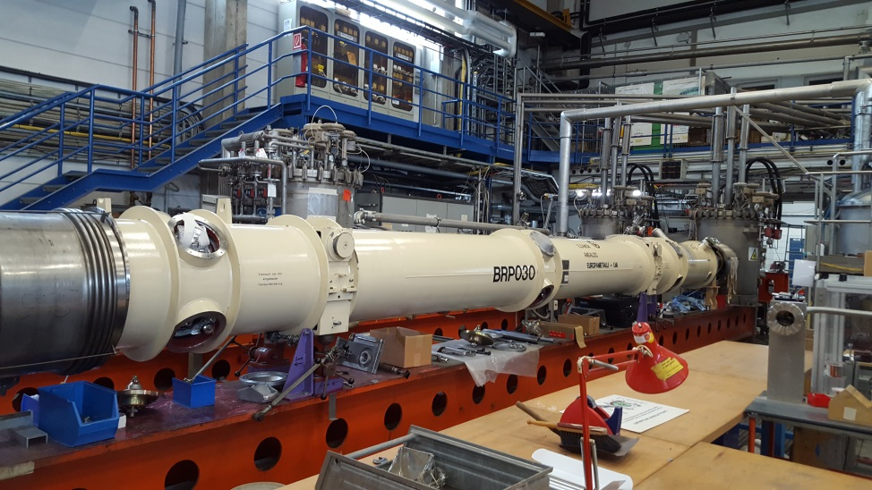
ALPS II @HERA north

Slide 16
ALPS II @HERA north
=> Means some work in parallel to ALPS II installation
Maintain for cryogenic supply in HERA north
=> 1st invest
Cut line and close

Slide 17
ALPS II @HERA north
=> Means some work in parallel to ALPS II installation
Maintain for cryogenic supply in HERA north
=> 1st invest
Cut line and close

Slide 18
Cryogenic supply
T-stability after He-transfer from cryogenic plant will be realized by subcooler box (stable and defined cryogenic supply)
Heat exchanger box + vacuum pump for 2K operation => cool down by supply (jt-valve) and exhaust line
4K: fill up magnet via jt-valve
2K: operation via heat exchanger (vapor pressure decreased by vacuum pump)

Slide 19
Cryogenic supply
Supply of forced supercritical helium (~5K; ~2,3bar) needs further investigations
=> of course, it is feasibly, but could produce some additional costs (if f.e. cold circulation pump is needed)
=> Wait for results of design report

Slide 20
Separate cryogenic plant
High investment cost
No subcooler box necessary (shorter way)
Power of new plant should be sufficient to recover the dynamic heat load during magnet operation
=> increased costs during standard operation
=> Consequently cool down takes longer
Additional cost/manpower for cryogenic operator
Warm gas management not solved!
Warm gas management and storage could not be realized at HERA hall north
Not recommended!

Slide 21
Conclusion
Site studies were done at DESY
Best solution for MADMAX at DESY is HERA hall north
First solutions of cryogenic supply were investigated

Slide 22
Thank you for your attention!

