Slide 1
Characterization of LYSO scintillator screen for future diagnostic of PWFA beams
Author
Oscar Cipolato
University of Padua, Italy
Physics Department
Supervisor
Pardis Niknejadi
DESY
FLA-PWA

Slide 2
FLASHForward
FLASHForward is a project to conduct Future-ORiented Wakefield Accelerator
Research and Development at the DESY free-electron laser (FEL) facility FLASH.
Produce high-quality beams with electron-beam-driven acceleration (high energy, high current, low energy spread and emittance)
Systematically analyze bunch parameters (emittance, beam size, …) for different injection techniques
Ultimate goal: demonstrate Free-Electron Laser (FEL) gain from plasma-accelerated electron beams

Slide 3
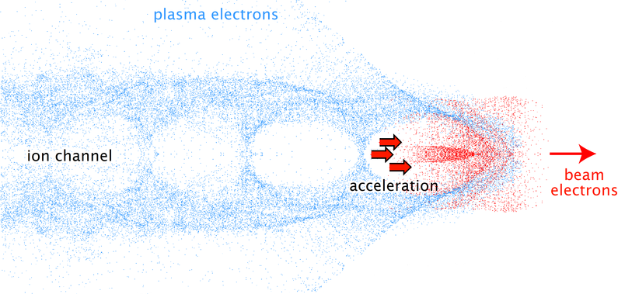
What is PWFA?

Slide 4
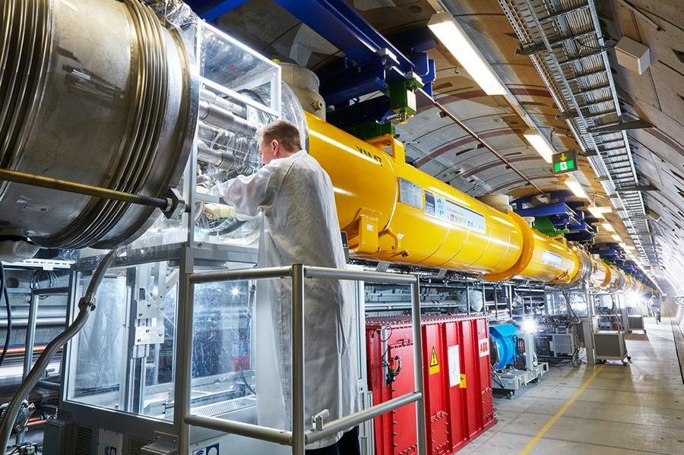
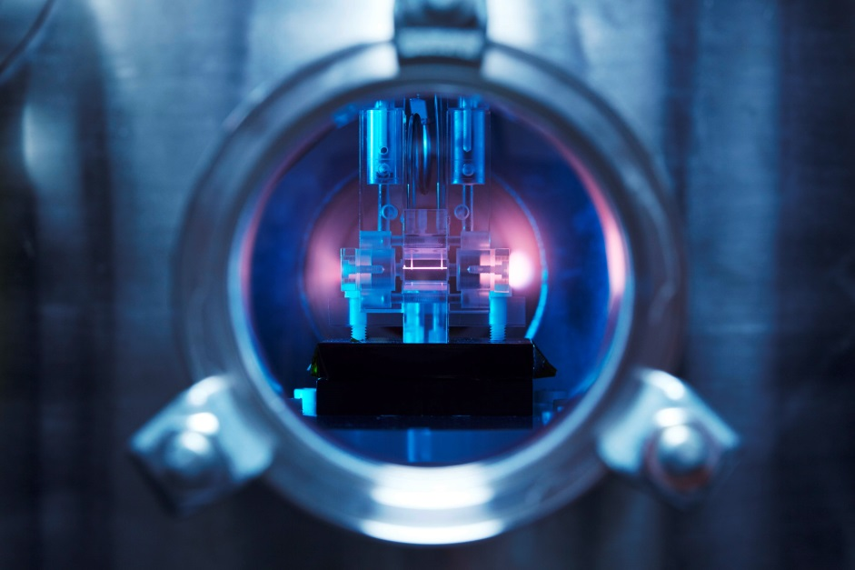
Usefulness of PWA
VS
Accelerating gradient achievable
in conventional RF cavities
around 100 MeV/m
Accelerating gradient
10-100 GeV/m

Slide 5
Scintillator screen diagnostic
In FLASHForward high energy electron bunches are created co-propagating with the laser used for ionizing the plasma
Intense E field of the laser may interfere with the diagnostic of the electron beam
It is necessary to block the laser before diagnostic of the electron bunch
Solution:
scintillator screen is able to reflect the laser while it can be also used for diagnostic

Slide 6
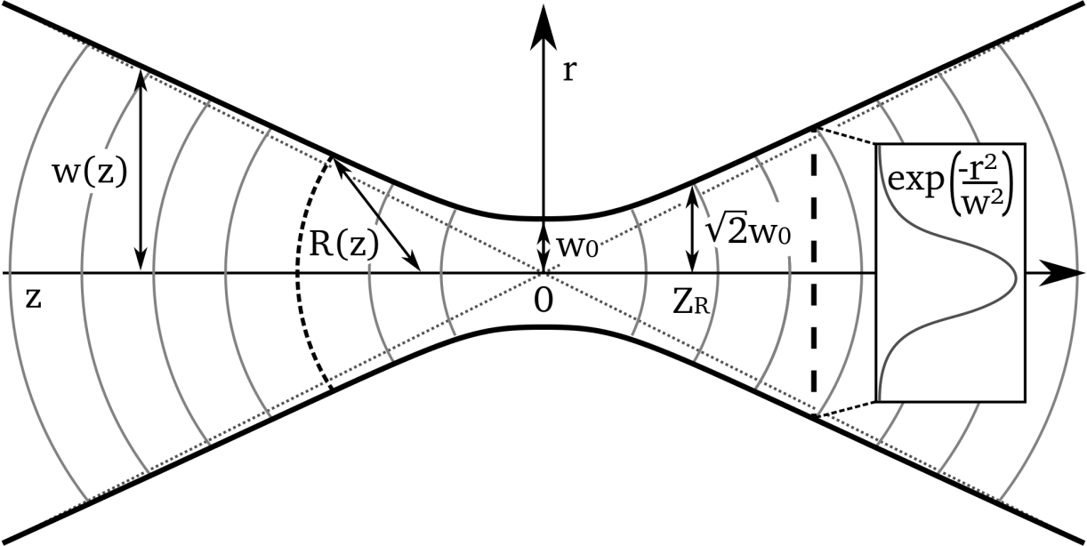
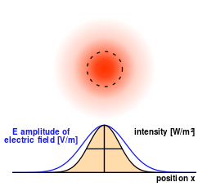
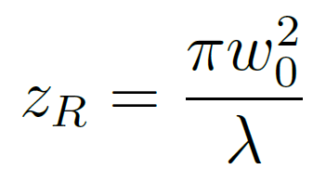
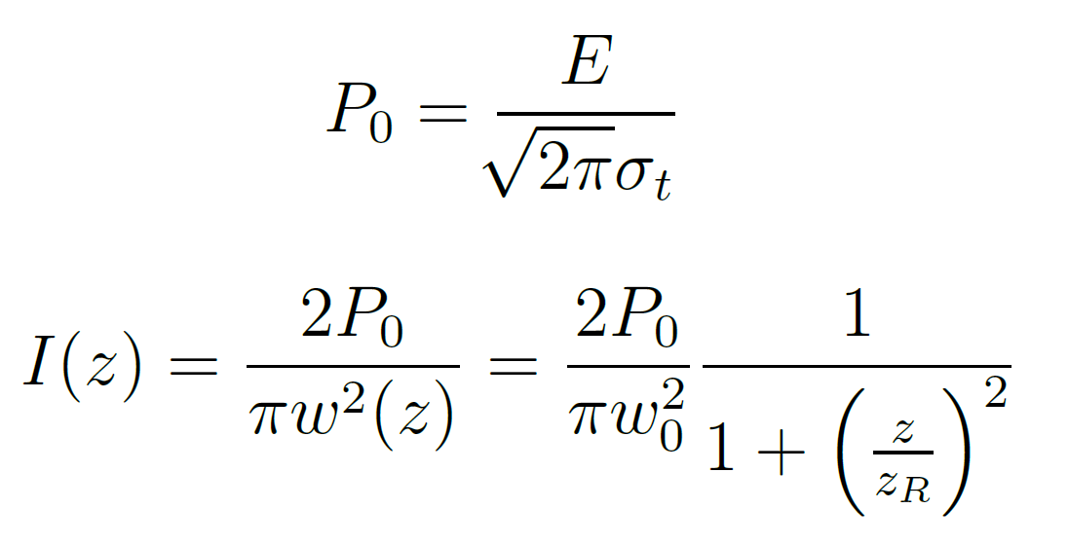
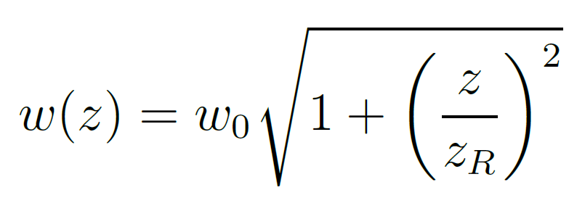
Gaussian beam
Notes:
Minimun transverse size of the beam

Slide 7
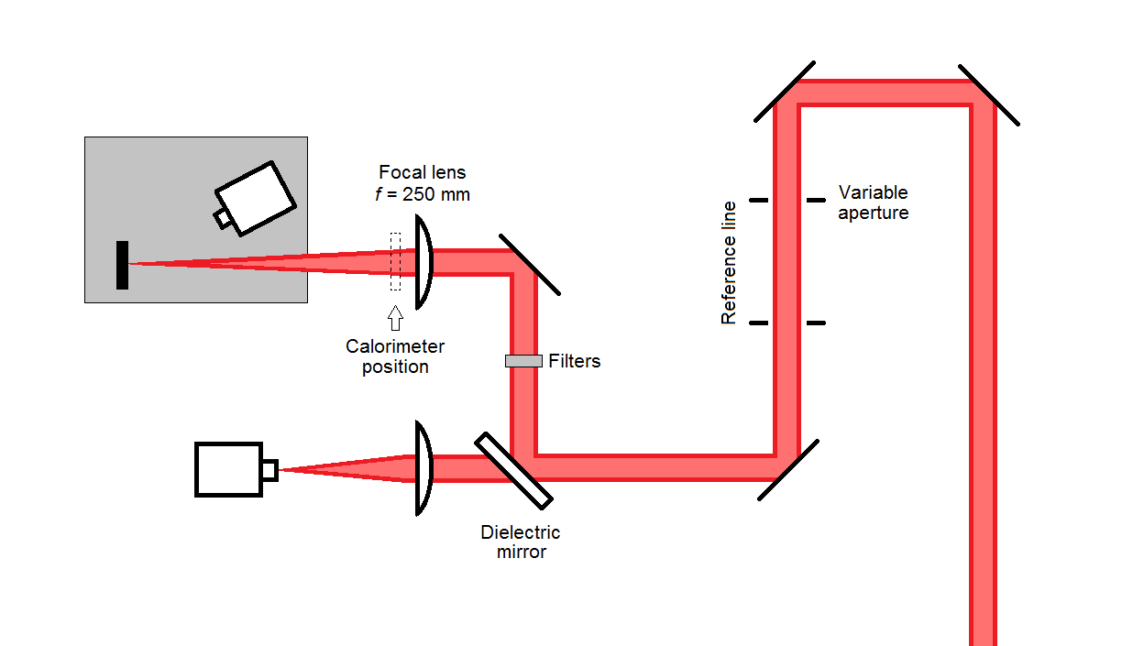
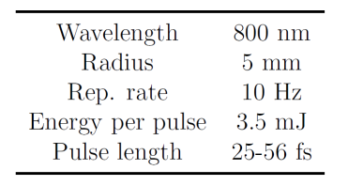
Experimental setup

Slide 8
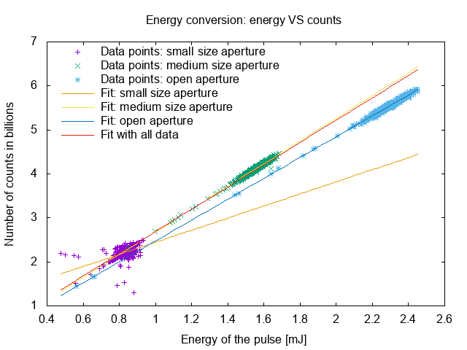
Calibration of image with calorimeter

Slide 9
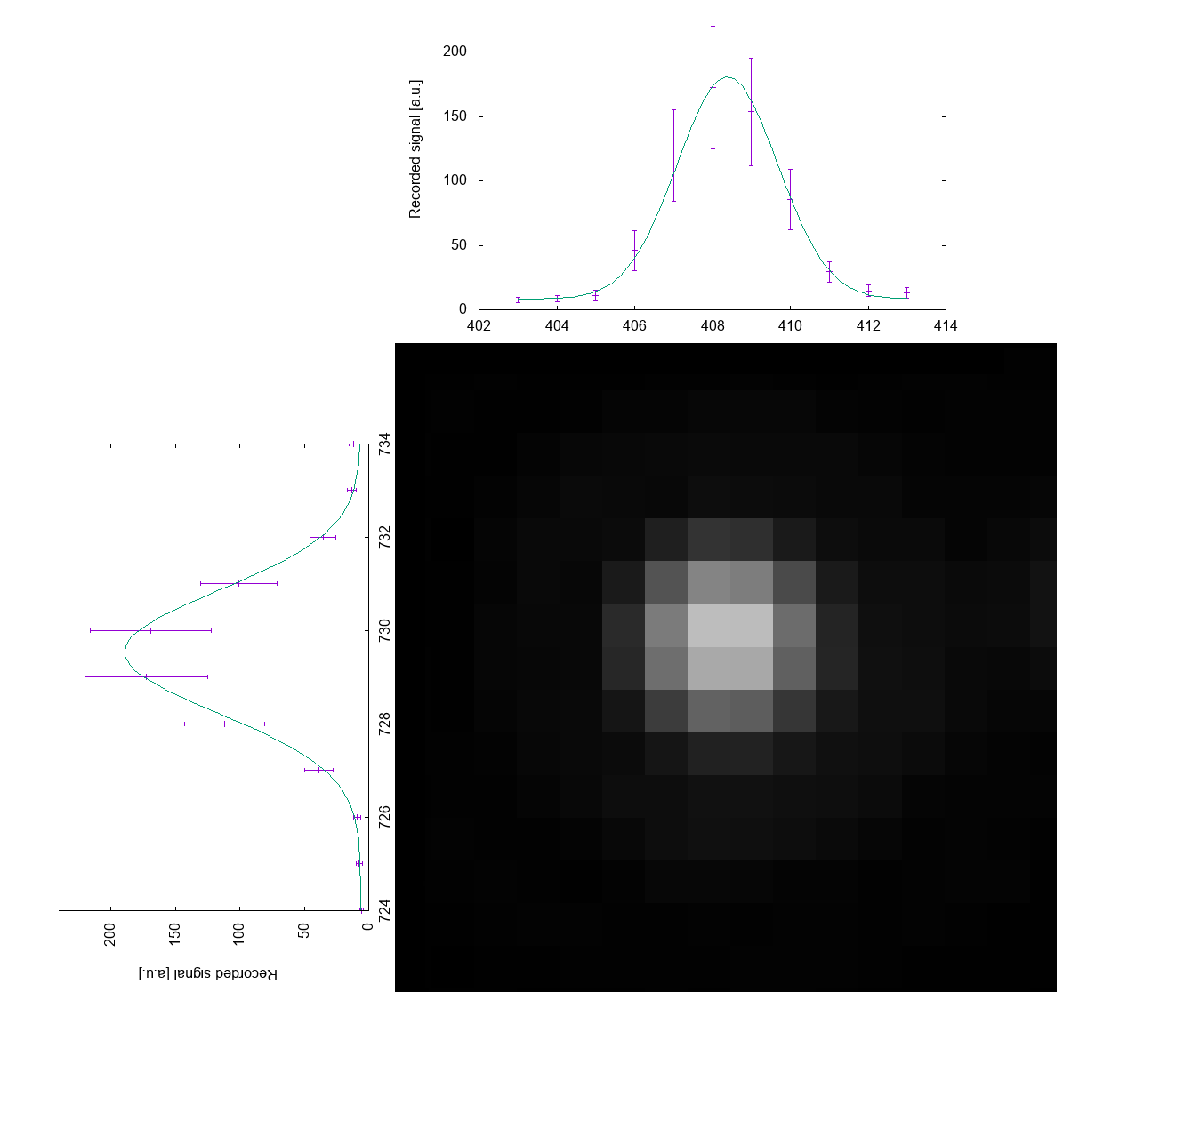
Beam spot size
Notes:
In many setups the beam is not perfectly symmetric, so as beam waist is used the range between the fit values of x and y

Slide 10
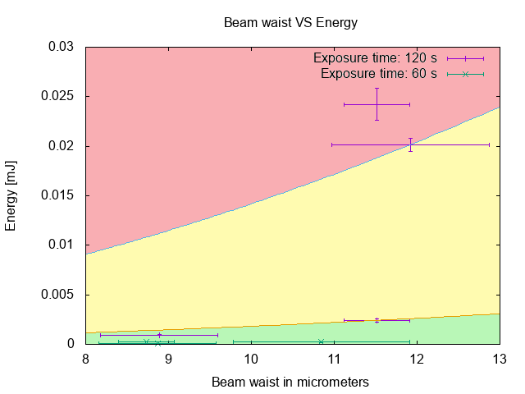
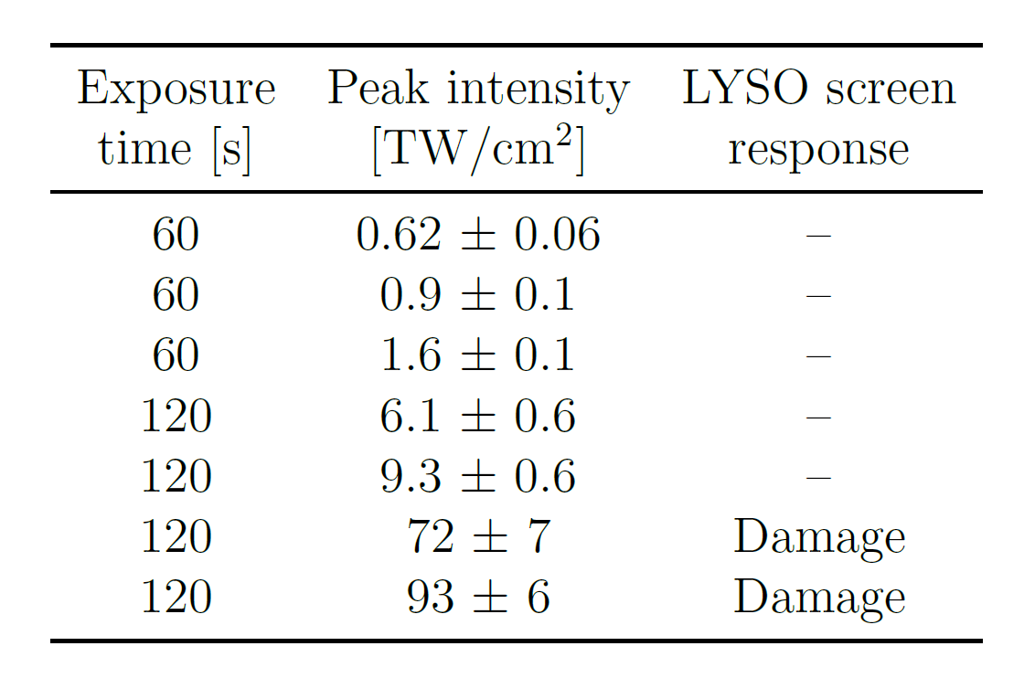
Final results
Notes:
It can be fine tuned for further characterizing the screen

Slide 11
Special thanks to: kris, bridget, jeya, office mates

Slide 12
