Slide 1
Tests on Chess 2 ASIC
Dionisio Doering, Yubo Han_{IHEP} , Pietro Caragiulo, Larry Ruckman, Camillo Tamma, Mazin Khader_{UIUC}, Murtaza Safdari, Su Dong

Slide 2
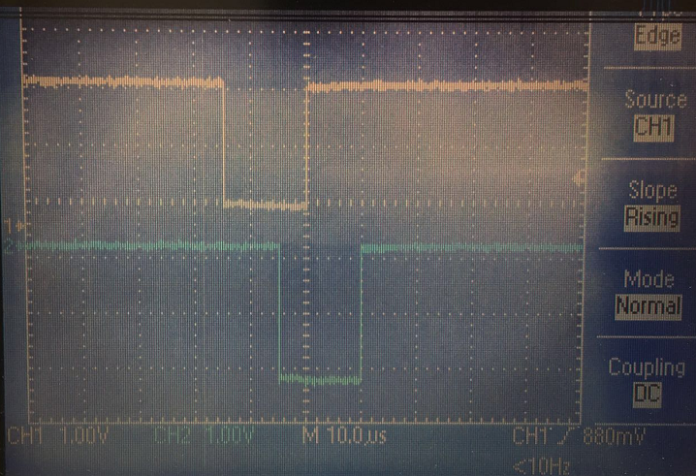
Outline
Tests with delayed Qinj :
->daughter board 01-carrier board 23
->daughter board 19-carrier board 28
Qinj: pulse width: 15μs
pulse delay: 35μs

Slide 3
Pixel description

Slide 4
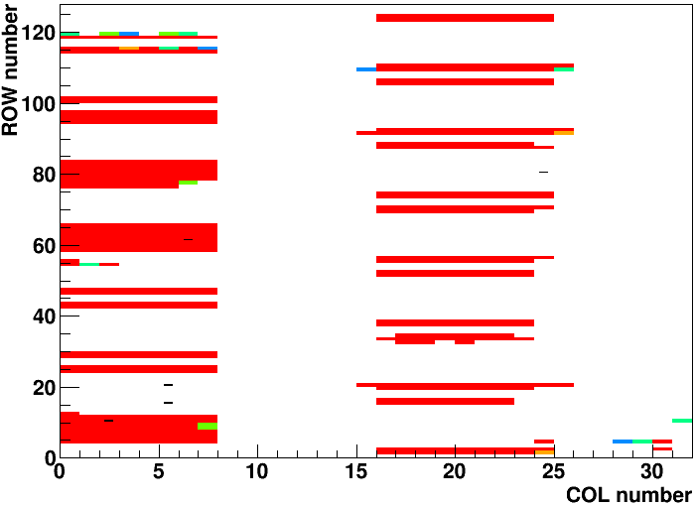
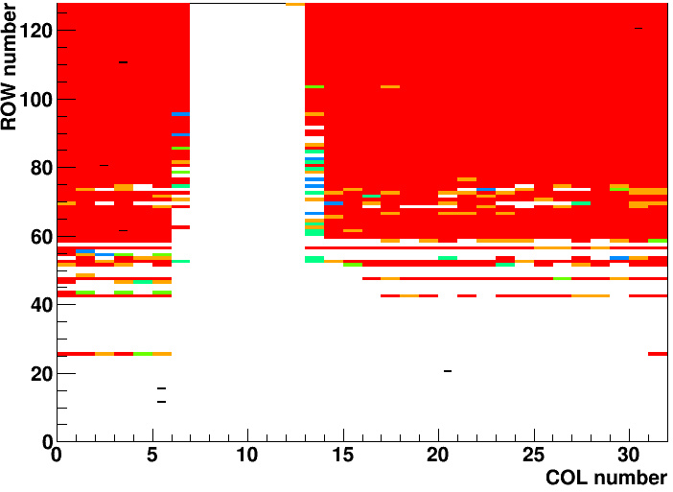
Running the test with Qinj delayed
Carrier Board 192.168.3.23
Daughter board: 01(std resistivity)
5 pixels were chosen
2 “hot ” pixel and 3 “quiet ” pixels
(20,5) (80,24) (10,2) (61,6) (15,5)
PIXTH=1.2V, default configuration
Carrier Board 192.168.3.28
Daughter board: 19(high resistivity)
7 pixels were chosen
4 “hot ” pixel and 3 “quiet ” pixels
(15,5) (20,20) (120,30) (110,3) (80,2) (11,5) (61,3)
PIXTH=1.2V,Default configuration
->first results didn’t show any “delay”
->change the firmware and add delay on both Qinj0 and Qinj1

Slide 5
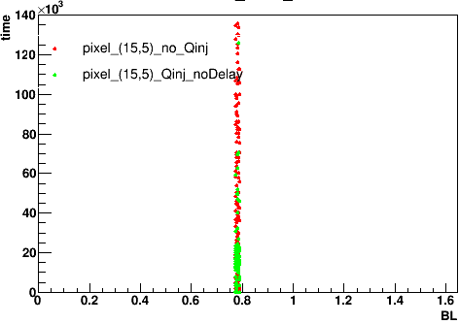
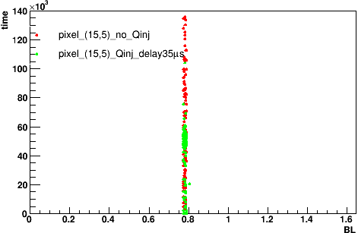
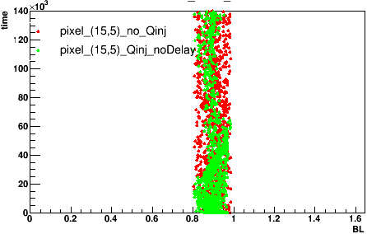
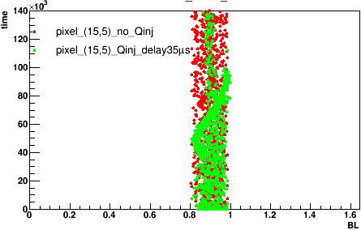
Pulse delay
No delay
with delay
Pixel (15,5)
Carrier Board 192.168.3.28
Daughter board: 19(high resistivity)
Default configuration
PIXTH: 1.2V
Pluse Delay: 35μs
Matrix 0
Matrix 1

Slide 6
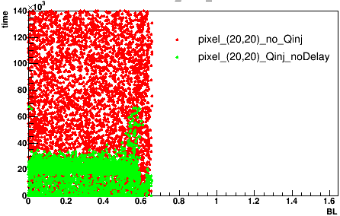
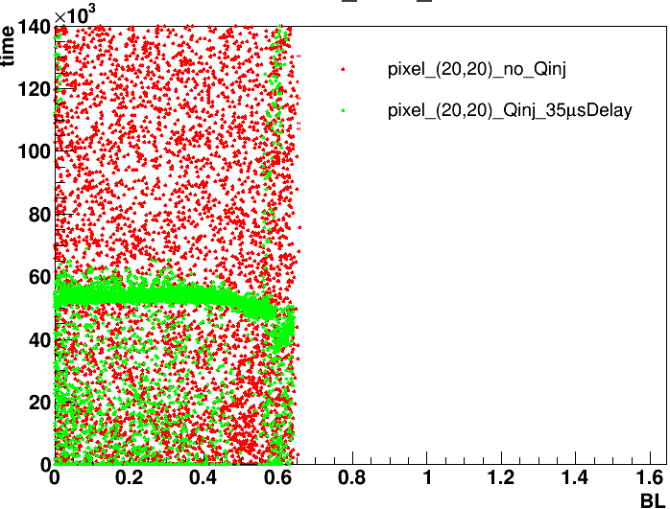
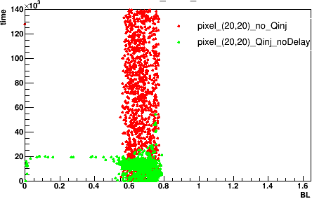
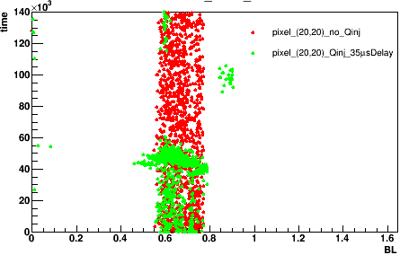
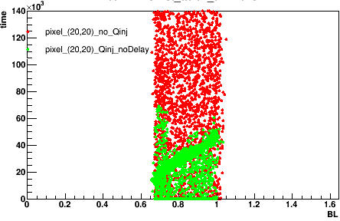
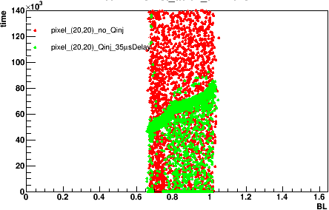
Pulse delay
No delay
with delay
Pixel (20,20)
Matrix 0
Carrier Board 192.168.3.28
Daughter board: 19(high resistivity)
Default configuration
PIXTH: 1.2V
Pluse Delay: 35μs
Matrix 1
Matrix 2

Slide 7
Summary
The structure will move with delayed Qinj on carrier board 28-daughter board 19. and the Qinj on that board doesn’t work properly.
carrier board 23-daughter board 01 didn’t show big difference with delayed Qinj.
Still didn’t see any strong evidence of signal.

