Slide 1
Vibration Monitoring
Sabine Cunis
PSPO
.
.

Slide 2
… current situation:
…end of this year the contract for construction accompanying measurements by Baudynamik Heiland & Mistler will run out.
By now in SASE1 we have all the infrastructure installations done and the research operation is starting. One of our measuring points is directly at the one pillar at SASE1. So far, the daily readouts from during the quiet times, shows no worrying results.
However, should the crews from SASE1 make some relevant observations, it would be good to let us know.
Heiland is going to do a final report now, to summarize the observations during the construction phase.
In SASE2 construction work is still going on. And also the technical infrastructure there will start operating bit by bit.
Question is, whether monitoring in HED-exp (A-12) should be continued until major installations are completed and the operation phase is starting.
… question is also, whether anything disturbing could be expected at SASE3 during further installations

Slide 3
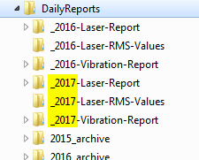
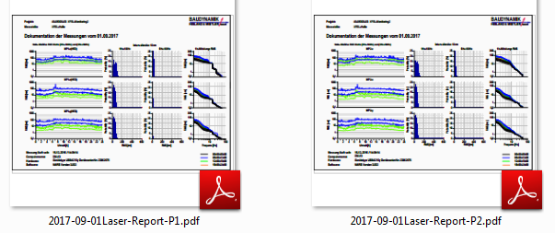
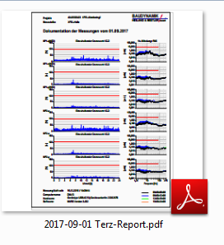
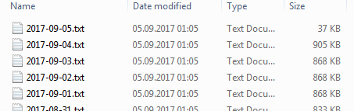
Daily Reports
We do get daily reports in two kinds of format. One is the standard Baudynamik format in third-spectra, giving the velocity of the excitation. The other one is the integrated power spectral density format, giving the amplitude of the vibration. For the later one we also get daily ascii files.
PSD spectra
[nm]
third spectra
[µm/sec]

Slide 4
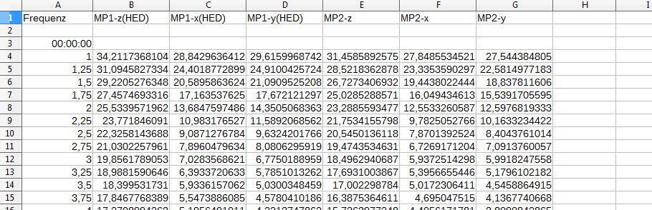
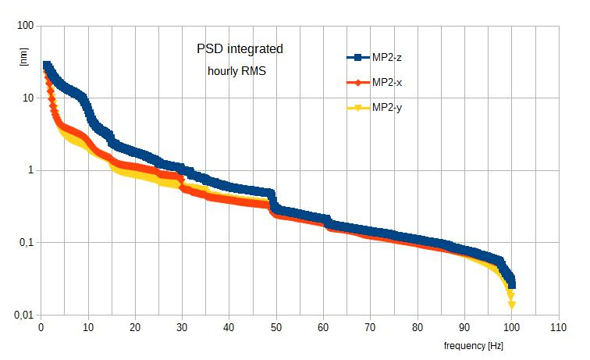
PSD Integrated Daily Data Output
hourly spectra
from 1 to 100 Hz
for both monitoring points
in z, x and y directions

Slide 5
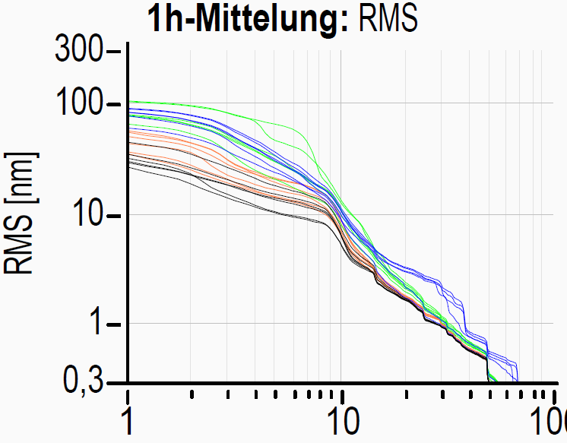
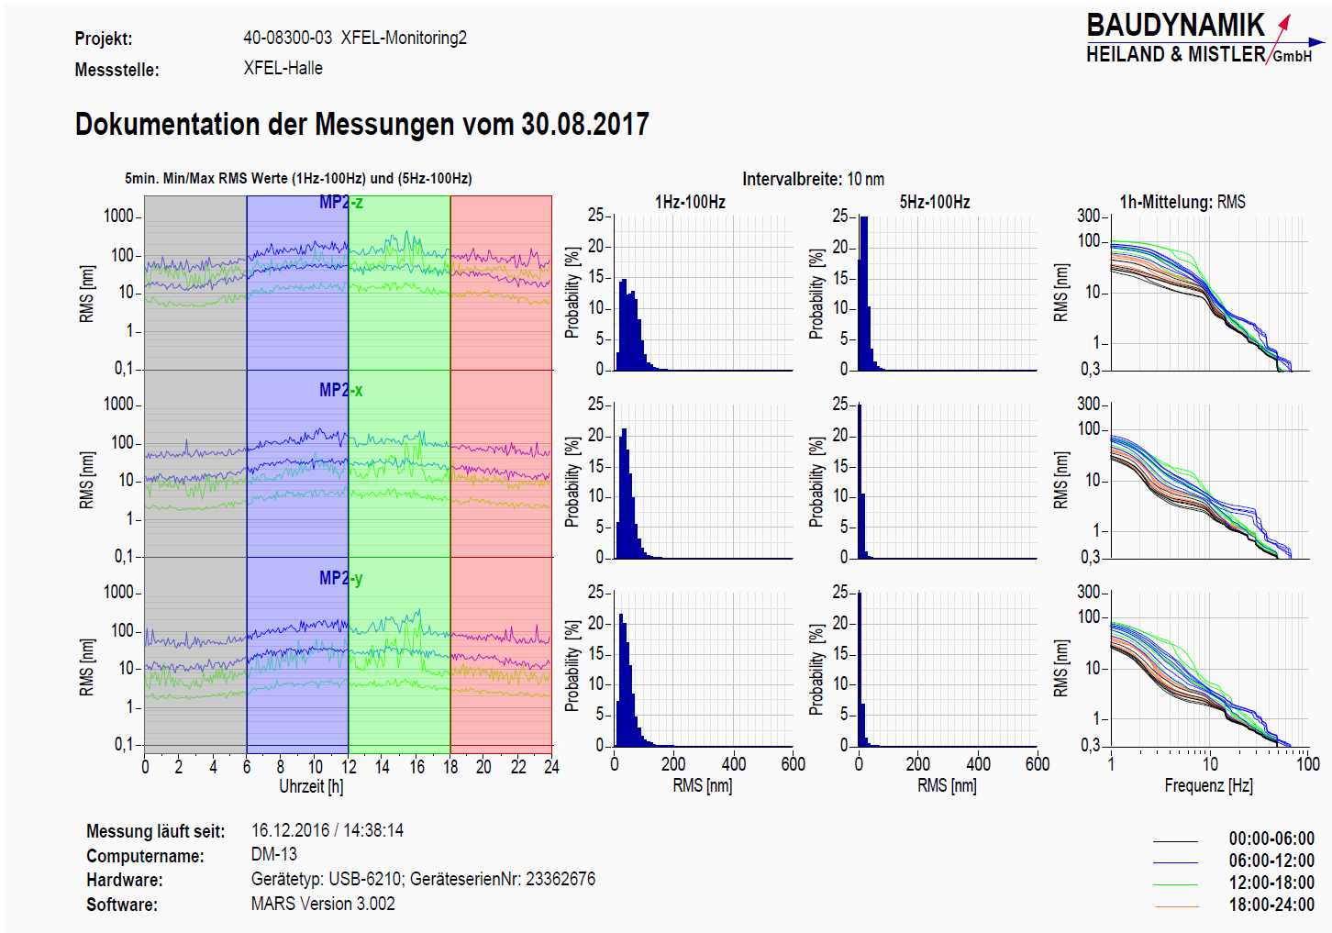
The Daily Printouts and the Data
integrated PSD Data

Slide 6
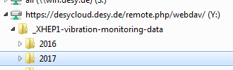
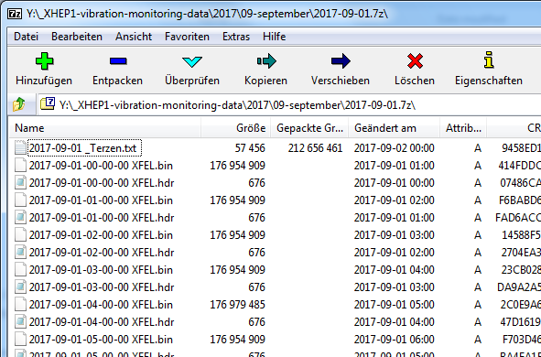
Third Spectra
Also for the third spectra we do get ASCII data. But they are archived together with the binary raw data in the desy-cloud
daily ASCII file
hourly raw data
  header
  binary

Slide 7
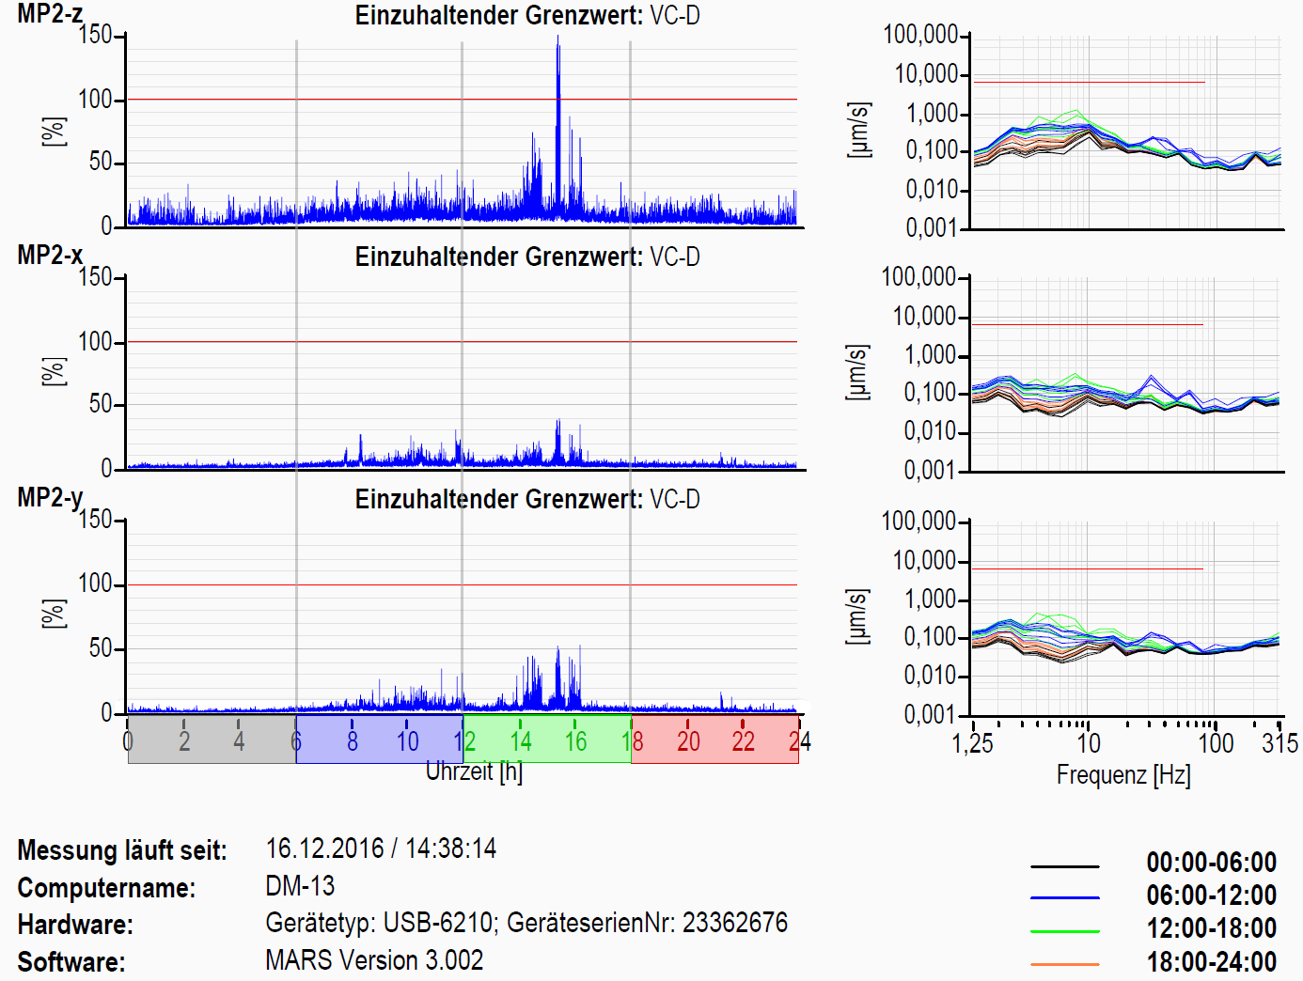
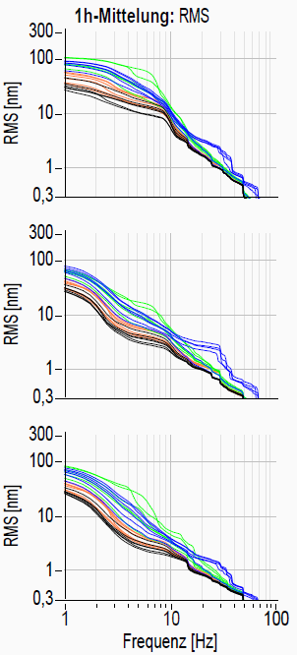
… Third Spectra
compared to … :

Slide 8
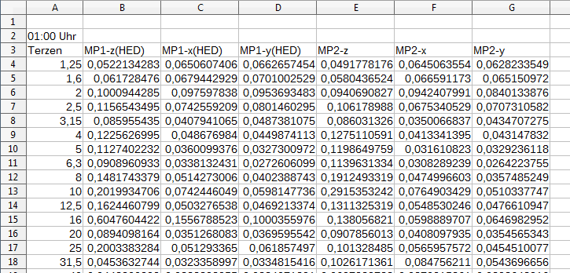
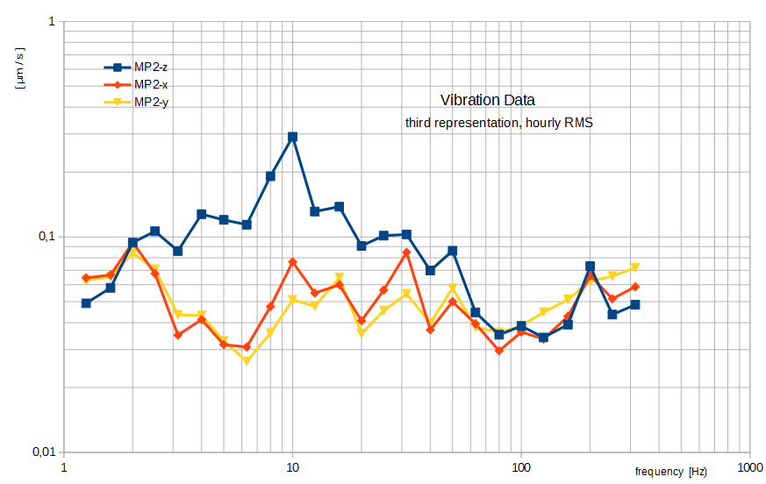
ASCII Data for Third Spectra

Slide 9
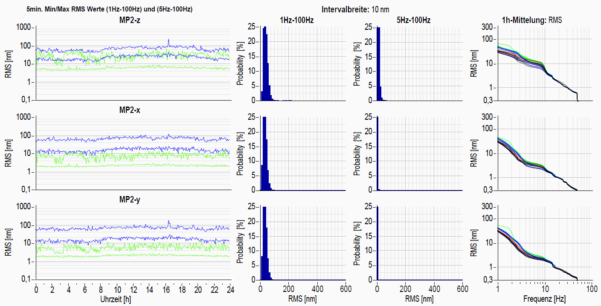
a typical Sunday … Aug. 20th at SPB (MP2)

Slide 10
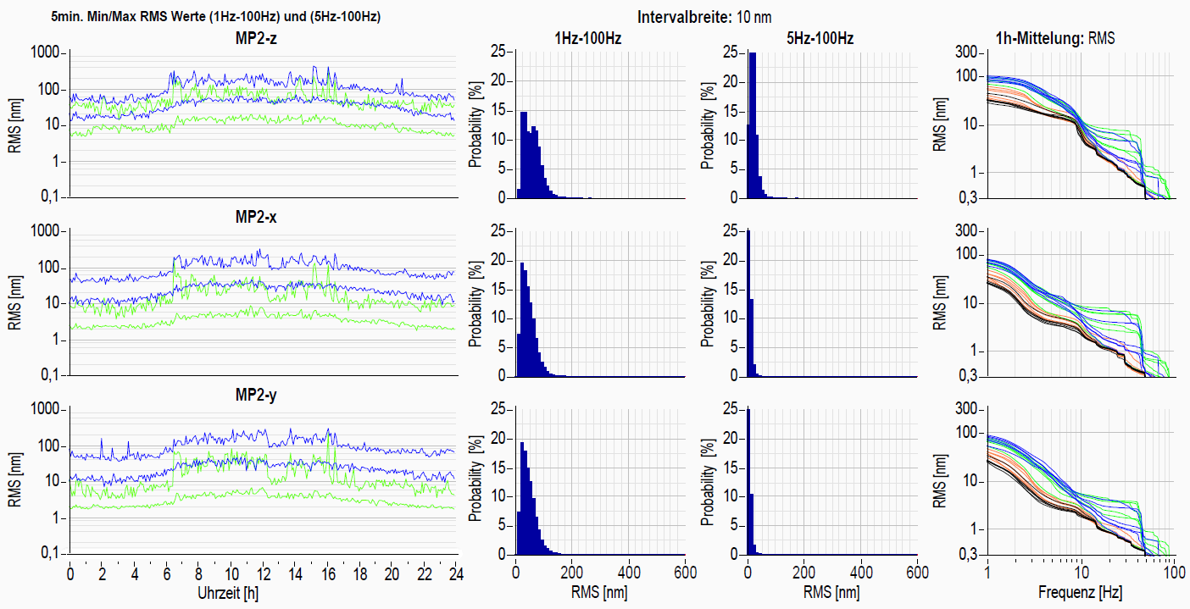
a typical workday … Sept. 5th at SPB (MP2)

Slide 11
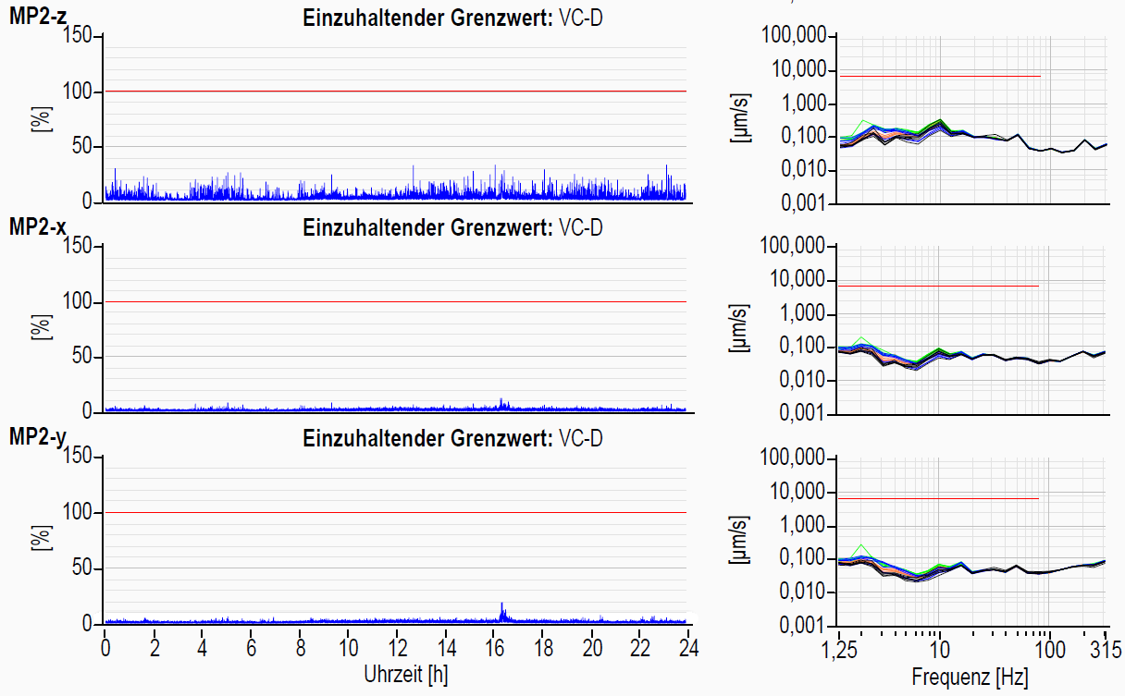
a typical Sunday … Aug. 20th at SPB (MP2)

Slide 12
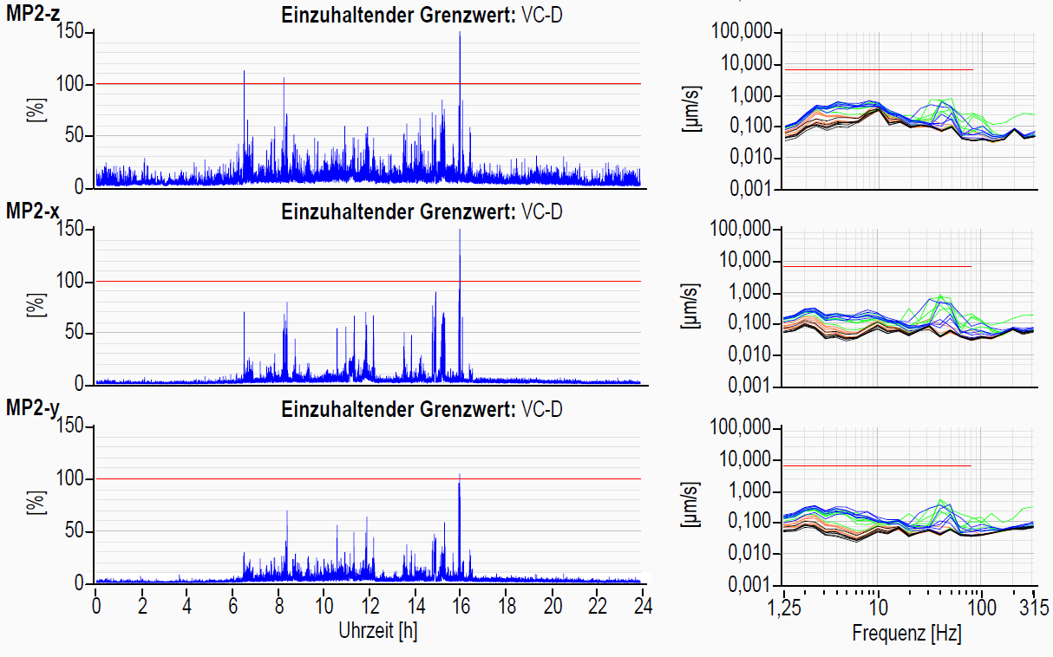
a typical workday … Sept. 5th at SPB (MP2)

Slide 13
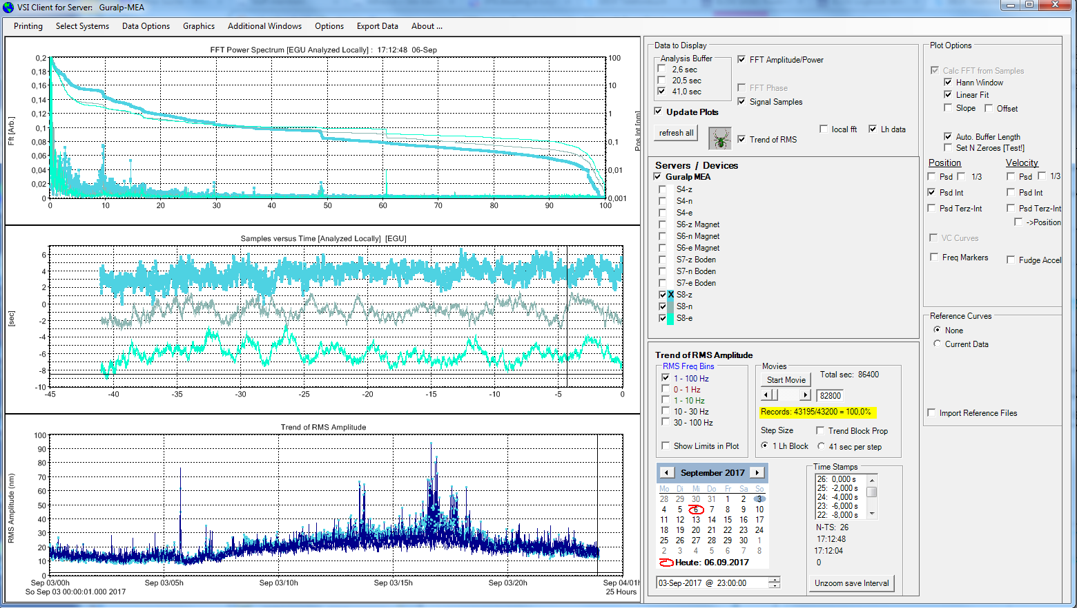
.
In parallel to those measurements by Heiland, we also are trying some live measurements.
The software is developed by Mark Lomperski of DESY-MIN. This software is used by DESY for all sorts of vibration measurements. It allows live measurements as well as analysis of previously recorded data.

Slide 14
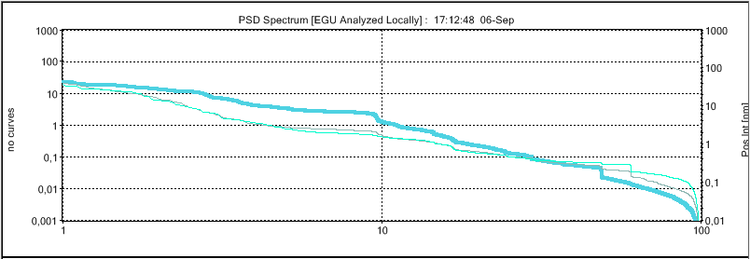
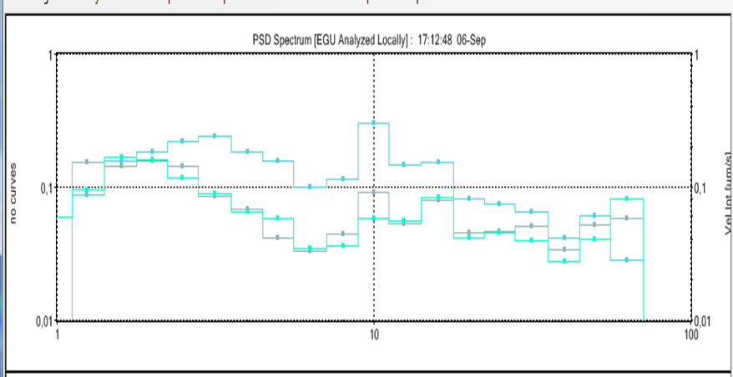
.
Currently this software can handle data from seismometers, from geophones, and from piezo sensors.
Also, data from other sources in different formats can be read as reference files.
Currently we have a Guralp seismometer connected to it. This seismometer connects directly to the DESY IT network and is recognized by the software.
The software offers among other representations also integrated PSD spectra and, to compare to the Heiland measurements, even a third representation of velocities.
This software is still under development. … so, bugs can be expected, but also new features can be added …

