Slide 1
Tests on Chess 2 ASIC
Dionisio Doering, Yubo Han_{IHEP} , Pietro Caragiulo, Larry Ruckman, Camillo Tamma, Mazin Khader_{UIUC}, Murtaza Safdari, Su Dong

Slide 2
Outline
Change the Qinj on daughter board 19-carrier board 28
inversed Qinj
Pulse delay:35μs
Pulse width:15μs
Tests with inversed and delayed Qinj:
on the pixels around (20,20): (19,19),(19,20),(20,19),(20,20),(20,21),(21,21)
Using new configuration to test:
on (20,20),(19,19)
Keep BL fixed and sweep the threshold :
->on (20,20),(19,19),(20,21))
->BL fixed at 0V, 0.46V, 0.6V, 0.7V, 0.8V, 0.9V, 1.03V, 1.24V
->Threshold sweep from 0-1.65V
Keep BL fixed at 0.7V and scan the thresholds:
-> on (19,19),(19,20),(20,19),(20,20),(20,21)
-> from 0.65V to 0.75V, with step of 0.8mV

Slide 3
Pixel description

Slide 4
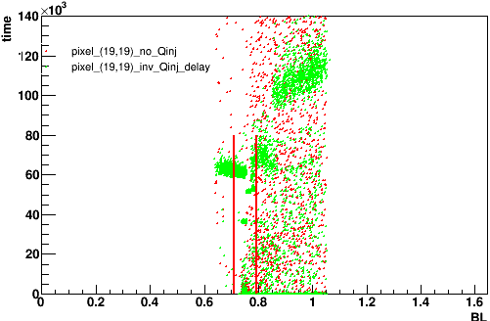
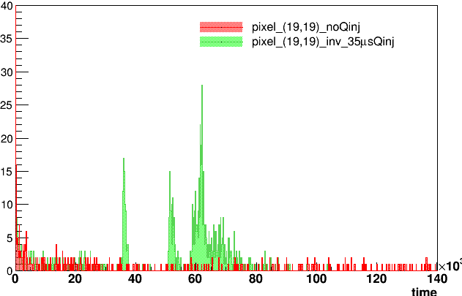
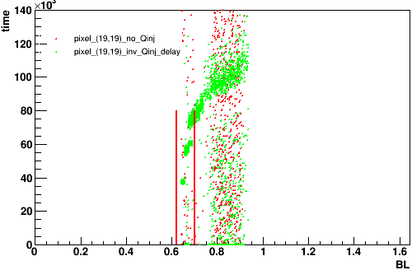
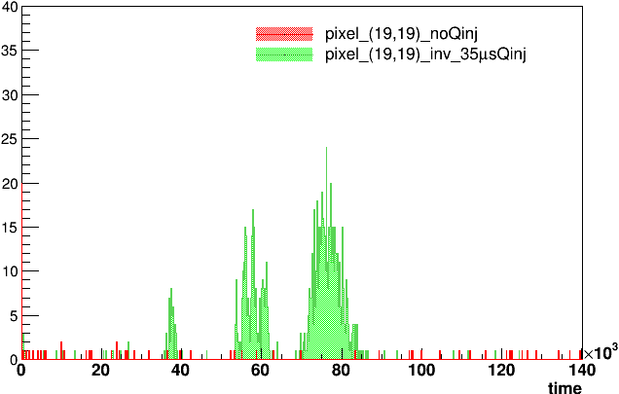
Pulse delayed and inversed
Inv-delay-all
Projection on time
Pixel (19,19)
Carrier Board 192.168.3.28
Daughter board: 19(high resistivity)
Default configuration
PIXTH: 1.2V
Tests with inversed and delayed Qinj:
Matrix 1
The 2nd column is the projection of hits in certain BL range between the two red bar.
Projection range:
Matrix1: 0.71-0.79V
Matrix2: 0.62-0.70V
3-peak can be get from most of the pixel around BL=0.7V.
Matrix 2

Slide 5
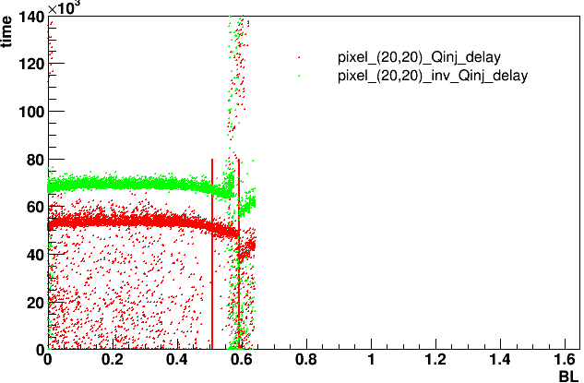
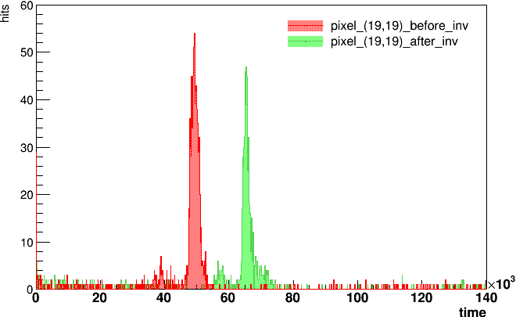
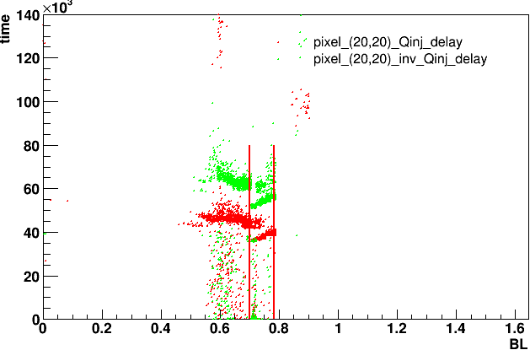
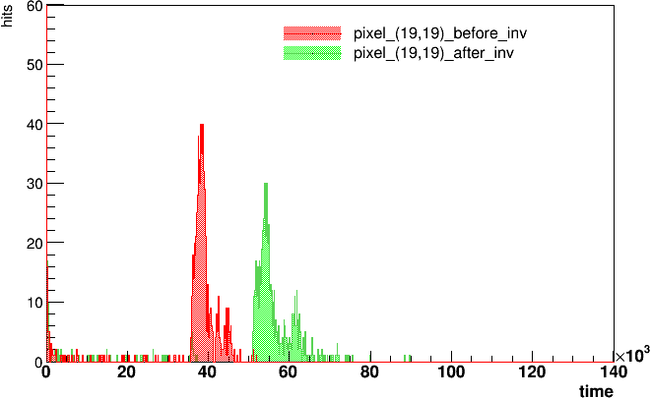
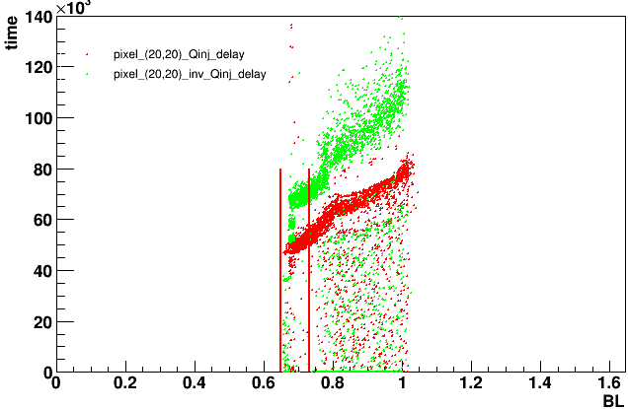
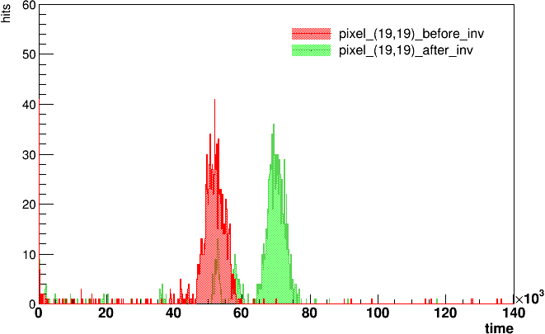
Inversed and delayed Pulse vs Delayed Pulse
Pixel (20,20)
Inv-delay-all
Projection on time
Carrier Board 192.168.3.28
Daughter board: 19(high resistivity)
Default configuration
PIXTH: 1.2V
If the heavy hit bands were “signal”:
A delay of 15μs after inversing the Qinj -> the falling edge of Qinj caused the gathering.
Matrix 0
Matrix 1
Matrix 2

Slide 6
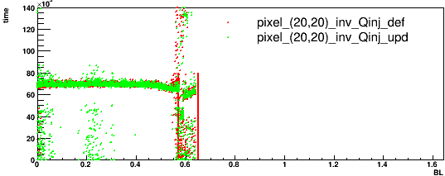
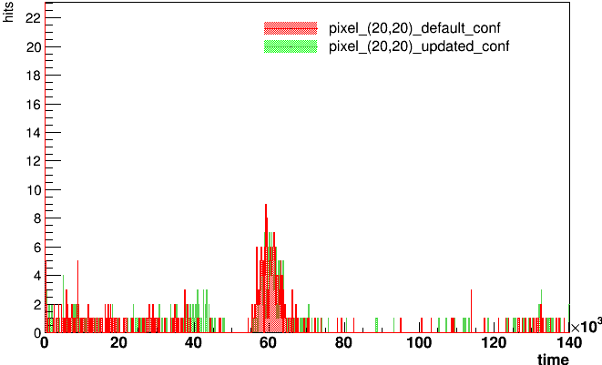
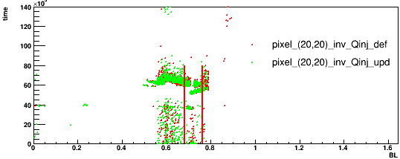
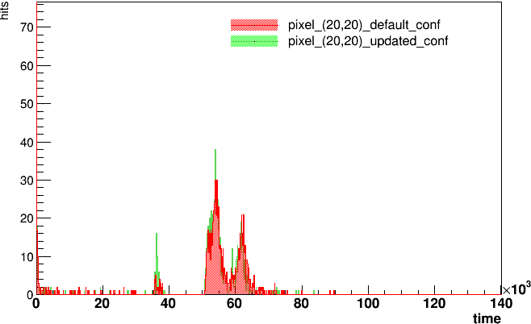
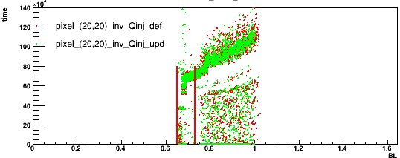
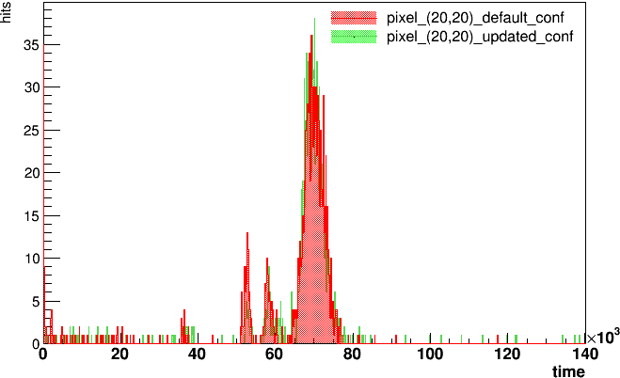
Pulse delayed and inversed
Inv-delay-all
Projection on time
Pixel (20,20)
Carrier Board 192.168.3.28
Daughter board: 19(high resistivity)
Default and upgraded conf
PIXTH: 1.2V
Matrix 0
Updated configuration: higher amplifier control current.
Projection range:
Matrix0: 0.57-0.65V
Matrix1: 0.68-0.76V
Matrix2: 0.65 -0.73V
No big difference between two configuration.
Matrix 1
Matrix 2

Slide 7
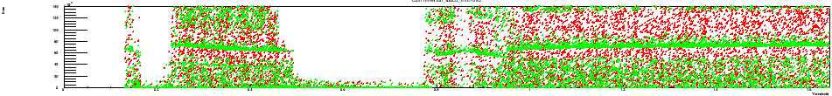
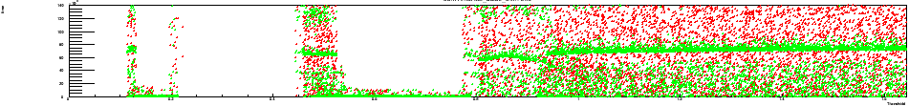
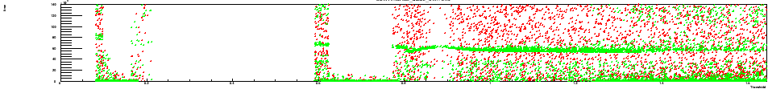
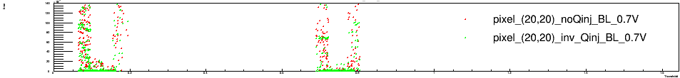
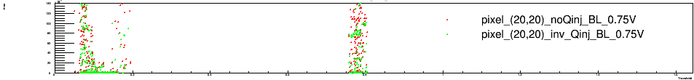
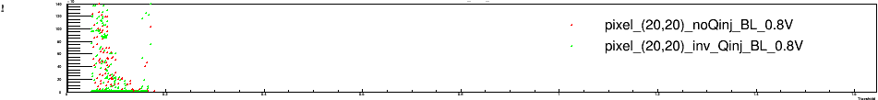
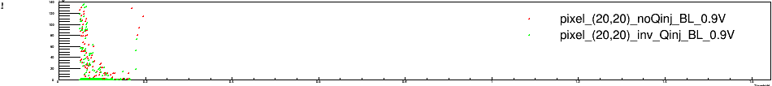
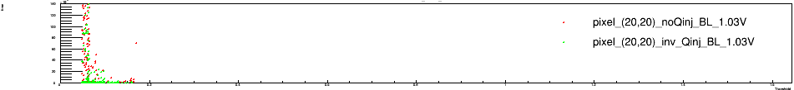
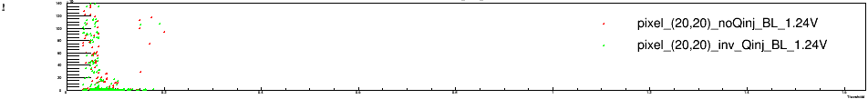
Pixel (20,20)
BL=0V
Carrier Board 192.168.3.28
Daughter board: 19(high resistivity)
Default configuration
Matrix0
BL=0.46V
Tests:
Keep BL fixed and
sweep the threshold
Time vs threshold
A “dead zone” above BL, below 0.8V.
Results of threshold below 0.2V should not be trusted.
BL=0.6V
BL=0.7V
BL=0.75V
BL=0.8V
BL=0.9V
BL=1.03V
BL=1.24V

Slide 8
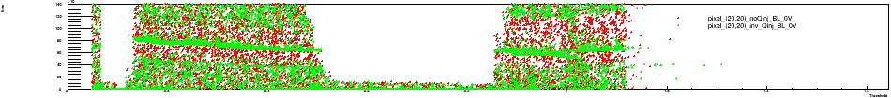
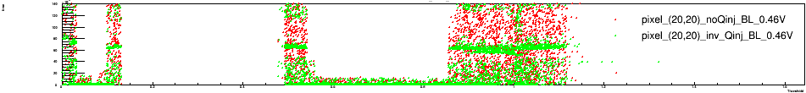
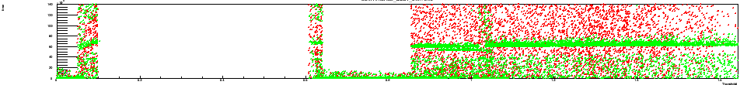
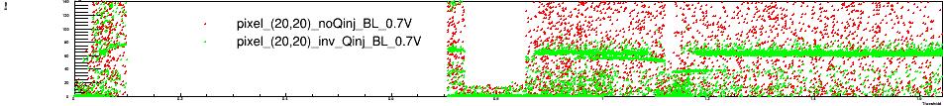
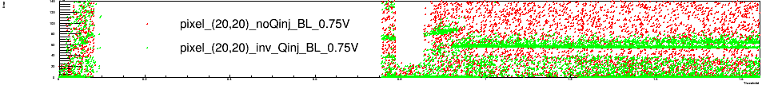
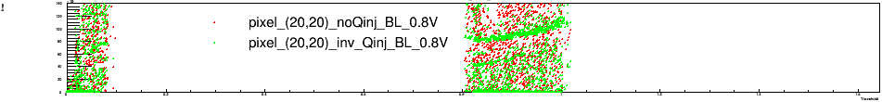
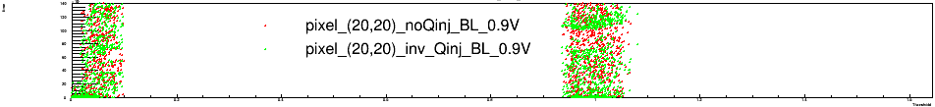
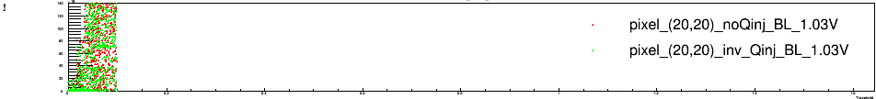
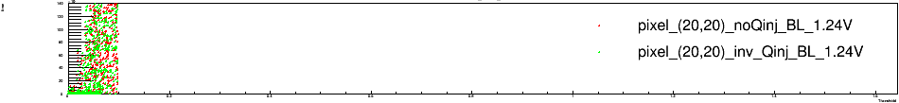
Pixel (20,20)
BL=0V
Carrier Board 192.168.3.28
Daughter board: 19(high resistivity)
Default configuration
Matrix1
BL=0.46V
The “dead zone” moved to 0.85V, and still have hit information after Threshold bigger that the block voltage.
A migrating up kicking green band can be seen at BL=0.75,0.8,0.9V.
BL=0.6V
BL=0.7V
BL=0.75V
BL=0.8V
BL=0.9V
BL=1.03V
BL=1.24V

Slide 9
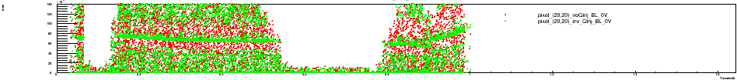
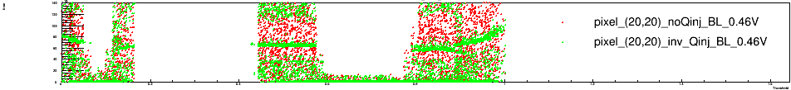
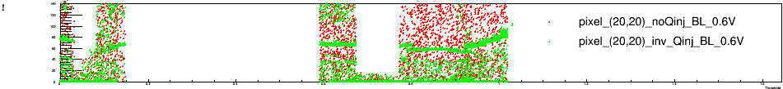
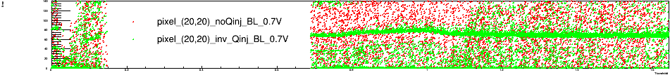
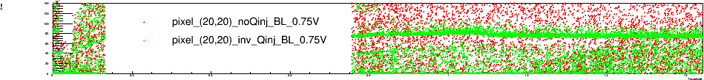
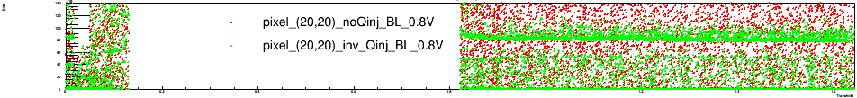
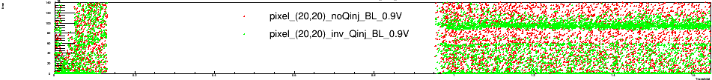
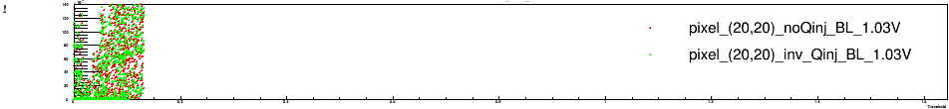
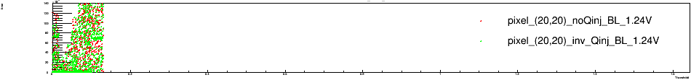
Pixel (20,20)
BL=0V
Carrier Board 192.168.3.28
Daughter board: 19(high resistivity)
Default configuration
Matrix2
BL=0.46V
BL can be correctly controlled.
Similar migrating band at BL=0,0.46,0.6V observed.
BL=0.6V
BL=0.7V
BL=0.75V
BL=0.8V
BL=0.9V
BL=1.03V
BL=1.24V

Slide 10
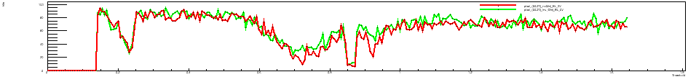
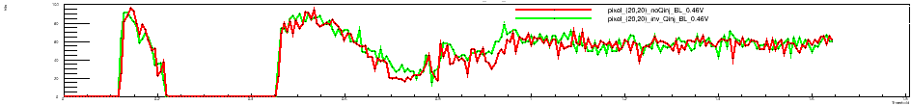
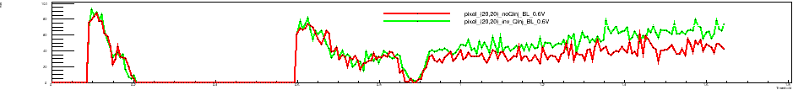
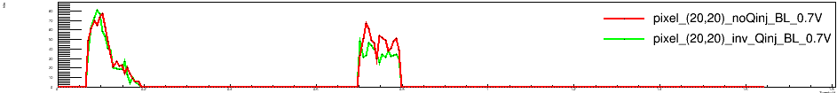
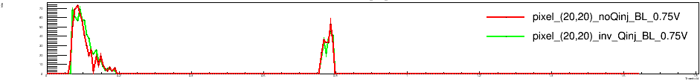
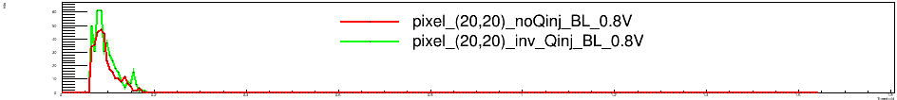
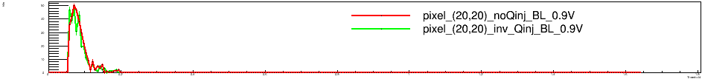


Pixel (20,20)
BL=0V
Carrier Board 192.168.3.28
Daughter board: 19(high resistivity)
Default configuration
Matrix0
BL=0.46V
BL=0.6V
Hit number vs threshold
BL=0.7V
BL=0.75V
BL=0.8V
BL=0.9V
BL=1.03V
BL=1.24V

Slide 11









Pixel (20,20)
BL=0V
Carrier Board 192.168.3.28
Daughter board: 19(high resistivity)
Default configuration
Matrix1
BL=0.46V
BL=0.6V
BL=0.7V
BL=0.75V
BL=0.8V
BL=0.9V
BL=1.03V
BL=1.24V

Slide 12









Pixel (20,20)
BL=0V
Carrier Board 192.168.3.28
Daughter board: 19(high resistivity)
Default configuration
Matrix2
BL=0.46V
BL=0.6V
BL=0.7V
BL=0.75V
BL=0.8V
BL=0.9V
BL=1.03V
BL=1.24V

Slide 13









Fix BL at 0.7V, sweep threshold (0.65-0.75)
Pixel (19,19)
All
33500-36500ns
Carrier Board 192.168.3.28
Daughter board: 19(high resistivity)
Default configuration
Matrix0
Look into the region of BL=0.7V.
More hit can be get at right side of the hits with time information within (33500ns-36500ns)
Matrix1
Matrix2

Slide 14









Fix BL at 0.7V, sweep threshold (0.65-0.75)
Pixel (20,19)
All
33500-36500ns
Carrier Board 192.168.3.28
Daughter board: 19(high resistivity)
Default configuration
Matrix0
Get a similar result.
Matrix1
Matrix2

Slide 15
Summary
Several tests using inversed and delayed Qinj have been done:
Qinj signal seems to be coming from leading edge of initial Qinj.
complex hit timing pattern for different BL values.
Keep BL fixed at 0.7V and scan the thresholds:
->sharp edge at threshold: we are probably controlling both BL and threshold correctly.
->A widening dead (or heavy noise) zone as BL decreases below 0.8V.
->Same pulse timing features just below the dead zone moves with BL
->Very low (<0.4V) and very high (>1.1V) threshold regions showing very different behaviors between different pixels
Inverted Qinj showing hits at leading edge for a very narrow Threshold range above BL. Small 10mV signal ?
Still haven't seen higher amplifier control current making a difference on signal.

