Slide 1
Status of the DSSC Project
Matteo Porro
For the DSSC Collaboration

Slide 2
Talk Outline
MiniSDD 1-Mpixel Camera Components and Specs
Towards the MiniSDD megapixel camera
F2 ASIC
Module and Camera Electronics
Mechanics and Integration
Calibration
Outlook on Future Cameras
Measurements with existing DEPFETs
Updates on new CMOS DEPFET production

Slide 3
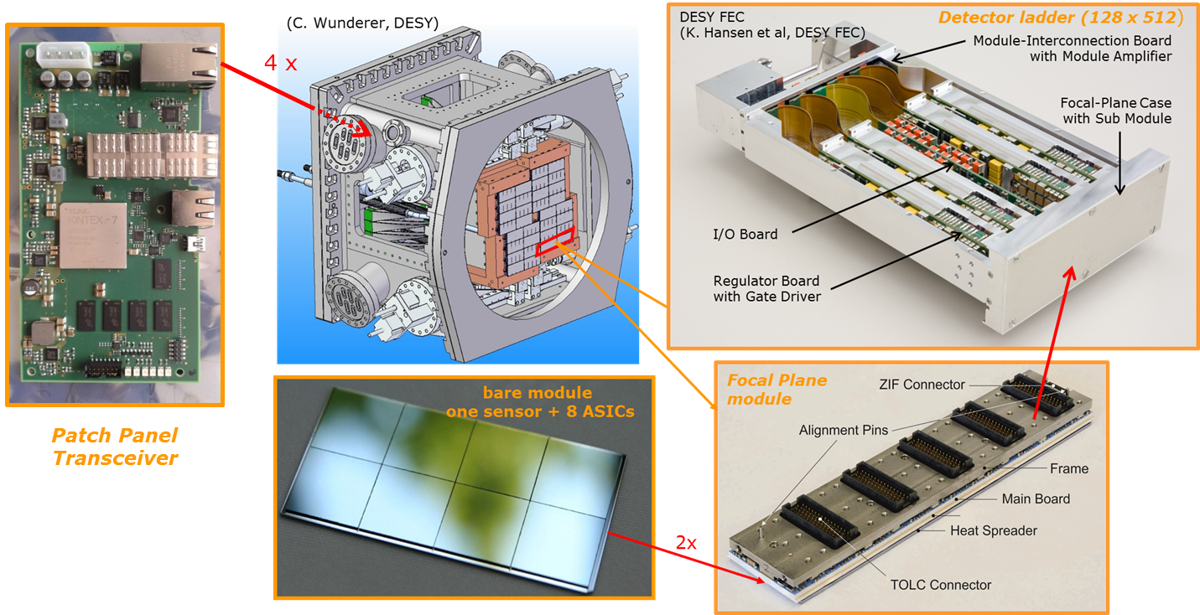
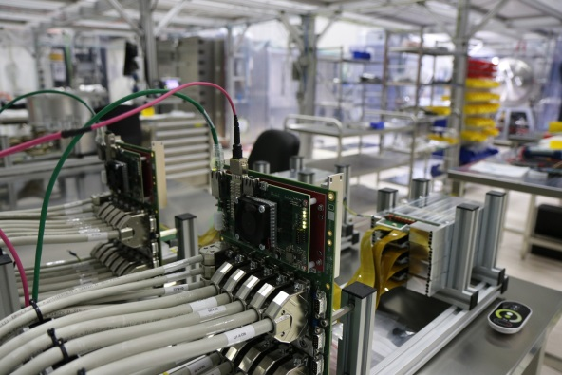
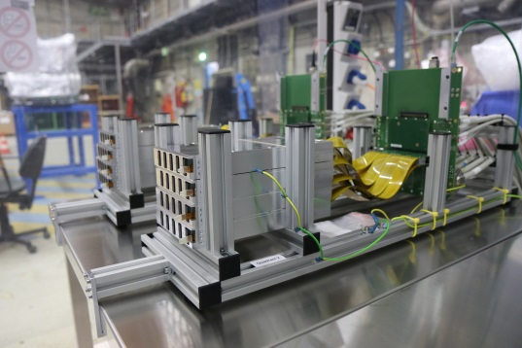
MiniSDD camera components overview
All camera components are available and fully qualified.
The MiniSDD ladder camera (128 x 512) is available since August 2016 and has been used at PETRA III beamline
For the MiniSDD MegaPixel camera foreseen by May 2018:
The mass production of electronics boards is successfully completed
The DAQ components are available
The complete camera head electronics together with PPTs and cables are installed and tested in Hera South
The second version of the full-format ASIC is available and successfully tested
The focal plane modules are in the assembly phase
The vacuum vessel is in production. The vessel will be available in February 2018

Slide 4
MiniSDD 1-Mpixel camera specs
 | XFEL 1st day requirements | MiniSDD 1-Mpixel
Number of pixels |  | 1024 x 1024
Sensor Pixel Shape |  | Hexagonal
Sensor Pixel pitch |  | ~ 204 x 236 µm²
Energy (keV) | 0.7, 1, 1.5 | 0.5, 0.7, 1, 1.5, 3
Single photon detection | NO | Selectable threshold
Dynamic range | 3 x 10³ @ 1 keV other E not specified | linear response – 8 bit (4.5MHz) 2560 ph – 10 ph. th. 1280 ph. - 5 ph. th.. 512 ph - 2 ph. th 256 ph. - 1 ph. th.
Noise | - | ~50 el. rms. with 1ph. th.
Frame rate | 4.5 MHz | 4.5 MHz, 2.2 MHz, 1 MHz
Veto capability | YES | YES
Memory | 800 Frames | 800 Frames
We have chosen the conservative front-end design for F2: linear response with selectable thresholds
Non linear response (high dynamic range) can be achieved with DEPFET camera

Slide 5
F2 ASIC

Slide 6
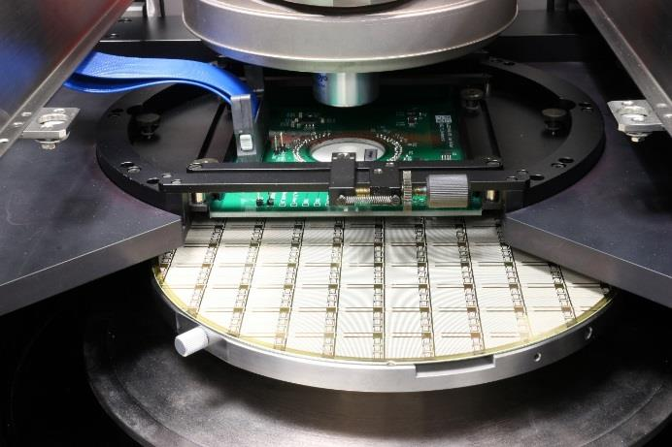
F2 Status
F2 engineering run → 3 chips, RTM: 12.04.17, wafers arrived in August
  F2 64 x 64 full scale chip with CSA based FE
  MM8 8 x 16 mini matrix with CSA based FE
  MM9 8 x 16 mini matrix with DEPFET FE
major modification in F2: CSA based linear front-end
→ no dynamic compression but various gain settings (next slide)
F2 can be fabricated also as a DEPFET (all pixels contain both FEs, one metal mask has to be changed to connect the CSA or DEPFET FE, MM8 and MM9 are identical despite for M4)
mini ASIC test chip (MM9) with revised
DEPFET FE is working fine
→ DEPFET submission is being prepared
all 10 wafers probed, yield: 68%
567 chips available, 320 needed for
5 quadrants to be delivered
only 64 x 64 sensors mounted at
the moment (single ASIC)
full modules are being assembled now
Notes:
The F2 engineering run was released to manufacturing on 12.04., the wafers arrived in August. The run contains three chips, F2, and two mini ASIC versions. The major change in F2 is that we have moved to a charge sensitive linear front-end. It is based on a classic CSA. There is no dynamic signal compression but there are various gain settings available which attribute different numbers of photons to the ADC bins (next slide). F2 also contains a DEPFET front-end, which is not connected in the CSA chip. In order to connect it, one metal mask has to be exchanged during fabrication. This procedure has been tested with the two mini ASICs (MM8 and MM9) on the F2 run and is working fine. The DEPFET FE has been revised and is working fine and we are preparing the submission of the full scale DEPFET variant. We have already probed all 10 wafers from the run and have a yield of 68% which gives us much more chips than needed for the 5 quadrants to be delivered.

Slide 7
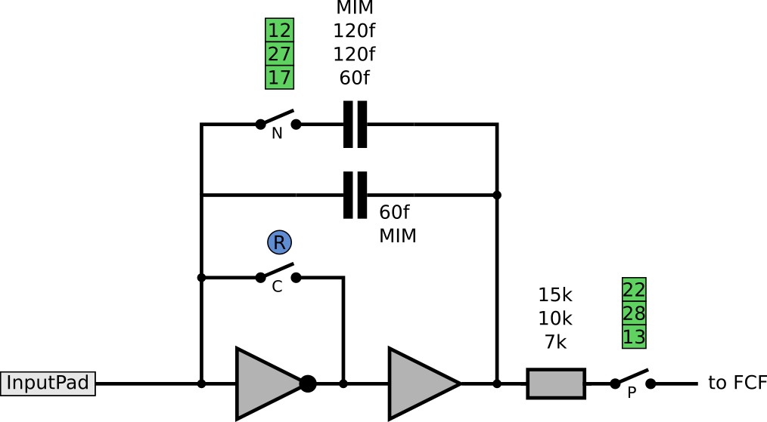
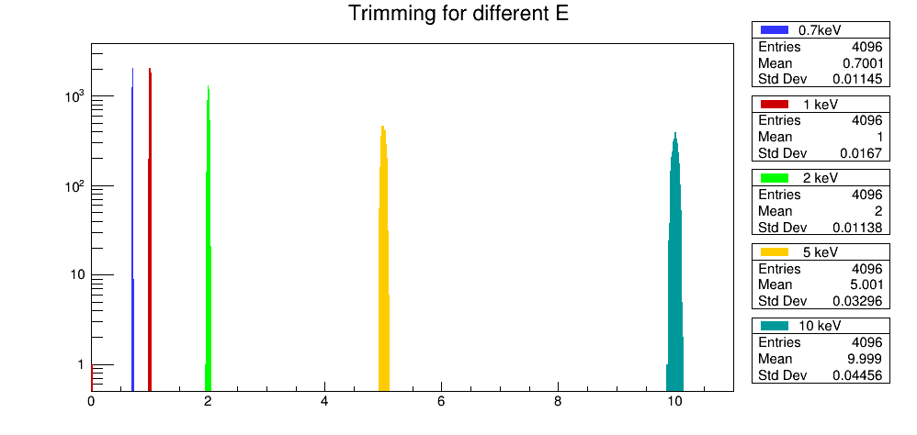
Gain trimming through the ADC 2/2
The new CSA FE is linear with various gain settings (through C_{Q→U}, R_{U→I})
C_{Q→U}
Threshold (photons / bin) | Maximum signal in photons (8 bit - 4.5 MHz)
10 | 2560^{(♦)}
5 | 1280
2 | 512
1^{(▼)} | 256
0.7^{(▼)} | 256
R_{U→I}
^{(▼)} single photon detection mode. Not available for 0.5 keV
^{(♦)} limited to ~ 1300 ph. for E=3 keV
One chip (4k pixels) trimmed for 5 different E
only the CSA gain is changed for different E
FCF gain = const.
(4.5 MHz setting,
FCF cap = 1pF, tau = 50ns)
ADC trimmed for fine tuning
gain ±2% for each E
# of pixels
Gain (keV / bin)
Notes:
This slide shows the gain settings of the CSA and trimming via the ADC for the full 4k pixel matrix. The plot in the bottom left shows the result of 5 separate trimming procedures which were run to tune for 0.7, 1, 2, 5 and 10 keV/bin. The procedure as shown in the previous slide was run for each target gain (target slope required by the charge injection extracted with 55Fe). For all 5 procedures, the FCF gain settings foreseen for the 4.5 MHz mode have been used and only the CSA gain settings (C+R) have been changed to tune to the target gain settings. The ADC fine trimming has then been used to reduce the spread. Each of the histograms has a final gain spread of +- 2% (as shown in the last slide).

Slide 8
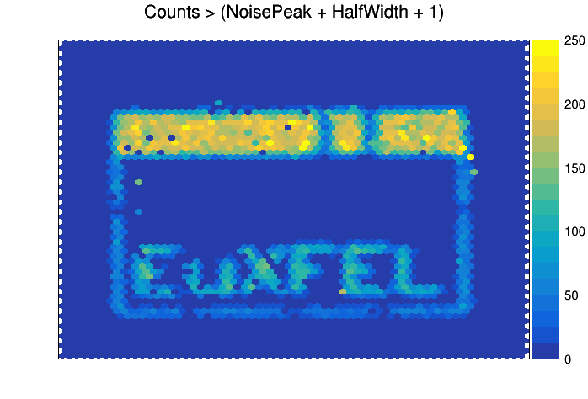
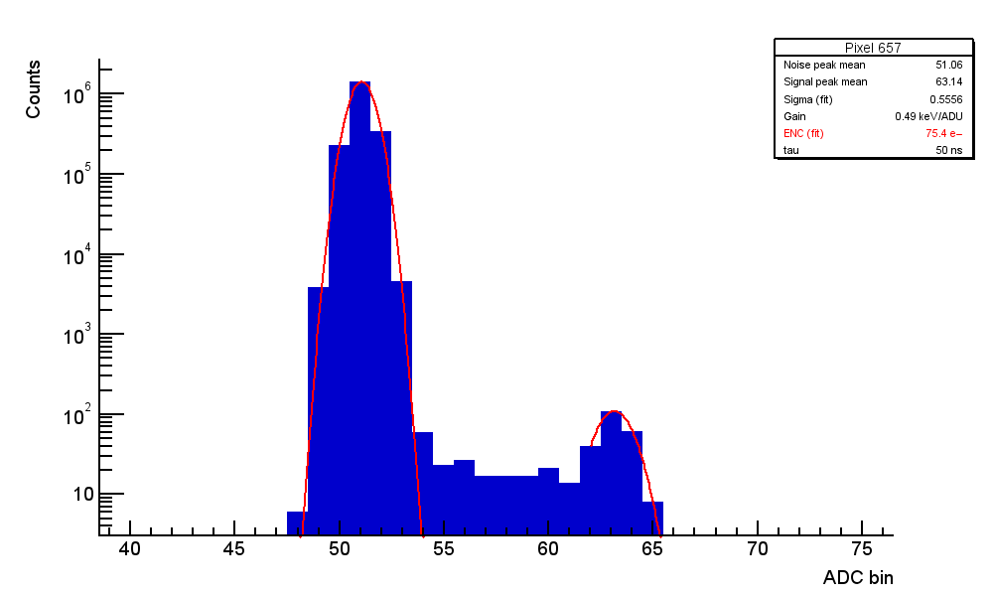
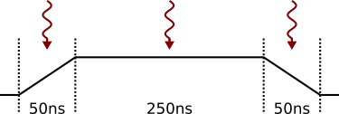
F2 Noise Estimation
Sample Spectrum for 0.5 kev / bin
^{12 ADU}
^{0.5 keV/ADU}
⁵⁵FE K_{α}
white pixels have no connection to the sensor,
in-house flipping, this is NOT the final yield
Gain Setting [keV / bin] | ENC [e⁻] ^{(♦)}
0.5 | 78
0.7 | 87
1 | 92
Trapezoidal Filter WTF
^{(▼)} mean on the bottom 16 rows, worse DNL in other pixel not accounted for yet
all measurements at 1 MHz with 250ns flattop, using 4.5 MHz parameter, i.e. integration time = 50 ns
These numbers hold when moving to 4.5 MHz with
short flattop using same the gain settings
Notes:
This slide shows the status of the noise measurements on F2. The measurements are run with the gain settings foreseen for the fast 4.5MHz mode, the flattop of the trapezoidal WTF is however stretched in order to collect photons to measure the actual gain. The noise increases slightly for larger energies, the reason is not yet understood and under study. The numbers shown here are from the very first measurements, optimizations are pending. When shortening the flattop to the duration foreseen for the 4.5 MHz @ XFEL, the noise numbers hold, showing, that the system is running stable also at the fast frame rate.

Slide 9
Module and Mega-pixel Camera electonics

Slide 10
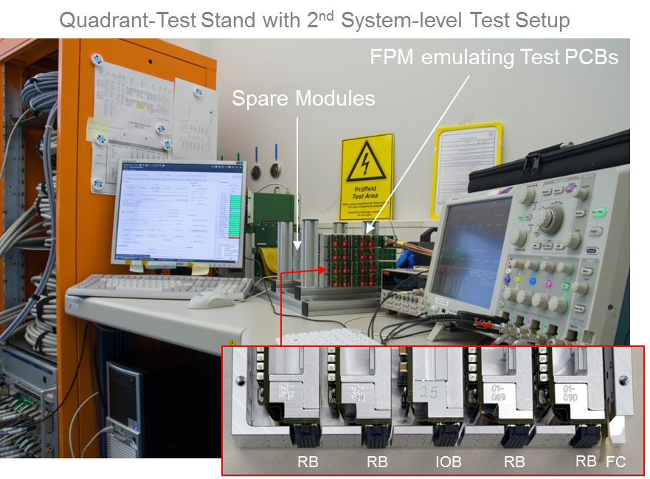
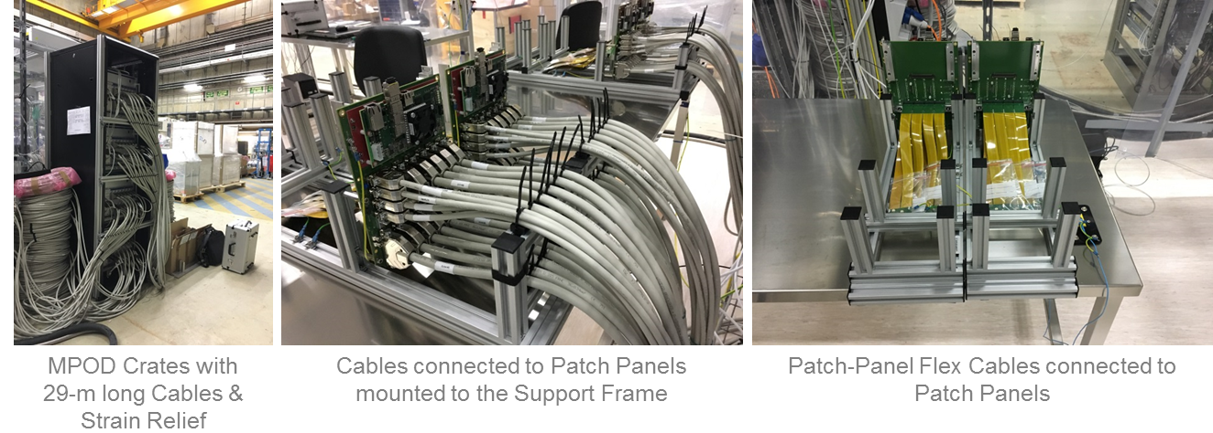

Integration of the 1 megapixel camera
FPM Interface
  Four RB Ports
    MB Power
    ASIC Power
  IOB Port
    Clock & Data Channels
  FC Port
    Sensor Power
    JTAG Signals
  3rd System-level Test
    ASIC Output
    JTAG Output
    µWire
    Source Voltage
Test Setup, Software Development & Test of Spare Modules completed
Test of Quadrants of Mega-Pixel Camera in Hera South Hall running
Patch-Panel Flex Cables connected to Ladder Electronics

Slide 11
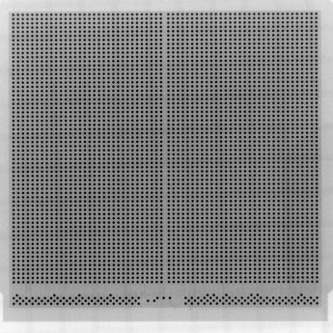
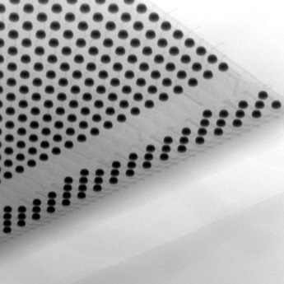

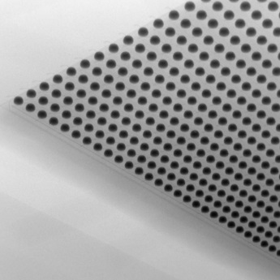
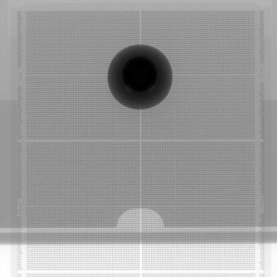
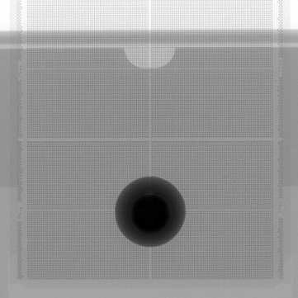
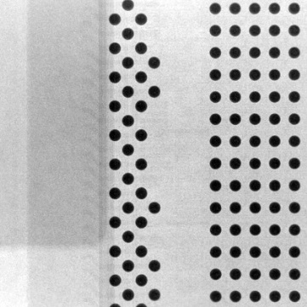
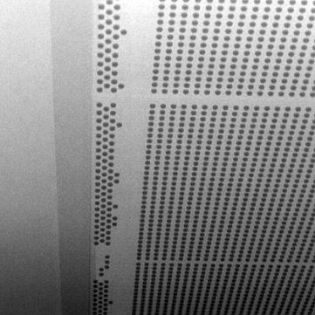
Mega-Pixel Camera: Bare-Module Production
HLL SF mini-SDD Sample with Cu UBM
HLL LF mini-SDD Sample with Cu UBM (inside Storage Container)
Production of
  12 small-format FBK & 10 HLL Bare Modules completed
  large-format HLL Bare Modules started

Slide 12
Mechanics and Integration

Slide 13
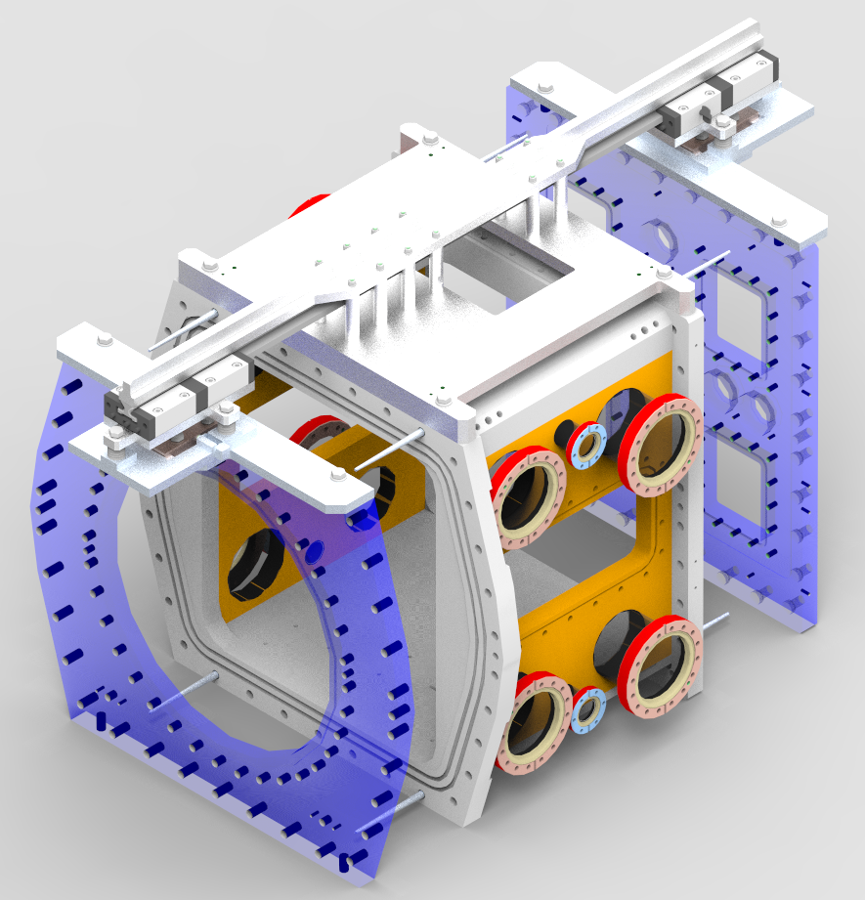
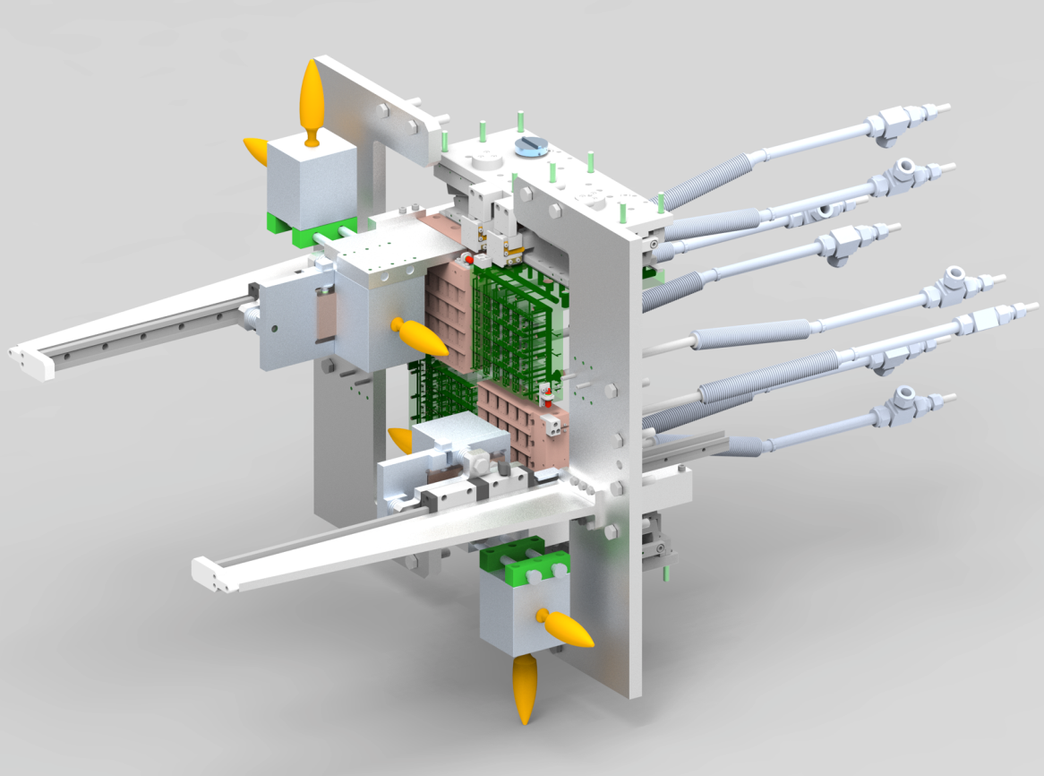
Tools for detector assembly
Flange mounting tool completed and ready for use
Quadrant mounting tool being purchased
Quadrant mounting tool
Flange mounting tool
Notes:
The flange mounting tool is needed for the first tests on the vessel, as it is used to mount the big flanges at the front and at the back of the vessel. The tool is ready in house and can be used as soon as the vessel arrives. It involves rails from sliding the flanges on the vessel, and also guiding ‘screws’ to precisely position the flanges.
The design of the quadrant mounting tool is finished and we expect technical drawings to be ready by end of November, so that we can start asking for offers immediately. I hope the parts can be in house by end of January, so we can practice with dummy quadrants or even with the real quadrants before the FPM are installed. The tool will be attached to the front flange of the vessel. It involves a rail system to slide the quadrants in the vessel from the front. The yellow handles shall allow ergonomic operation. The design was quite complicated as the space for the tool is very limited.
The work on both tools would not have been possible in this time frame without the substantial help of Frank Okrent.

Slide 14
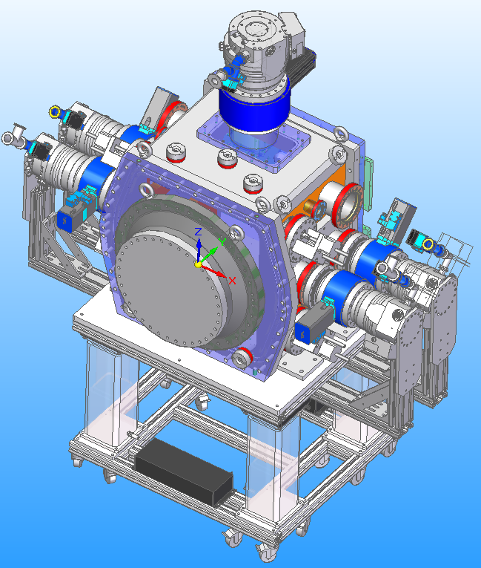
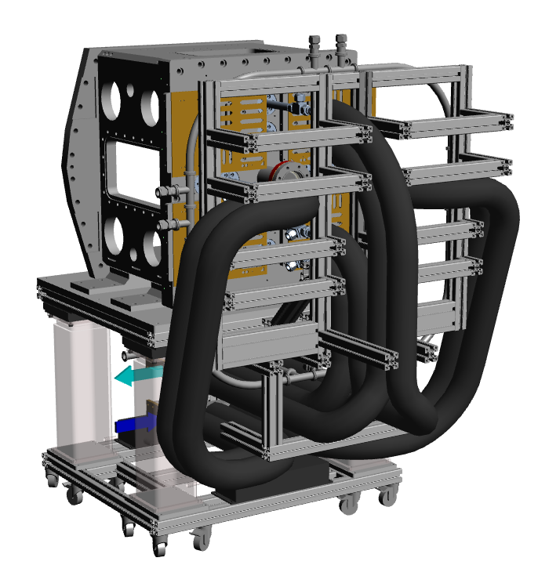
Detector vacuum and cooling systems
Design has been done and components have been purchased. Ready for vessel arrival.
DSSC with cooling pipes and support for power
cables at the back. Double-wall pipes pressure
monitoring in place.
DSSC with turbo pumps attached. Up to
5 TPs can be used for running at SCS.
Notes:
The vacuum system of the DSSC allows a maximum of 5 turbo pumps (TPs) to be attached to the vessel. If needed, one can be replaced by another kind of pump (e.g. cryo pump, to have a colder place than the quadrant and the sensors in the vessel. The detector is shown on its support with the pumps attached. Between the vessel and each turbo pump, a gate valve is installed. The design of the support at the beamline is presently under discussion with SCS, some changes might be needed (not critical).
The DSSC cooling system consists of double wall pipes in vacuum and in the first part outside vacuum. As vacuum needs to be created between the pipe walls, the pipes will be pumped and the pressure monitored to reveal possible leaks. On the back of the detector, both power and cooling pipes come out. A simple support for cables and pipes in the lab has been designed and implemented. The big black pipes on the back are the pipes for the cooling liquid (silicone oil), which are not double wall and need therefore a think insulation. The power cables are not shown.

Slide 15
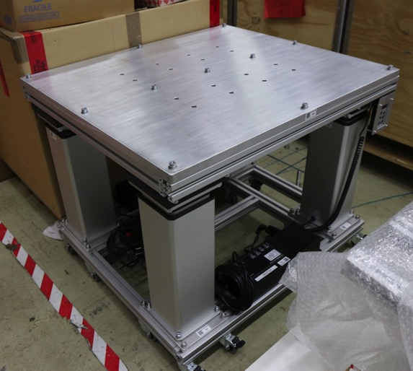
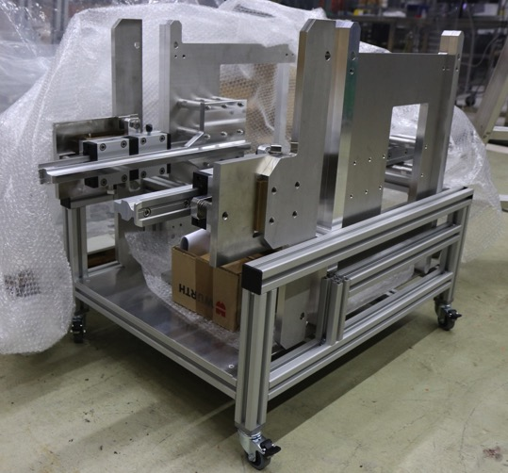
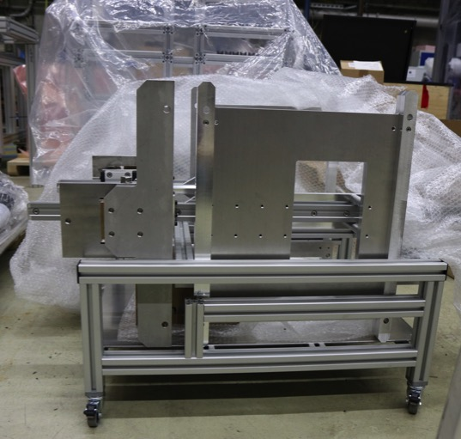
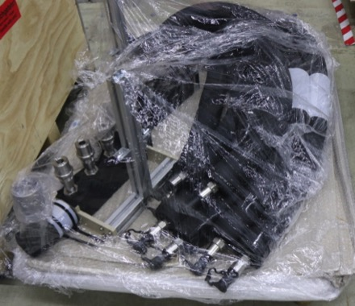
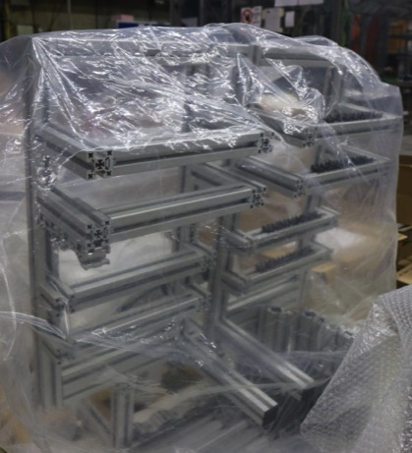
Detector infrastructure
Detector
support
Support for power cables
at detector back
Flange mounting tool
Coolant distribution system

Slide 16
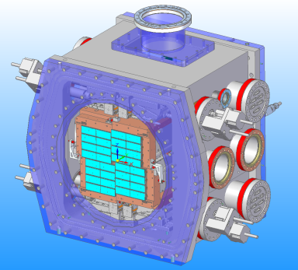
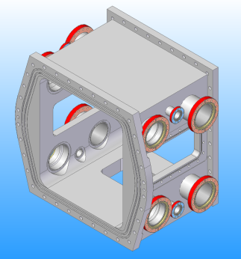
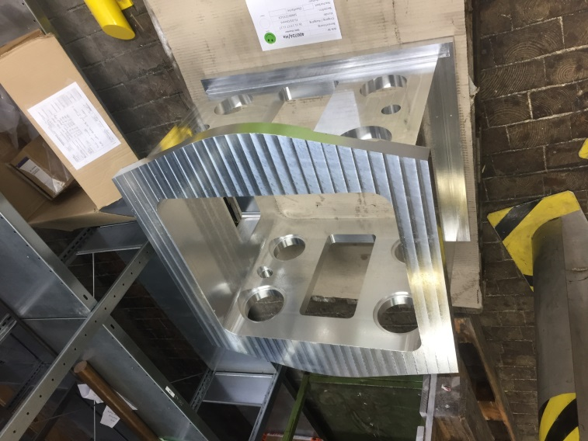
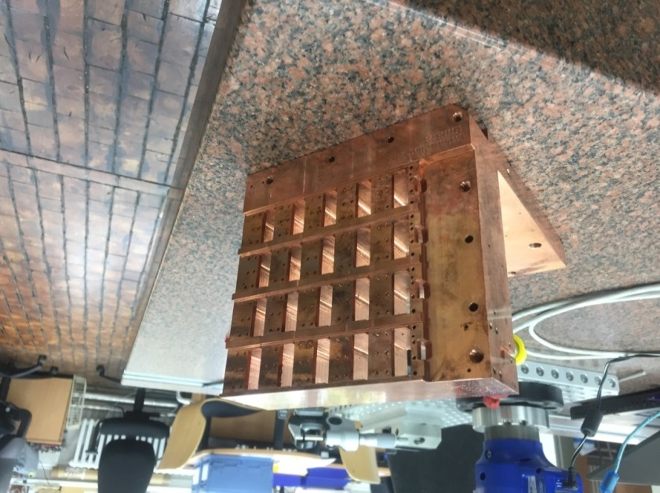
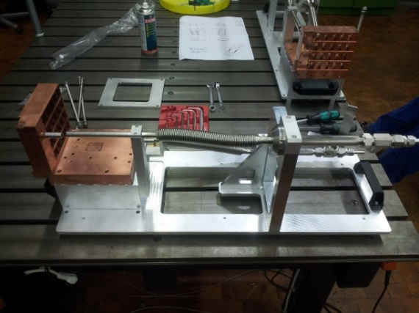
Vacuum Chamber & Cooling Blocks
Core chamber at DESY
Next step: weld in tubes with flanges
(this will unfortunately run into January)
Followed by 2nd milling at company
Final step: milling of XY stage mount surfaces on inner surfaces, at DESY
Expect finished chamber end of February
Two Cu blocks in hand at DESY (Q1-3 & Q2-4) both quality checked, accepted
Measurements
Pressure check
Delivery foreseen in early January

Slide 17
Calibration

Slide 18
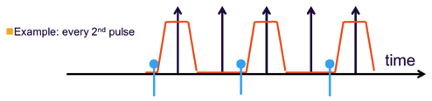
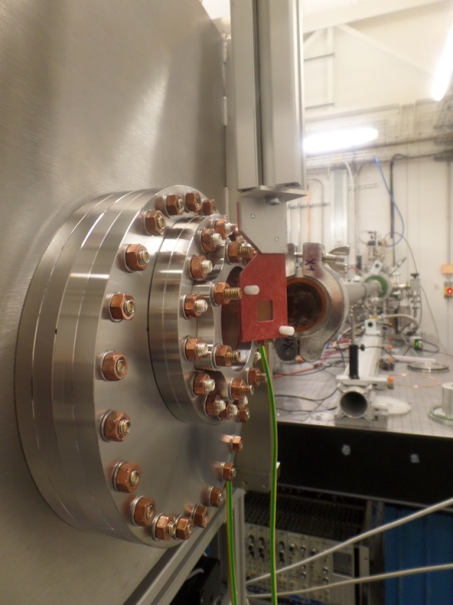
Analysis of Beamtime Data:
PETRA III / P65 I
PETRA III / P65 (May 2017):
  Hard X rays (4-44 keV)
  40 bunch mode, 5.2 MHz
miniSDD-F1 ladder system
Goal: study fluorescence line generation
(flux, homogeneity)
  33 keV photons
  Ag target (K shell lines at 22 and 25 keV)
  Distance target to detector about 16 cm
preliminary
Initial fit
parameters
Fit
Example:
Ag fluorescence line spectrum,
no binning correction

Slide 19
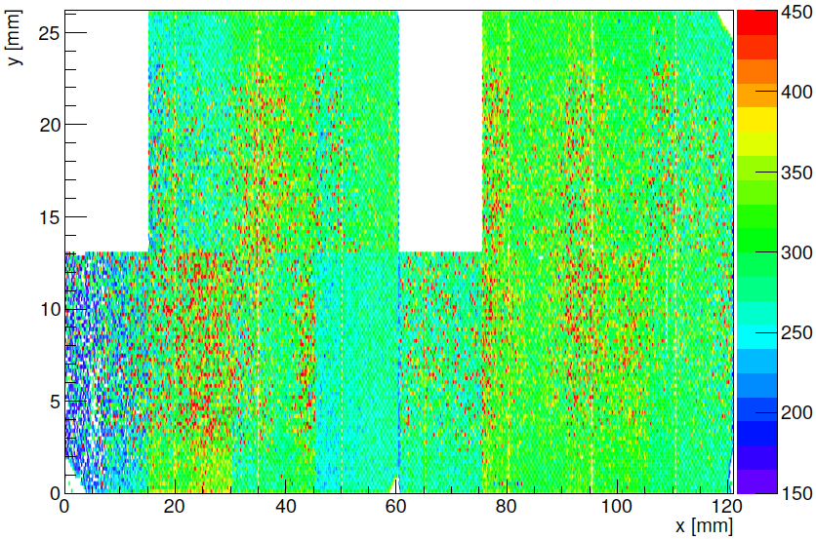
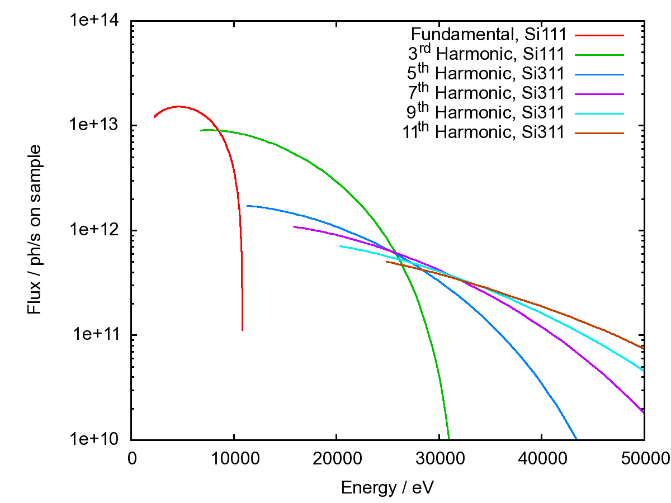
Analysis of Beamtime Data:
PETRA III / P65 II
Results:
Karabo based control and DAQ stable
Homogeneity of Ag photon events:
  As expected sufficient for ladder and quadrant
  Variation in x direction, center to edge: ~ 1.5
  Expected for quadrant: center to corner: ~ 2
Level of incident Ag photon flux
  About 2.4×10⁻⁵ evts/pix/pulse
  Time for 10⁴ events about 6 days
  ⇒ too low for calibration
For calibration: trade-off between
photon energy and beam flux
P64 proposal:
  Time for 10⁴ events:
    Ag (22, 25 keV): ~ 300 s
    Mo (17, 19 keV): ~ 100 s
    Cu (8, 9 keV): ~ 10 s
Ag photon events per pixel
preliminary
P64 vs. P65 photon flux
P64
May
2017
P65

Slide 20
Outlook:
DEPFET results and
Industrial CMOS process based DEPFET for Second 1-Mpixel Camera

Slide 21
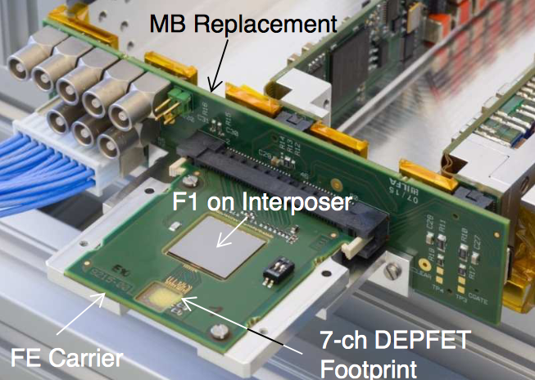
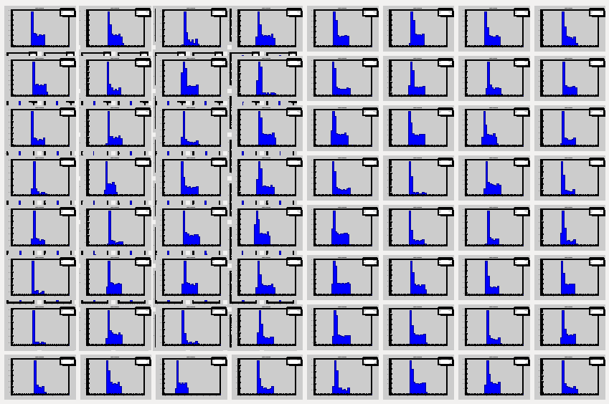
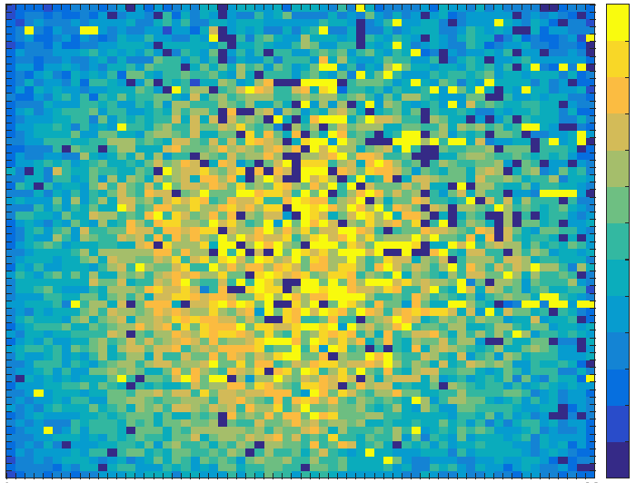
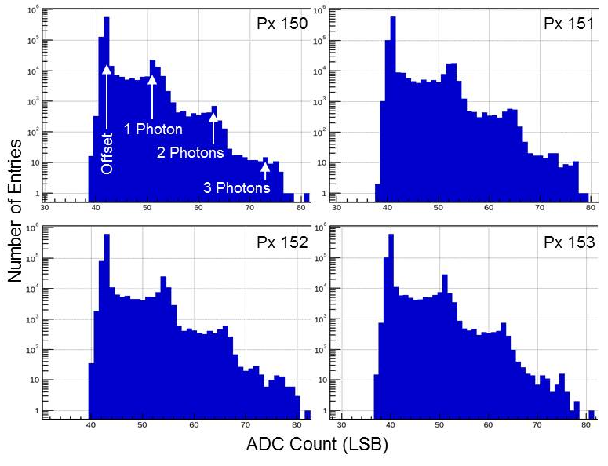
DEPFET Operation with F1 ASIC and Ladder electronics
⁵⁵Fe Spectra
4.5-MHz Sequence, 2.6-MHz Readout, 1000 x 800 Frames
Mean Gain (not trimmed): ~0.9 keV / Bin
Count Rate per Pixel:
          Mean = 72 kcts/s & Peak = 124 kcts/s (1-Photon Peak)
          Mean = 326 kcts/s & Peak = 915 kcts/s (whole Spectra)
Count-Rate Map (64-by-64 Px)
Cu-Fluorescence Spectra @ PETRA III P65
← ~500 cps
DEPFETs successfully operated with Ladder Electronics

Slide 22
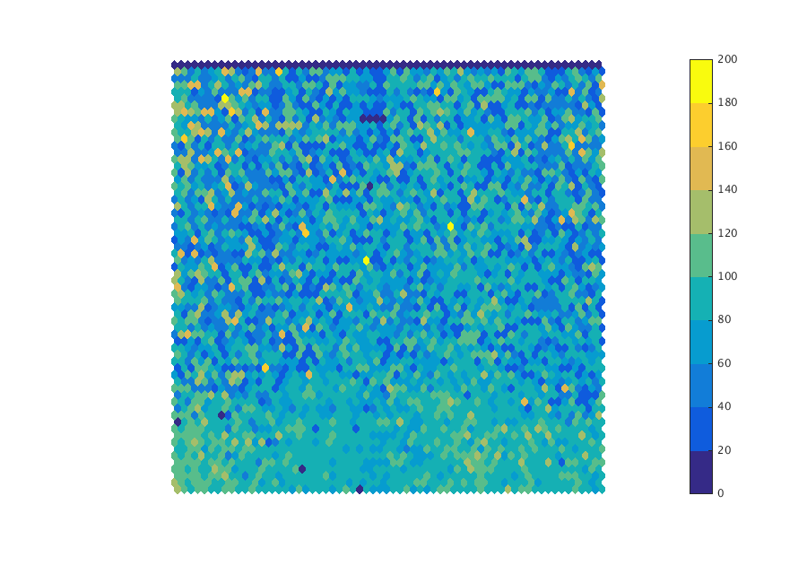
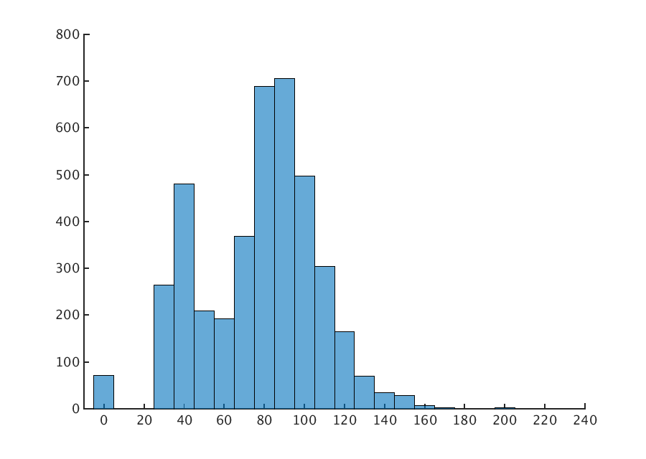
F1 + DEFPET @ Fast Speed
A 64 x 64 DEPFET matrix with full ladder electronics has been operated @ PETRA III to determine the noise @ fast operation without artificial flattop
(stretch needed with async. sources)
Frame rate = 2.6 MHz, settings eq. to XFEL 4.5 MHz
mean gain across the matrix: 0.87 keV/bin
The revised DEPFET FE on MM9 aims to improve the performance @ fast operation
64 x 64 ENC [e⁻] Map
64 x 64 ENC [e⁻] Histogram
no DNL correction
mean ENC ~ 90e⁻
Notes:
A 64 x 64 DEPFET matrix has been operated at PETRA III to evaluate the gain and noise at fast operation. The ASIC frame rate was set to 2.6 MHz which is half of the 5.2 MHz bunch clock @ PETRA III. Nevertheless, the gain settings and filter integration time foreseen for the 4.5 MHz operation @ XFEL were used. The pixels with bad DNL again show better noise because the binning has not been accounted for. On the full matrix we get a mean of ~90e-.

Slide 23
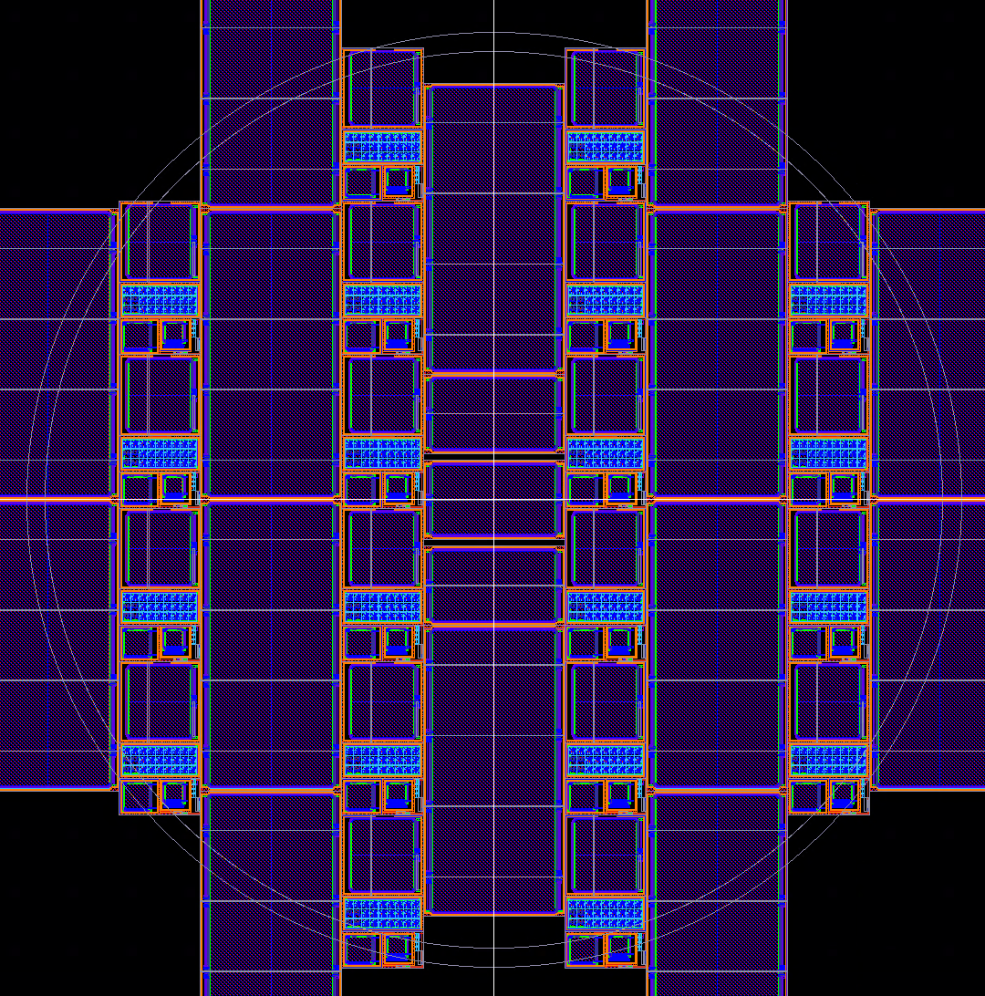
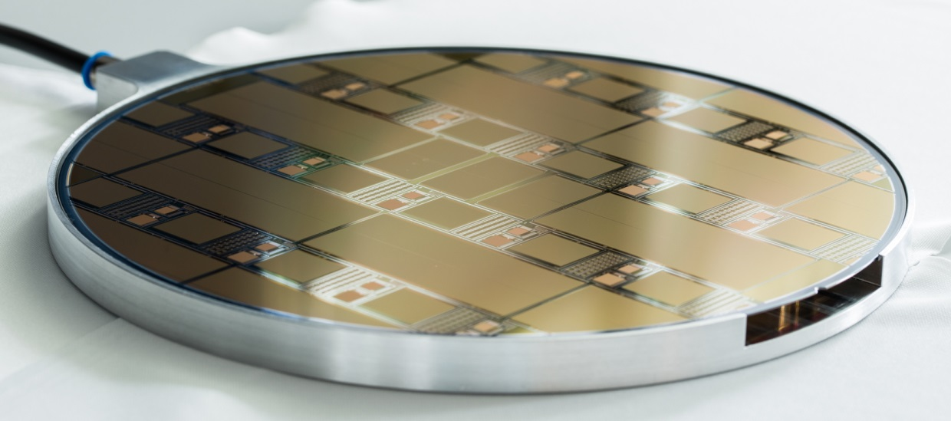
Waferlayout for 2nd DEPFET run @ IMS
First wafer of IMS02-1 received end of May 2017
Structures
DEPFET Structures
  7-cell clusters
  Macropixels
  32x32 matrix
  64x64 matrix (UBM required)
  128x64 matrix (UBM required)
  128x256 matrix (UBM required)
Technology test structures
  Diodes
  Capacitors
  Resistors
  SIMS-Fields
  ….

Slide 24
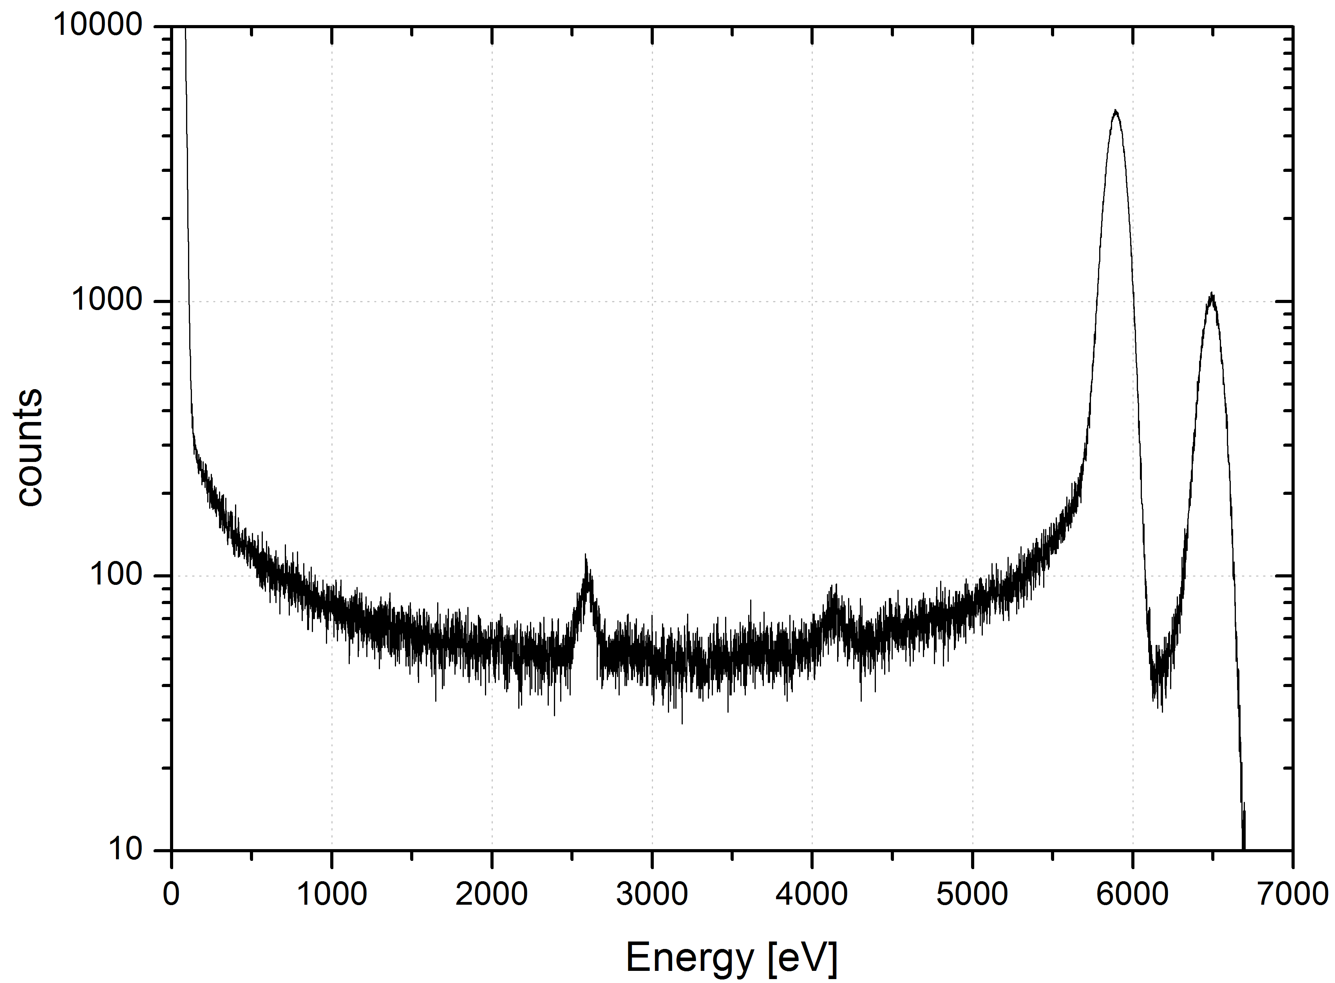
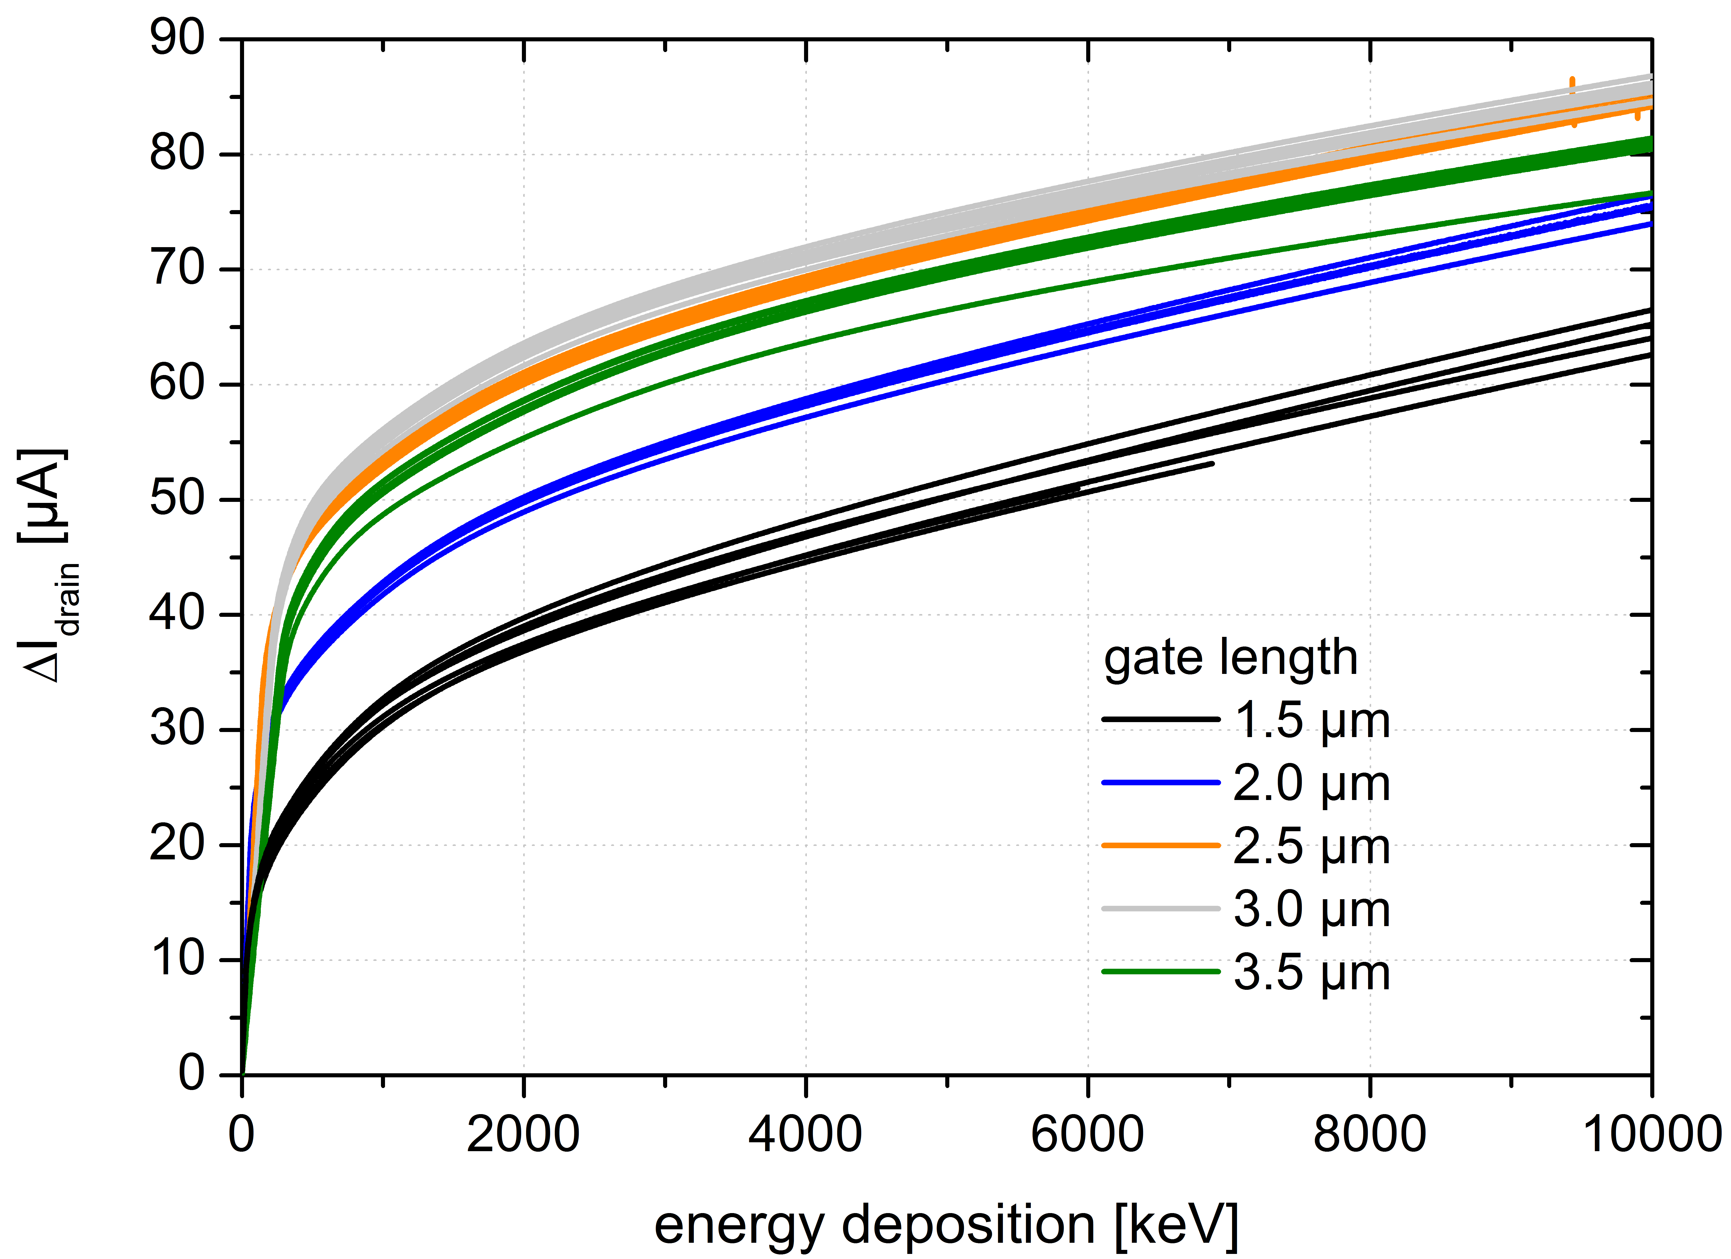
IMS02 Frontside Tests
Transistor characteristics are excellent
  Threshold voltage shifted from +7 V to 0 V as expected
  Spectroscopic performance is far better than needed for DSSC
  Nonlinear characteristic is already very close to the desired
First Large Format structures will be available in the first half of 2018

Slide 25
Summary
The first MiniSDD Ladder Camera with F1 is operational and is regularly used
The mass production and qualification of electronics components for the MiniSDD 1-Mpixel camera is complete
The F2 ASIC has been produced and successfully tested. More detailed characterization is ongoing, but the ASICs are already being flipped to Large format sensors
We are in the Focal Plane Module assembly phase. We are waiting (in a few days) for results on the first assembled structures
The 1-Mpixel camera Mechanics will be available in February 2018
The MiniSDD 1-Mpixel camera will mounted by May 2018
The pxd-8 64 x 64 DEPFET prototype has been tested together with F1 and the full ladder readout chain at PETRA III. Results are very promising
An improved mini-ASIC containing the F2D front-end has been successfully tested. F2D design is completed and the gds already transferred to CERN. Production can start when paperwork is completed
The second production of CMOS DEPFET prototypes in an industrial foundry is ongoing. First full-format format sensors should be available in April 2018
The consortium is negotiating with XFEL a contract (prolongation) to implement a second DEPFET-based camera

Slide 26
BACKUP SLIDES

Slide 27
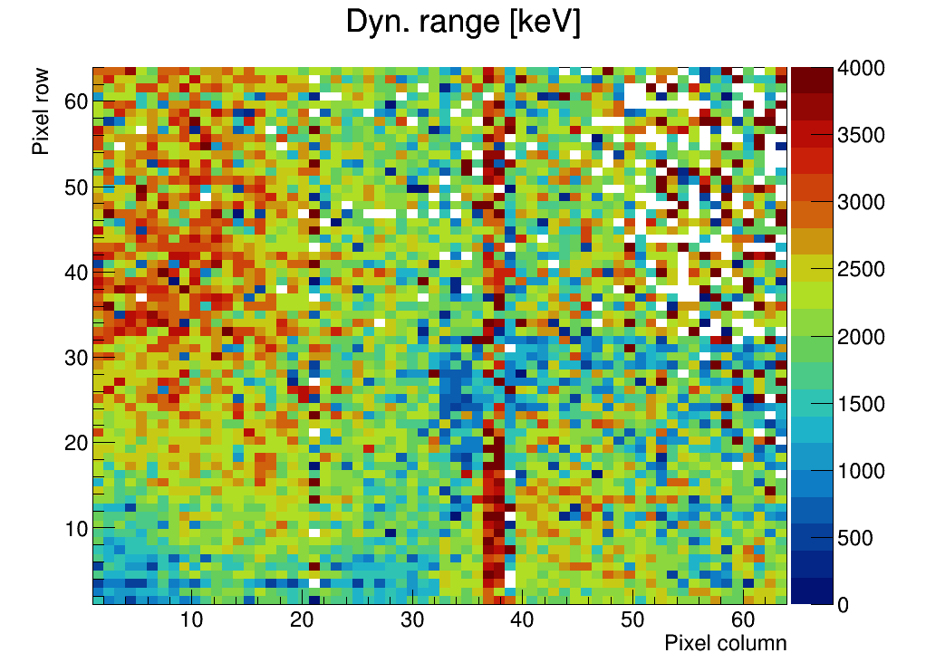
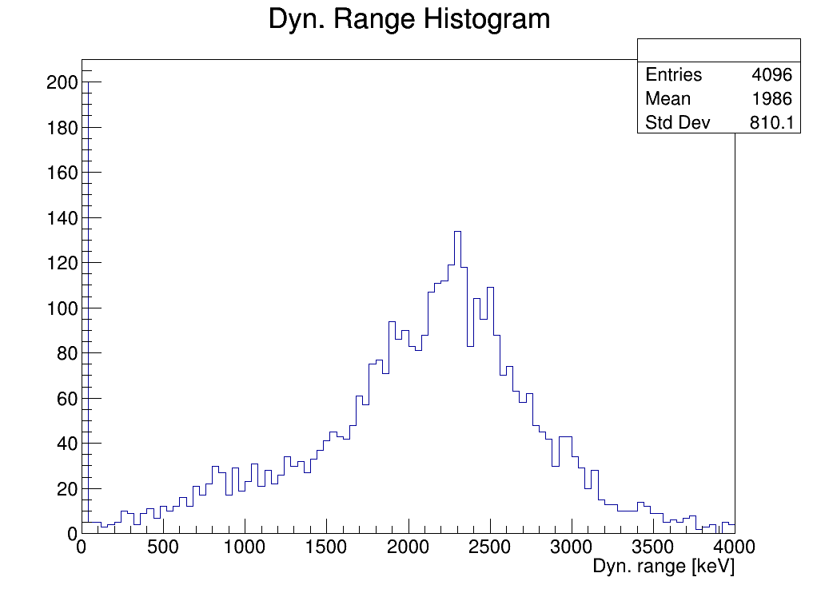
Reminder: F1 full format ASIC
F1 was the first full size ASIC (14.9×14mm², 64×64 pixels)
Initially conceived for DEPFETs, F1 was submitted in 2014 with a ‘quick’ MiniSDD front-end in parallel to the DEPFET front-end. We were aware of some limitations.
F1 was thoroughly characterized with different setups in different consortium premises:
Several sources have been used:
¹⁰⁹Cd, ⁵⁵Fe in Munich and Mannheim
Y Fluorescence lines with X-ray Suite in Milano
Proton source at LABEC, Florence
It was possible to determine:
Gain map
Noise map
dynamic range dispersion map after trimming
The results have been cross-checked and refined with the measurements with the ladder camera at PETRA III / P04 in December 2016
An optimized F2 ASIC has been designed and produced. The modifications have been preliminary tested on a small 8 x 16 MM7 ASIC

Slide 28
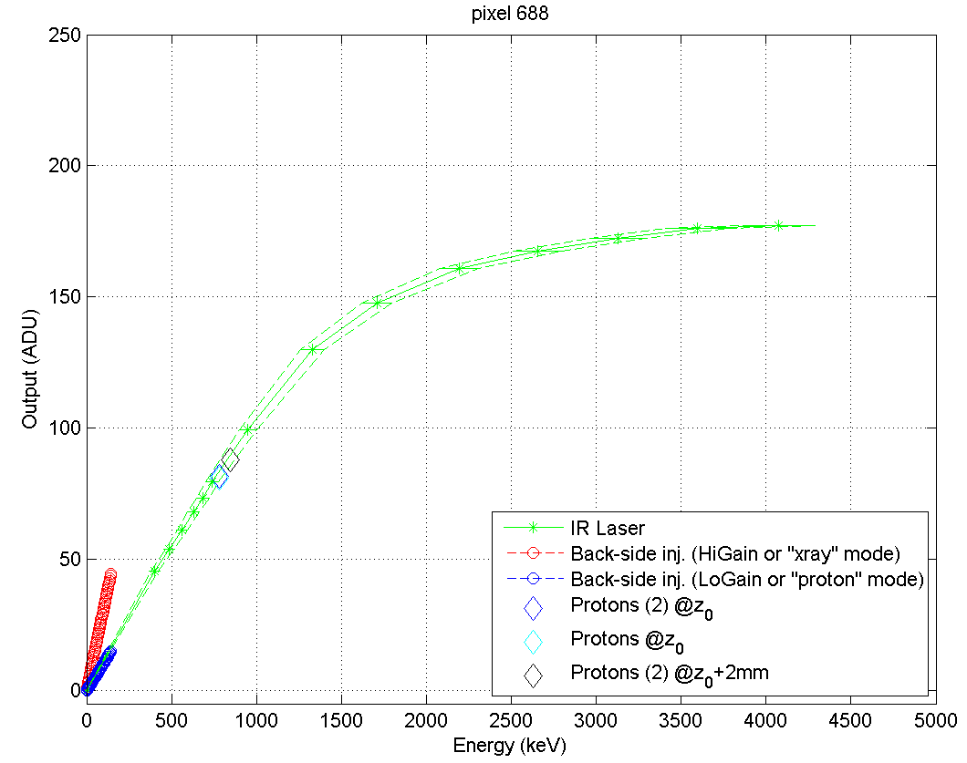
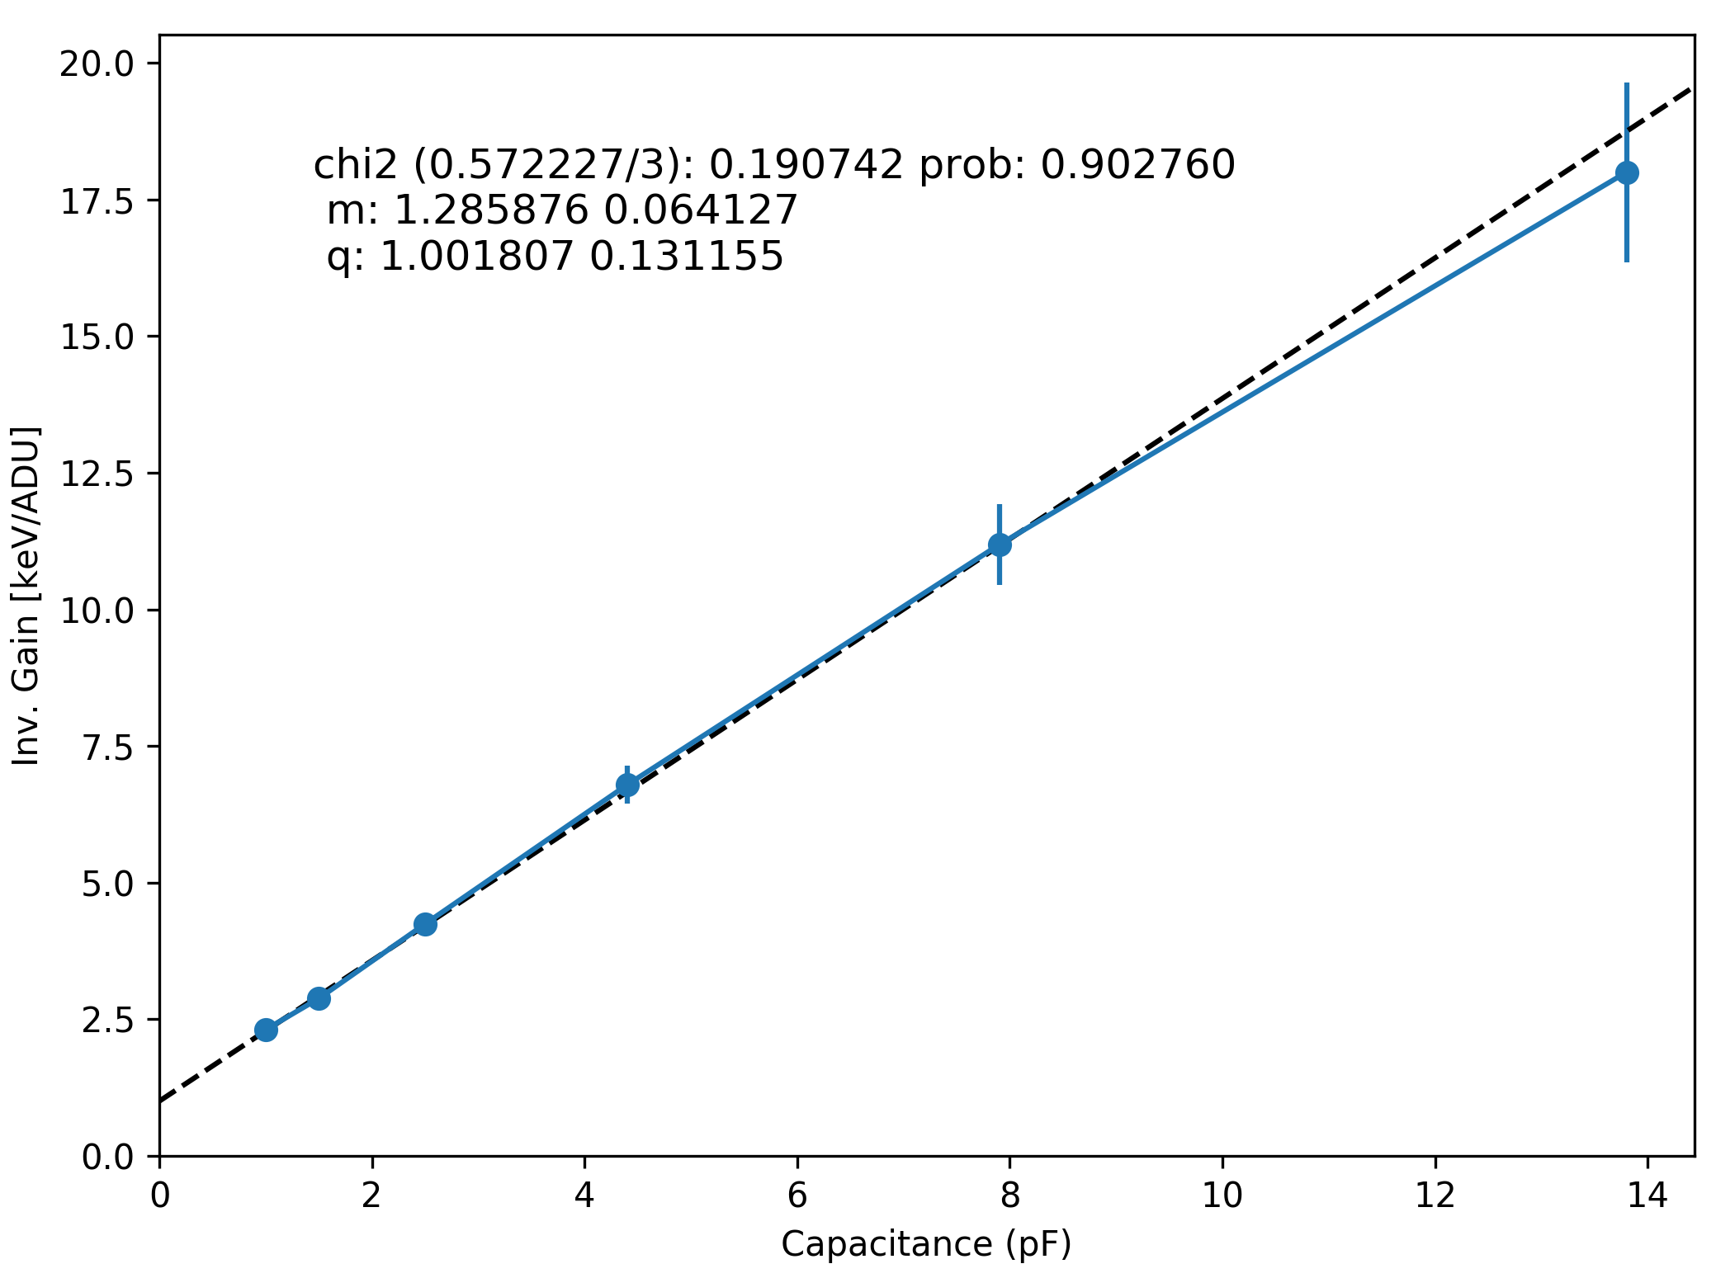
Calibration and System Simulation I
Analysis of data collected at beamtimes
LABEC proton data
  miniSDD-F1 single ASIC
  Validation of pixel characteristic calibration with
  X-rays, electrical charge injection, laser pulses,
  and protons
PETRA III / P04
  miniSDD-F1 ladder
  Study of ladder operation and performance
PETRA III / P65
  miniSDD-F1 ladder
  Study of generation of fluorescence lines
  for gain calibration
Study of charge collection time in
miniSDD sensors
  miniSDD-MM4 single ASIC
  X-rays and pulsed laser
  Charge collection as function of deposited energy,
  photon incidence, experimental conditions, …
  Measured properties compatible with 4.5 MHz
  operation
LABEC
PETRA III
P04
E

Slide 29

Calibration and System Simulation II
Statistical uncertainty:
gain determination
Study of uncertainty in offset, noise,
and gain determination
  Test data generated with
  system simulation tools
  Analysis with calibration tools
  For each analysis approach:
  quantification of uncertainty from
  comparison of analysis results
  with simulation truth
X-ray sources for DSSC gain calibration
PETRA III / P64
  Proposal submitted in August
  Decision pending
XFEL / FXE
  Assessment of technical feasibility in progress
1% limit
binning
known
binning unknown,
assume ideal binning
uncertainty
5%
uncertainty
10%
FXE
hutch
LPD

