Slide 1
Calibration Working Group and Calibration Infrastructure
Jola Sztuk-Dambietz
on behalf of
the European XFEL Calibration Group
December, 13th 2017
23rd Meeting of the XFEL Detector Advisory Committee
European XFEL GmbH, Schenefeld
Notes:
How to edit the title slide
Upper area: Title of your talk, max. 2 rows of the defined size (55 pt)
Lower area (subtitle): Conference/meeting/workshop, location, date,
your name and affiliation,
max. 4 rows of the defined size (32 pt)
Change the partner logos or add others in the last row.

Slide 2
Outline
Calibration status and highlights from the calibration meeting
  Detectors in operation (AGIPD and LPD)
  Detectors under development (DSSC, FastCCD, Jungfrau, Gotthard, ePix)

Slide 3
Calibration activity at XFEL
LPD and AGIPD commissioning, tests activity including calibration at XFEL instrument - FXE and SPB
Development of calibration software tools, simulation → S. Hauf’s presentation
Characterization and calibration of FastCCD detector
Characterization and calibration of ePix detector
Preparation for Jungfrau and Gotthard integration and characterization
Coordination of calibration activity

Slide 4
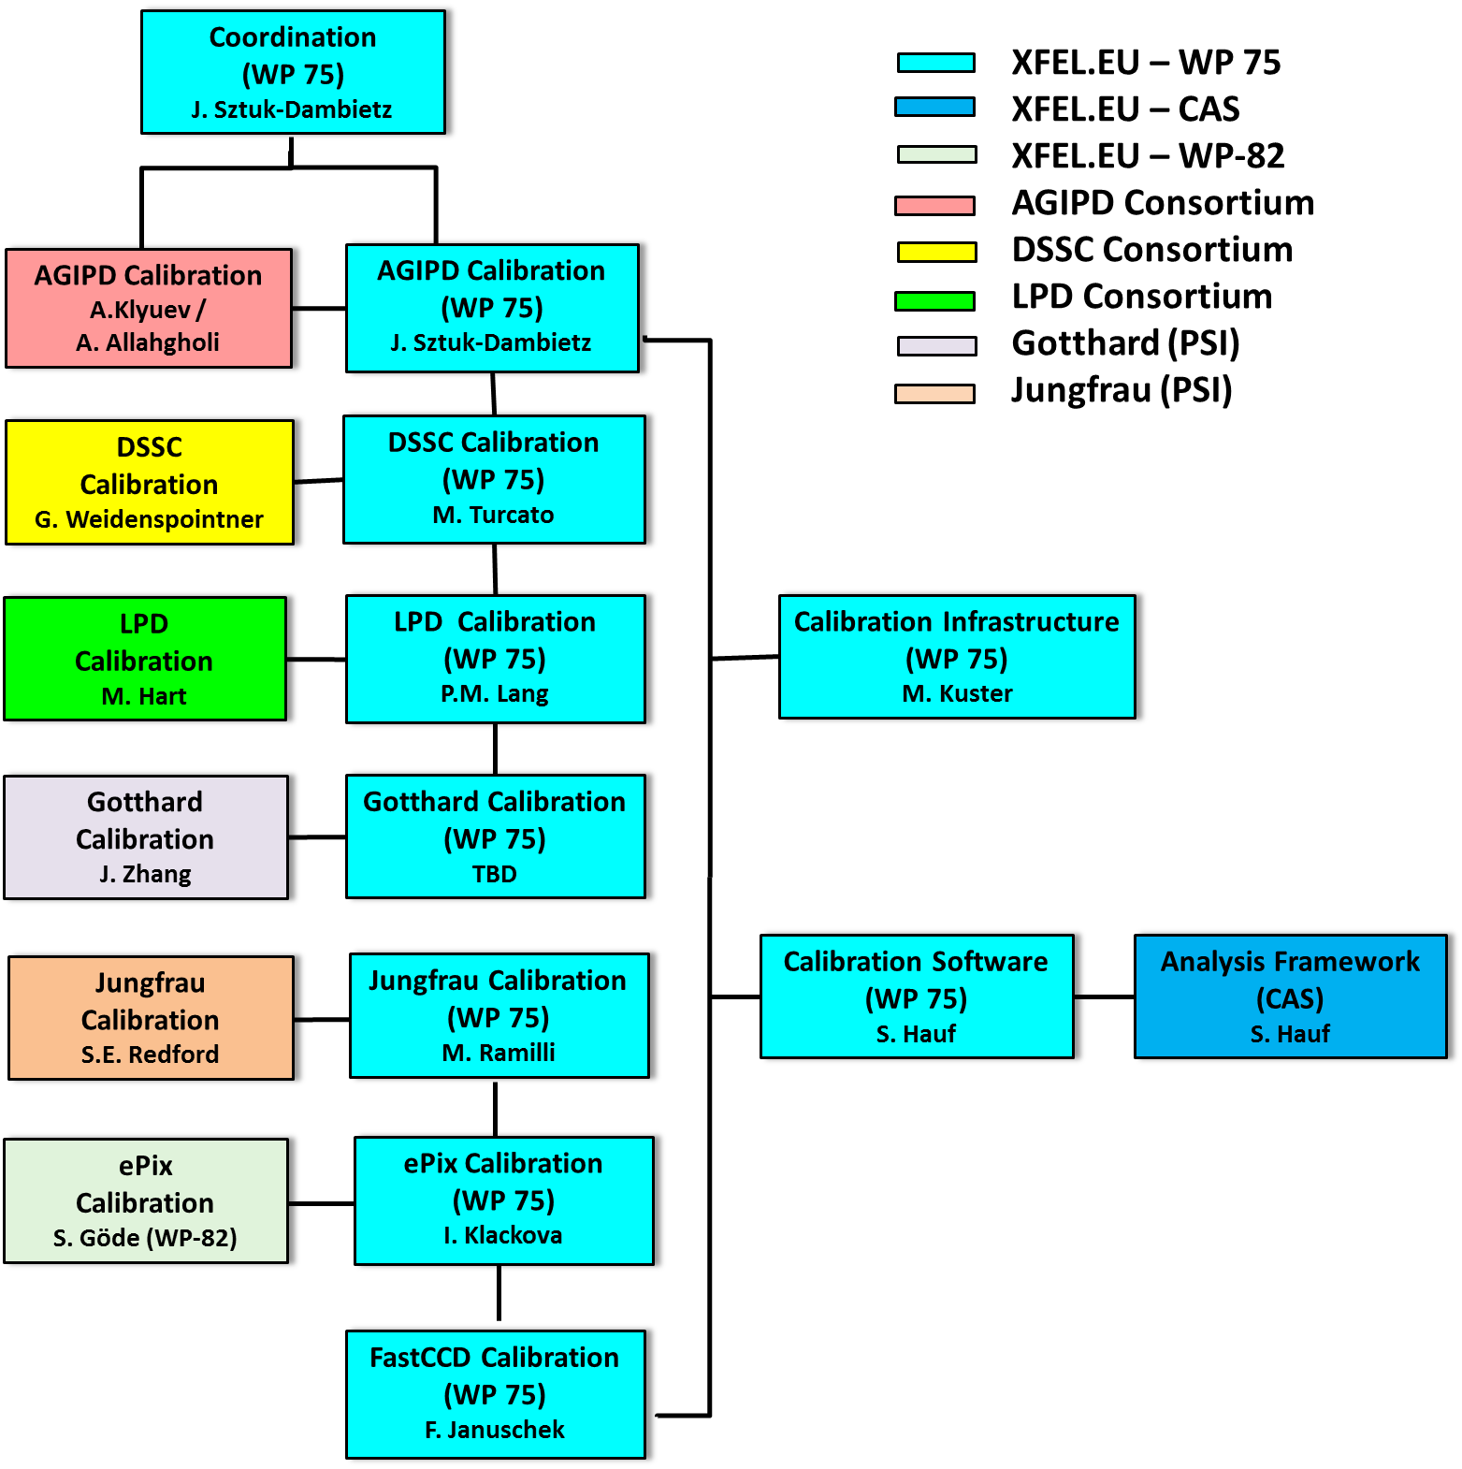
Calibration Working Group
Work done by detector consortia/developers and XFEL groups
Experts from consortia available beyond start-up phase of the project
Involvement of beamline scientist → calibration at beamline during commissioning and operation phase
Involvement of user community through SAC has been discussed → workshop involving user groups and XFEL to take place in first half of 2018
Responsible contact persons:
Indico page with presentations and documents:
https://indico.desy.de/categoryDisplay.py?categId=278
Calibration Working Group site @ Alfresco - https://docs.xfel.eu/share/page/site/calibration/dashboard

Slide 5
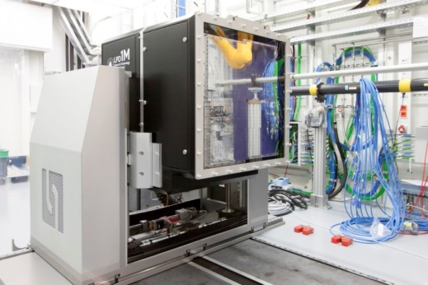
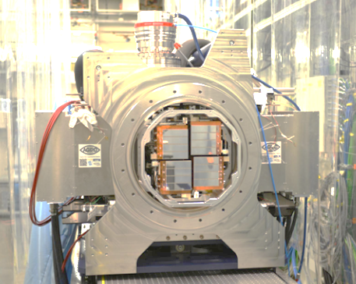
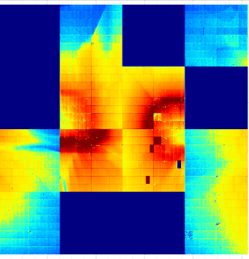
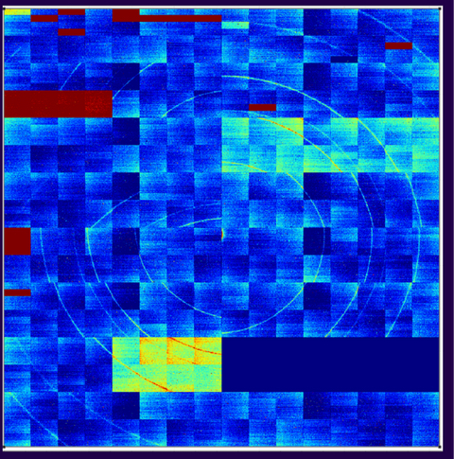
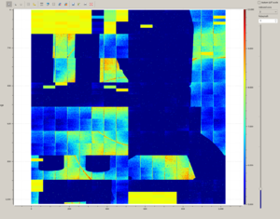
AGIPD and LPD at XFEL.EU
LPD detector was transported from HERA South to FXE hutch - July 7th
First LPD data at FXE
  First dark/test images acquired in FXE hutch– July 20th
  First XFEL X-rays – August 13th
AGIPD detector was transported from HERA South to SPB hutch - August 14th
First AGIPD data at SPB
  First dark/test images acquired in SPB/SFX hutch – August 19th
  First XFEL X-rays – August 27th

Slide 6
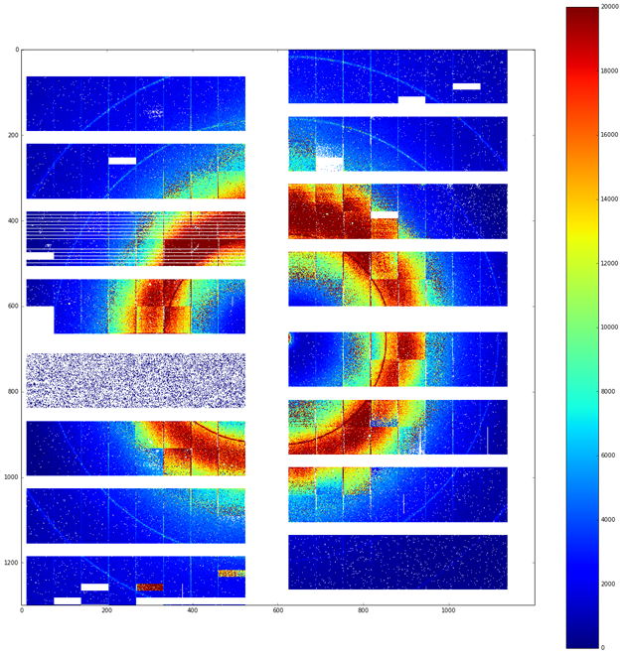
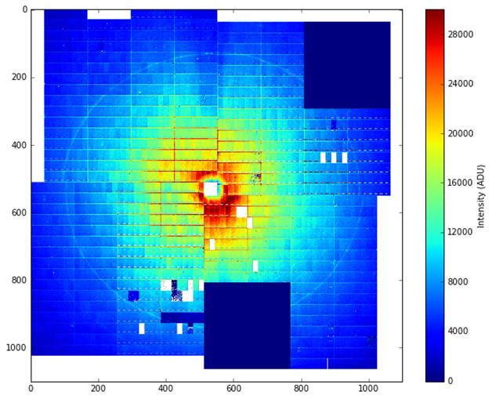
AGIPD and LPD at XFEL.EU
LPD detector was transported from HERA South to FXE hutch - July 7th
First LPD data at FXE
  First dark/test images with XFEL DAQ (no X-rays) – July 20th
  First XFEL X-rays – August 13th
AGIPD detector was transported from HERA South to SPB hutch - August 14th
First AGIPD data at SPB
  First dark/test images with XFEL DAQ (no X-rays) – August 19th
  First XFEL X-rays – August 27th
First User Beam started – September 14th

Slide 7
Calibration of the LPD detector at FXE
Work done by XFEL
First calibration data set exist → work on optimization ongoing
First procedures at the experiment are established
Data set | Frequency | Collection time | Parameters | Time for processing
Dark data sets high/med/low x 2 preamp. setting | At least at the beginning of shift | 300 sec | Offset, Noise Bad pixels | < 5 min
Charge injection | After change of detector parameters (i.e integration time) | 2.5 days | Relative gain, bad pixels | 2-4 hours/ module
Flat fields, different intensities | to be defined, setup for flat fields needs to be optimize | To be defined | (Relative) gain, bad pixels | Expected 2-4 hours
* can be run in parallel on Maxwell cluster

Slide 8
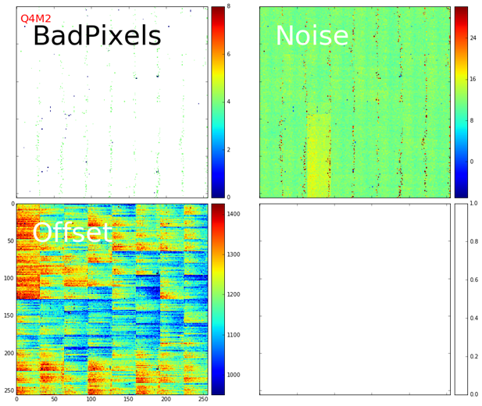
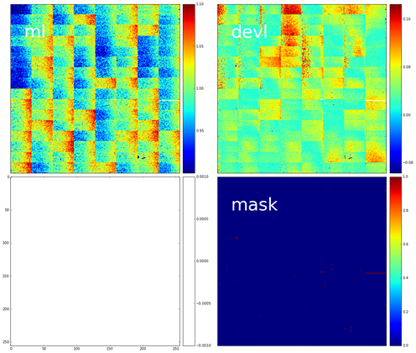
LPD Calibration at XFEL.EU
Noise/Offset Maps for one supermodule
Rel. Gain Map information for one supermodule
Bad pixels
Noise
Linear part
of gain slop
Deviation from linearity
Offset
Bad pixel mask
Correction: Run automatically in online stream and whenever data is migrated to the offline cluster → S. Haufs’ talk

Slide 9
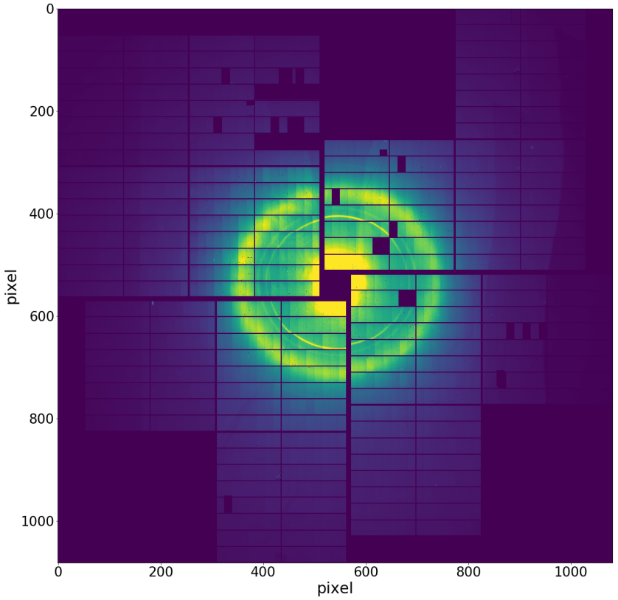
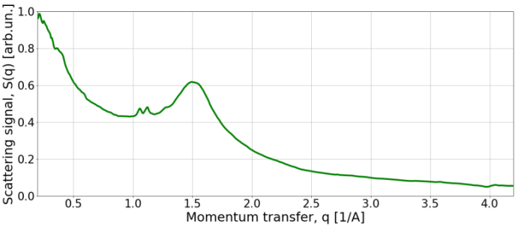
LPD at FXE – User Operation with LPD
Pump-probe Scattering
on Cu-complex solution in THF
User Operation SPB
  5 experiments
  LPD stable operation ~ 90% of the time
Scattering from 300 um jet, sum of 5 trains
Experiment/proposal | Number of hours | Raw data size [TB]
p2016 | 60 | 4.1
p2073 | 60 | 2.3
p2052 | 60 | 3.9
p2072 | 48 | 20
p2050 | 60 | 27
Total | 288 h | 57 TB

Slide 10
Calibration of the AGIPD detector
Joint effort from XFEL, AGIPD consortium
First calibration data set for high and medium gains exist → work on optimization ongoing
First calibration procedures at the experiment are established
Data set | Frequency | Collection time | Parameters | Time for processing
Dark data sets for high/med and low gains | At least at the beginning and the end of shift, Always after detector has to be restarted | 300 sec | Offset, Noise Bad pixels | < 5 min
Pulse capacitor data | After change of detector parameters (i.e. HV, LV, int. time, number of cells) | < 15 min | Relative gain for high and medium | 2-4 hours/ module*
Flat fields, different intensities | After change of detector parameters (i.e. HV, LV, int. time, number of cells) | 300 sec per intensity + preparation in sample chamber | (Relative) gain, bad pixels | 2-4 hours/ module*
* can be run in parallel on Maxwell cluster

Slide 11
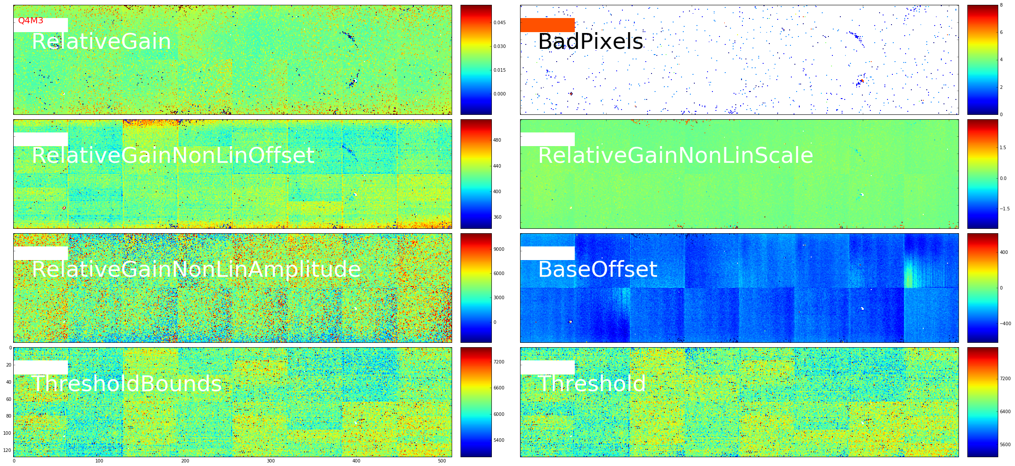
AGIPD Calibration at XFEL.EU
Relative Medium Gain - Characteristic of one module Q4M3
Fit parameters
Relative gain
Offset correction
Threshold for gain bit
Bad pixels

Slide 12
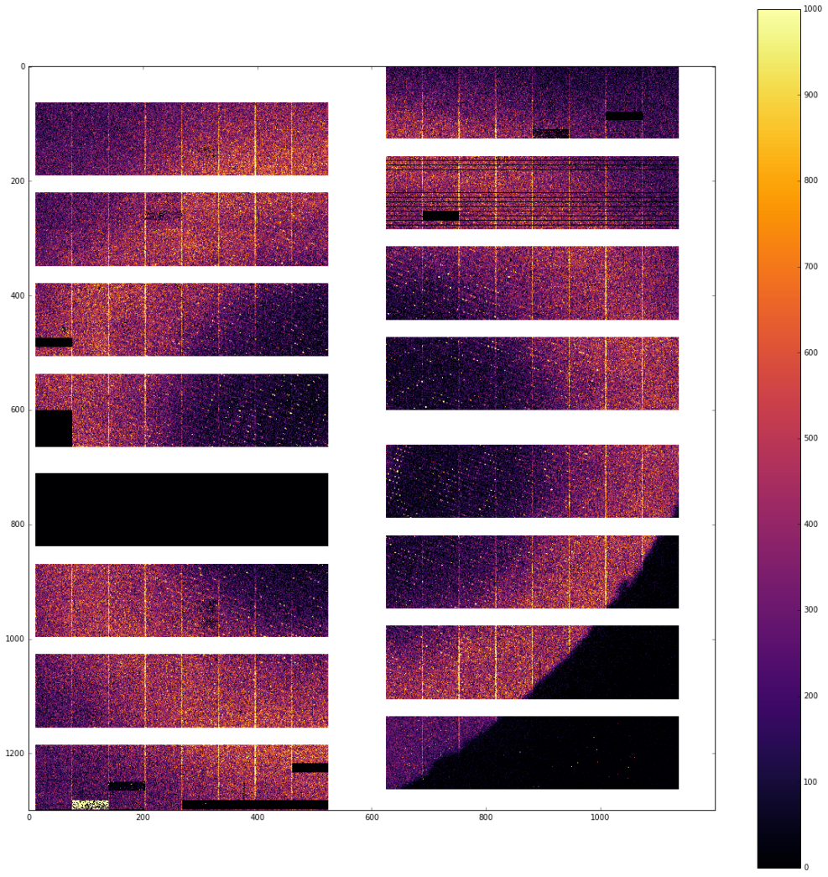
AGIPD at SPB – User Operation with AGIPD
Time resolved fs crystallography –
example of XFEL-corrected diffraction pattern
User Operation SPB started 14th September
  5 experiments
  AGIPD stable operation ~90% of the time
Scattering from 300 um jet, sum of 5 trains
Experiment/proposal | Number of hours | Raw data size [TB]
p2012 | 60 | 57
p2042 | 60 | 87
p2017 | 60 | 49
p2066 | 48 | 80
p2013 | 60 | 116
Total | 288 h | 389 TB*
* Double size images, X-rays in every 2nd image
Corrections have been cross-verified by
Barty et al. group

Slide 13
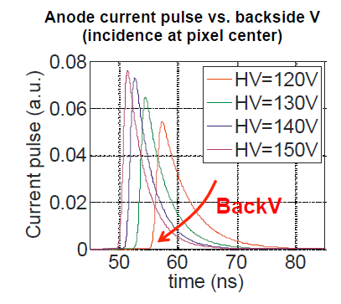
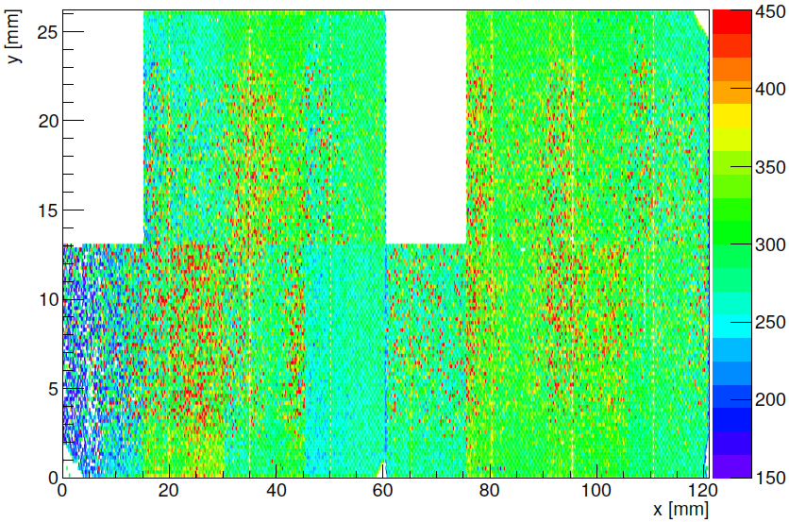
Calibration Activity – DSSC
DSSC – planning for calibration up to operation at beamline exists
Preparation for full system calibration
Analysis of LABEC and PETRA III / P04 data finalized
Politecnico di Milano: study of charge collection time
Study of uncertainty in offset, noise, and gain determination
→ best possible offset and gain calibration (granularity)
Study of charge collection time
At 4.5 MHz, there are only 220 ns for read-out sequence (charge
collection and signal processing)
Charge collection time depends on deposited charge, experimental conditions (sensor biasing, photon incidence)
Measured properties compatible with 4.5 MHz operation
PETRAIII/P65: Fluorescence line generation
Ag photon events per pixel
System under test: miniSDD-F1 ladder (128×512 pixels)
Goal: study fluorescence line generation (flux, homogeneity)
Photon energy 33 keV, Ag target
Distance target – detector about 16 cm
As expected, homogeneity sufficient for quadrant calibration
Fluorescence line flux too low at P65 → use P64 instead
Simultaneous gain calibration of quadrant feasible at P64
preliminary

Slide 14
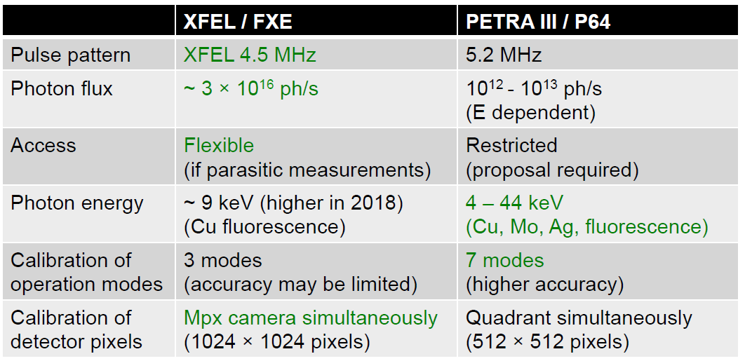
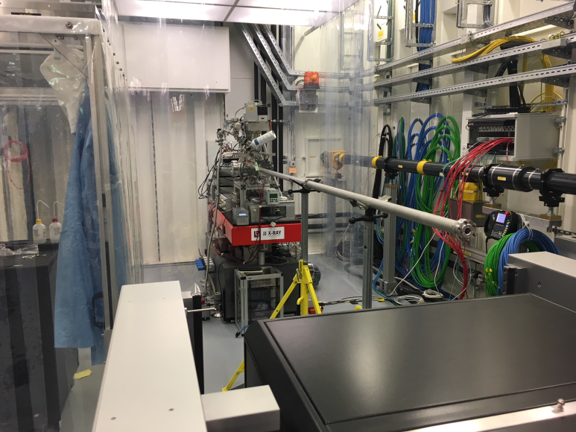
DSSC – Preparation for 1MPix Calibration
Main goals for P64 and/or FXE:
  Perform all measurements that require
  X rays
  Gain calibration for suitable operation modes
  Collect data for cross calibration of electrical injection circuits to calibrate remaining operation modes
Currently two X-ray line sources
  PETRA III / P64
  XFEL /FXE
XFEL/FXE
First contacts with Christian Bressler
  visit of FXE beamline
  Willing to support DSSC calibration,
  provided there is no interference with FXE operation
In progress: assessment of technical feasibility
PETRA III /P64
Space for
DSSC?
Proposal submitted Aug. 11, 2017
Beamtime requested for period June – July 2018
Requested number of beamline shifts (maximum possible) : 18, i.e. 6 days
LPD

Slide 15
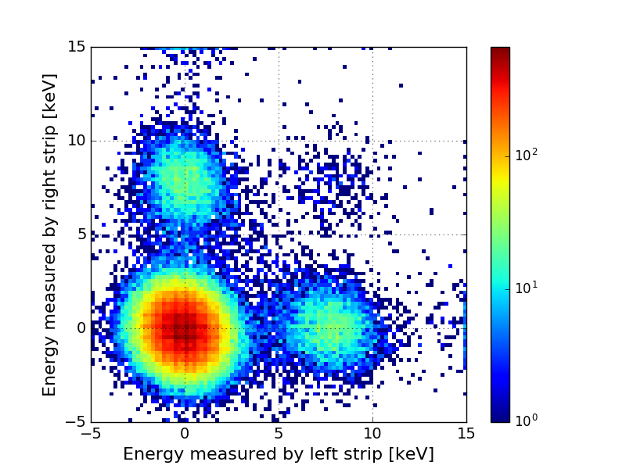
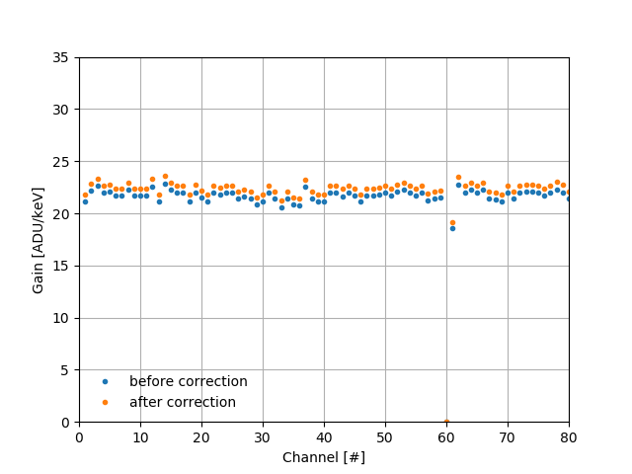
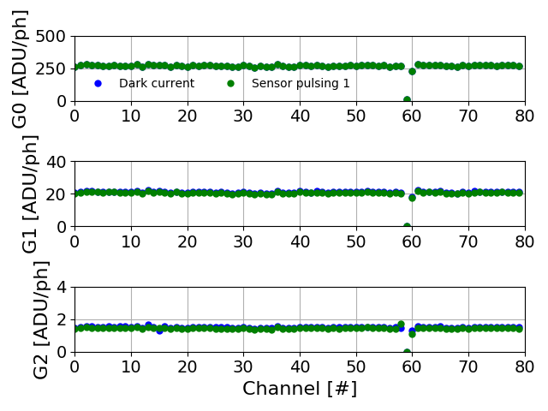
Gotthard detector at PSI
Characterization of Gotthard 1.7 → testing/verification of the strategy for calibration of Gotthard II is ongoing
Calibration of G-1.7 with 5 steps :
  Conversion gain extraction from X-ray fluorescence
  Coupling factor / fractional charge determination using 2D correlation map
  → need good statistics and complex!
  Correct the coupling for conversion gain to obtain G0
  Dynamic range scan with backside pulsing / sensor leakage current → all channels should be injected together!
  Unit conversion to keV photons and extract G1 and G2
Implication for further development:
  Simple, reliable current injection circuit of each channel to reduce the complexity of fractional charge
Calibration procedures/results need to be validated under real conditions
Charge collection distribution of neigh. strips
G0 =
Conv. Gain divided by fractional charge
Dynamic Range scan + G0/G1/G2

Slide 16
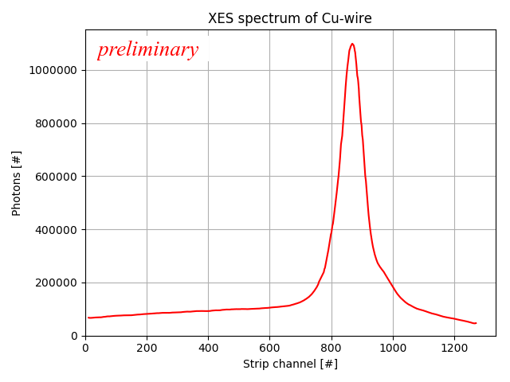
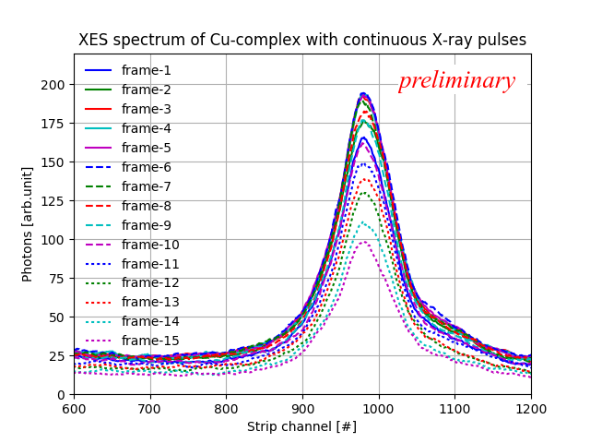
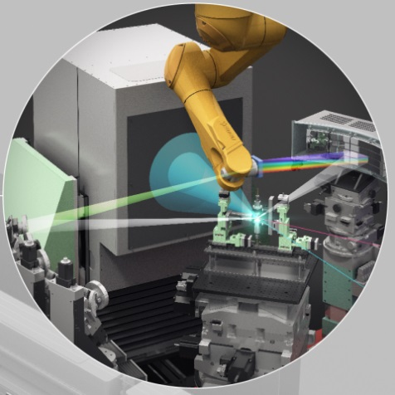
Gotthard-I at FXE
First user experiments at FXE using Gotthard-1.0:
  Detector running at 800 kHz, recording 3 frames every 6 pulses
  Detector currently being used still need to be calibrated– On-site calibration possible using a copper wire
  XES spectrum measured:
    Copper wire → pedestal correction + gain correction needed
    Jet (typical experiment) → simple counting procedure works
  Lessons learnt according to detector performance + feedback
X-ray emission spectroscopy
using Gotthard-I

Slide 17
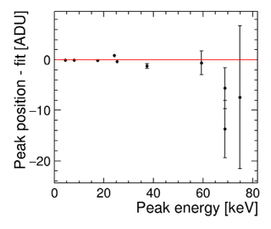
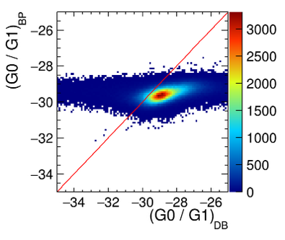
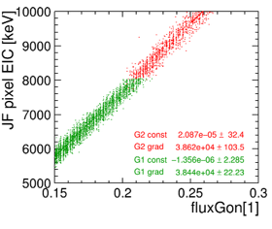
Jungfrau at PSI
Jungfrau module
  2 x 4 chips bump-bonded to a 320 μm silicon sensor
  sensing area ~ 4 cm x 8 cm
  0.5 Mpixels
Full calibration of JUNGFRAU module
Calibration validation at several X-ray sources (ESRF, LCLS, PSI lab X-ray sources)
Update on calibration of JUNGFRAU module
  Improve and validate three step process to cover all gains
    High gain (G0): demonstrated linearity up to 80 keV
    Medium gain (G1): two methods, agree to 3%
    Low gain (G2): improved fit → gap between medium and low gain closed
  Data analysis procedures are defined at PSI → to be verified what needs integration into XFEL framework
  Calibration is valid for kHz operation (to be used at 10 Hz at XFEL.EU)
  Calibration to be verified for MHz operation (more memory cells)
G0:
Fluorescence
G0/G1:
Backplane pulse
and
X-ray tube beam
G1/G2:
Current source

Slide 18
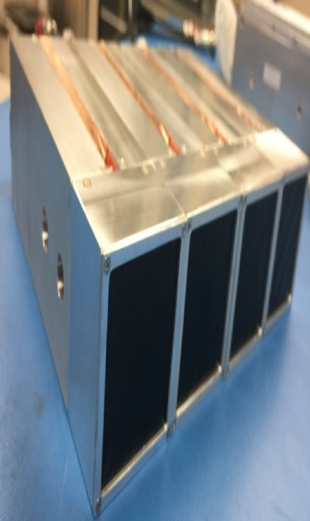
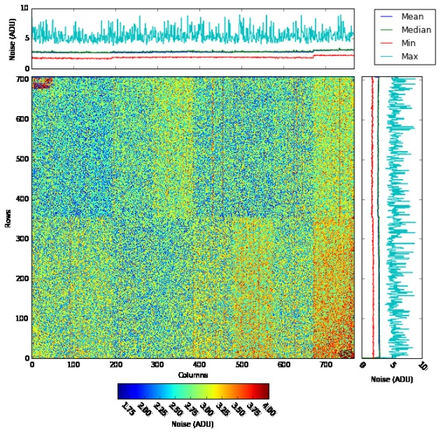
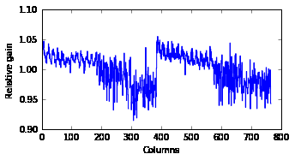
ePix detector for HED and MID
HED instrument ordered ePix detector 100 and 10k → Assembly of ePix100 cameras done
Performance of ePix100 has been demonstrated at LCLS → 4 modules have been build for XFEL and successfully passed Factory Acceptance test (FAT) at SLAC in October
  Module noise within instrument specs
  Gain variation low (~5%)
  Currently investigating event distributions and split-event uniformity
    need to further optimize event classification thresholds
    need investigate impact on correction accuracy performance
Overall, XFEL tool-chain sufficient to characterize and correct ePIX
Noise performance
Module | RMS noise [eV]
0015 | 150 ± 26
0016 | 197 ± 62
0017 | 148 ± 26
0018 | 134 ± 25
Relative Gain per column
ADU

Slide 19
Conclusions
First user operation of LPD and AGIPD:
  preliminary calibration exists
  work on improvement of calibration and characterization ongoing
  we need dedicated commissioning beam in order to better calibrate and optimize detector parameters
Detectors under development:
  Calibration/characterization strategies exist → verification with small scale prototypes and full scale detector systems ongoing
  Preparation for calibration of 1Mpix DSSC
Planned involvement of the scientific community in the calibration activities
Calibration Infrastructure in WP-75 lab
  Big Amber setup used for E2E of LPD detector
  The focus has been set on preparing the laboratory in XHQ

Slide 20
Backup slides

Slide 22
Calibration and Correction Parameters of XFEL Detectors

