Slide 1
Tests on Chess 2 ASIC
Dionisio Doering, Yubo Han_{IHEP} , Pietro Caragiulo, Larry Ruckman, Camillo Tamma, Mazin Khader_{UIUC}, Murtaza Safdari, Su Dong

Slide 2
Outline
Brief review of the results showed last time.
Several tests:
Turn off the pre-amp to see the results of thresholds from 0.9-1V.
Change the VN to 3μA, 6.6μA and compare the results with that of default setting (VN=5μA).
Change the temperature: put the fan for cooling the chip a little bit far.
Common setting:
Daughter board 19 (High Resistivity)-carrier board 28.
Always use the inversed Qinj (positive pulse with amplitude of 2.5V)
Leading edge at t=35μs and trailing edge at t=50μs.
Cut off the hits with time < 3μs.

Slide 3
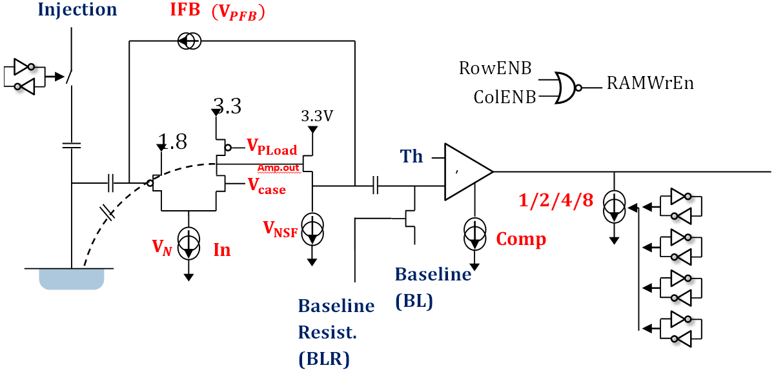
Pixel description

Slide 4
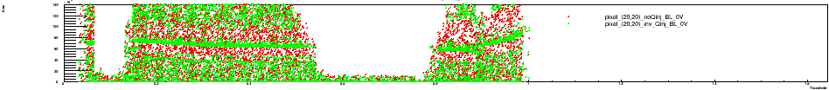
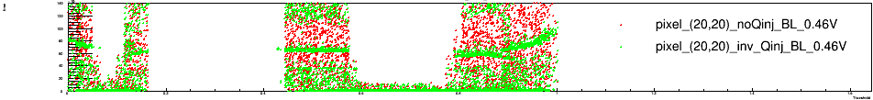
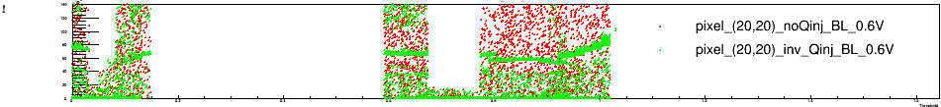
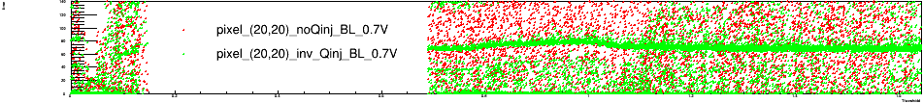
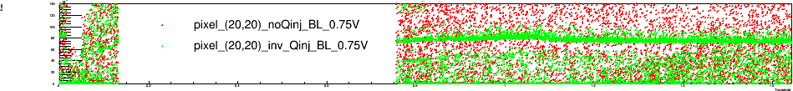
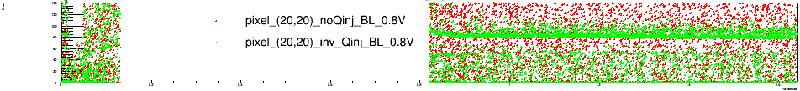
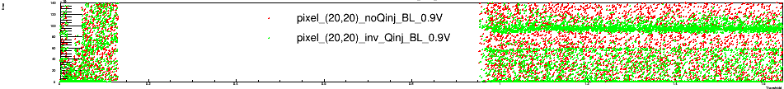
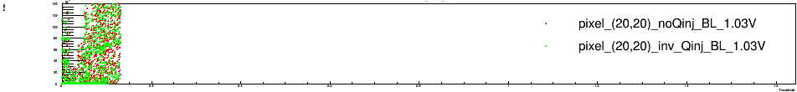
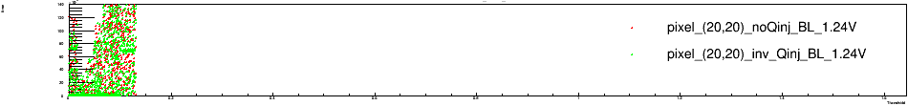
Brief review
BL=0V
Pixel (20,20)
Carrier Board 192.168.3.28
Daughter board: 19(high resistivity)
Default configuration
Matrix2
BL=0.46V
BL=0.6V
Typical results
BL has good linearity between 0.6-0.9V.
Both BL and threshold could be well controlled within 0.6-0.9V.
Still some mysteries.
Add the results of BL=0.25 and 0.35V to see the “connection point” in detail.
BL=0.7V
BL=0.75V
BL=0.8V
BL=0.9V
BL=1.03V
BL=1.24V

Slide 5
Brief review
Pixel (20,20)
BL=0V
Carrier Board 192.168.3.28
Daughter board: 19(high resistivity)
Default configuration
Matrix2
BL=0.25V
BL=0.35V
By adding the two results and updating the results of all the BL values, a big difference at threshold around 0.9-1V observed.
Much fewer noise hits, more “signal” hits.
->instable performance.
Try to turn off the pre-amp to see whether the “signal” will disappear or not.
BL=0.46V
BL=0.6V
BL=0.7V
BL=0.75V
BL=0.8V
BL=0.9V
BL=1.03V

Slide 6
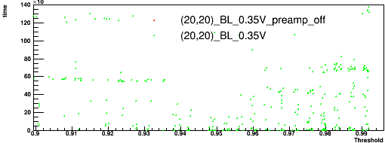
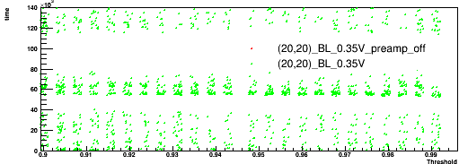
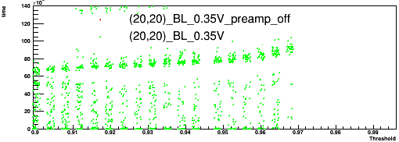
Turn off the pre-amp
Pixel(20,20)
Carrier Board 192.168.3.28
Daughter board: 19(high resistivity)
Default configuration
BL=0.35V
Threshold :0.9-1.0V
Matrix0
Turn off the pre-amp by setting VN and VNSF =0A.
The hits information disappeared.
Also run a test using updated configuration.
But after that, the results from same pixel and using same configuration became totally different.
Matrix1
Matrix2

Slide 7
new1
Pixel (20,20)
BL=0V
Carrier Board 192.168.3.28
Daughter board: 19(high resistivity)
Default configuration
Matrix2
BL=0.25V
Less hits at lower thresholds.
BL stucked at value smaller than 0.46V
Good linearity at BL=0.6-0.9V
The results of BL=0.7-0.9V is the expected results.
The width of the green signal is governed by the signal at 50μs ->a 50mV signal?
BL=0.35V
BL=0.46V
BL=0.6V
BL=0.7V
BL=0.75V
BL=0.8V
BL=0.9V
BL=1.03V

Slide 8
New1
Pixel (20,20)
BL=0V
Carrier Board 192.168.3.28
Daughter board: 19(high resistivity)
Default configuration
Matrix2
BL=0.25V
BL=0.35V
More hits observed with Qinj on.
Always see 2(some times 3) signal time.
The first 2 bands have the time information corresponding to the leading edge and the back edge of the Qinj.
BL=0.46V
BL=0.6V
BL=0.7V
BL=0.75V
BL=0.8V
BL=0.9V
BL=1.03V

Slide 9
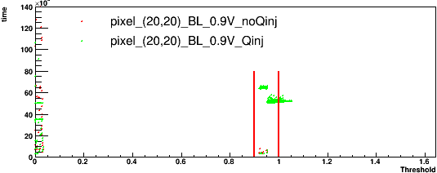
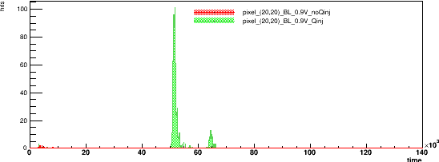
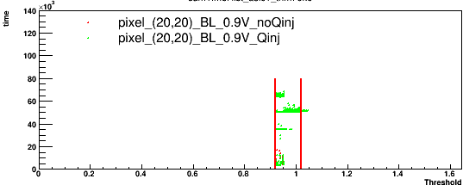
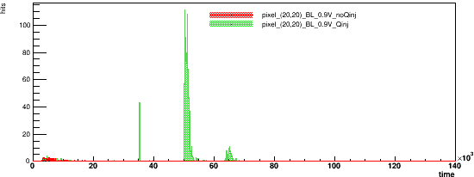
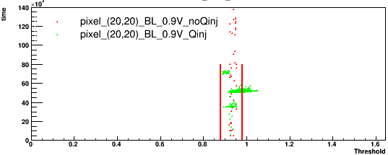
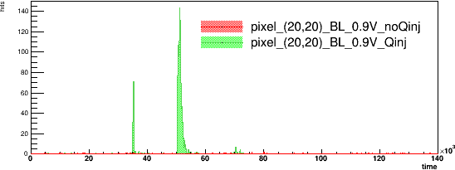
New1
Pixel (20,20)
Carrier Board 192.168.3.28
Daughter board: 19(high resistivity)
Default configuration
Matrix0
BL=0.9V
Project the time information of the hits between the two red bar.
3 peak in matrix1 and matrix2.
First 2 corresponding to the leading edge and back edge of the Qinj pulse.
What cause the signal at t=65μs?
Matrix1
Matrix2

Slide 10
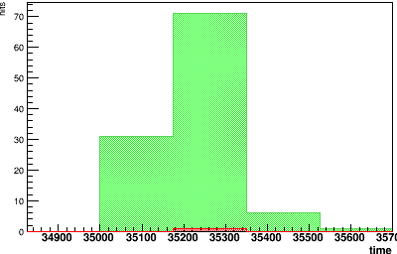
New1
Pixel (20,20)
Carrier Board 192.168.3.28
Daughter board: 19(high resistivity)
Default configuration
Matrix0
Matrix0
BL=0.9V
The peak around 35200ns has the time information as expected.
Matrix1
Matrix2

Slide 11
new1
Pixel (20,20)
BL=0V
Carrier Board 192.168.3.28
Daughter board: 19(high resistivity)
Default configuration
VN=3μA
Matrix2
BL=0.25V
BL=0.35V
Only change VN in this test.
Except BL=0.7V, others with BL from 0.6V-0.9V still have a good linearity.
A region has both noise and “signal” in the same time showed up 1V after the BL value.
BL=0.46V
BL=0.6V
BL=0.7V
BL=0.75V
BL=0.8V
BL=0.9V
BL=1.03V

Slide 12
New1
Pixel (20,20)
BL=0V
Carrier Board 192.168.3.28
Daughter board: 19(high resistivity)
Default configuration
VN=3μA
Matrix2
BL=0.25V
BL=0.35V
BL=0.46V
BL=0.6V
BL=0.7V
BL=0.75V
BL=0.8V
BL=0.9V
BL=1.03V

Slide 13
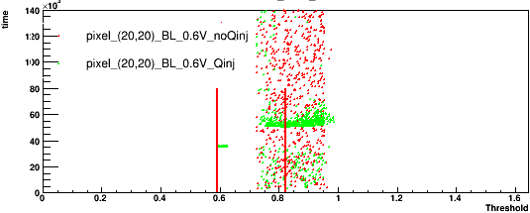
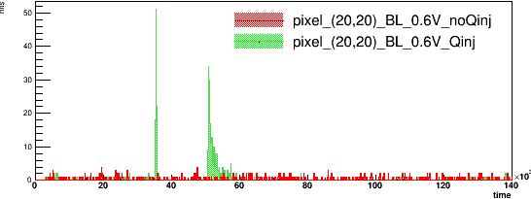
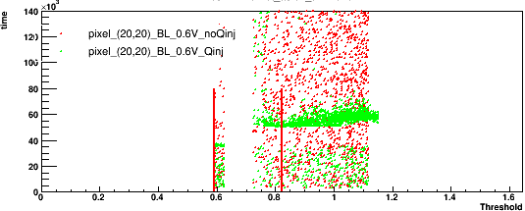
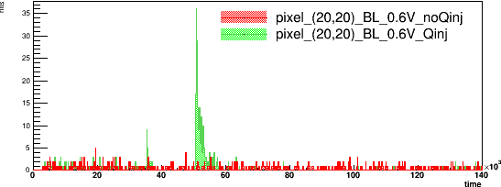
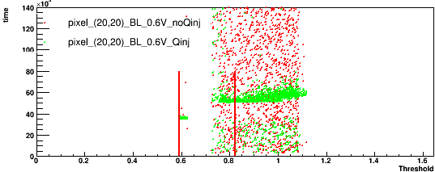
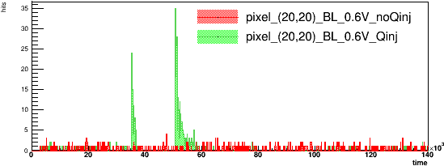
New1
Pixel (20,20)
Carrier Board 192.168.3.28
Daughter board: 19(high resistivity)
Default configuration
VN=3μA
Matrix0
Matrix0
BL=0.6V
Still have 2 band.
The time of the two gathering still correlated with the Qinj pulse.
Matrix1
Matrix2

Slide 14
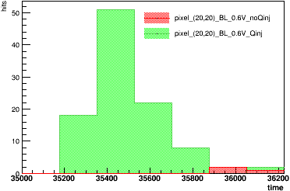
New1
Pixel (20,20)
Carrier Board 192.168.3.28
Daughter board: 19(high resistivity)
Default configuration
VN=3μA
Matrix0
Matrix0
Matrix1
BL=0.6V
Fast band has peak around 35500ns.
Matrix2

Slide 15
new1
Pixel (20,20)
BL=0V
Carrier Board 192.168.3.28
Daughter board: 19(high resistivity)
Default configuration
VN=6.6μA
Matrix2
BL=0.25V
BL=0.35V
Much fewer hits with VN=6.6μA.
BL=0.46V
BL=0.6V
BL=0.7V
BL=0.75V
BL=0.8V
BL=0.9V
BL=1.03V

Slide 16
New1
Pixel (20,20)
BL=0V
Carrier Board 192.168.3.28
Daughter board: 19(high resistivity)
Default configuration
VN=6.6μA
Matrix2
BL=0.25V
BL=0.35V
Still have 2 band even not in the linearity region of BL.
Most of them have blank results.
BL=0.46V
BL=0.6V
BL=0.7V
BL=0.75V
BL=0.8V
BL=0.9V
BL=1.03V

Slide 17
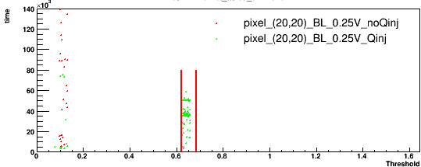
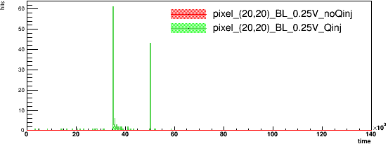
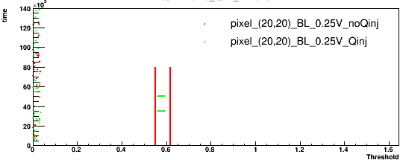
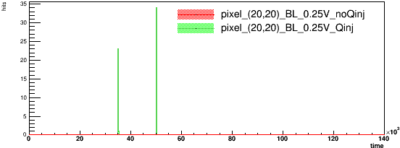
New1
Pixel (20,20)
Carrier Board 192.168.3.28
Daughter board: 19(high resistivity)
Default configuration
VN=6.6μA
Matrix0
Chose the result of BL=0.25V.
Centralized time information.
Matrix0
Matrix2

Slide 18
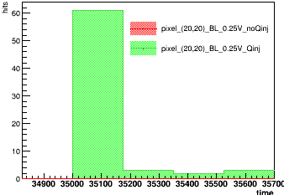
New1
Pixel (20,20)
Carrier Board 192.168.3.28
Daughter board: 19(high resistivity)
Default configuration
VN=6.6μA
Matrix0
BL=0.25V
Matrix0
The fast band happened right after the leading edge of the Qinj. The slower band happened right after the back edge.
Matrix2

Slide 19
new1
Pixel (20,20)
BL=0V
Carrier Board 192.168.3.28
Daughter board: 19(high resistivity)
Matrix2
BL=0.25V
Compare the results of 3 VN value. (Qinj on)
The results of default setting seems more understandable.
The signal largely diminished at VN=3 and 6.6μA compared to VN=5μA -> overly sensitive? Change of temperature?
BL=0.35V
BL=0.46V
BL=0.6V
BL=0.7V
BL=0.75V
BL=0.8V
BL=0.9V
BL=1.03V

Slide 20
New1
Pixel (20,20)
BL=0V
Carrier Board 192.168.3.28
Daughter board: 19(high resistivity)
Matrix2
BL=0.25V
Two band having time information correlated with the Qinj pulse could be seen almost with every BL.
BL=0.35V
BL=0.46V
BL=0.6V
BL=0.7V
BL=0.75V
BL=0.8V
BL=0.9V
BL=1.03V

Slide 21
new1
Pixel (20,20)
BL=0V
Carrier Board 192.168.3.28
Daughter board: 19(high resistivity)
Matrix2
BL=0.25V
Put the fan a little bit further and compare the results with the initially one.
Big change observed.
The unrepeatable results might be caused by different operating temperature.
BL=0.35V
BL=0.46V
BL=0.6V
BL=0.7V
BL=0.75V
BL=0.8V
BL=0.9V
BL=1.03V

Slide 22
New1
Pixel (20,20)
BL=0V
Carrier Board 192.168.3.28
Daughter board: 19(high resistivity)
Matrix2
BL=0.25V
The results with further fan has longer response range.( which might explain the long tail with VN=3μA)
BL=0.35V
BL=0.46V
BL=0.6V
BL=0.7V
BL=0.75V
BL=0.8V
BL=0.9V
BL=1.03V

Slide 23
Summary
Significant sensitivity to temperature observed. May explain many previously inconsistent results and the very large noise bands observed.
Pre-amp can be controlled but surprising variations vs VN.
Puzzling signal time clusters as both edges of Qinj pulse and later time also.
Updates: the firmware/software update to readout 8 hits per matrix simultaneously to speed up tests.
Next:
- Installing Peltier cooler to control sensor temperature
- Checking observed Qinj amplitude with reduce input Qinj voltage
- Further investigate Qinj behavior vs BL/threshold and amplifier parameters, under stable condition, to establish nominal operating values.

