Slide 1

Activation of the beamline in XSDU2 by failure of the dump magnets on 20.09.2017
Eric Boyd
SRP
XHEXP1 Meeting
29,09,2017

Slide 2
Event:
A failure of all magnets downstream of the SASE3-Undulators occurred, around approx. 8:30 at the XFEL This failure remained unnoticed by the operators until a vacuum break in the beamline made the further operation impossible. Since the dump magnets had failed, the electron beam propagated straight in the direction of XTD 10, but was then properly deflected by the two safety permanent magnets in XSDU2. As a result, the electron beam hit the beamline approx. 2 m behind the second permanent magnet which led to a considerable activation and presumably to the vacuum leak.
30 Bunches
14 GeV
the SASE3 undulators were open
XTD6
HED
MID
660m
L
L
XTD7
XSDU1
141m
XTD5
1
XS2
L
1
XS4
200m
XTD8
XTD3
267m
361m
XHEXP1
480m
1
1
L
XTD1
L
SASE2
XSIN
XSE
XS3
XTL
1
XTD2
544m
XTD9
L
50m
1
1050m
1050m
594m
1
L
L
1
1
L
1
SASE1
L
XTD4
XTIN1/2
1
XSDU2
SASE3
300m
XS1
L
XTD10
1
220m
L

Slide 3
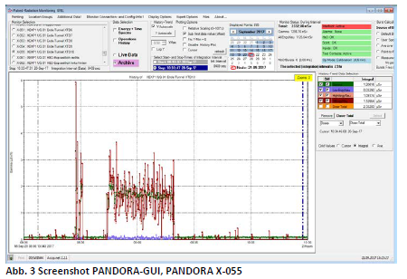
Radiation Measurements During the Event
According to the PANDORA data the failure of the magnets occurred at 8:33 clock, operation with the failed magnets took place from 8:33 - 8:37 clock as well as 8:50 - 9:26 clock.
The PANDORA X-055 at the end of the XTD10 tunnel in the XHEXP1 experimental hall has detected a dose of approx. 2 μSv for the entire event at a dose rate of 2.5 μSv / h.

Slide 4
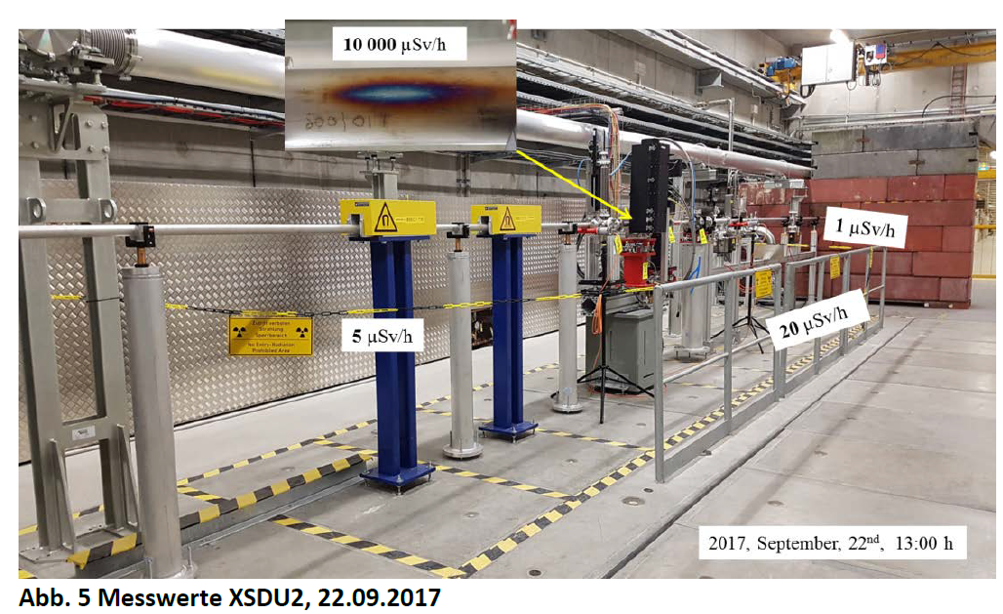
Radiation Measurements at Activated Hotspot
 | 20.09.2017, 12:00 Uhr mSv/h | 21.09.2017, 9 Uhr mSv/h | 22.09.2017, 13 Uhr mSv/h
Flange in front of OTR-C | 19 | 8 | 4
Flange behind the OTR-C | 26 | 9 | 5
"Hot" spot beam tube below, surface | NA | 10 | 10
"Hot" position of the spray tube on the side, 30 cm | 2 | 0,5 | 0,2
Boundary, at the railing (max.) | 0,1 | 0,03 | 0,02

Slide 5
Corrective Actions
The following measures were agreed at a meeting on 22.09.2017 to ensure safe 30 bunch operation:
Implementation of the fault message of the magnets in the MPS (in the October shutdown).
Improvement of the representation on the overview screen of the operators, so that such an event can be immediately recognized (already done).
D3 will measure levels before scheduled maintenance and shutdowns with the machine set. The interlock is not broken until D3 has finished measuring.
For planned or unplanned ZZs in XFEL control areas, a dose rate measuring device is to be carried in the vicinity of the beamline and the dose rate at the place of work must be measured and assessed in advance. In case of doubt, please contact D3.
Starting with the October shutdown, access to the XFEL accelerator will only be possible with EPDs (electronic personal dosimeters). Carrying an active EPD replaces the need for a dedicated measurement.

Slide 6
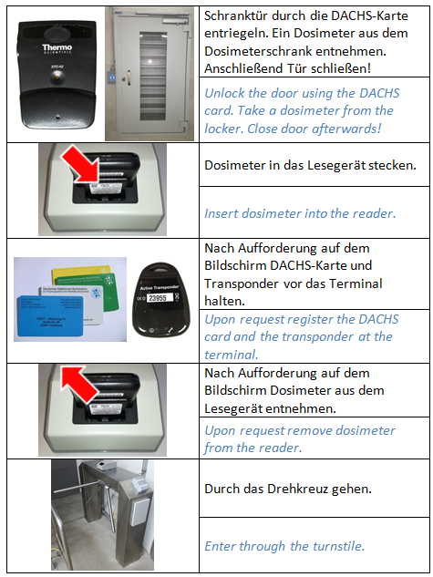
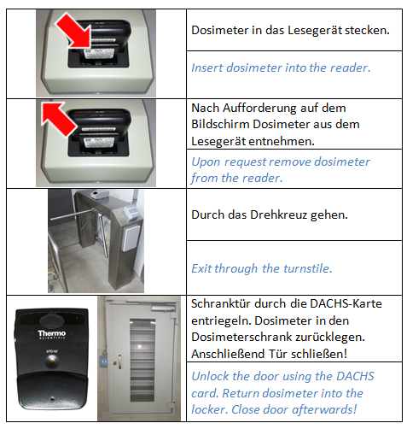
Electronic Personal Dosimeters (EPD)

