Slide 1
Schedule and Priorities
2018 / 2019

Slide 2
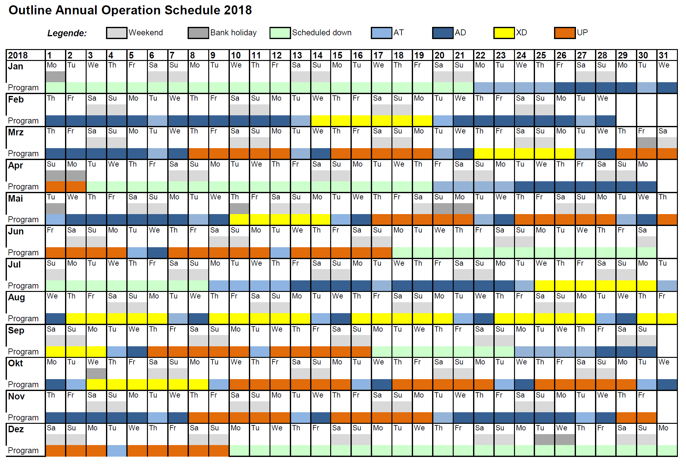
Current 2018 schedule
XTD4+10 ready
XTD1+6 ready
Start of
SASE1+2+3 beamline commissioning with beam
3rd user run

Slide 3
Scope 2018/19 / Order of priorities
SASE1 tunnel operation
SASE1 instrument operation
SASE3 tunnel readiness ➔ SASE3 tunnel operation
SASE2 tunnel readiness ➔ SASE2 tunnel operation
SASE3 instrument readiness ➔ SASE3 instr. operation
SASE2 instrument readiness ➔ SASE2 instr. Operation
SASE1 tunnel & instrument completion
SASE3 tunnel & instrument completion
SASE2 tunnel & instrument completion

Slide 4
1. SASE1 tunnel operation
Tasks & effort required to operate the tunnel:
(including items for Day-1 or required to meet promises in Call for Proposals)
  Installation & commissioning of distribution mirror cooling
  Complete commissioning of MCP, Hirex, K-Mono
  (required for improvements of the accelerator)
Accelerator:
  Good understanding of the FEL gain curve
  Measurement of the spectral jitter and bandwidth

Slide 5
2. SASE1 instrument operation
Tasks & efforts required to operate the instruments: (including items for Day-1 or required to meet promises in Call for Proposals)
  CAS:
    Exchange of data between DOOCS and Karabo
    (required for improvements of the accelerator)
    Improve DAQ: Data storage and handling, detector performance
    Improve Control Software: Scan tool, timing tool, overall stability, …
  Accelerator & SPB/SFX:
    Improvement of the focal properties
  SPB/SFX:
    October: CSS, (re)cabling works, laser table, vacuum works, …
    2018: KB-mirror installation, integration & commissioning

Slide 6
3. SASE3 tunnel readiness
Achieve first lasing: 1st attempt in Nov. 17
  XGM, FEL- & SR-Imager, Vacuum in XTD10 up to absorber required
  Test of entire vacuum system with controls, interlock etc.
Major works finished XTD4+10 : End of Jan. 18
  Vacuum & Optics: Beam shutters, mirrors, soft X-ray Monochromators
  Diagnostics: MCP, Pop-Ins, K-Mono
  ...
Simultaneous operation of SASE1+3: End of Q1 18
  To be discussed with Acc. and incorporated into schedule

Slide 7
4. SASE2 tunnel readiness
Achieve first lasing: 1st attempt in Mar. 18
  XGM, FEL-&SR-Imager, Vacuum in XTD1+6 up to XTD6 absorber
  Test of entire vacuum system, with controls, interlock etc. required
Major works finished XTD1+6: End of Apr. 18
  Vacuum & Optics: Beam shutters, Mirrors, Split&Delay Unit, High resolution monochromator, CRLs
  Diagnostics: 2nd XGM, MCP, Pop-Ins and other Imagers
Simultaneous operation of SASE1+3+2: End of Q2
  To be discussed with Acc. and incorporated into schedule

Slide 8
5. SASE3 instrument readiness
TGA
  AC ready until Feb. / Apr. 18, Elec. ready until Mar. 18
Instrument installation
  Major time of installation: Feb. – Apr. 18
Beckhoff electronics
  Cabling Phase II done until Jan.18
  Day 1 hardware BH done until Feb. 18
  Beckhoff electronics E2E done until Jul. 18
Instrument commissioning without beam
  Installation of Rad. Saf. Interlocks in Apr. 18
  …

Slide 9
6. SASE2 instrument readiness
TGA
  AC ready until Mar. / Apr. 18, Electricity ready until Apr. 18
Instrument installation
  Major time of installation: Q4 2017 - Q1 2018
  AGIPD ready for installation in Feb. 18
Beckhoff electronics (MID / HED Opt. / HED)
  Cabling Phase II done until May / July / Sep. 18
  Day 1 hardware BH done until Feb. / Mar. / June 18
  Beckhoff electronics E2E done until Sep. 18 / Oct. 18 / Jan. 19
Instrument commissioning without beam
  Installation of Rad. Saf. Interlocks in July 18

Slide 10
7. SASE1 tunnel & instrument completion
Tunnel:
  …
FXE:
  Jungfrau detector planning, cabling, integration & commissioning
  4-bounce monochromator
  …
SPB/SFX:
  Jungfrau detector planning, cabling, integration & commissioning
  AGIPD4M detector planning, cabling, integration & commissioning
  Additional work regarding downstream region
  …

Slide 11
8. SASE3 tunnel & instrument completion
Tunnel:
  Undulators: Self-seeding, Circular polarization undulator, Helical afterburner
  Diagnostics: Full PES operation, Exit-Slit Imagers
  …
SCS:
  …
SQS:
  …
Third experiment (TR-XPES):
  …

Slide 12
9. SASE2 tunnel & instrument completion
Tunnel:
  Undulators: Self-seeding, …
  Diagnostics: Hirex?
  …
MID:
  …
HED / HIBEF-UC:
  …
(Third experiment:)
  …

