Slide 1
Readiness Meeting
6.10.2017

Slide 2
Feedback received by PSPO
Feedback was not complete
  Feedback from ITDM could not be integrated anymore
  CAS was unable to provide feedback
Feedback was incomplete
  Start / end times: „ASAP“, „now“, „?“, or simply not given
  ➔ We tried to assume reasonable end-dates / durations
Some activities were reported twice
  ➔ Fixed, typically kept the tasks which were better described
  ➔ Monica has a Project-File, which allows to select groups or locations
  ➔ Feedback from ITDM & CAS should be included starting on Monday.

Slide 3
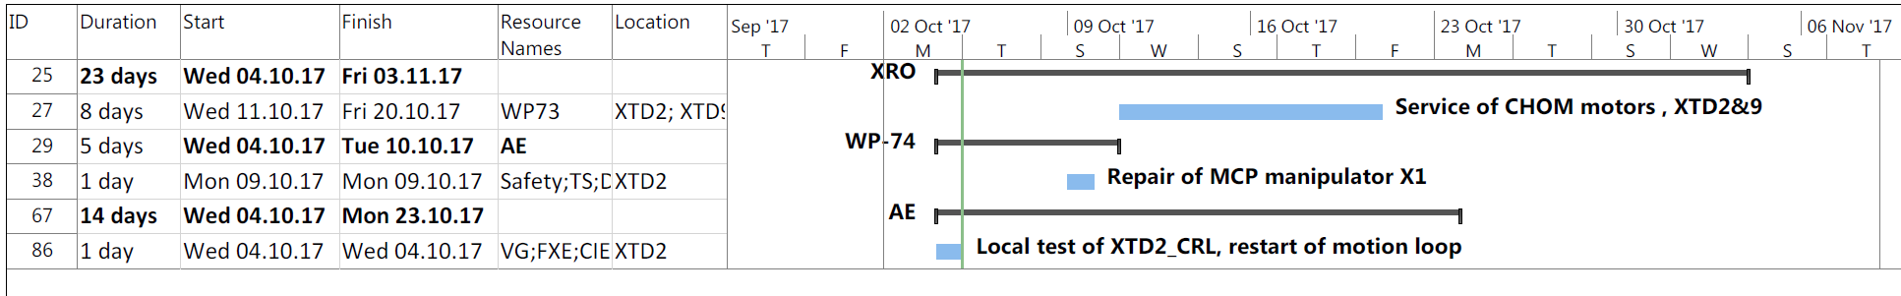
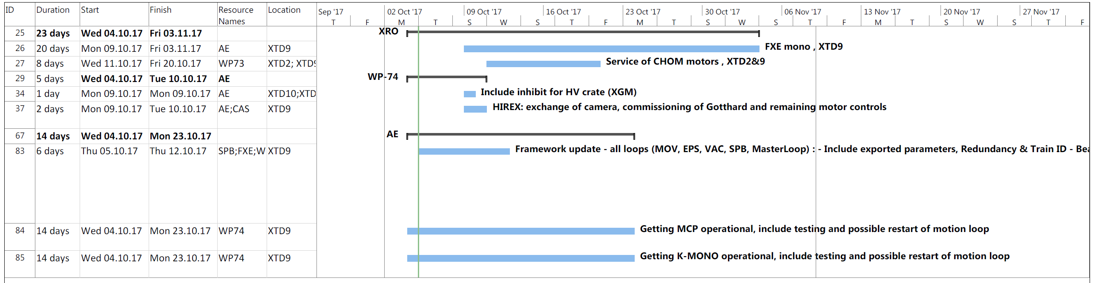
Location: XTD2 + XTD9

Slide 4
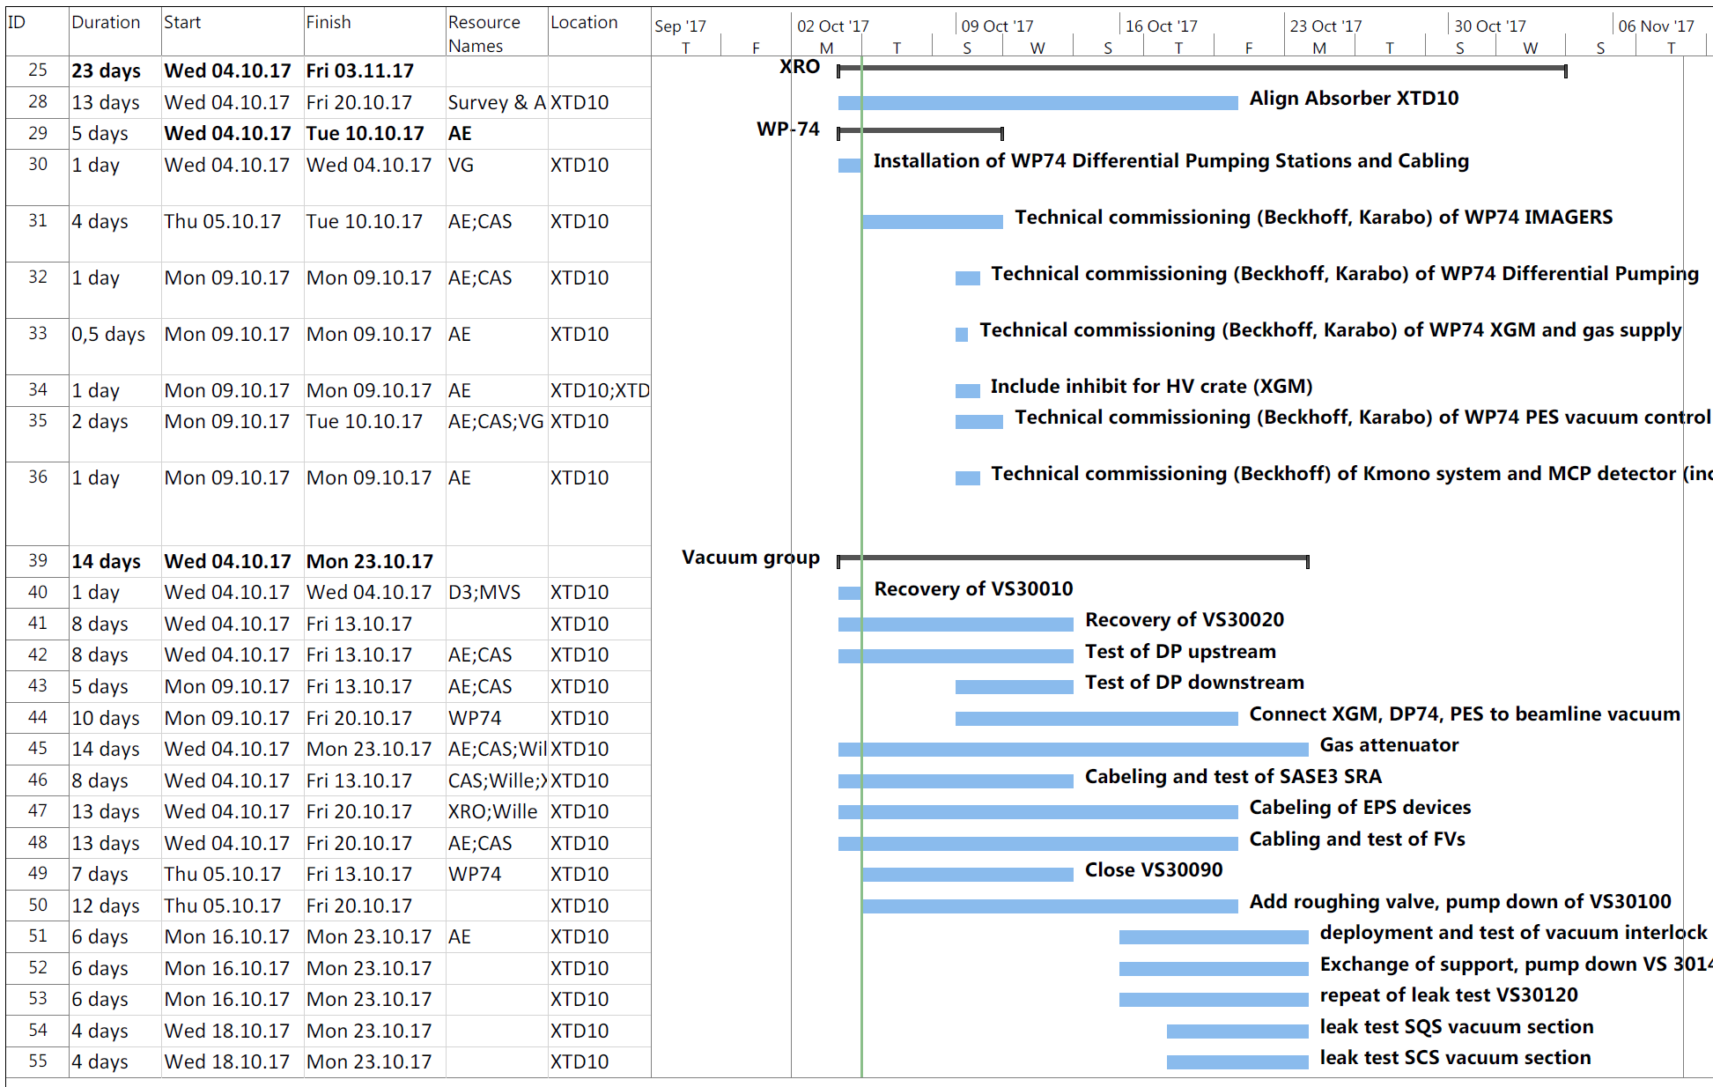
Location: XTD10

Slide 5
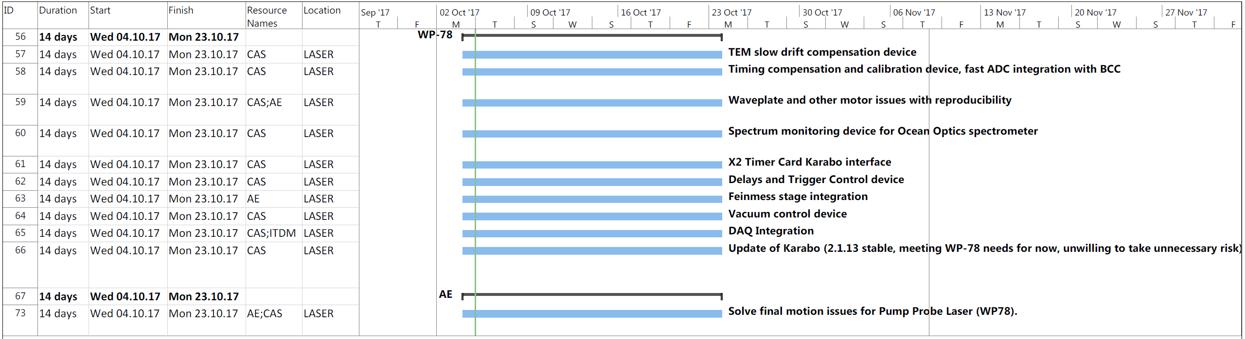
Location: Laser

Slide 6
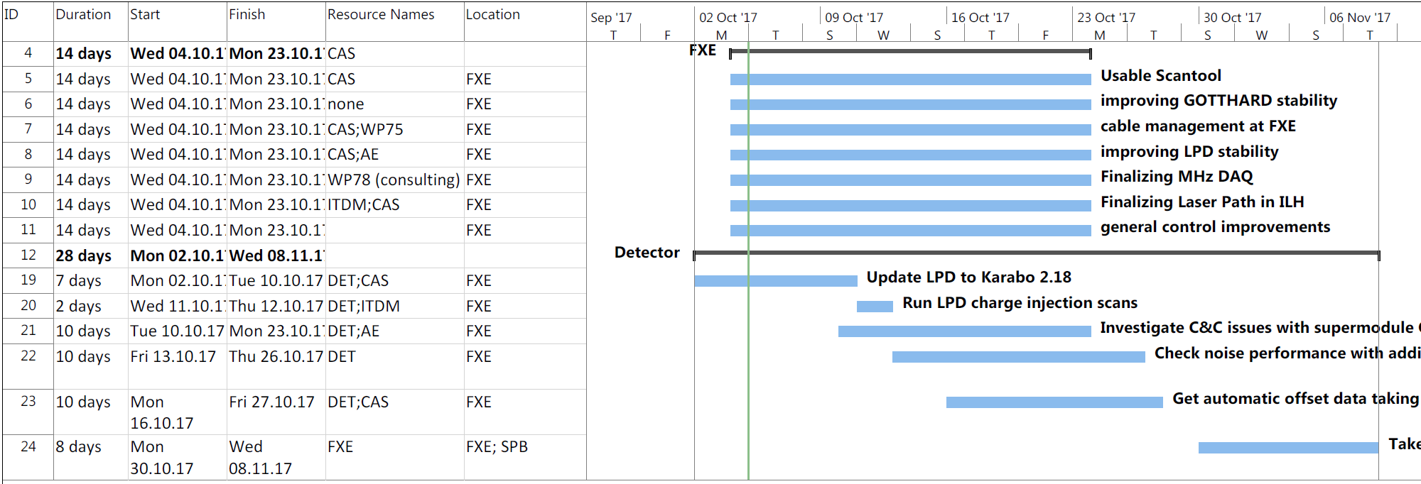
Location: FXE

Slide 7
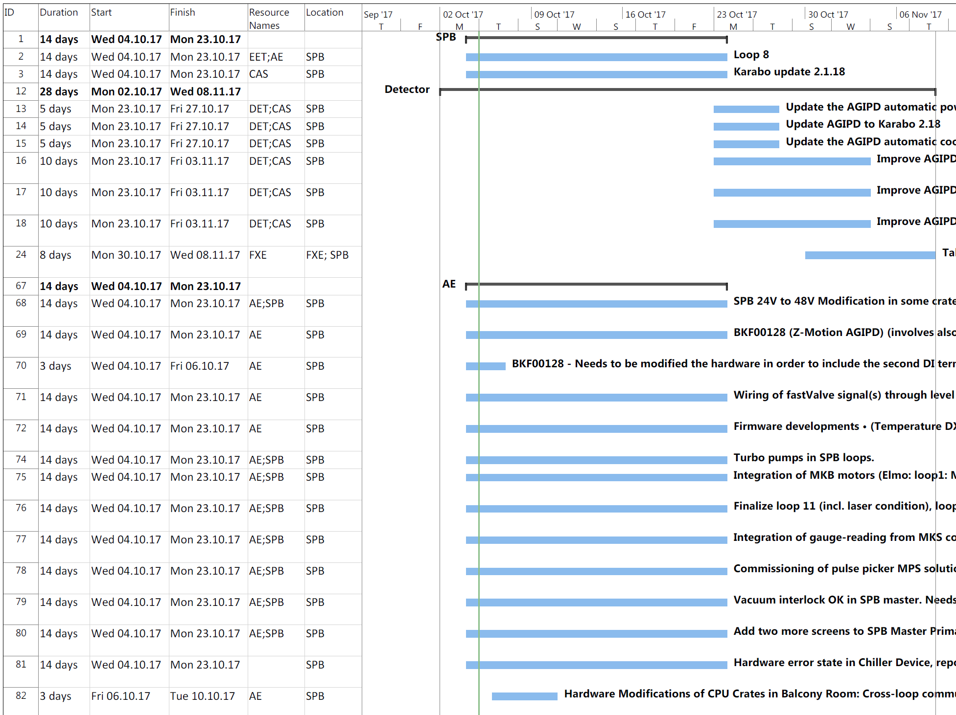
Location: SPB/SFX

Slide 8
Next steps (ideally in this order):
Feedback from CAS is required.
CAS- and ITDM-feedback has to be integrated
AE and CAS should meet with PSPO still today
  Sufficient resources available?
  Collisions / dependencies correct?
  Any priorities unclear?
Updated plan could be shown to MB on Tuesday
  Opportunity to clarify any specific priorities

Slide 9
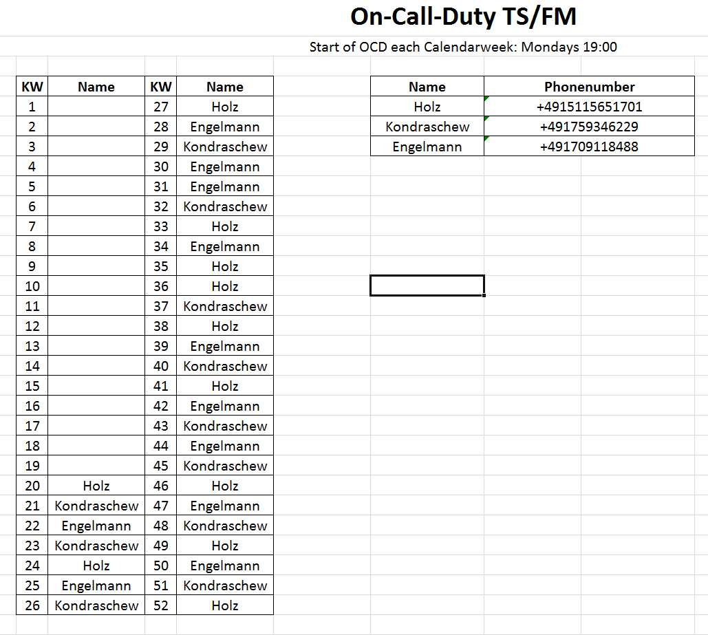
OCD Technical Services

Slide 10
Upcoming Dates & Meetings
Readiness Dispatch
  Mo, 09:30? 12:00? 13:00? 14:00?
  Wed, 09:30? 12:00? 13:00? 14:00?
  When are most people available / when is the smallest impact of ongoing work in the tunnels / instruments?
13.10., 8:30: TC meeting
13.10., 9:00: Readiness-Meeting

