Slide 1
NAF Status Report
Subtitle of Presentation
Yves Kemp
DESY 11.10.2017

Slide 2
DUST

Slide 3
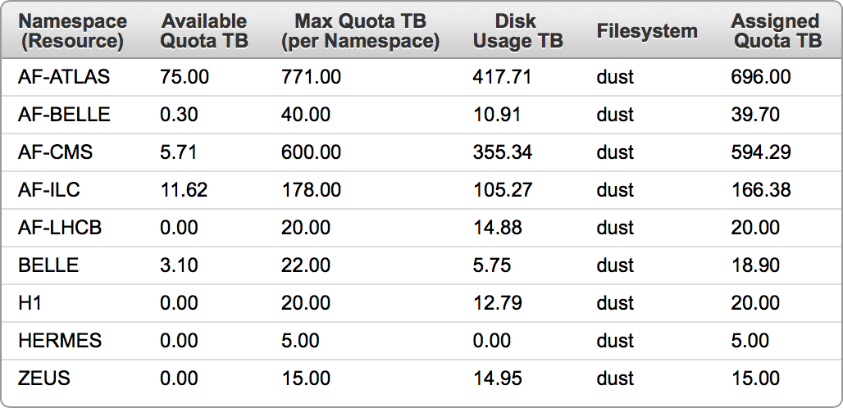
DUST – Doubling capacity
Purchase
Exactly doubling the capacity
Data and Metadata
Current capacity:
Proposal
Doubling capacity of the active groups
… not exactly doubling: Reduce overcommitment factor (ideally from 1.25 to 1)
x2

Slide 4
DUST – Upgrade
Plan
First step: Done
Need to upgrade current DUST from 4.0 -> 5.0
During operation
Unfortunately, HW trouble occurred (also inducing temporary performance issues), delaying upgrade
Second step: Done
Current DUST from 5.0 -> 5.2
During Operation, no troubles seen
Third step: Done
Install new components with 5.2
Enlarge Systems
Last steps
New quotas: Do be done

Slide 5
DUST – Metadata
Problem
Metadata is located on special server with SSD
Space is tight … posing problems some weeks ago: People could no longer write into DUST despite quota available
We contacted experts and users, ehm, little response
If response, turned out to be garbage
In future, we have to resort to more drastic approaches to ensuring functionality
E.g. setting quota of problematic users to zero
We do not want to set a Metadata Quota
With current ratio Metadata/Data, ~700 TB of enlarged DUST cannot be written as not enough metatada available
Another solution
Purchase another MetaData server
With this server, we will be just safe to write the ~700 TB data with current ratio
FYI: This solution costs ~100k EUR
FYI: User file count available via AMFORA quota management for admins (not for users currently)

Slide 6
BIRD: SGE and HTCondor

Slide 7
BIRD: SGE
Status
Well used
Some problems, usually because SGE AFS volume troubled
Reason unclear. We suspect user induced troubles, but cannot pinpoint this further
Solution: Switch to another batch system

Slide 8
BIRD: Hardware
Status
Currently 495 WNs (in SGE, plus 25 in HTCondor pilot)
~60 are rather old, will be decommissioned end 2017
~60 new WNs will be purchased: 20 cores with 128 GB RAM each
Would like to put them into operation with HTCondor
And use some for WGS server

Slide 9
BIRD: HTCondor
Status
Pilot is there: Working AFS and Kerberos
Initial documentation for migration http://bird.desy.de/htc/
In progress
Dedicated WGS for experiments (small VMs, would be transformed into more powerful physical machines when pilot is advancing)
Pilot user mailing list
What we lack are test users that actually do tests
Contact e.g. sge.service@desy.de for becoming a pilot user
The funny patterns in the occupation come from YK to present at least something for the PRC next week

Slide 10
BIRD: HTCondor … next steps
Next steps: Short term future
User testing and reporting
Fixing things like missing DUST mounts etc. (DONE)
User input: SSH-to-job and DAGman is considered useful, will be implemented
Growing #WNs: Move additional 33 WNs from SGE to HTCondor
Setting up powerful WGS as needed
Adding IPv6 (almost done)
Next steps: Longer future
Monitoring and accounting
Migration: Add even more nodes still 2017 (e.g. new purchases) -> 50/50 SGE/HTCondor on 1.1.2018
2018Q1: Push all users to migrate
1.4.2018: Shut down BIRD/SGE
2018Q2: Work on containers to help SL6 -> EL7 migration
Currently only IT managed containers envisionned
Users might be offered Singularity
2018Q3: Integration Grid/HTCondor with BIRD/HTCondor

Slide 11
Meetings

Slide 12
Meetings
PRC next week
Regular NUC meetings
NAF Users Meeting @TeraScale meeting

