Slide 1
Tests on Chess 2 ASIC
Dionisio Doering, Yubo Han_{IHEP} , Pietro Caragiulo, Larry Ruckman, Camillo Tamma, Mazin Khader_{UIUC}, Murtaza Safdari, Su Dong

Slide 2
outline
Review of the results last month.
Install cooling modules ->less noise, more stable performance.
Add more results with different Vnsf.
How the 8 hits distribute with different VNSF
 | VNSFatt | VNSFres | Current
Default | 27 (11011) | 0 | 0.311μA
1st test | 28 (11100) | 3 | 2.99μA
2nd test | 25(11001) | 1 | 0.327μA
3rd test | 24(11000) | 3 | 0.18μA
4th test | 22(10110) | 2 | 0.0262μA
5th test | 23(10111) | 3 | 0.0909μA

Slide 3
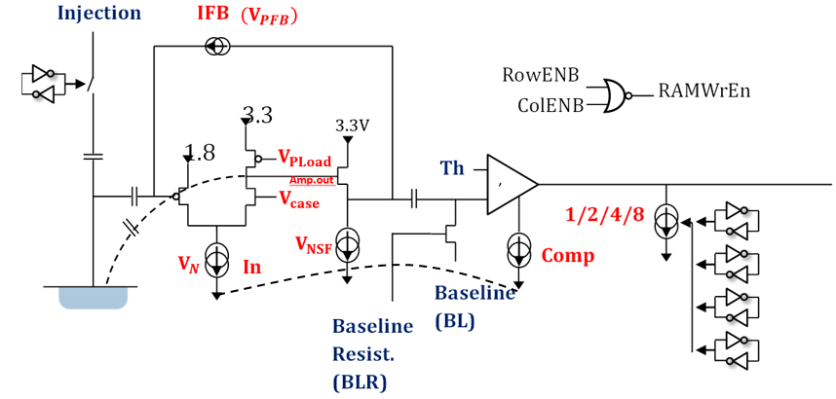
Pixel description

Slide 4
Review of last results
Pixel (20,20)
BL=0V
Carrier Board 192.168.3.28
Daughter board: 19(high resistivity)
Matrix2
BL=0.25V
Initial cooling test.
Put the fan a little bit further and compare the results with the initially one.
Big change observed.
-> add cooling module.
BL=0.35V
BL=0.46V
BL=0.6V
BL=0.7V
BL=0.75V
BL=0.8V
BL=0.9V
BL=1.03V

Slide 5
Review of last results
Pixel (20,20)
BL=0V
Carrier Board 192.168.3.28
Daughter board: 19(high resistivity)
Matrix2
BL=0.25V
BL=0.35V
Time vs threshold.
Change the value of VN.
The control of VN is coupled with that of the comparator(comp current).
-> change the Vnsf.
BL=0.46V
BL=0.6V
BL=0.7V
BL=0.75V
BL=0.8V
BL=0.9V
BL=1.03V

Slide 6
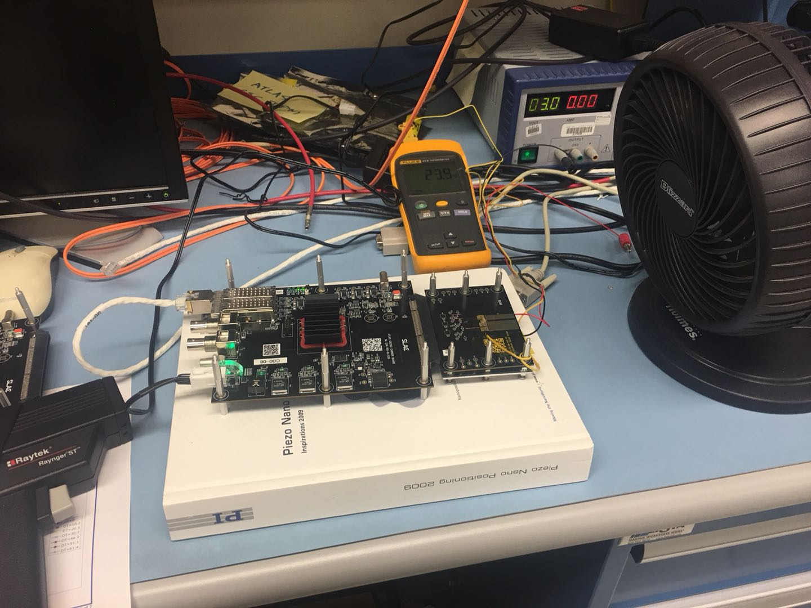
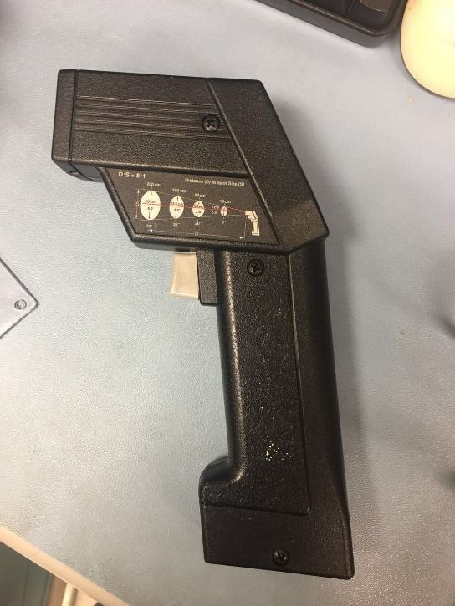
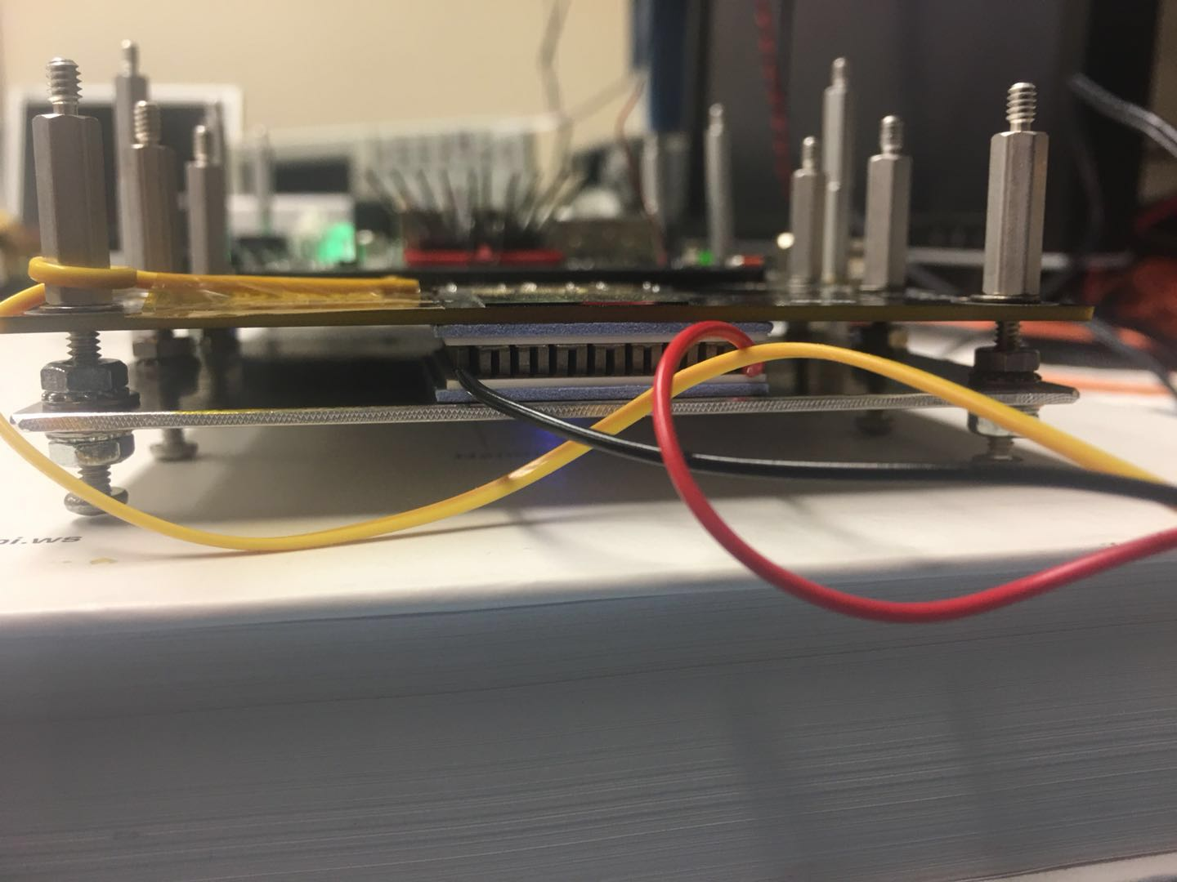
Thermoelectric module
Power supply for the peltier module.
Raytek:
Measure the highest temperature on the chip.
Thermometer
—the temperature near to the chip.
Raytek
Carrier board
Daughter board #19
Adding a peltier module. (area:30mm*30mm, height: 4.8mm).
The temperature changed a lot with different setting.
V=3V+ fan ->24℃ on the chip.(the following tests have been done using this setting).

Slide 7
Update the results of
Pixel (20,20)
Carrier Board 192.168.3.28
Daughter board: 19(high resistivity)
Matrix1
Default configuration
BL=0.25V
BL=0.46V
Time vs Threshold.
Time cut: >30000ns
Linearity between BL=0.6-1.2V -> larger linear range.
Threshold>~1.03V may not be trustworthy but still have good linearity.
Stopped at BL=0.46V
Long signal tail with BL bigger than 0.9V.
Two line gradually merged into one line.(obvious with Higher BL)
Less noise hit.
BL=0.6V
BL=0.7V
BL=0.75V
BL=0.8V
BL=0.9V
BL=1.03V
BL=1.1V
BL=1.2V

Slide 8
Pixel (20,20)
Carrier Board 192.168.3.28
Daughter board: 19(high resistivity)
Matrix1
Default configuration
BL=0.25V
BL=0.46V
Hits number vs Threshold.
Linear range:0.6-1.2V
A peak observed at linear range. -> why this distribution?
BL=0.6V
BL=0.7V
BL=0.75V
BL=0.8V
BL=0.9V
BL=1.03V
BL=1.1V
BL=1.2V

Slide 9
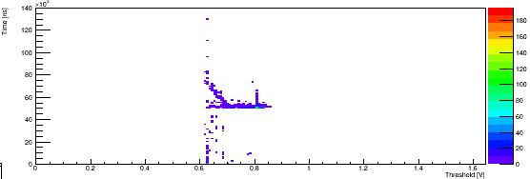
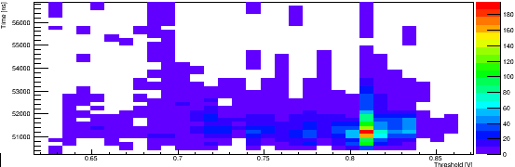
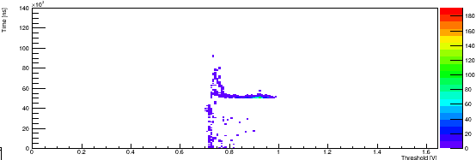
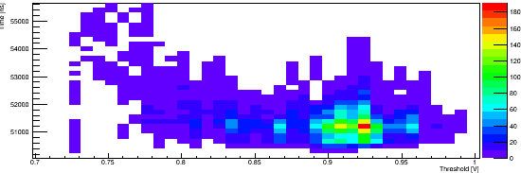
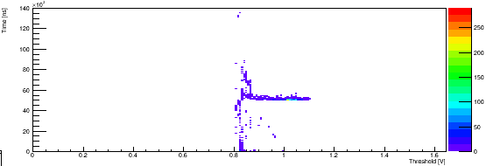
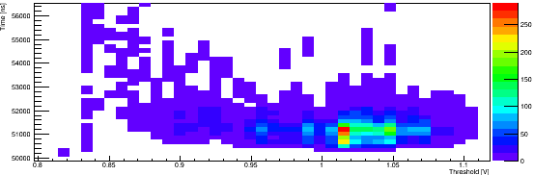
Pixel (20,20)
Carrier Board 192.168.3.28
Daughter board: 19(high resistivity)
Matrix1
Default configuration
BL=0.6V
Choose the results of BL=0.6V, 0.7V, 0.8V.
Zoom in to see the position of the peak in detail.
the peak moved with different BL.
Always around the threshold=BL+0.22V.
Two band merged into one.
Is the second band mostly consist of the hits after the first one?
BL=0.7V
BL=0.8V

Slide 10
Pixel (20,20)
Carrier Board 192.168.3.28
Daughter board: 19(high resistivity)
Matrix1
Default configuration
BL=0.25V
BL=0.46V
Hits number vs time.
Project all the hits observed in whole threshold range on time axis.
Peak position: 50μs
50μs peak keep its position consistent with different BL.
Tiny peak at: 35μs
-> more sensitive to the falling
edge?
At the linear range(BL=0.6-0.9V), sharp and similar distribution of hits obtained.
-> the better operating BL
range?
BL=0.6V
BL=0.7V
BL=0.75V
BL=0.8V
BL=0.9V
BL=1.03V
BL=1.1V
BL=1.2V

Slide 11
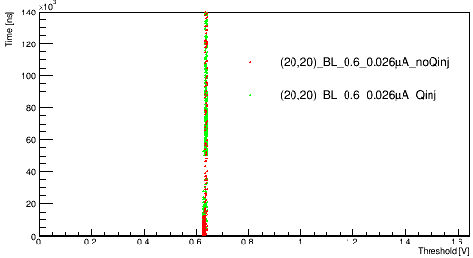
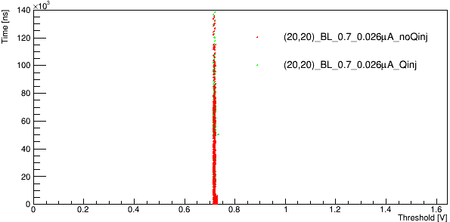
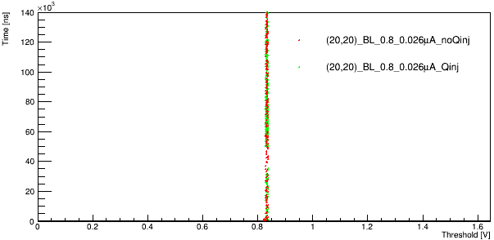
Results of different Vnsf
Pixel (20,20)
Carrier Board 192.168.3.28
Daughter board: 19(high resistivity)
Matrix0
Default configuration
Vnsf=0.0262μA
BL=0.6V
Vnsf= 0.0262μA
0.0909μA
0.311μA
2.99μA
0.327μA
0.18μA
->0.0262μA may be too small.
The signal turned to be very narrow.
Still have good linearity.
BL=0.7V
BL=0.8V

Slide 12
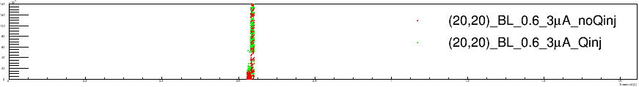
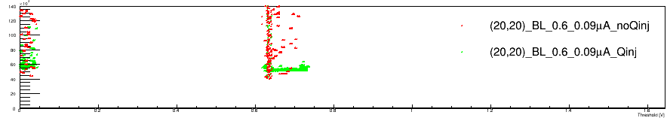
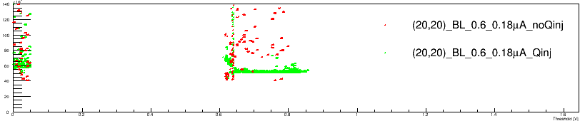
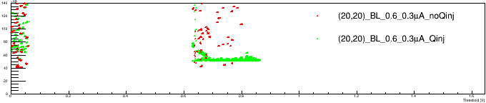
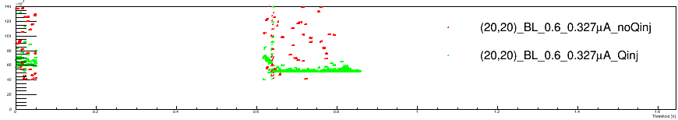
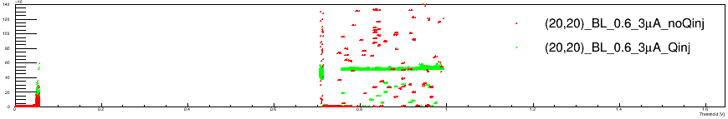
Results of different Vnsf
Pixel (20,20)
Carrier Board 192.168.3.28
Daughter board: 19(high resistivity)
Matrix0
BL=0.6
Vnsf=0.026μA
Results of different Vnsf.
Still see two band merging into one.
The amplitude of the signal changed.
Tuning the signal.
Vnsf=0.09μA
Vnsf=0.18μA
Vnsf=0.311μA
Vnsf=0.327μA
Vnsf=3μA

Slide 13
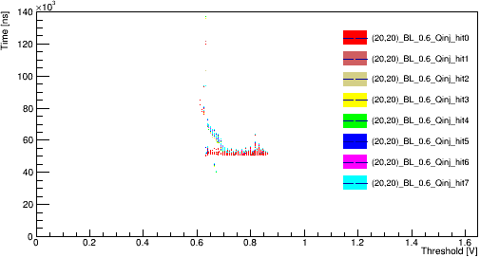
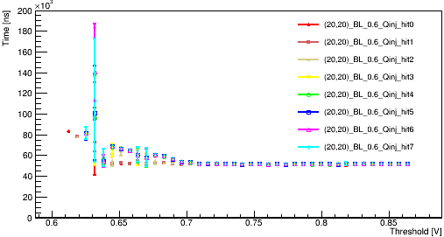
Results of reading 8 hits
Pixel (20,20)
Carrier Board 192.168.3.28
Daughter board: 19(high resistivity)
Matrix1
Default configuration
BL=0.6
Reading 8 hits enable us to see hits after the 1st one.(but should only have one hit for each event)
Plot the 8 hits in different color.
Most of the hits of the second band are not from the 1st hit.

Slide 14
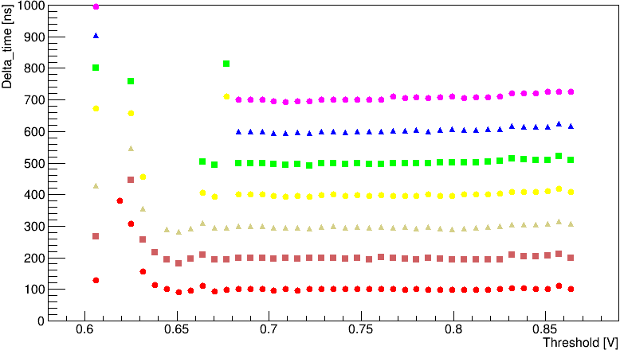
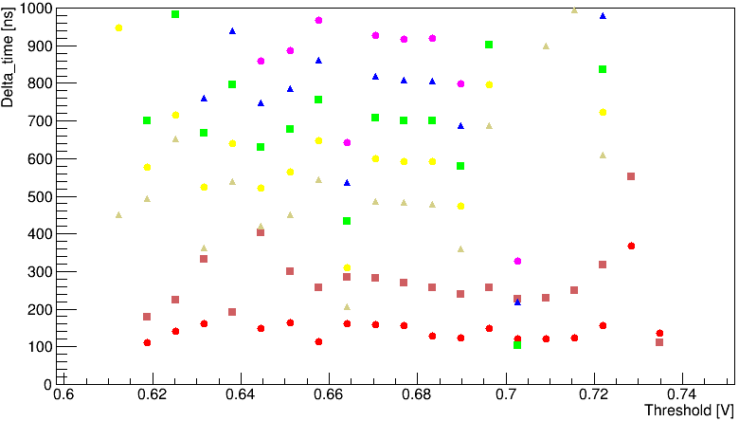
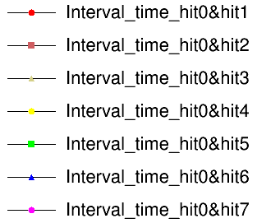
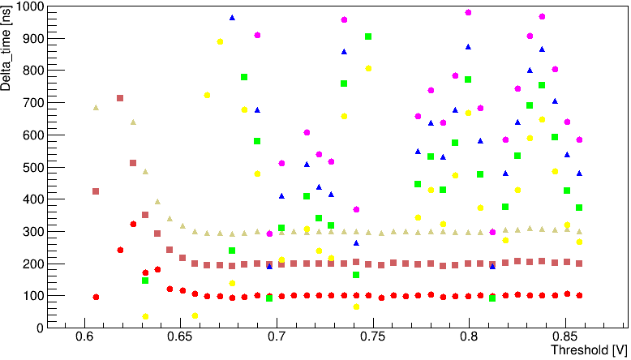
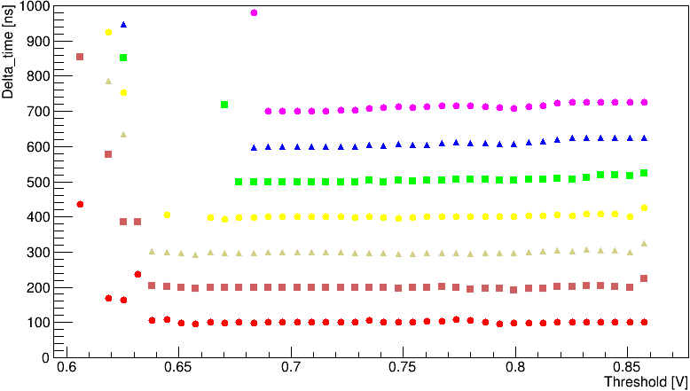
Pixel (20,20)
Carrier Board 192.168.3.28
Daughter board: 19(high resistivity)
Matrix2
BL=0.6
Matrix 2 Vnsf=0.311μA
Matrix 2 Vnsf=0.0909μA
Time difference with the 1st hit.
Constant reset time?
Matrix 2 Vnsf=0.327μA
Matrix 2 Vnsf=0.18μA

Slide 15
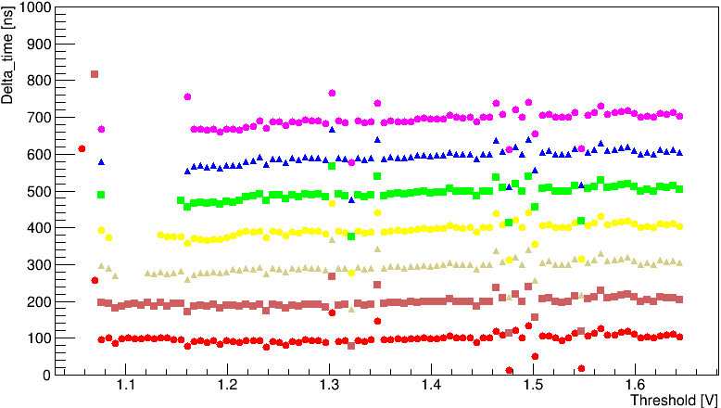
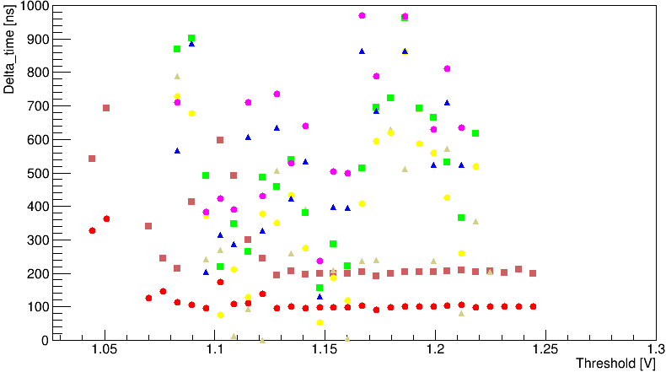
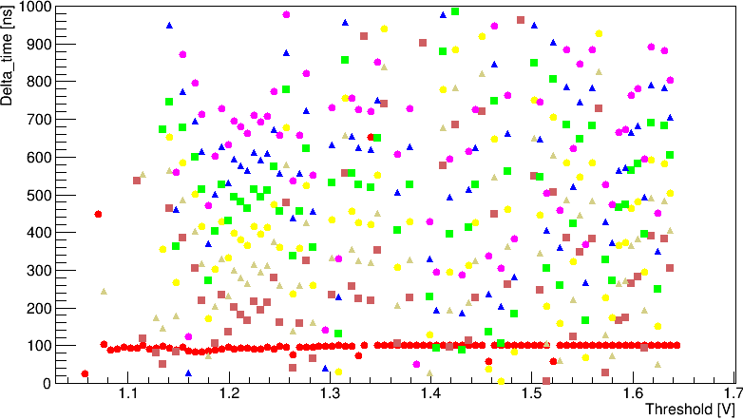
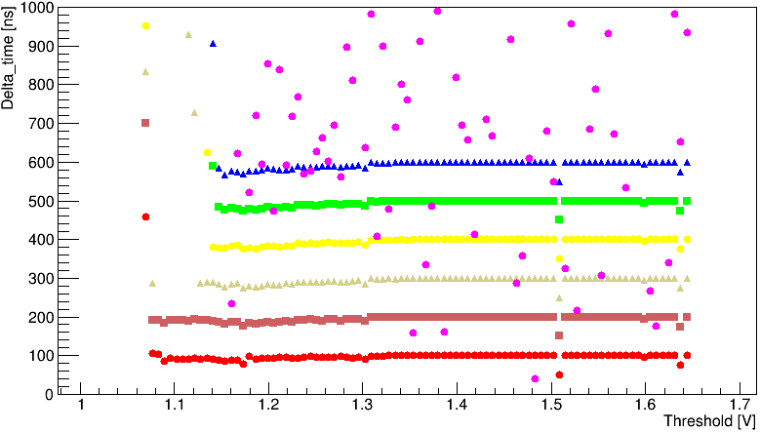
Pixel (20,20)
Carrier Board 192.168.3.28
Daughter board: 19(high resistivity)
Matrix0
BL=1.03V
Matrix 2 Vnsf=0.311μA
Matrix 2 Vnsf=0.0909μA
Matrix 2 Vnsf=0.327μA
Matrix 2 Vnsf=0.18μA

Slide 16
Summary
less noise and consistent results with lower and stable operating temperature.
BL around 0.6-0.9V has good linearity.
Signal at –ve Qinj edge (50μs) is more prominent than +ve edge(35μs).
A peak at threshold(=BL+0.22V) appeared. ->signal slope getting shallower?
Different results with varies Vnsf -> Evidence of tuning the signal.
Next:
Integrate an external pulser into the carrier board.
Test another daughter board (standard resistivity, recently wire bonded by UCSC)

