Slide 1
Efficient Dipoles with HELAC-PHEGAS
Michael Czakon
RWTH Aachen
Wuppertal, June 3rd 2009

Slide 2
Two Goals
Implementation of the dipole subtraction formalism within
HELAC-PHEGAS A. Kanaki, C.G. Papadopoulos ‘00
C.G. Papadopoulos ‘00
A. Cafarella, C.G. Papadopoulos, M. Worek ‘07
Speedup by techniques used in LO generators in particular
randomization of polarization summation
Solution:
MC, C.G. Papadopoulos, M. Worek, arXiv:0905.0883 [hep-ph]

Slide 3
Reminder on Dipoles
Master formula for NLO calculations
Pointwise cancellation of divergences
Smooth interpolation between the soft and collinear limits
Catani-Seymour Dipoles derived from the singular behavior
of the amplitude

Slide 4
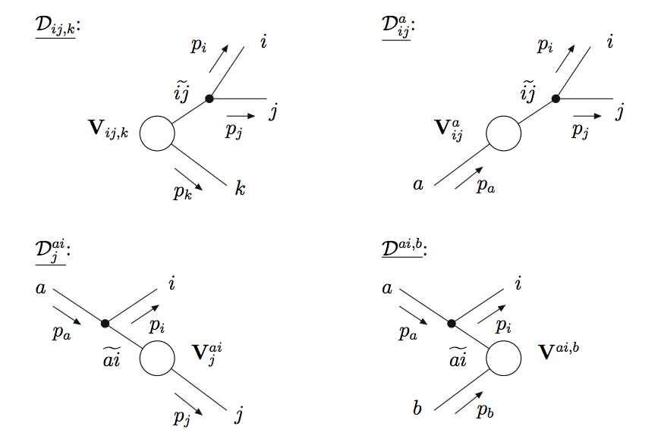
Reminder on Dipoles
Example:

Slide 5
Polarization
Full summation either slow or needs special implementation
HELAC does only trivial helicity summation
In practice summation is replaced by integration over a phase
Even though large differences between helicity configurations,
distribution in the phase rather flat
Usually needs less than twice more points for the same error
and variance
P. Draggiotis, R. Kleiss, C.G. Papadopoulos ‘98

Slide 6
Why We Sometimes Like Helicity…
In the soft limit with unpolarized gluons
Introducing polarization needs only this change
For helicity eigenstates
The soft limit is independent of helicity !!!

Slide 7
The Strategy
In the dipole formulae the general soft limit is implied by the
soft limit of the collinear splitting
Since the soft limit does not depend on helicity, it’s enough to
include polarization in the collinear splitting
Summation over helicities can be replaced by optimized sampling
This works well if not too many configurations
In NLO calculations really large multiplicity due to decays,
therefore use random polarizations for non-partons
This setup works very well for “wishlist-like” processes

Slide 8
Three Phases
Phase space optimization – use flat distribution in helicity
configuration space
Initial helicity distribution optimization – compute all
configurations (equivalent to summation) and optimize
a la Kleiss-Pittau
Main integration with helicity sampling – self-updating of the
distribution for best results
Phase space integration done with PHEGAS !!!
multichannel Monte Carlo with channels derived from real radiation

Slide 9
Behavior in the Collinear Limit
Let’s start from a splitting in two momenta
The limit is defined by uniform rescaling
The matrix element behaves as

Slide 10
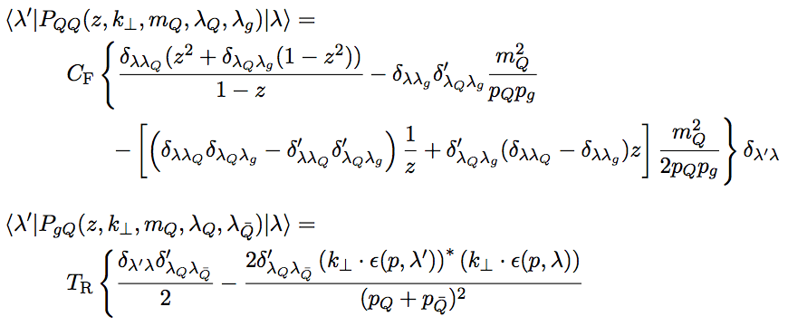
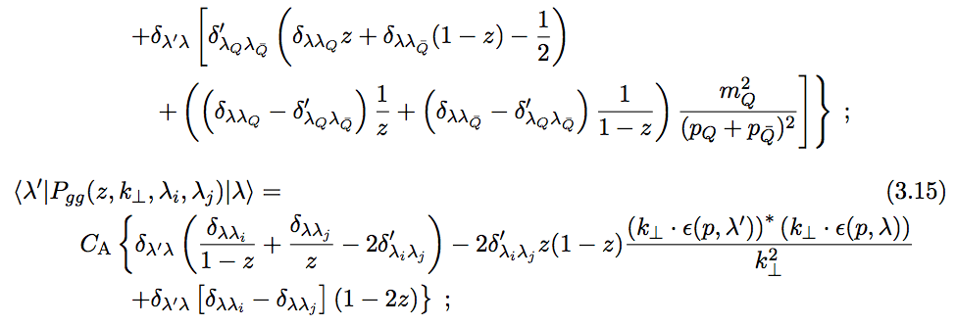
Behavior in the Collinear Limit

Slide 11
Example Formulae
Final-final dipole contribution with full polarization information
gluon-gluon splitting
Simple modification of the original formulae by
Catani, Dittmaier, Seymour & Trocsanyi !!!

Slide 12
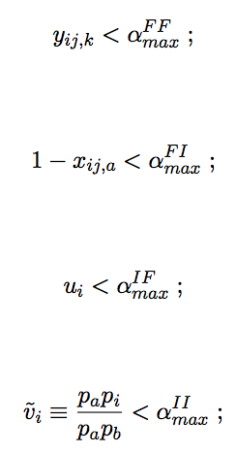
Features of the Implementation
Arbitrary processes
Massive and massless external states
Helicity sampling for partons
Random polarizations for non-partons
Restrictions on the subtraction phase space
Phase space integration
for now, multichanneling based on channels from
real radiation
in the future channels needed for dipoles

Slide 13
Crazy Configuration
hi_file err_file
2 1
7
35 35 11 -11 12 -12 35
0 1 0 0
T F 1
F 1000 50000
0
10000000
25000 25000 1.2 4 1000000 1
14000
1
0 0
2212 2212 7000.0000 7000.0000 3 1
dipoles.input
HELAC-PHEGAS documentation
+ README of the dipoles software
F F T T ! onlyreal, onlylast, onlydiv, hybrid
0 ! signmode
2 ! sumtype
30000 1000 10000 ! nsumpol, noptpol, nuptpol
1d-5 ! alphaMinCut
1d-2 1d-2 1d-2 1d-2 ! alphaMaxII,…
0d0 ! kappa
dipoles.conf

Slide 14
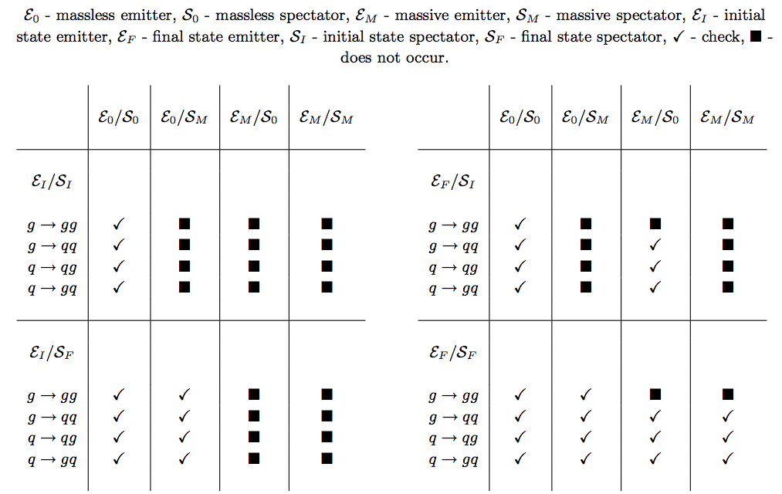
Checks
Pointwise and helicity-wise cancellation in the soft, collinear,
and quasi-collinear limits
Helicity-summed dipoles checked against MadDipole
Relies on the correctness of HELAC (heavily-tested)

Slide 15
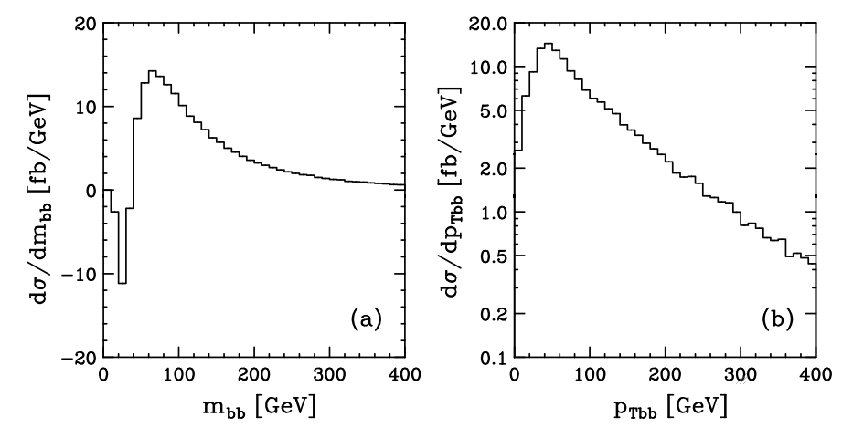
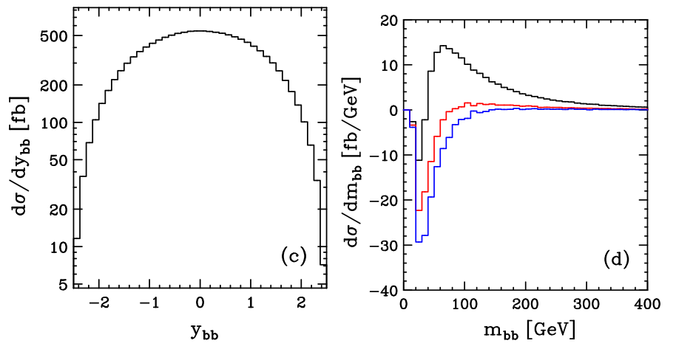
Some Distributions

Slide 16
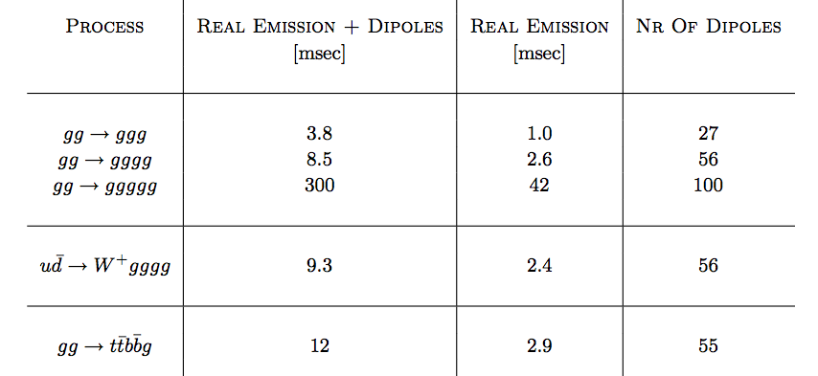
Timings
Timings obtained on a Core 2 Duo 2.53 GHz machine
with Intel Fortran, compilation with –fast
All dipoles included !!!

Slide 17
Conclusions
Complete system for real radiation at NLO with HELAC-PHEGAS
Massless and massive cases implemented
Speedup thanks to helicity configuration sampling
Integrated dipoles to be made available soon
Future improvements to be made to phase space generation
If needed, color sampling easy to include
Code public, we provide user support !!!

