Slide 1
Tests on Chess 2 ASIC
Dionisio Doering, Yubo Han_{IHEP} , Pietro Caragiulo, Larry Ruckman, Camillo Tamma, Mazin Khader_{UIUC}, Murtaza Safdari, Su Dong

Slide 2
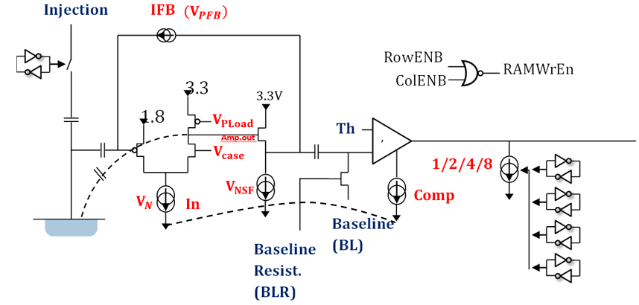
Pixel description

Slide 3
Outline
Review:
stable results with cooling modules on
good linearity ( BL:0.6V-0.9V)
more hits at falling edge
evidence of tuning the band with time information about 50μs
Tests on new board
->hitmap of the new std resistivity board
->check the voltage on the daughter board
->regular threshold sweeping tests.
Integrate a external pulser to the system
->preliminary results.

Slide 4
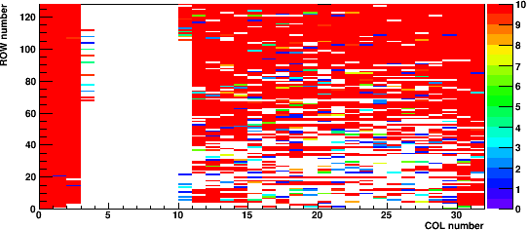
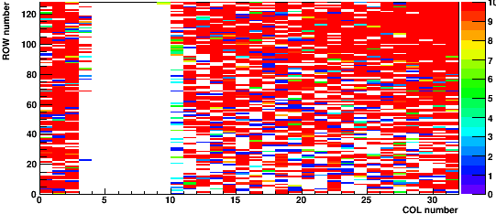
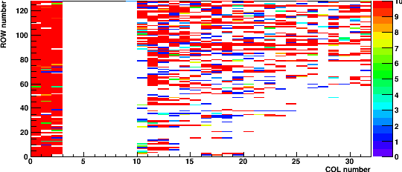
Tests on the new board
Carrier Board 192.168.3.28
Daughter board: 02(std resistivity)
Default configuration
Qinj on
Matrix0
‘Hitmap’ of the std resistivity board.
The number of hits each pixel has when BL=0.7, Threshold=0.71V.
Dead band: col 3-10.
Dead band: Different column number with the other two board but still exits.
Matrix1
Matrix2

Slide 5
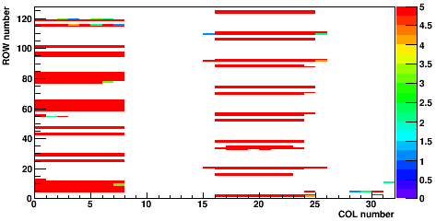
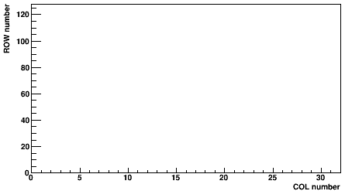
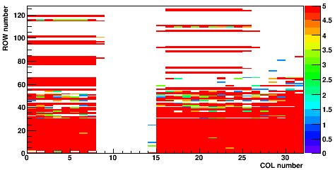
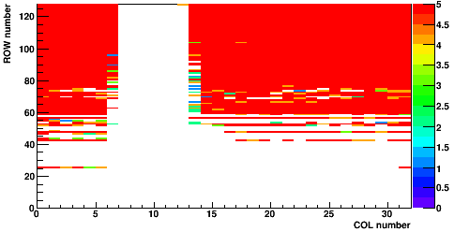
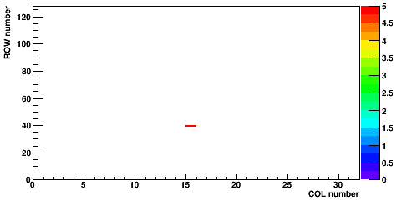
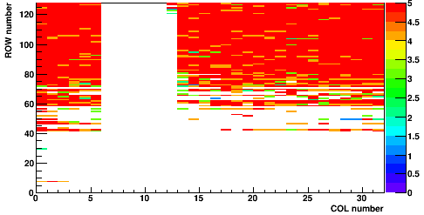
Hitmap on other two board
Daughter board: 01(std resistivity)
Default configuration
No Qinj
Daughter board: 19(high resistivity)
Default configuration
No Qinj
Matrix0
Matrix0
Different column range.
Matrix1
Matrix1
Matrix2
Matrix2

Slide 6
Pixel (20,20)
Carrier Board 192.168.3.28
Daughter board: 02(std resistivity)
Matrix2
Default configuration
Inversed Qinj
BL=0.25V
BL=0.46V
BL=0.6V
Time vs Threshold.
First results from the #02 board.
More noise hits than the high resistivity one.
Still have good linearity with BL within (0.6-0.9V)
BL=0.7V
BL=0.75V
BL=0.8V
BL=0.9V
BL=1.03V
BL=1.1V
BL=1.2V

Slide 7
Pixel (20,20)
Carrier Board 192.168.3.28
Daughter board: 02(std resistivity)
Matrix2
Default configuration
Inversed Qinj
BL=0.25V
BL=0.46V
BL=0.6V
Hit counts vs time.(t=50μs is Qinj falling edge)
Distribution similar to the other board.
More noise hits at early time (red region at left part of each plot).
BL=0.7V
BL=0.75V
BL=0.8V
BL=0.9V
BL=1.03V
BL=1.1V
BL=1.2V

Slide 8
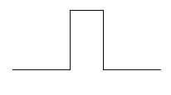
Pixel (20,20)
Carrier Board 192.168.3.28
Daughter board: 02(std resistivity)
Matrix1
Default configuration
Qinj vs Inversed Qinj
BL=0.25V
BL=0.46V
Time vs Threshold.
Red dot: invQinj
Green dot: Qinj
BL=0.6V
BL=0.7V
BL=0.75V
3.2V
invQinj:
BL=0.8V
0V
BL=0.9V
3.2V
Qinj:
0V
BL=1.03V
15μs
BL=1.1V
BL=1.2V

Slide 9
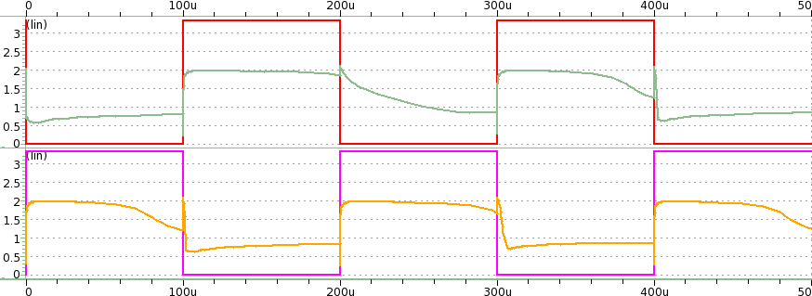
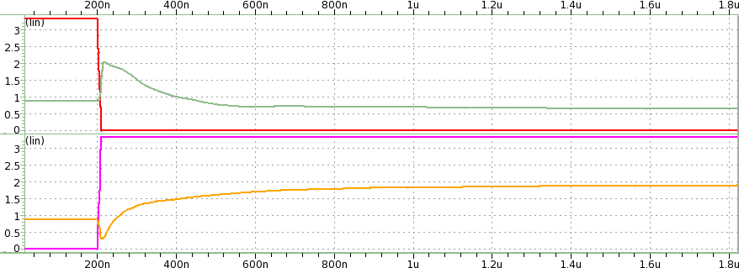
Simulation
Simulation results of inversed Qinj vs Qinj
falling edge has higher signal.
Consistent with the test results.

Slide 10
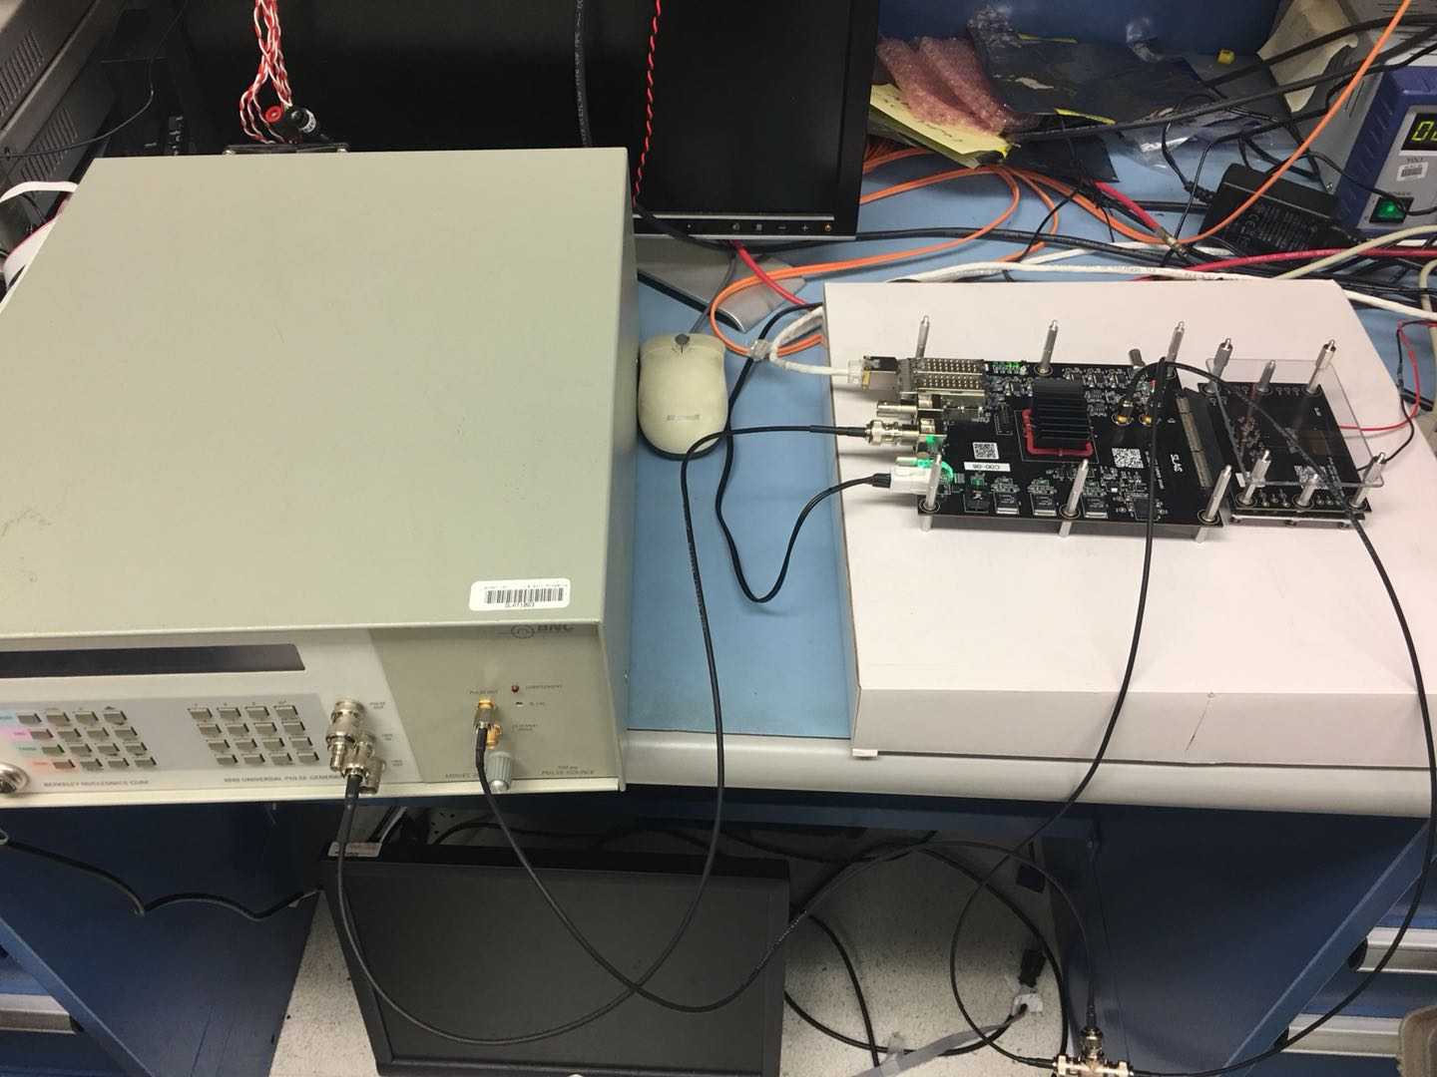
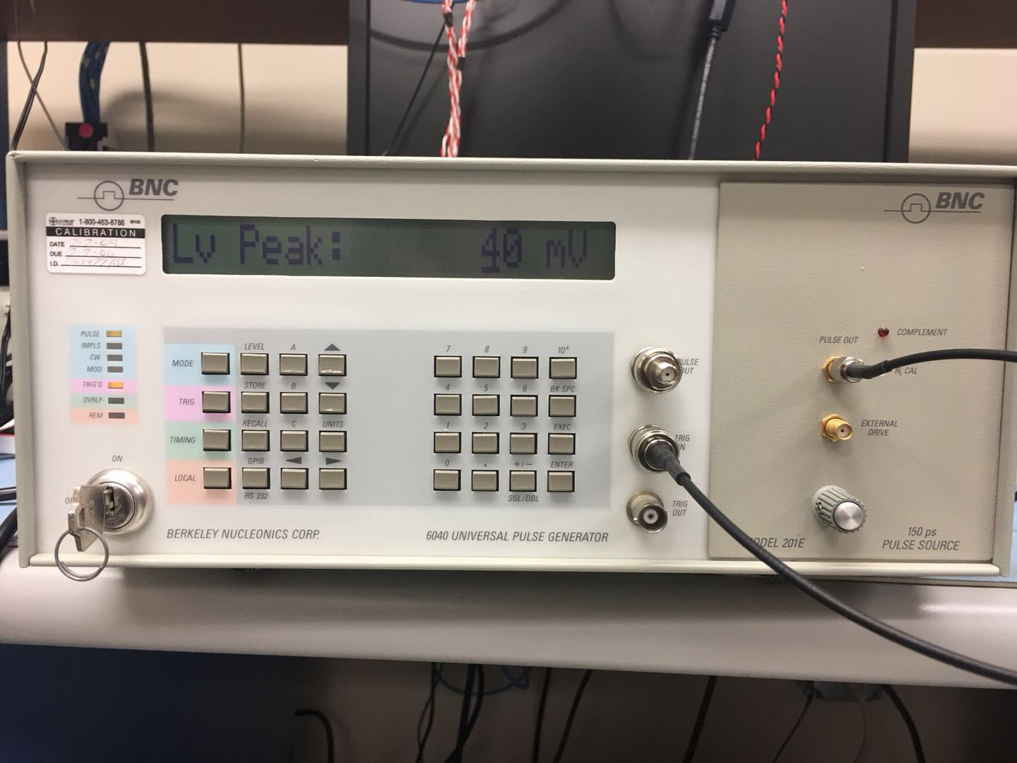
External pulser
Using the pulse from an external pulser as the Qinj pulse.
Settings of the pulser: Mode: PULSE; Trig: ex Trig; Timming: pulse width:15μs, level: lv BL=0mV.
Std resistivity board #02: ~2.5V
High resistivity board #19 : ~1V
Pulse out
Pulser
Qinj (x2)
Trig in

Slide 11
Pixel (1,0)
Carrier Board 192.168.3.28
Daughter board: 2(std resistivity)
Default configuration
Pulse amplitude:1V
BL=0.25V
BL=0.46V
Time vs threshold
No big difference with Qinj disabled.
1V is too low this time.
More noise than high resistivity board.
Result changes with different pulse amplitude.
Still running the test with other pulse size.
BL=0.6V
BL=0.7V
BL=0.75V
BL=0.8V
BL=0.9V
BL=1.03V
BL=1.1V
BL=1.2V

Slide 12
Summary
Several tests on the new std resistivity board has been done.
->Also has a dead band, but different columns.
->still see Qinj signal and good BL/threshold linearity.
->Qinj signal is affected by reduced Qinj voltage swing (but more quantitative tests needed)
Problem:
the bit order maybe different with what we thought.
Next:
->try to bias the std resitivity board
->verify the bit order by testing with different configuration (to ensure we are correctly setting the configuration parameters)
->tests with different pulse size and simulation

Slide 13
Pixel (20,20)
Carrier Board 192.168.3.28
Daughter board: 19(high resistivity)
Matrix0
Default configuration
Inversed Qinj
BL=0.25V
BL=0.46V
BL=0.6V
Time vs Threshold.
Linearity between BL=0.6-0.9V.
Stopped at BL=0.46V
Long signal tail with higher BL.
Less noise hit.
BL=0.7V
BL=0.75V
BL=0.8V
BL=0.9V
Backup
BL=1.03V
BL=1.1V
BL=1.2V

Slide 14
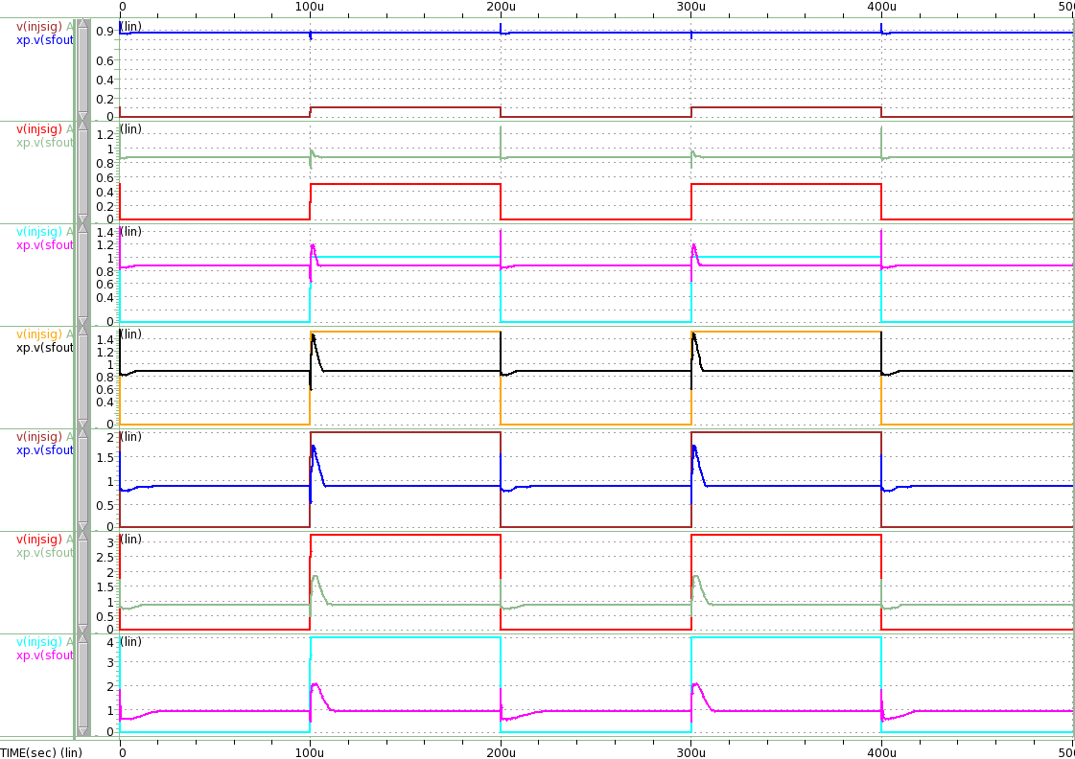
Updated configuration
Change the pulse amplitude to 0.1,0.5,1,1.5,2,3.2V,4V

Slide 15
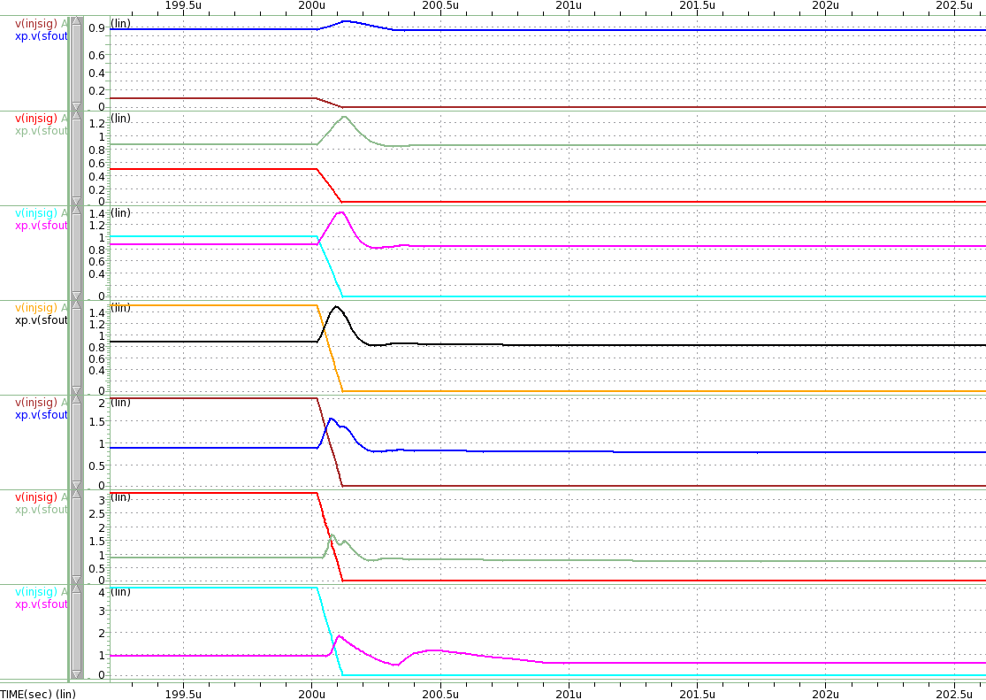
Updated configuration
Change the pulse amplitude to 0.1,0.5,1,1.5,2,3.2V,4V

