Slide 1

Proton irradiated passive test strucutres on CHESS 2
Strip CMOS regular meeting, 09.11.2017
Bojan Hiti, Igor Mandić et al.
Jožef Stefan Institute, Experimental Particle Physics Department (F9)
Ljubljana, Slovenia

Slide 2
Samples
Irradiation hardness studies with CHESS2 carried out in Ljubljana:
  reactor neutrons (Ljubljana) – 4 resistivities, 5 fluences (1e14 – 2e15 neq/cm2)
  24 GeV protons (CERN PS) – 3 resistivities, 2 fluences
  800 MeV protons (Los Alamos) – 4 resistivities NEW
Characterization of passive structures using Edge-TCT and Sr90
Measurements before and after annealing
Table of proton irradiated samples/fluences
φ (10¹⁴ n_{eq} cm⁻²) | 20 Ω·cm (W1) | 50 Ω·cm (W7) | 200 Ω·cm (W13) | 1000 Ω·cm (W19)
4.2 | CERN PS | n.a. | CERN PS | CERN PS
7.7 | Los Alamos | Los Alamos | Los Alamos | Los Alamos
8.7 | CERN PS | n.a. | CERN PS | CERN PS
14 | n.a. | Los Alamos | Los Alamos | n.a.
36 | n.a. | Los Alamos | Los Alamos | n.a.

Slide 3
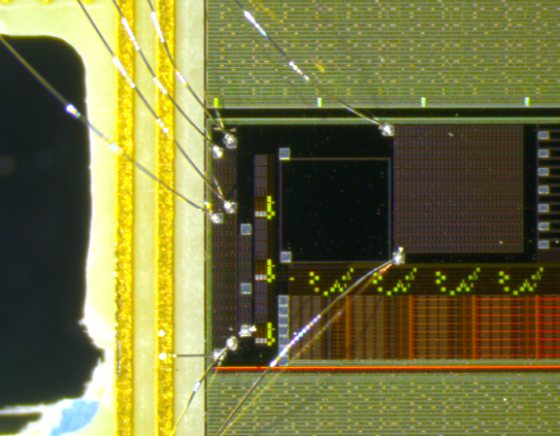
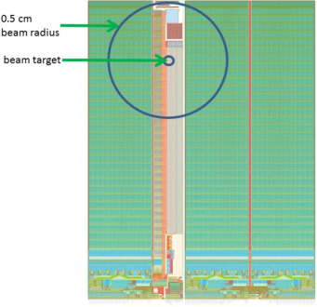
Test structures
to external amplifiers
Sr90 pad
What fluence did the Edge-TCT structure receive?
proton beam radius at Los Alamos
Edge-TCT
array
Test structures:
3 x 3 pixel array for Edge-TCT (pixel size 630 x 40 μm²)
Large pad for Sr90 measurements (1.2 x 1.2 mm²)

Slide 4
Edge-TCT: quick reminder
Generate charge carriers at a fixed depth in the sample using narrowly focused (10 μm) infrared laser
Measure collected charge at a given depth (pulse integration time 5 ns)
Run a scan along sample depth to determine depleted depth (y-direction)
Only signal from the central pixel is amplified
Peripheral pixels are biased, but not read out
IR laser beam incidence
HV
scope
x
GND
y
Beam direction
Substrate (p-type)
Pixels (n-well)

Slide 5
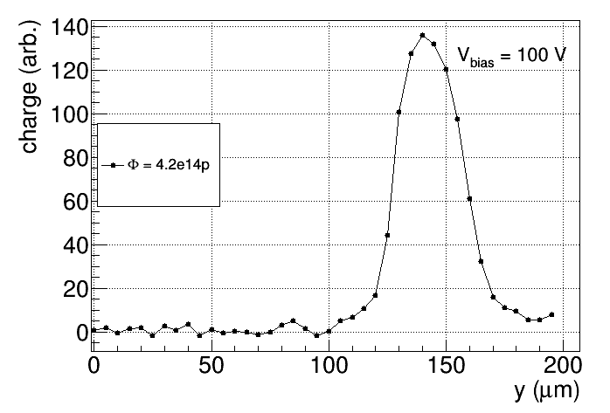
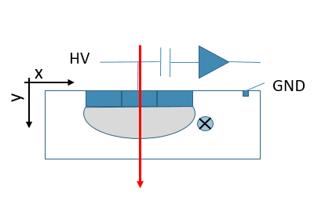
Edge-TCT charge collection profile
surface
scan direction
depth
end of depletion zone
surface
Depleted depth is evaluated as FWHM of the charge collection profile

Slide 6
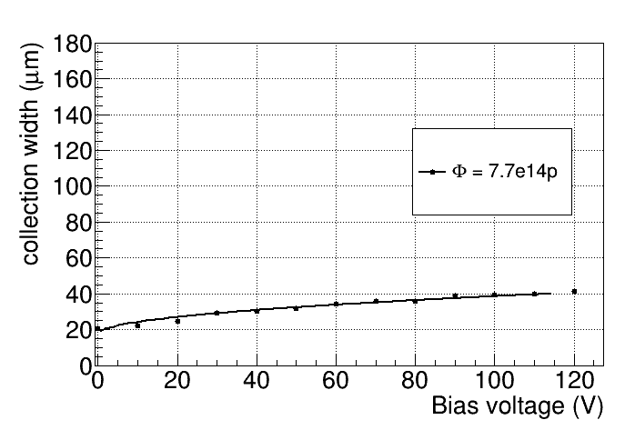
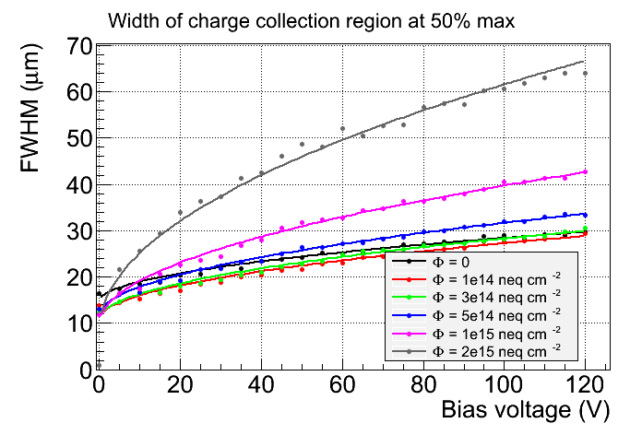
Edge-TCT Results W1 (20 Ohm-cm)
depth
neutrons
surface

Slide 7
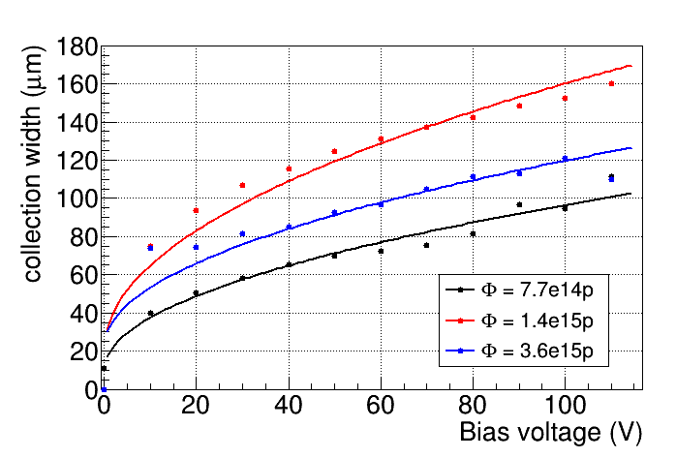
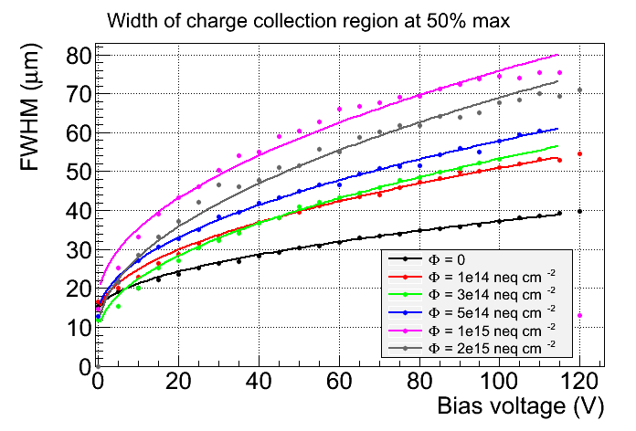
Edge-TCT Results W7 (50 Ohm-cm)
depth
neutrons
surface

Slide 8
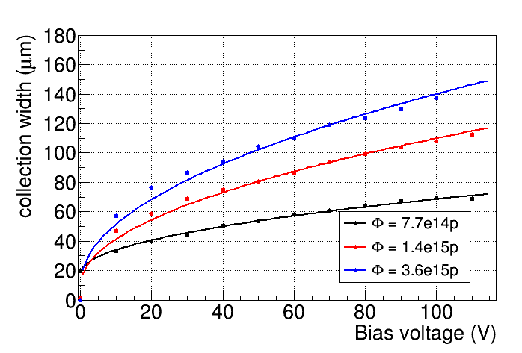
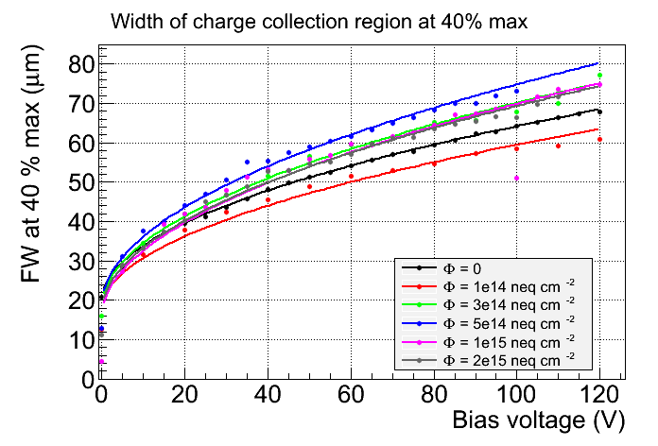
Edge-TCT Results W13 (200 Ohm-cm)
depth
neutrons
surface

Slide 9
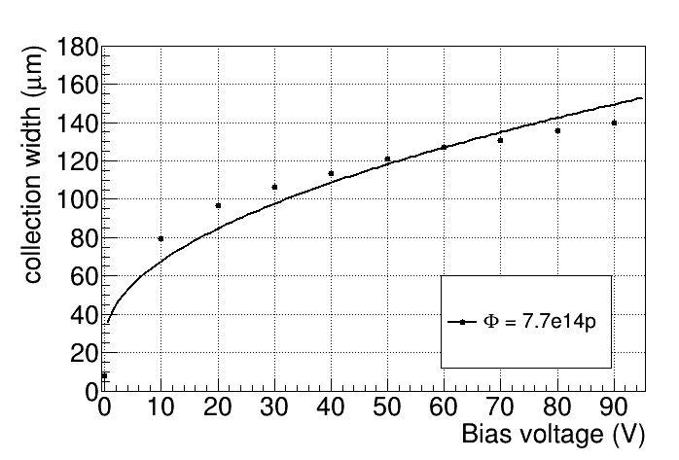
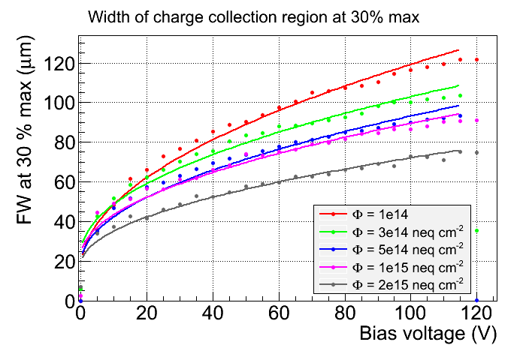
Edge-TCT Results W19 (1000 Ohm-cm)
depth
neutrons
surface

Slide 10
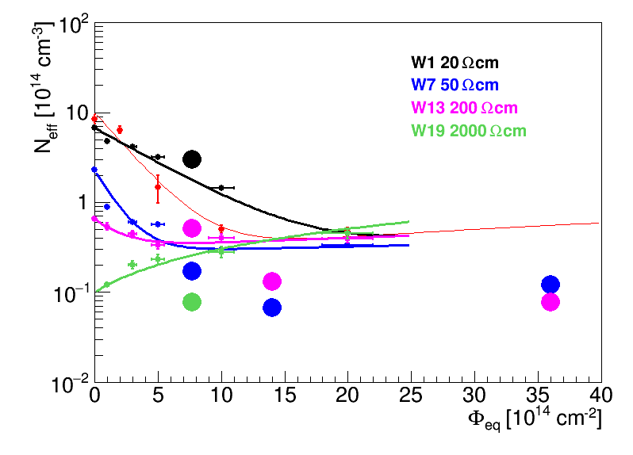
Neff vs. fluence
proton Los Alamos
Acceptor introduction rate is lower with protons than with neutrons
Common in oxygenated material

Slide 11
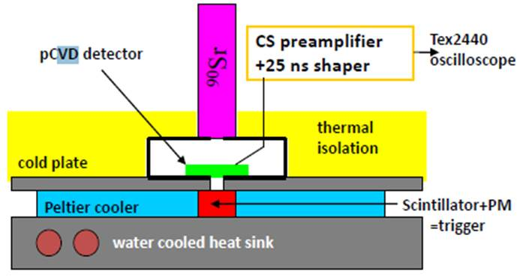
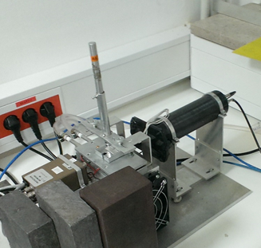
⁹⁰Sr setup
ORTEC 142 charge sensitive amplifier + custom made shaper (25 ns)
+ digital oscilloscope
detector
⁹⁰Sr
PMT
ampl.
cooling jig
DUT
HV-CMOS: small signals, large noise → S/N very low
  clean sample of events needed (no hits missing DUT)
  require a large detector (trigger rate), good collimation, small scintillator
Measurement:
  1) Record N ( = 2500) waveforms
  2) Average over all waveforms and determine time of the signal peak
  3) Sample waveforms at the peak and fill the spectrum
  4) Fit the spectrum with a convoluted landau+gauss function

Slide 12
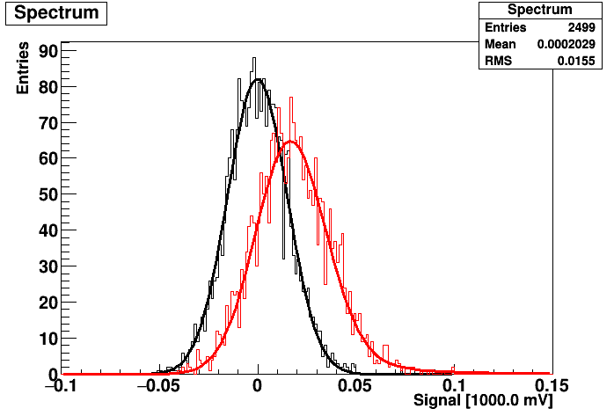
Typical Sr90 spectrum
noise peak
signal peak
deposited charge = shift between noise and signal

Slide 13
Sr90 measurements
Collected charge vs. bias voltage for different resistivities / proton fluences

Slide 14
Sr90 measurements
Very high amount of charge in the wafer of the highest initial resistivity

Slide 15
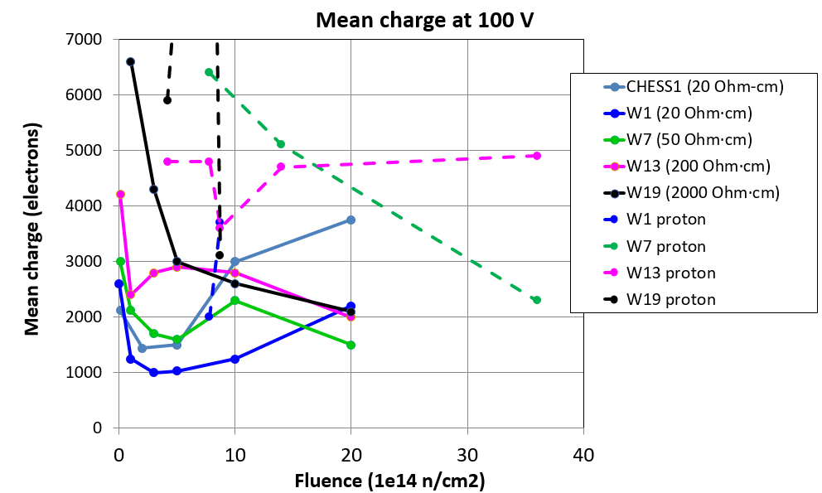
Sr90 Comparison for different substrates
dashed lines:
proton irr.
full lines:
neutron irr.
Preliminary!
With Sr90 the charge in proton irradiated samples is much higher than in neutron irr.

Slide 16
Possible explanation for missing charge
Discrepancy between expected charge (Edge-TCT – depleted depth) and measured charge (Sr90): 50 % less charge collected than expected
The reason is due to top biasing
  Drift of both types of charge carriers ends on the chip surface
  Holes have to drift through a low E region, where trapping is high
  Trapped charge carriers only pass a part of the weighting field (Shockley Ramo theorem)
  The effect is strongly mitigated by a processed and metalized back plane
  Observed in LFoundry CMOS chips with and without processed back plane
n-well (+HV)
p-ring (gnd)
electrons
holes
low electric field

Slide 17
Summary
Collected charge is roughly proportional to the depleted depth
Proton irradiation induces less effective space charge than neutrons
  Increased depletion zone at same fluences
  More charge
The absolute amount of collected charge is smaller due to trapping related with top bias

