Slide 1
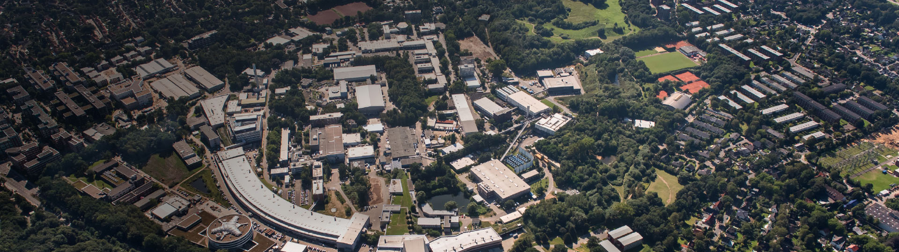
Research Unit:
Theoretical Particle Physics
Subtitle of Presentation
Helmholtz Program: <program name> (<program short term>)
PoF III Topic: <topic> OR PoF III Research Theme: <research theme>
DESY Research Unit: <research unit>
Georg Weiglein
Centre Evaluation DESY, 5 – 9 February 2018

Slide 2
Overview
Theoretical Particle Physics at DESY
Strategy
Address origin of mass, structure of the vacuum, nature of dark matter and dark energy, asymmetry between matter and anti-matter in the Universe, ... making use of the synergies between the different research areas Develop new concepts and algorithms
Provide input (predictions, tools) and guidance for the experimental programme on- and off-site, in particular LHC physics, Belle, axion and neutrino physics, interpret the experimental results in terms of the underlying physics and assess the capabilities of possible future facilities
Foster links to other research areas: experimental particle physics, astroparticle physics, mathematics, condensed matter physics, accelerator physics, ...
Extend position as leading international centre for the theory of the fundamental interactions of nature, matter and space-time
Extend position as leading international centre for the theory of the fundamental interactions of nature, matter and space-time
Explore scientific opportunities in the Hamburg-Berlin metropolitan area
Theory building, importance of communication space

Slide 3

Theory groups: profile
Collider phenomenology Particle cosmology
e.w. symmetry breaking dark matter
BSM predictions and baryogenesis
model building phase transitions
precision calculations: hidden sectors
QCD and EW inflation
massive computating: gravitational waves
algebraic and numeric
String theory Lattice QCD
dualities QCD parameters
strings on curved spacetimes John von Neumann flavour physics
integrable systems Institute for computing hadron structure
conformal field theory DESY – Jülich - GSI algorithms

Slide 4
Theory group at DESY (Hamburg and Zeuthen) OLD SLIDE!
Staff: 17 permanent / tenure-track, increase in collider phenomenology by 3 (renewal of activities in this field was prime goal of PoF 2 period)
Fellows: 17 DESY-funded, 19 third-party-funded
PhD Students: 28 theses completed during PoF 2, currently 25 ongoing (15 DESY-funded, 10 third-party-funded)
Success in Helmholtz recruitment initiative: two ongoing appointment procedures
Fellowship programme: 479 applications in current round (HH), very high success rate in hiring first-choice candidates in world-wide competition

Slide 5
Structure of the group

Slide 6
Theory groups: structure and staff
Collider phenomenology Particle Cosmology
Hamburg:
M. Diehl, C. Grojean (joint with HU Berlin), T. Konstandin, A. Ringwald (also ALPS)
Z. Nagy, J. Reuter, K. Schmidt-Hoberg (hired as G. Servant (joint with Univ. Hamburg),
permanent staff) A. Westphal
F. Tackmann, G. Weiglein V. Domcke and F. Sala (5yr fellows)
Zeuthen:
J. Blümlein, P. Marquard
1 position vacant since Nov. 2016
Lattice QCD (NIC) String theory
K. Jansen, S. Schäfer, H. Simma, R. Sommer E. Pomoni (5yr fellow), V. Schomerus
J. Teschner (joint with Univ. Hamburg,
Joint W2 position at HU Berlin in progress Math. Dept.),
G. Papathanasiou (5yr fellow)

Slide 7
Base and third-party funding

Slide 8















Funding and Networking
Collider phenomenology Dresden – Berlin – Zeuthen
String Theory Particle Cosmology
Nordic network on dark matter

Slide 9
Funding and Networking
Collider phenomenology Dresden – Berlin – Zeuthen
String Theory Particle Cosmology
Nordic network on dark matter

Slide 10
Research topics and methods
Mission:
Identify fundamental particles
Discover fundamental laws of nature
Understand development of the Universe

Slide 11
Objectives and their achievement
Main scientific achievements in the context of the PoF III strategy
Broad spectrum of research topics and world-leading expertise
Synergies within the group
World-wide reputation

Slide 12
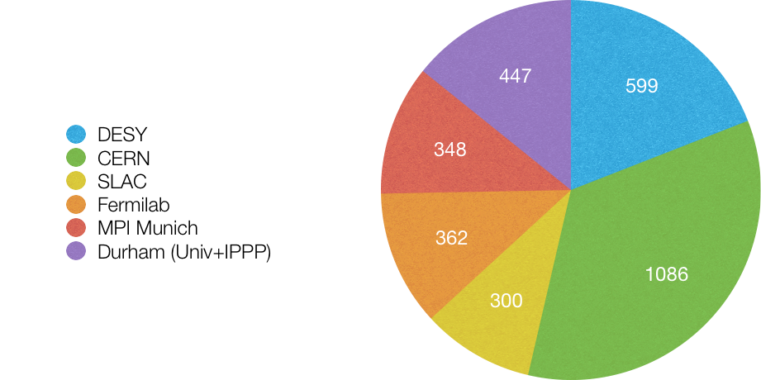
Scientific output: international comparison
Example: Papers 2010-2014 in hep-ph by affiliation (INSPIRE, Oct 28, 2014)
DESY: HH and Zeuthen

Slide 13
Theory activities: wider impact
Workshops, schools, coordinating tasks

Slide 14
Networking and cooperation, use of infrastructures, talent management
Networking and cooperation:
Research centre with international reputation, hub of scientific excellence
On-site expertise on wide range of topics, multi-disciplinary environment: full spectrum of topics in high-energy theory with close connections to experiments; interplay and mutual enrichment of theoretical physics, mathematics, computing
National laboratory, well-established cooperation with local universities and prominent role in education
Cooperation with the local experimental activities (LHC, Belle, ALPS, ILC), strong collaboration with experiments (globally)
Third-party funding and networking
Links to (inter)national partners: Very international field, many international cooperations already exist, e.g. CERN, Durham (UK), IPMU (Japan), MIT(USA), Nikhef (Netherlands), ...
High potential in all fields for leading and coordinating international collaborations
Use of excellent local infrastructure:
DESY computing centres, HPC, J von Neumann institute for computing: hub for lattice computing
Logistics and facilities to organise workshops, schools and scientific exchanges
Talent management:
Rich Fellowship, PhD programmes
Interaction with highly qualified students

Slide 15

Wider impact and networking
Wolfgang-Pauli-Centre:
LHC Physics Discussions:
Terascale alliance: Monte Carlo generators, pdfs, SUSY / BSM fit working group, ...
Many collaborations with institutes world-wide
Key contributions to working groups for LHC and e+e- physics, European Strategy update, ``Snowmass process’’, ...
+ ILC, Belle, ...
Theory forms link in communication across the experiments

Slide 16
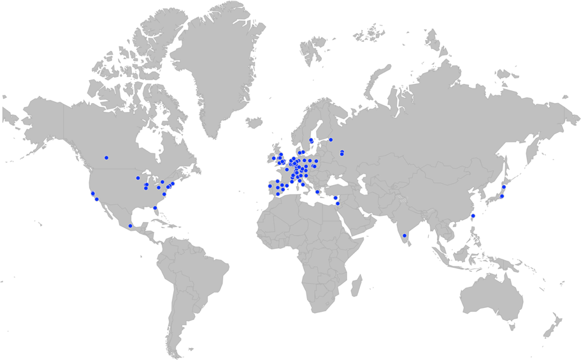
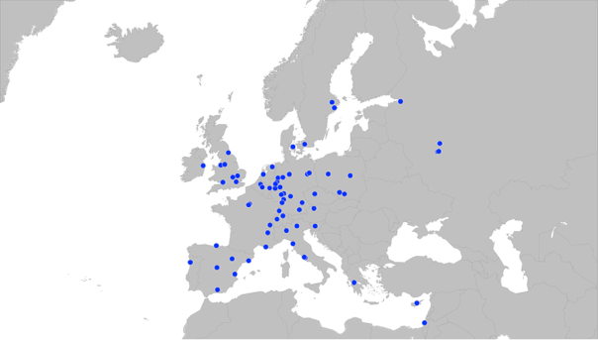
Networking: world-wide collaborations

Slide 17
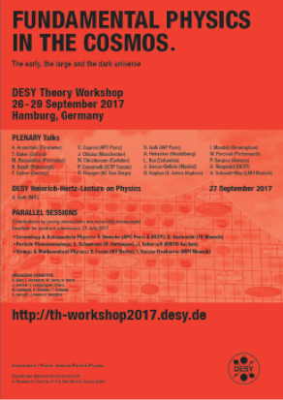
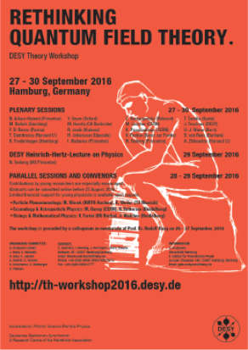
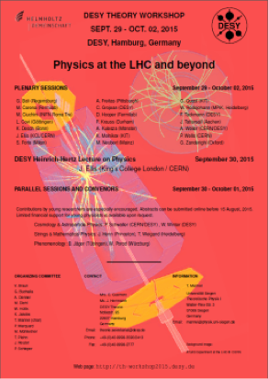
DESY Theory Workshop
Annual Meeting of the German Theory Community
Main topic rotates between the areas Cosmology & Astroparticle Physics / Strings & Mathematical Physics / Particle Phenomenology each year; parallel sessions cover all areas at each workshop; forum for young researchers from German particle physics institutions; > 200 participants each year
Chair 2018: M. Krämer (Aachen)

Slide 18






Outreach
Public lectures in bars Art meets Science, 13.10. – 9.11.2017
Last: April 2017 Vernissage with 300 participants, ~ 2/3
Theory group members of the guests on campus for the 1st time
in all 3 editions
Einstein exhibition in Hamburg (HAW) Night of Science / DESY Day, 4 Nov.
Public outreach theory talk with lectures from DESY theorists

Slide 19
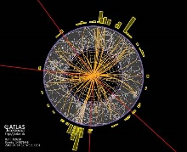
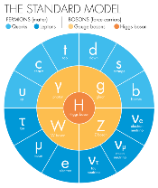


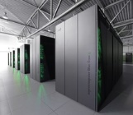
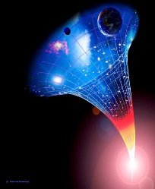

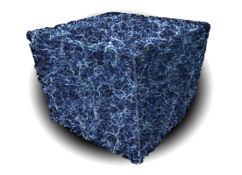
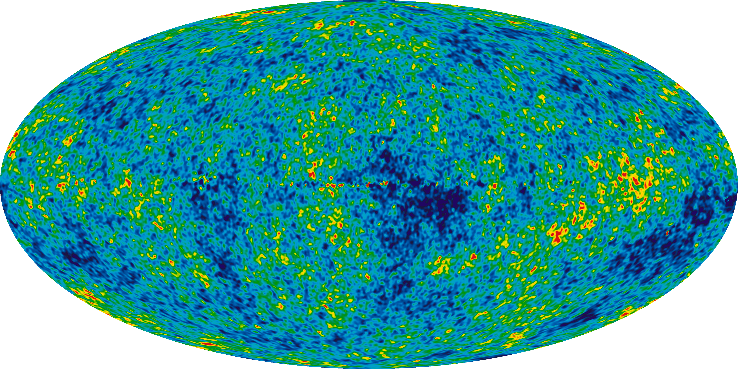
Outlook
Competence centre addressing all aspects in the theory of matter and gravity through research and training, from observation to mathematics.
offers unique cross-disciplinary training opportunities for young researchers
WPC will be the national laboratory for theoretical physics/sciences.
Hamburg-Berlin-Zeuthen: centre for science of matter and space-time, interaction between theory, computing and experimental activities in particle and astrophysics
Matter
Dark Sector
Cosmology
Observation Theoretical Mathematics
Physics
Presentation Title | Firstname Lastname | <program short term> | <research unit short term>
Notes:
Repeat what we need for this, put in Zeuthen more also as part on WPC ….

Slide 21
Heading
Subheading, optional
Guidelines for presentations’ format
Arial, not smaller than 16 pt (must be readable)
Do not overload slides
Other logos than Helmholtz or DESY not on title or conclusion slide and not as standard design element – only at selected places within the talk
Please adapt the footer to your presentation including title, your name, program short term (i.e. MLL) and research unit short term (Bio-Soft): Edit by "Insert > Header and Footer"

Slide 22
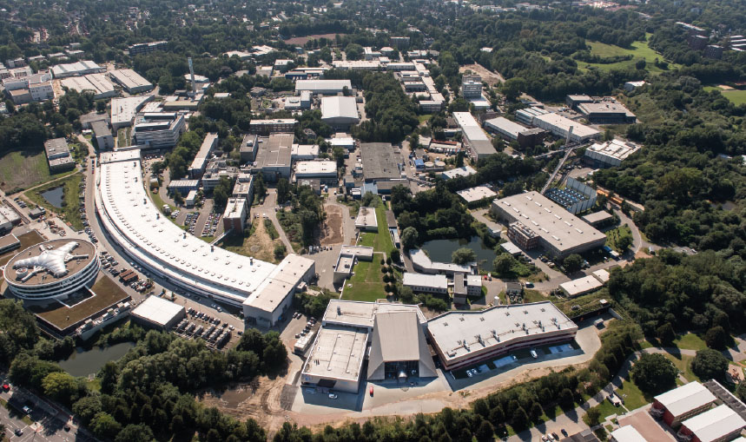
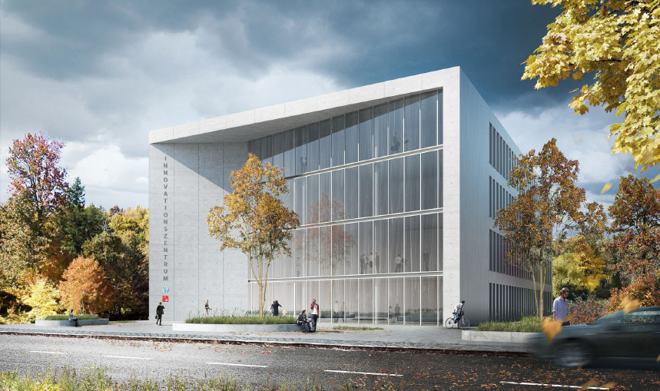
Heading
Subheading, optional
Heading Copy
Copy derferecus mint esequiam corepelenet aute dolesti aerorio minctotat.
Essunt qui aut ipsamusandae sunt am ut officiatus maxim quo molesti oriatii ssedit, untiunt odit volentotat. Xeris voloressi aut et molo es quae sed enihilit
as autestiatur.
Heading Copy
Copy derferecus mint esequiam corepelenet aute dolesti aerorio minctotat.
Essunt qui aut ipsamusandae sunt am ut officiatus maxim quo molesti oriatii ssedit, untiunt odit volentotat. Xeris voloressi aut et molo es quae sed enihilit
as autestiatur.

