Slide 1
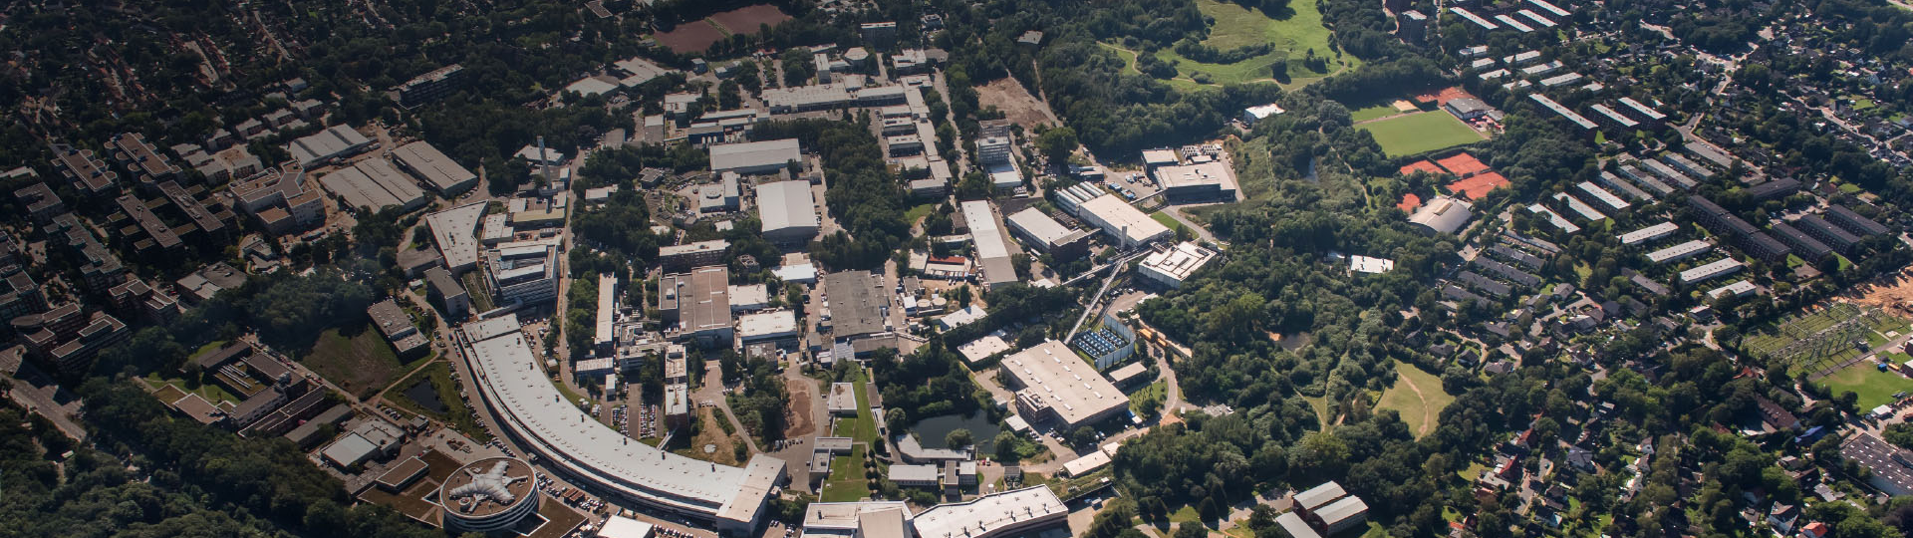
Particle Cosmology
This image is a place-holder for the respective program - image
Subtitle of Presentation
Helmholtz Program: <program name> (<program short term>)
PoF III Topic: <topic> OR PoF III Research Theme: <research theme>
DESY Research Unit: Theoretical Particle Physics
Géraldine Servant
Center Evaluation DESY, 5 – 9 February 2018

Slide 2
Staff members
Staff members
Domcke, Valerie
Konstandin, Thomas
Ringwald, Andreas
Sala, Filippo
Servant, Geraldine
Westphal, Alexander (ERC)

Slide 3
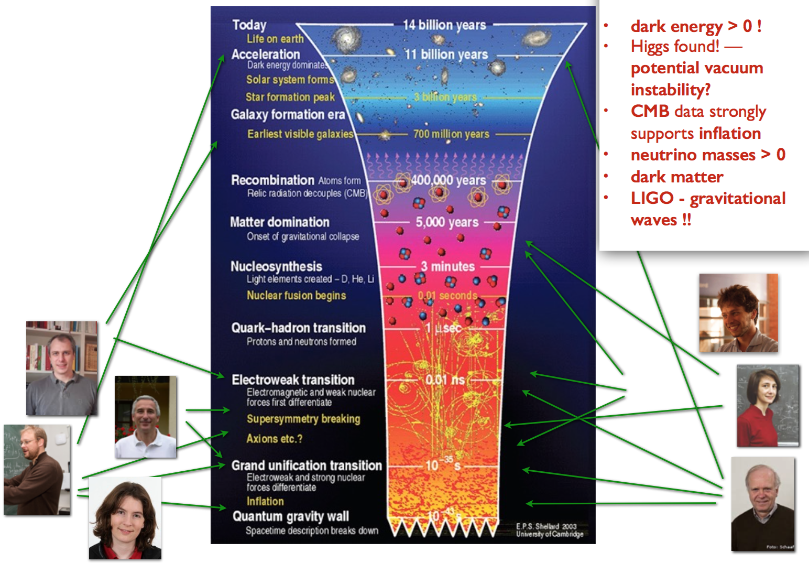

Slide 4
Networking
LISA Cosmology working group
Nordic network on DM
…

Slide 5
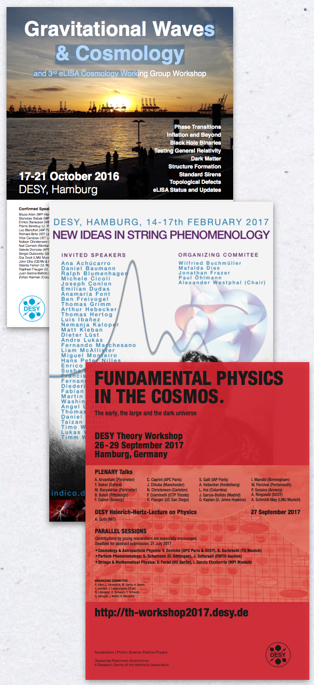
Organized Events

