Slide 1
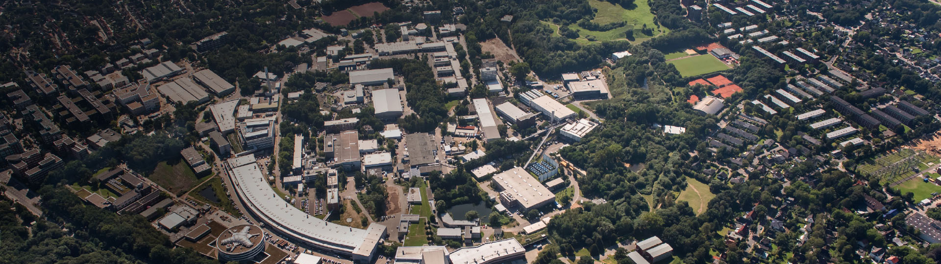
Lattice Field Theory
This image is a place-holder for the respective program - image
Research highlights of the NIC group
Helmholtz Program: Matter and the Universe (MU)
PoF III Research Theme: Lattice Field Theory
DESY Research Unit: Theoretical Particle Physics
Karl Jansen
Center Evaluation DESY, 5 – 9 February 2018

Slide 2
NIC: John von Neumann-Institute for computing
Research group “ Elementary Particle Physics”
Guidelines for presentations’ format
Cooperation between Hemholtz Centres Forschungszentrum Jülich, Deutsches Eletronensynchroton DESY and GSI Helmholtzzentrum für Schwerionenforschung
NIC maintains five research groups: Computational Biophysical Chemistry (JSC), Computational Structural Biology (JSC), Elementary Particle Physics (DESY), Lattice Quantum Chromodynamics (GSI), Nuclear Matter (GSI)
NIC provides supercomputer time at Jülich supercomputer centre through a peer review process
Gauss, Prace etc. ?
Mention management of configuration generation, collaborations guidance
Link to universities
European Joint Doctorates

Slide 3
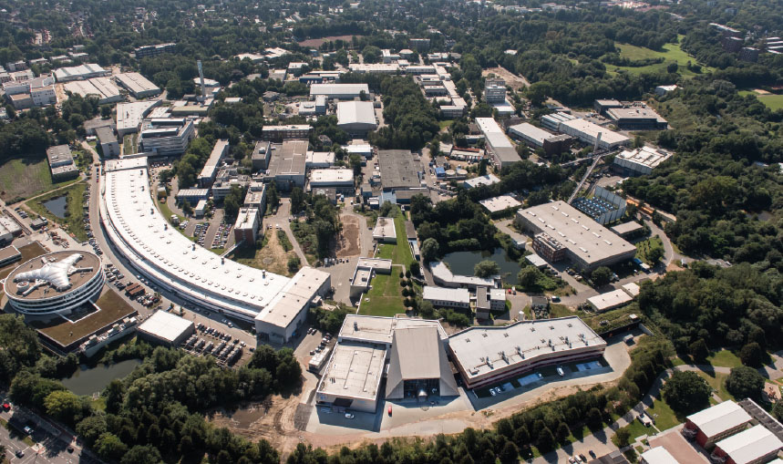
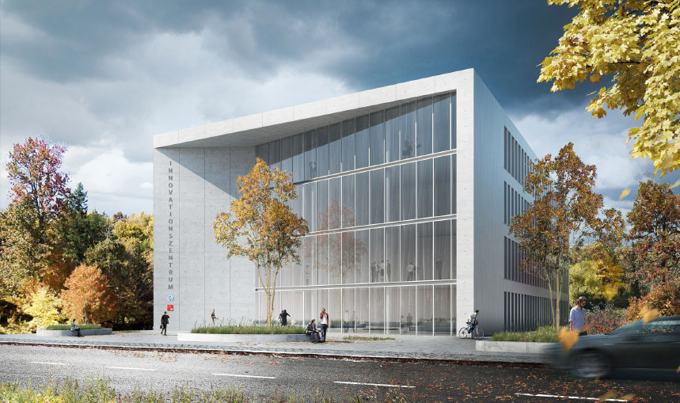
NIC Research highlight: computation of running strong coupling constant
Have one-two slides for running coupling, PRL
One graph, precise determination with controlled errors

Slide 4
Further achievements
Selected achievements (only mention, not discuss in detail)
NIC project excellence award muon anomalous magnetic moment
Development of multilevel algorithm, breakthrough
Spin and Momentum composition of nucleon, PRL
Development of NPHQET for B-decays (Belle II)
Scalar quark content of nucleon → coupling to WIMP, PRL
Tensor networks, PRL and PRX
Non-perturbative renormalization of lattice PDFs
?

Slide 5
Outlook
One slide outlook
Continuum limit for four active quarks in physical condition
Tensor networks in higher dimensions
Half the error of alpha_s
Investigate reliability of perturbation theory
Form factors for Belle II
Further development of speed up if simulations (e.g. domain decomposition)
Activities related to scientific computing/data (c.f. CDCS)
Be ready for the unkwown

