Slide 1
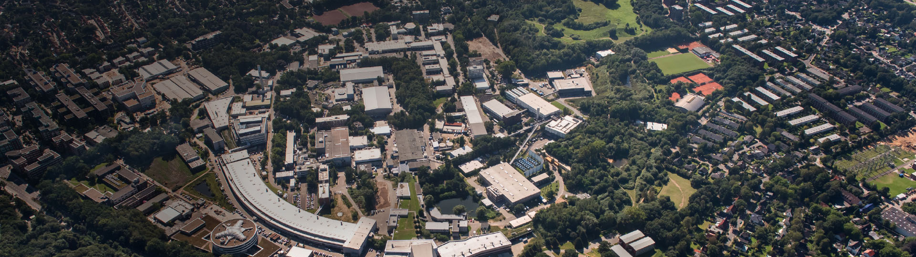
LHC physics
Here ATLAS/CMS images like Ingrid, or possibly possibly common FH?
Physics with ATLAS and CMS
Helmholtz Program: Matter and the Universe (MU)
PoF III Research Theme:
DESY Research Unit: “Experimental Particle Physics”
Elisabetta Gallo
Center Evaluation DESY, 5 – 9 February 2018

Slide 2
Some general introduction
Here some general introduction
If there will be some image/sketch for everybody, show where we are, add picture
Stress that since DESY has joined ATLAS and CMS in 2006, they have acquired leading roles in detector operation and calibration, object reconstruction, physics analyses and upgrades (refer to Ingrid’s talk). Covering several management and leading roles
Stress the unique environment and close vicinity of ATLAS, CMS groups and theory. LHC discussion days each month on a particular topics
Stress the role as national hub, numerous workshops, schools and meetings of the ATLAS and CMS communities here at DESY. Several international guest scientists attracted to work with us
Unique role of DESY facilities (NAF, TIER-2) for data analysis (refer to Tier-2). Close vicinity to detectors from people performing analysis
etc.

Slide 3
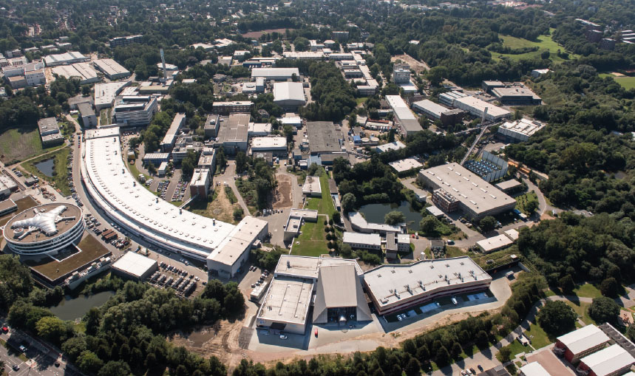
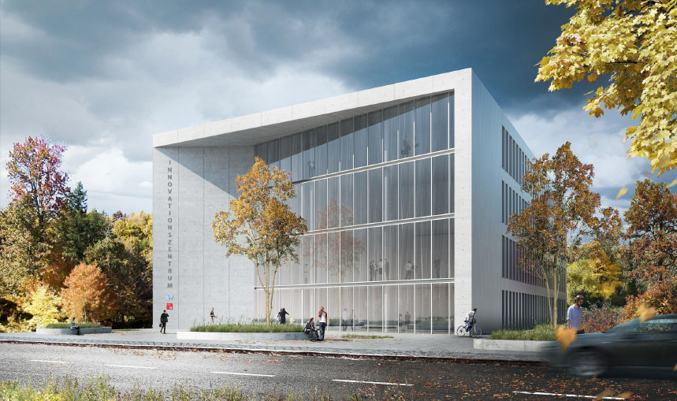
Then starts with physics results
Slides will be of this type, 1 plot ATLAS 1 plot CMS typically (plan to show also all 3 plots in POF)
Concentrate on physics:
Slide 3: recall Run1, legacy Higgs plot, Run 2 luminosity
Slide 4: Higgs physics
Slide 5: SM ATLAS (Wmass, LbyL )
Slide 6: Top and pdf at CMS
Slide 7/8: Susy, searches and DM
✓ milestone
Slide 9: Future
Continue to address the most important topics in particle physics today along the 3 themes:
Higgs/SM precision physics
Searches for new physics
Dark Matter searches
reference

Slide 4
Conclusion
Style of slide will adapt to content
Slide 10: Conclusions
Here a short conclusion on the physics results
Shall I add some numbers here (like number of PhD theses, YIGs, ERCs, common appointments, etc.?, most important management positions in the experiments?)

