Slide 1
Schedule and Priorities 2018 / 2019

Slide 2
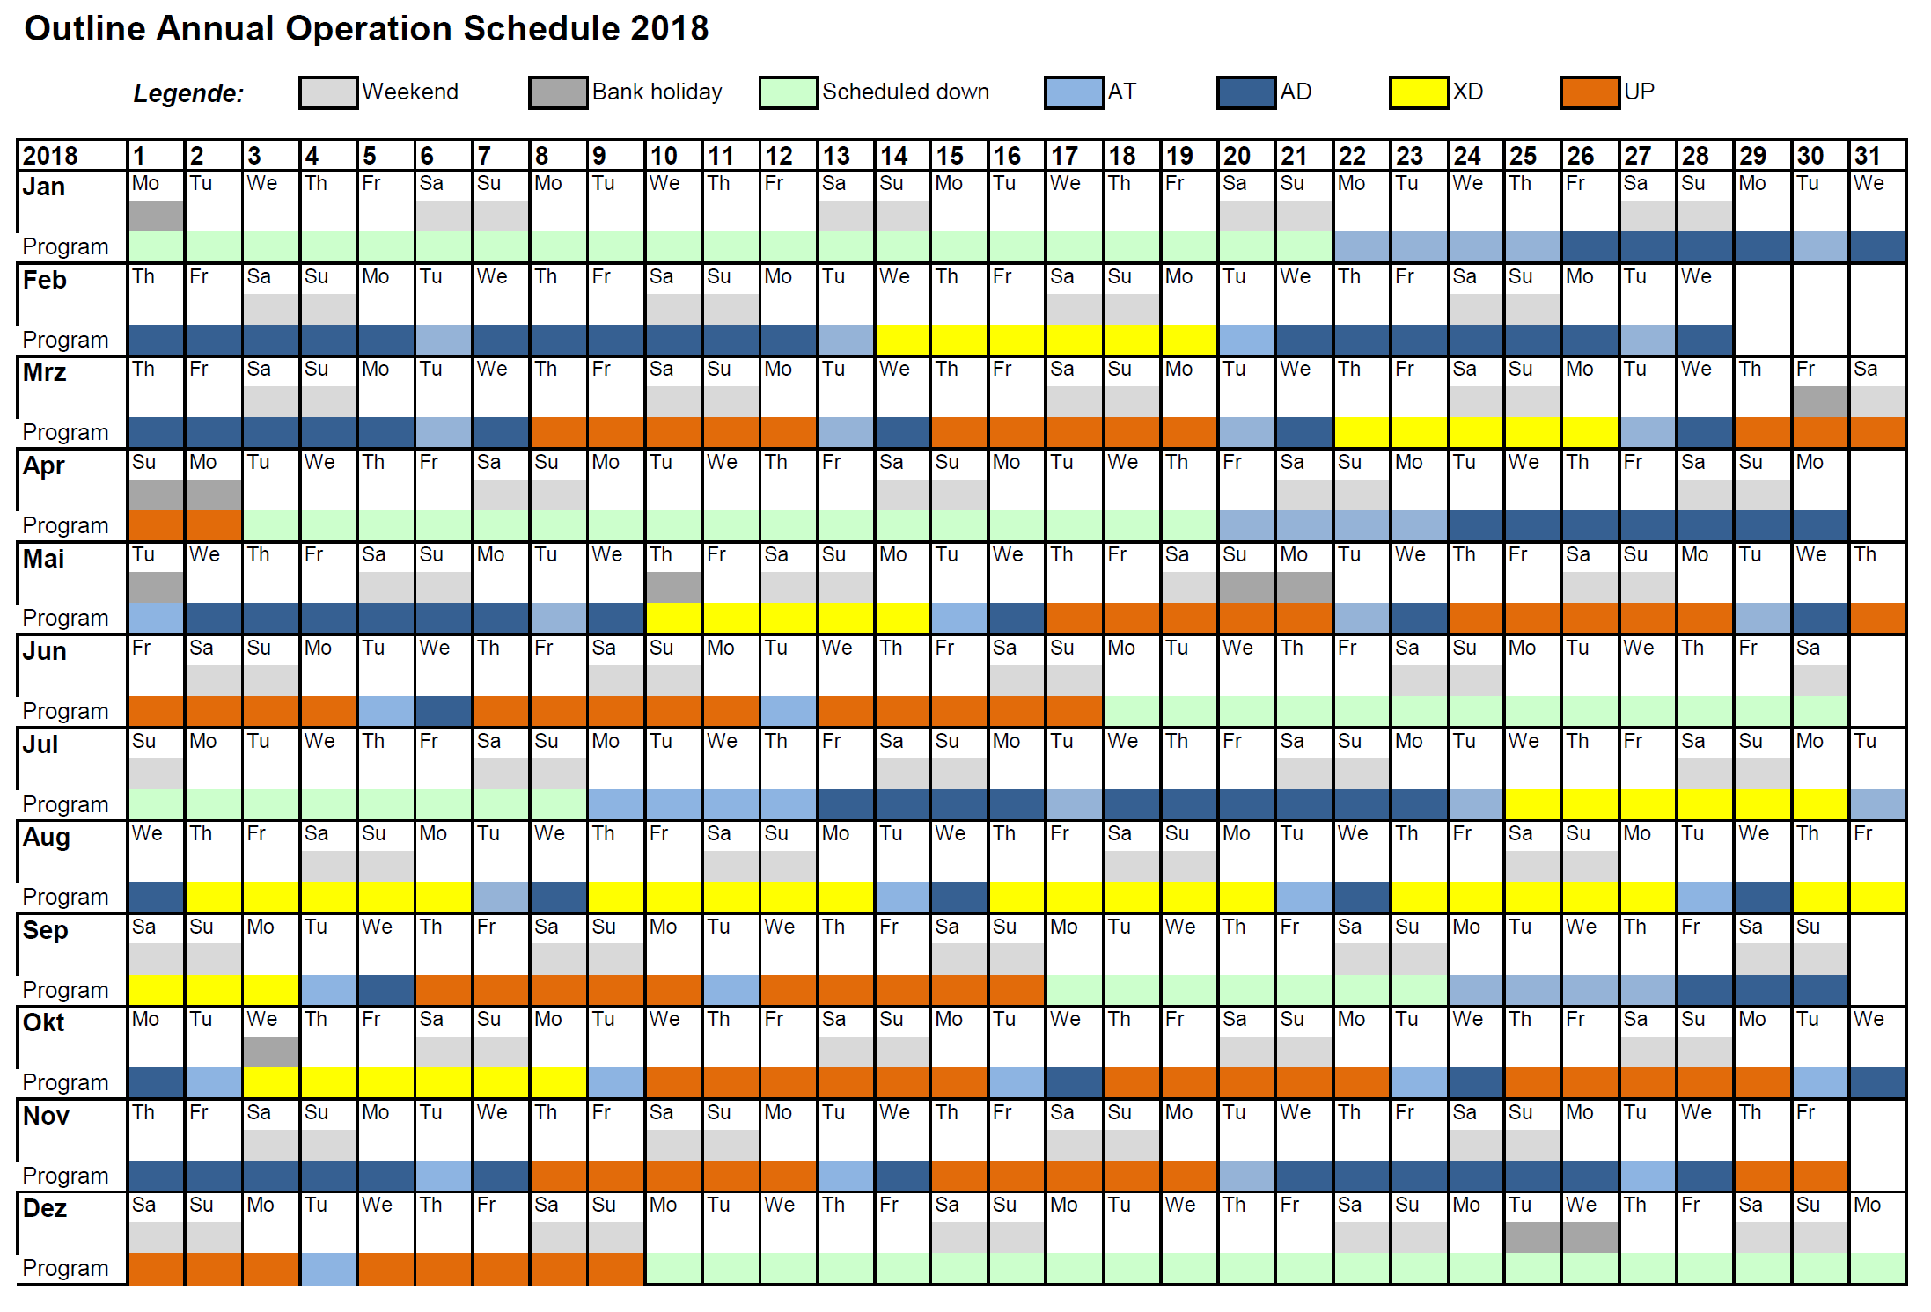
Current 2018 schedule

Slide 3
Scope 2018/19 / Order of priorities
SASE1 tunnel operation
SASE1 instrument operation
SASE3 tunnel readiness ➔ SASE3 tunnel operation
SASE2 tunnel readiness ➔ SASE2 tunnel operation
SASE3 instrument readiness ➔ SASE3 instr. operation
SASE2 instrument readiness ➔ SASE2 instr. Operation
SASE1 tunnel & instrument completion
SASE3 tunnel & instrument completion
SASE2 tunnel & instrument completion

Slide 4
1. SASE1 tunnel operation
Tasks & effort required to operate the tunnel: (including items for Day-1 or required to meet promises in Call for Proposals)
Accelerator: Achieve >0.5 mJ and good pointing stability (matching our optics)
Accelerator / XFEL: Improve undulator controls & adjustments / reduce losses
Accelerator: Good understanding of the FEL gain curve (?)
Accelerator: Working kicker magnets
Accelerator / Diagnostics: Measurement of the spectral jitter and bandwidth
Optics: Installation & commissioning of distribution mirror cooling
Diagnostics Complete commissioning of MCP, Hirex, K-Mono (now 50%) (required for improvements of the accelerator)
CAS & ITDM: Tunnel DAQ reliability / commissioning
Vaccuum & CAS: Final implementation of vacuum controls.
FXE: Installation & commissioning of diamond grating
FXE: Commissioning of 4 bounce monochromator
AE & SPB: Pulse picker has to be comissioned with beam
SPB: Update attenuator foils

Slide 5
2. SASE1 instrument operation
Tasks & efforts required to operate the instruments: (including items for Day-1 or required to meet promises in Call for Proposals)
October:
SPB: AGIPD (re)cabling works done, CSS, laser table & vacuum works partially done, …
CAS: Exchange of data between DOOCS and Karabo: Established, currently testing and bugfixing.
CAS: Improve Control Software: Scan tool being tested @ FXE, overall stability was increased.
ITDM: Improve DAQ: Data storage and handling, detector performance waiting for opportunity to conduct high speed test (300/512 bunches)
December:
ITDM: Test of new storage system + expansion of InfiniBand network
AE: Test of train builder (at least LPD)
Accelerator & SPB/SFX: Improvement of the focal properties
From beginning of 2018:
SPB: KB-mirror installation, integration & commissioning

Slide 6
3. SASE3 tunnel readiness
Achieve first lasing: 1st attempt in Nov. 17 → Q1 2018
Diagnostics: XGM, FEL- & SR-Imager are (almost) ready for commissioning
Vacuum: Vacuum in XTD10 up to absorber completely done
Vacuum: Local test of vacuum system with controls, interlock etc. done General vacuum sector interlock test has still to be done
Major works finished XTD4+10 : End of Jan. 18
Vacuum & Optics: Beam shutters, mirrors, soft X-ray Monochromators cabling was already started
Diagnostics: MCP (30% inst. done), Pop-Ins, K-Mono (50%)
Simultaneous operation of SASE1+3: End of Q1 2018
To be discussed with Acc. and incorporated into schedule

Slide 7
4. SASE2 tunnel readiness
Achieve first lasing: 1st attempt in Mar. 18 → Apr.-May
Beam shutters, XGM, FEL-&SR-Imager, Vacuum in XTD1+6 up to XTD6 absorber
Test of entire vacuum system, with controls, interlock etc. required
Major works finished XTD1+6: Apr. 18 → End of Q2 2018
Vacuum & Optics: Mirrors, Split&Delay Unit, High resolution monochromator, CRLs
Diagnostics: 2nd XGM, MCP, Pop-Ins and other Imagers
Simultaneous operation of SASE1+3+2: End of Q2 2018
To be discussed with Acc. and incorporated into schedule

Slide 8
5. SASE3 instrument readiness
TGA
AC ready until Feb. / Apr. 18, Elec. ready until Mar. 18
Instrument installation
Major time of installation: Feb. – Apr. 18
Beckhoff electronics
Cabling Phase II done until Jan.18
Day 1 hardware BH done until Feb. 18
Beckhoff electronics E2E done until Jul. 18
Instrument commissioning without beam
Installation of Rad. Saf. Interlocks in Apr. 18
…

Slide 9
6. SASE2 instrument readiness
TGA
AC ready until Mar. / Apr. 18, Electricity ready until Apr. 18
Instrument installation
Major time of installation: Q4 2017 - Q1 2018
AGIPD ready for installation in Feb. 18
Beckhoff electronics (MID / HED Opt. / HED)
Cabling Phase II done until May / July / Sep. 18
Day 1 hardware BH done until Feb. / Mar. / June 18
Beckhoff electronics E2E done until Sep. 18 / Oct. 18 / Jan. 19
Instrument commissioning without beam
Installation of Rad. Saf. Interlocks in July 18
Installation of Laser Interlocks ???

Slide 10
7. SASE1 tunnel & instrument completion
Tunnel:
…
FXE:
Jungfrau detector planning, cabling, integration & commissioning
…
SPB/SFX:
Jungfrau detector planning, cabling, integration & commissioning
AGIPD4M detector planning, cabling, integration & commissioning
Additional work regarding downstream region (day 2 / SFX)
…

Slide 11
8. SASE3 tunnel & instrument completion
Tunnel:
Undulators: Self-seeding, Circular polarization undulator, Helical afterburner
Diagnostics: Full PES operation, Exit-Slit Imagers
…
SCS:
…
SQS:
…
Third experiment (TR-XPES):
…

Slide 12
9. SASE2 tunnel & instrument completion
Tunnel:
Undulators: Self-seeding, …
Diagnostics: Hirex?
…
MID:
…
HED / HIBEF-UC:
…
(Third experiment:)
…

