Slide 1
Tests on Chess 2 ASIC
Dionisio Doering, Yubo Han_{IHEP} , Pietro Caragiulo, Larry Ruckman, Camillo Tamma, Mazin Khader_{UIUC}, Murtaza Safdari, Su Dong

Slide 2
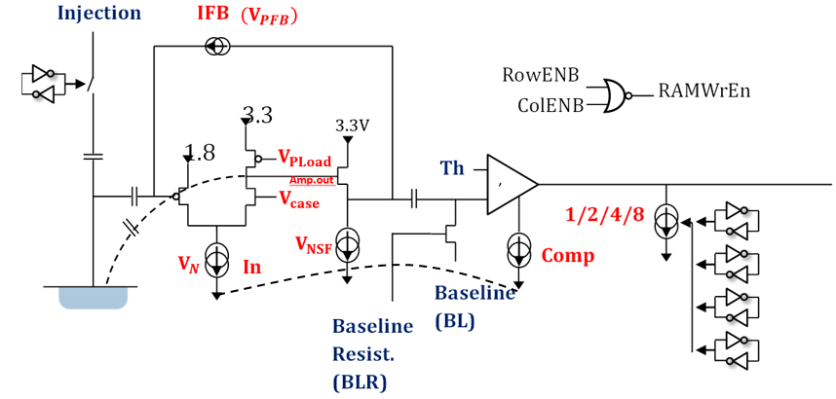
Pixel description

Slide 3
Outline
Review:
start testing on the new board
adding a external pulser as Qinj signal
Tests on new board
different pulse size(Qinj)
different pulse width(Qinj)
enable multiple hits every time

Slide 4
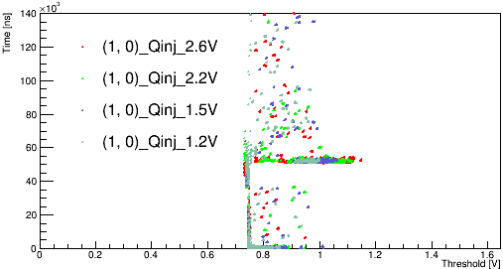
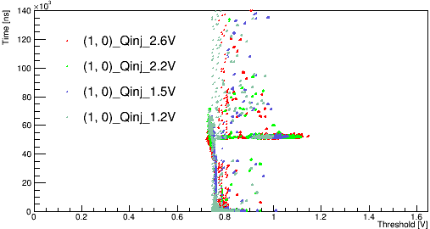
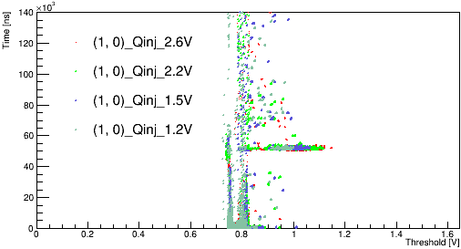
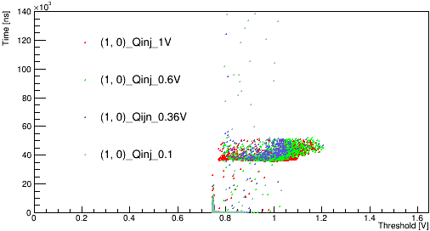
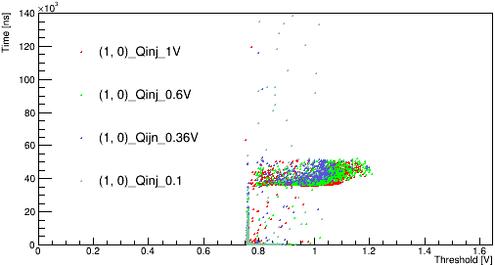
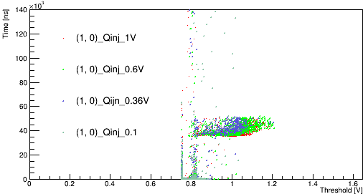
Why Qinj
Inv-Qinj
Matrix 0
Matrix 1
Matrix 2
Inversed Qinj: 35μs->leading edge. Low-high
50μs->back edge. High-low
More sensitive to the back edge but almost no hits after the leading edge before the back edge.
Leading edge is changing the state of the circuit.
Change to Qinj to get a more clean start.
Qinj
Matrix 0
Matrix 1
Matrix 2

Slide 5
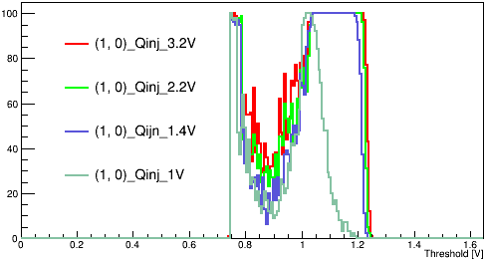
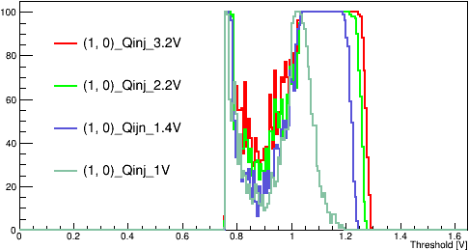
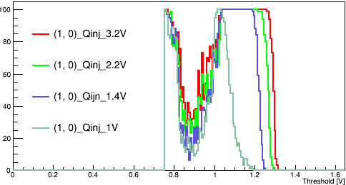
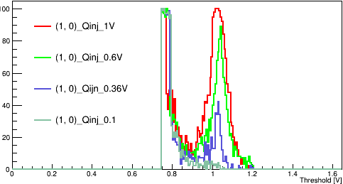
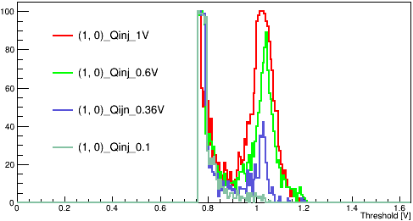
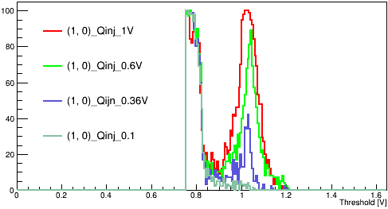
Different Pulse size
Carrier Board 192.168.3.28
Daughter board: 02(std resistivity)
Default configuration
Pixel (1,0)
Hitnumber vs threshold
BL=0.75V
Pulse size:
3.2V, 2.2V, 1.4V, 1V,
0.6V, 0.36V, 0.1V
Only 1st hit collected.
Less hit collected with lower Qinj Pulse size
A valley structure.
Matrix 0
Matrix 1
Matrix 2
Matrix 0
Matrix 1
Matrix 2

Slide 6
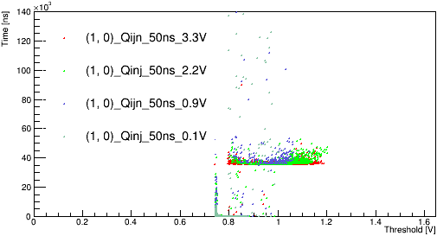
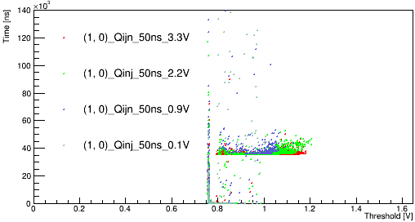
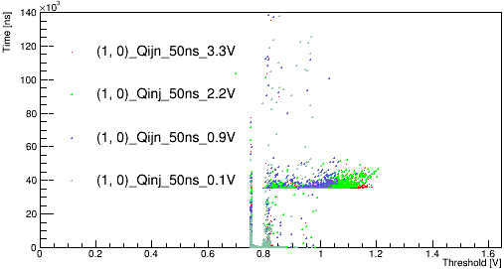
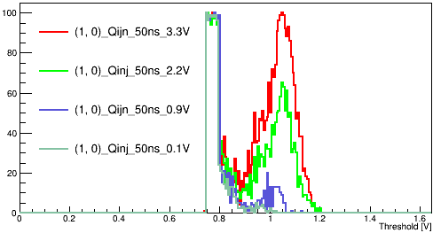
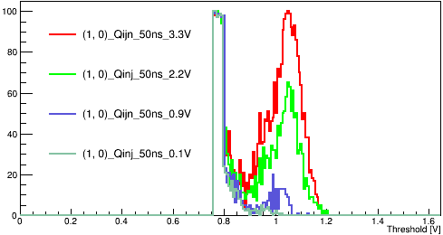

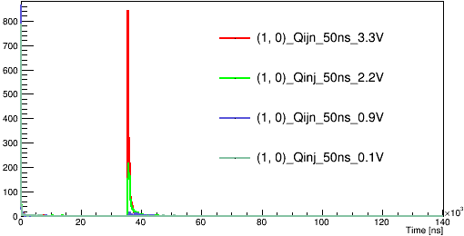
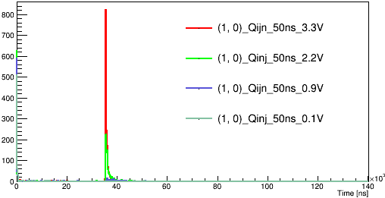
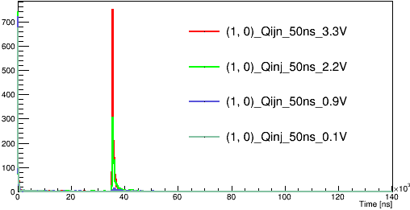
Tests with smaller pulse width
Carrier Board 192.168.3.28
Daughter board: 02(std resistivity)
Default configuration
Pixel (1,0)
Time vs Threshold
Hitnumber vs threshold
Hitnumber vs time
BL=0.75V
Pulse size:
3.3V, 2.2V, 0.9V,0.1V
Only 1st hit collected.
Similar valley structure.
why that structure?
Matrix 0
Matrix 1
Matrix 2
Matrix 0
Matrix 1
Matrix 2
Matrix 0
Matrix 1
Matrix 2

Slide 7
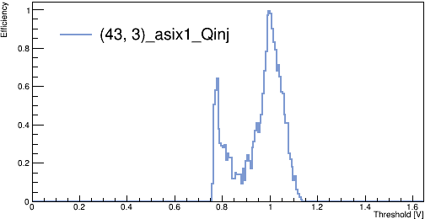
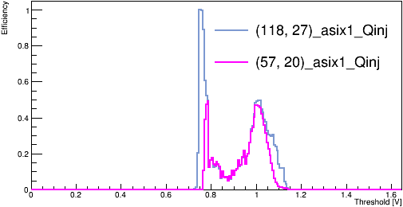
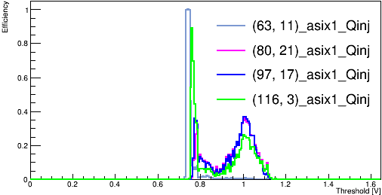
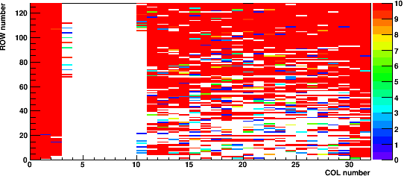
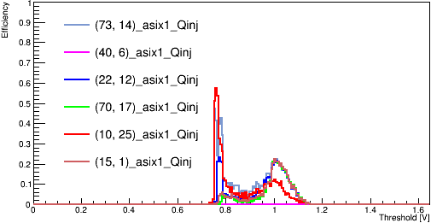
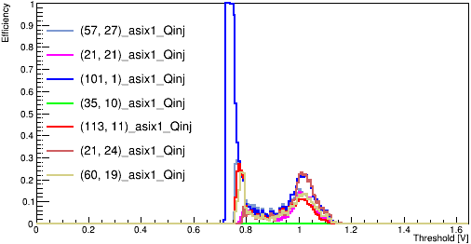
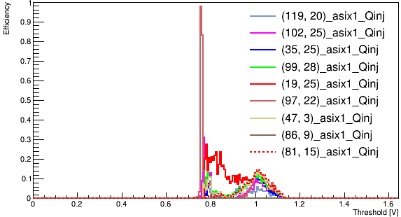
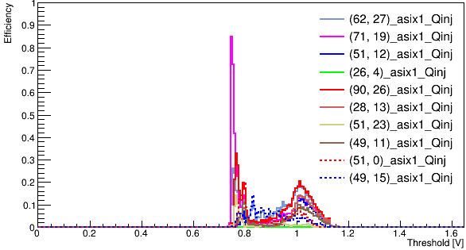
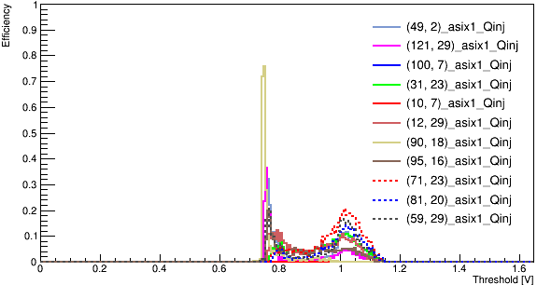
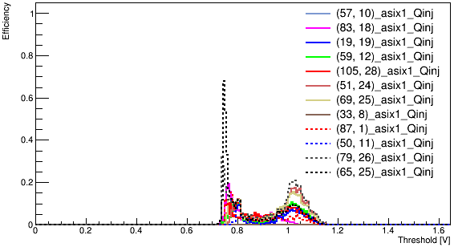
Enable more pixels at a time
Carrier Board 192.168.3.28
Daughter board: 02(std resistivity)
Default configuration
Read 8 hits from one matrix at a time.
The first 8 hits’ time information came from one of the enabled pixel.
Randomly enable 1~12 pixels at a time.
Sometimes pixel at the “dead band” will be chosen.
1 pixel
2 pixel
3 pixel
5 pixel
6 pixel
8 pixel
Hit number vs Threshold
The real number of pixels contribute to the result.
Decreasing efficiency at the second peak.(consider as the signal)
The first peak always consists of hits from a few pixels.
9 pixel
10 pixel
10 pixel

Slide 8
Summary
Several tests have been done on the new std resistivity board.
Change to use (35μs and 50ns) Qinj instead of inversed of inv-Qinj.
Different hit number observed with different pulse size.-> why that valley structure?
Reading multiple pixels at a time will get lower average efficiency. But they don’t have equivalent efficiency.
NEXT
Mainly about trying to bias the board.

