Slide 1



Disemination in Science
ELI-NP
Communication experience
EUCALL, Sitges, Spain, 14 – 15 NOV

Slide 2

Channels of communication
National Public Radio
Private media
Online media
Bilateral chamber of commerce and industry
Ethnic groups
The diplomacy of science (Ministry of Foreign Affairs)
EUCALL, Sitges, Spain, 14 – 15 NOV

Slide 3
The new role of the public radio in a competitive world
Radio Romania
supporter of state-of-the-art
Scientific Projects – ELI-NP, Magurele, Romania
EUCALL, Sitges, Spain, 14 – 15 NOV

Slide 4
Why National Public Radio?
Tradition in honest public communication
Less funds than the private sector: it has to be smarter
It has the use to train its stuff
Dedication to culture, science, education
Supporter of projects with major positive impact
Nation wide coverage and international networking
EUCALL, Sitges, Spain, 14 – 15 NOV

Slide 5
One chance in a generation and even more
Extreme Light Infrastructure – Nuclear Physics
Măgurele, ROMANIA
The most powerful laser in the world
10% of the Sun’s energy in a spot
1 million of billion of second
A PROJECT LIKE THIS
CAN NOT BE MISSED BY A PUBLIC RADIO!
EUCALL, Sitges, Spain, 14 – 15 NOV

Slide 6
Radio Romania News embracing ELI-NP (I)
I. Business as usual: day by day coverage
II. Generating communicational experiments with ELI-NP scientists
Testing their communication capacity for different target groups
    1) Educated audience
    2) General public
    3) Decision makers
Supporting the group of ELI-NP science communicators
EUCALL, Sitges, Spain, 14 – 15 NOV

Slide 7
Radio Romania News embracing ELI-NP (II)
III. Training a group of journalists to specialize in scientific communicationTrainers:
ELI-NP top management and researchers
IV.Initiating events together, to explain what ELI-NP means and why it is useful for the Romanian citizens
EUCALL, Sitges, Spain, 14 – 15 NOV

Slide 8
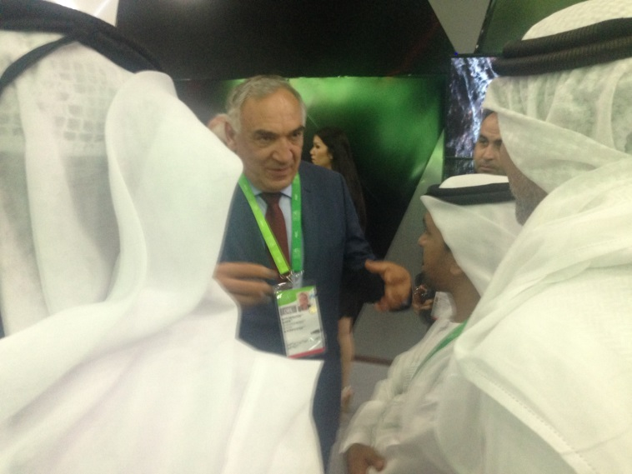
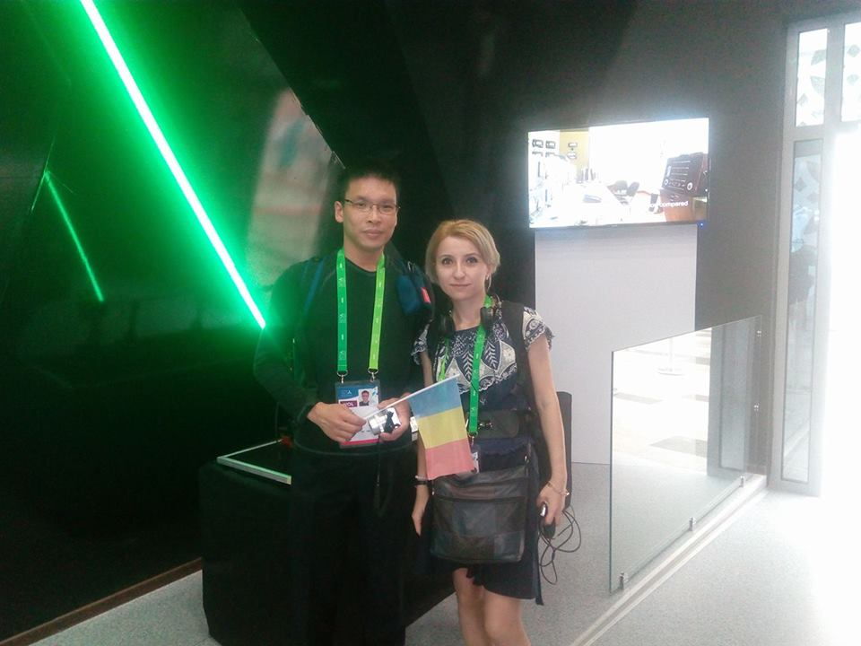
Radio Romania News embracing ELI-NP (II)
V. Joint efforts at international level to promote a Romanian, a European and, at some point, a Global relevant project – Astana, 2017 – World Exhibition –The Energy of The Future
EUCALL, Sitges, Spain, 14 – 15 NOV

Slide 9
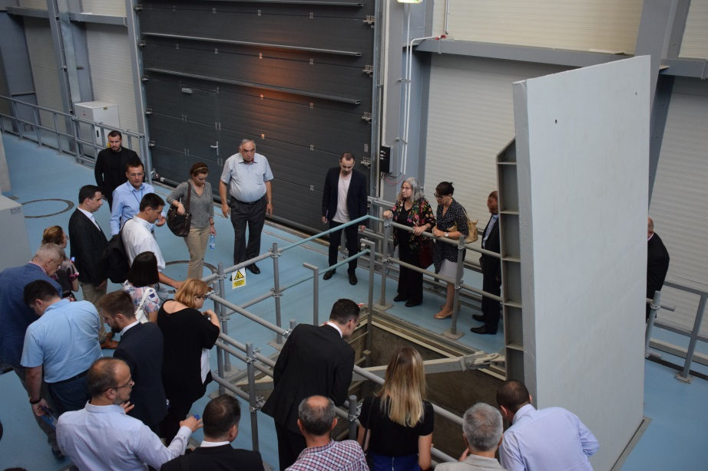
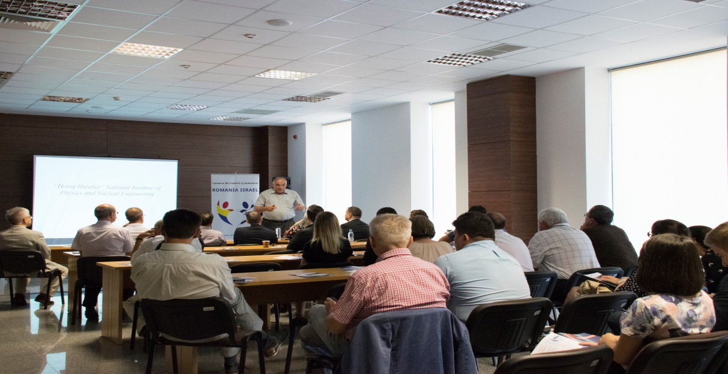
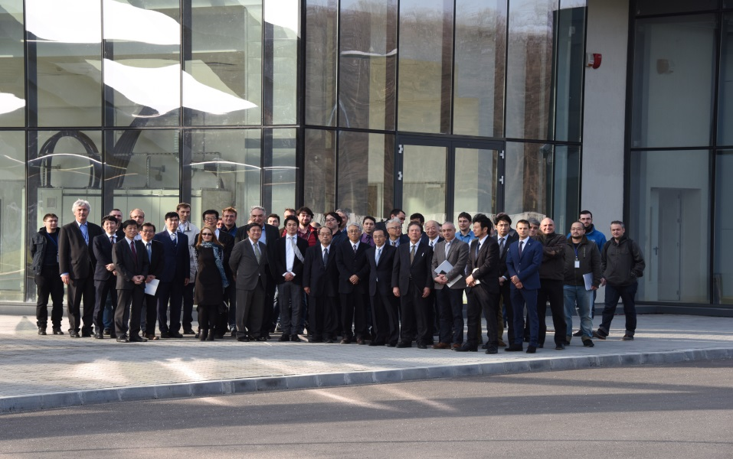
Bilateral chambers of commerce

Slide 10
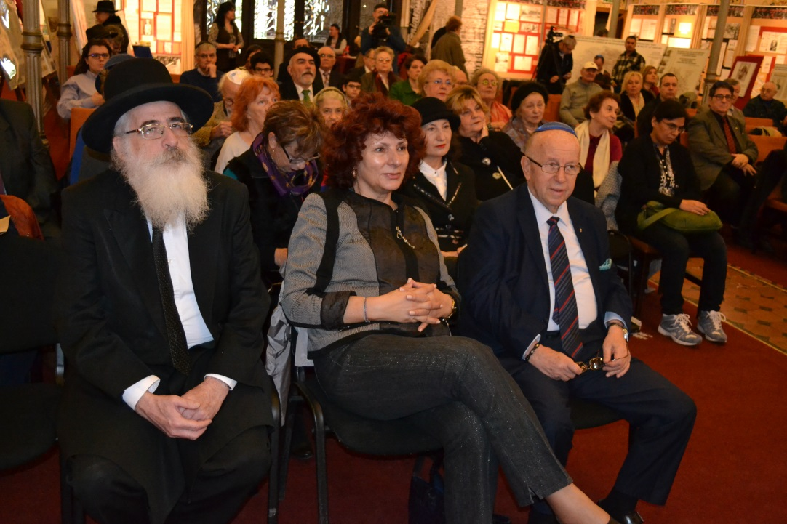
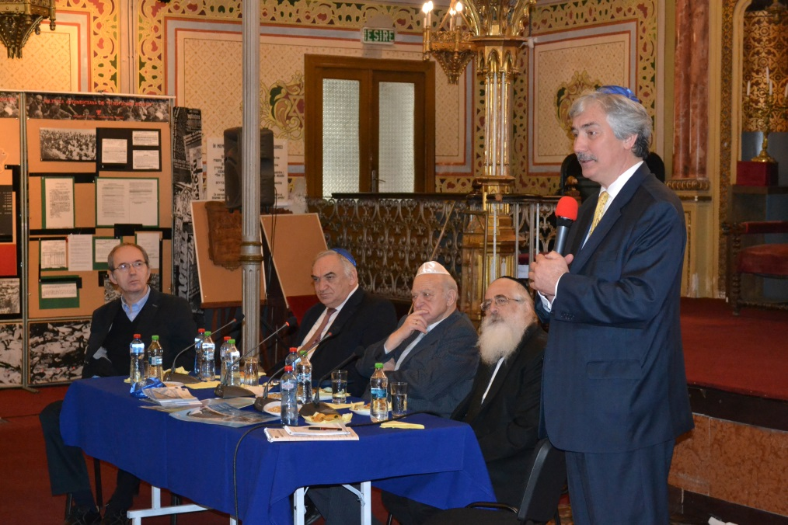
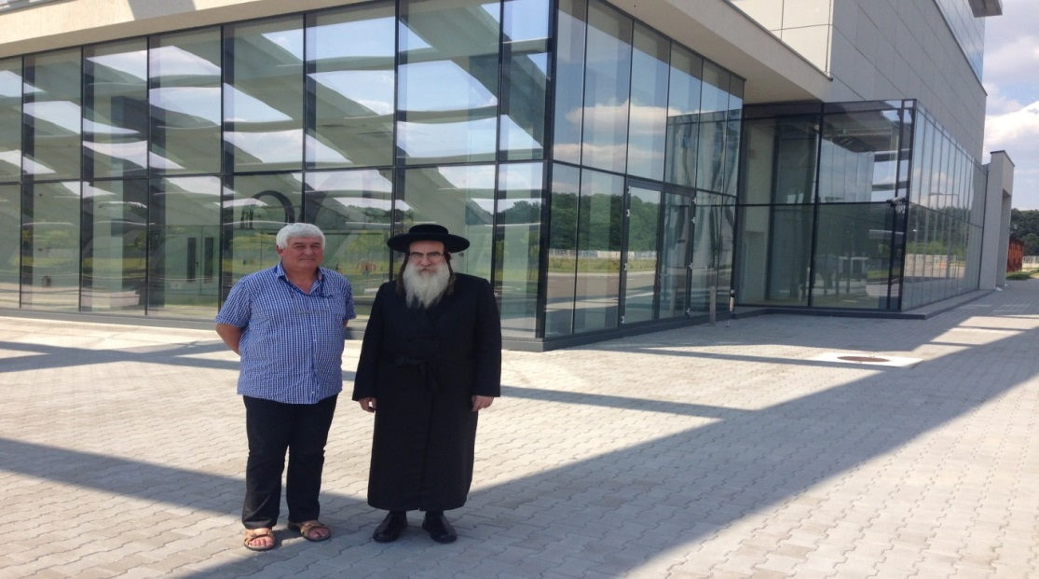
Ethnic groups
EUCALL, Sitges, Spain, 14 – 15 NOV

Slide 11
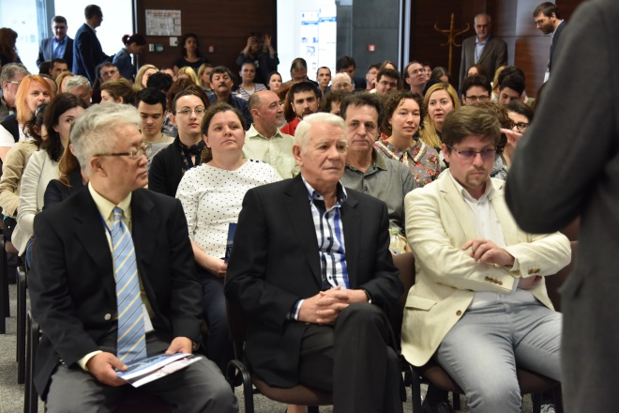
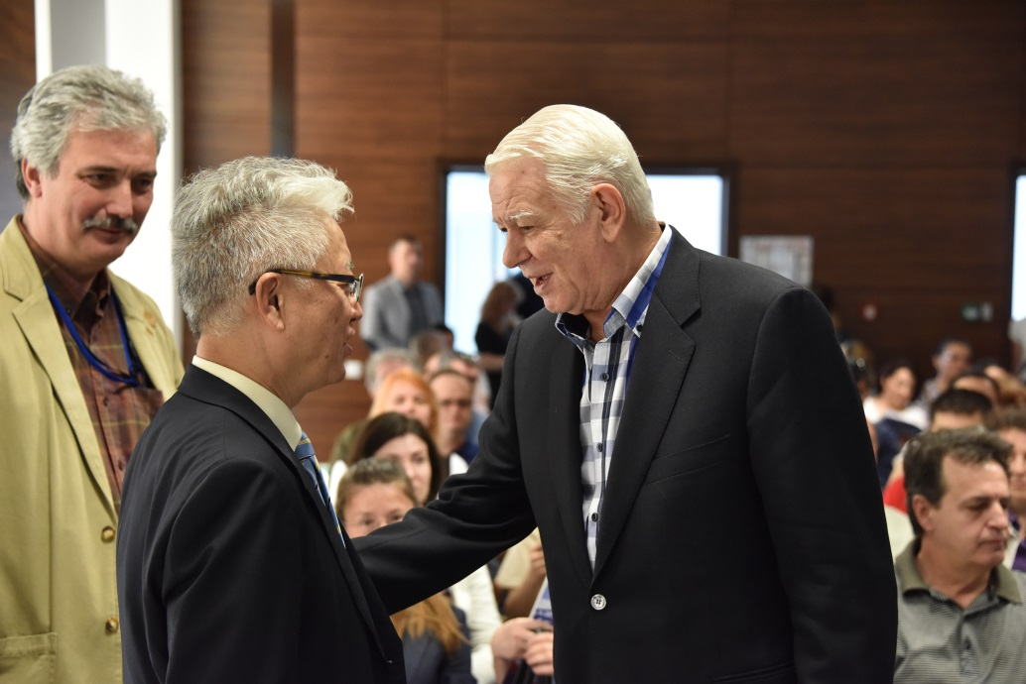
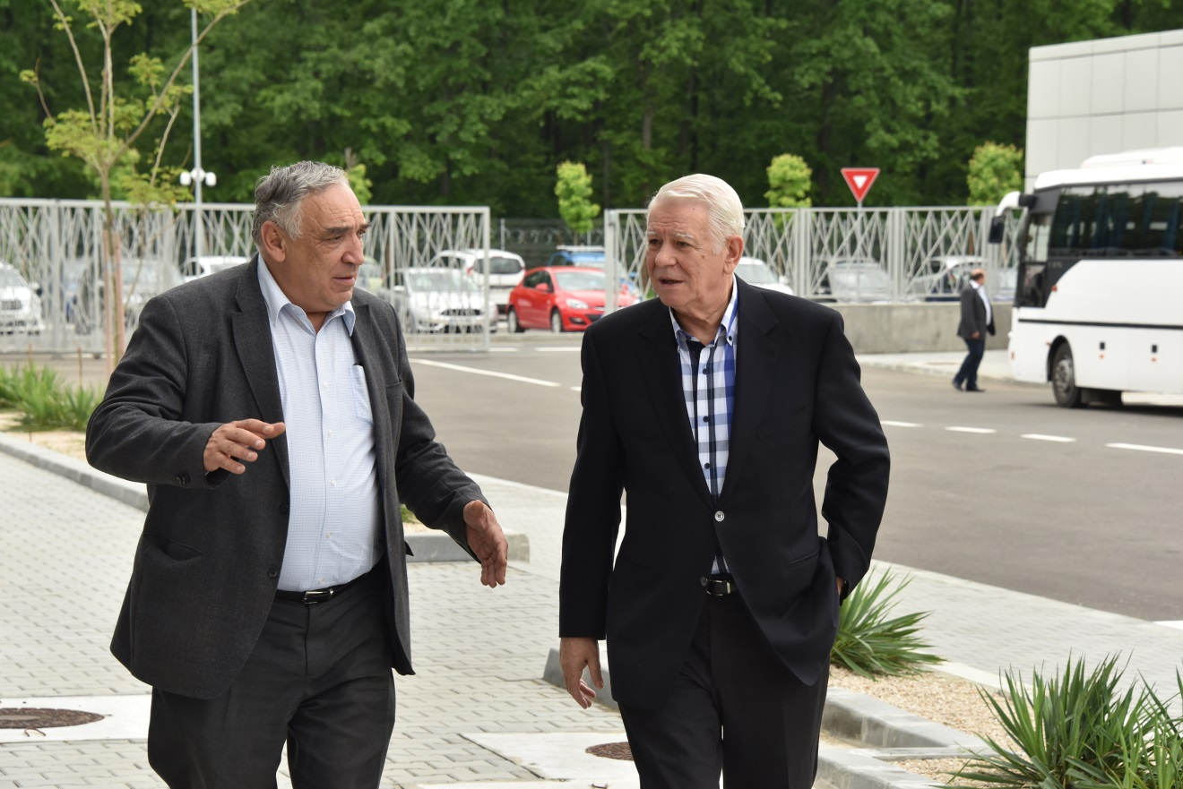
Diplomacy of science

Slide 12
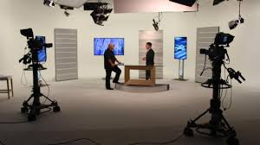
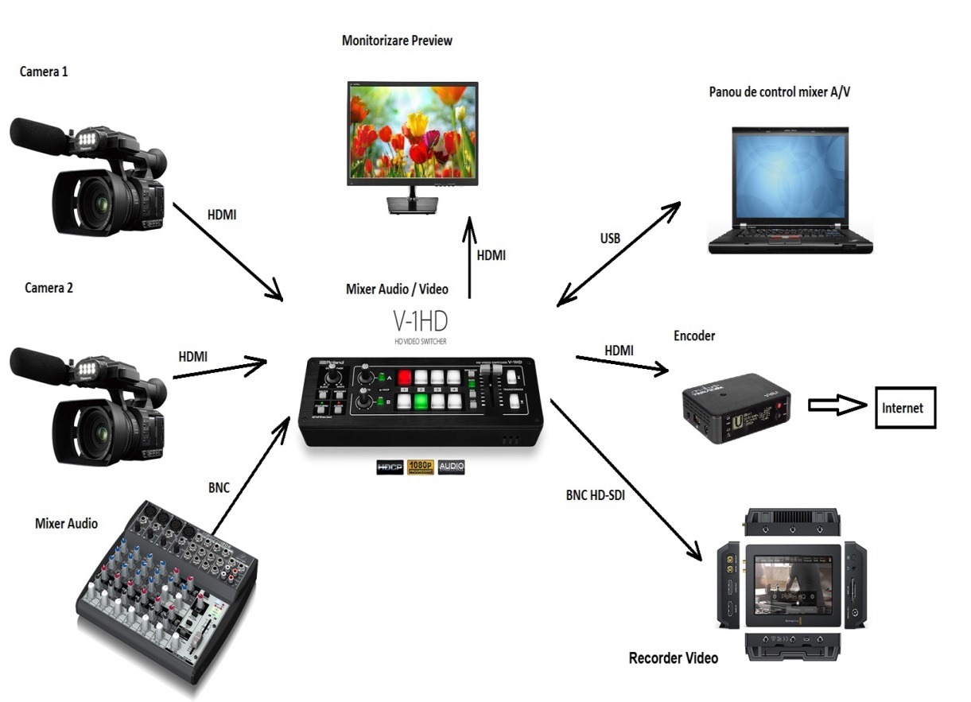
ELI – NP is going online!
EUCALL, Sitges, Spain, 14 – 15 NOV

Slide 13
I. Calibration of the citizens’ information level regarding LSSIs
II. Knowledge transfer is generating Technology transfer
Conclusions
EUCALL, Sitges, Spain, 14 – 15 NOV

Slide 14

Thank You !
Dragos Seuleanu, CEO
+40 744 312 651
dragos.seuleanu@eli-np.ro
EUCALL, Sitges, Spain, 14 – 15 NOV

