Slide 1
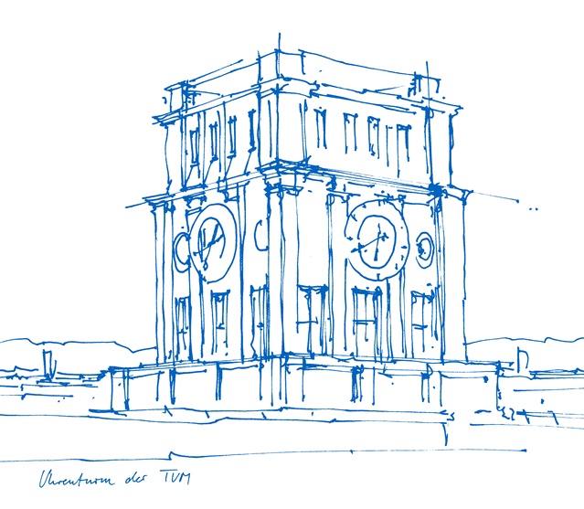
DHH in the ATCA shelf
Stefan Huber
24.01.2018

Slide 2
DHH in the ATCA module
DHI
ł
ł
ł
ł
DHE2
ł
DHC
DHE
DHE1

Slide 3
DHH in the ATCA module / RTM

Slide 4
DHC Features
Hardware Link to EPICS, ONSEN and FTSW
Jitter cleaned clock via SiLabs-chip, has to be programmed after power cycle $→$ Used as reference clock on all DHEs
Interface to all connected DHEs via UCF protocol (Up to 5 DHEs)
Distribute Trigger and Clock $→$ Phase synchronous to all DHEs
IPBus hub for all connected DHEs $→$ Multiplex Ethernet packages
Buffer Data from DHEs

Slide 5
DHE Features
Operates on the recovered UCF clock
Phase synchronous to the B2TT clock
Controlled via IPBus 2
DHP data-interface as used in PERSY
Limited trigger rate
No overlapping triggers $⇒$Not surprisingly limit of 12 kHz trigger rate

Slide 6
Installation at KEK
One ATCA shelf
Two ATCA carriers
Each houses one DHC and two DHEs
Control connection to the DHPT via DHI prototype
Data interface via optical fibers
Accessible via shroud computer

Slide 7
Status KEK
Status
All modules accessible by IPBus
UCF link stable over long periods
Possible to take data at 12kHz over long time period

Slide 8
Issues at KEK
Issues
IPBus looses packages
Trigger number in DHE/DHC mismatch requires manual reset $→$ Simon implemented IOC
After powering up: Reprogram DHC to get stable UCF clock
Memory dump data: Sometimes one additional word
Not full trigger number transferred to DHE

Slide 9
Issues at KEK
DHC has to be reprogrammed after switching on power
Explanation:
High speed transceivers need toggling reference clock during startup
Resolution: Boot with oscillator clock Program SiLab chip Switch reference clock
IPBus looses packages
Trigger number in DHE/DHC mismatch requires manual reset $→$ Simon implemented IOC
After powering up: Reprogram DHC to get stable UCF clock
Memory dump data: Sometimes one additional word
Not full trigger number transferred to DHE

Slide 10
Issues at KEK
IPBus looses packages
Explanation:
Multiplexer logic on DHC
Resolution: Rewrite that logic

Slide 11
Issues at KEK
Trigger number in DHE/DHC mismatch requires manual reset
Explanation:
Runreset not propagated to all necessary places
Resolution: Propagate reset to DHE Keep reset high for ~1us at DHC (distance to first trigger should be at least 1us)
Memory dump data: Sometimes one additional word
Not full trigger number transferred to DHE

Slide 12
Issues at KEK
Memory dump data: Sometimes one additional word
Explanation:
Not understood yet
Resolution: ??? Memory dump data: Sometimes one additional word
Not full trigger number transferred to DHE

Slide 13
Issues at KEK
Not full trigger number transferred to DHE
Explanation:
Only 16 bit transferred from DHC to DHE
Resolution: Transfer 32 bit

Slide 14
Recent firmware improvements
Startup with oscillator instead of B2TT clock
UCF stability improvements
Full 32 bit trigger information to DHE
Reset DHC for 1us after runreset signal
$⇒$ Tested last week, not able to get good data

Slide 15
Last missing item: Support of overlapping triggers
FIFO1 SOE
Buffer first-row information
FIFO2 SOE
Start pointer
first frame
Assemble one frame per trigger
Trigger
Dual ported Memory
Data
Hit row boundary
FIFO1 EOE
Buffer first-row information
FIFO2 EOE
Start/End pointer
second frame
Trigger
Firmware developed, tested during the next weeks

Slide 16
Conclusion
Phase2 DHH system is installed at KEK
Possible to take data at trigger rates <= 12kHz
Some issues identified, no showstoppers
High rate firmware to be tested

