Slide 1
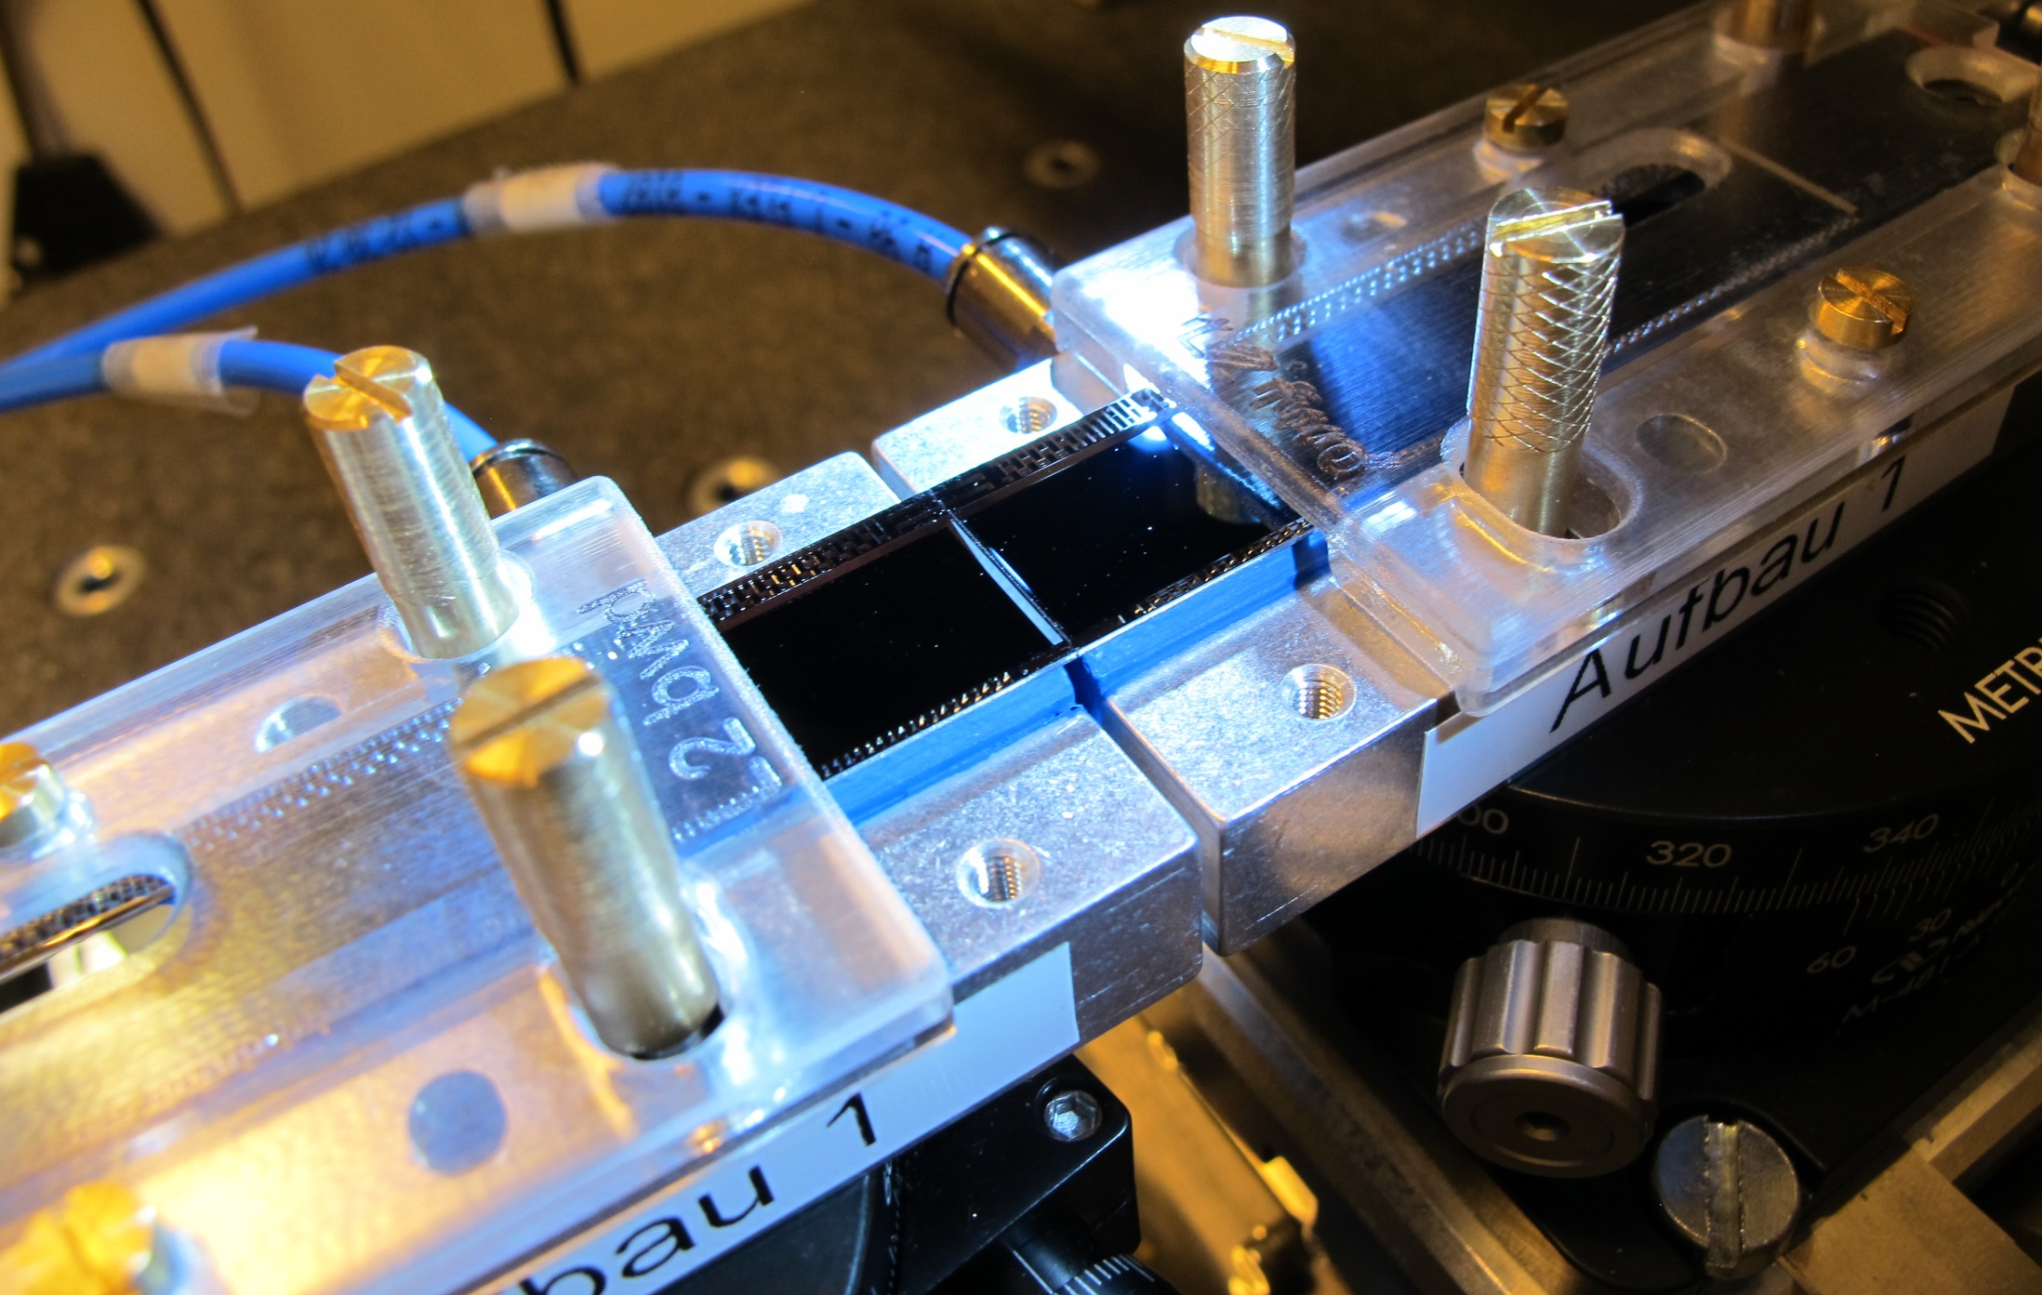
Ladder Assembly
Assembly procedure
Pull Strength
Alignment
Electrical Tests
Conclusions

Slide 2
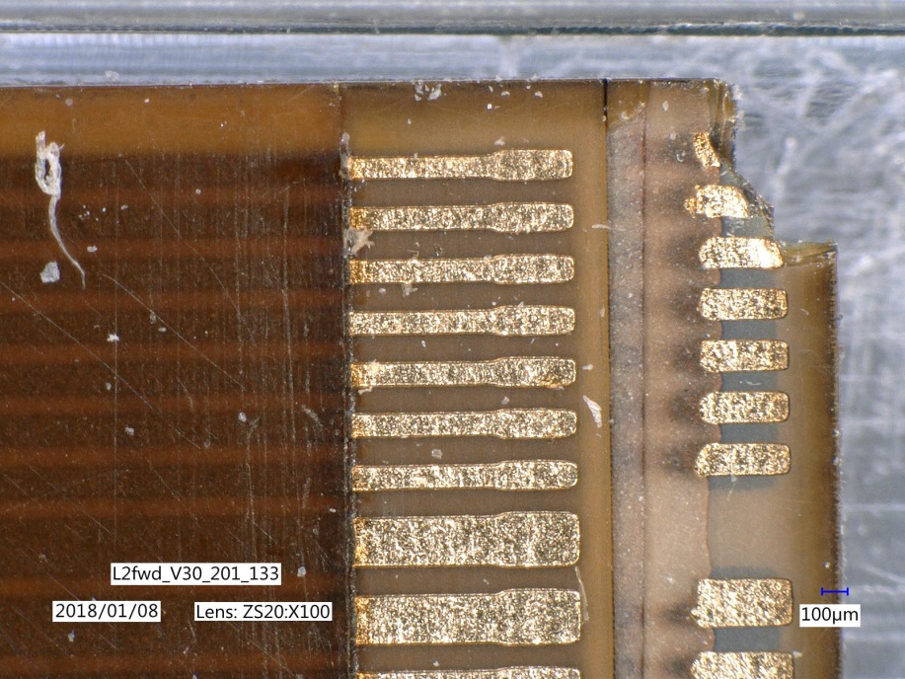
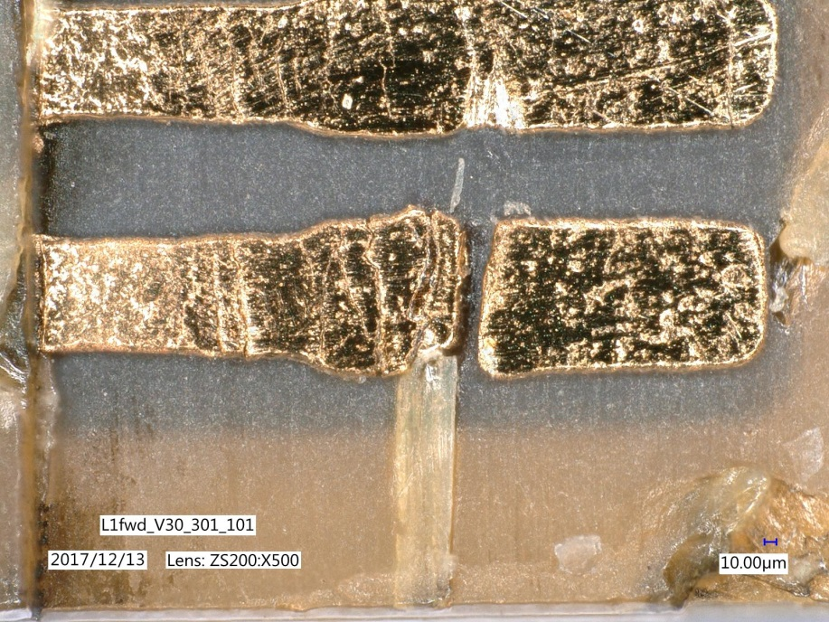
Kapton Tests
Optical tests of 2nd batch
L1fwd 17 of 30 ok 56%
L1bwd 15 of 30 ok 50%
L2fwd 27 of 40 ok 68%
L2bwd 23 of 40 ok 58%
On stock (16.1.2018)
stock needed
L1fwd: 13 ~5
L1bwd 17 ~5
L2fwd 44 ~10
L2bwd 36 ~10

Slide 3
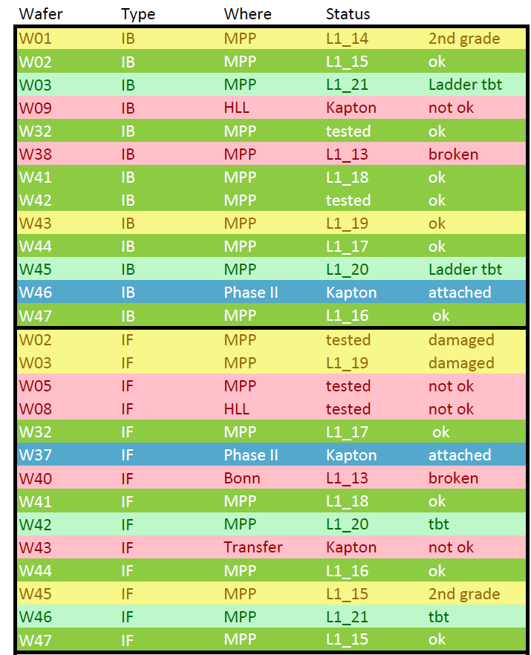
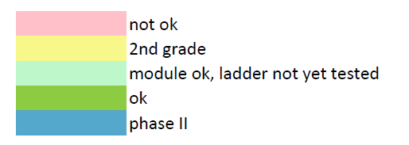
Kapton Attachment
Inner Layer
IB: 13 Modules with Kapton
IF: 14 Modules with Kapton
All tested
Failures not related to Kapton attachment

Slide 4
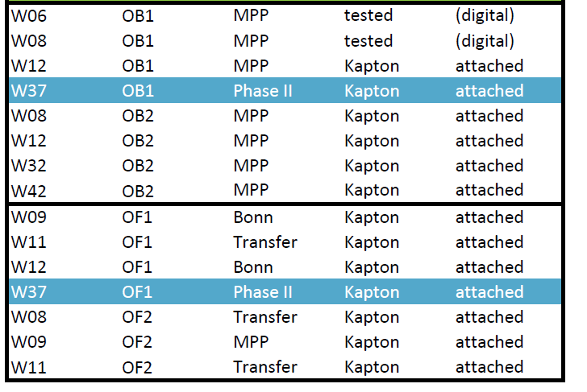
Kapton Attachment
Outer Layer
OB: 8 Modules with Kapton
OF: 7 Modules with Kapton
Testing started

Slide 5
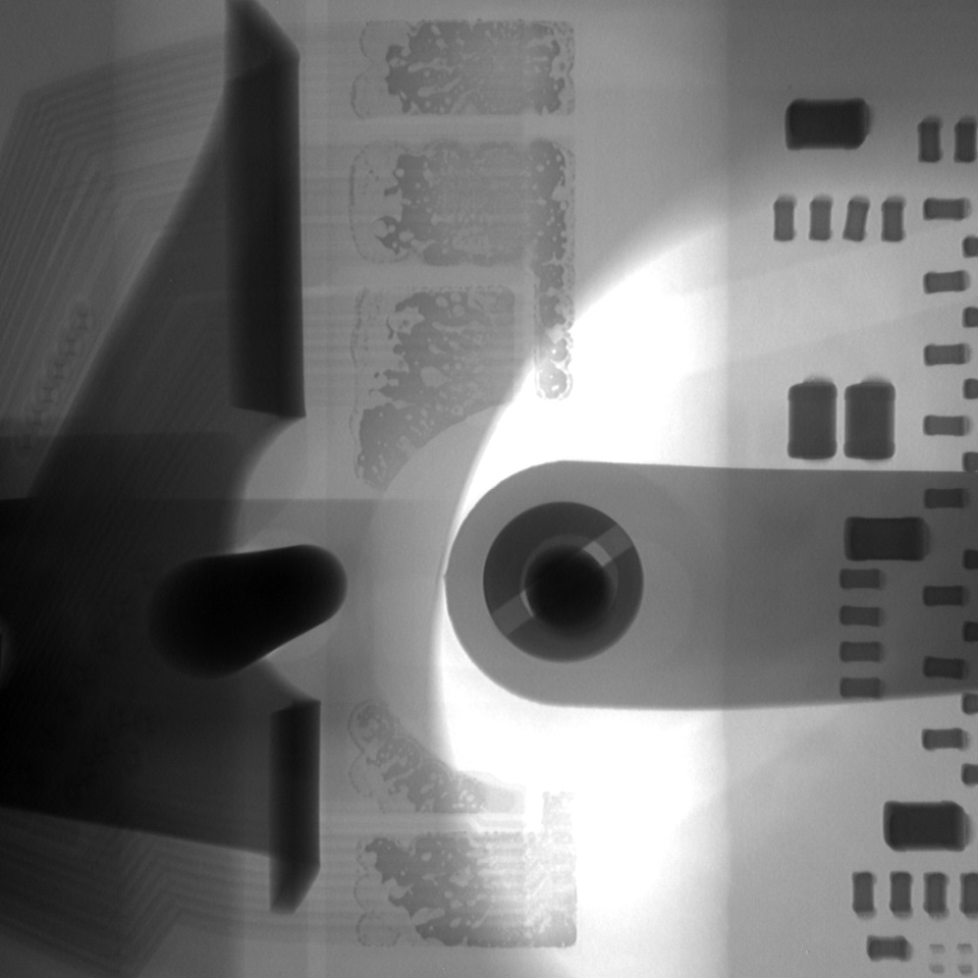
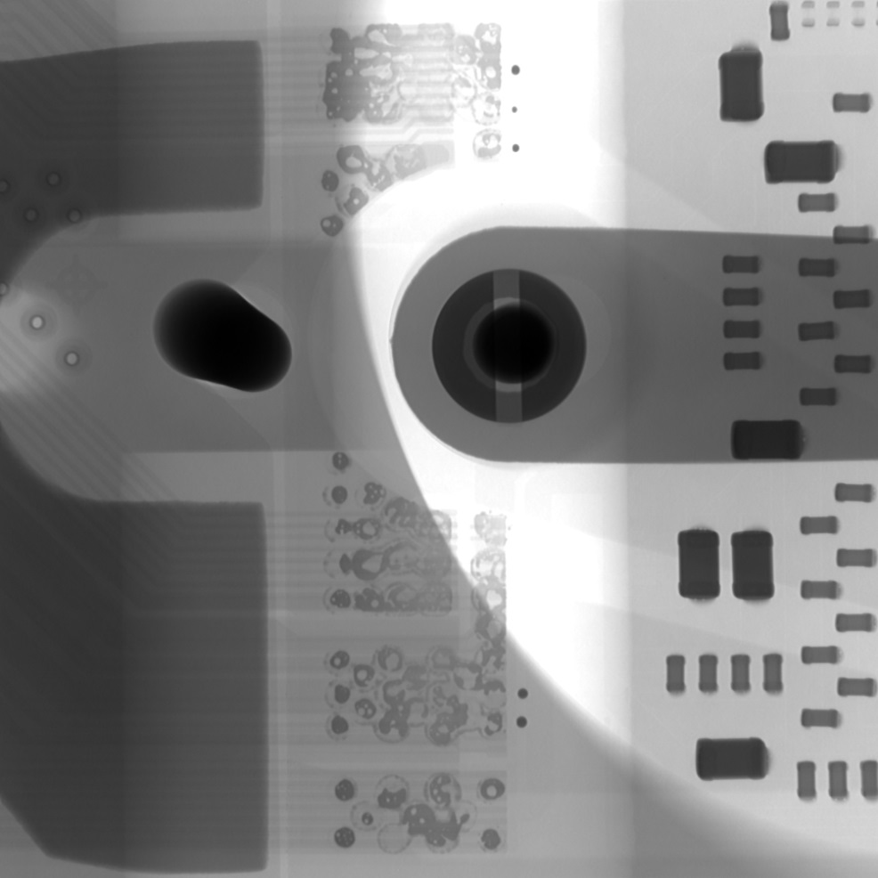
X-ray control
All soldered kaptons are x-rayed to check the solder wedding. Sometimes it looks marginal but always the electrical contact is ok

Slide 6
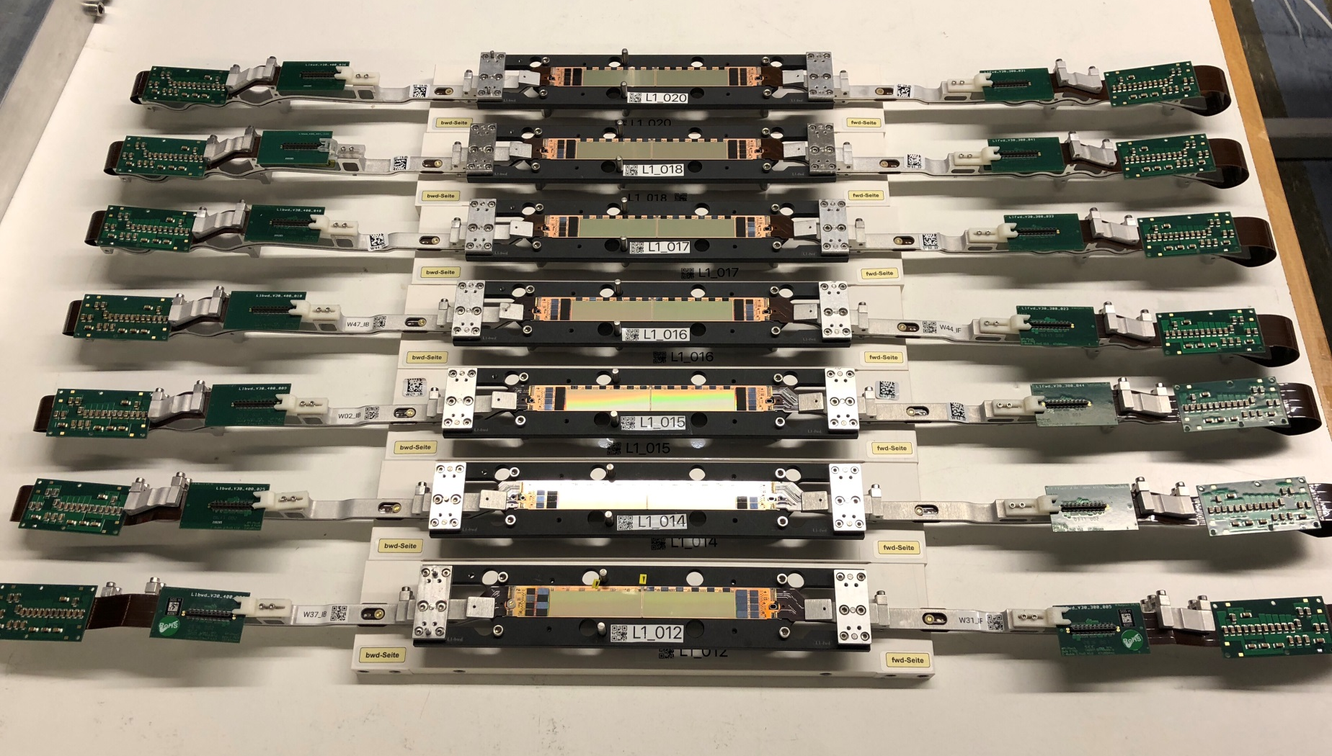
Ladder glueing
So far 9 production ladders were glued. Failures due to gluing: 0

Slide 7
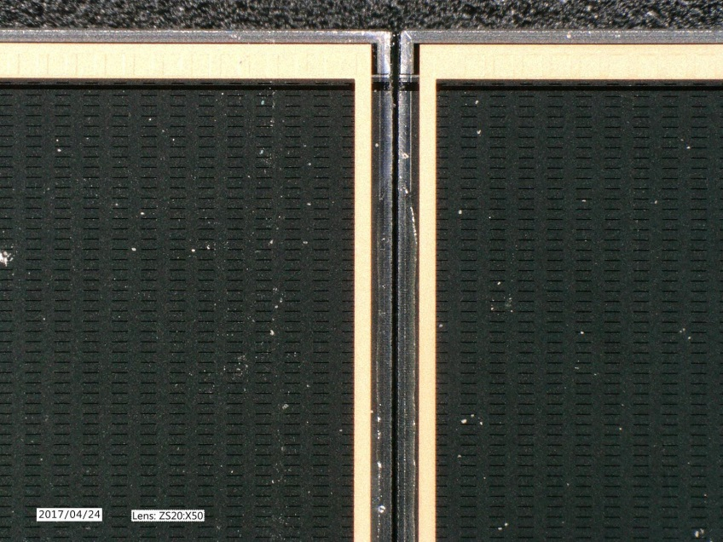
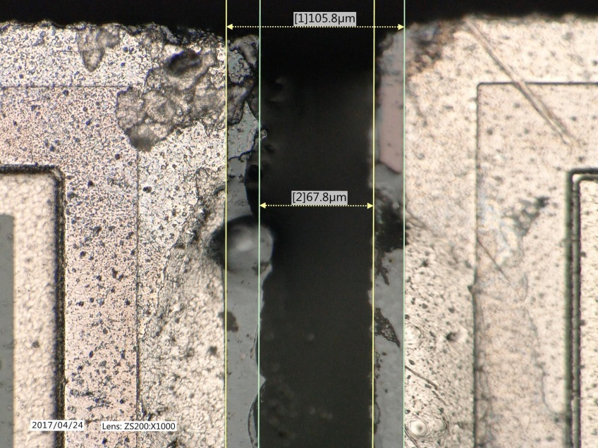
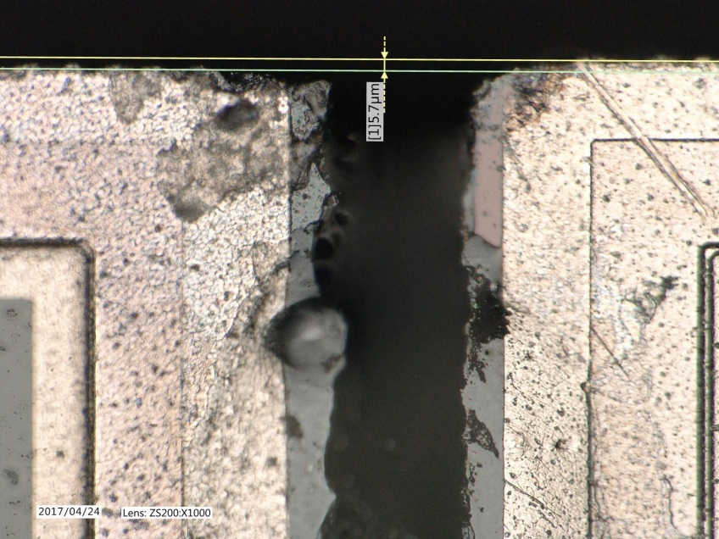
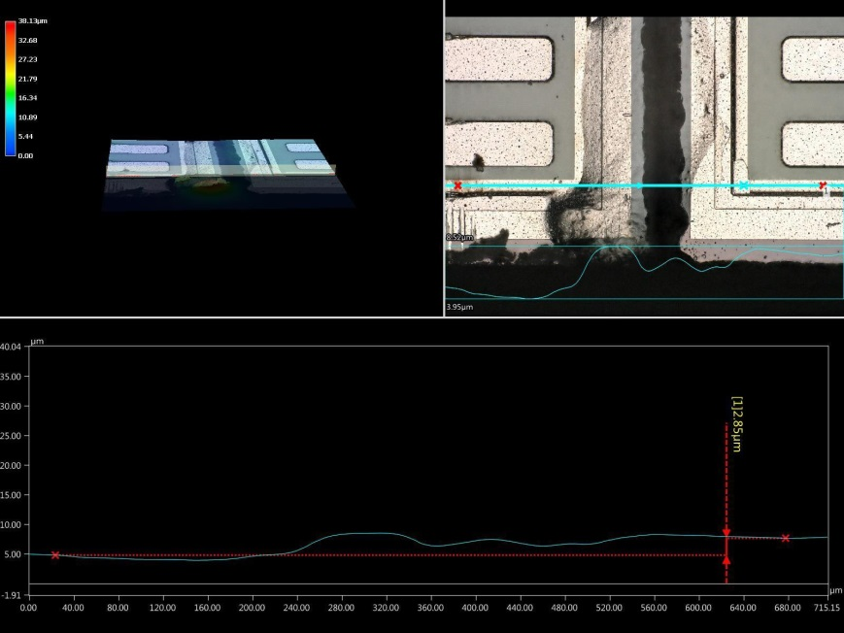
Optical Inspection and Survey
Glue gap
Delta in plane
Delta out of plane

Slide 8
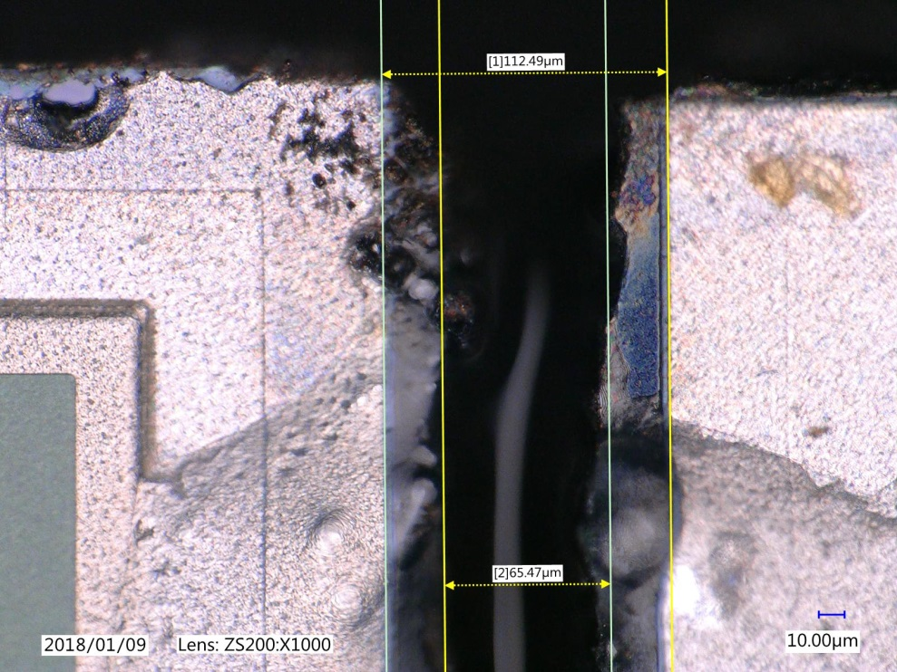
Gap
µm
Gap between Metallisation
all ladders production ladders
mean 107 µm 110 µm
rms 10 µm 11 µm

Slide 9
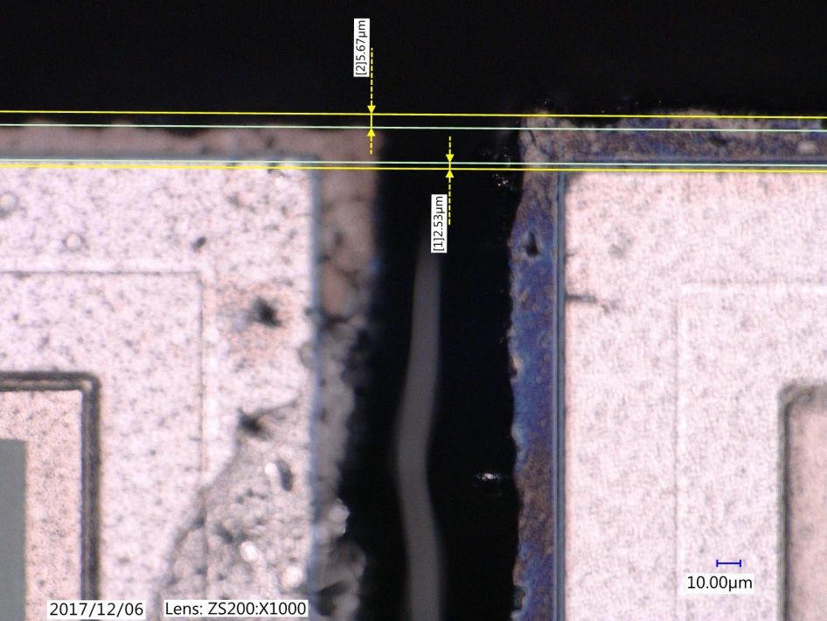
Lateral displacement
µm
Lateral displacement (metal)
all ladders
mean -2 µm
rms 10 µm

Slide 10
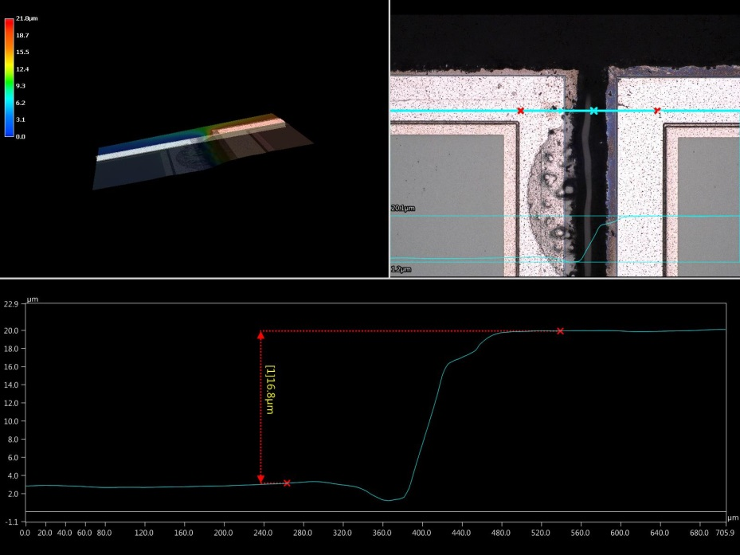
Height displacement
Protypes, before re-adjustment
µm
height displacement
all ladders production ladders
mean 11 µm 13 µm
Rms 14 µm 2 µm

Slide 11
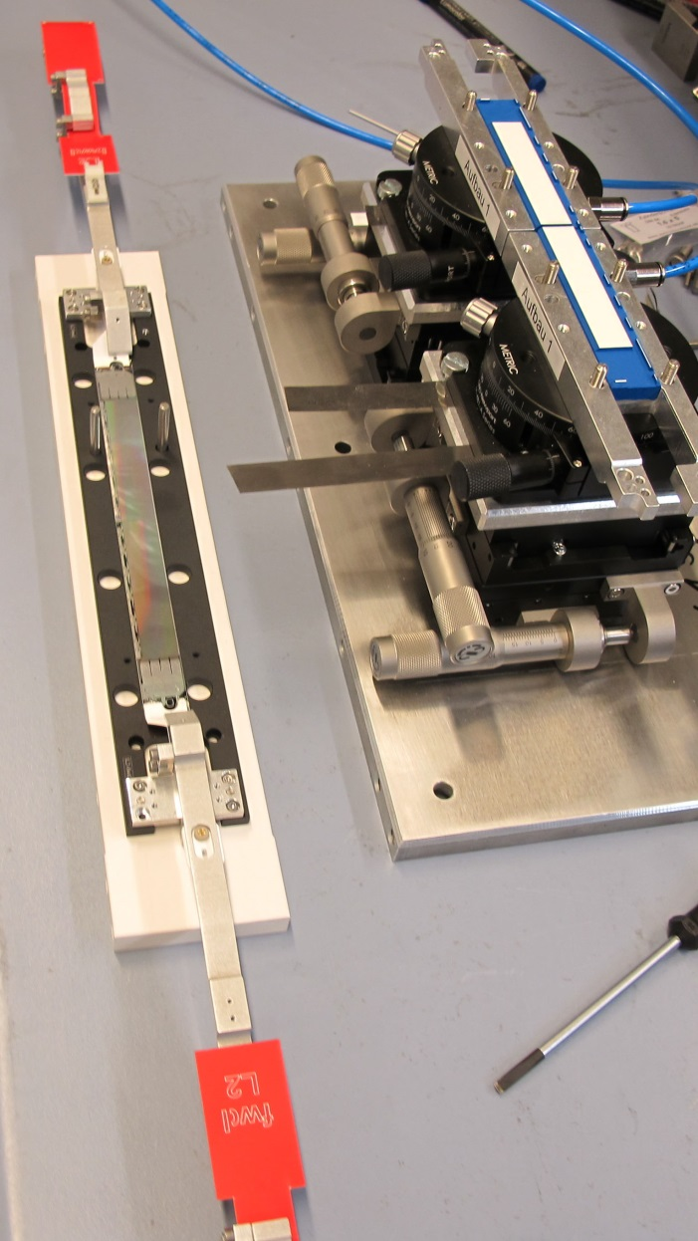
Summary
9 production ladders assembled
ladder IB/IF status
L1_13 38/49 broken during testing
L1_14 01/45 2nd grade
L1_15 02/47 ok
L1_16 47/44 ok
L1_17 44/32 ok
L1_18 41/41 ok
L1_19 43/03 damaged during testing, ~3 dead lines
L1_20 45/42 not yet electrically tested
L1_21 03/46 not yet electrically tested
5 good ladders ok for DESY half shell production
8 ladder functional (assuming 20 & 21 are ok) but 2 of them marginal
One more could be assembled now:
W42_IB (ok) and W02_IF (some dead lines)
=> More IF and IB modules needed for real prime ladders & spares

