Slide 1
DHPT Temperature Sensing
For Phase 2
Leonard Germic
University of Bonn

Slide 2
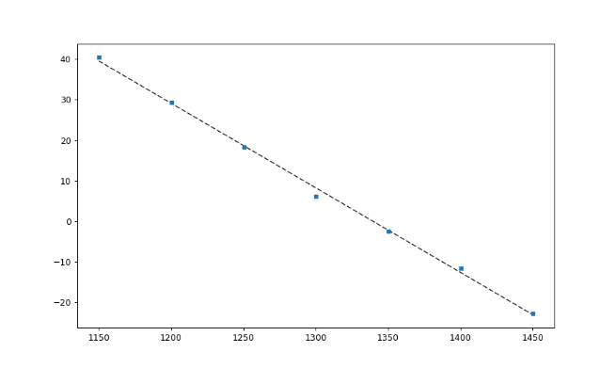
Why we cannot use the DHP Temp Sensor?
The DHP Temp Sensor needs a reference voltage
Nominal VDD=1.2V
Problem: Sensing not working properly; value of VDD?
Per design: The temperature has a linear dependency on VDD
$TDHP\left(VDD\right)=m×VDD+b, m<0$
$TDHP$[C]
VDD?
$VDD$ [mV]

Slide 3
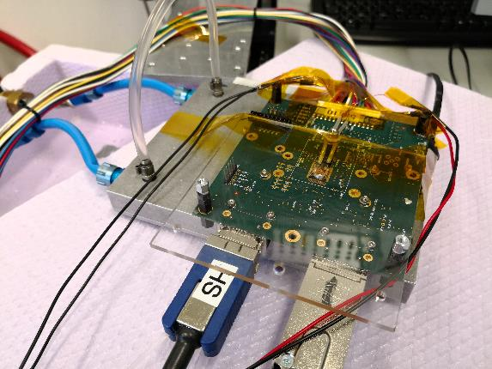
Measurements
Hybrid5.0.10 (DHPT1.1, DCDBv2)
Temp Sensor has not changed since DHPTv1.0
PT100 4-wire sensing
100Ω @ 0°C
T(R) dependency

Slide 4
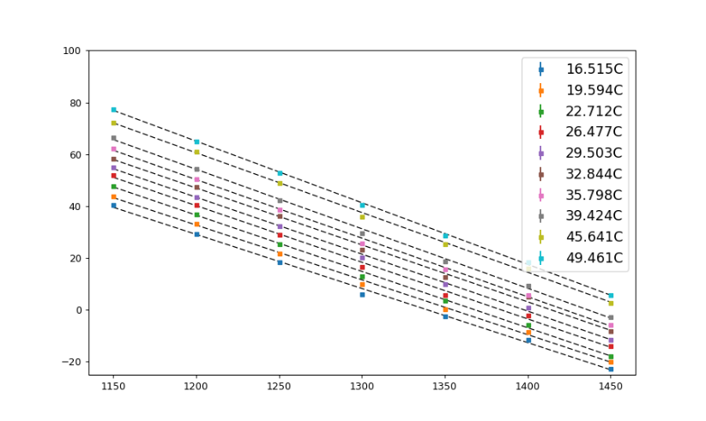
Measurements
Set chiller temperature from 0C to +50C (increment in 5K steps)
Measured T_{DHP}(VDD) with Hybrid5 and ‘true’ T_{PT100} with PT100
For each T_{DHP}-curve one ‘true’ temperature is assigned
T_{PT100}
DHP temp higher than chiller temp
T_{DHP} [C]
DHP temp lower than chiller temp
VDD [mV]

Slide 5
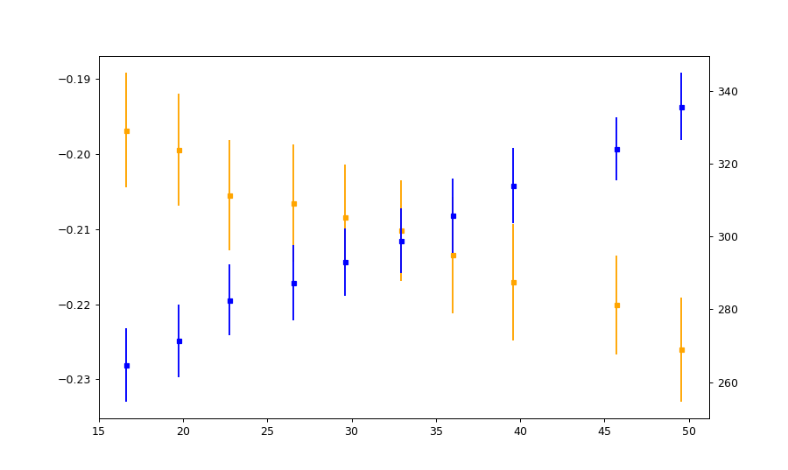
Measurements
Curve parameters $TDHP=b+m×VDD$
Intercept b does not supply any information since real VDD unknown
Slope m does supply information, but errors are to large!
$$slope m$$
Intersept b
m(T_{PT100})
b(T_{PT100})
T_{PT100} [C]

Slide 6
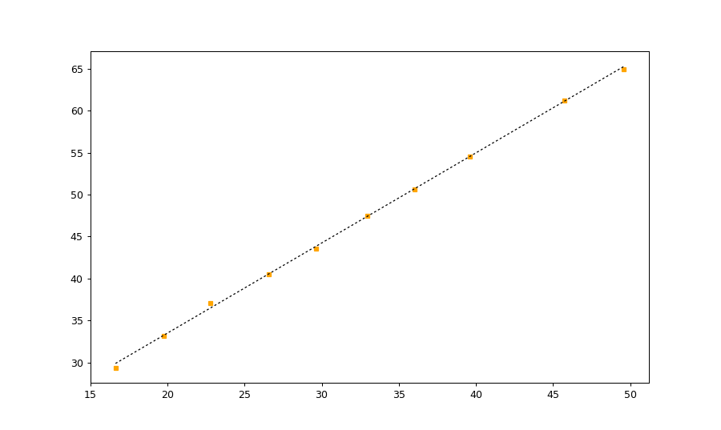
Measurements
Calibration curve for T_{DHP} vs T_{PT100} @VDD=1.2V
T_{DHP}(T_{PT100}) = 12.0(3) + 1.07(3) x T_{PT100}
Offset of +12C : DHP temperature measurement returns higher values
T_{DHP} [C]
T_{PT100} [C]

Slide 7
Conclusion
DHP temperature read-out withou VDD sensing not possible
DHP temperature calibration yields offset of +12C @ VDD=1.2V
DHP temperatures measurements returns higher values
Due to voltage drop the DHP temperature measurement returns significantly higher values than the real temperature.
Overestimation ->
T_{DHP} [C]
Voltage drop
VDD [mV]

