Slide 1
BonnDAQ Work Packets for final Development
Florian Lütticke

Slide 2
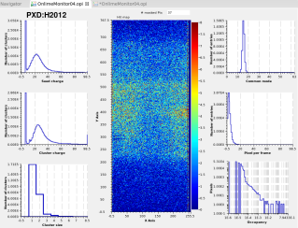
Current Idea for BonnDAQ
HLT
x 8
DHE
DHE
ONSEN
EVB
DHE
DHC
Express Reco
DHE
DHE
Simplified
BonnDAQ
Subset of events
Standalone DAQ running without HLT for
PXD Calibration data
PXD DQM on full data (no ROI)
measuring ROI efficiency, Slow Pion rescue
Proven useful during test beams
Currently: standard lab tool for measurements

Slide 3
Current status of BonnDAQ – Lab Version (12/2017)
CMD Client(s)
CMD Client(s)
CMD Client(s)
Keyboard Command Decoder
TCP Command Server
Thread
Data structure
Main Thread
dh<x>_receiver.cpp
Control
Statistics/ Health
Write/Control
Read/React
Read/React
DHE/DHC Receiver Thread
Buffer 1
Data Distribu-tion Server
Buffer 2
File Writer Thread
Socket
DHE/DHC
File
Compression thread pool
Compression thread pool
Compression thread pool
Data listener(s)
Error log file
Listener
Data File
Listener

Slide 4
BonnDAQ for Belle II – integrated threads
Create multiple DH<x> threads and build events
Easy to control, one file for all data, full online events.
Needs powerfull machine
CMD Client(s)
Keyboard Command Decoder
TCP Command Server
BonnDAQ instance
Control
Statistics/ Health
DHE/DHC Receiver Thread
Event building and sorting
Data Distribu-tion Server
File Writer Thread
DHE/DHC Receiver Thread
Buffer 1
Buffer 3
DHE/DHC Receiver Thread
Buffer 1
Buffer 2
Buffer 1
DHE/DHC
DHE/DHC
DHE/DHC
Compression thread pool
Compression thread pool
Compression thread pool
Error log file
Data listener(s)
Data File
Error log file
Error log file

Slide 5
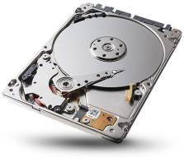
More than just a DAQ
DAQ Health and Status
EPICs Server,
CMD client
BonnDAQ
DHE/DHC
DHE/DHC
DHE/DHC
Communicates with BonnDAQ
Development for
Phase 2 and Phase 3
CS-Studio GUI
DQM
EPICs Server,
Data listener
DQM
EPICs Server,
Data listener
DQM
EPICs Server,
Data listener
DQM
EPICs Server,
Data listener
Maintain
compatibility
Measurement Script
Uses pyDepfetReader.TCPReader for data subscripton
Uses pyDepfetReader.FileReader for Analysis
Communicates with BonnDAQ

Slide 6
Current development status
Mandatory (or done)
Port to newer threading model Done!
Develop tools for test bench Done!
Create event builder for multi DHC events
Create new file format: supports large events, has less overhead
Implement live data support for multi DHC events
Implement support for new format in pyDepfetReader
Optional:
(fix) Data compression (currently switched off)
Performance tests and optimizations

Slide 7
Cost estimates
BonnDAQ is mission critical.
We need a backup system!
Phase 2 Server
(Doubles as Phase 3 Backup)
8 Core Server
32-64GB RAM
8x 1 Gbit Ethernet ports
From Dell: 4000 Euro
Homemade: 2000 Euro
Phase 3 Solution
24-32 Core Server
64GB RAM
8x 1 Gbit Ethernet port
7000-10000 €
We need information if we can use KEK Storage!

Slide 8
Conclusion
Unified BonnDAQ already needed for Phase 2.
Development currently on hold. I will continue after my thesis defense, but that is more important to me right now.
Time estimate: Mid to End of Feb, 2018.
Components for a self-made server selected. Need to be ordered to Japan.
We need information if we can use KEK Storage!

Slide 9
Thank You

Slide 10
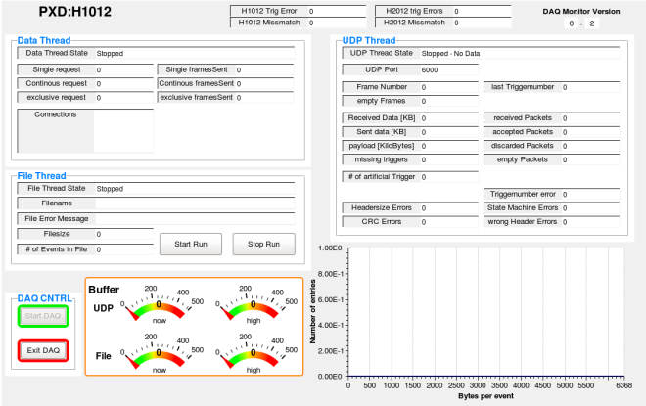
BonnDAQ: EPICS Integration status
DAQ Health module (python + CS-Studio)
Shows status of threads, filename, file size, connected clients (for live data), buffer fill status, error counts etc.
Creates EPICs server, requests DAQ status and publishes EPICS variables.
OPI display available
Used in testbeams
Trigger mismatch display bad
Start/Stop buttons sometimes crash.
Stability testing needed
Sometimes does not reconnect when BonnDAQ is restarted

Slide 11
BonnDAQ: EPICS Integration status
DQM display (python + CS-Studio)
Uses pyDepfetReader.TcpReader
Gets live data and calculates hit map, Seed/Cluster histogram, pixel occupancy histogram, common mode histogram, event size histogram
Creates EPICs server and publishes results
OPI display available
Used in testbeams
~500 frames/sec
two PXD modules, single thread
~25 frames/sec for 40 modules
Currently can only handle 1 DHC (5 DHEs)
OPI Display has hardcoded DHE IDs
Clustering only in space not in time.
Single threaded

Slide 12
Development Work Packets

Slide 13
Work packets
Port from pthread
Develop new File format
Basic
Efficient
Develop event building thread
Implement group event support in data distribution thread
Performance Fixes:
Use Buffers
Unwrapping UDP in Userspace
Compression
Port to new BLOSC version
Implement faster compression
Develop test bench

Slide 14
Port from pthread to native c++11 thread/mutex
Current way of starting multiple threads not scalable
Pthread is not portable
C++11 threads and mutexes have a much nicer interface
Remove startup variables form shared variables. This separates inter-thread communication from non-critical variables.
Time estimate: 2+ 1(testing) days.
Current status: finished, tested and pushed to master
Priority: Recommended

Slide 15
Develop new file format - basic
Current file format supports only up to 4MByte/event, we need up to 8MByte/event.
Expand to 16MByte/event
Idea: Single DH<x> are stored as sub-events in a event group
Store each single DH<x> frame as header + data
Time estimate: 2+ 2(testing) days.
Current status: not started
Priority: Critical for Phase 3, optional for Phase 2

Slide 16
Develop new file format - efficient
Create more efficient data format
Use one TOC per event instead of header+data sequence
Check data and remove redundant information if everything is ok:
Remove CRC checksum on each frame and replace by one global checksum
Remove end of event frame (implicitly given)
Remove redundant parts of DH<x> frame (trigger, DHE ID…)
Time estimate: 0.5(research) +2 + 2(testing ) days.
Current status: started, 1 day in
Priority: optional

Slide 17
Develop event building thread
Gather data from single DH<x> receiver threads
Built event groups from these.
Time estimate: 2 + 1(testing + debug) days.
Current status: 1 day in,
Priority: critical

Slide 18
Implement group event support in data distribution thread
Basic support – client can receive full events
Time estimate: 0.25 + 0.25(testing) days.
Current status: not started
Priority: Critical
Full support – client can select sub-event
Time estimate: 1 + 1(testing) days.
Current status: not started
Priority: optional

Slide 19
Performance – use buffers
Faster receiving and no dynamic memory allocation.
First gather all (UDP) frames and then write event at once
Complete rewrite of receiver and event checking needed
Time estimate: 4 + 2(testing) days.
Current status: not started
Priority: optional, but now would be best time. When starting data

Slide 20
Performance – Unwrapping UDP in Userspace
Don’t let linux kernel handle hardware but do it in BonnDAQ.
Massive performance improvements possible
Much better scaling when using several connections
Time estimate: unknown.
Current status: not started
Priority: please don’t

Slide 21
Performance – other
Check NUMA, fix thread to core associativity
Quite large improvement in cache locality possible
Time estimate: unknown. Implementation rather short.
Current status: not started
Priority: please don’t.

Slide 22
Compression: Port to new BLOSC
Implement new BLOSC version which supports faster context switches and compression with more cores.
Needed for new compression algorithm zStandard.
Time estimate:
Porting is rather fast but breaks backward compatibility. 2+1 days
Creating a backward compatible solution: 5+3 days.
Current status: not started
Priority: optional

Slide 23
Develop test bench
Develop DH<x> simulation
Time estimate: 1 + .5(testing) days.
Done
Develop raw data reader (like pyDEPFET reader but w/o interpretation)
Time estimate: .5 + .25(testing) days.
Done
Implement tests
Time estimate: 1 + .5(testing) days
Basic tests developed, already found an old bug ☺
Current status: Infrastructure there, further tests tbd.
Priority: recommended

Slide 24
File format
Event header
Seqeuence of packets:
128bit Header (with size)
Payload package
Event header
Table of contents TOC
Number of packets, type of TOC.
List of frame sizes
List of Payloads.

Slide 25
Cost estimates
Cost estimate:
Buying complete server is considerably more expensive.
Phase 2 Solution
(Doubles as Phase 3 Backup)
8 Core Server
32-64GB RAM
8x 1 Gbit Ethernet ports
From Dell: 4000 Euro
Homemade: 2000 Euro
Phase 3 Solution
24-32 Core Server
64GB RAM
8x 1 Gbit Ethernet port
7000-10000 €
We need information if we can use KEK Storage!

Slide 26
Data Reduction summary
Data per Scan
Reduction | None | Medium | Strong | Very Strong
Pedestal | 7.5 GB | 0.4 GB | 0.14GB | 0.008GB
Offset | 400 GB | ~115GB | 20GB | ~ 5 GB
Delays | 10 GB (0.1GB) | 0.01 GB | - | 0.0001GB
ADC curve * | 80 GB (8 GB) | 0.8 GB | - | 0.01 GB
Data for lifetime
Reduction | None | Medium | Strong | Very Strong
Pedestal x 6000 | 45 TB | 2.4 TB | 0.84 TB | 0.048 TB
Offset x 400 | 160 TB | ~46TB | 8 TB | ~ 2 TB
Delays x 100 | 1 TB (0.01TB) | 0.001 TB | - | 0.00001TB
ADC curve ** | 200 TB (20 TB) | 2TB | - | 0.025 TB
* Single Setting, all ADCs
** Assuming 50 Scans during lifetime with RefIn/AmpLow, IPSource/IPSource2, 5 values for each setting (2 * 5 * 5 measurements), scan over all channels

