Slide 1
FOS status (a very succinct summary) and proposal for phase-3 funding
Belle-2 PXD Workshop
DESY, January 22, 2017
I. Vila
Instituto de Física de Cantabria
(CSIC-UC)

Slide 2
FOS at phase-2 in a nutshell (details in tomorrow’s talk).
FOS based temperature and humidity sensors installed on both FANGs.
Highlights:
System installed and commissioned ( integrated in EPICs)
The sensors were pre-irradiated to saturate the radiation-induced response bias.
Temperature sensor smooth running (no change in sensitivity after irradiation).
Humidity sensors:
no-change in sensitive after irradiation.
Latency τ ∼ 10’ with respect to the stimulus.
Low-Humidity Induced offset drift.

Slide 3
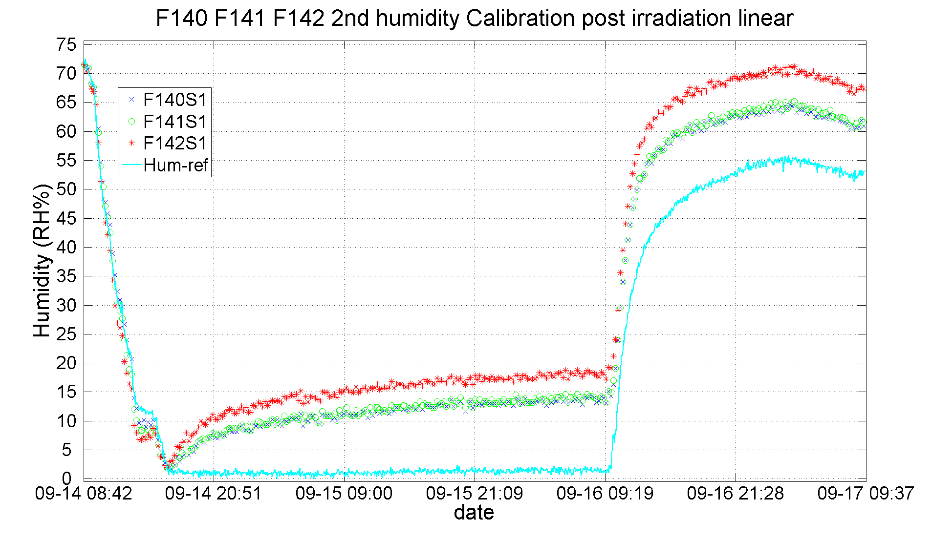
Low-Humidity-Induced Off-set (LHIO)

Slide 4
Phase-3 funding proposal (2)
No dedicated fund for PXD/Belle-2 at Santander but the lion share of the effort completed during phase-2.
Request to fund the phase-3 additional costs (fungibles, equipment & travels)
Existing baseline Proposal:
Ten monitoring fibers in the PXD envelop (5 Temp & 5 RH)

Slide 5
Phase-3 funding request (2)
Advanced student/post-doc secondment at Santander for two months in 2018 (in two periods):
trained for the phase-3 system commissioning.
Additional budget estimate (no personnel).
Concept | Amount (K€)
Fungibles (fibers) | 5.5
Full Daq Option (dedicated PXD daq) | 18
No daq Option (Integration SVD daq) | 1.4
Irradiation burn-in | 2.2
Travels (Japan) | 8.0

