Slide 1

Data Acquisition
Krzysztof Wrona
ITDM
Schenefeld, 08.12.2017

Slide 2
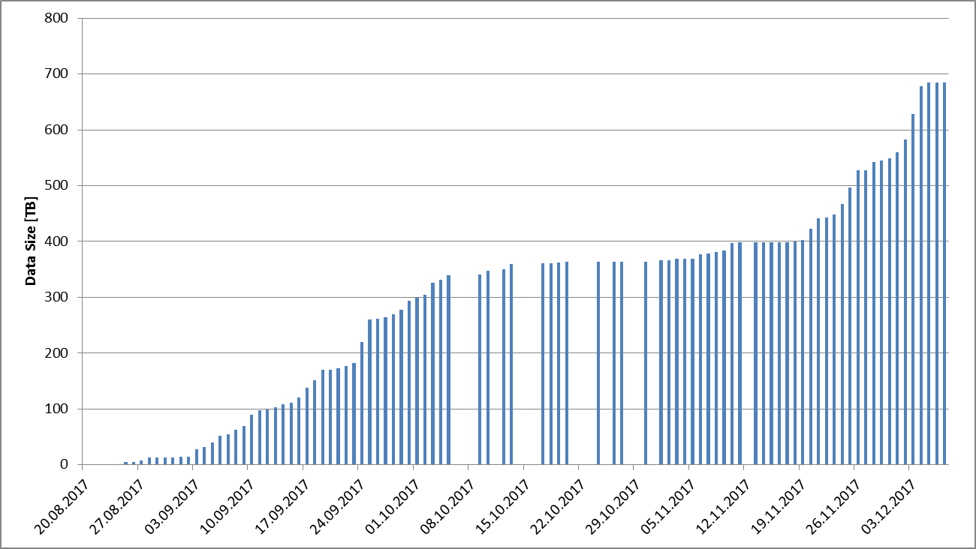
All generated data
Includes User Experiments and Commissioning Activities
FXE, SPB/SFX instruments and SASE1 tunnel

Slide 3
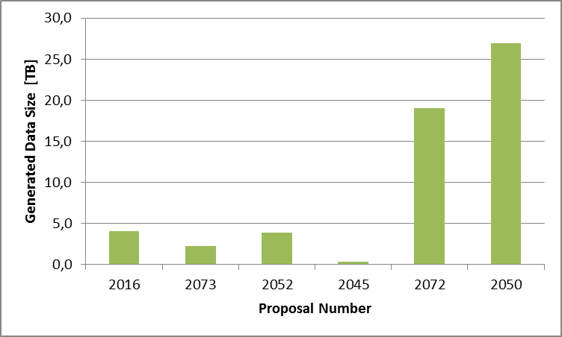
Generated Data at FXE
6 proposals
  2016, 2073, 2052 - September
  2045 canceled beamtime

Slide 4
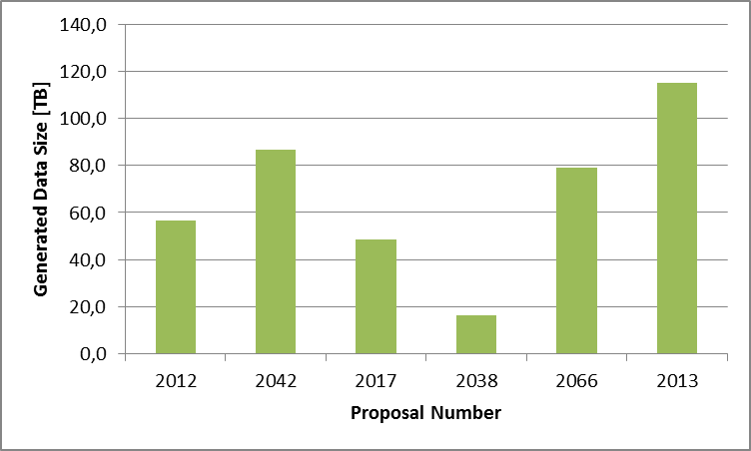
Generated Data at SPB
6 proposals
  2012, 2042, 2017 – September
  2038 – canceled, dark runs only
  2066 – 4 shifts only

Slide 5
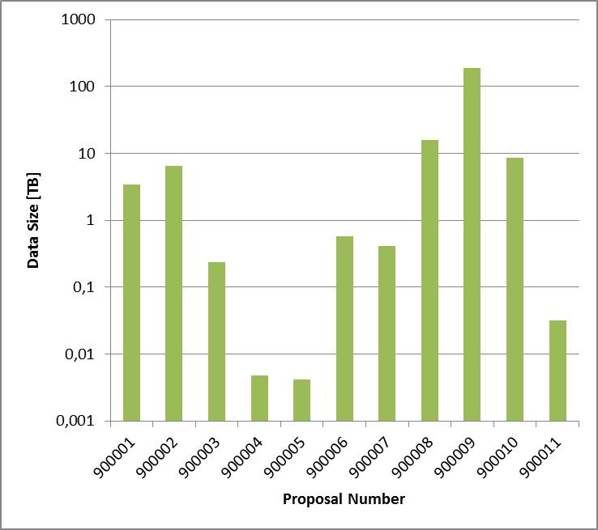
Other activities
Commissioning beam time (internal proposal number)
Note logarithmic scale
FXE Commissioning |  | 900001 | 3,4
LPD Commissioning |  | 900002 | 6,6
LPD DAQ Commissioning |  | 900003 | 0,24
Tunnel DAQ commissioning |  | 900004 | 0,005
AGIPD Calibration Commissioning |  | 900005 | 0,004
First LPD commissioning |  | 900006 | 0,58
SASE1 Tunnel commissioning |  | 900007 | 0,41
SPB DAQ commissionning |  | 900008 | 15,8
SPB/SFX commissioning |  | 900009 | 191,2
DAQ tests |  | 900010 | 8,6
DAQ tests 2 |  | 900011 | 0,03

Slide 6
Run Sizes
Histogram of data size per run in GigaBytes
Many small runs <25GB (e.g. no 2D detector)
The peak around 300GB comes from AGIPD
Few very large runs
Run data size [GB]

Slide 7
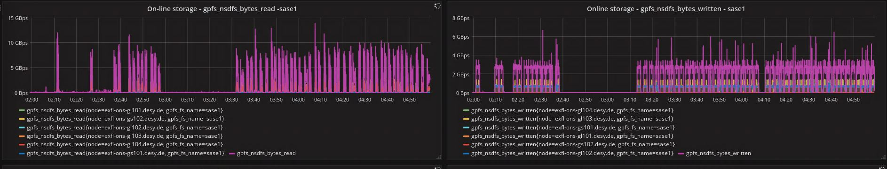
Data rates
Single run
Example: SPB – 2-17-12-03
  Typical data acquisition rate 3.5 GigaBytes/sec
  Typical data rate for migration to offline cluster: 7-10 GigaBytes/sec

Slide 8
Where is your data? What next?
Where is your data now?
  Data is still stored on the online cluster
  Data is stored also in GPFS offline cluster
  Data is copied to dCache and archived on tape media
What next?
  We are cross-checking the online – offline data to be sure that nothing is forgotten or lost?
  We will contact you in case we see some discrepancy or runs which were not requested to be migrated
  We will delete online files when everything is clear – latest by mid January
  At some point we will also need to remove raw data from offline GPFS. We will propose a procedure when we know better how much we can relay on processed (calibrated) data – February 2018 (?)
  We will create new internal beamtimes for commissioning starting from Jan 2018 – probably for the duration of c.a. 3 months – see https://in.xfel.eu/metadata

