Slide 1
Shutdown December
Progress
Notes:
How to edit the title slide
Upper area: Title of your talk, max. 2 rows of the defined size (55 pt)
Lower area (subtitle): Conference/meeting/workshop, location, date,
your name and affiliation, max. 4 rows of the defined size (32 pt)

Slide 2
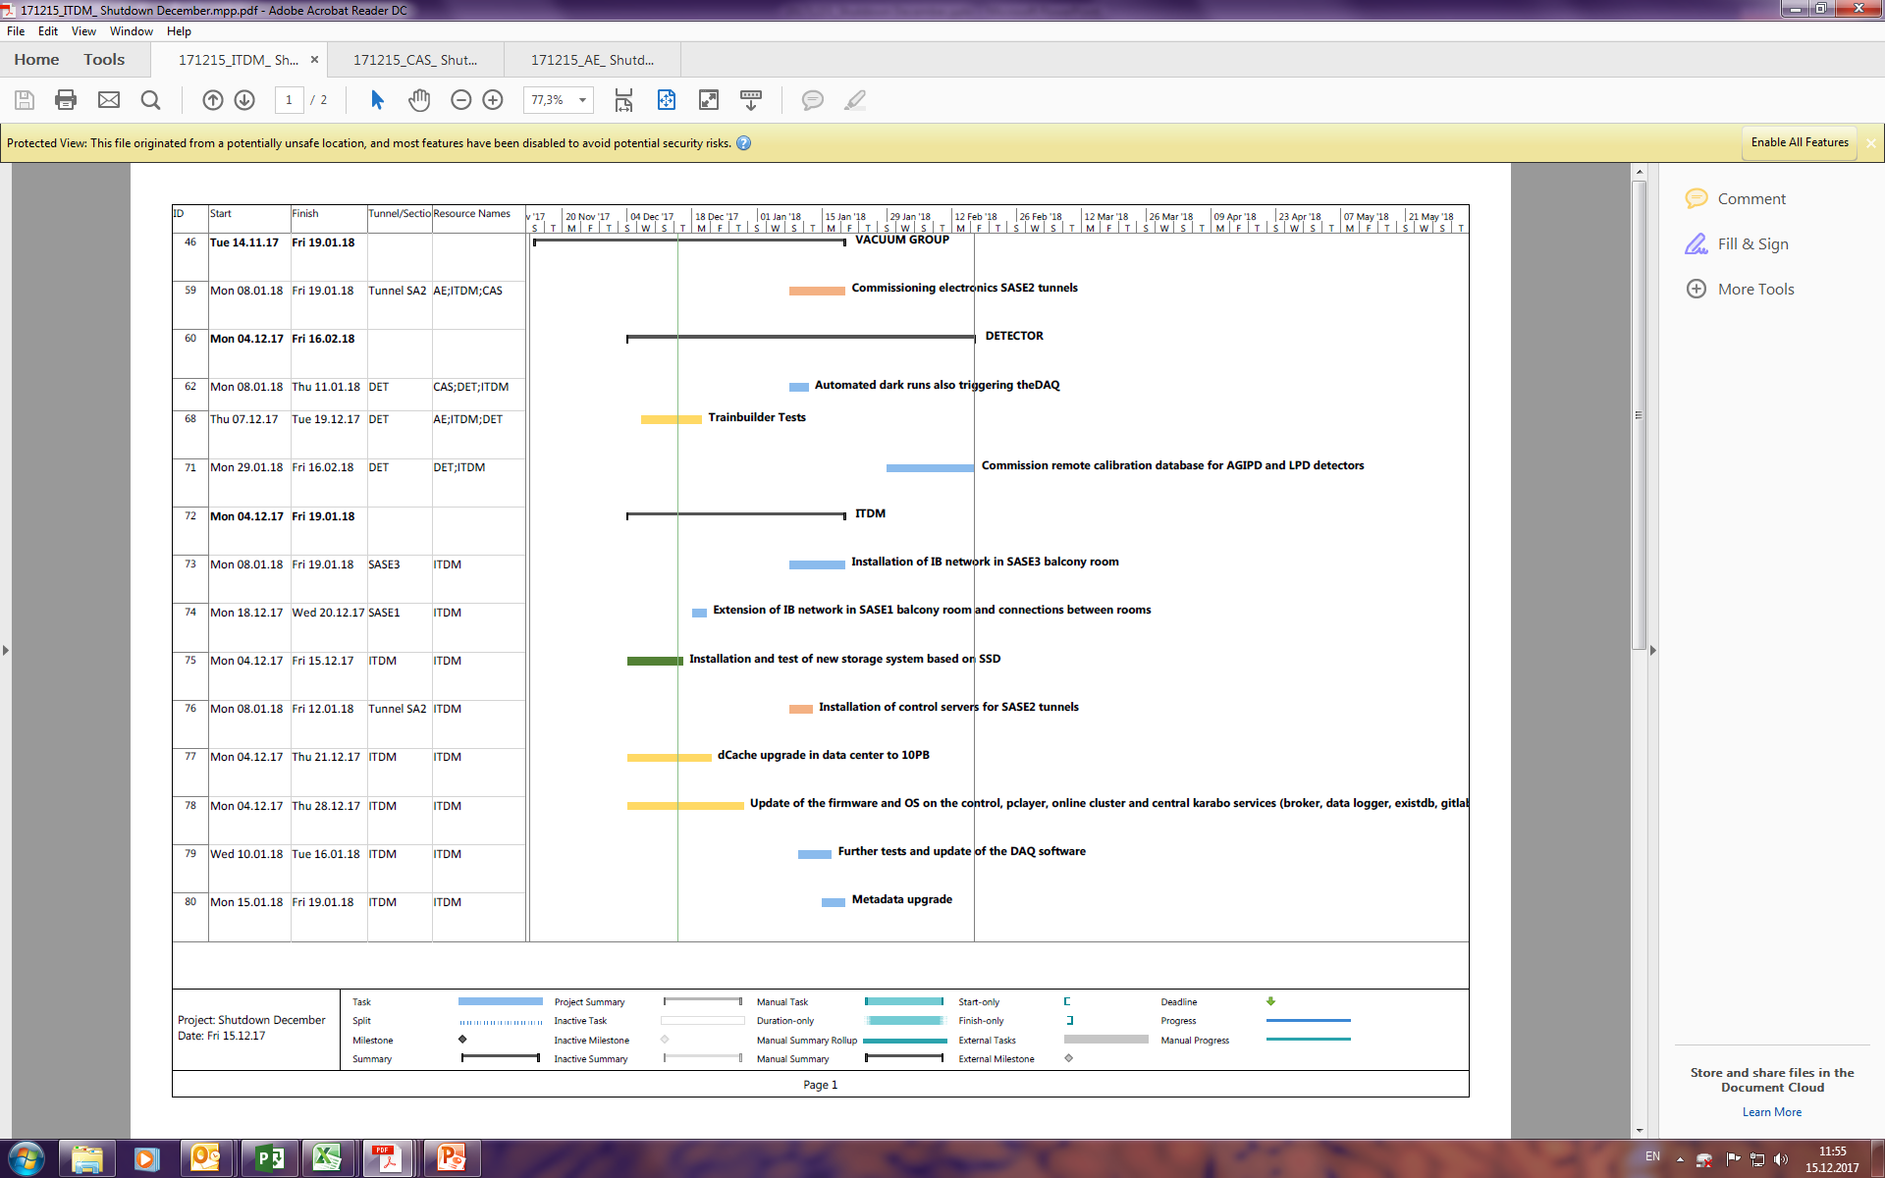
ITDM
Feedback from AE

Slide 3
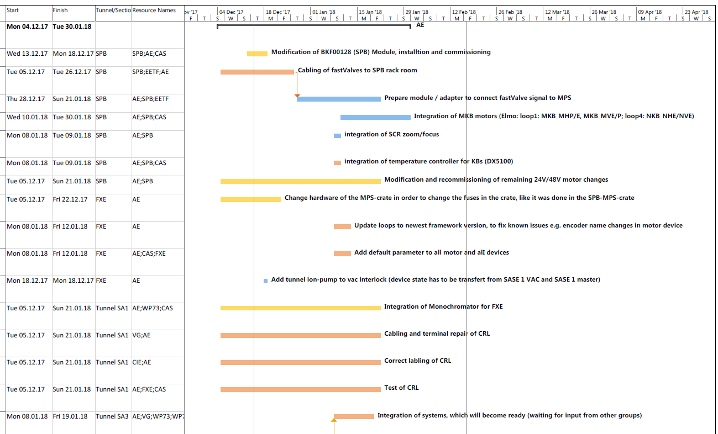
AE

Slide 4
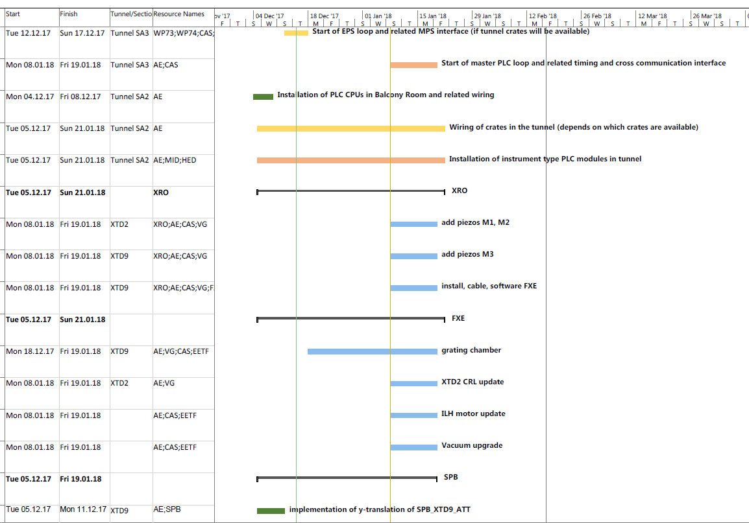
AE
Not installed, to schedule
Not installed, to schedule when CRL ready

Slide 5
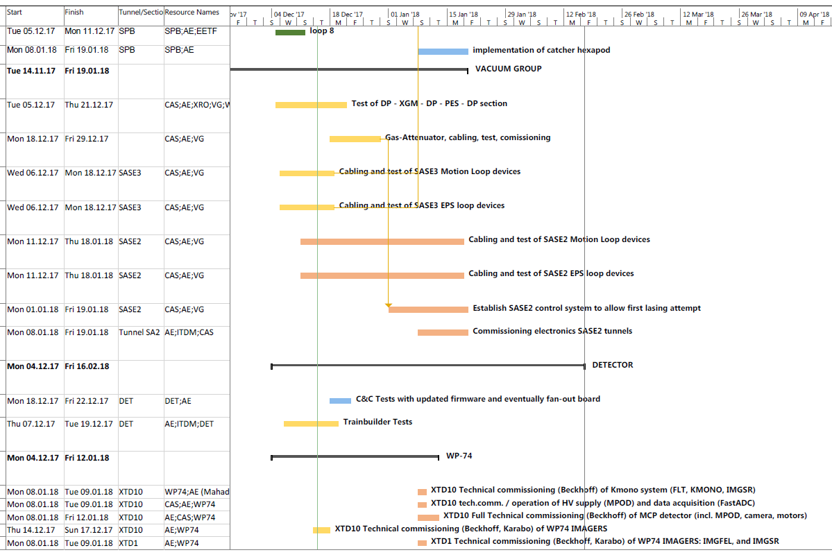
AE

Slide 6
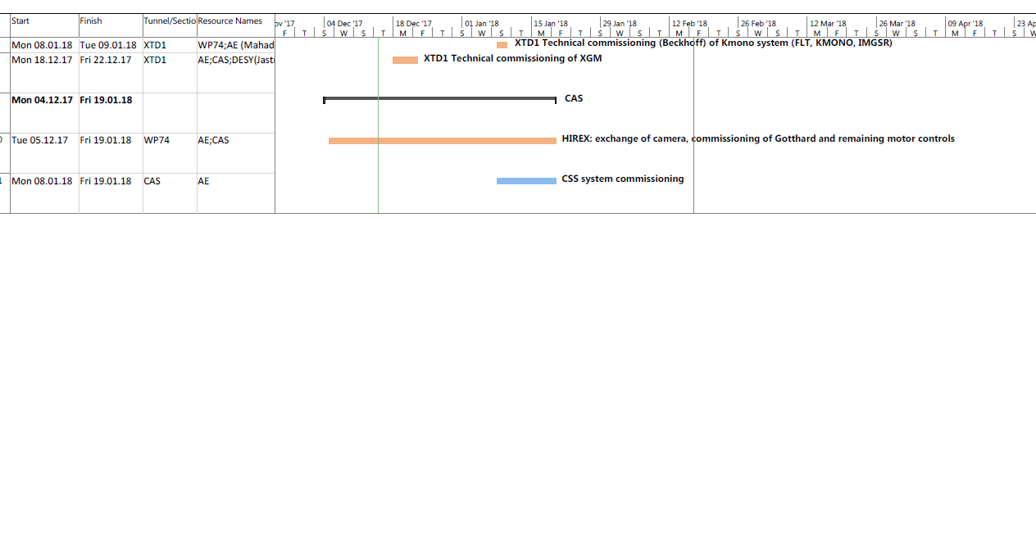
AE

Slide 7
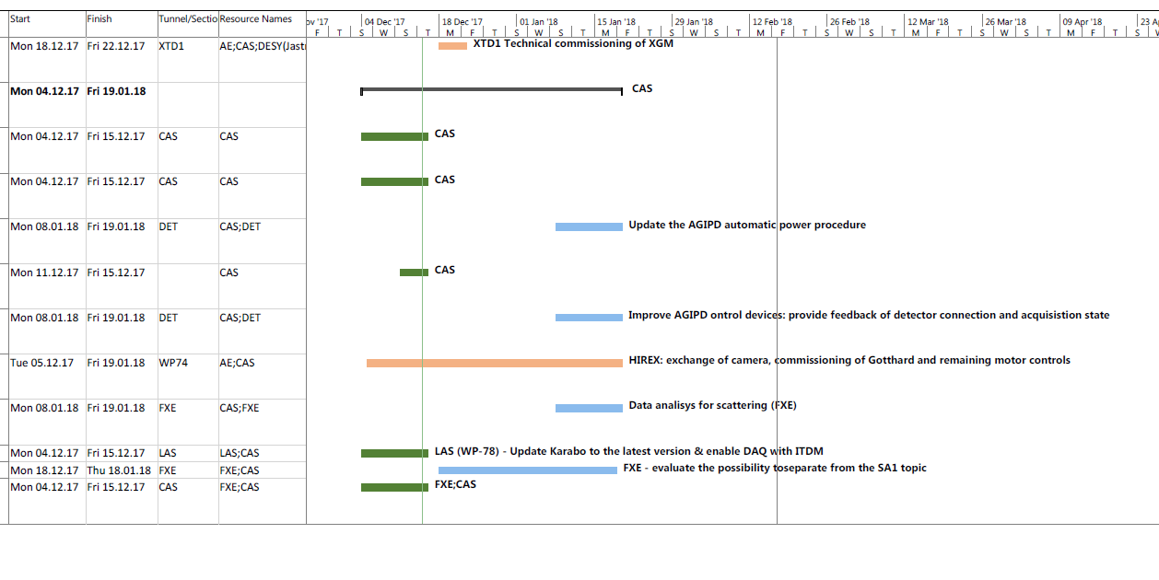
CAS

Slide 8
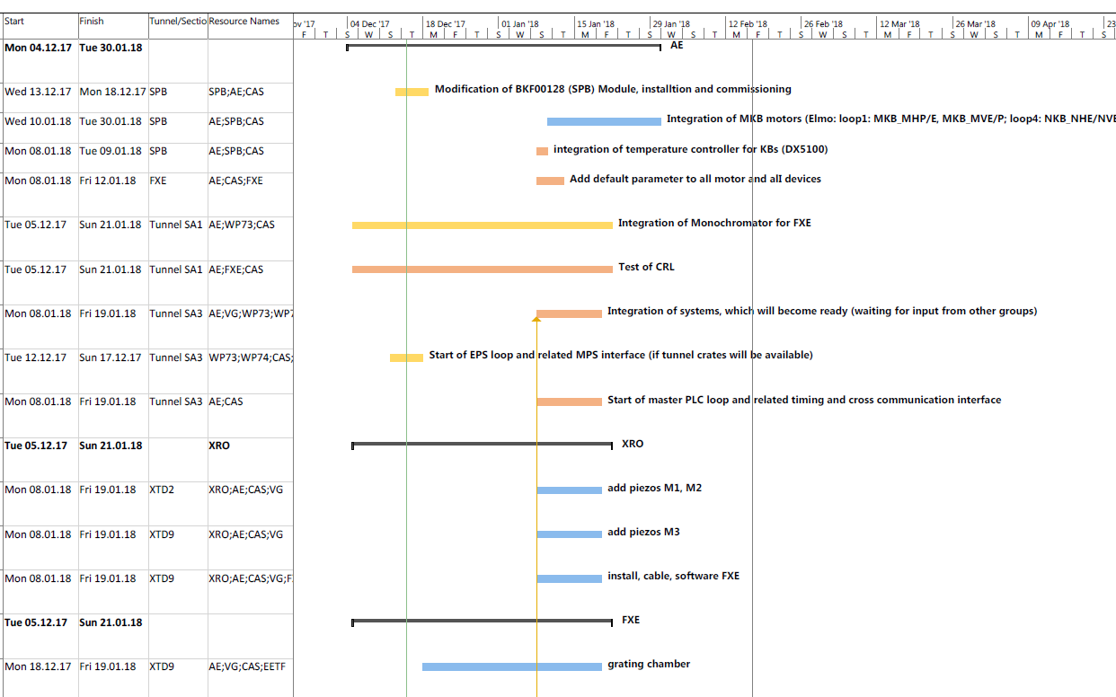
CAS
Not installed, to schedule
It's important to know the order the systems can be tested, is it SMONO, M1, M2, M3?

Slide 9
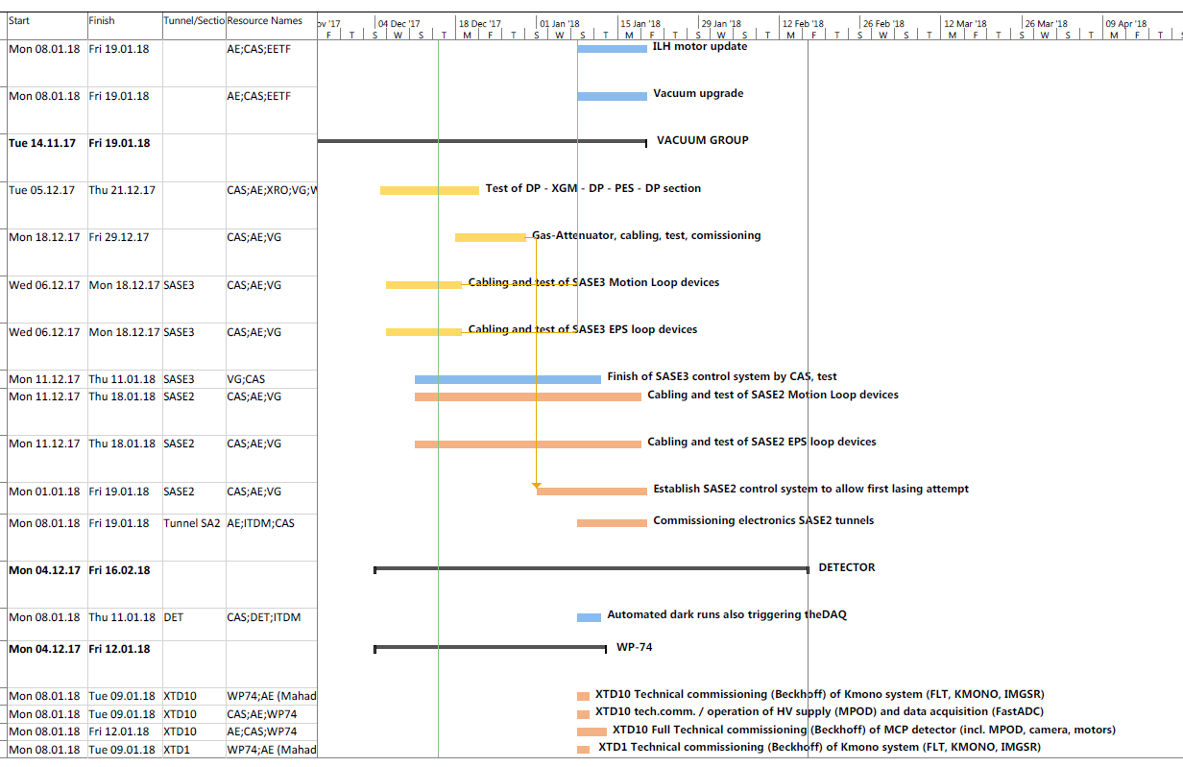
CAS

