Slide 1
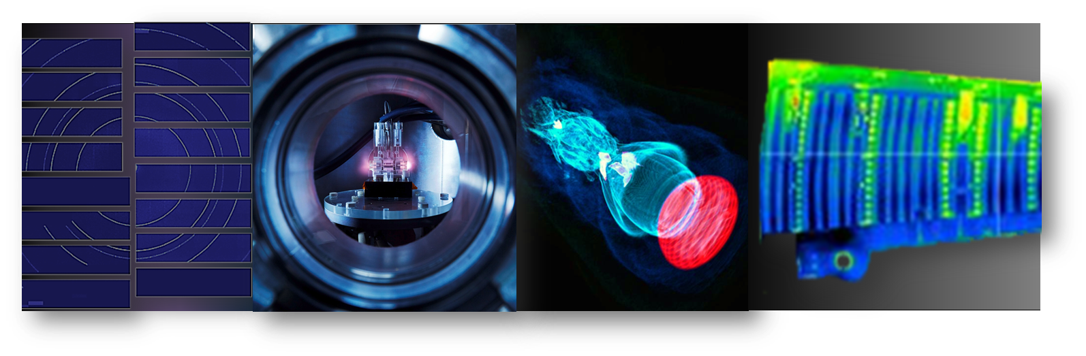
ASICs and Sensors
Hybrid systems
Helmholtz Program: Matter and Technologies
PoF III Topic: Detector Technology and Systems
DESY Research Unit: Detectors
David Pennicard
Center Evaluation DESY, 5 – 9 February 2018

Slide 2
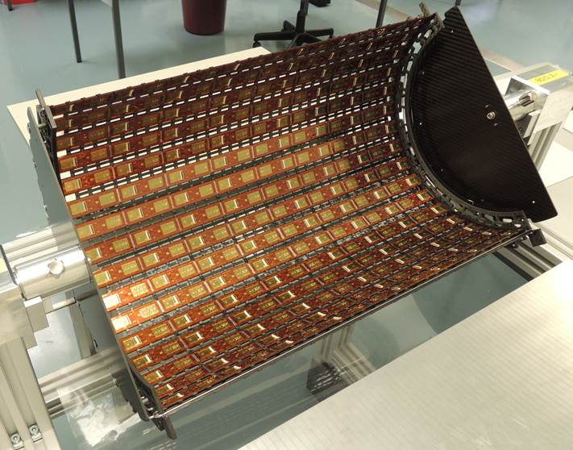
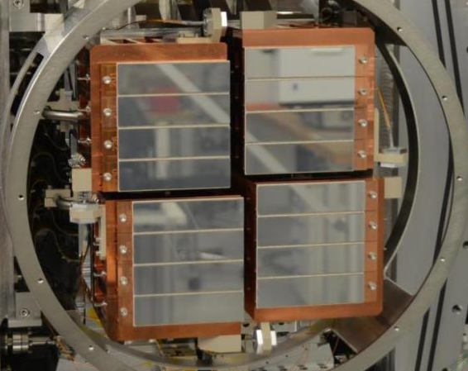
ASICs and Sensors
Hybrid detectors in DESY research
Versatile technology used in many experiments
Detectors for tracking and vertexing in particle physics (LHC @ CERN)
  ATLAS strips, CMS strips and pixels
Detectors for X-ray detection at synchrotrons and FELs
  Eu.XFEL, PETRA, FLASH
CMS pixel barrel
AGIPD detector for Eu.XFEL
Notes:
Consider reordering…
Stress DESY activities – general bit at start.
Other areas? E.g. CFEL applications, spinoff (e.g. medical)
Light sources
Why DESY contributing to this? – Unique requirements?
Challenges and opportunities.
In turn, advances in accel tech and new experiments
POSS MOVE ASIC STUFF TO FRONT? LIST OF STUFF WE DO?
CMS or ATLAS strips? Picture?
Requirements…
FLASH – Gotthard strips
DELETED challenges section - avoid repetition. But what is the message? Next slide illustrative examples.

Slide 3
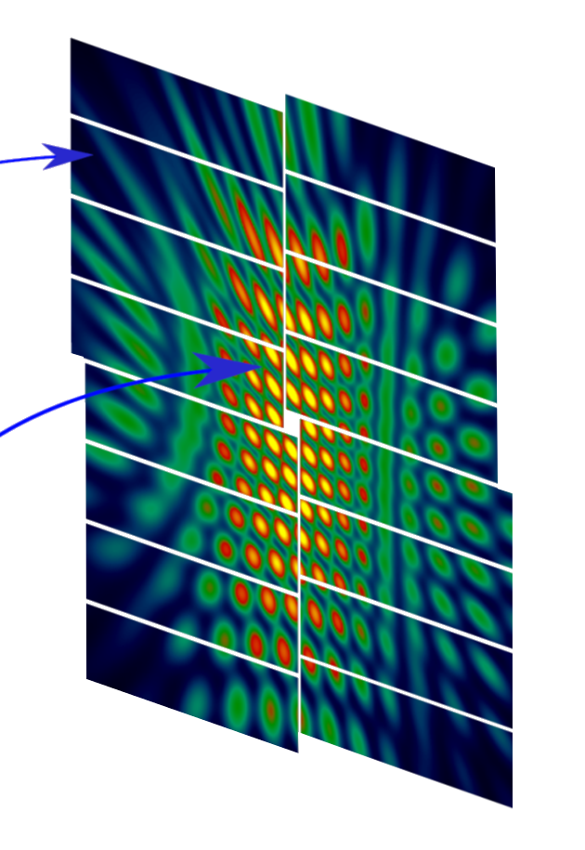
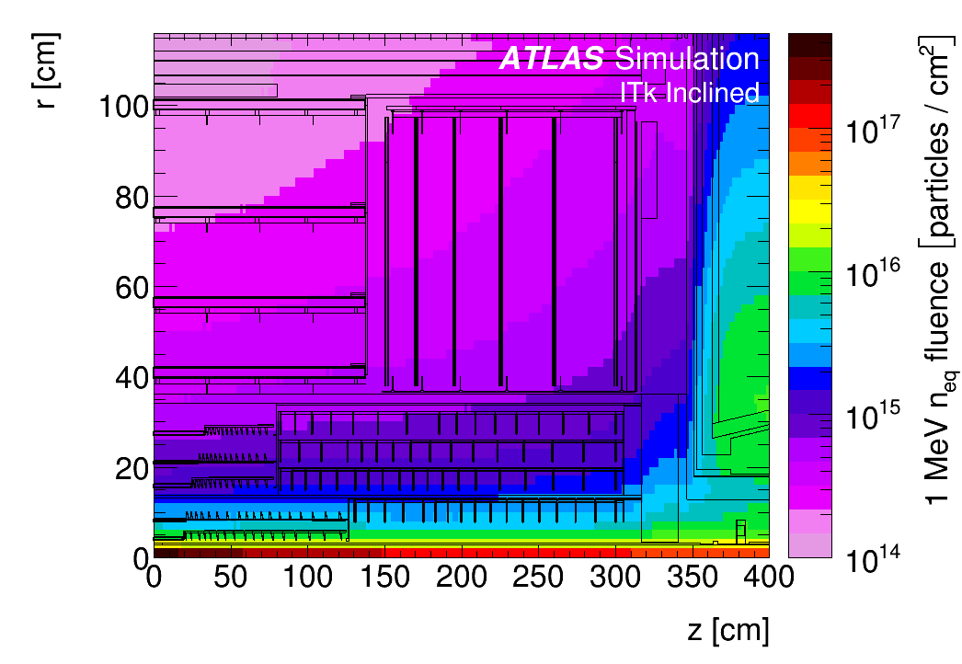
ASICs and Sensors
Challenges
European XFEL – High repetition rate X-ray laser
LHC upgrades – high radiation environment
100 ms
1 photon
at 12 keV
600μs
99.4 ms
10⁴ photons
<100 fs
220 ns
Up to 1 GGy dose during lifetime
Strip Sensors
Notes:
Better transition…
Data rate – mention for LHC – 10G
To meet requirements of new experiments, both customize sensors and asic to meet specific requirements
XFEL – Common feature of FEL dynamic range. Unique feature is bunch train structure of
Improvements in acc technolog – generic challenges such as speed, segmentation, etc. Key message?
Extremely large dynamic range, burst imaging at 4.5 MHz, large dose
Challenges – both customization and generic (speed, rad hardness)
4.5 MHz – no trigger
Need facts and figures
Intense worldwide R&D.
https://indico.desy.de/indico/event/16431/contribution/10/material/slides/0.pdf - can mention DAF perhaps?
Question – presentation says 5000 modules, 6 endcap disks – but looks different here?
5000 modules
All silicon tracker, higher radiation – don’t overdo systems aspect
What to say? Refs elsewhere? Previous stuff – speed, precision, radiation hardness

Slide 4
Meeting the Eu.XFEL challenge: AGIPD ASIC
Ultrafast X-ray imager
Sensor
Electronics per pixel
Pixel matrix
AGIPD ASIC
Developed by DESY and PSI
Adaptive gain integrating amplifier
  Single 12 keV photon sensitive
  Maximum signal 10⁴ photons
4.5 MHz frame rate
  Analog memory pipeline
  352 images
Radiation-hard design (10 MGy)
…
HV
Analog Mem
CDS
Read Out bus
+
SW
RO Amp
-
CTRL
DAC
Analog Mem
THR
…
Chip output driver
Mux
ASIC periphery
Notes:
Focus on ASIC development

Slide 5
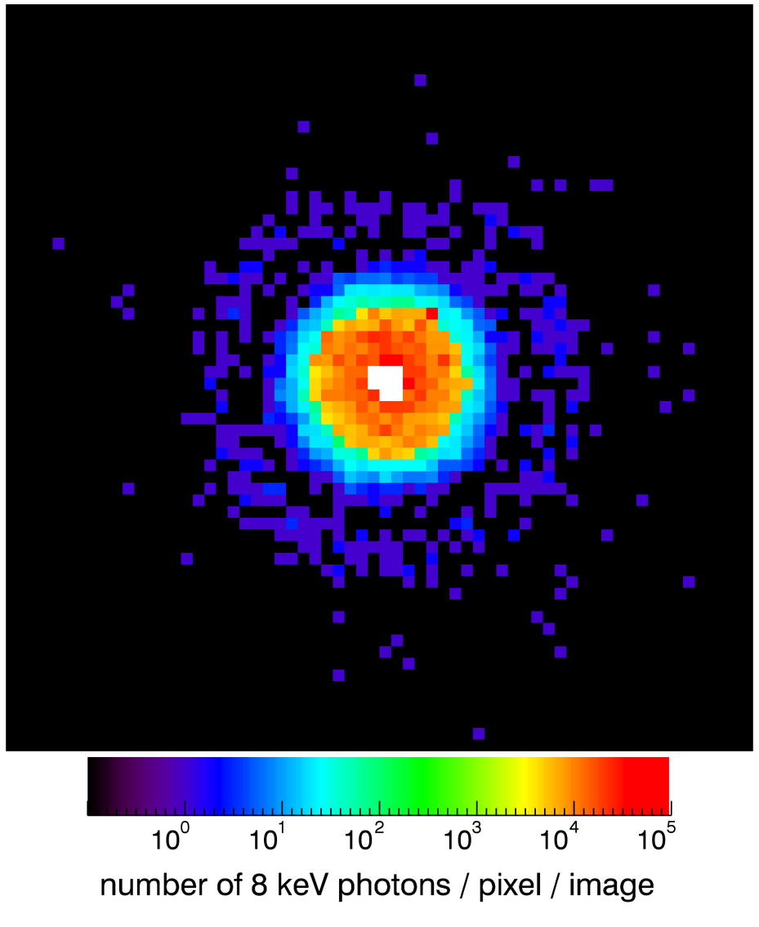
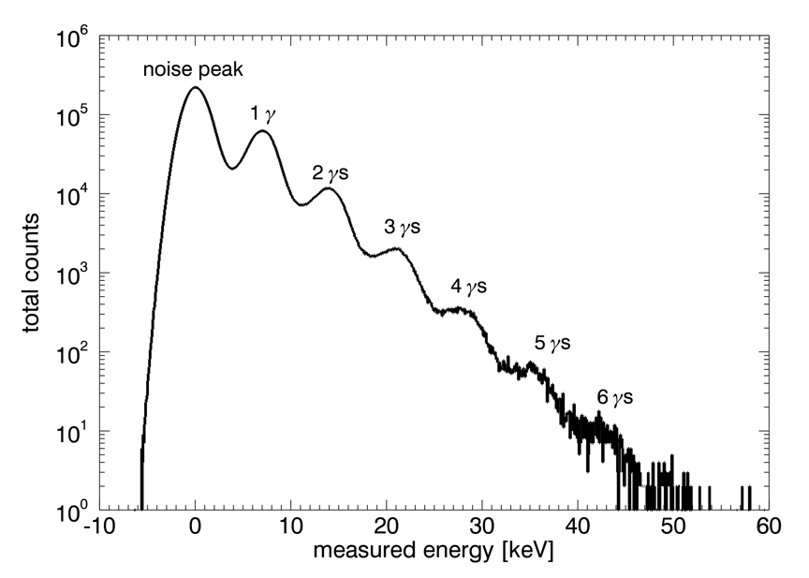
Meeting the Eu.XFEL challenge: AGIPD ASIC
Ultrafast X-ray imager
AGIPD ASIC
Developed by DESY and PSI
Adaptive gain integrating amplifier
  Single 12 keV photon sensitive
  Maximum signal 10⁴ photons
4.5 MHz frame rate
  Analog memory pipeline
  352 images
Radiation-hard design (10 MGy)
Imaging the direct X-ray beam at PETRA-III P10
Notes:
Big up PETRA-II I beamtime

Slide 6
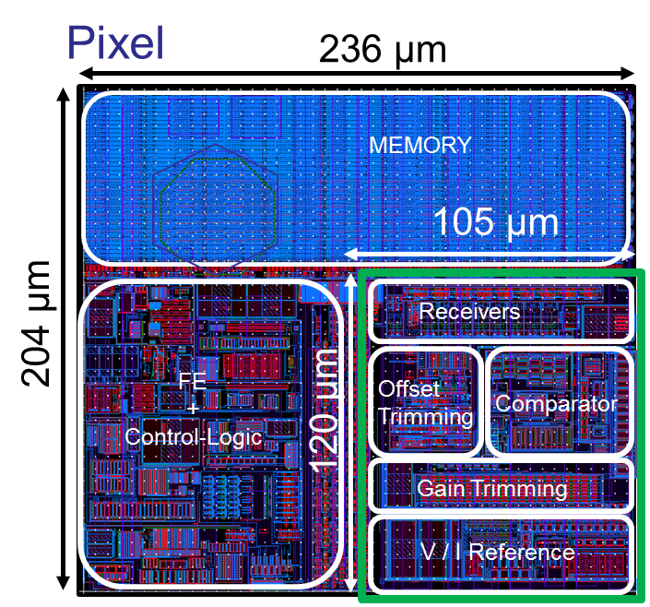
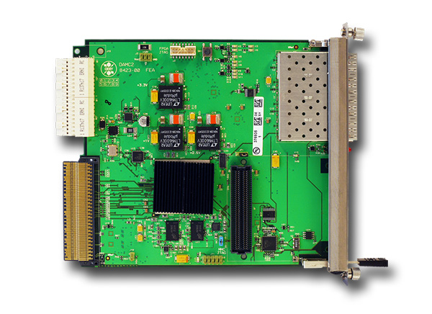
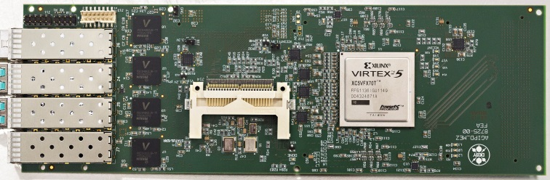
On-chip digitization and high-speed readout
In-ASIC digitization of data – increasing detector speeds
In-pixel ADC for DSSC (soft X-ray detector for XFEL)
  Digitization of images at 4.5 MHz
Digital front-end for SiPMs
  77 ps TDC bin, 3 MHz frame rate
Future plans – high-speed detectors
Fast digitization of data on-chip[further improvement]
High-speed off-chip drivers
Improved off-chip interconnect, e.g. TSV
High-speed DAQ
Computing for data reception, calibration etc.
DSSC pixel layout
High speed readout and µTCA cards
Notes:
100 kHz – explain?
Maybe early conversion to optical?
More broadly, working on on-chip digitization
Want to tie in with high-speed data readout
High-speed readout card
Pushing data off-chip at higher rates, in a format that can be handled by high-speed devices further down the chain
More broadly…
Why is this relevant? Digitization?
Challenge of high-speed readout – what can we say about this? Shared components in Helmholtz? Computing issues – say that we’re aware? Issue is speed?
Put something here – what to be said? Not so much
SiPMs – what is the application? Tracking detectors, medical… some apps such as nuclear resonant scattering (check this out)
Maybe a bit much here? What can we say on each front? Too concrete architecture?
Can mention Helmholtz uTCA?
Effort on ASIC?

Slide 7
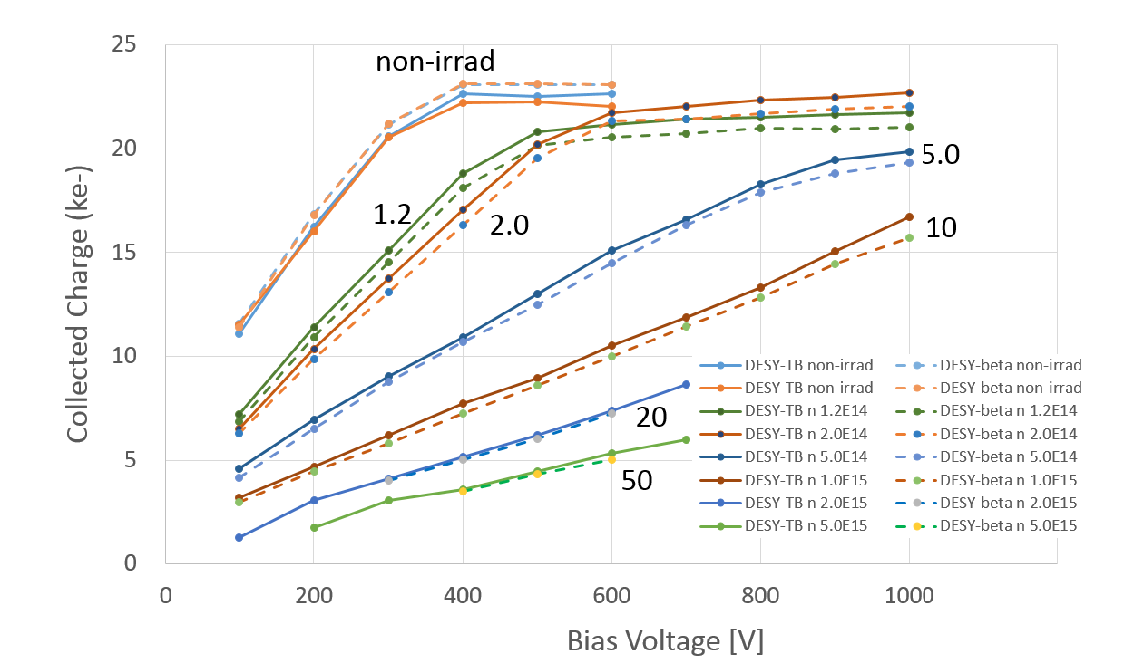
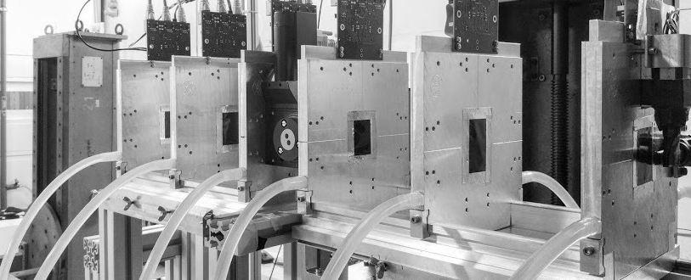
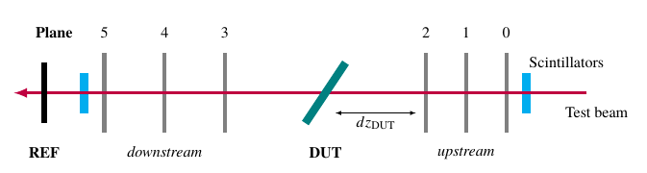
Radiation-hard silicon sensors for LHC upgrades
Detector characterization with the DESY testbeam
Testbeam provides 1-6 GeV electrons
Sensors irradiated with protons and neutrons
Charge collection studies:
  Increase bias voltage during lifetime
  Signal to Noise: Sufficient at the end of HL-LHC ✓
Atlas Strip Sensor
10¹⁵ n_{eq}/cm²
Electron energy
1-6 GeV (tunable)
Notes:
User facility.
Units – graph…
Electrons Selectable energy up to 6 GeV
Uni Hamburg people – sensor development for European XFEL
Maybe reduce?
MORE EMPHASIS ON LORENZ ANGLE (NEEDS TESTBEAM)
Reorganise…

Slide 8
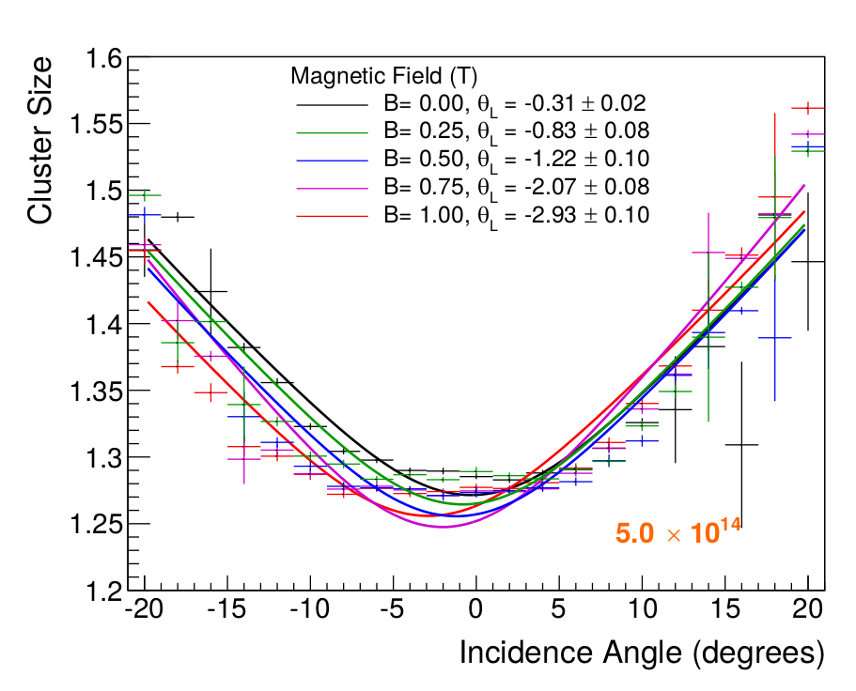
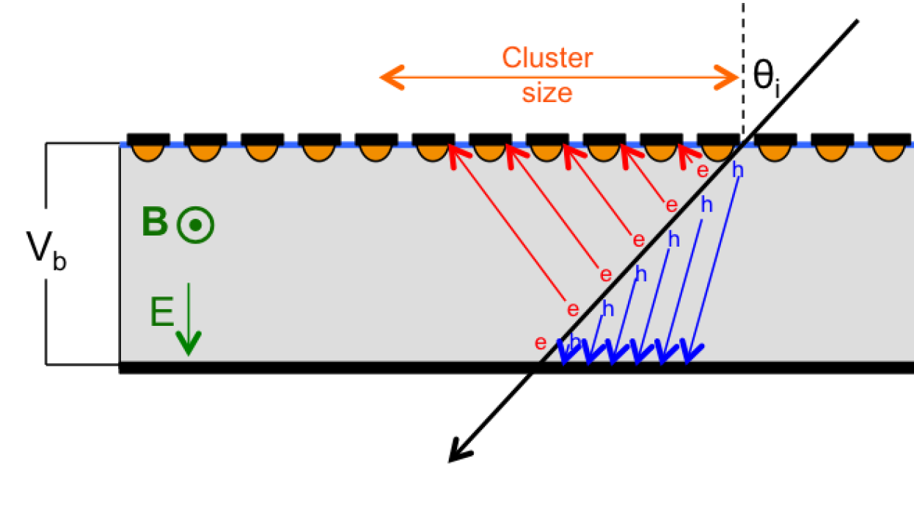
Radiation-hard silicon sensors for LHC upgrades
Detector characterization with the DESY testbeam
Crucial to understand Lorenz Angle dependence on radiation damage
  Key for track reconstruction
  Comparison with models
Measurement relies on test beam, magnets and telescope
Notes:
Lorentz Angle measurement:
2D Scan (particle incidence angle / magnetic field)
Extract the angle shift yielding the minimum
cluster size for a certain magnetic field
KEY POINT – THIS NEEDS TESTBEAM FEATURES – TRUE HIGH-ENERGY PARTICLES, TELESCOPE AND MAGNETIC FIELD
WORK IN STUFF ON RAD DAMAGE FOR AGIPD
http://bib-pubdb1.desy.de/record/317686

Slide 9
Summary and conclusions
Summary
Established capabilities in ASIC development
  Crucial to delivering first detectors for Eu.XFEL
Strong expertise in detector characterisation
  DESY testbeam
Collaboration with national and international groups
  E.g. shared ASIC development for AGIPD and DSSC, testbeam as user facility, on-campus links to Uni Hamburg
Outlook
New experiments will demand increasing speed and precision
  Continuous-wave operation of FELs (100 kHz frame rate)
  Future hadron colliders
More basic technology development required to meet this challenge
  High-speed signal processing and readout in ASICs
  Novel sensor concepts
Notes:
Expand testbeam
OUTLOOK AND CONCLUSIONS – Two slides…
Summary - subbullets
List achievements
5-10 years
2/3 current, 1/3 future?
Achievements – but this is mostly present
Sensor and ASIC R&D
Established ASIC design groups – how to compare with future?

Slide 10
Relation to rest of the program etc
DTS Flavour
The talk template has two flavours, ARD and DTS. Please pick the correct one for your talk.
You are free to use different graphical elements on your slides, as you see fit. You should however keep style and
size of the head lines, and the font.

Slide 11
Relation to rest of the program etc
DTS Flavour
The talk template has two flavours, ARD and DTS. Please pick the correct one for your talk.
You are free to use different graphical elements on your slides, as you see fit. You should however keep style and
size of the head lines, and the font.

Slide 12
Other ASIC work – FE

Slide 14
Heading
Subheading, optional
Guidelines for presentations’ format
Arial, not smaller than 16 pt (must be readable)
Do not overload slides
Other logos than Helmholtz or DESY not on title or conclusion slide and not as standard design element – only at selected places within the talk
Please adapt the footer to your presentation including title and your name. Please use the relevant flavour for the research unit (ARD or DTS)

Slide 15
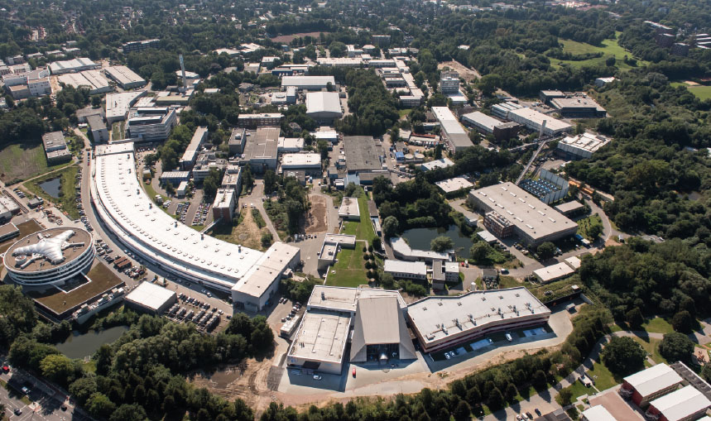
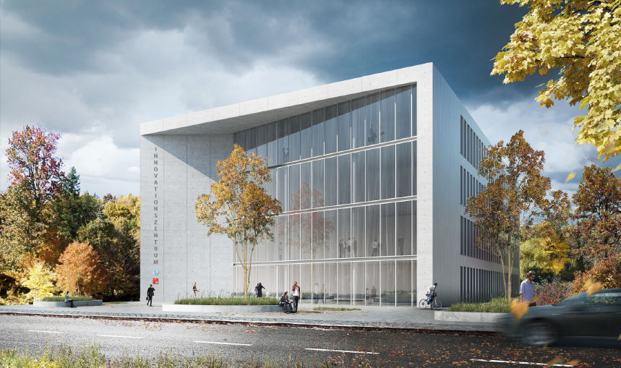
Heading
This is an example for a slie with two graphical elements, and two text boxes
Heading Copy
Body font is arial 16; do not change the font
Make sure your slides have a clear structure, and, in particular, that
there always is a clear relation between text and pictures.
Heading Copy
Avoid too large text blocks,
At the same token, avoid overloading your slides with too many small
pictures

Slide 16
MT guidelines
ARD Flavour
The talk template has two flavours, ARD and DTS. Please pick the correct one for your talk.
You are free to use different graphical elements on your slides, as you see fit. You should however keep style and
size of the head lines, and the font.

Slide 17
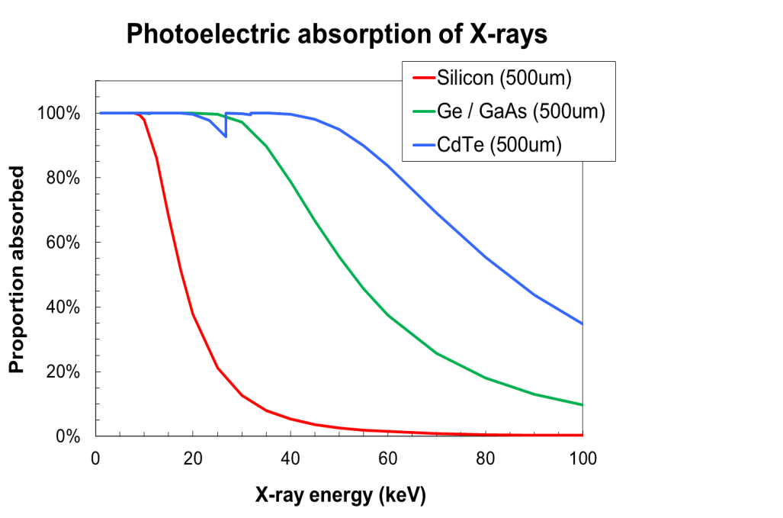
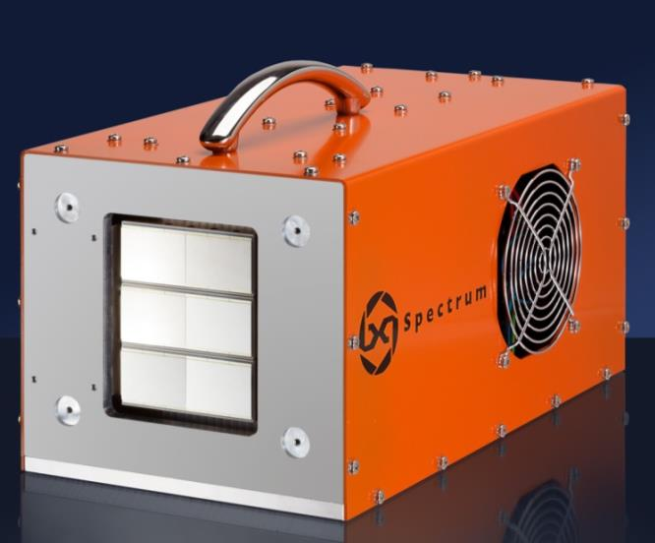
High-Z sensors for hard X-ray detection
Introduction
Hard X-ray detection, blah blah

Slide 18
Radiation-hard sensors for the LHC upgrades
???????
Radiation challenge at the HL-LHC
Upgrade current LHC with Factor 10 more luminosity
Factor 10 more radiation damage
Next generation of radiation-hard silicon sensors required
  Intense world-wide R&D
Pixel Sensors
Strip Sensors

Slide 19
ASICs and Sensors
Major uses in DESY research
Tracking detectors for particle physics
DESY contributions to ATLAS and CMS experiments
New detectors for LHC upgrades and future linear colliders
X-ray scattering detectors in photon science
PETRA-III and PETRA-IV
New ultra-fast cameras for European XFEL
Future upgrades such as CW-FELs

Slide 20
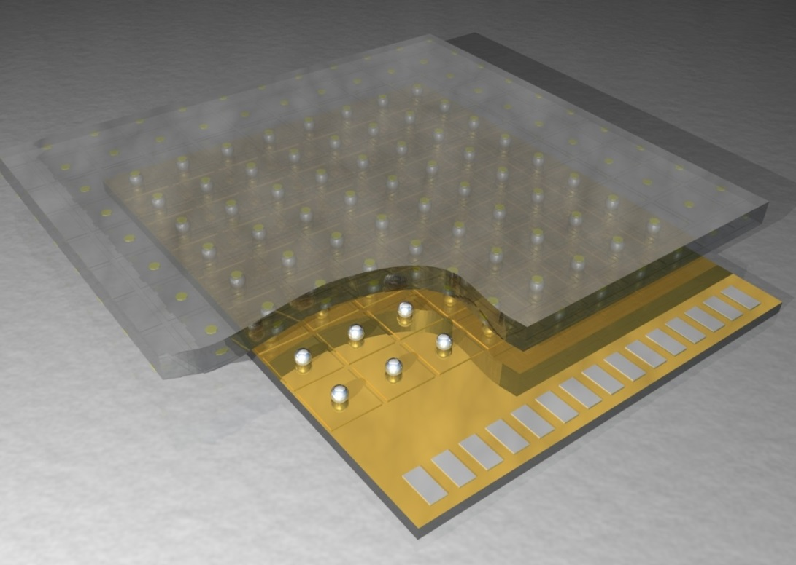
ASICs and Sensors
Introduction
Hybrid pixel detector structure
Main pixel detector technology for accelerator-based experiments
ASICS
Custom ASIC design allows versatility
Benefit from developments in semiconductor industry (smaller CMOS scale, 3D integration)
Sensors
Sensors must meet increasingly hard challenges (e.g. radiation hardness
Semiconductor technology provides new processes and materials

Slide 21
Other sensors stuff for photon science
Introduction
Rad-hard sensors for AGIPD
High-Z
Notes:
Novel combinations? Could put this?

Slide 22
Radiation-hard sensors for LHC upgrades
Charge collection performance
Studies using the DESY test beam and sources
Irradiation with neutrons and protons
Increase bias voltage during lifetime to compensate damage
Signal to Noise: Sufficient at the end of HL-LHC ✓
CMS Pixel Sensor
Atlas Strip Sensor
Notes:
Who does what?
Who did design?
Uni Hamburg people – sensor development for European XFEL
Maybe reduce?

Slide 23
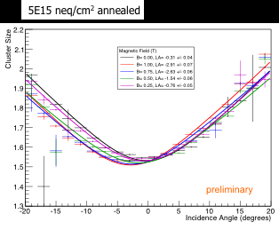
Radiation-hard sensors for LHC upgrades
Lorentz angle
In Silicon, the Lorentz drift leads to an improvement of the resolution
Crucial to understand Lorenz Angle dependence on radiation damage
  Comparison with models
  Key for track reconstruction
Notes:
Lorentz Angle measurement:
2D Scan (particle incidence angle / magnetic field)
Extract the angle shift yielding the minimum
cluster size for a certain magnetic field

Slide 24
Radiation-hard sensors for LHC upgrades
Characterisation of sensor performance
Studies using the DESY test beam and sources – protons and neutrons
Increase bias voltage during lifetime to compensate damage
Signal to Noise: Sufficient at the end of HL-LHC ✓
Lorenz angle characterisation – crucial for track reconstruction
Lorenz angle – which sensor? New plot?
Atlas Strip Sensor - CCE
Notes:
Who does what?
Who did design?
Uni Hamburg people – sensor development for European XFEL
Maybe reduce?

Slide 25
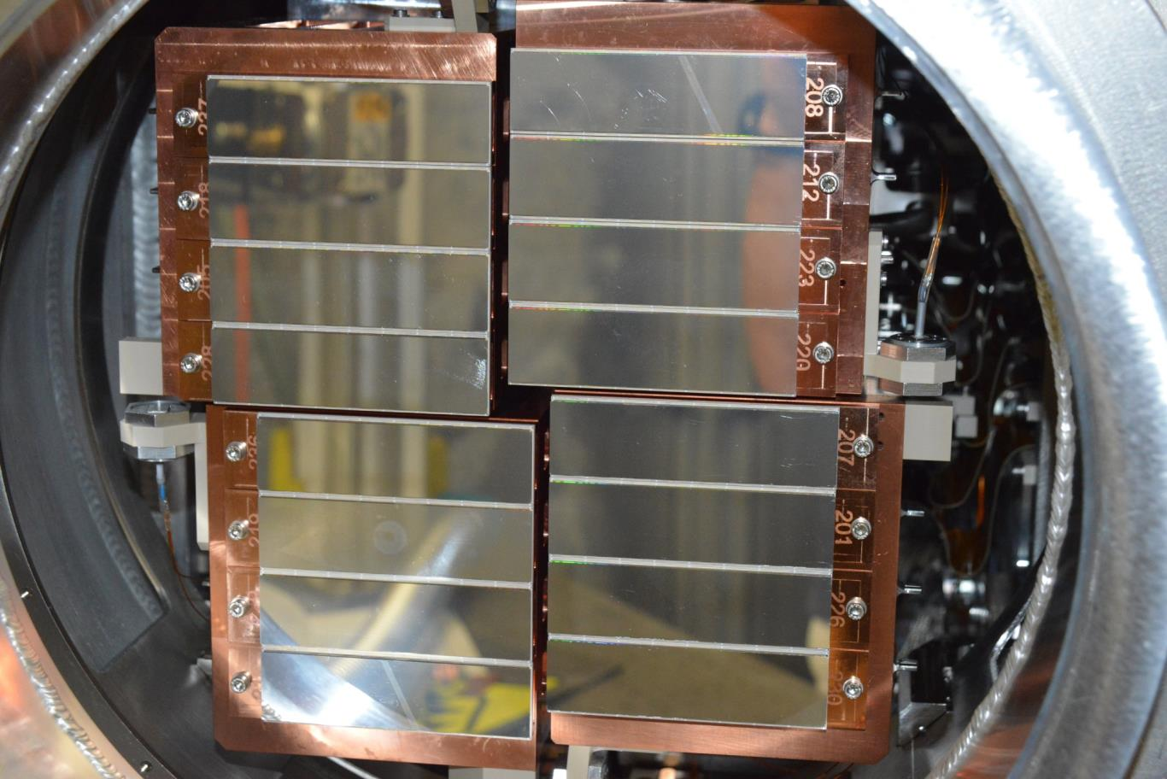
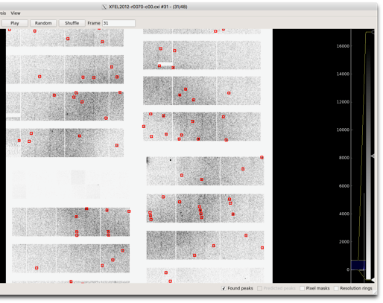
AGIPD detector for the European XFEL
1 Megapixel system at XFEL beamline SPB
16-module system with 16 ASICs per module
Radiation hard silicon sensor - studies and sensor design by University of Hamburg
    Guard ring designed for reliable 500V operation after saturation of surface damage effects
    High bias needed to ensure full collection in 220ns
Currently running in first user experiments at XFEL
Diffraction from Lysosyme crystal (experiment by DESY coherent imaging)
Notes:
Remove this point – covered elsewhere. Relocate radiation damage later.

Slide 26
Other ASIC and sensor activities
In-ASIC digitization of data – increasing detector speeds
In-pixel ADC for DSSC (soft X-ray detector for XFEL)
  Digitization of images at 4.5 MHz
Digital front-end for SiPMs
  77 ps TDC bin, 3 MHz frame rate
“High-Z” sensors for hard X-ray detection
Replace Si with Ge, GaAs, CdTe…
Collaborate with institutes and industry to integrate new sensor materials into photon-counting detector for PETRA
2-megapixel GaAs developed and commercialised by spinoff
Notes:
CHECK TIME – EITHER REMOVE OR EXPAND HIGH-Z STUFF.

Slide 27
Summary and conclusions
DTS Flavour
Summary
Current ASIC and sensor development primarily driven by accelerator-based science
  Development of multi-MHz X-ray imagers for FELs
  Sensor R&D for LHC upgrades
Outlook
New experiments will demand increasing speed and precision
  Continuous-wave operation of FELs (100 kHz frame rate)
  Future hadron colliders
Novel accelerators also being developed (e.g. plasma acceleration)
More basic technology development required to meet this challenge
  High-speed signal processing and readout in ASICs
  Increasing functionality through 3D integration ….? (Do we say more on plans for the future?
  ?????????????
Notes:
List achievements
2/3 current, 1/3 future?

