Slide 1
XFEL-Gun Operator Training
F.Brinker
Notes:
How to edit the title slide
Upper area: Title of your talk, max. 2 rows of the defined size (55 pt)
Lower area (subtitle): Conference/meeting/workshop, location, date, your name and affiliation, max. 4 rows of the defined size (32 pt)
Change the partner logos or add others in the last row.

Slide 2
Content
Overview Gun system
Typical measurements
Critical parts
RF-window
Cathode holder
Diagnostics and interlock systems
RF-operation

Slide 3
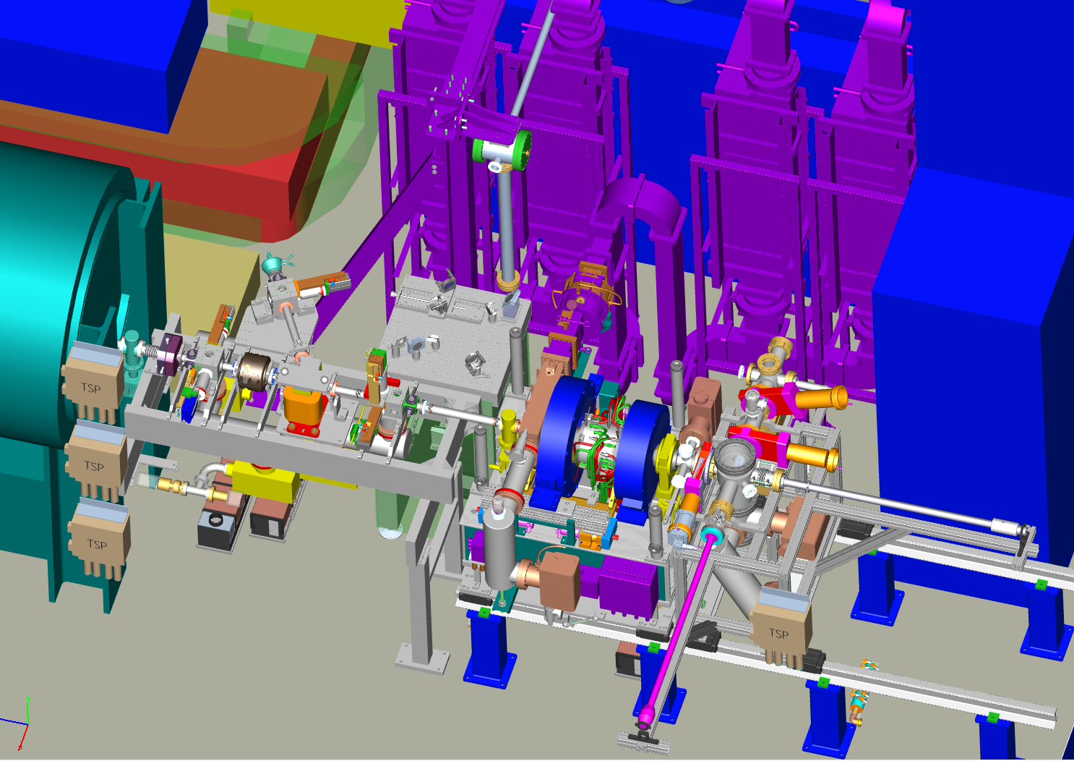
Actual view to the XFEL gun
UV Laser beamline
4 circulators to the 10MW Klystron
Water distribution
cathode- exchange system
gun body

Slide 4
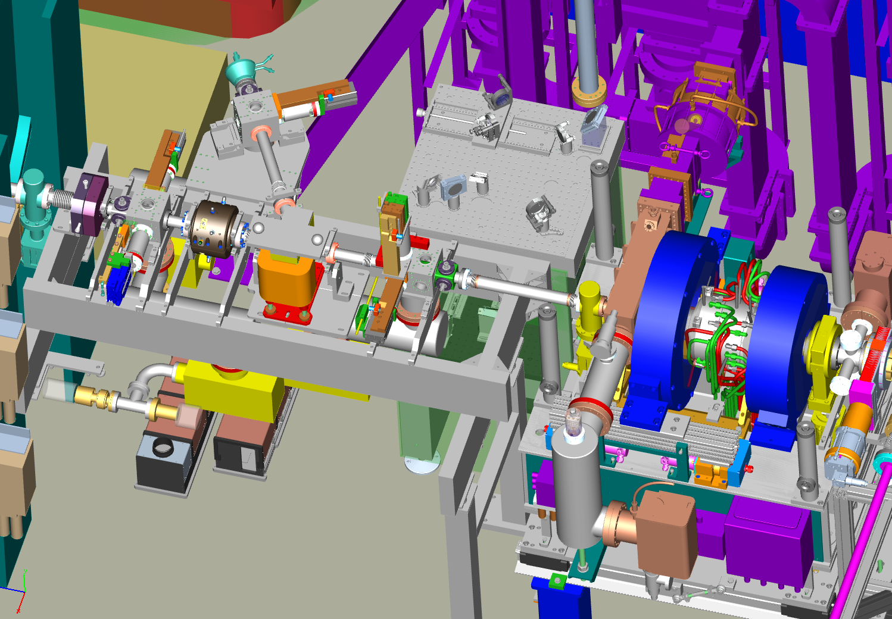
Actual view to the XFEL gun diagnostics
Faraday cup
Optics table
RF-Vacuum window (Thales)
Darc current collimator
Darc current kicker
Toroid
screens
BPM
Dark current monitor

Slide 5
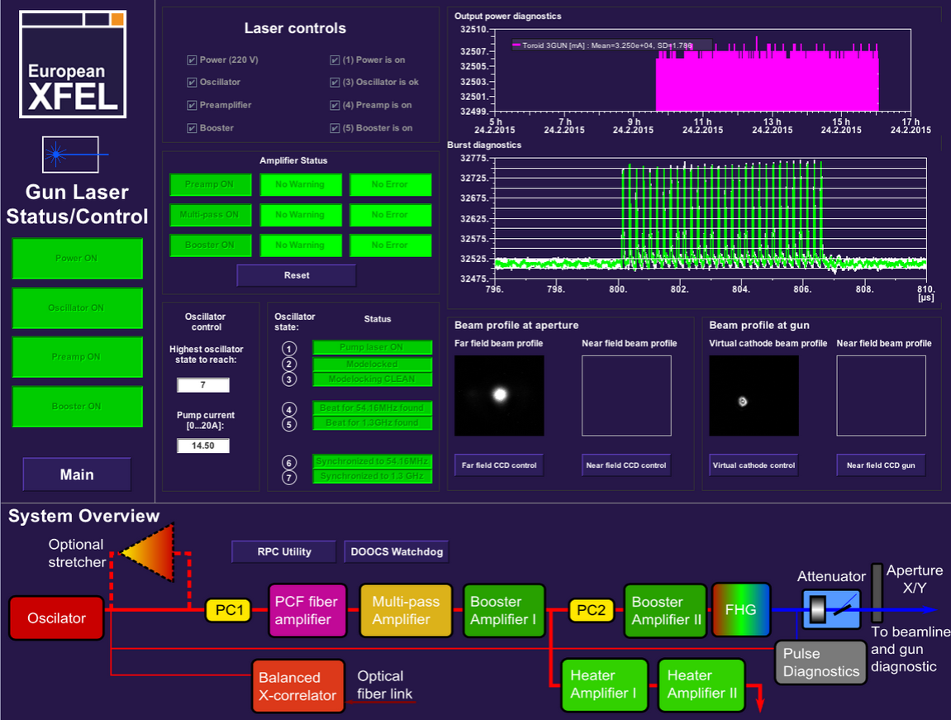
Cathode laser
Laser profile before the aperture
and on the virtual cathode

Slide 6
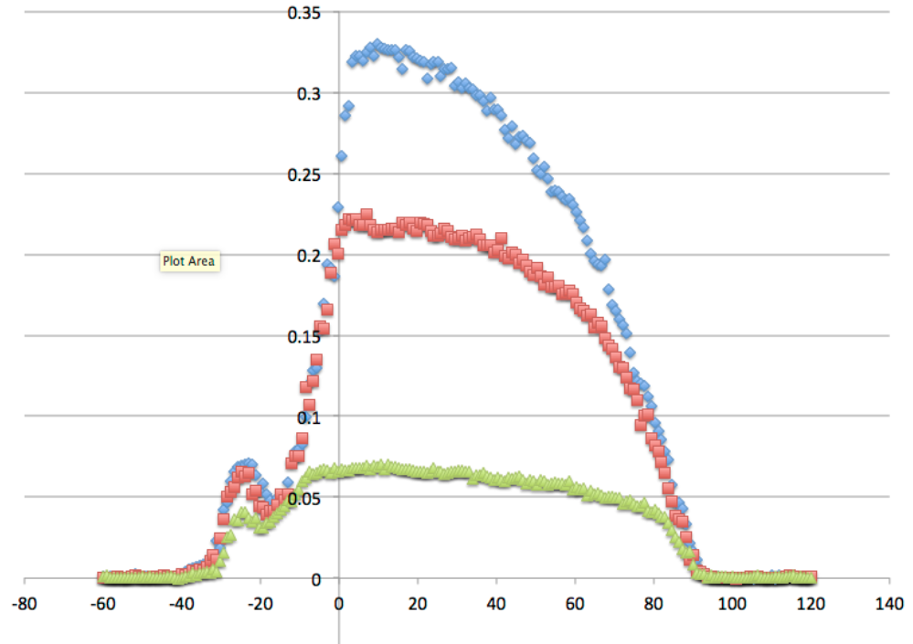
First measurements with beam:
Phase scan for different laser intensities
Charge [nC]
Phase scans at different laser intensities
„Han bump“
Famous „Zero crossing“
RF-phase [deg]

Slide 7
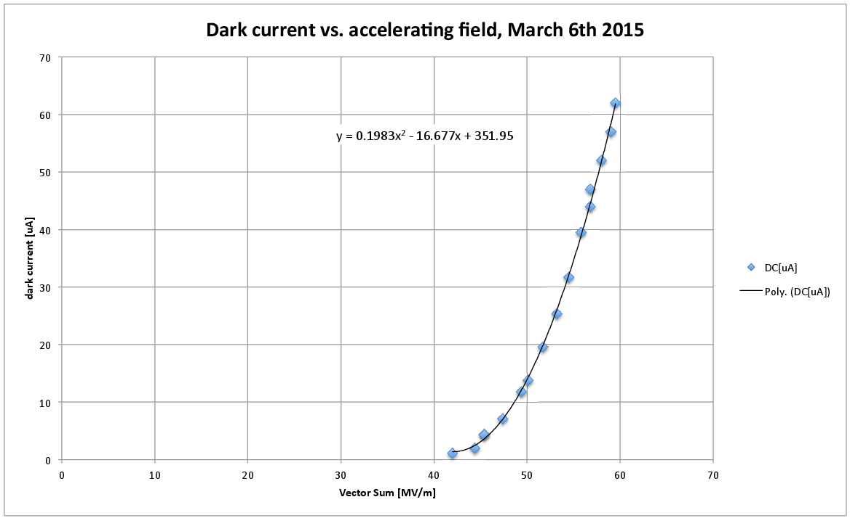
Measurement of dark current

Slide 8
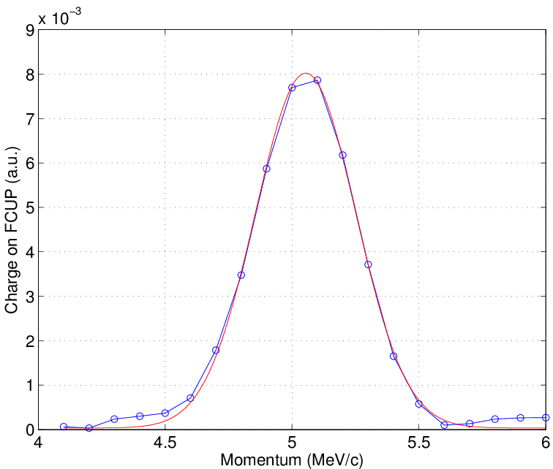
Beam energy measurement with spectrometer magnet

Slide 9
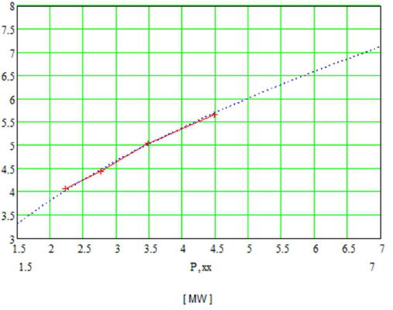
First measurements with beam:
Energy measurement
MeV/c
16.2. :
Measurement of beam momentum depending on RF-power

Slide 10
critical parts
Cathode plug and RF-spring
RF-Window

Slide 11
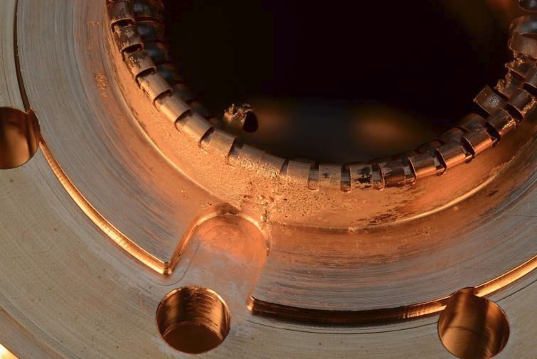
Short History of the XFEL Gun in HH
1. RF operation Dezember 2013
Successful test of RF-system
5.5 MW, 650 us reached
Limit : light at the window
Massive damages on the cathode RF spring
2. RF operation September 2014
Successful test of the improved cathode spring system
4.8 MW, 400us reached
Limit : vacuum leak at the window
3. RF operation Dezember 2014
Short test of glued window
4.8 MW, 400us reached
Limit : vacuum leak at the window
( See last years talk )
1. Beam operation February 2015
2. Beam operation April/May 2015

Slide 12
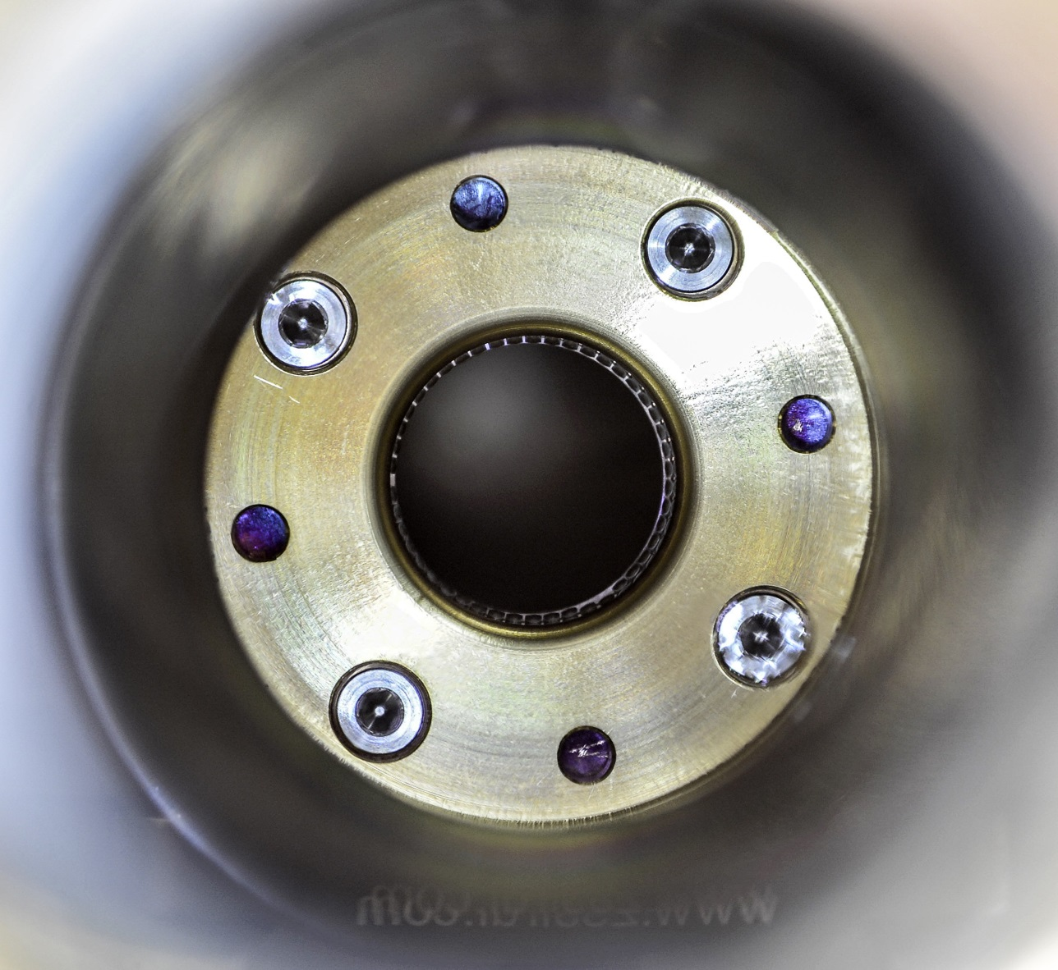
View from the backside into the cathode holder with the spring ( still under vacuum )
Assumption: the trouble came from a bad contact between the holder, spring and plug.
The cathode spring system had been replaced by a system where all contact surfaces had been polished and/or gold plated. ( same geometry )
No signs of damage so far after 88-days of operation

Slide 13
Cathode plug without any damages or marks after the December run

Slide 14
Examination of the leakage after September run 2014 ( typ. 4.8MW, 400 us ):
While the cathode spring test had been successful the RF-window developed a leakage after some days
Since a new Thales window was not available at that time it has been tried to localize and fix the leakage
Surprisingly it was not the brazing but the ceramics which got leaky
Ceramic disk from air side

Slide 15
Test run on the window test stand with the Thales6 and one Gamp-window
Test with 6.5 MW, 900 us travelling wave
Test with full reflection:
20 μs pulse length ( + 35% )
10 Hz
2-6 MW RF-power
Distances to the reflector were varied
After about 1.5 weeks the conditioning was stopped – no vacuum break outs, no light from Thales, still continuous light from Gamp
Simulation for the test stand configuration: M.Bousonville

Slide 16
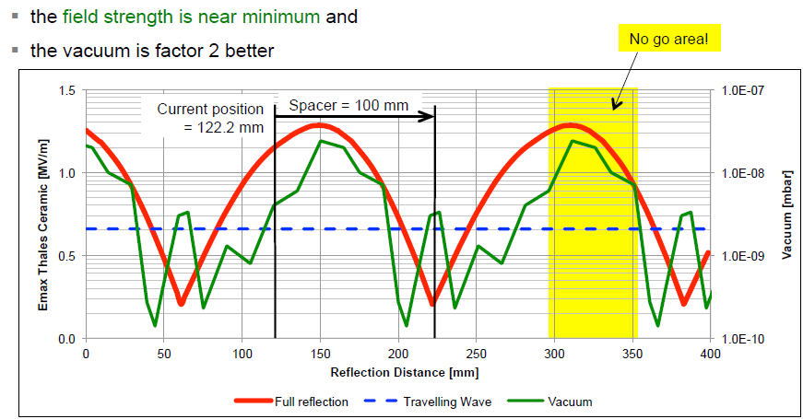
Dependance of field strength and vacuum activity on window Position [ D.Kostin, M.Bousonville ]
Actual position
field strength on the ceramics is nearly at maximum
medium vacuum activity
with 100mm shift:
field strength on the ceramics is minimal
bit less vacuum activity

Slide 17
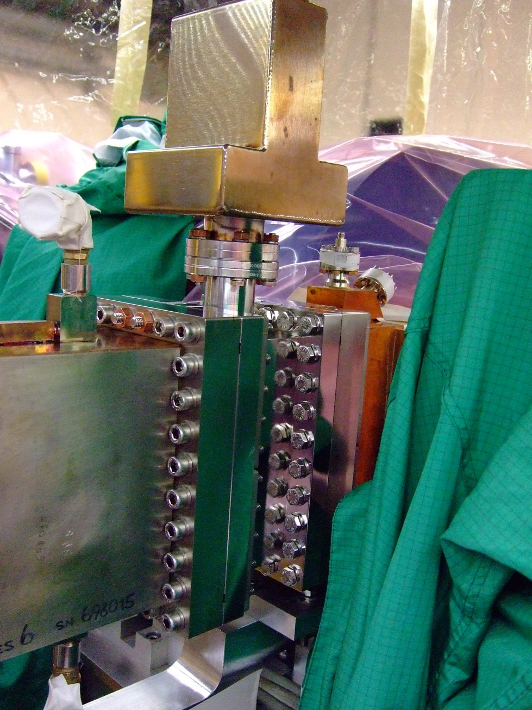
Exchange of RF-window, March ’15 with 100mm insertion
100mm vacuum waveguide between Thales RF-window and coupler
Massive reduction of field strength on the ceramic
Significant improved pumping speed with additional IGP

Slide 18
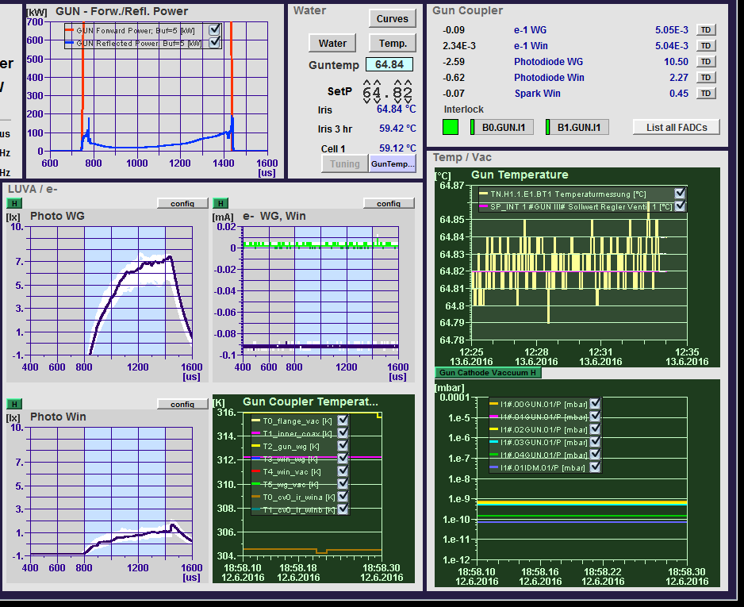
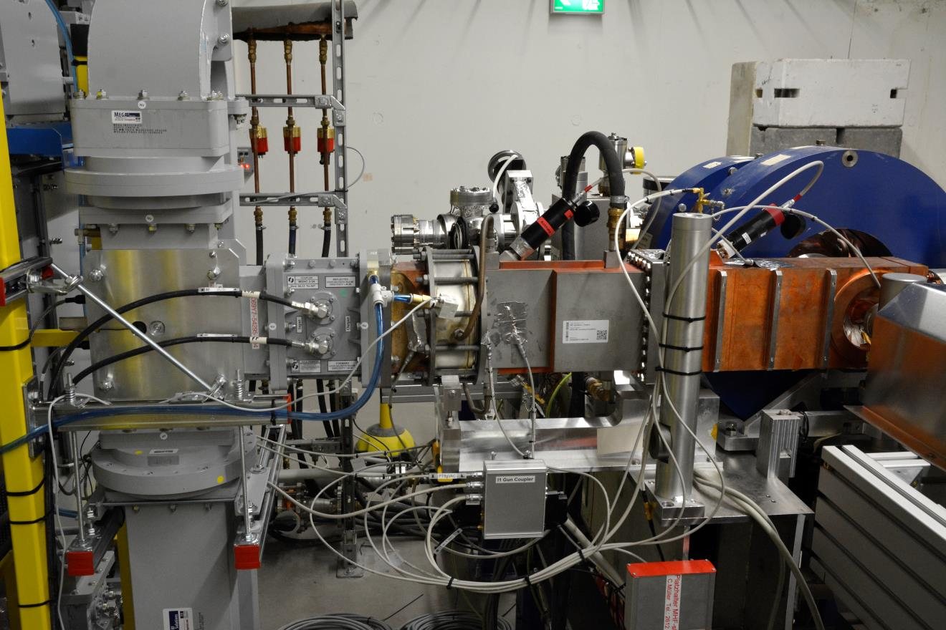
Gun signals and interlocks

Slide 19
Gun signals and interlocks

Slide 20
Gun signals and interlocks

Slide 21
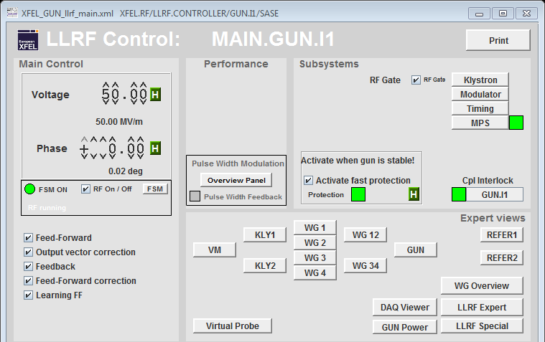
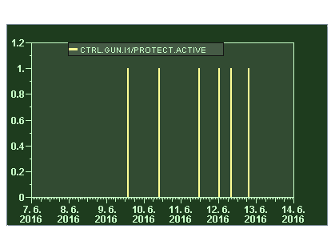
LLRF fast protection – looking at the reflected power

Slide 22
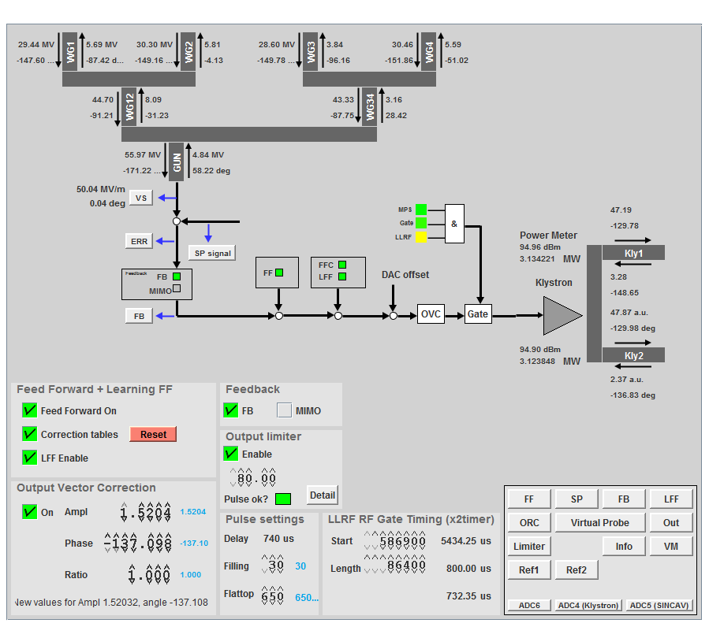
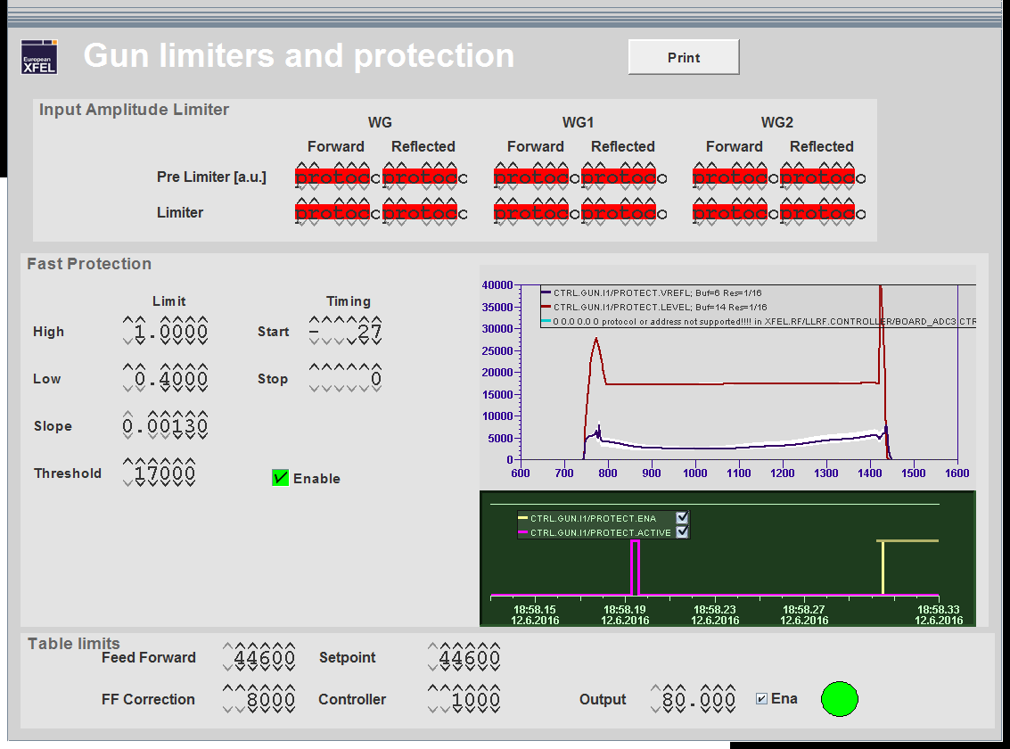
Limits of fast protection

Slide 23
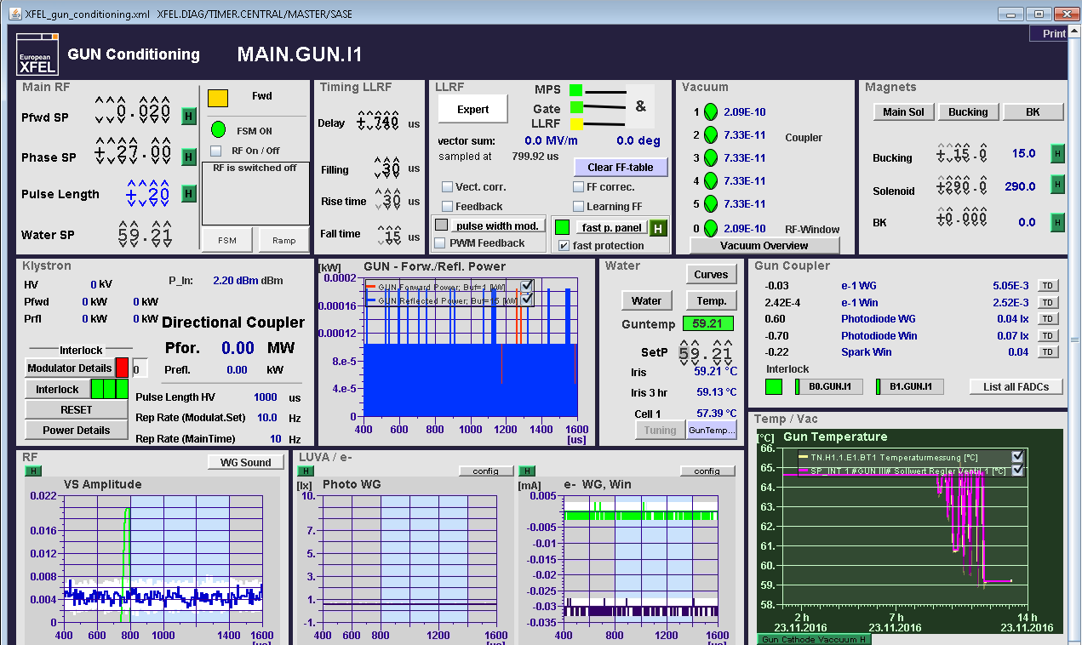
Fast Gun Ramp Up – new FSM version
1) FSM On
2) Choose targets: gradient and pulse width
Estimation for the start temperature
3) Set start temperature and wait until it’s reached (~0.2 C )
4) Start ramp by switching FSM RF On
FSM messages

Slide 24
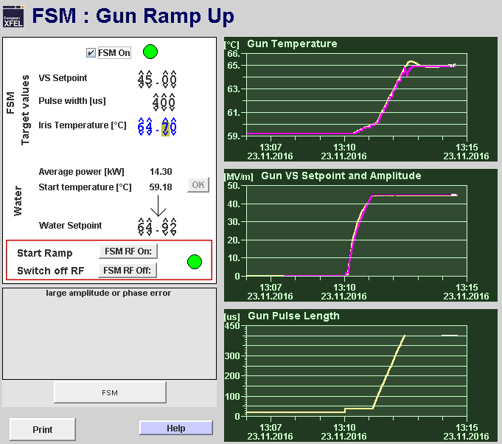
Fast Gun Ramp Up – new FSM version
The FSM sets the Gun frequency on the actual resonance frequency defined by the temperature
Gradient and pulse length are ramped up
The temperature set point tracks the actual temperature which rises with RF power
The frequency is kept on resonance to avoid reflections
After reaching the target values, the FSM is waiting for the temperature to stabilize before setting the frequency to nominal.
When Set points for amplitude and phase are close to the measured values the feedback and learning feed forward are started plus the pulse width modulation
From now on the gun parameters can be changed by hand as usual

Slide 25
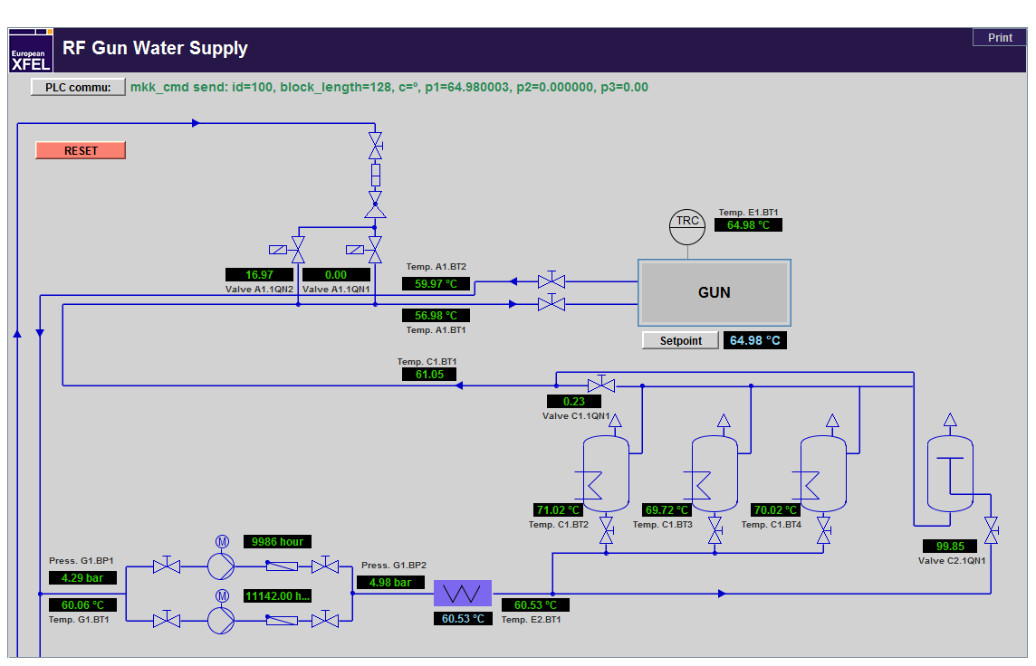
Water temperature regulation
Precise,fast temperature regulation by adding cold water
Heating by adding hot water ( slow )

Slide 26
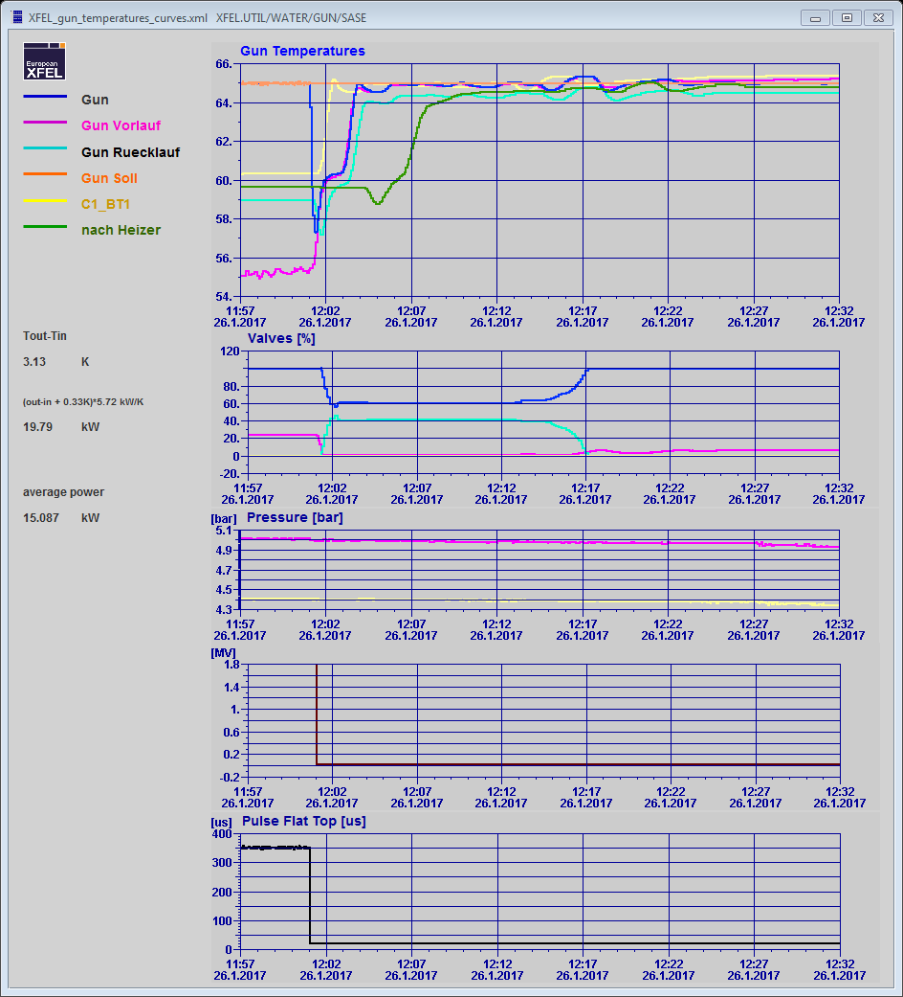
Heating up by adding hot water from the tanks

Slide 27
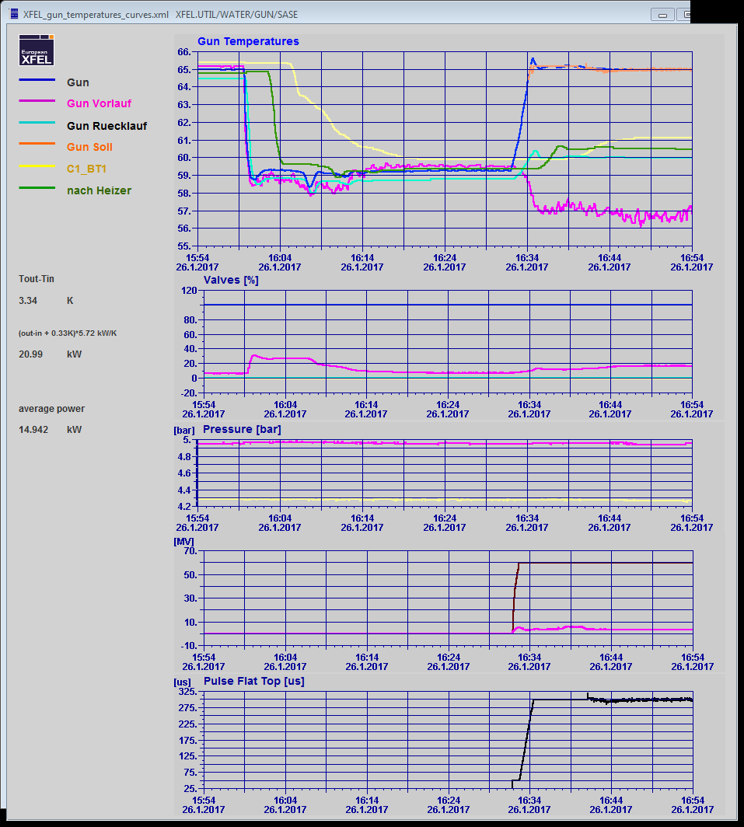
Cooling down with cold water

Slide 28
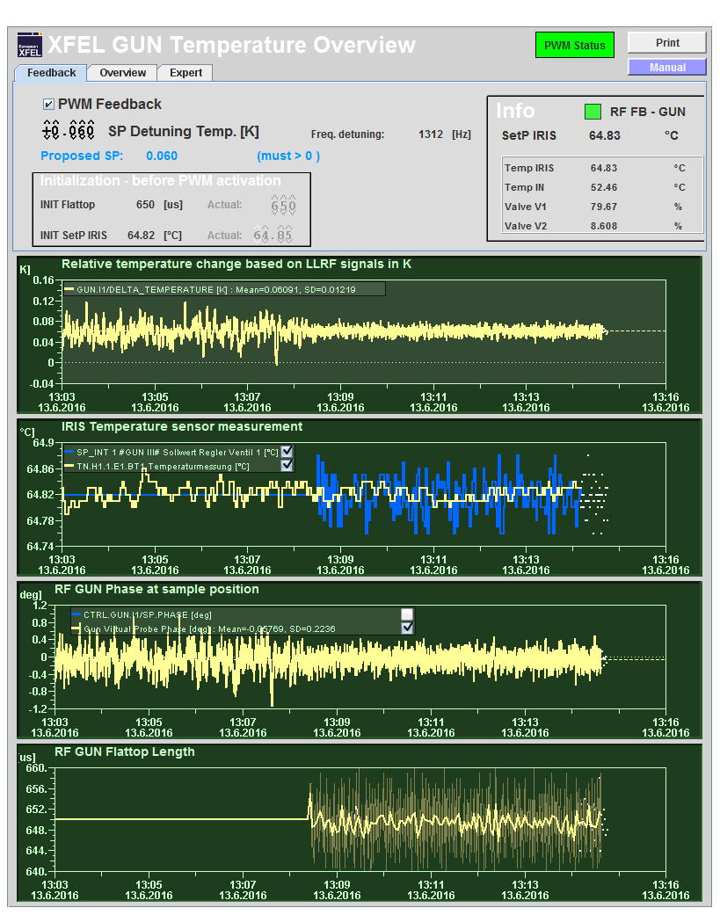
Pulse width modulation
Fast measurement of gun temperature (0.1sec vs. 7 sec)
compensate temperature deviations with the RF pulse width

Slide 29
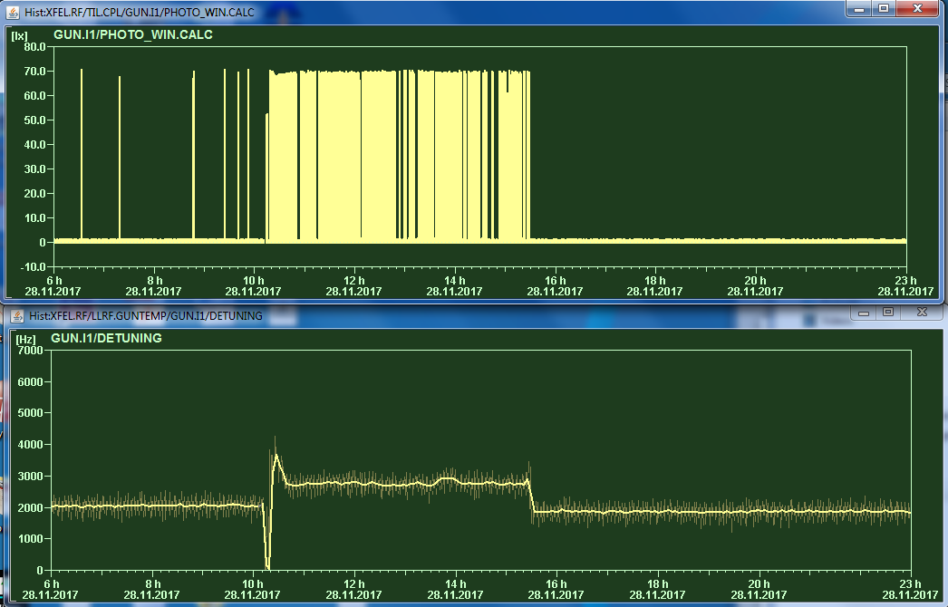
Strong temperature ( detuning ) dependance of light emission
Below 2200 Hz
Much less activity.
200Hz = 0.01°C!

Slide 30
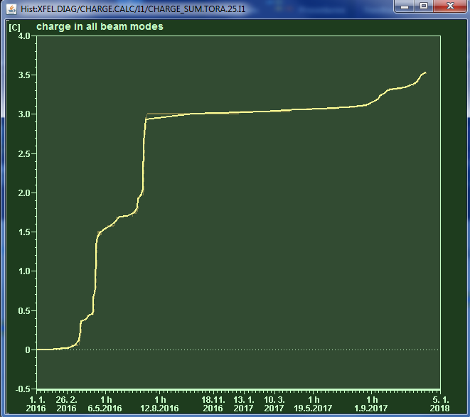
Charge delivered from Gun 4.3 since Jan 2016:
Practically no interlocks since 2 years during the runs
Light interlock at the window vacuum side was disabled – but the vacuum threshold stood at 3·10⁻¹⁰ mbar
3.5 C
2700 bunches, 0.5 nC (July 2016)

Slide 31
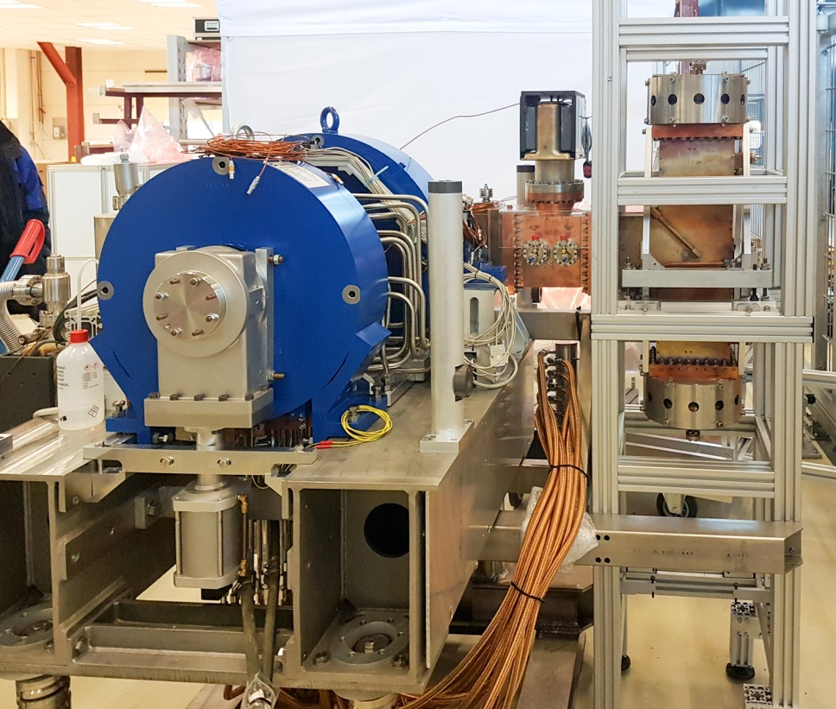
December 2017: Exchange of the gun
This December the gun will be exchanged with the Gun 4.6, which has been conditioned at PITZ
The two guns are identical beside a different cathode spring design ( watchband reloaded at 4.6 )
The goal is to have two identical guns available which proved to deliver beams for SASE
Before the installation the two Gamp windows have been exchanged by one Thales window
Reconditioning will be necessary at beginning of next year for one week

Slide 32
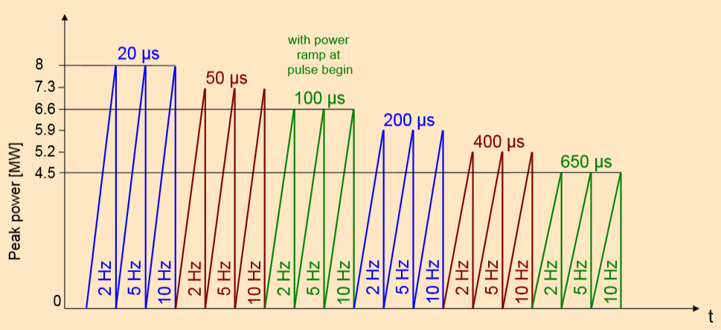
( re- ) conditioning starting ~Jan 4th
Startup without frequency detuning
Starting with short pulses, low rep rate and high power
Encreasing the rep rate and the pulse length while reducing the peak power
Restart with short pulses after interlocks
Exact parameters will be defined
Procedure after last window exchange
Restart after vacuum >1E-7
reflected power IL
Spark detected

Slide 33
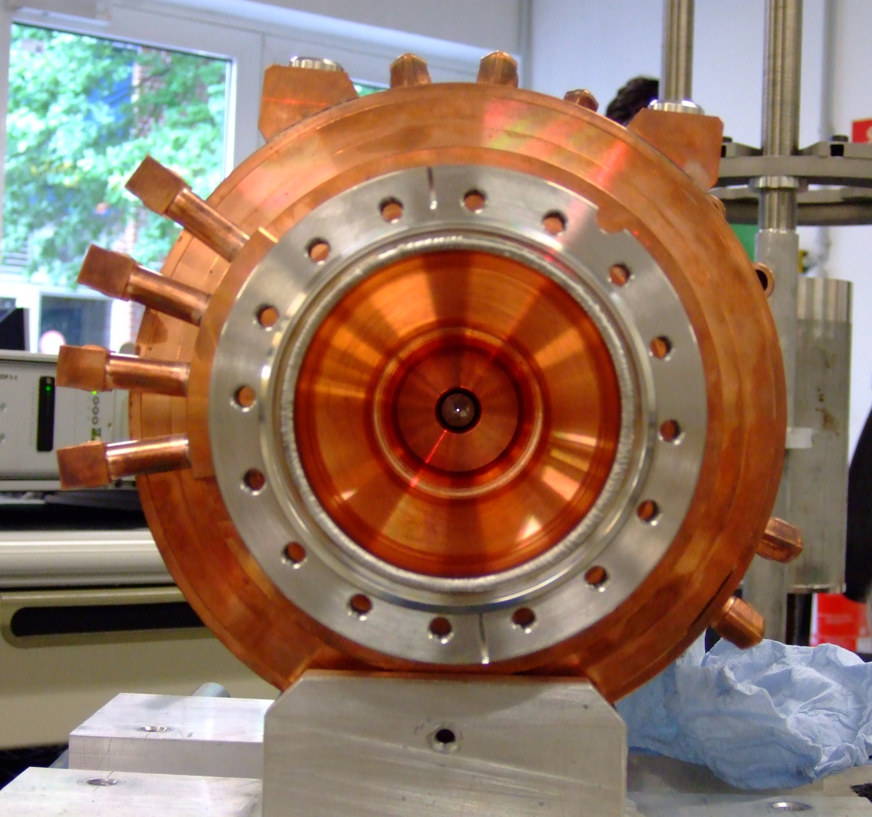
Thank you !

