Slide 1
What is new? A summary of new tools/panels and some hacks and trick to make the operation of the XFEL easier.
Matthias Scholz
January 9, 2018

Slide 2
Topics
Run coordinator/ RC Meeting
Emergency shutdown button
XFEL energy manager
Tripping RF stations
Beam energy measurements
AH1 cavity
Orbit tools
Orbit feed backs
Intra bunch train feedback (IBFB)
Trajectory storage server
Operation of the safety magnets
Beam dumps/ dump switch panel
Collimators
Multi quad scan tool
Magnet coupling server

Slide 3
Run coordinators and RC meeting
We are now 9 run coordinators:
Dirk
Frank
Lars
Matthias
Raimund
Shan
Thomas
Torsten
Winni
There are two run coordinators scheduled for each week to reduce the work load.
A second mobile phone number will be communicated as soon as it is available.
There will be a new location and time for the run coordination meeting!
Monday 10 am
Meeting room in 30b, 4th floor.
Starting January 15th, 2018

Slide 4
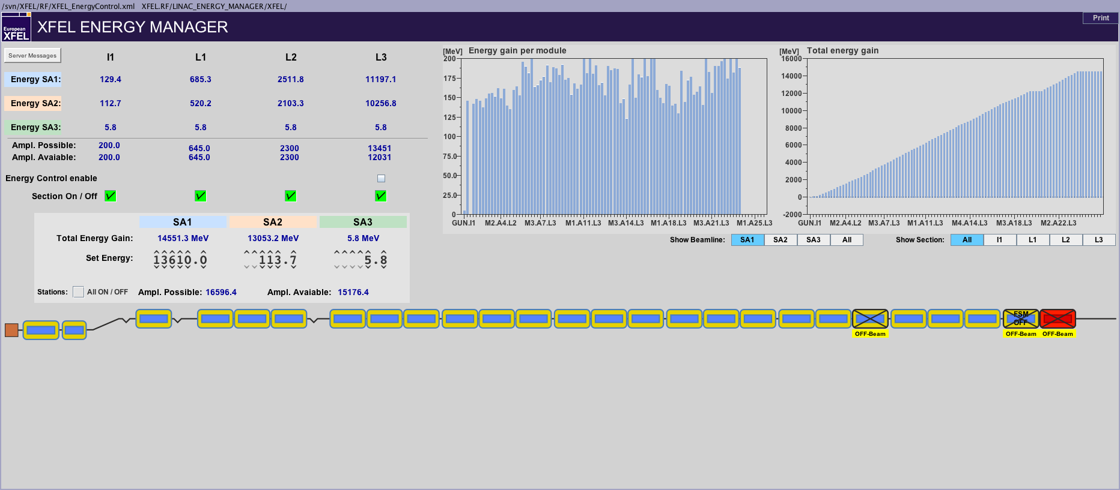
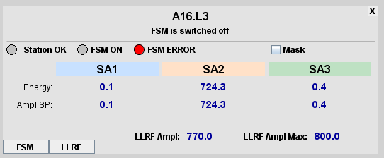
XFEL Energy Manager
This panel helps you to change the electron beam energy without changing single RF station settings.
Main Panel -> RF -> Linac Energy Manager
Current energy for all subtrains
Switch on/off complete sections
Set final energies for all subtrains
Click on modules to get a detailed view.
It is possible the mask single modules.

Slide 5
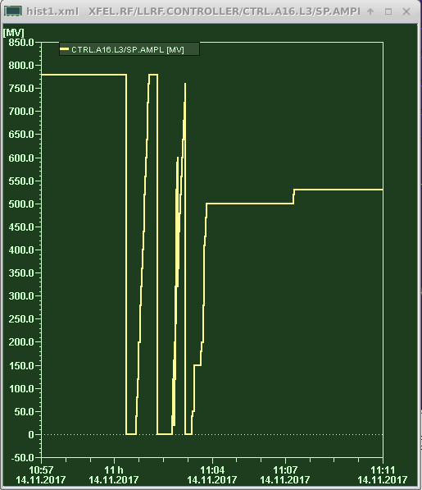
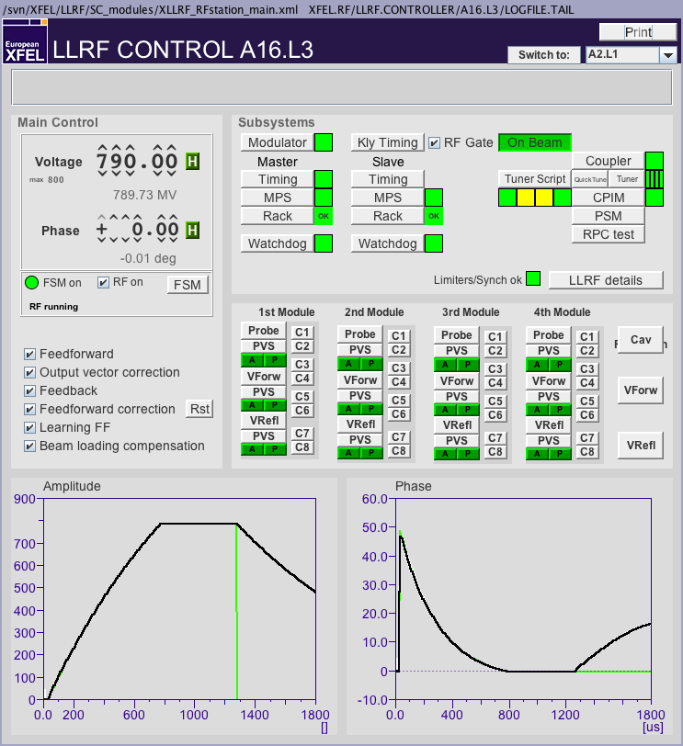
Continuously tripping RF stations
Situation: An RF station trips once, the FSM tries to ramp up the amplitude again but that causes further trips. Procedure:
Switch the FSM off.
Open the feedback loops (if that is not already the case).
Ramp up the voltage to the maximum possible value that does not lead to further trips.
The reason for the trips might be that some cavities are detuned. You can use the tuner script to improve that. (AH1 is slightly more difficult to tune. Call LLRF expert if you do not feel comfortable with tuning AH1).
You can try to increase the voltage again after the cavity tuning.
Close all feedback loops. Do not forget to reset the tables of the feed forward correction.
Start the FSM again.
Problems? Call the LLRF expert!

Slide 6
Emergency shutdown button
Please use this dedicated button to shut down the machine in an emergency (e.g. a fire alarm).
Confirm the shut down request on the popup panel.
The complete machine will be shut down safely.

Slide 7
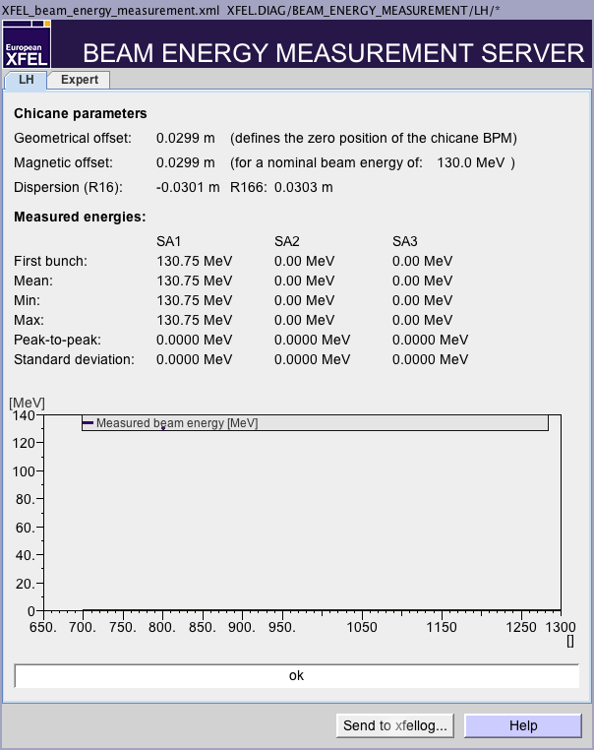
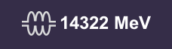
Beam energy measurements
All available beam energy measurements can be found here: Main Panel -> Diagnostics -> Beam Energy Measurement
Reasons for deviating measurements:
The measurement depends on the knowledge of the magnet fields in the respective section.
Especially uncycled magnets (e.g. correctors) make it more difficult to measure the correct beam energy.
A measurement precision of about 1% (~100 MeV) is good.
LLRF vector sum
Measured

Slide 8
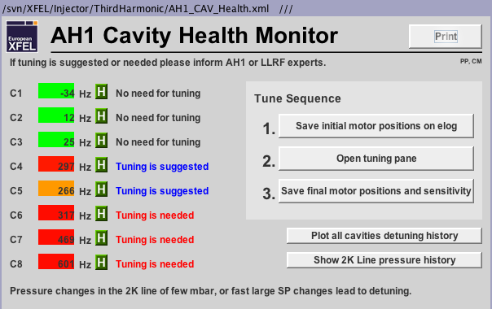
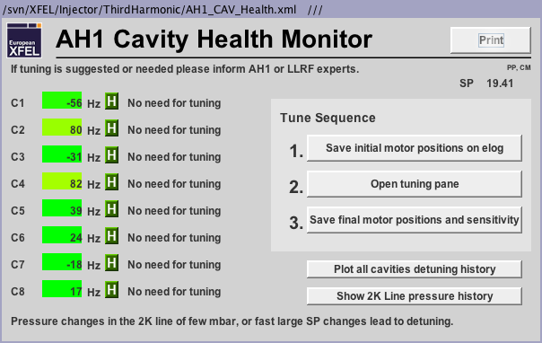
AH1 health status
It is time well spend to check the cavity health status of AH1 from time to time.
AH1 is more sensitive to e.g. helium pressure variations than the larger 1.3 GHz cavities.
You can find the AH1 cavity health monitor here: Main Panel -> Injector -> AH1 Health & Tuning.
You can start to tune the cavities. However, AH1 tuning is a little more complicated than tuning the other cavities.
Please inform the LLRF expert on call if you feel uncomfortable with the tuning.
This is not an emergency as long as the machine is running properly. Thus, you might inform the expert the next morning when you find the detuning during you night shift…

Slide 9
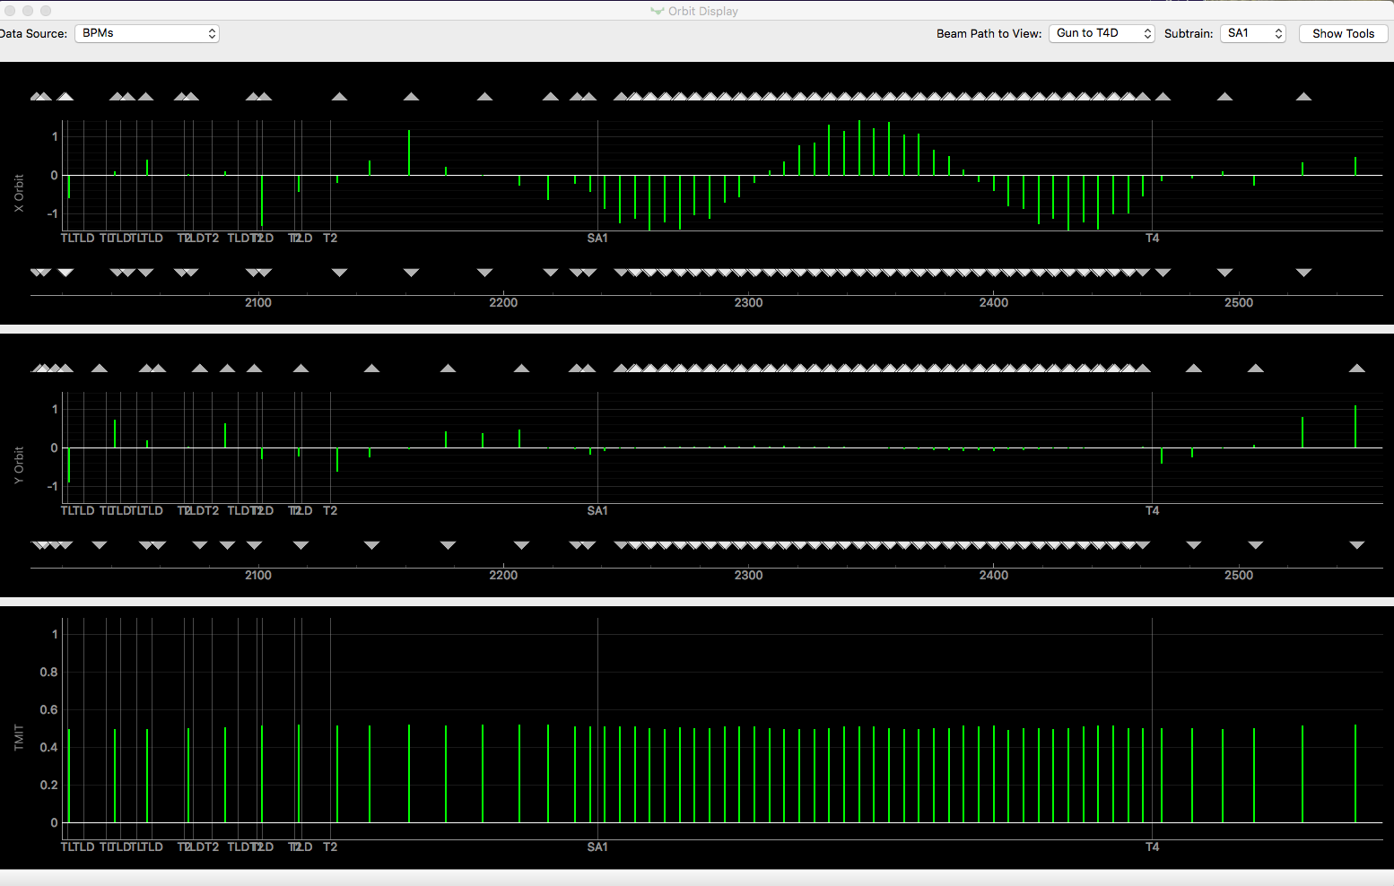
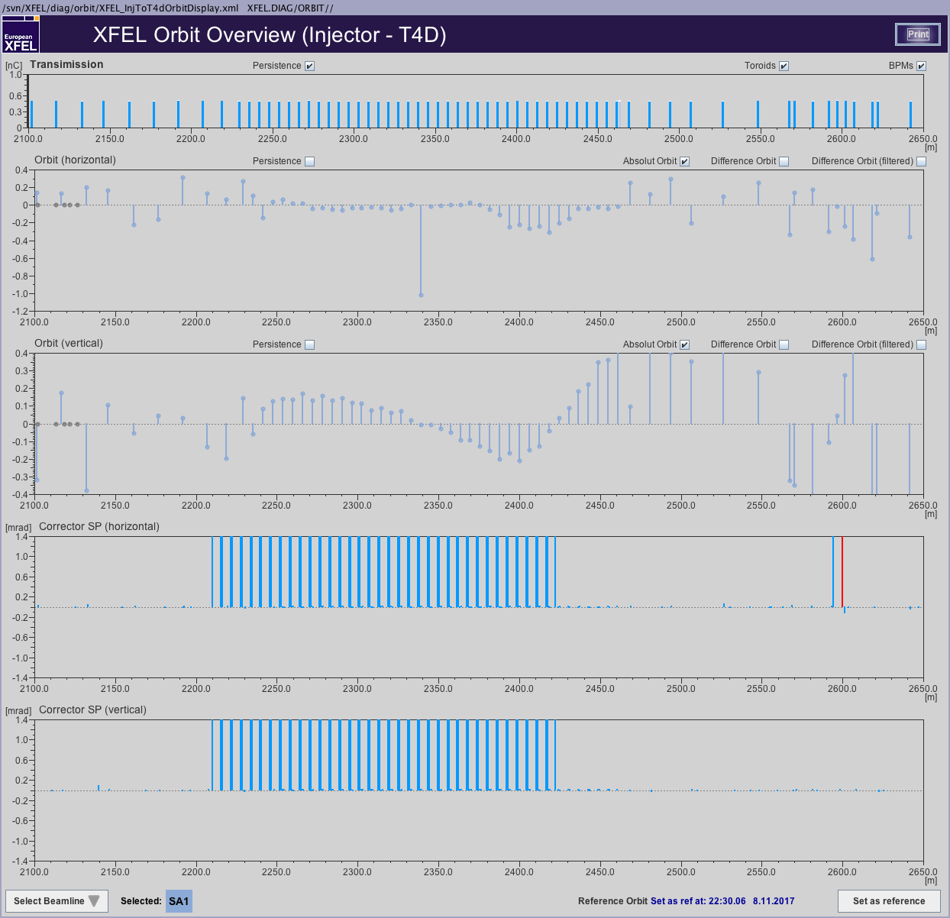
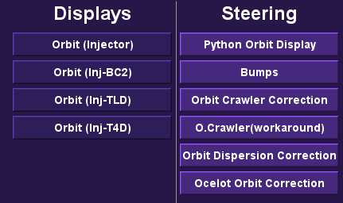
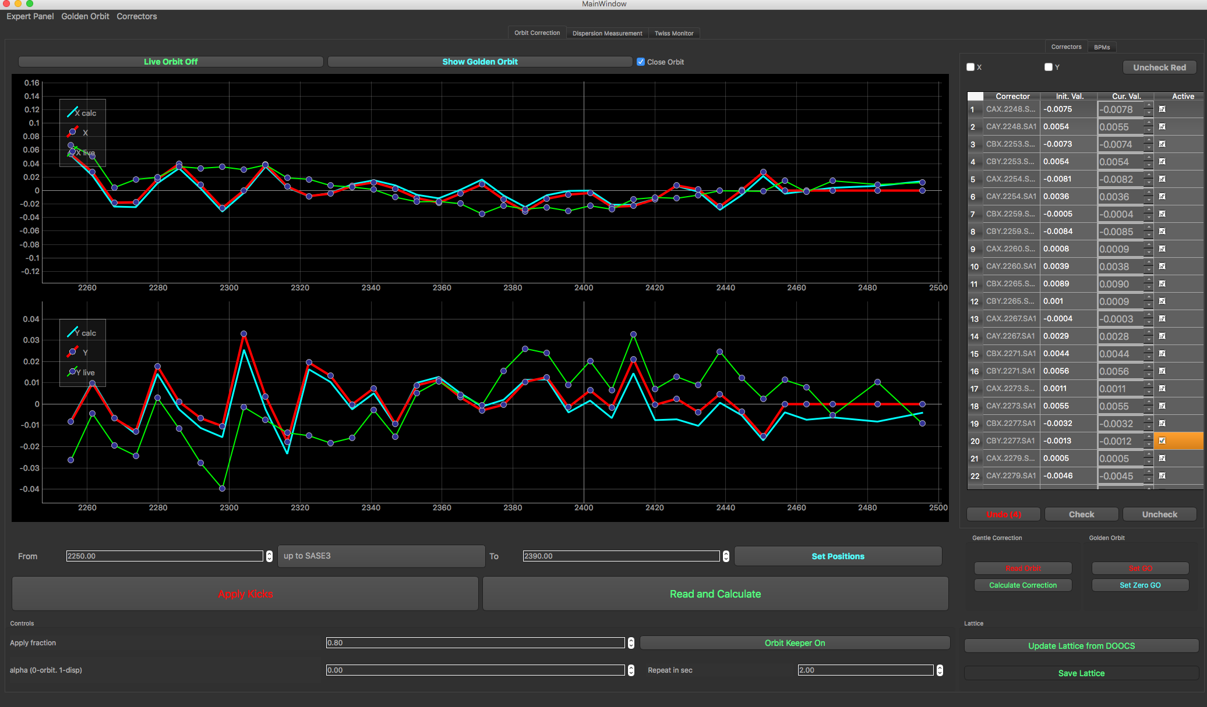
Orbit Tools
Witch orbit tool for which task?
Find all under Main Panel -> Orbit

Slide 10
The JDDD orbit panel
Comes with the well known JDDD features.
Double click on BPMs and correctors opens the respective JDDD panel of that beamline element.
Shows the corrector strengths!

Slide 11
The Python orbit (clicker tool)
Comes with tick dials for corrector strength thus it’s very handy.
However, there is no visualization of corrector strengths. Thus it happens easily that correctors become too strong and cause further problems.
Other tools (see next one) can do the same tasks better.
This tool might have a few use cases but it should be mainly used to display the orbit but not for orbit corrections.

Slide 12
Orbit correction tool based on Ocelot
That tool should mainly be used for orbit corrections.
It uses and SVD algorithm to calculate an orbit correction.
Easy to used due to predefined settings for various sections/tasks.
It is the only program so far that offers a “single shot” operation.
It provides also the often used adaptive orbit feedback.
Further details in a dedicated operator training.

Slide 13
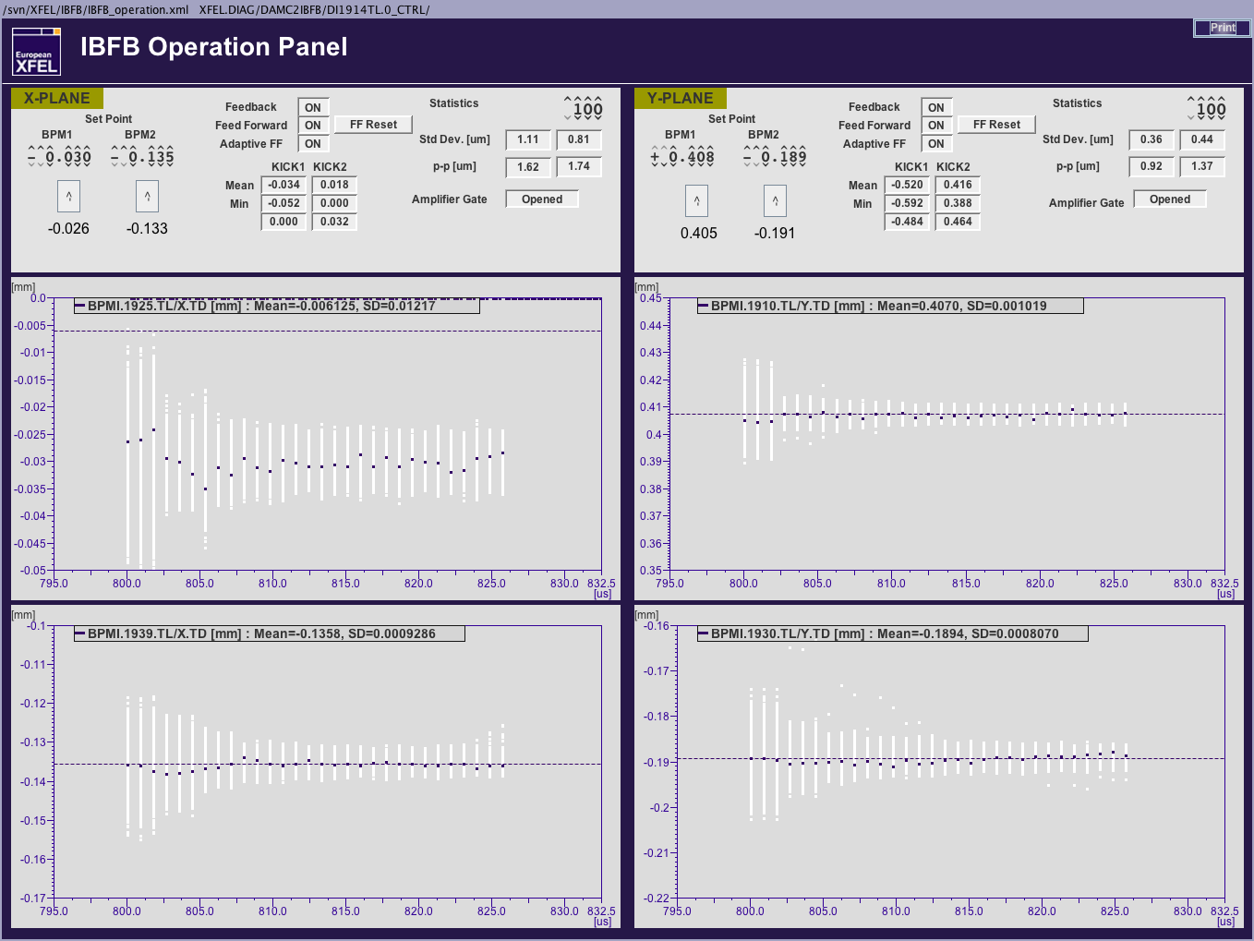
IBFB
Intra bunch train feedback
This feedback stabilizes the orbit within a bunch train.
It was running during the last user runs and worked well.
A dedicated training for that feedback will be part of the orbit feedback operation training. Don’t miss it!

Slide 14
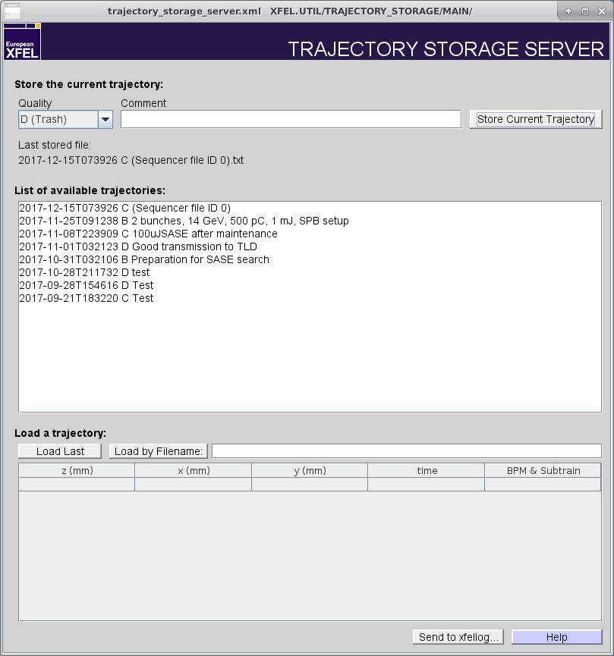
Trajectory storage server
A place to store beam orbits.
You do not have to take care of that ☺

Slide 15
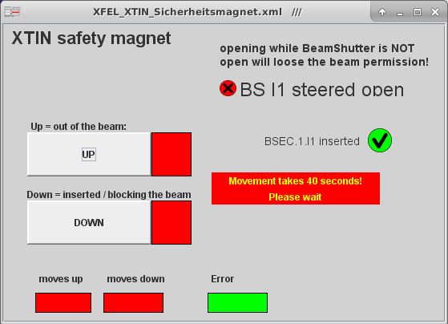
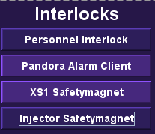
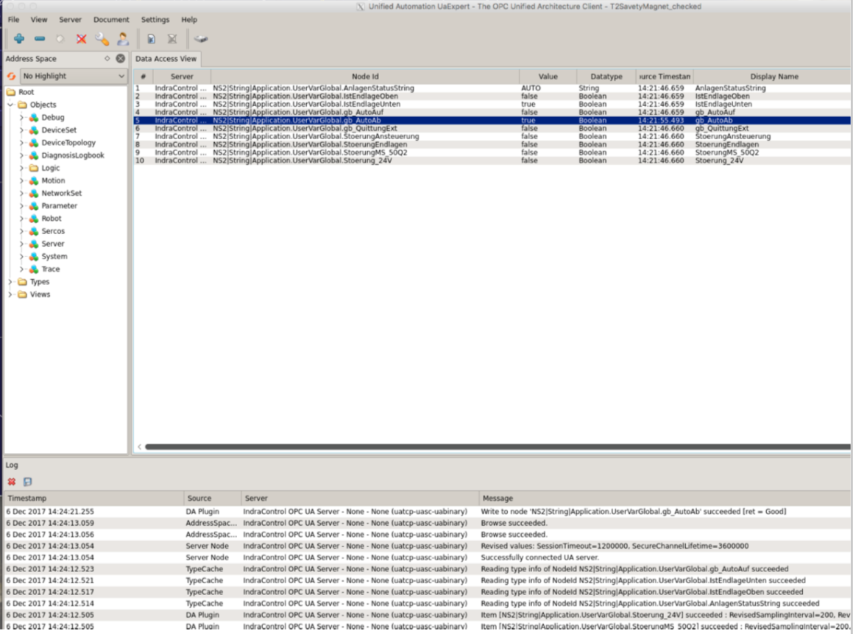
Safety magnets
We had two movable safety magnets in operation so far. One in the injector, the second one in XS1. A further one will be in operation with beam in the SASE2 beamline.
Moving the XS1 magnet was sometimes troubling. However, after exchanging hardware components this problem is maybe not existent any more.
But, there is still no JDDD panel available. The run coordinator will help you with that until further notice.

Slide 16
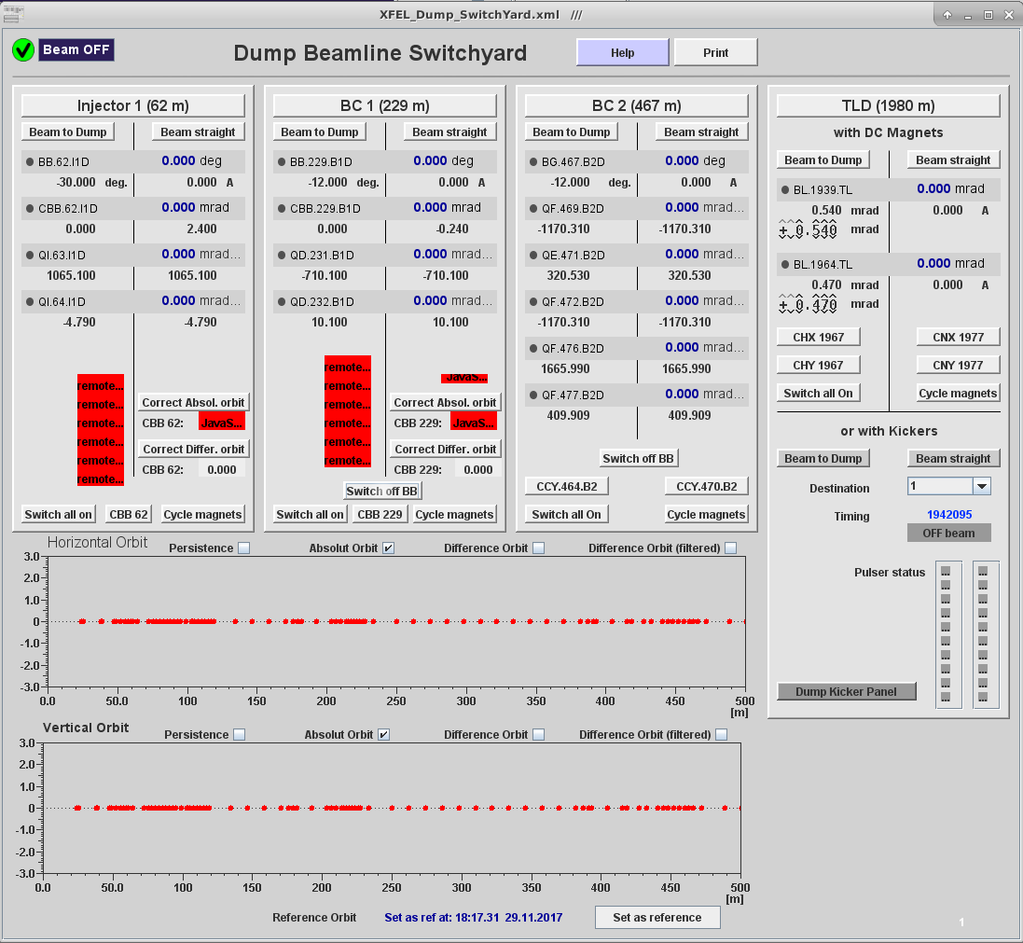
Dump switch panel
Main Panel -> Operations Procedures -> Dump Switch.
This panel helps to switch dump beamlines on and off.
It takes care that also the destinations of the bunches are set correctly.
Please be aware that you can only use either the dipoles or the kickers to steer the beam into the TLD beamline.

Slide 17
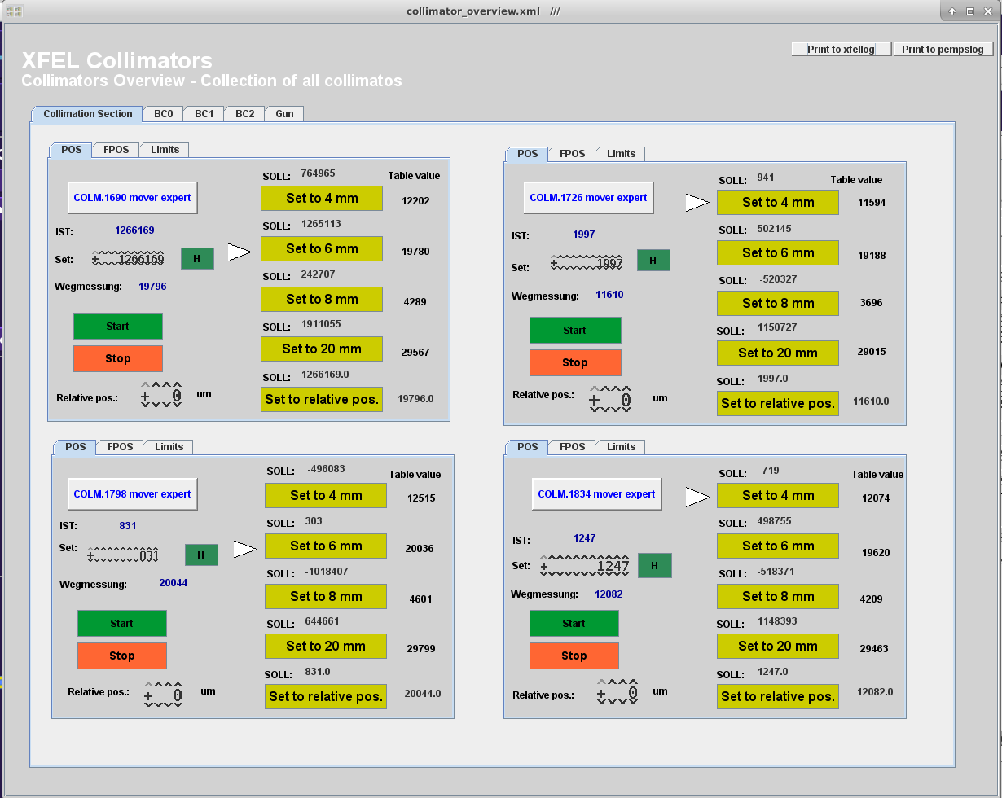
Collimators
There is a new collimator panel available.
You can select the collimators with the taps top left.
The panel makes it easier to move the main collimators to different apertures.
You can find it here: Main Panel -> Operations and Procedures -> Collimator Setup

Slide 18
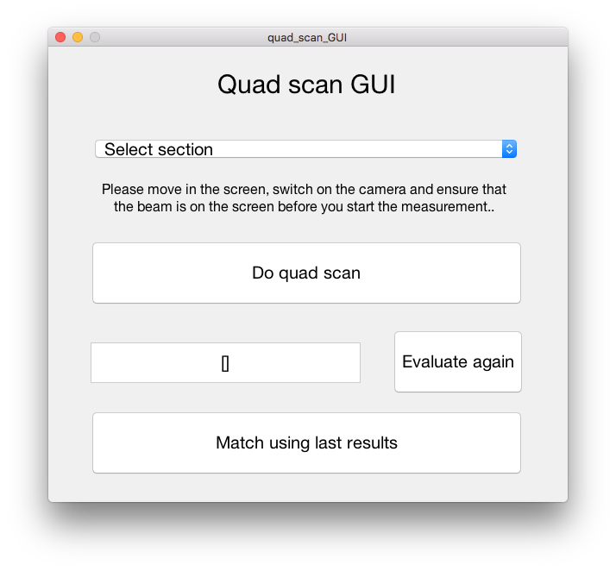
Multi quad scan tool
Quad scans are used to measure Twiss functions (mismatch) and emittances.
An easy to use GUI is available to do the scans. You just have to select the measurement screen and press the ‘Do quad scan’ button.
The results can also be used to match the beam.
You can find the tool here: Main Panle -> Beam Dynamics -> Multi Quad Scan Tool

Slide 19
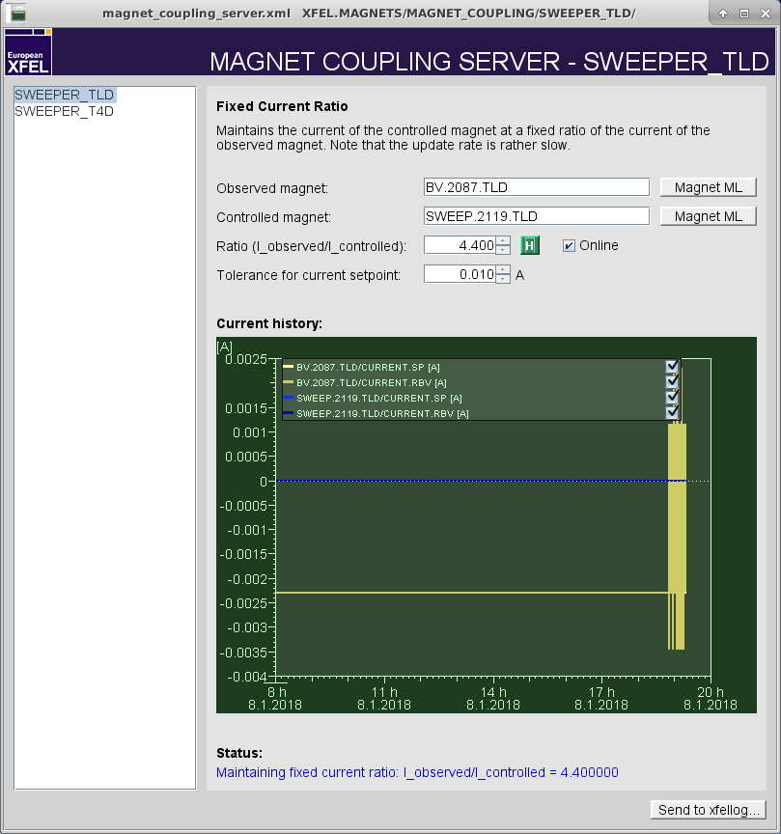
Magnet coupling server
New, but not necessarily a panel that you will use on a daily basis.
This server takes care that the ratio between the current of a selected magnet and the current of an observed magnet stays constant.
Its currently used for the dump sweepers.

Slide 20
Shift documentation
It is not required to do a shift documentation such as it is done at FLASH.
Of course you can plot several panels to the logbook that you consider to be important either for your shift or for later post-processing of your work.
More important is that you do a documentation of your work in the logbook! It is good practice to fill out the header in the logbook and to write some bullet points about what happened and what doubled you during the shift!
Please do not forget to tag the important entries in the logbook and to add you name.

