Slide 1
What is new? A summary of new tools/panels and some hacks and trick to make the operation of the XFEL easier.
Matthias Scholz
January 23, 2018

Slide 2
Topics
Laser heater
Laser 2
Undulator operation
HAMP settings
Dosimetry in SASE1 and SASE3
Shift documentation
Panel expert
Big brother
Gun power measurement

Slide 3
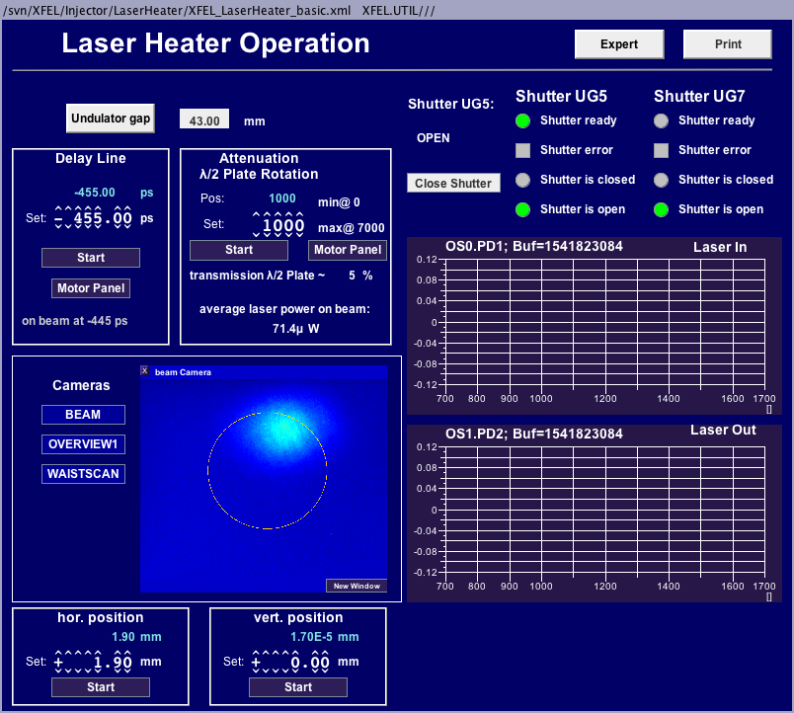
Laser heater
Why a laser heater?
The laser heater helps to reduce so called longitudinal micro bunching instabilities. Those reduce the SASE output power.
How to do that?
The electron beam has to overlap with an IR laser beam transversely and in time. That has to be the case inside the small LH undulator. This increases the uncorrelated energy spread along the bunch and mitigates micro bunching.
You can find the LH panel here: Main Panel/Injector/Laser Heater Operation

Slide 4
Laser heater
You can adjust the delay of the IR lasers with respect to the electron bunches here. Typically it is not necessary to change that value.
Close the shutter from time to time and check whether your setup works or not.
The power of the IR laser can be adjusted here. Keep in mind: too much power blows up the uncorrelated energy spread of you beam too much and reduces/kills you SASE output level!
The horizontal and vertical position of your laser beam inside the undulator.
You can scan those parameters in order to find an overlap with the electron beam.

Slide 5
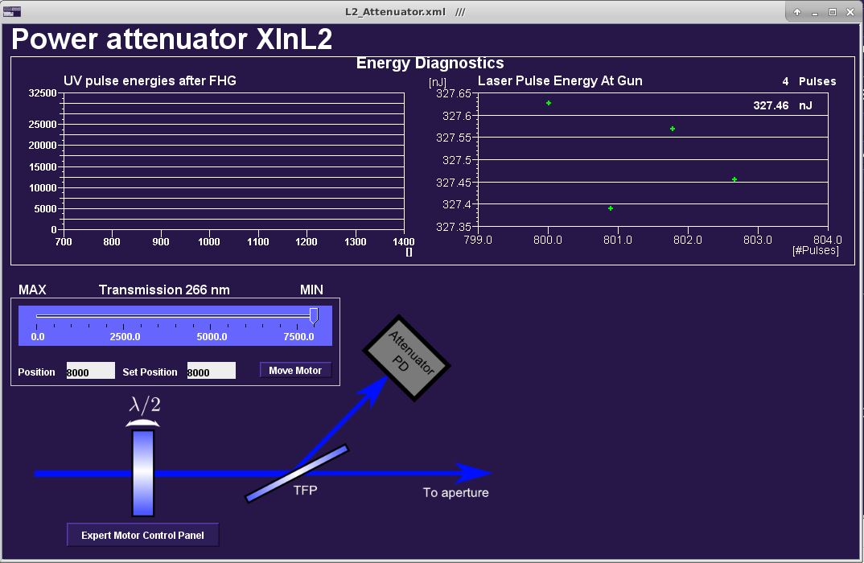
Laser 2 attenuator
We have a second injector laser in operation.
This laser provides a beam with higher charge stability.
The laser attenuator is on a dedicated panel. You can find it here:
Main Panel/Injector/Laser 2 Attenuator
The charge feedback works also with laser 2.

Slide 6
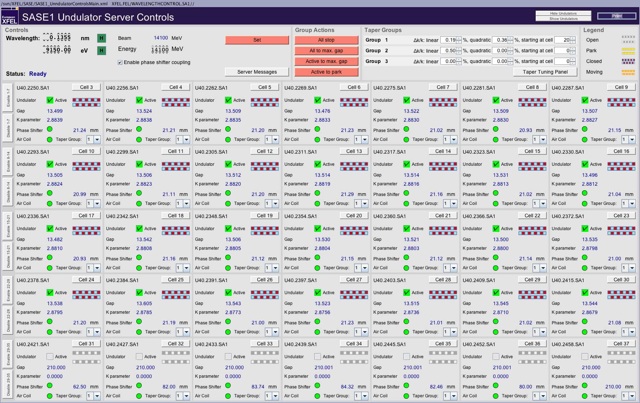
Undulator operation
This shows the electron beam energy. The upper number is the momentum set point of a dump dipole, the lower one should be changed such that both show the same number. The electron beam energy is used to calculate the correct undulator gaps.
If you get a request from the users to change the photon energy, these are the dials you should to use. Wavelength and energy are coupled. However, they request typically photon energy changes rather than wavelength changes.
To taper the undulator means to change the undulator gaps from cell to cell in a predefined way in order to increase SASE output.
A typical taper setting for a ~14 GeV electron beam and 9.15 keV photons can be found in this panel.
Press the ‘Set’ button after you changed the photon or the electron beam energy in order to apply the changes.
The names of the group control buttons are self-explaining. All undulator cells with a checked ‘Active’ check box can be operated with the buttons ‘Active to max. gap’ and ‘Active to park’.

Slide 7
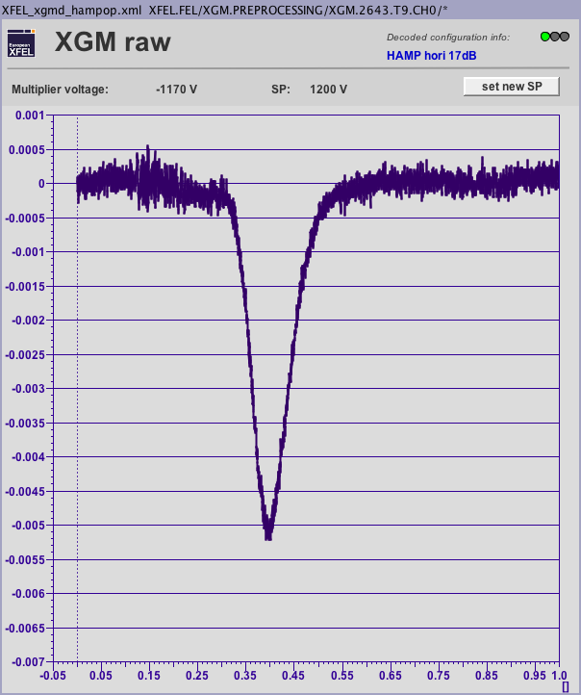
HAMP settings
The HAMP is a fast and sensitive signal for SASE tuning.
You can find the panel here:
Main Panel/Photons/XGMD Overview/HAMP Operator
You can increase the multiplier voltage via the ‘set new SP’ button in order to get a better signal to noise ratio.
Keep in mind that the shown signal should never go beyond -7 mA.
The panel pops up with the shown axis range. Take care that the signal always stays within this range!
The panel change slightly but it looks not much different…

Slide 8
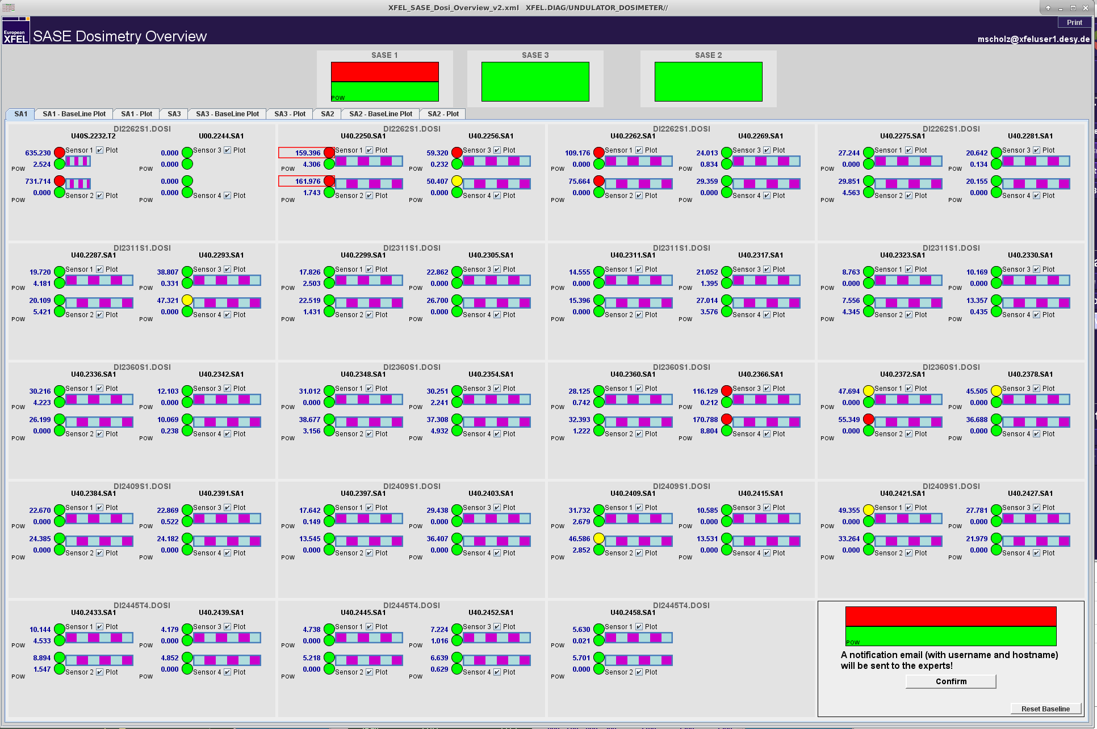
Dosimetry in SASE undulators
The standard SASE dosimetry panel.
You had already a large dose measured in the respective undulator if one of the panels are red as shown.
You can find this panel here:
Main Panel/Diagnostics/SASE Machine Dosimetry.
You can reset a baseline, which will affect a plot that can be opened with the tab ‘SA1-Baseline Plot’.

Slide 9
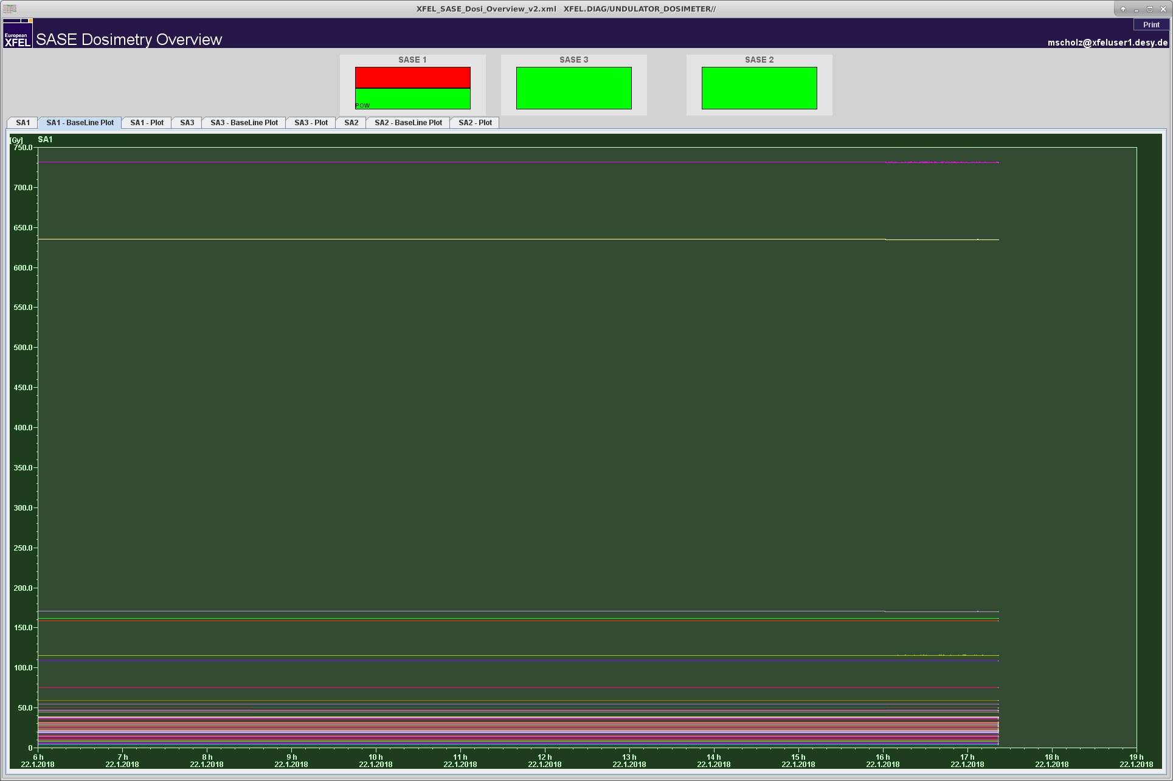
Dosimetry in SASE undulators
That plot shows the accumulated dose since you pressed the ‘reset baseline’ button shown on the last slide.
Of course we should keep the accumulated losses in the undulator as small as possible.

Slide 10
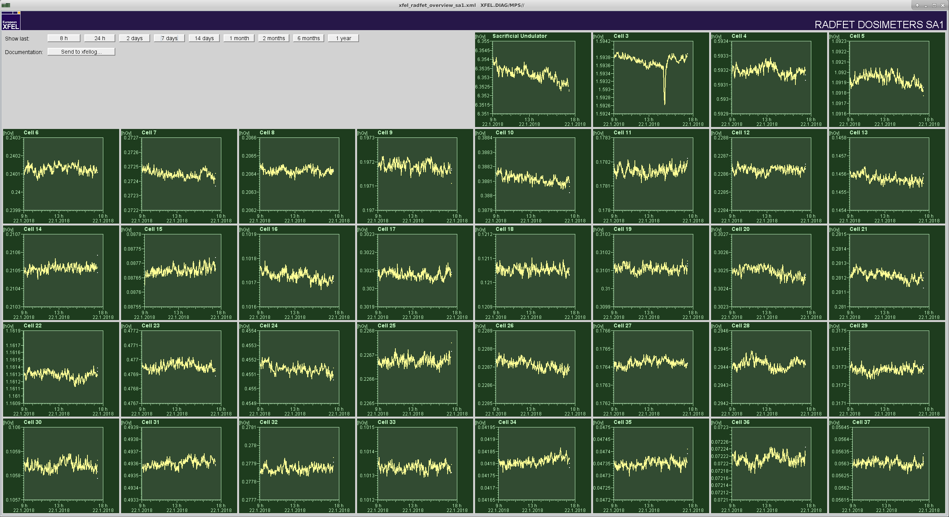
Dosimetry in SASE undulators
Another, often used panel to show the losses in the undulators.
Again, it is our goal to keep the losses as small as possible. In the best case, you do not see any positive slope in the plots.
The buttons top left help to select time ranges.
You can find the panel here:
Main Panel/Diagnostics/SA1 Radfet Overview

Slide 11
Shift documentation
Please choose for all important entries at least a severity tag.
It is also important that you type in you name as the author of the entry.
Titles are very helpful and should be used. Especially when you want to send the entry to an expert.
Logbook entries can also be written in German in case you do not feel comfortable writing them in English.
Please write a summary of you shift!
That can either be done in the logbook header on an an entry pint on top of all other entries.

Slide 12
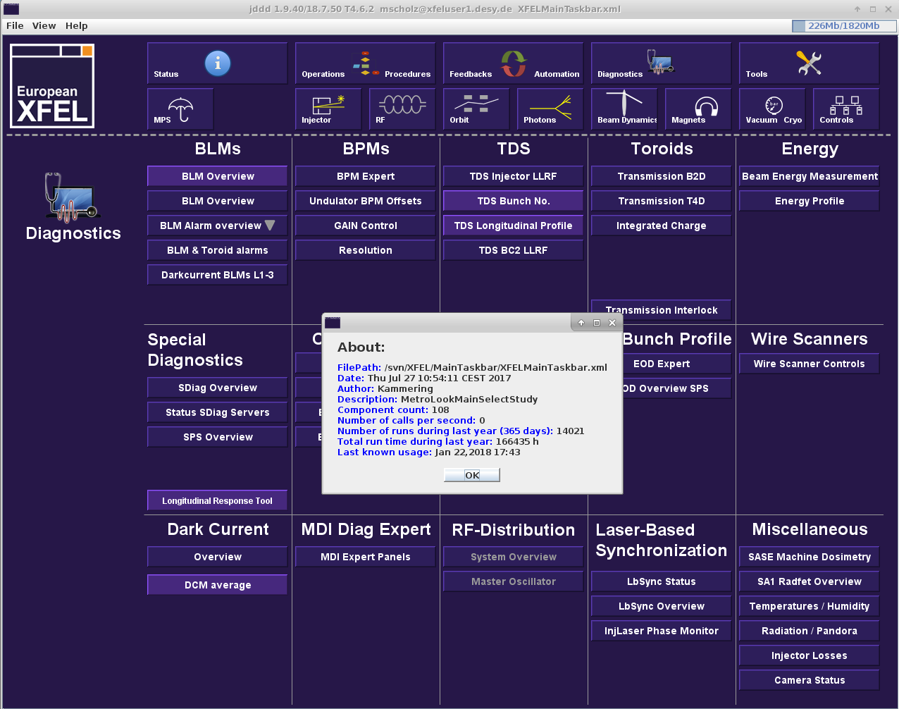
Panel expert
You want to find out who made the panel?
Right click on the panel and chose ‘about this panel’.
Often the panel author is also the expert for the tool/device.
Sometimes you can also find the experts name on the panel itself.

Slide 13
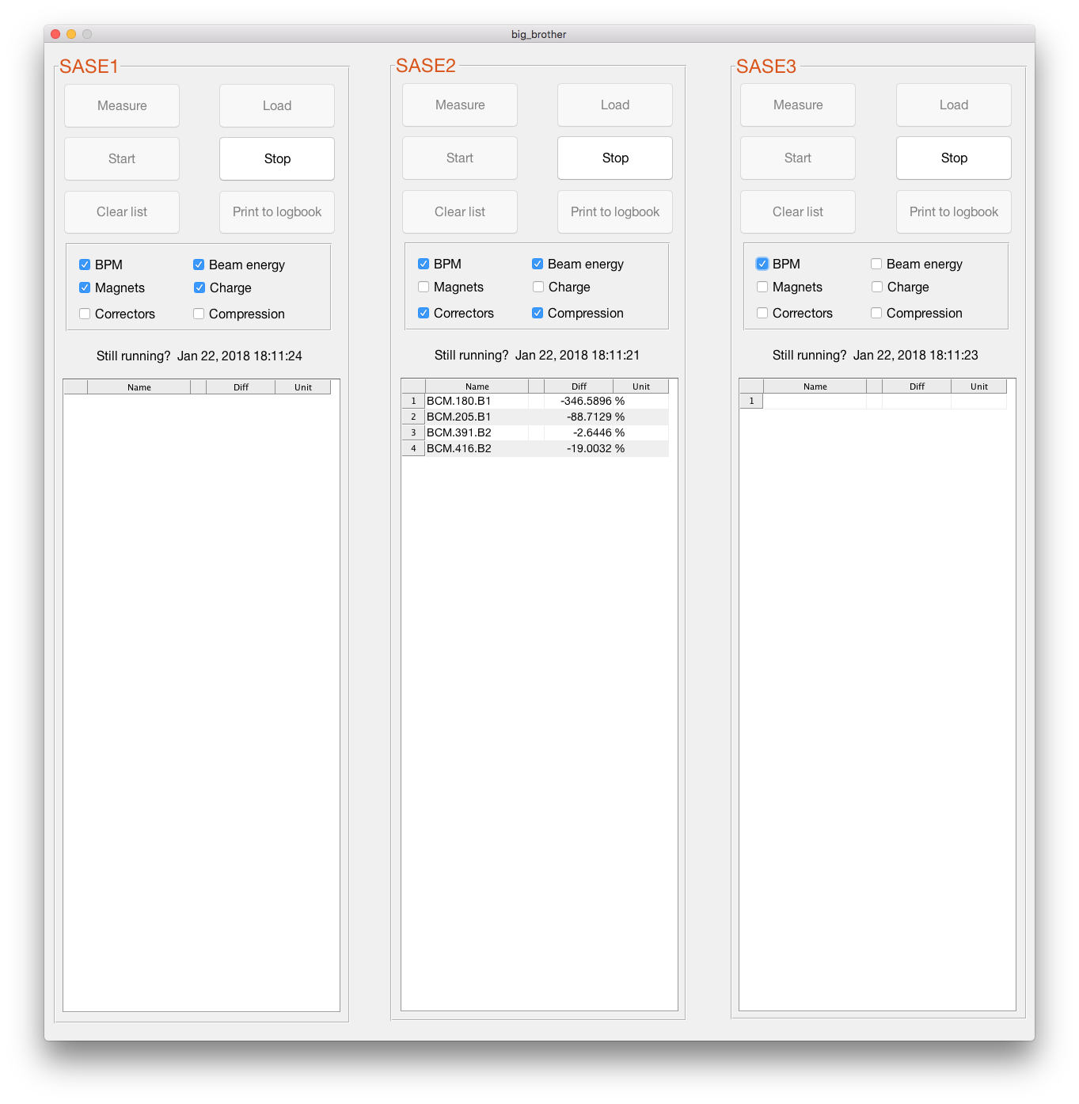
Big brother
We had the situation before, that the machine was running nicely and all were happy.
Out of a sudden, the SASE level dropped and we had to search for a long time to find the difference to the setup we had before.
We wanted to have one list with elements/readings that shows only the changes in the machine.
How to operate the tool:
As soon as you have a nice setup, press ‘Measure’.
The press ‘Start’
The lists show only elements with differences to the initial setup.
If an element name is shown but no value, that means that the difference was measured in the past and is not existing any more.
Differences are either shown with units or as relative differences in percent.
Check the clock every now and then to ensure that the tool is still running.

Slide 14
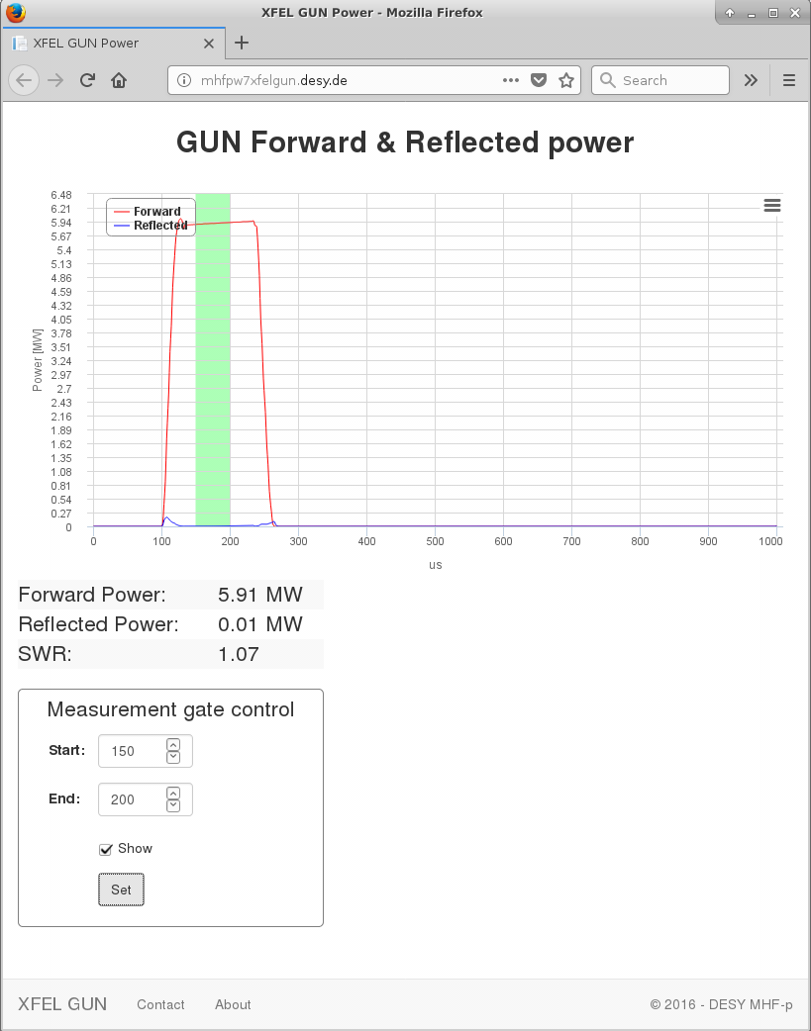
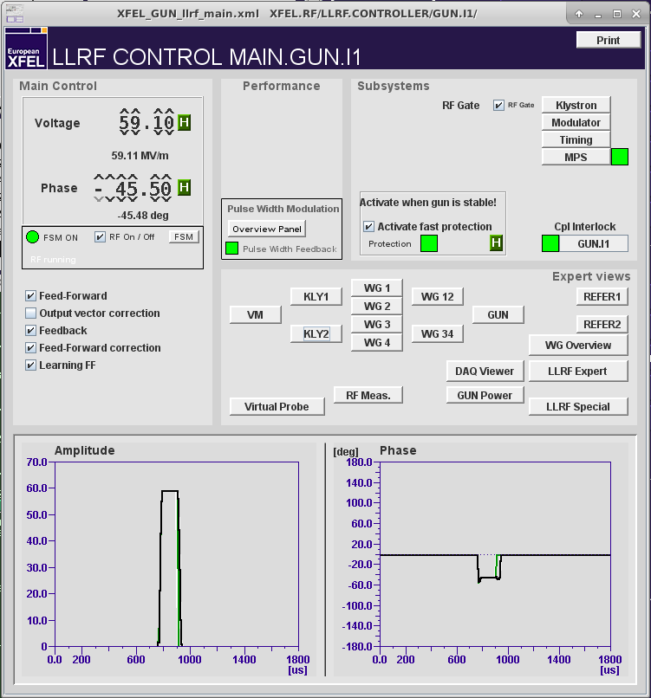
Gun power measurement
If you are interested in the actual measured gun power, open the following panels:
Main Panel/LLRF/Gun
And then:
RF Meas.
A browser window opens and shows the proper power measurement.
Be careful, that did not work on all consoles in the past…

