Slide 1
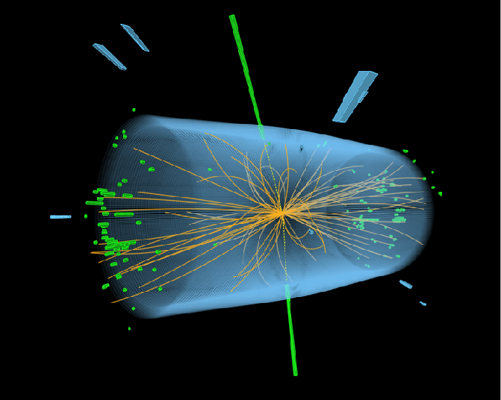
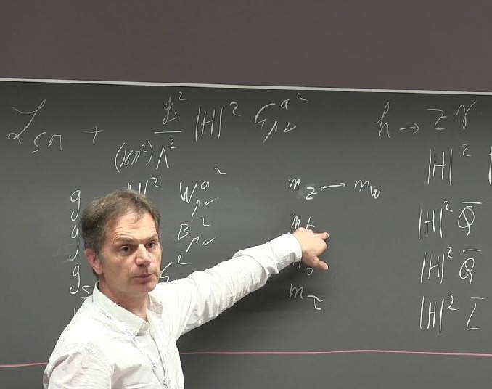
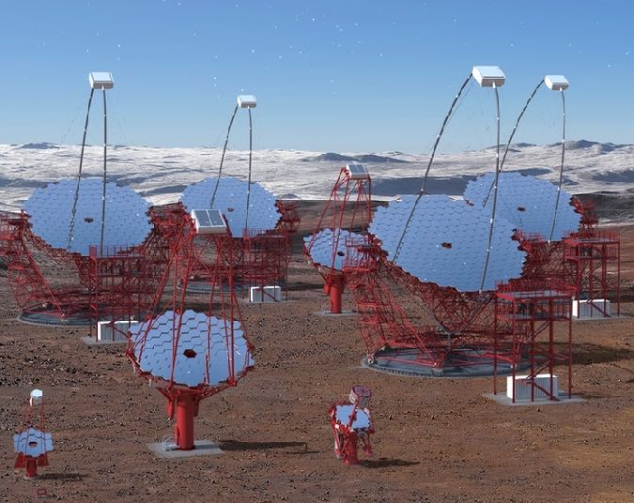
ILC and Future Accelerator Projects
Looking beyond the LHC
Helmholtz Program: Matter and the Universe (MU)
PoF III Topic: Fundamental Particles and Forces
DESY Research Unit: Experimental Particle Physics
Felix Sefkow
Center Evaluation DESY, 5 – 9 February 2018

Slide 2
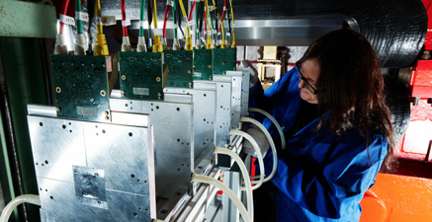
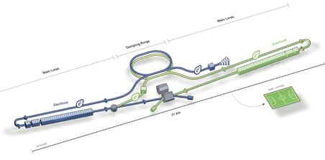
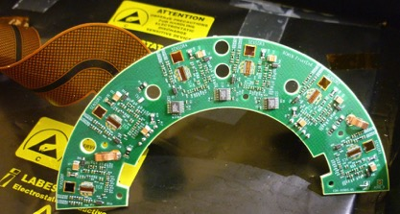
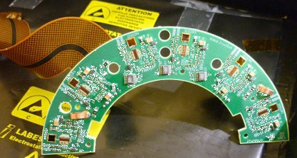
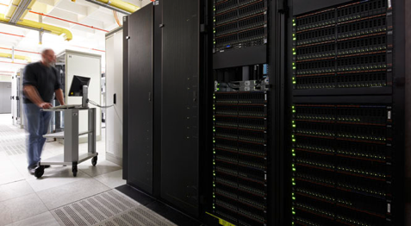
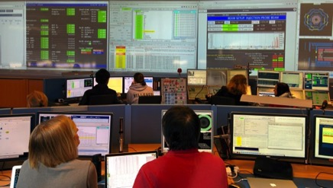
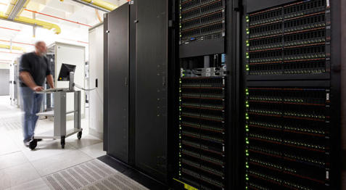
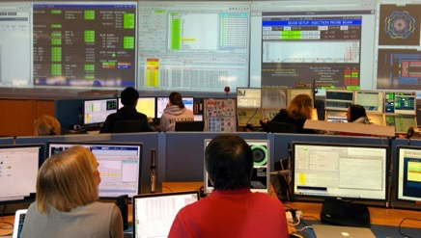
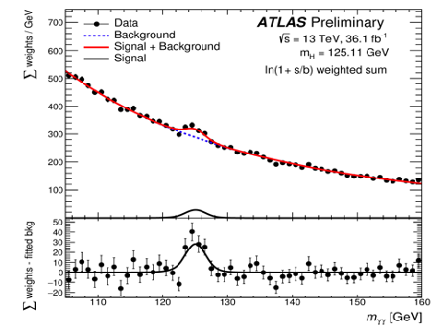
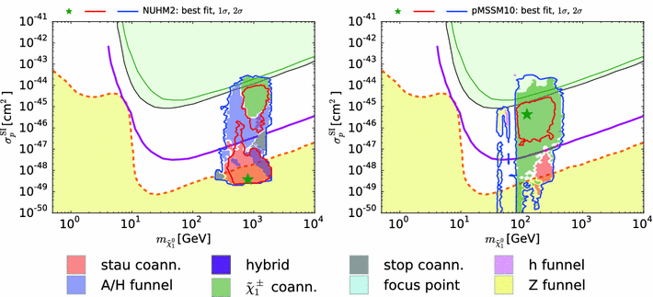
Lifecycle Competence
R&D
R&D
From conception to exploitation.
Construction
Commissioning
Construction
Commissioning
Conception
Design
Decision
Conception
Design
Decision
This talk:
ILC: Physics and detectors
Future projects: example opportunities
Data preservation
Outreach into society
Data preservation
Outreach into society
Operation
Operation
Interpretation
New ideas
Interpretation
New ideas
Physics analysis
Analysis Strategy
Physics analysis
Analysis Strategy
ILC and Future Accelerator Projects | Felix Sefkow | MU | EPP

Slide 3
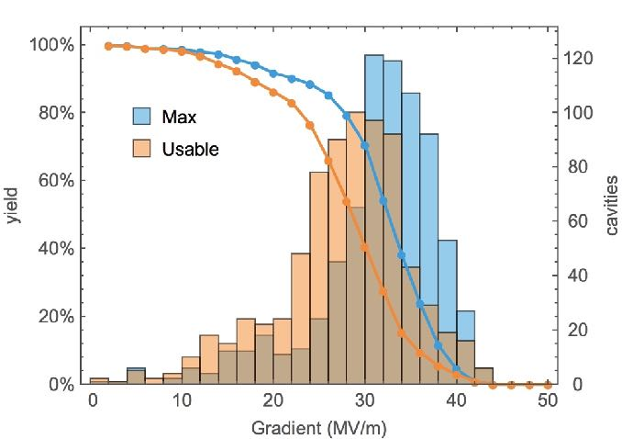
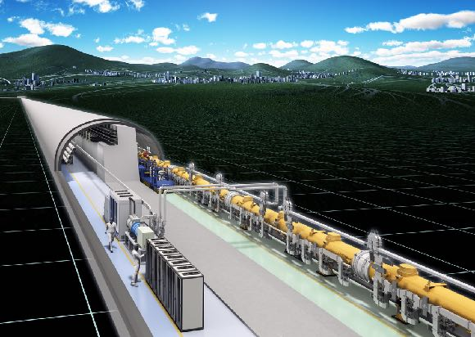
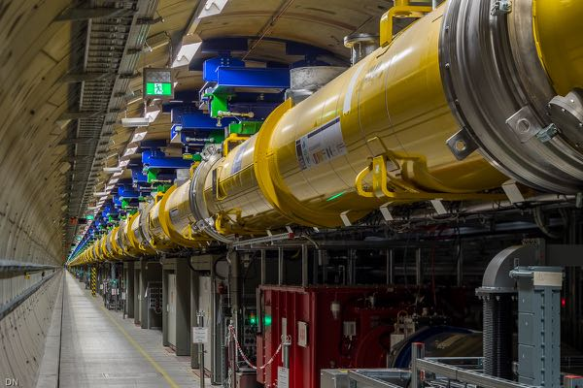
The International Linear Collider
The most advanced and mature future project.
XFEL
spec.
e⁺e⁻ collider with E_{CM} from 90 GeV to 1 TeV, Initial stage of 250 GeV
  Expect input from Japan for European Strategy update 2019
Supported by ICFA (Ottawa, November 2017):
  ”ICFA (…) very strongly encourages Japan to realise the ILC in a timely fashion as a Higgs boson factory with a centre-of-mass energy of 250 GeV as an international project, led by Japanese initiative.”
Based on superconducting RF technology
Industrialisation successful with XFEL –
a ”10% prototype” of ILC
  Cavity production according to ILC specs (31.5 GeV/m)
ILC and Future Accelerator Projects | Felix Sefkow | MU | EPP

Slide 4
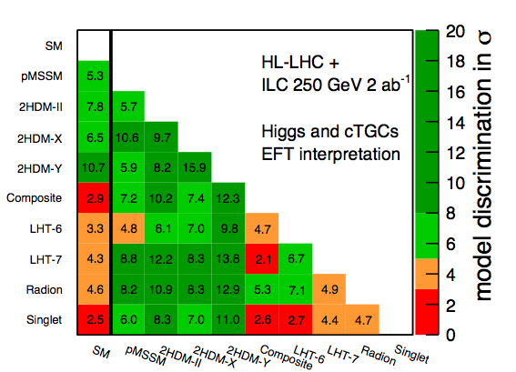
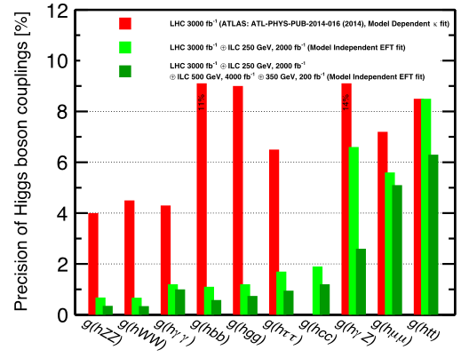
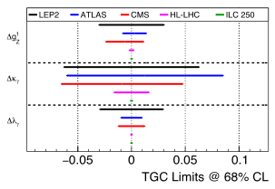
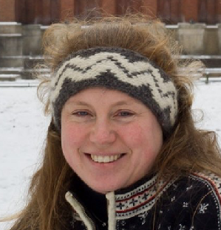
Physics Case for ILC 250
Precision and discovery potential.
Leading involvement
of DESY physicists (experiment and theory)
PhD thesis R.Karl
HL-LHC
+ ILC 250
+ ILC 500
DESY-17-155, hep-ex/1710.07621
Already at 250 GeV precision of model-independent Higgs coupling measurements exceeds HL-LHC projections
Fully exploit EFT formalism, include angular dependences
Absolute coupling measurements at the ILC using inclusive Zh cross section remain key element
Percent-level deviations expected in many extensions of the Standard Model – precision does matter
Use Higgs and Triple Gauge Couplings from e⁺e⁻ → W⁺W⁻ to distinguish between SM and different BSM points
  Example points: no new particles would be seen at HL-LHC
J.List
ILC and Future Accelerator Projects | Felix Sefkow | MU | EPP

Slide 5
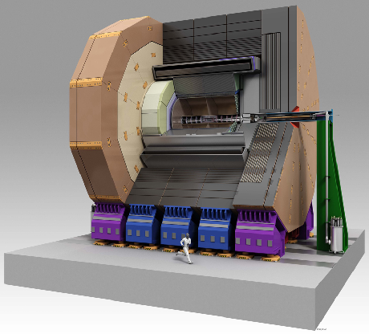
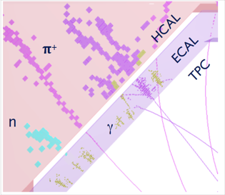
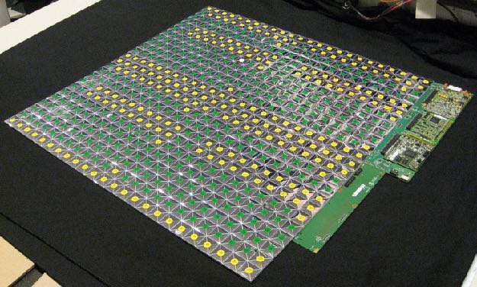
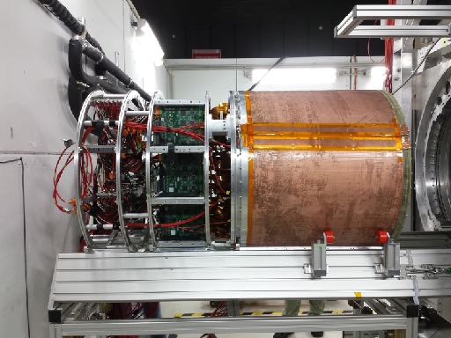
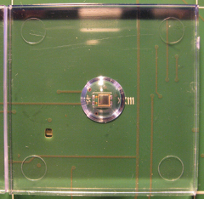
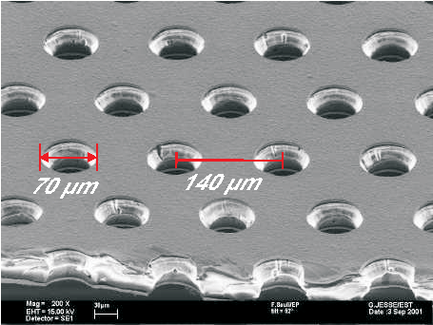
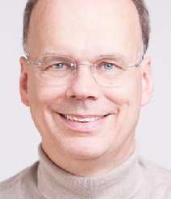
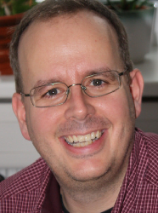
ILC Detector Concepts and Development
Precision experiments for precision physics.
TPC fieldcage
Software compensation and particle flow
Eur. Phys. J. C77 (2017) 698
SiPM read-out
HCAL active layer
GEM read-out
DESY leads world-wide LC detector effort
Physics analysis and software, coordination (ILD Spokes, SiD Co-spokes: DESY)
Detector overall integration and interface with machine
All linear collider (ILC, CLIC) detector concepts based on particle flow
  Ultra-light tracking systems, Highly granular calorimeters, software algorithms
Leading detector R&D: Hadron Calorimeter and Time Projection Chamber
Realistic prototypes built – POF-III goals achieved
T.Behnke
M.Stanitzki
ILC and Future Accelerator Projects | Felix Sefkow | MU | EPP

Slide 6
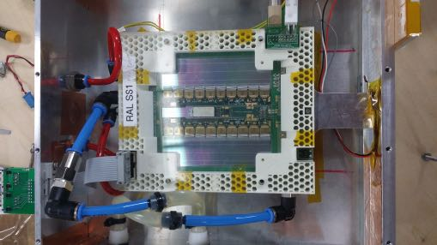
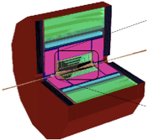
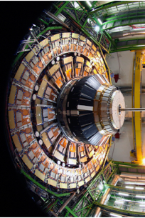
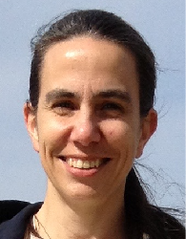

Preparing Future Experiments
Detector R&D and software frameworks.
DD4HEP
Geometry kit
Here: CLICdet
ATLAS ITK module
@ DESY test beam:
1st EUDAQ2 user
ILC-motivated detector activities serve a wide range of future projects
  HL-LHC upgrades and future collider projects
Supported by EC funded initiative AIDA-2020; scientific coordination: DESY
Examples:
  Test beam support and instrumentation using LC technologies
    MAPS pixel telescope, precision Si strip telescope
  Common test beam DAQ system EUDAQ
  Software frameworks for ILC, CLIC, FCC
Application of LC technologies for HL-LHC upgrade
  Example: SiPM-on-tile technology for CMS HGCAL endcap calorimeter
K.Krüger
CMS endcap
calorimeter
F.S.
ILC and Future Accelerator Projects | Felix Sefkow | MU | EPP

Slide 7
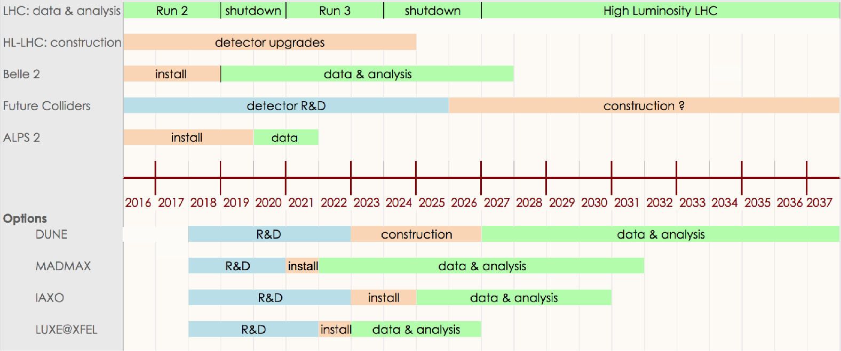
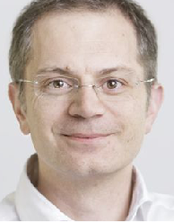
Future Accelerator Projects
Overview.
Particle physics has many options for the future
  European Strategy update 2019 will guide the way
CLIC: linear e⁺e⁻ collider at CERN with E_{CM} from 380 GeV to 3 TeV
  Existing cooperation in software and SiPM-on-tile HCAL
CEPC: circular linear e⁺e⁻ collider in China with E_{CM} from 90 to 250 GeV
  Existing cooperation in software, interest in TPC and SiPM-on-tile HCAL
FCC: circular collider (100 km) at CERN, ee E_{CM} = 90 – 350 GeV, pp E_{CM} = 100 TeV (later)
  Existing cooperation in physics and software
All except FCC-hh could start construction in the next decade
C.Grojean
Expand in Quantum Universe
framework with UHH:
Future Collider Platform
ILC and Future Accelerator Projects | Felix Sefkow | MU | EPP

Slide 8
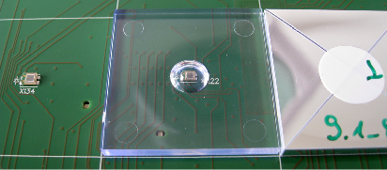
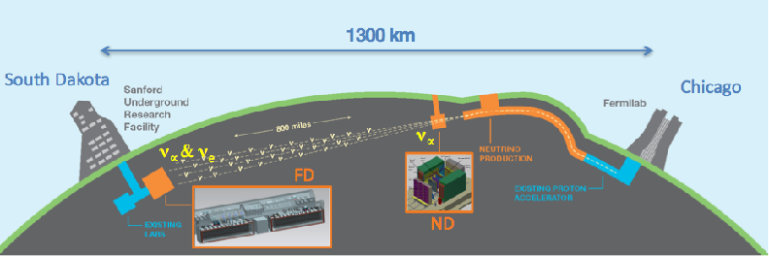

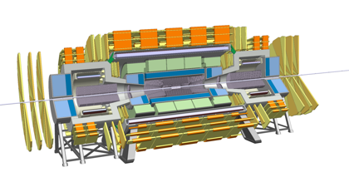
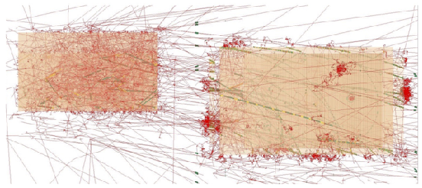
Opportunities at Future Accelerators
Application of DESY competences and technologies.
Example: possible applications of highly granular calorimeters
CMS end-cap calorimeter upgrade: on-going (R&D)
  strong interest in CMS to use DESY SiPM-on-tile technology
DUNE @ LBNF: long baseline neutrino experiment at FNAL
  Highly granular ECAL in Near Detector needed
  strong interest in German community (universities & MPG)
Calorimetry at Future Colliders
  FCC-ee: high granularity for particle flow precision
  FCC-hh high granularity pile-up rejection
SiPM-on-tile
Construction started
Similar for other detector technologies, e.g. silicon tracking
Central role of DESY for coherent German contributions to LHC and BELLE detector upgrades as a model
Pile-up in DUNE Near Detector
FCC-hh detector with FeSc HCAL
ILC and Future Accelerator Projects | Felix Sefkow | MU | EPP

Slide 9
Summary
ILC and Future Accelerators
The ILC - based on DESY’s super-conducting RF technology - is ready to be built and offers excellent precision physics and discovery potential beyond HL-LHC already at its initial 250 GeV stage.
DESY is leading the world-wide ILC physics and detector effort with conceptual design, HCAL and TPC technologies, software and management.
DESY’s life-cycle early-stage competences already now bear fruit in a wide range of on-going R&D and future accelerator studies; focus will be discussed in line with the European Strategy for Particle Physics update, to which we actively contribute.
ILC and Future Accelerator Projects | Felix Sefkow | MU | EPP

