Slide 1
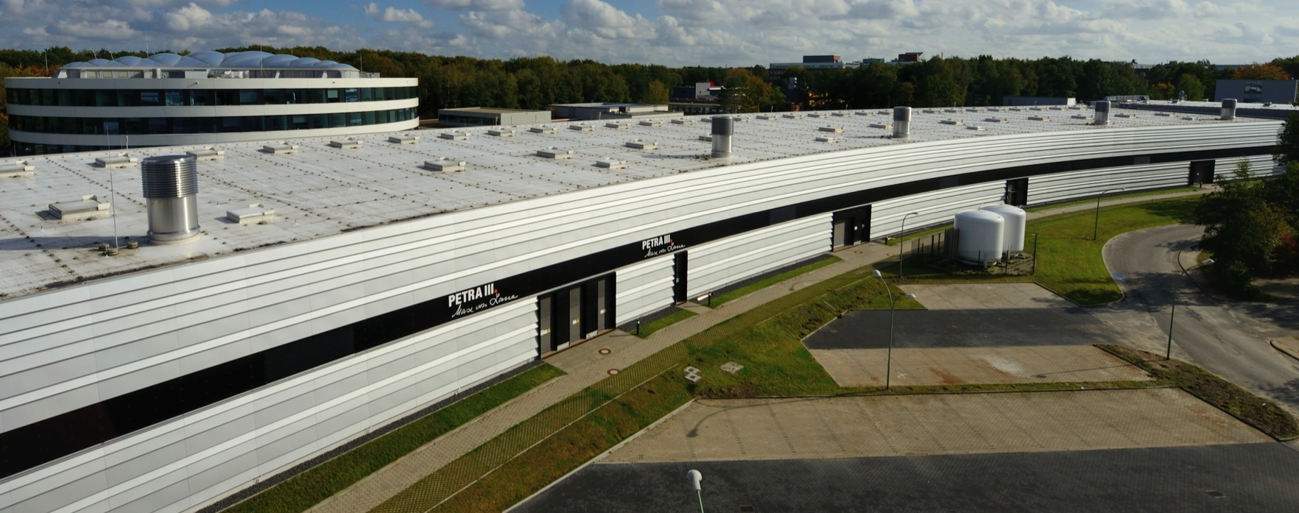
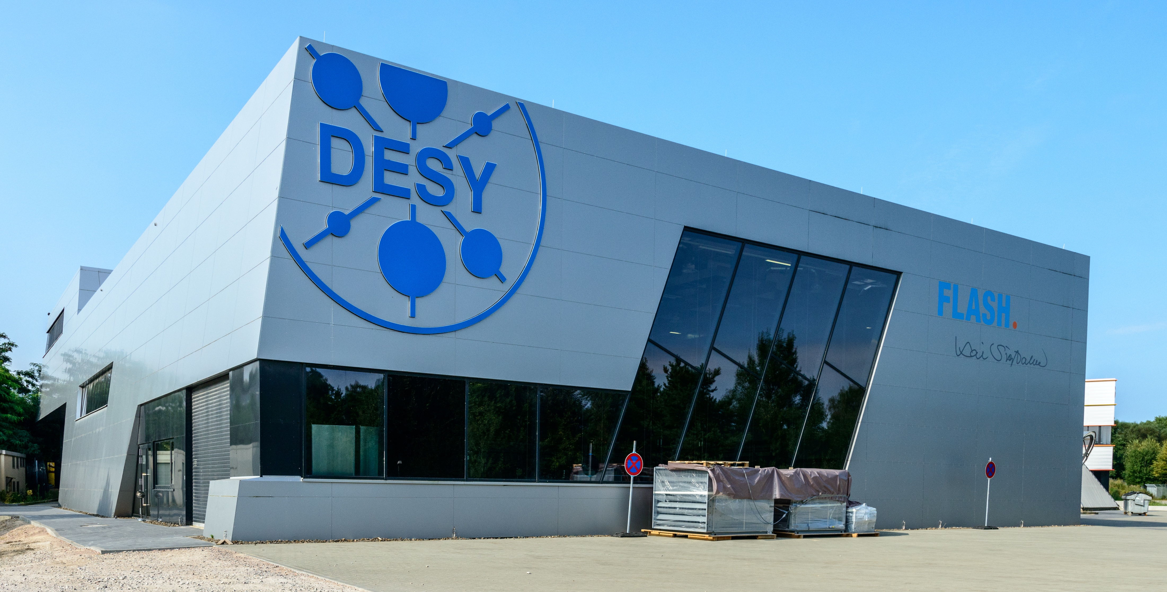
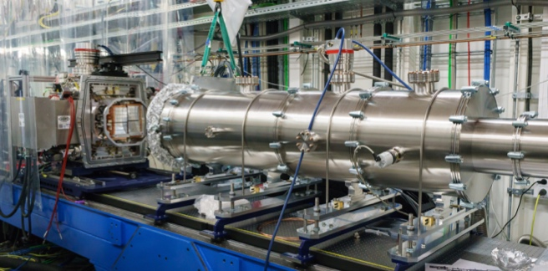
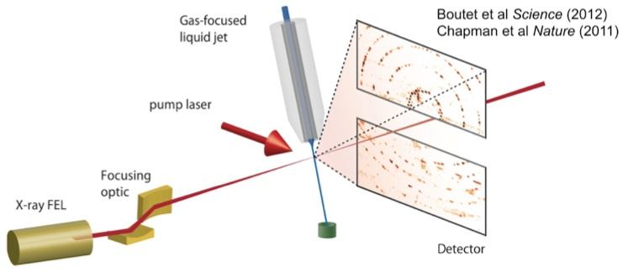
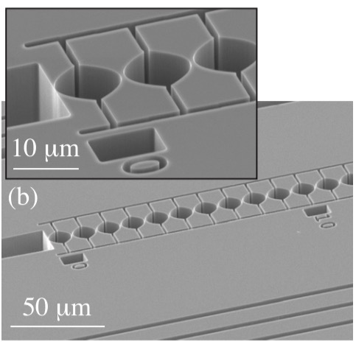
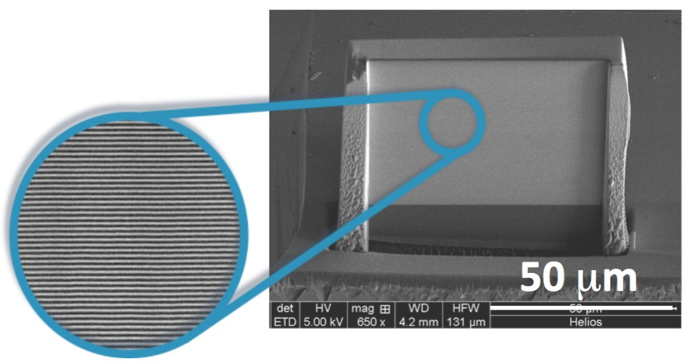
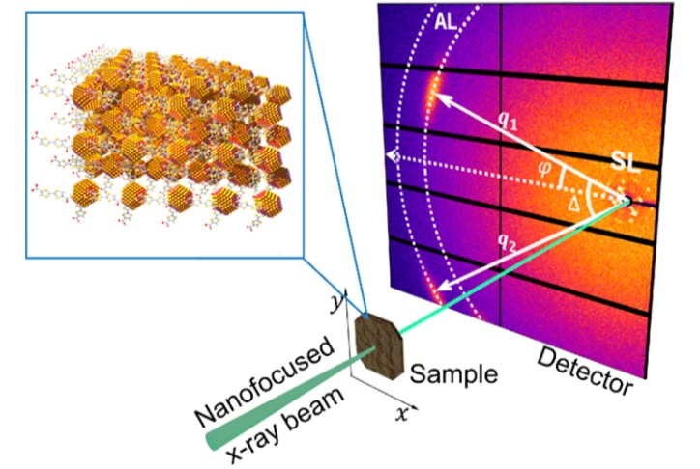
DESY Photon Science – mission
Forefront research on the structure, dynamics and function of matter based on large scale photon sources from the VUV to X-ray regime
LK II: Design, construction and operation of advanced experimental stations at synchrotron (SR)
and FEL sources
LK I Research at Frontiers of X-Ray Science and Technology
PETRA III
FLASH
HIB:SFX/SPB@EU.XFEL
SFX: pump-probe scattering from jets
nano-focusing CRLs
nano-focusing MML
X-ray angular cross correlation

Slide 2
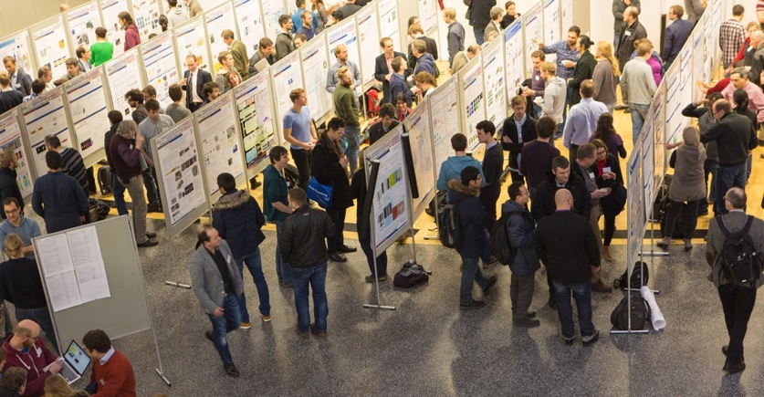
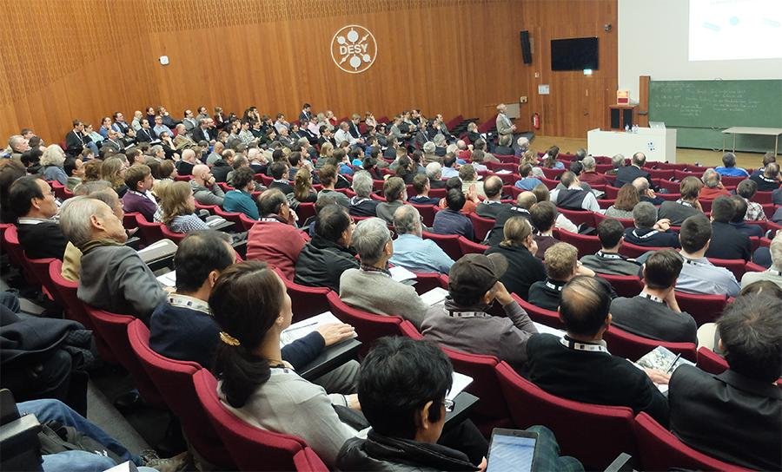
DESY – PHOTON SCIENCE – LK II USERS and Facility Operation
Unique opportunities for a wide range of photon science applications:
  Photon science facilities
    PETRA III: tender to hard X-rays ( > 2400 users)
    FLASH: VUV to soft X-rays (~300 users)
    HIB @ EU.XFEL (Helmholtz int. Beamline, starting)
  Additional facilities on campus
    NanoLab (CXNS)
    CryoEM (CSSB)
Vivid, very active and interdisciplinary user community
  About 30 - 40 dedicated conferences and workshops every year
  One of the largest user meetings in photon science
  (> 1000 participants)

Slide 3
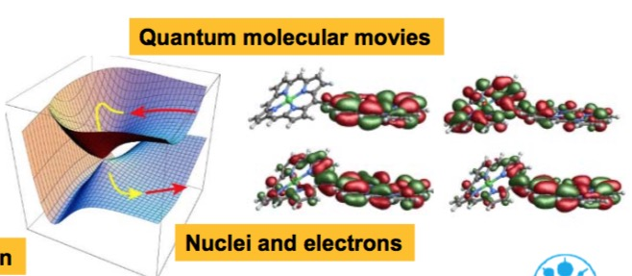
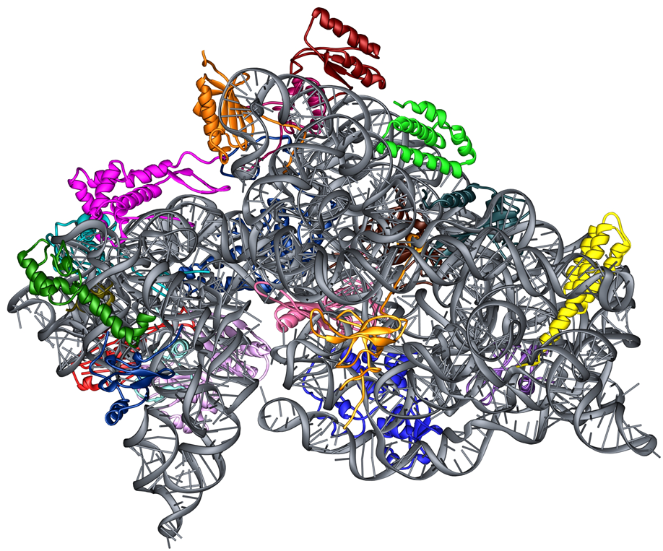
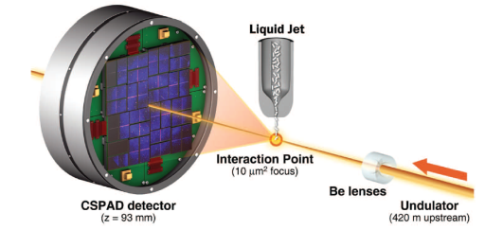
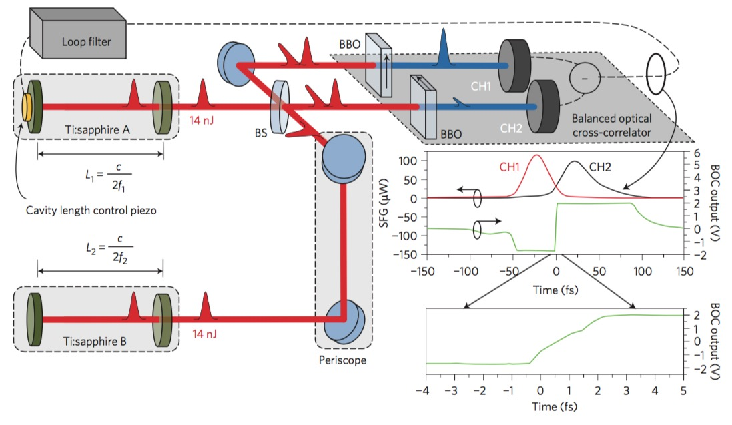
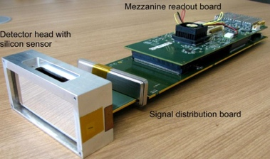
DESY – PHOTON SCIENCE – LK I RESEARCH
What are our goals and ambitions ?
Research in Photon Science designed to underpin DESY´s competences in operating and developingworld-leading X-ray facilities by
Exploration of new areas of SR-FEL applications
  Fundamentals in X-ray-matter interactions
  Molecular processes at interfaces
  (➔ exploiting coherence and/or temporal resolution)
  …
Development of new methods in X-ray science
  Serial femto second crystallography
  X-ray cross correlation analysis
  X-ray quantum optics
  …
Exploration and design of novel X-ray technologies
  Novel nano-focusing X-ray optics
  High performance pixel detectors
  Laser synchronization at FELs
  …

Slide 4
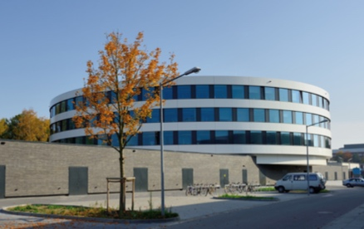

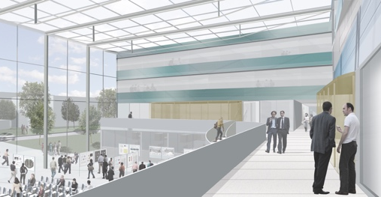

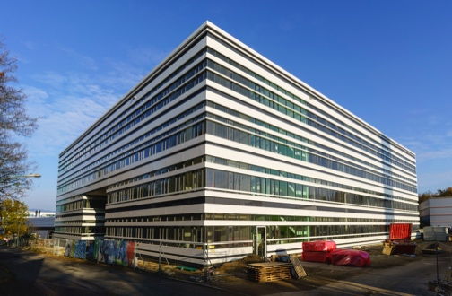










DESY – PHOTON SCIENCE – LK I RESEARCH
How is Research in Photon Science organized ?
Interdisciplinary Research Centers
CFEL, CSSB, CXNS, (in planning: CWS)
Cooperation with Universities and Partner
Laboratories
Research Units – Helmholtz Dimension
Matter – Dynamics, Mechanism and Control (Mat-DMC)
Fundamentals in X-ray science questions
Nano and Materials Science (Nano-MAT)
Physico-chemical properties, nano materials
Biological and Soft Matter (Bio-Soft)
Structure and Dynamics at the atomic Scale
CXNS
Detector Development (DTS)
High frame rate 2D pixel detectors
Accelerator Research and Development (ARD)
Compact accelerators and timing distribution systems
This is the scheme for the evaluation this week !
Notes:
Alternative 1
FS hat auch signifikante Beiträge in MT, wenn wir ‘one-Lab’ ernst nehmen sollten wir das hier auch so darstellen
Die Research Units / Competence Teams sind in unserer Auffassung doch nicht nur für die Helmholtz Begutachtung, das klingt hier aber so …
Es ist auch nicht mehr nur die Helmholtz-Sicht !!

Slide 5
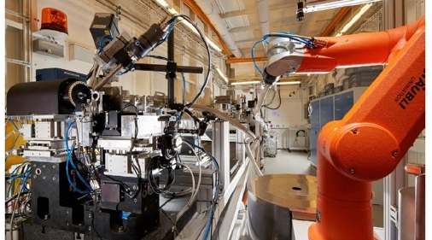

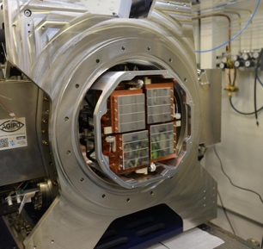
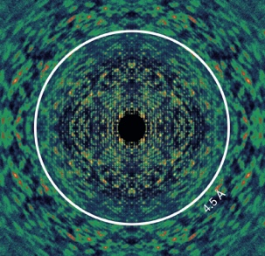
DESY – PHOTON SCIENCE - Summary
Activities Photon Science Division
DESY Photon Science Division contribution to the laboratory’s infrastructure
Central mechanics workshop
(including 80 apprentices)
Division administration
EU project office
PETRA III
125
LK II
User operation of the high
energy low emittance
synchrotron radiation source
514 FTE
FLASH
50
LK II
User operation of the
SC-Linac driven
VUV and soft X-ray FEL
Research Program MML
Research units
Mat-DMC, Nano-Mat, Bio-Soft
Research Program MT
Research units
DTS, ARD
* Scientific staff at LK II facilities counts to 1/3 in LK I and 2/3 in LK II

Slide 6
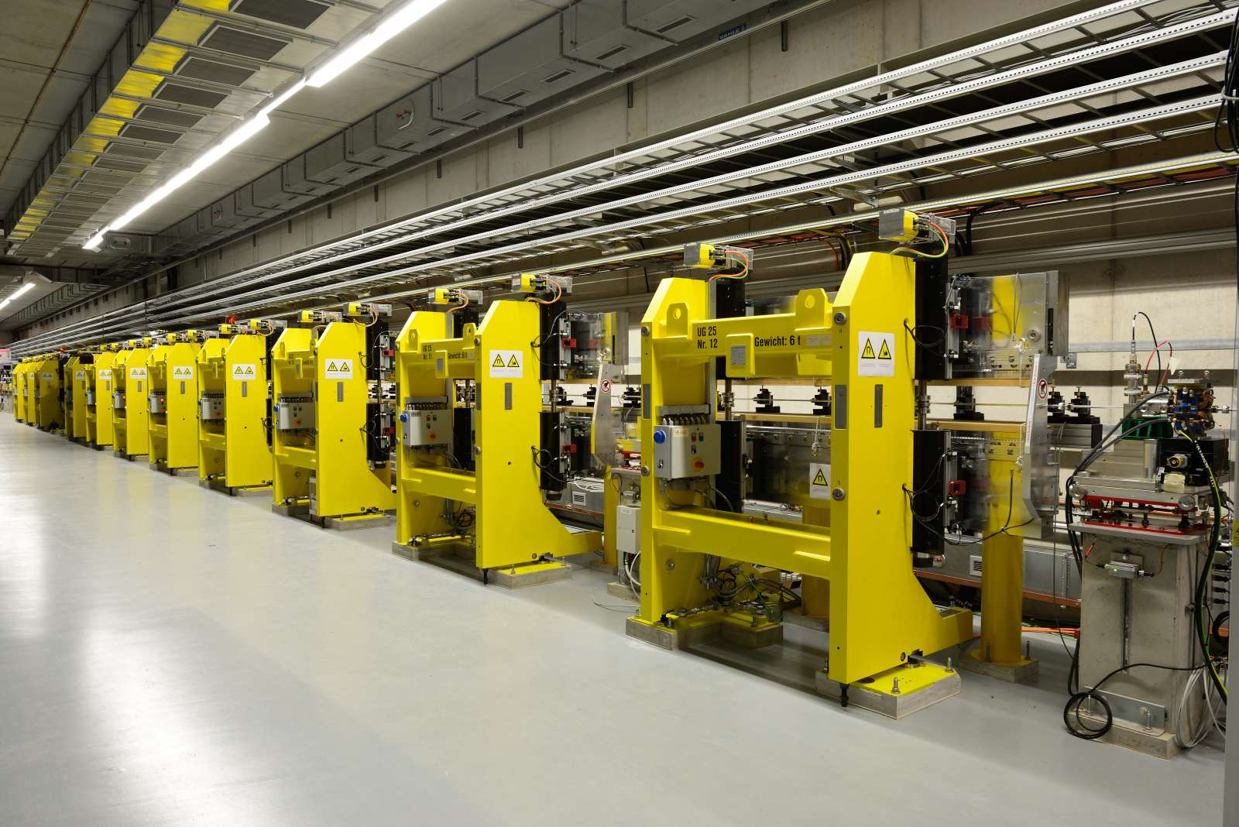

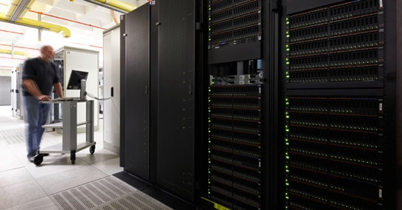
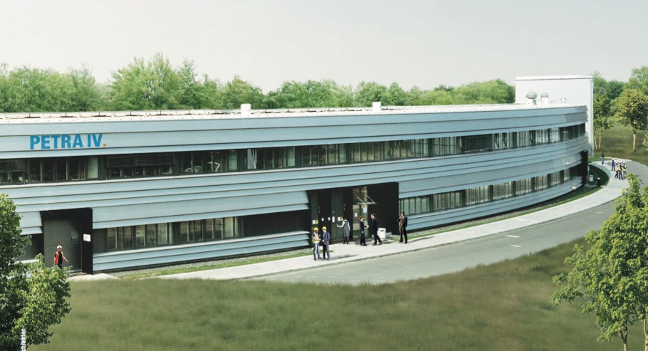
DESY – PHOTON SCIENCE – Future
Research
Forefront research related to large scale photon facilities;
Data harvesting at European XFEL
SPB/SFX station @ EU.XFEL
FLASH2 undulator
PETRA III and IV
Finalize ongoing PETRA III extension project;
Upgrade of PETRA III to PETRA IV a diffraction limited SR source
FLASH
Further development of FLASH facility;
Joint FEL strategy together with European XFEL
Data Science
Intensify efforts in data science and handling;
Support users for data intensive experiments

