Slide 1
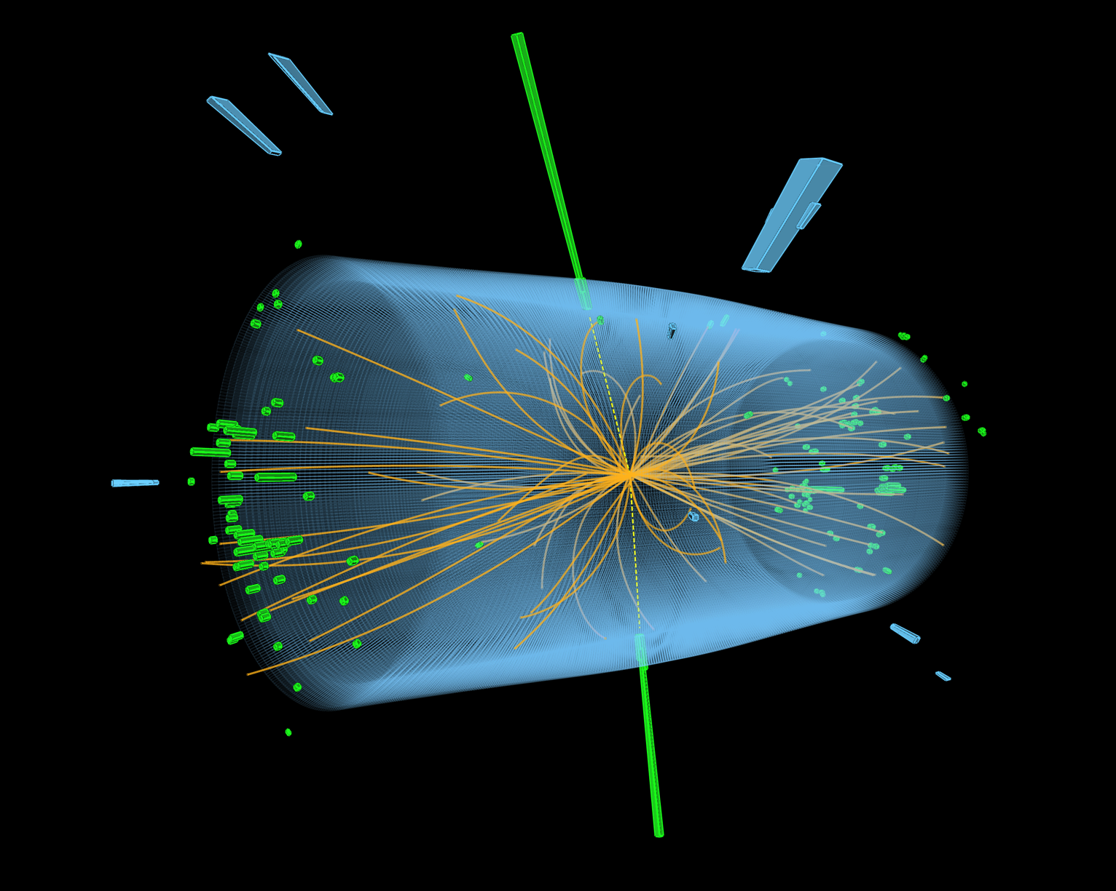
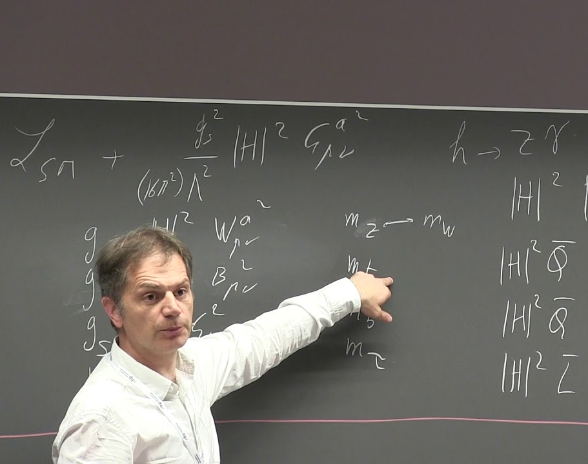
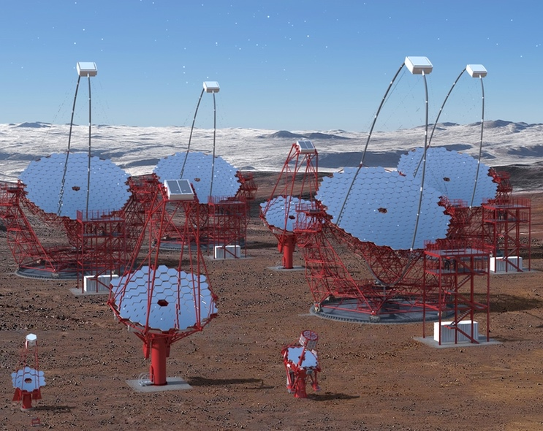
Lattice Field Theory
A Pillar of Theoretical Physics at DESY
Helmholtz Program: Matter and the Universe (MU)
PoF III Topic: Fundamental Particles and Forces
DESY Research Unit: Theoretical Particle Physics
Karl Jansen
Center Evaluation DESY, 5 – 9 February 2018

Slide 2

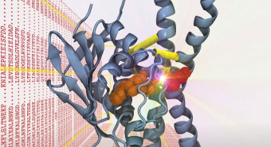
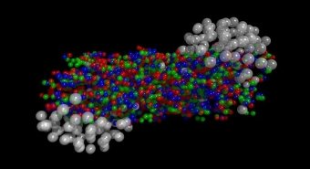
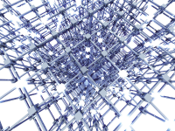
NIC: John von Neumann Institute for Computing
Research group “ Elementary Particle Physics”
What is NIC?
Cooperation between Helmholtz Centres Forschungszentrum Jülich, Deutsches Eletronensynchroton DESY GSI Helmholtzzentrum für Schwerionenforschung
NIC maintains five research groups: Computational Biophysical Chemistry (JSC) Computational Structural Biology (JSC) Elementary Particle Physics (DESY) Lattice Quantum Chromodynamics (GSI) Nuclear Matter (GSI)
NIC provides supercomputer time at Jülich
supercomputer centre through a peer review process
Group “Elementary Particle Physics”:
staff : Karl Jansen, Stefan Schaefer, Hubert Simma, Rainer Sommer
Connection to HU Berlin, joint professorship in progress
3 Postdoc position plus 1 PhD
Third party grants

Slide 3





Coordination and Compute Time Awards
Role of NIC group at DESY for international collaborations
Coordination of large collaborations
Alpha collaboration
(Dublin, Madrid, Münster, Rome, Wuppertal, Zeuthen)
Coordinated Lattice Simulations (CLS)
(CERN, Madrid, Mailand, Mainz, Münster, Odense, Regensburg, Rome,Wuppertal, Zeuthen)
European Twisted Mass Collaboration (ETMC)
(Bern, Bonn, Cyprus, Grenoble, Rome, Zeuthen)
Leading role in generation of gauge field configurations
Supercomputer time through successful applications at
Gauss, NIC, PRACE
Notes:
Logo fuer CLS? Der Symmetrie halber? Dann wuerde ich auch anders layouten – sieht komisch aus mit der halben leeren Seite.
Der Punkt “Guide collaborations” steht etwas alleine; gehoert das nicht zu dem “coordination of … “ ganz oben? Auslassen?
Bei management of config generation and applications ist nicht klar, ob das nur Ihr als NIC macht, oder fuer die Collabs, oder im Rahmen der collabs … ? Klarstellen?

Slide 4
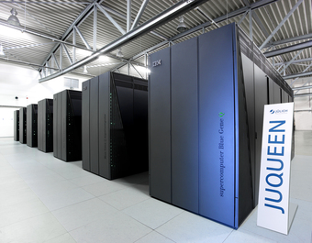
Compute Time
Table of awarded supercomputer time
(Alpha, CLS, ETMC + smaller projects)
Local HPC infrastructure in Zeuthen
Parallel Linux cluster with 1762 cores
Delivering 63TFlops
Shared with astroparticle theory group
Notes:
Ich finde das untere Bild nicht eindrucksvoll. Remove? Dann auch mehr Platz fuer die Tabelle.

Slide 5



European Projects
Networking in Europe
HPC-LEAP
High Performance Computing in Life sciences, Engineering and Physics
runs until end 2018
STIMULATE
SimulaTIon in MUltiscaLe physicAl and biological sysTEms
starts fall of 2018
QTFLAG
Quantum Technologies For LAttice Gauge theories
starts in April 2018
Notes:
Add subtitle?

Slide 6
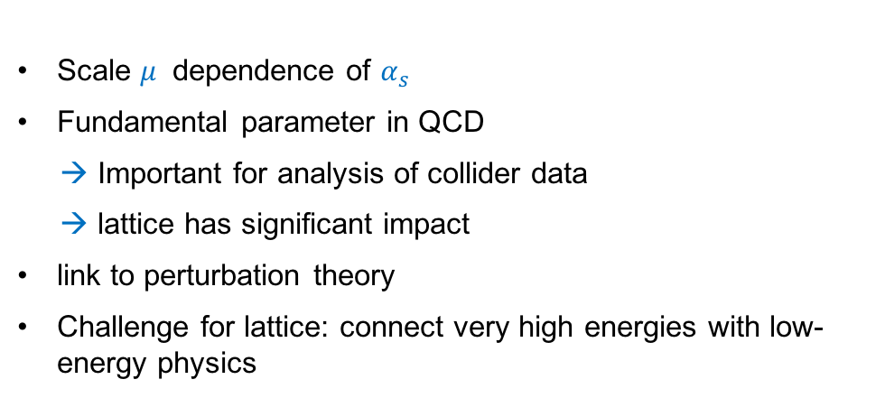
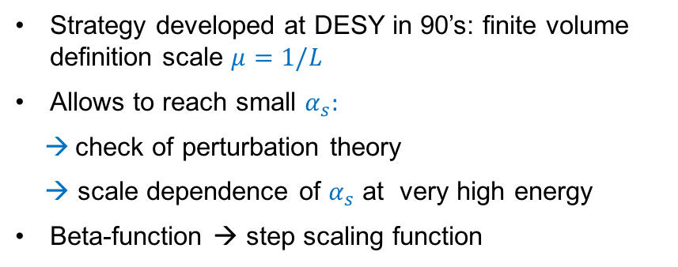
Highlight: Computation of Running Strong Coupling
Phys. Rev. Lett. 119 (2017) no. 10, 1020
Scale $μ$ dependence of $α_{s}$
Fundamental parameter in QCD
→ Important for analysis of collider data
→ lattice has significant impact
link to perturbation theory
Challenge for lattice: connect very high energies with low-energy physics
Strategy developed at DESY in 90’s: finite volume definition scale $μ=1/L$
Allows to reach small $α_{s}:$
→ check of perturbation theory
→ scale dependence of $α_{s}$ at very high energy
Beta-function → step scaling function
Notes:
Does more justice to the plots, and is closer to design that is used in many talks.
Ist das blau bei Symbolen und Pfeilen noetig?

Slide 7
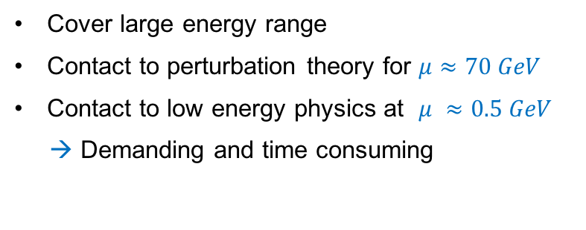
Highlight: Computation of Running Strong Coupling
Phys. Rev. Lett. 119 (2017) no. 10, 1020
Cover large energy range
Contact to perturbation theory for $μ≈70 GeV$
Contact to low energy physics at $μ ≈0.5 GeV$
→ Demanding and time consuming
Notes:
Try to do more justice to the pictures. However, relation of three numerical values and second plot unclear to me . If three values important element could also layout like the PDG016 referecen – in orange.

Slide 8
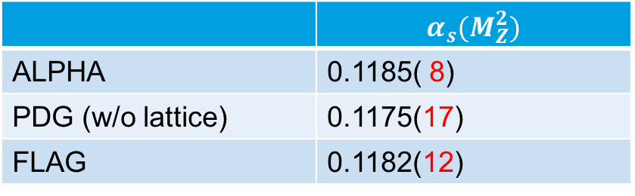
Highlight: Computation of Running Strong Coupling
Comparison of $α_{s}$($M_{Z}^{2}$)
 | $$α_{s}(M_{Z}^{2})$$
ALPHA | 0.1185( 8)
PDG (w/o lattice) | 0.1175(17)
FLAG | 0.1182(12)
PDG 2016
"the recent ALPHA lattice result is potentially a breakthrough”
G. Salam in arXiv:1712.05165
Notes:
Try to do more justice to the pictures. However, relation of three numerical values and second plot unclear to me . If three values important element could also layout like the PDG016 referecen – in orange.

Slide 9
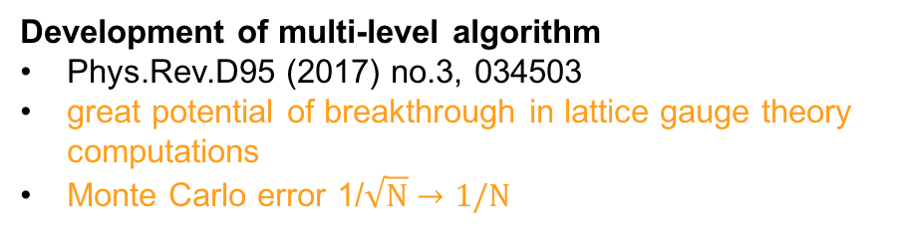
Further achievements
Nucleon structure and algorithm development
Nucleon spin and momentum decomposition using lattice QCD simulations
Phys.Rev.Lett. 119 (2017) no.14, 142002
complete determination of the proton's spin and momentum composition
important step to solve the "spin puzzle”
→ connection to phenomenology
Development of multi-level algorithm
Phys.Rev.D95 (2017) no.3, 034503
great potential of breakthrough in lattice gauge theory computations
Monte Carlo error 1/$\sqrt{N}→1/N$
Notes:
Alternative – selbes Argument wie ein paar Seiten vorher.
Subtitle?
Im Linken Diagramm fehlt die y-Achsenbeschriftung. Mir ist leider auch unklar, was sich genau worauf bezieht!Just had my best guess ;-)
Ich schlage vor, weniger Farben im Text zu benutzen. Das ist aber nur Gefuehl und das Verlangen nach strikterer Anwendung des Templates

Slide 10
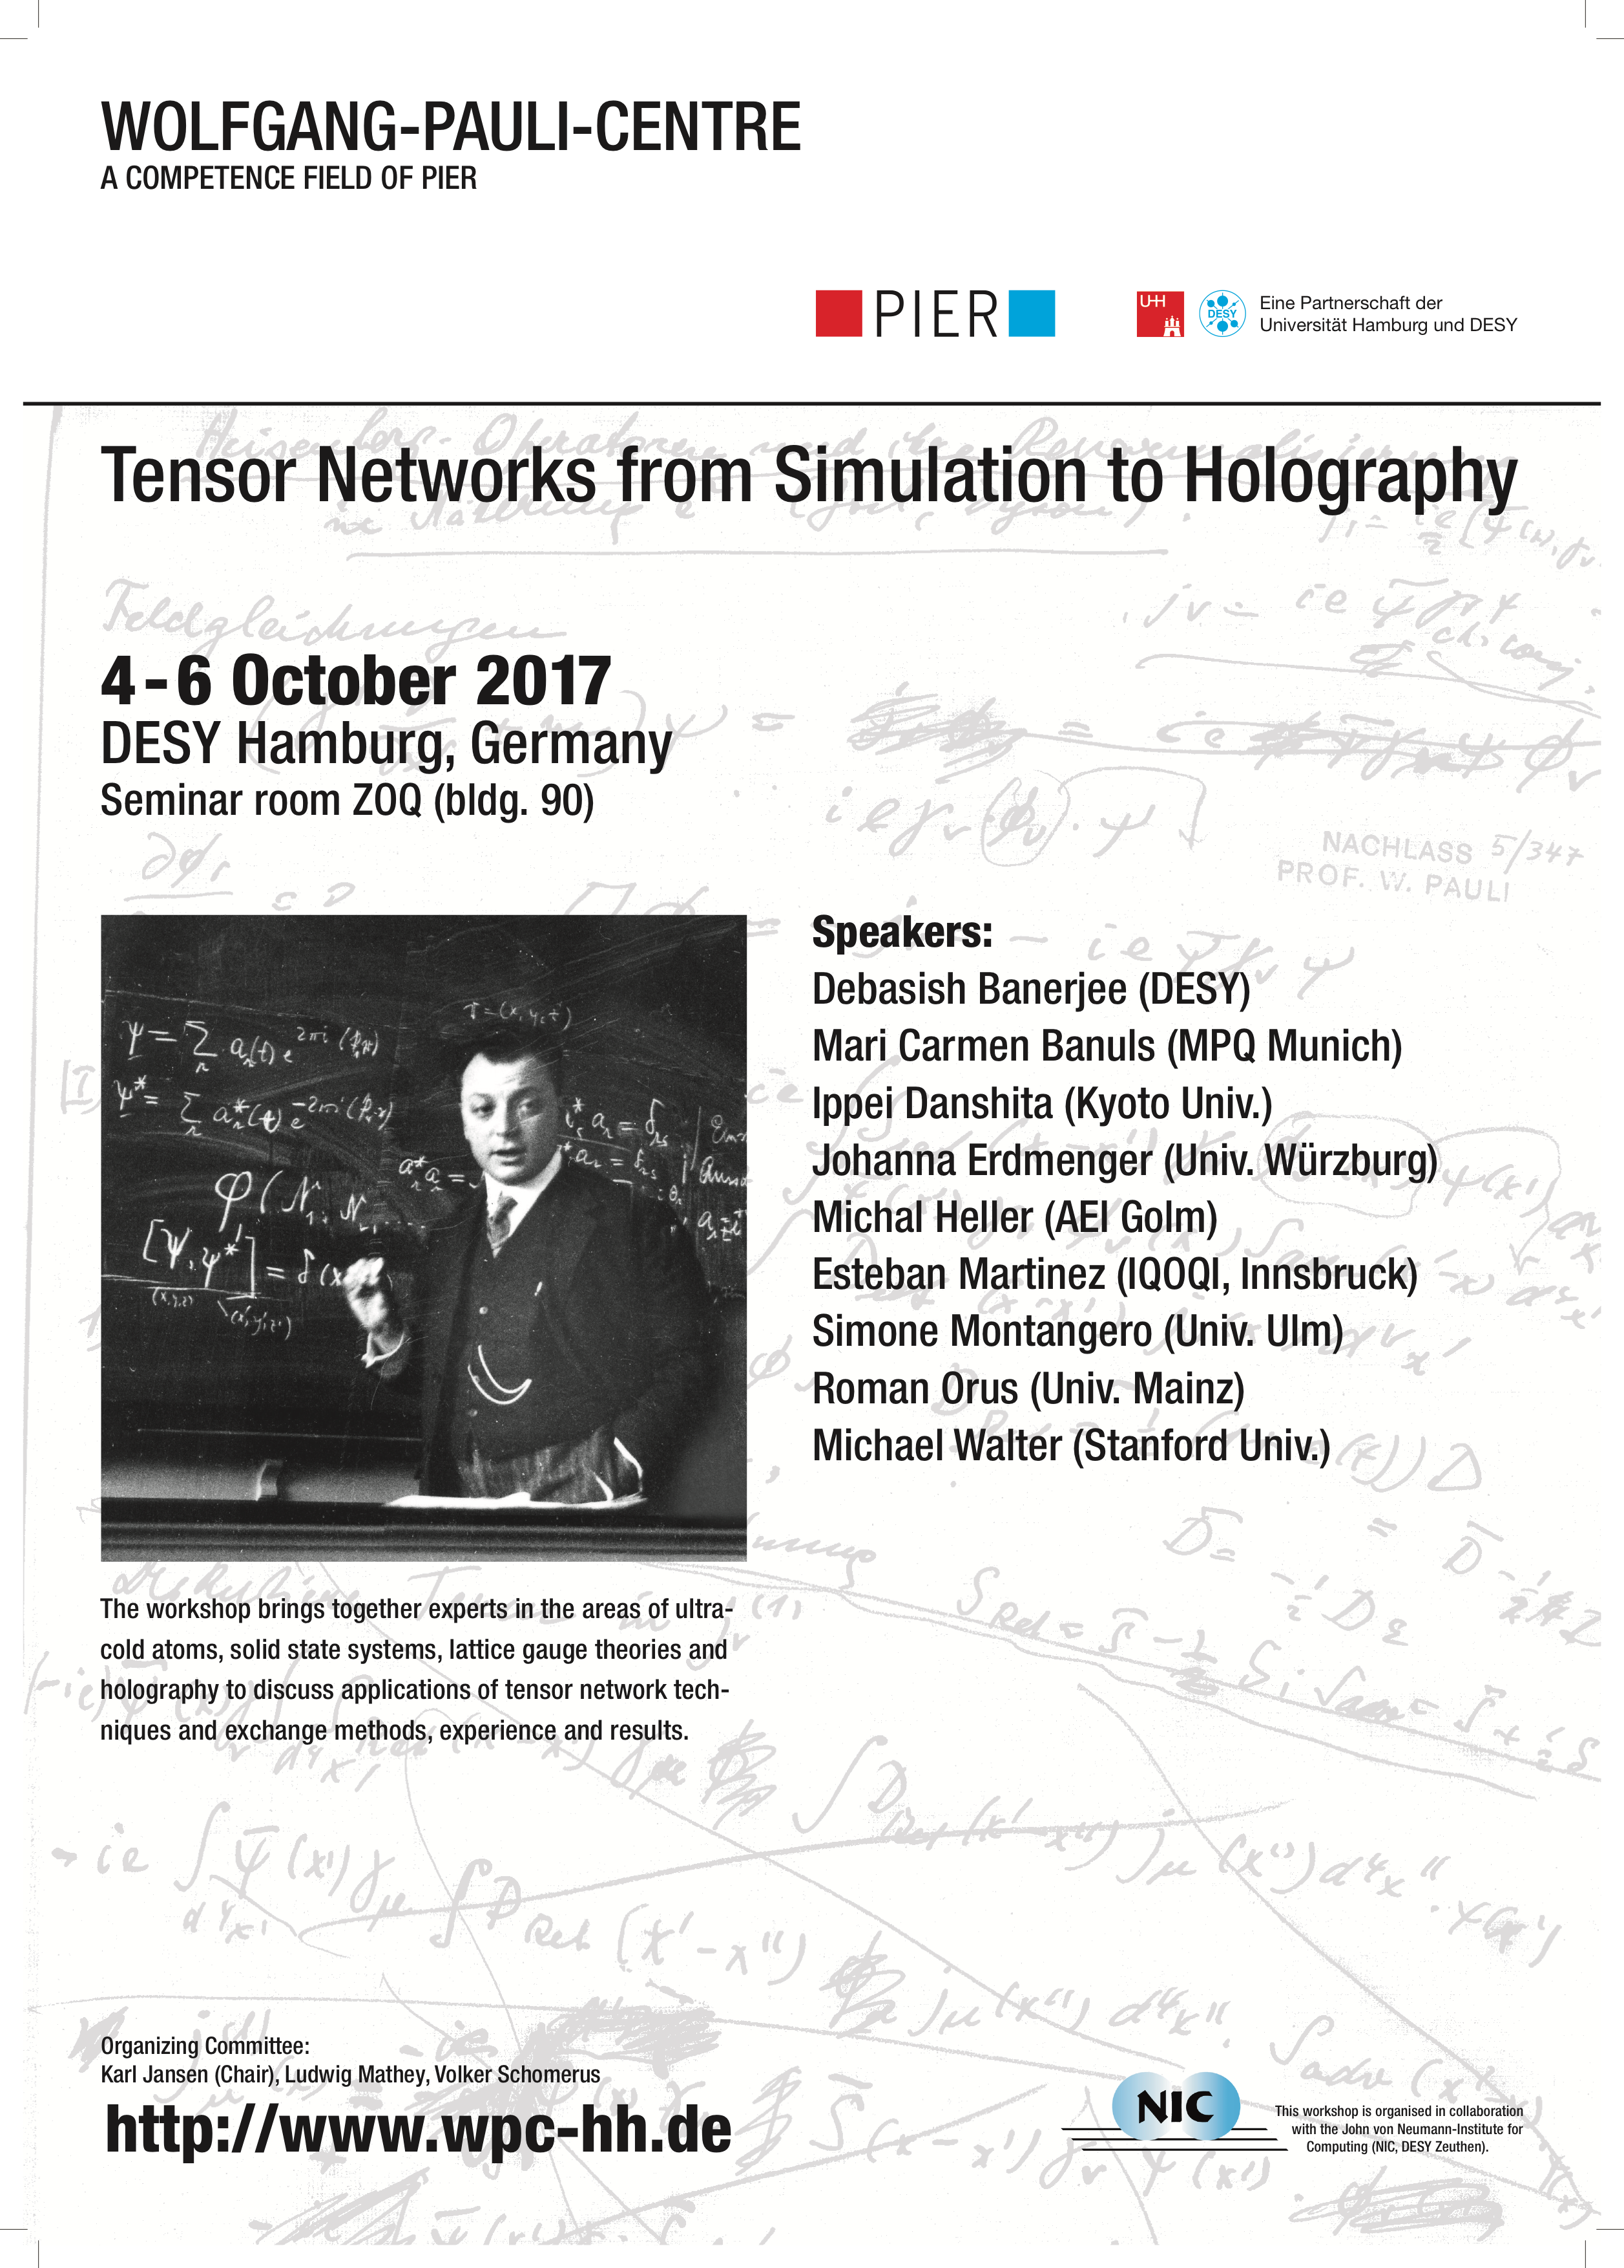
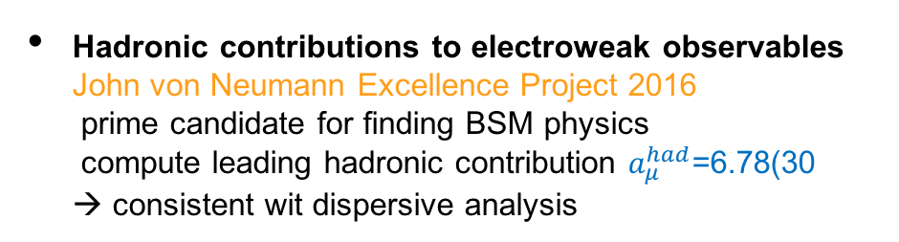
Further achievements
B-physics, muon anomalous magnetic moment and tensor networks
Development of lattice HQET for B-decays
New tool for non-perturbative precision computations
in flavour physics (Belle)
→ important input for DESY theory and experiment groups
→ see poster by M. Koren
Hadronic contributions to electroweak observables
John von Neumann Excellence Project 2016
prime candidate for finding BSM physics
compute leading hadronic contribution $a_{μ}^{had}$=6.78(30
→ consistent wit dispersive analysis
Tensor networks for chemical potential and
non-abelian gauge theories
Phys.Rev.Lett. 118 (2017) no.7, 071601;
Phys.Rev. X7 (2017) no.4, 041046
new approach to solve the "sign problem"
preparation for quantum simulations (ultra cold atoms)
→ common DESY workshop with DESY string theory group
and institute for laser physics
Notes:
Ich schlage vor, weniger Farben im Text zu benutzen. Das ist aber nur Gefuehl und das Verlangen nach strikterer Anwendung des Templates
Subtitle?

Slide 11
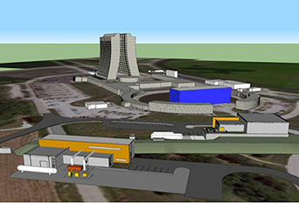

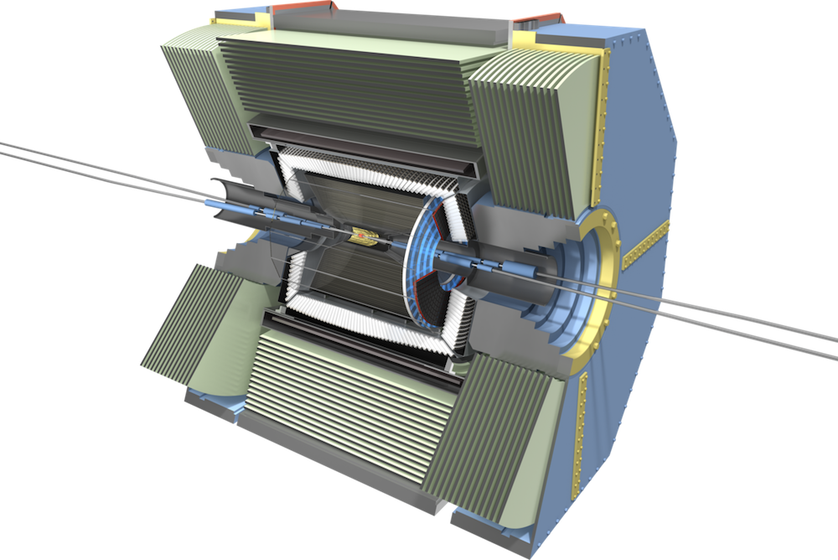
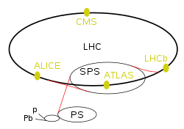

Outlook
Improving the already good
Adding charm to reach four active quarks in physical condition
→ continuum computation of broad spectrum of physical observables
g-2, PDFs, hadronic form factors, scattering amplitudes, …
Form factors for Belle II
→ input for and interpretation of experiment
Half the error of $α_{s}(M_{Z}^{2})$
→ reach new level of precision of fundamental parameter
Investigate reliability of perturbation theory
→ compute several observables at intermediate to high energies
Notes:
Needed? Fuer 10 Minuten ist das eine Wiederhlung von fast allem. Erscheint mir unnoetig und angesichts eines Zeitzieles von 9 Minuten unnoetig. Zumindest mit der Folie vorher integrieren, oder?
Ihc wuerde auch hier weniger Farbe vorschlagen.

Slide 12
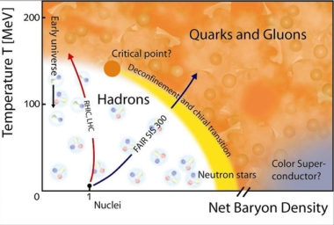
Outlook
Exploring news paths
Tensor networks in higher dimensions
→ ambitious goal to solve sign problem, real time simulation …
Development of algorithms for next generation of lattice simulations
→ exploit more, e.g. domain decomposition, tensor networks
Activities related to scientific computing/data (c.f. Heibrids, CDCS)
→ algorithm performance modelling on new architectures, quantum simulations
Be ready for the unkwown
Notes:
Needed? Fuer 10 Minuten ist das eine Wiederhlung von fast allem. Erscheint mir unnoetig und angesichts eines Zeitzieles von 9 Minuten unnoetig. Zumindest mit der Folie vorher integrieren, oder?
Ihc wuerde auch hier weniger Farbe vorschlagen.

Slide 13
Rounding up the picture
WIMPs, renormalization and Higgs-Yukawa model
Backup!
Computation of scalar quark content of nucleon
Important input for WIMP cross-section for dark matter searches
→ connection to DESY cosmology group
Non-perturbative renormalization of lattice PDF
Frontier article in Nucl. Phys. B923 (2017) 394
→ complementary to phenomenological extractions at DESY
Study of Higgs-Yukawa models on the lattice
question of 1st-order phase transition, matter anti-matter asymmetry
→ connection to cosmology group
Notes:
Please add subtitle

Slide 14
Gauss center and PRACE
National and European supercomputer resources BACKUP!
Gauss Center for Supercomputing (CGS)
The Gauss Centre for Supercomputing (GCS) provides the most powerful
high-performance computing infrastructure in Europe to serve a broad range
of research and industrial activities in various disciplines. GCS is the alliance
of the three national supercomputing centres
High Performance Computing Center Stuttgart (HLRS),
Jülich Supercomputing Centre (JSC), and
Leibniz Supercomputing Centre, Garching near Munich (LRZ).
Partnership for Advanced Computing in Europe
The mission of PRACE is to enable high impact
scientific discovery and engineering research and development across all disciplines.
The computer systems and their operations accessible through PRACE are provided by
5 PRACE members (BSC representing Spain, CINECA representing Italy, CSCS representing Switzerland,
GCS representing Germany and GENCI representing France). Computing time available via the
PRACE Peer Review Process to researchers from academia and industry.
Notes:
Please add subtitle

