Slide 1
“All”-in-one
Monolithic Sensor Systems
CMOS Imagers
Helmholtz Program: Matter and Technologies
PoF III Topic: Detector Developments and Systems
DESY Research Unit: Detector Developments
Cornelia Wunderer
Center Evaluation DESY, 5 – 9 February 2018

Slide 2
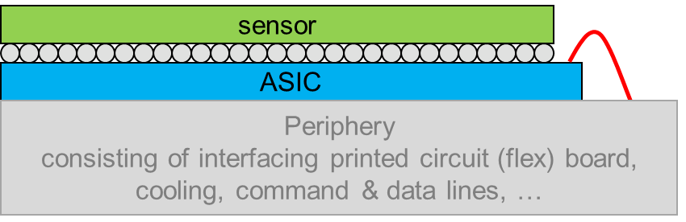

Why go monolithic?
Hybrid Sensor
Implementing intelligence right into the sensor
Processing on-chip reduces integration complexity
Capacitance of bump bonds eliminated
Yield issues of bump bonds eliminated
Pixel size not limited by bump bond pitch
Potential for material & cost savings in large systems
Radiation-tolerant CMOS imagers have become feasible
Wafer-size imagers have become feasible with standard processes
Where other approaches have advantages:
Thick high-resistivity sensors
Optimizing sensor & ASIC independently
Monolithic Sensor
Notes:
Money: ATLAS has evaluated this for pixel & strip trackers and comes up with cost savings on the order of factor 2-4.
xxx meeting also says significant overall project cost savings for particle physics trackers.
Material savings = X_0 reduction

Slide 3
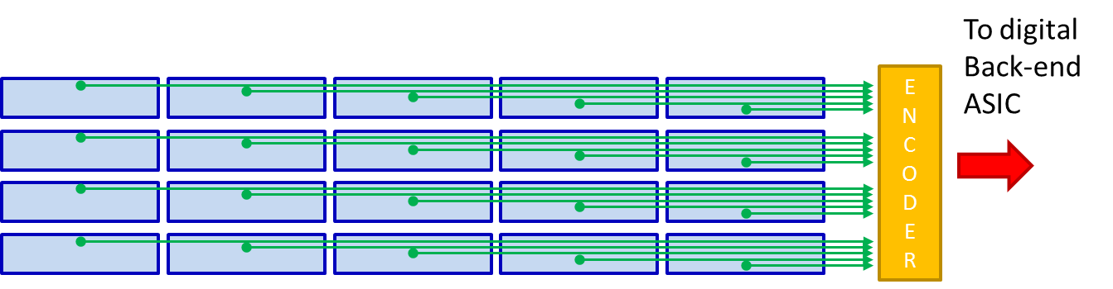
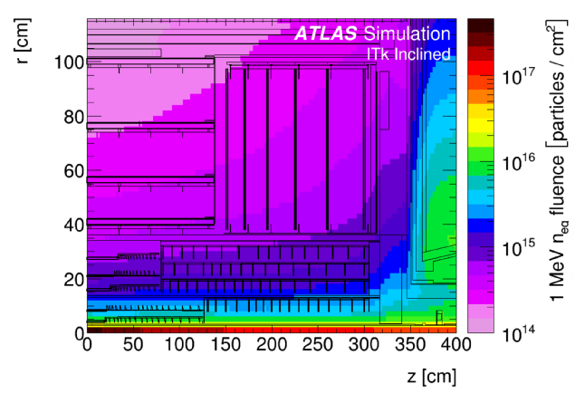
CMOS sensors for LHC: CHESS
CMOS HR/HV Evaluation for Strip Sensors: alternative approach for the ATLAS InnerTracker Strip Detector
Reduce material
Save cost
Possibly improve resolution
CHESS kick-off in 2014
14 institutions, DESY co-coordinating
3-year R&D Program
Architecture fitting foreseen ATLAS ITk Strip Detector infrastructure
Outstanding issues in 2014
  biggest hurdle: radiation tolerance
  signal/noise, charge collection, yield
  long-term reliability
Challenge:
radiation levels
Notes:
10^15 MeV/neutronEquiv fluence

Slide 4
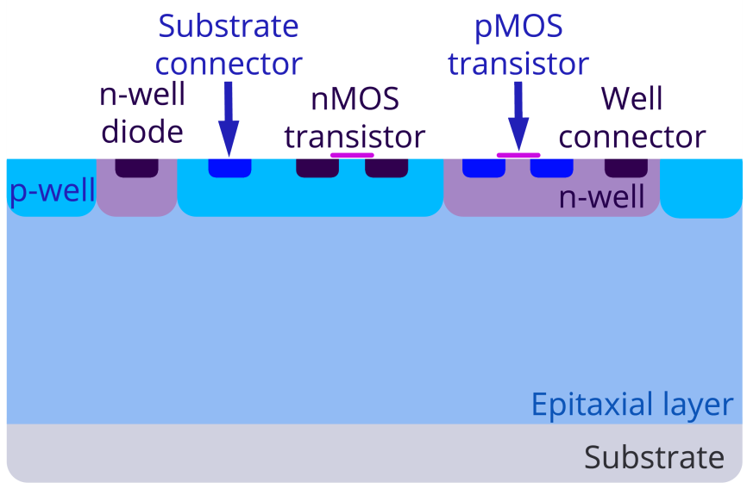
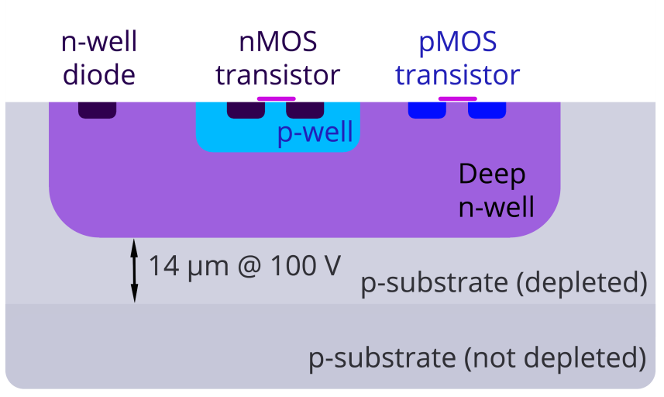
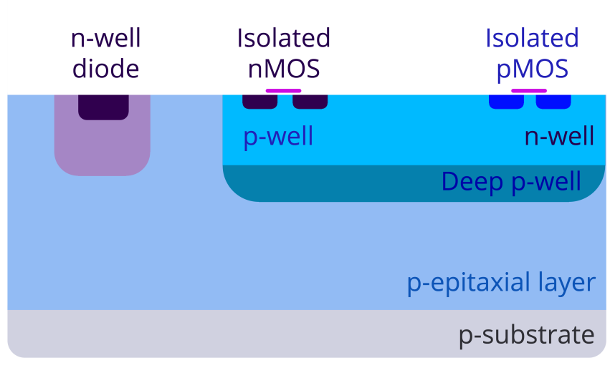
CHESS profits from HV / HR – CMOS
Key to achieving HL-LHC level radiation tolerance
“Radiation tolerance is basically a product of resistivity and drift field”
(Igor Mandic, Ljubljana)
“standard” CMOS process
possible bias << 1 V
low-to-medium resistivity substrate (~1 Ω cm)
HV CMOS technology
enables ~100 V bias
higher resistivity substrates
(few 100 Ω cm)
High-resistivity CMOS
bias up to few V
high-resistivity thin epilayer
(1-10k Ω cm)
developed for imaging applications
Notes:
What’s the answer to SOI question?
Igor Mandic is a neutron irradiation expert from Ljubljana

Slide 5
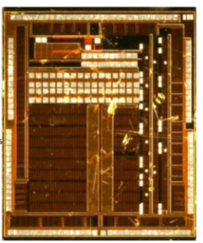
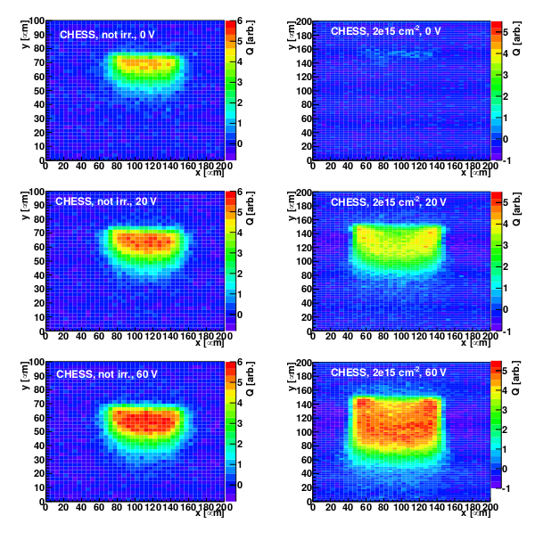
CMOS sensor radiation tolerance: CHESS prototype
Edge TCT: charge collected from focused laser illumination into edge of pixel
Project followed the HV-CMOS route in the end, with AMS as foundry (350 nm)
CHESS I: small 5 × 5 mm² prototype
CHESS II: 2 × 2 cm² die, large enough for a system demonstrator
5 mm
Prototype has demonstrated acceptable radiation tolerance
Paradox, beneficial behavior to ~1·10¹⁵ n_{eq(1MeV)}/cm²:
  Diffusion completely removed
  Depletion zone increases with radiation damage
  ⇒ Collected charge increases with radiation damage
Expected deterioration from radiation doses beyond
~ 1·10¹⁵ MeV n_{eq(1MeV)}/cm²
Applied Voltage: 0V to 60V
Irradiation: 0 to 2·10¹⁵ n_{eq(1MeV)}/cm²
Notes:
Punchline: huge hurdle of radiation tolerance is taken for HL-LHC tracker levels. Further “engineered improvement” appears feasible once “acceptor removal” is understood, currently sensor theoreticians at work here. => CMOS imager demonstrated as viable option for future trackers.
Effect seen by other projects as well. “acceptor removal” hypothesis
Edge TCT (TCT = Transient Current Technique):
The /edge/ Transient Current Technique (/TCT/) is a method for the investigation of silicon sensors. This method requires infrared light from a sub-ns pulsed laser to be focused to a. µm-size spot and scanned across the polished cut /edge/ of a sensor. Electron-hole pairs are generated along the light beam in the sensor.

Slide 6
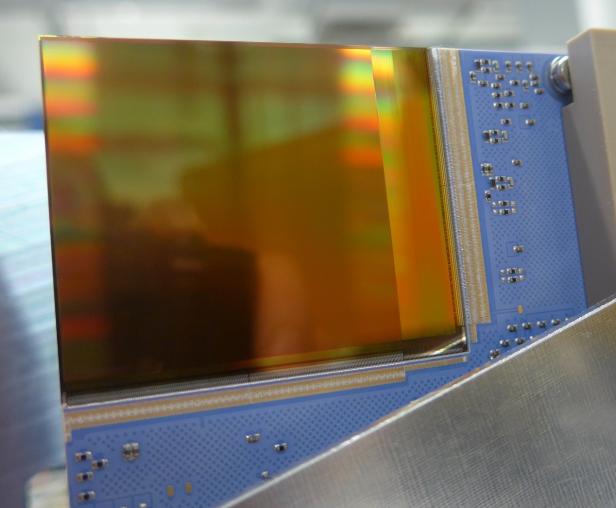






Soft X-ray CMOS Imager for FLASH and Petra III: Percival
CMOS imager to meet the combination of challenges
Novel imager meeting key FEL challenges simultaneously,
in the soft X-ray regime:
  (at least) Megapixels in a single sensor (avoid dead area)
  fast enough for “shot by shot” science
  dynamically adjust to single photons & large signals
Project initiated by DESY
Actively invited collaboration from the community
-> today four light sources plus RAL/STFC, DESY lead
Sensor CMOS design at RAL, with tight feedback loops to DESY ASIC designers and system experts
System overall design by DESY, with contributions from partners
Unprecedented combination:
1408 × 1484 pixels
300 Hz frame rate
below 15 e⁻ noise
sensitive to single photons
handle 5·10⁴ ph/pix/frame
5 cm
Rutherford
Appleton
Lab / STFC
Elettra
Sinchrotrone
Trieste
Diamond
Light
Source
Pohang
Accelerator
Laboratory

Slide 7
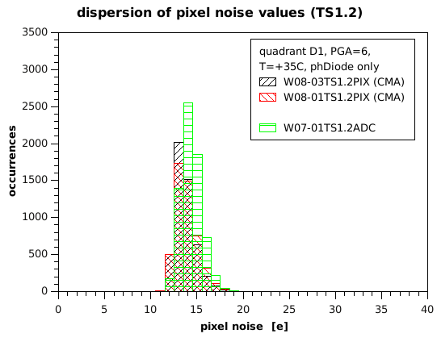
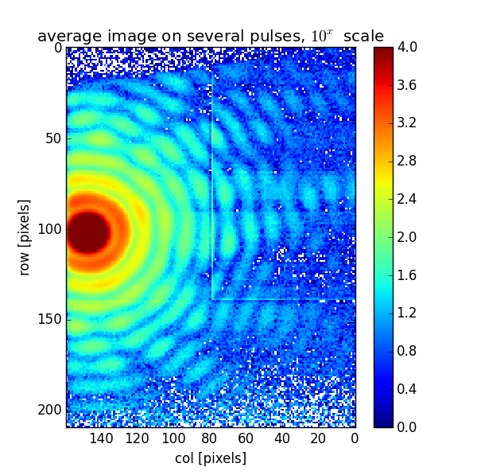
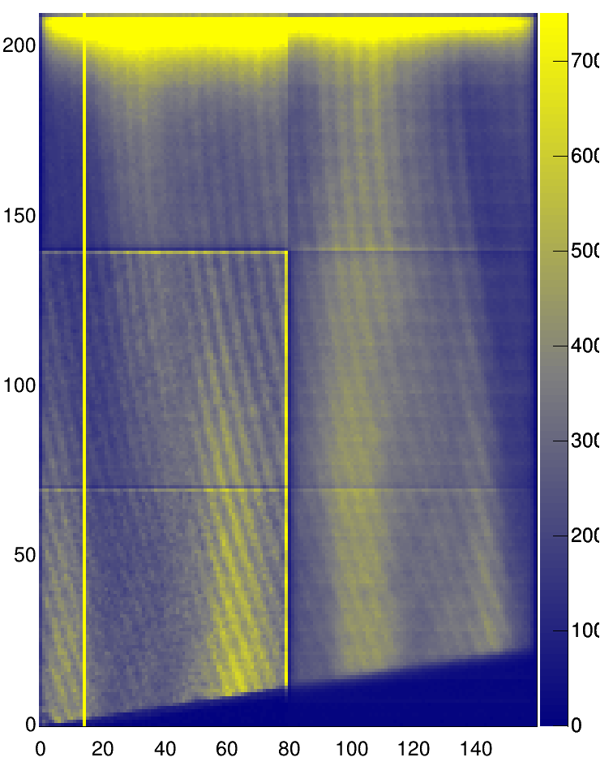
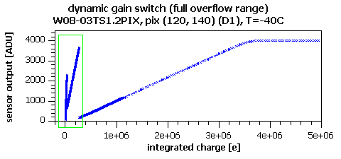
Performance of a CMOS imager: Percival Prototype
Pixel noise average below 15 e⁻
-> single photon detection at 250 eV
Automatic per-pixel per-frame gain switching demonstrated
“full well” 3.5 Me⁻
-> up to 50000 ph/pix/frame at 250 eV
Demonstrated sensitivity down to 92 eV at FLASH
Charge collection efficiency, a lower limit to quantum efficiency, measured at ~70% above 400 eV
Backside illumination processing by NASA/JPL
Single-shot
92 eV image taken at FLASH

Slide 8
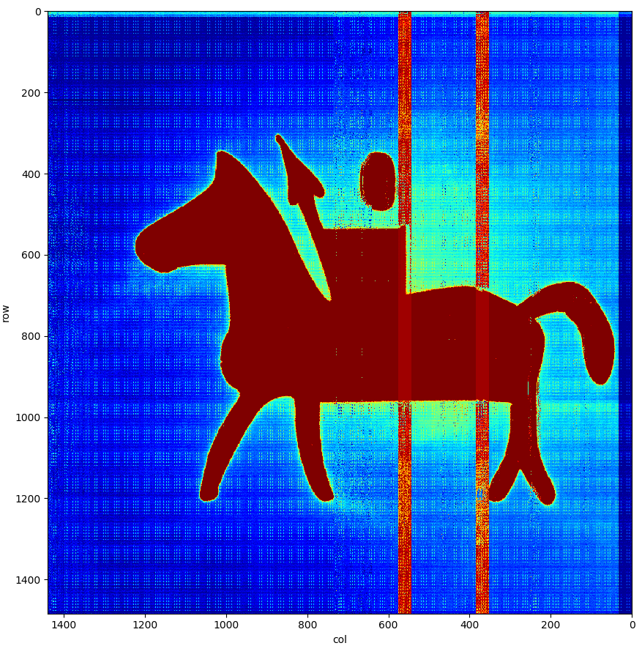
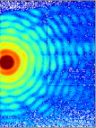
Stitched CMOS sensor in action: Percival 2-Megapixel “P2M”
4cm x 4cm stitched imaging area, 27 μm × 27 μm pixels
option: 13 Megapixel imager, 120 Hz, 10 × 10 cm²
P2M Power-up commenced in late September 2017
Currently P2M front illuminated version being brought into full operation using visible light
Data rate 20 Gbit/s for one sensor
(reading full images: 300 Hz, 2M pixels, 30 bit/pixel incl. CDS)
… a challenge even for calibration
Processing for backside illuminated operation ongoing
First soft X-ray images expected ~mid-2018
see also poster 25
P2M first light image (Dec 2017),
top left: prototype image on same scale

Slide 9
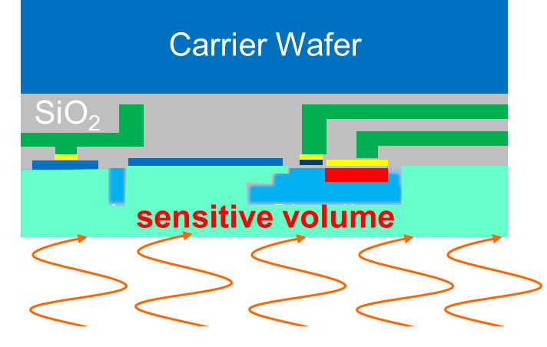
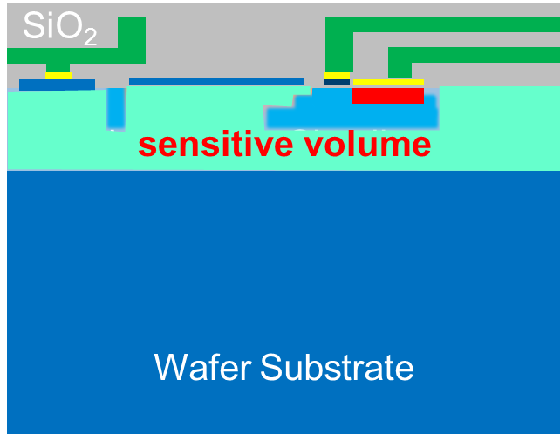
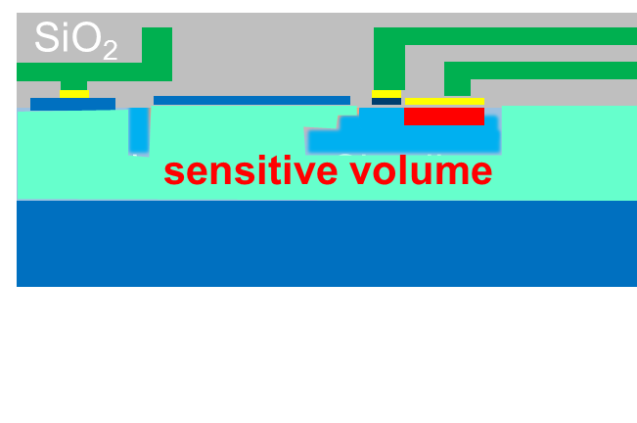
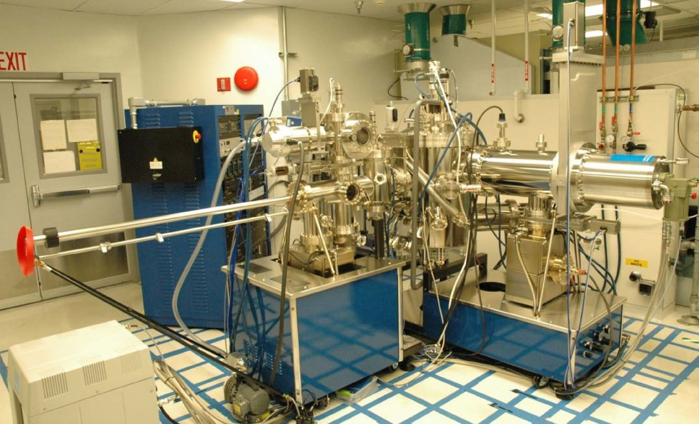
Outlook - Processing
Optimal science use requires processing beyond foundry wafer production and 3D integration
Our science requires access to
  Flexible thinning capabilities for CMOS chips and wafers
  Surface post-processing for thin entrance windows & optimal electric fields
  Quick turnaround and flexible access for prototype development
Paths:
Identify and cultivate commercial partners where possible
Strengthen relationships with partners in national & international research landscape (e.g. Fraunhofer)
Establish capabilities within Helmholtz where necessary
  e.g. MBE-grown ultrathin dopant layers
  e.g. grow filters or scintillators
    would be contributions to Helmholtz Distributed Detector Lab
delta-doping MBE at LBNL
Notes:
Remember to reference Karsten’s talk for 3D integration

Slide 10
Outlook – CMOS imager development at DESY
CMOS imagers: a key future workhorse for science in Matter
To date:
  DESY scientists guiding the actual CMOS chip design
  Strong ASIC design experience in house
  Some CMOS-imager design experience in house
  CMOS sensors in photon science (Percival), in particle physics (ATLAS tracker option) and workhorse in DESY-II test beam pixel telescopes (Mimosa)
Future:
  Step 1: Increase local CMOS design experience
  Step 2: Share CMOS sensor chip design work with collaborators, following e.g. the model of the successful design of the AGIPD ASIC
  Step 3: In-house CMOS sensor design an option
LASSENA wafer-scale sensor (© RAL/STFC, I.Sedgwick)

Slide 11
BACKUP SLIDES

Slide 12
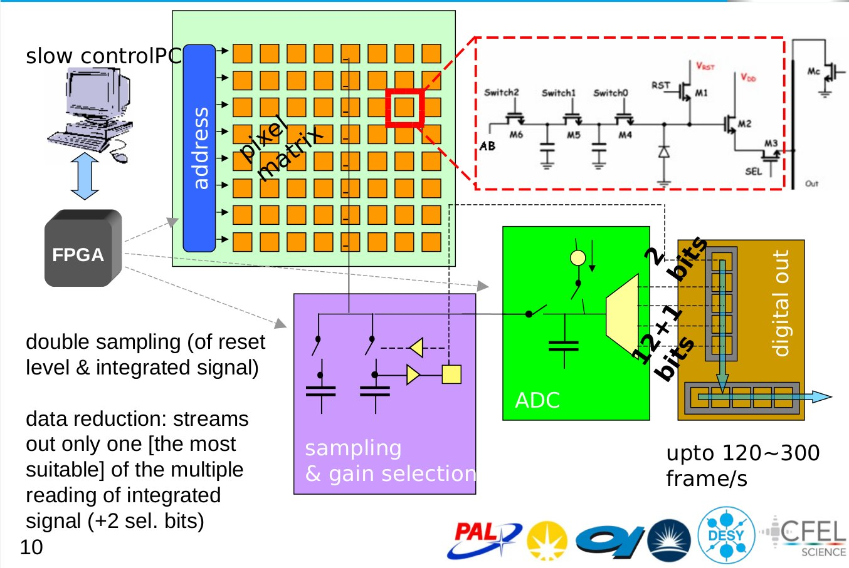
Percival – Sensor Operation
Need a nicer version of this

Slide 13
Trixi’s Scratch Area

Slide 14
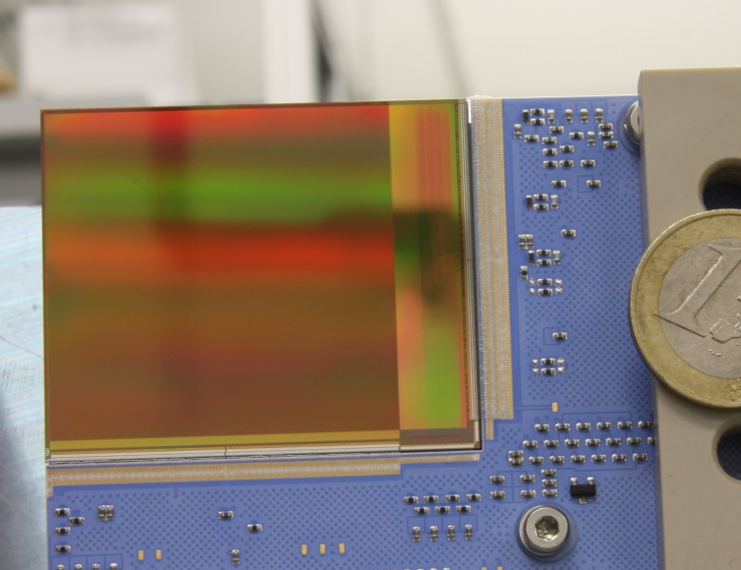
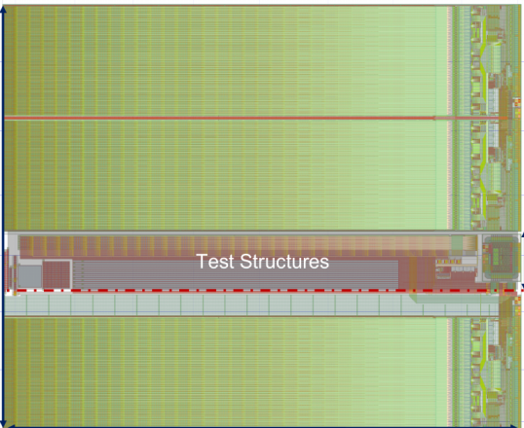
Summary
CMOS imagers: a key future workhorse for science in Matter
Monolithic Active Pixel sensors offer specific advantages
DESY is pushing CMOS sensor development in the context of scientific needs and robust systems
We have made significant progress in the last years
  CHESS with promising results
  Percival stitched sensor works, will see soft X-rays in 2018
Building on existing in-house ASIC expertise,
in combination with growing in-house CMOS knowledge,
in-house designed CMOS imagers are a realistic future option

Slide 15
Drawing hybrid vs monolithic systems
sensor
ASIC
CMOS “active” sensor
e.g. ADCs
Periphery
consisting of interfacing printed circuit (flex) board, cooling, command & data lines, …
Periphery
consisting of interfacing printed circuit (flex) board, cooling, command & data lines, …

Slide 16
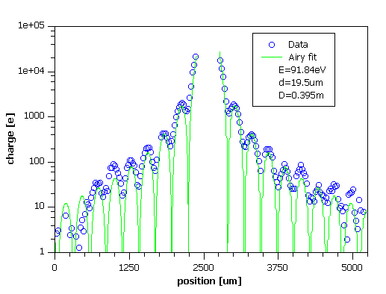
Performance of a CMOS imager: Percival Prototype
Pixel noise average below 15e-
-> single photon detection at 250eV
Automatic per-pixel per-frame gain switching demonstrated
“full well” 3.5 Me-
-> up to 50000 ph/pix/frame at 250eV
Demonstrated sensitivity down to 92eV at FLASH
Predictions & data agree for 92eV images recorded in triggered operation at FLASH
Charge collection efficiency, a lower limit to quantum efficiency, measured at ~70% above 400eV
Backside illumination processing by NASA/JPL

Slide 17
Performance of a CMOS imager: Percival Prototype
Pixel noise average below 15e-
-> single photon detection at 250eV
Automatic per-pixel per-frame gain switching demonstrated
“full well” 3.5 Me-
-> up to 50000 ph/pix/frame at 250eV
Demonstrated sensitivity down to 92eV at FLASH
Charge collection efficiency, a lower limit to quantum efficiency, measured at ~70% above 400eV
Backside illumination processing by NASA/JPL
Single-shot 92eV image taken at FLASH

Slide 18
“All”-in-one
Monolithic Sensor Systems
CMOS Imagers
Helmholtz Program: Matter and Technologies
PoF III Topic: Detector Developments and Systems
DESY Research Unit: Detector Developments
Firstname Secondname
Center Evaluation DESY, 5 – 9 February 2018

