Slide 1
ASICs and
Sensors
Hybrid detectors
Helmholtz Program: Matter and Technologies
PoF III Topic: Detector Technologies and Systems
DESY Research Unit: Detector Developments
David Pennicard
Center Evaluation DESY, 5 – 9 February 2018

Slide 2
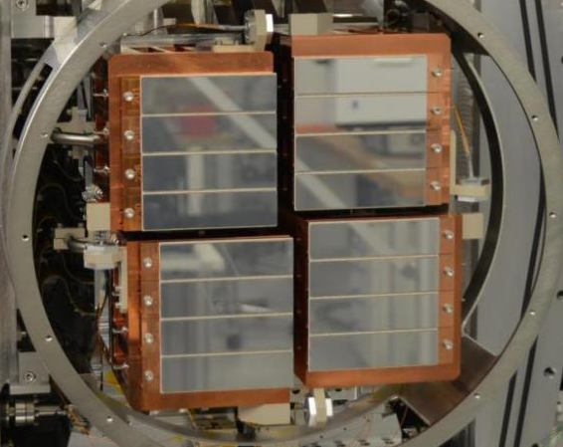
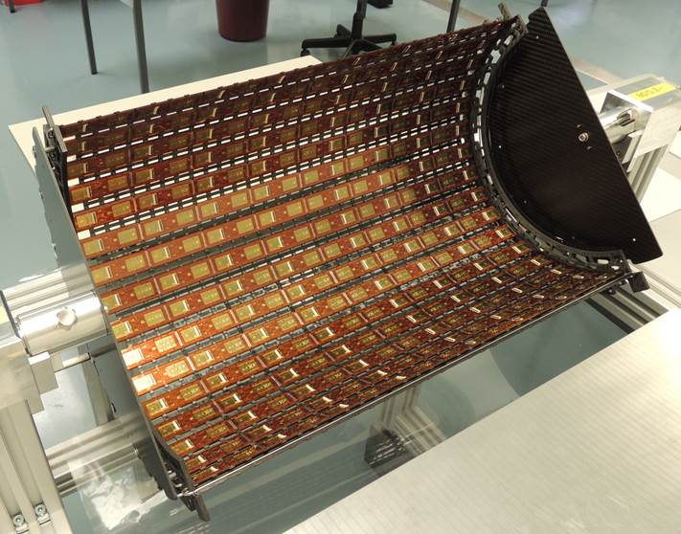
ASICs and Sensors
Hybrid detectors in DESY research
Versatile technology used in many experiments
Detectors for X-ray detection at synchrotrons and FELs
  XFEL.Eu, PETRA, FLASH
Detectors for tracking and vertexing in particle physics (LHC @ CERN)
  ATLAS strips, CMS strips and pixels
AGIPD detector for XFEL.Eu
CMS pixel barrel
Notes:
Consider reordering… on campus
Stress DESY activities – general bit at start.
Other areas? E.g. CFEL applications, spinoff (e.g. medical)
Light sources
Why DESY contributing to this? – Unique requirements?
Challenges and opportunities.
In turn, advances in accel tech and new experiments
POSS MOVE ASIC STUFF TO FRONT? LIST OF STUFF WE DO?
CMS or ATLAS strips? Picture?
Requirements…
FLASH – Gotthard strips
DELETED challenges section - avoid repetition. But what is the message? Next slide illustrative examples.

Slide 3
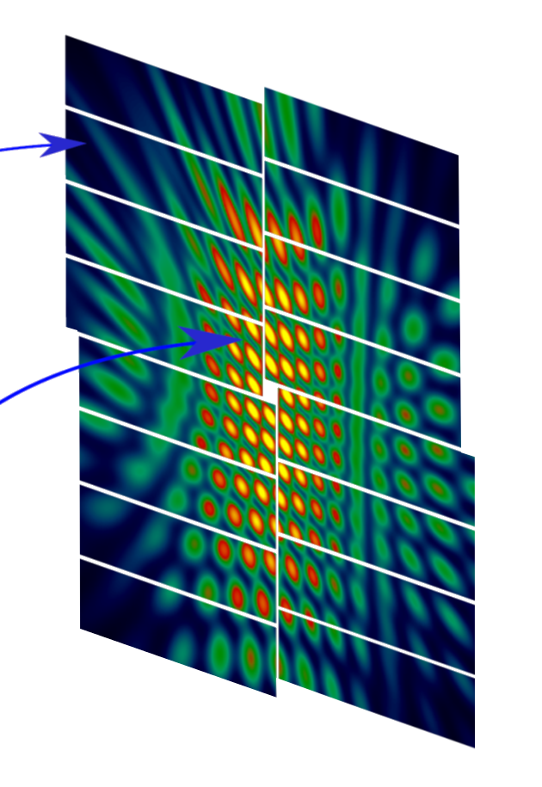
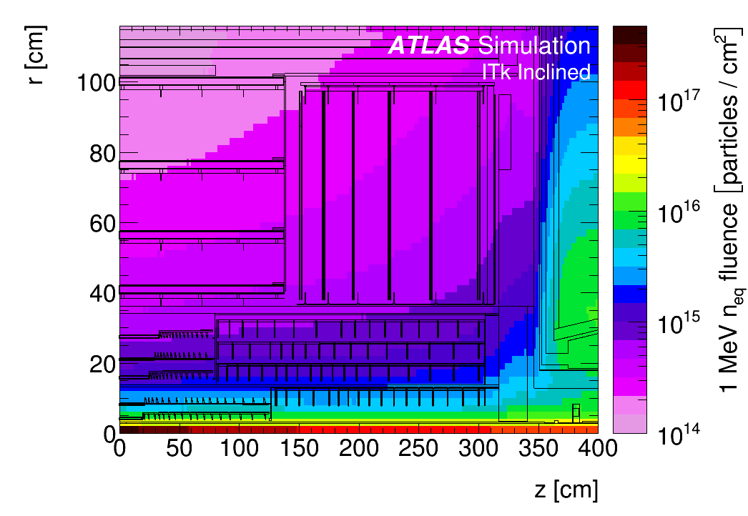
ASICs and Sensors
Challenges
European XFEL – High repetition rate X-ray laser
LHC upgrades – high radiation environment
100 ms
1 photon
at 12 keV
600ms
99.4 ms
10⁴ photons
< 100 fs
220 ns
Up to 1 GGy dose during lifetime
Strip Sensors
Notes:
Data rate – mention for LHC – 10G
To meet requirements of new experiments, both customize sensors and asic to meet specific requirements
XFEL – Common feature of FEL dynamic range. Unique feature is bunch train structure of
Improvements in acc technolog – generic challenges such as speed, segmentation, etc. Key message?
Extremely large dynamic range, burst imaging at 4.5 MHz, large dose
Challenges – both customization and generic (speed, rad hardness)
4.5 MHz – no trigger
Need facts and figures
Intense worldwide R&D.
https://indico.desy.de/indico/event/16431/contribution/10/material/slides/0.pdf - can mention DAF perhaps?
Question – presentation says 5000 modules, 6 endcap disks – but looks different here?
5000 modules
All silicon tracker, higher radiation – don’t overdo systems aspect
What to say? Refs elsewhere? Previous stuff – speed, precision, radiation hardness

Slide 4
Meeting the Eu.XFEL challenge: AGIPD ASIC
Ultrafast X-ray imager
Sensor
Electronics per pixel
Pixel matrix
AGIPD ASIC
Developed by DESY and PSI
Adaptive gain integrating amplifier
  Single 12 keV photon sensitive
  Maximum signal 10⁴ photons
4.5 MHz frame rate
  Analog memory pipeline
  352 images
Radiation-tolerent design (10 MGy)
…
HV
Analog Mem
CDS
Read Out bus
+
SW
RO Amp
-
CTRL
DAC
Analog Mem
THR
…
Chip output driver
Mux
ASIC periphery
Notes:
Better transition? Highlights
Focus on ASIC development

Slide 5
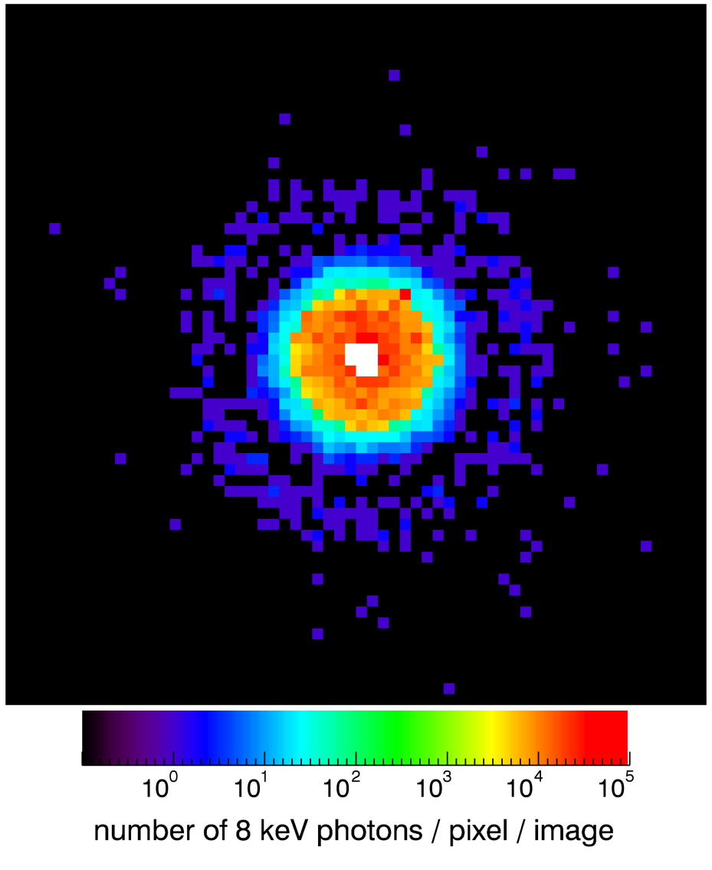
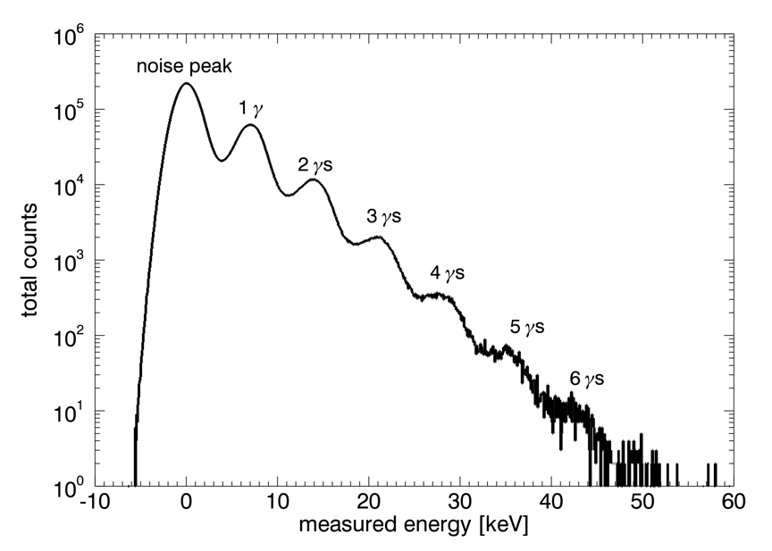
Meeting the Eu.XFEL challenge: AGIPD ASIC
Ultrafast X-ray imager
AGIPD ASIC
Developed by DESY and PSI
Adaptive gain integrating amplifier
  Single 12 keV photon sensitive
  Maximum signal 10⁴ photons
4.5 MHz frame rate
  Analog memory pipeline
  352 images
Radiation-tolerent design (10 MGy)
Imaging the direct X-ray beam at PETRA-III P10
Notes:
Big up PETRA-II I beamtime

Slide 6
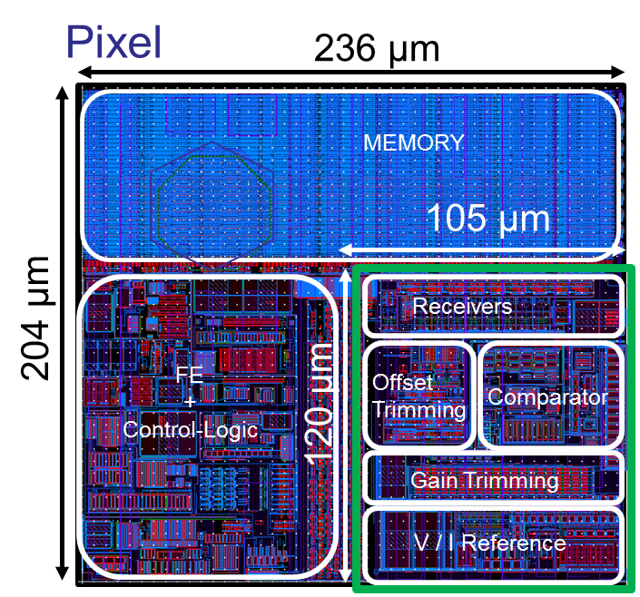
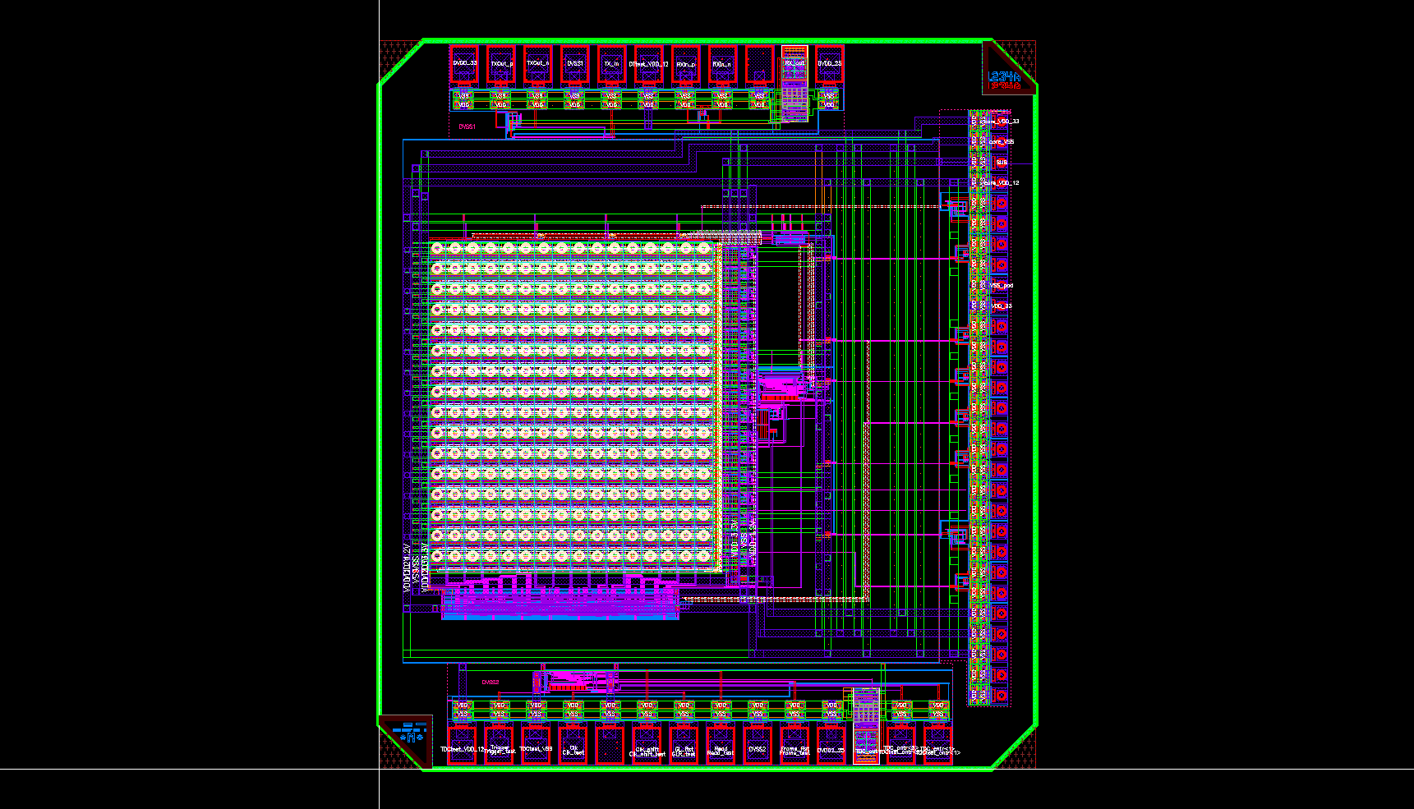
On-chip digitization
Fast in-pixel circuitry
In-pixel ADC for DSSC
Soft X-ray detector for XFEL.Eu
Digitization of images at 4.5 MHz
Small footprint – 120 µm x 105 µm
DSSC pixel layout
1.9 mm
Digital Silicon Photomultiplier ASIC
Light detection e.g. hadron calorimeter
High speed and granularity
  50 µm pixel, 3 MHz frame rate, 77 ps TDC bin
dSiPM
ASIC
2.1 mm
Notes:
SiPM – hadron calorimetry but perhaps photon science? Entrance window issue. What to say? Meaningful specs
Seems to read out entire frame with 1-bit depth when trigger occurs (sophisticated trigger logic). 32 x 32 pixel layout, 50um pixel. 3MHz rate – 12 Gbit/chip fast link.
MPI design – high fill factor, compact.
For outlook, can reduce these points somewhat.
On-chip digitization – XFEL upgrade would still allow burst operation as presently done – would this be needed much? Also, current XFEL upgrade?
100 kHz – explain? CW upgrade would
Maybe early conversion to optical?
More broadly, working on on-chip digitization
Want to tie in with high-speed data readout
High-speed readout card
Pushing data off-chip at higher rates, in a format that can be handled by high-speed devices further down the chain
More broadly…
Why is this relevant? Digitization?
Challenge of high-speed readout – what can we say about this? Shared components in Helmholtz? Computing issues – say that we’re aware? Issue is speed?
Put something here – what to be said? Not so much
SiPMs – what is the application? Tracking detectors, medical… some apps such as nuclear resonant scattering (check this out)
Maybe a bit much here? What can we say on each front? Too concrete architecture?
Can mention Helmholtz uTCA?
Effort on ASIC?

Slide 7
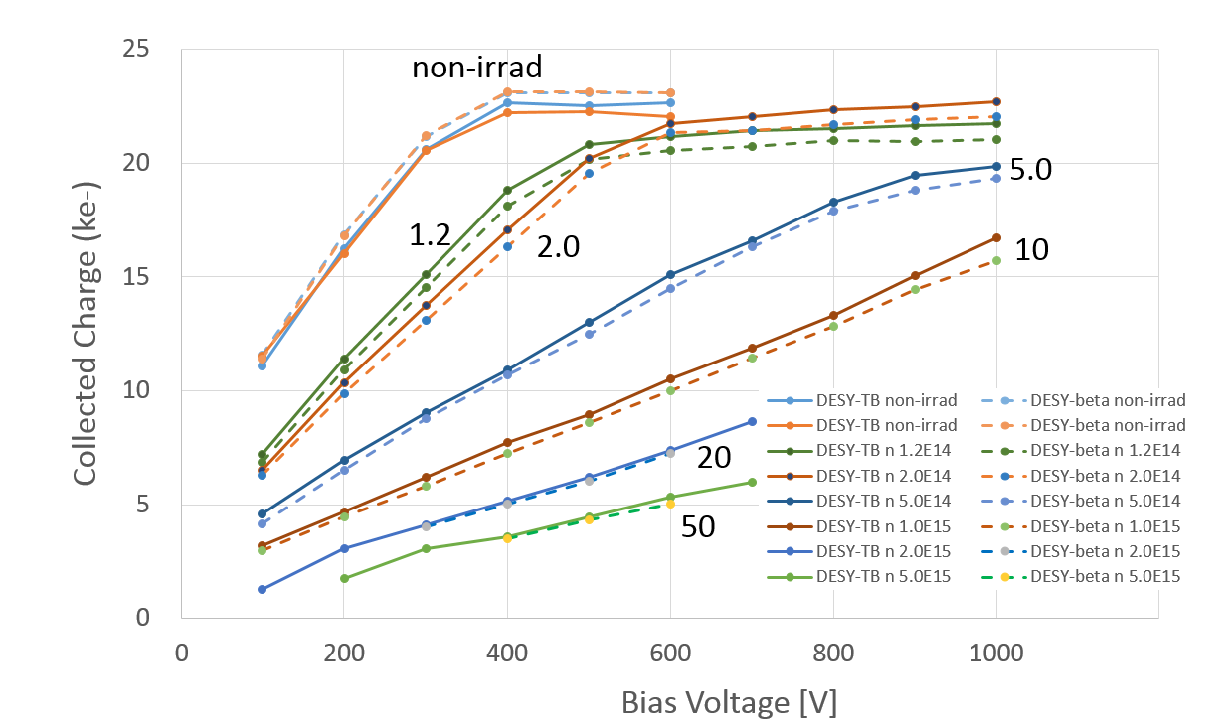
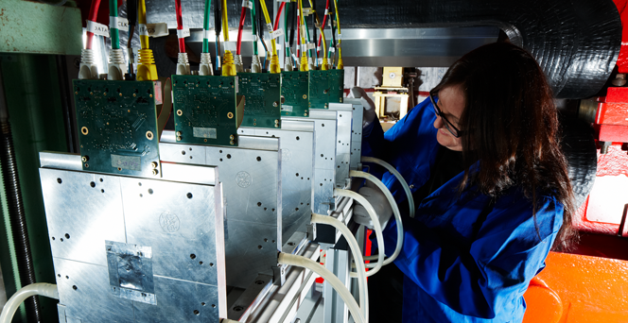
Radiation-hard silicon sensors for LHC upgrades
Detector characterization with the DESY testbeam
Atlas Strip Sensor
Testbeam provides 1-6 GeV electrons
Beam telescope and magnets
Charge collection in irradiated strips:
  Signal to Noise: Sufficient at the end of HL-LHC ✓
  Increase bias voltage during lifetime
10¹⁵ n_{eq}/cm²
Notes:
***IS*** a user facility.
Units – graph…
Electrons Selectable energy up to 6 GeV
Uni Hamburg people – sensor development for European XFEL
Maybe reduce?
MORE EMPHASIS ON LORENZ ANGLE (NEEDS TESTBEAM)
Reorganise…
N-in-p strip detectors

Slide 8
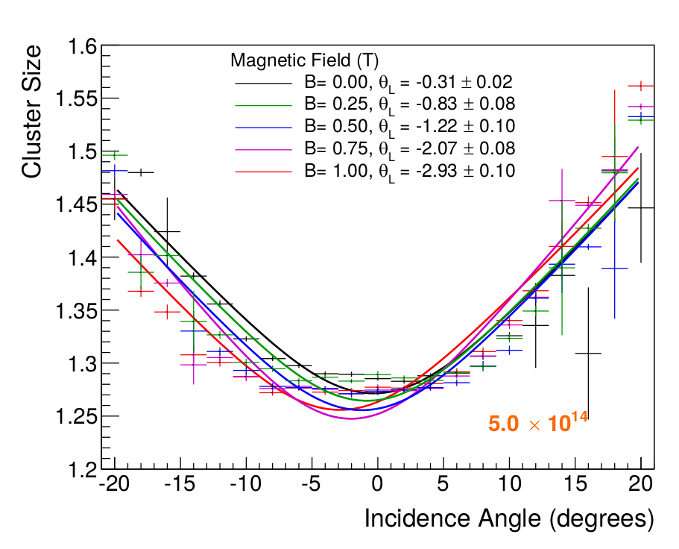
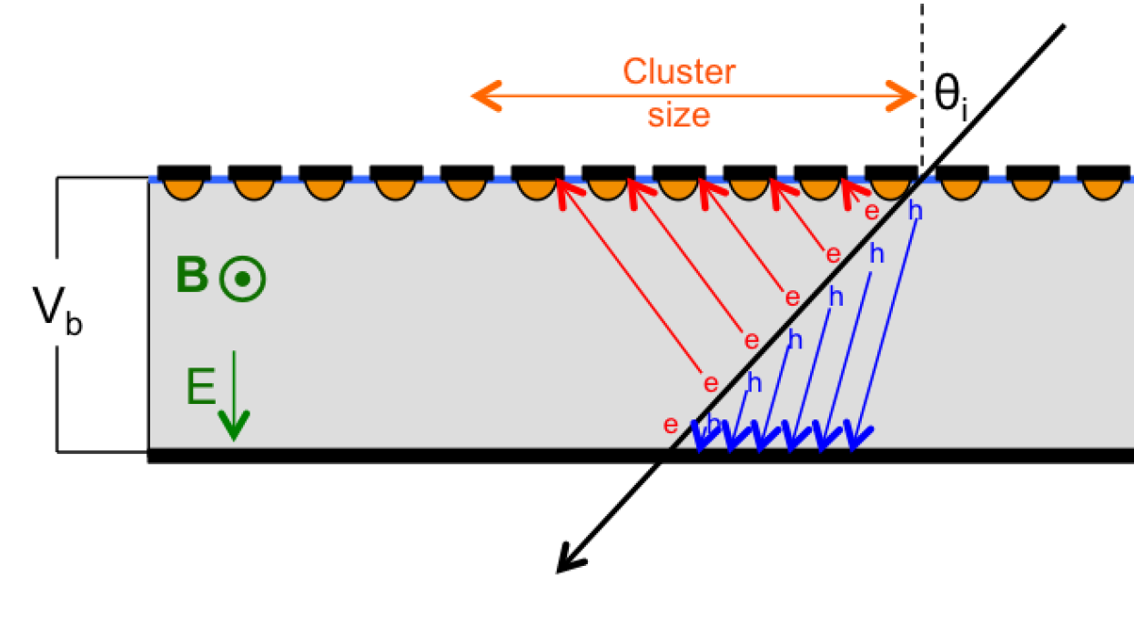
Radiation-hard silicon sensors for LHC upgrades
Detector characterization with the DESY testbeam
Lorenz Angle dependence on radiation damage
  Key for track reconstruction
  Allows comparison with models
Notes:
Lorentz Angle measurement:
2D Scan (particle incidence angle / magnetic field)
Extract the angle shift yielding the minimum
cluster size for a certain magnetic field
KEY POINT – THIS NEEDS TESTBEAM FEATURES – TRUE HIGH-ENERGY PARTICLES, TELESCOPE AND MAGNETIC FIELD
WORK IN STUFF ON RAD DAMAGE FOR AGIPD
http://bib-pubdb1.desy.de/record/317686

Slide 9
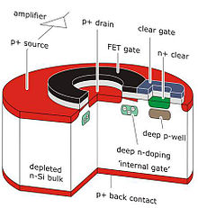
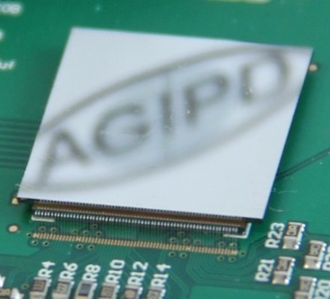
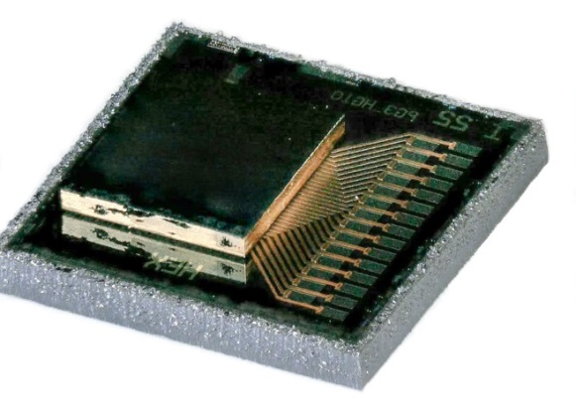
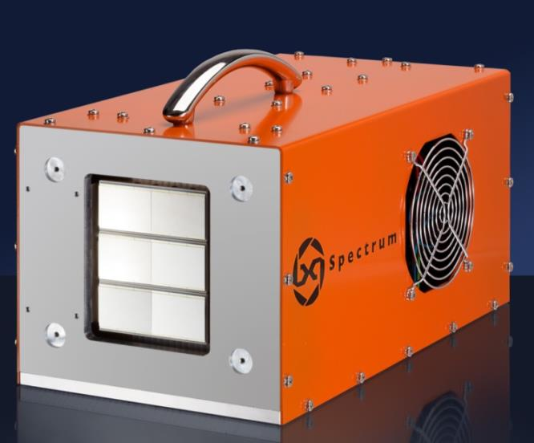
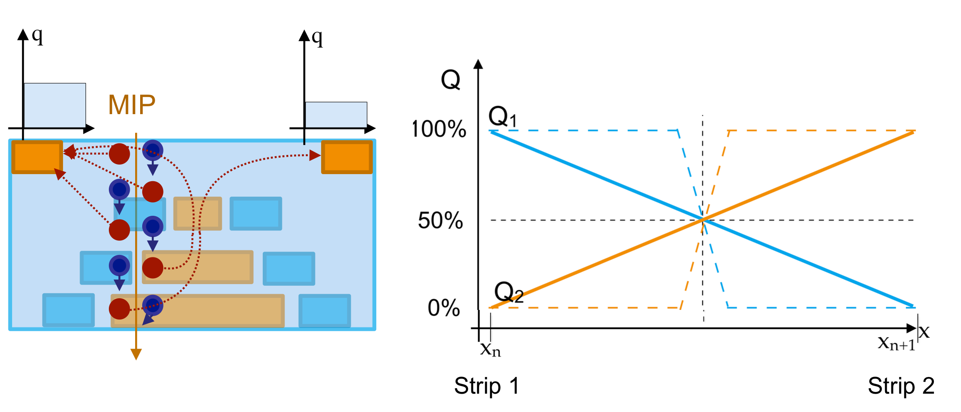
Novel sensors
Collaborations and developments
“XFEL tolerant” silicon pixels (AGIPD) – University of Hamburg
DEPFET soft X-ray sensors (DSSC) – Max Planck Halbleiterlabor
Silicon Photomultipliers - Max Planck Halbleiterlabor
“High-Z” materials for hard X-ray detection – University of Tomsk, Canberra, X-Spectrum (DESY spinoff)
Enhanced Lateral Drift Si sensors – Novel DESY development
Notes:
Lorentz Angle measurement:
2D Scan (particle incidence angle / magnetic field)
Extract the angle shift yielding the minimum
cluster size for a certain magnetic field
KEY POINT – THIS NEEDS TESTBEAM FEATURES – TRUE HIGH-ENERGY PARTICLES, TELESCOPE AND MAGNETIC FIELD
WORK IN STUFF ON RAD DAMAGE FOR AGIPD
http://bib-pubdb1.desy.de/record/317686

Slide 10
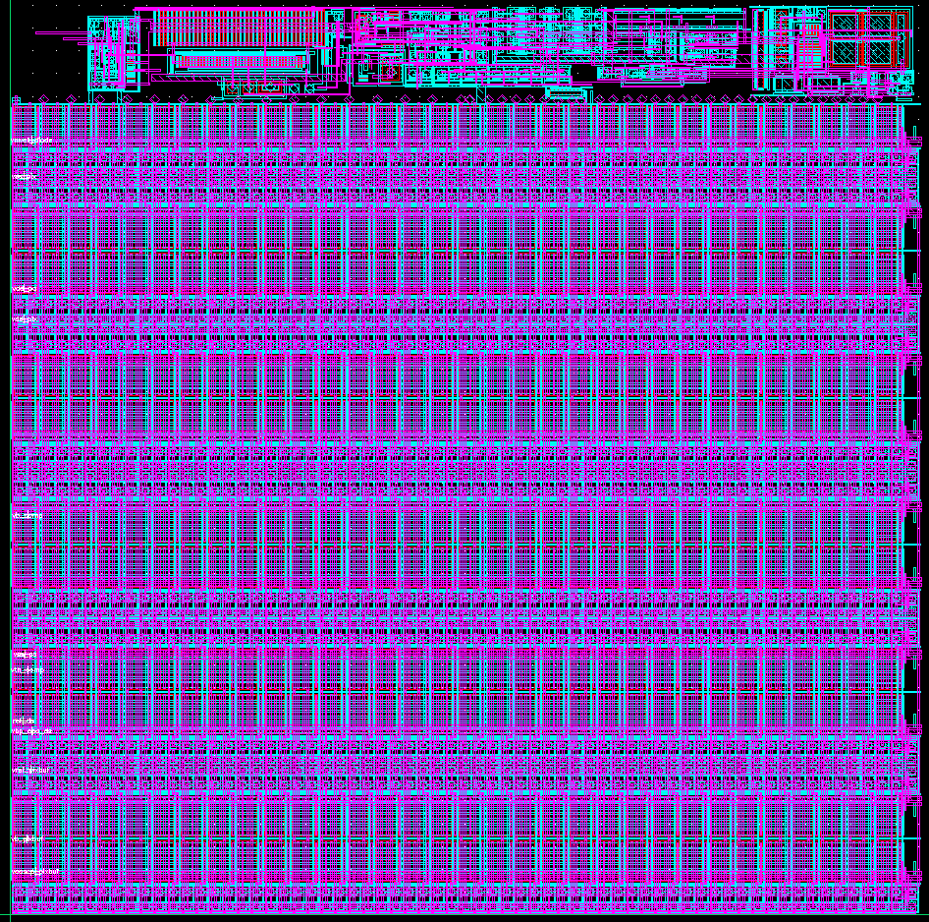
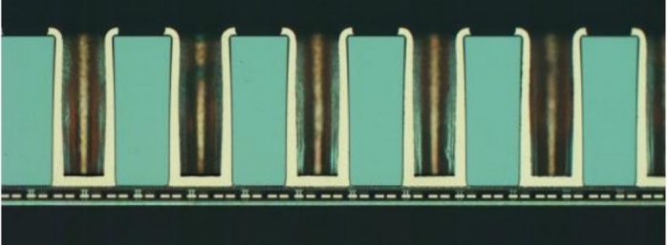
Outlook
New experiments will demand increasing speed and granularity
  Photon beamlines needing 100 kHz+ continuous frame rate (CW-FELs, PETRA-IV)
  Increased event rate at future collider experiments
Development required to meet this challenge
  ASIC development in 65nm CMOS
  Sensors – improving conventional silicon and adopting new technology
    Expanding testbeam facilities
Important links to other areas of development
  Interconnect (bump-bonding, 3D integration)
  High-speed DAQ
  Computing for data reception & calibration
AGIPD
pixel design
TSV interconnect
Notes:
Reference to Doris – expanding testbeam facilities
What to say about sensors? Need to decide – less specific – rad hardness, mention new techs.
Sensors – continued use of standard silicon. What to say about sensors? Strong collaborators?
- Range of operation – soft and hard X-rays… emphasize diversity of sensor requirements…
Expand testbeam
OUTLOOK AND CONCLUSIONS – Two slides…
Summary - subbullets
List achievements
5-10 years
2/3 current, 1/3 future?
Achievements – but this is mostly present
Sensor and ASIC R&D
Established ASIC design groups – how to compare with future?

Slide 11
Conclusions
Established capabilities in ASIC development
Strong expertise in sensor characterisation
Collaboration with national and international groups
Future:
  Developments driven by future DESY science
  More basic technology development (e.g. high-speed ASICs) to meet high demands
Notes:
Expand testbeam
OUTLOOK AND CONCLUSIONS – Two slides…
Summary - subbullets
List achievements
5-10 years
2/3 current, 1/3 future?
Achievements – but this is mostly present
Sensor and ASIC R&D
Established ASIC design groups – how to compare with future?

Slide 13
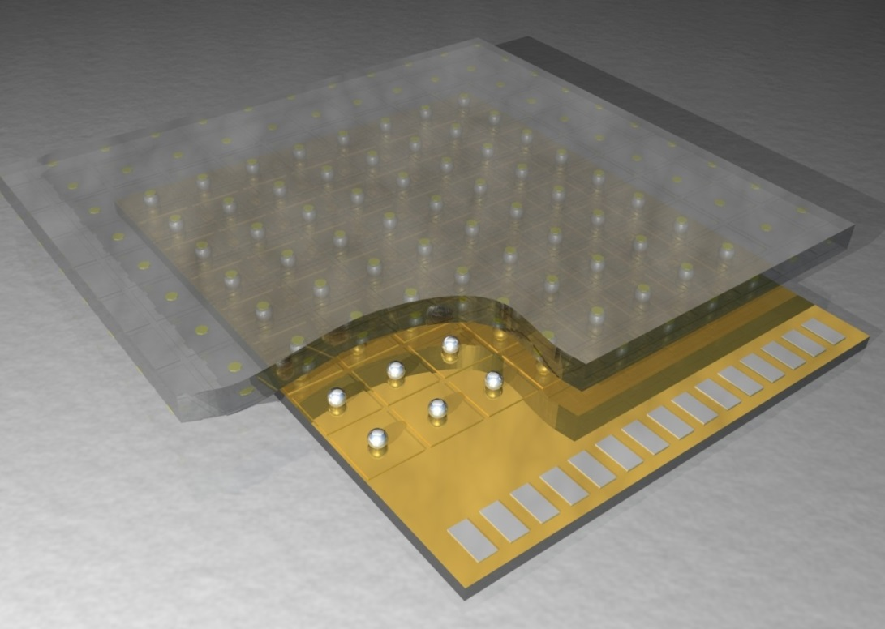
ASICs and Sensors
Introduction
Hybrid pixel detector structure
Main pixel detector technology for accelerator-based experiments
ASICS
Custom ASIC design allows versatility
Benefit from developments in semiconductor industry (smaller CMOS scale, 3D integration)
Sensors
Sensors must meet increasingly hard challenges (e.g. radiation hardness
Semiconductor technology provides new processes and materials

Slide 14
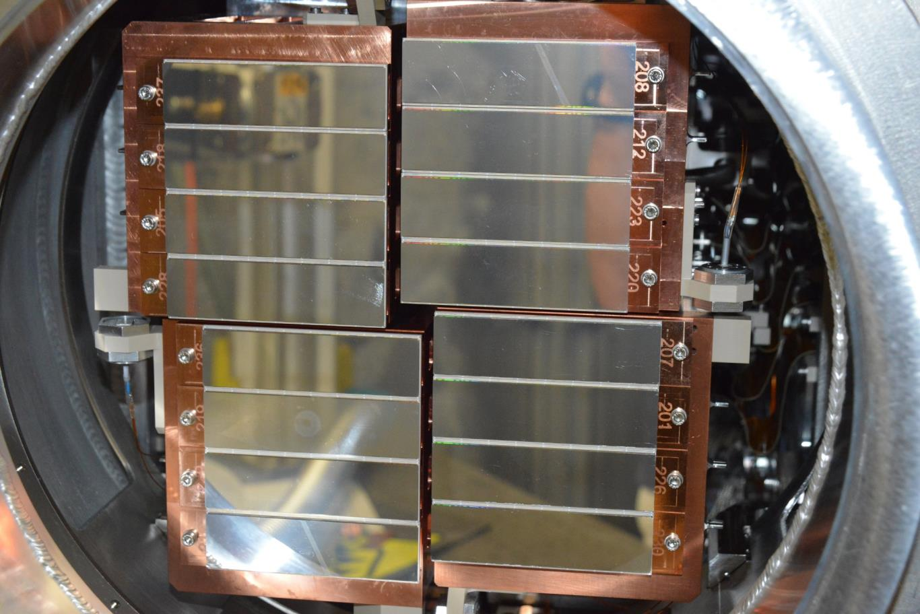
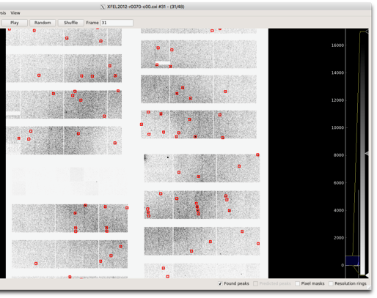
AGIPD detector for the European XFEL
1 Megapixel system at XFEL beamline SPB
16-module system with 16 ASICs per module
Radiation hard silicon sensor - studies and sensor design by University of Hamburg
    Guard ring designed for reliable 500V operation after saturation of surface damage effects
    High bias needed to ensure full collection in 220ns
Currently running in first user experiments at XFEL
Diffraction from Lysosyme crystal (experiment by DESY coherent imaging)
Notes:
Remove this point – covered elsewhere. Relocate radiation damage later.

Slide 15
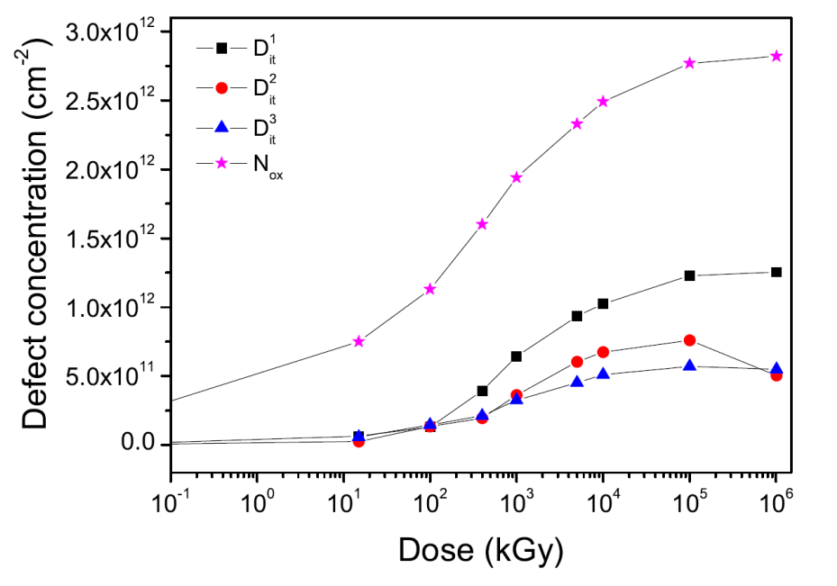
X-ray sensor development
X-ray Si radiation hardness studies
Uni Hamburg contribution to AGIPD development
Characterisation of surface damage up to 1 GGy
  Affects breakdown behaviour and surface currents
Sensor design for reliable 500V operation
“High-Z” sensors for hard X-ray detection
Replace Si with Ge, GaAs, CdTe…
Collaborate with institutes and industry to integrate new sensor materials into photon-counting detector for PETRA
2-megapixel GaAs developed and commercialised by spinoff
Notes:
Maybe not good at covering all bases?
500 pSv cm^2 – ish for neutrons
So, for 1e15 neq/cm^2, this is about 500,000 Sv – assume 500 kGy – so 5 MGy for 1e16. Factor of 100 higher ionising dose here compared to particle physics.
Unsure about this setup – on the one hand, want to cover all bases, and good to include. On the other hand, time issue, and limited content…
Can I say about more generic challenges?

Slide 16
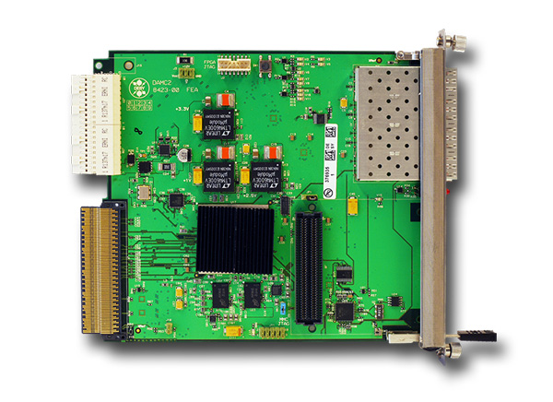
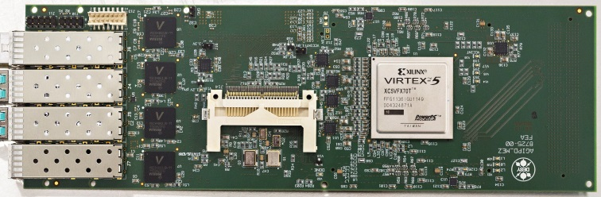
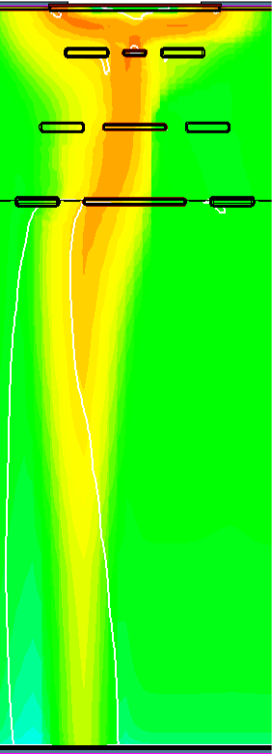
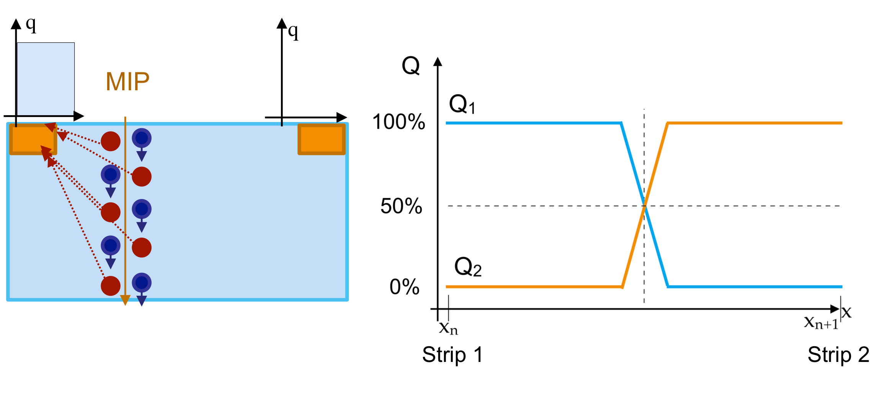
High speed readout and µTCA cards
MIP
standard planar sensor
Enhanced lateral drift sensor

