Slide 1
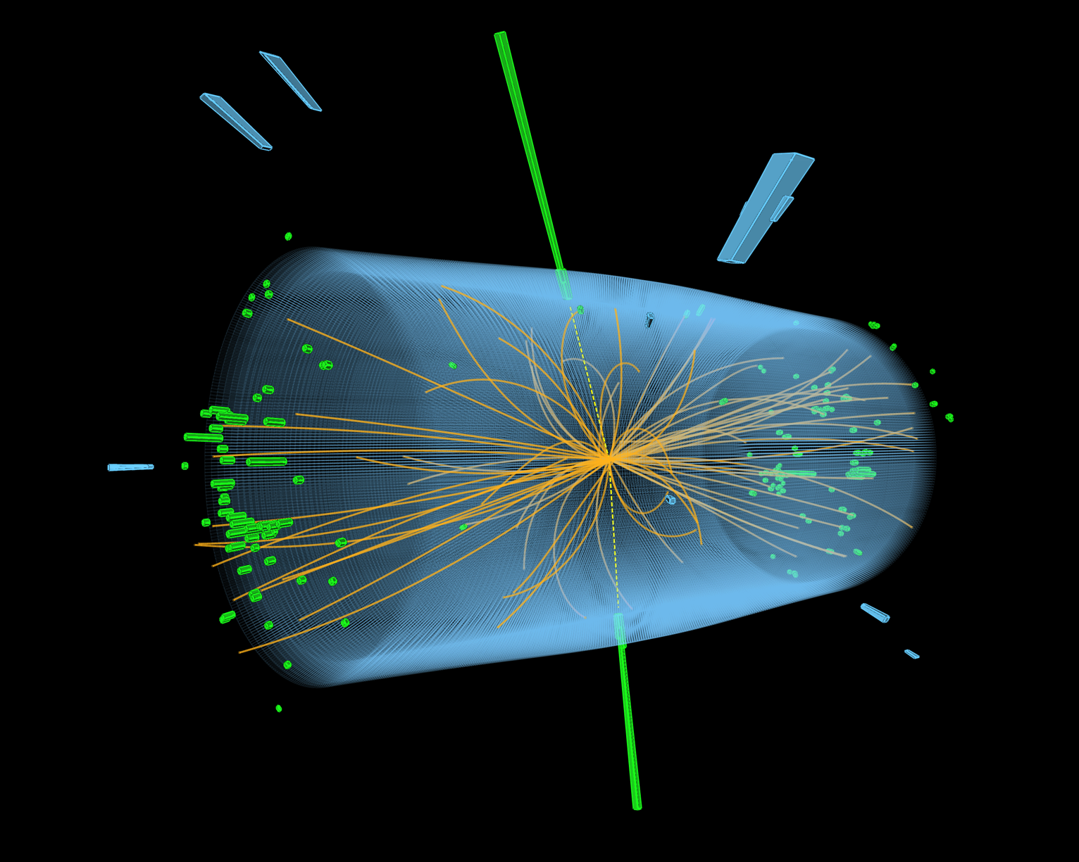
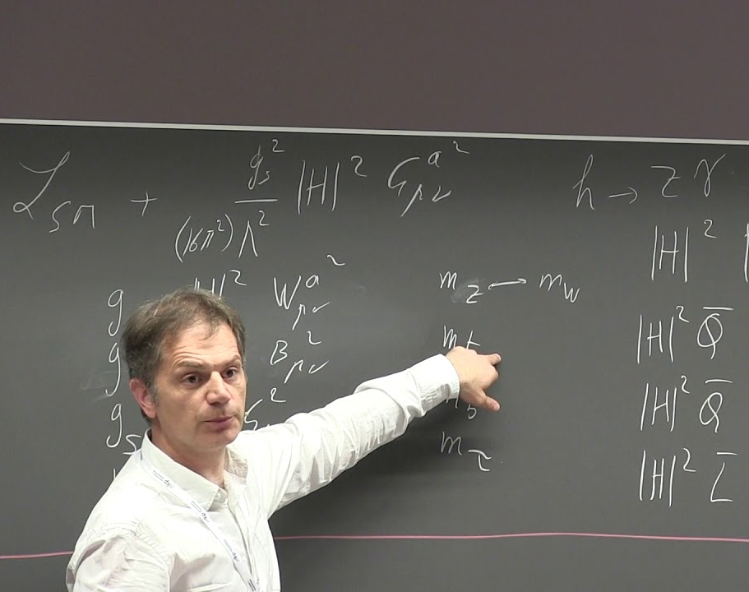
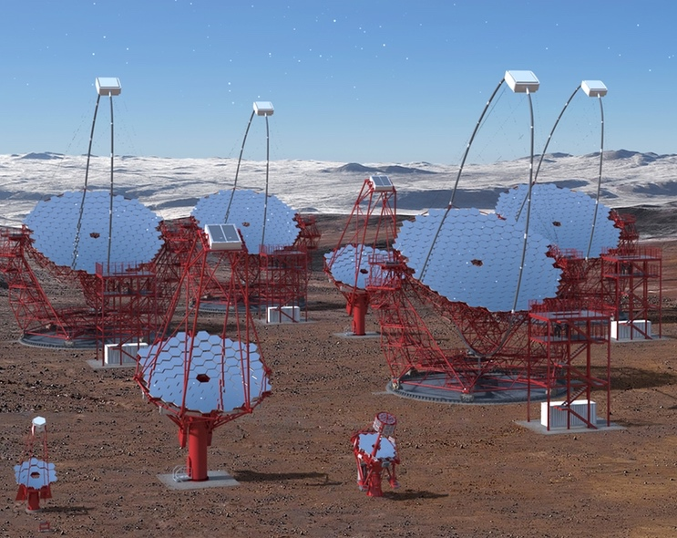
Experimental particle physics on-site (DESY in Hamburg)
Elementary Particle and Astroparticle Physics at DESY
Helmholtz Program: Matter and the Universe (MU)
PoF III Topic: Fundamental Particles and Forces
DESY Research Unit: Experimental Particle Physics
Axel Lindner
Center Evaluation DESY, 5 – 9 February 2018

Slide 2
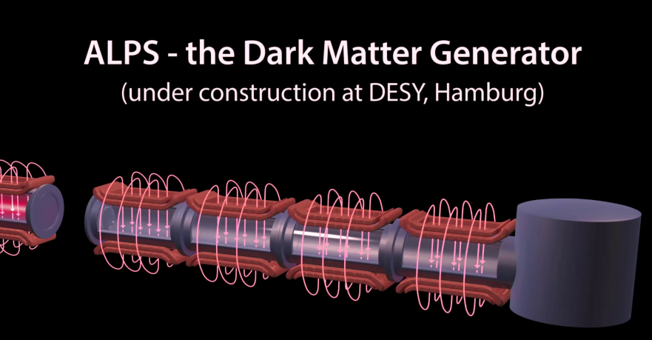
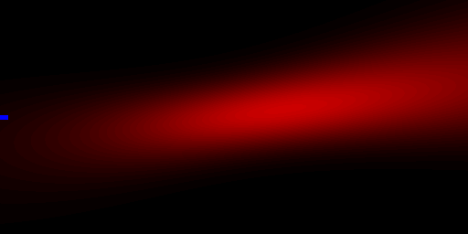
Experimental particle physics on-site (DESY in Hamburg)
Using infrastructure at DESY in Hamburg
Approaching the dark sector via
axion / axion-like particle experiments:
ALPS II (under construction)
MADMAX (under preparation)
IAXO (under preparation)
Nonperturbative QED in strong fields with
LUXE (feasibility study)
Courtesy S. Barke,
UF postdoc at ALPS II
https://www.slac.stanford.edu/exp/e144/focpic/focpic.html

Slide 3

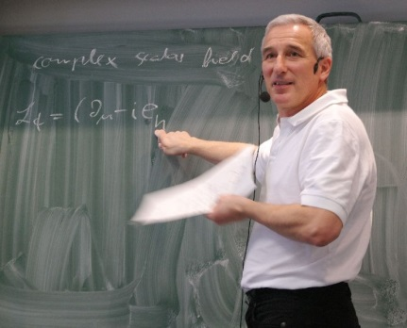
Introduction to axions and axion-like particles (ALPs)
Looking for an entrance to the dark sector
A dark sector beyond the Standard Model
is strongly motivated by cosmology,
might be complex with several constituents.
Axions and axion-like particles
are strongly motivated by theory (CP conservation in QCD)
and cosmology (dark matter),
might be starting to show up in astro(particle) physics already
  excess radiation from stars,
  transparency of the universe to TeV photons,
offer new experimental approaches towards the dark sector,
  strongly guided also from DESY theory.
http://www.symmetrymagazine.org/
sites/default/files/images/standard/
Feature_DarkMatter3.jpg
A. Ringwald,
also member of exp. collaborations.

Slide 4
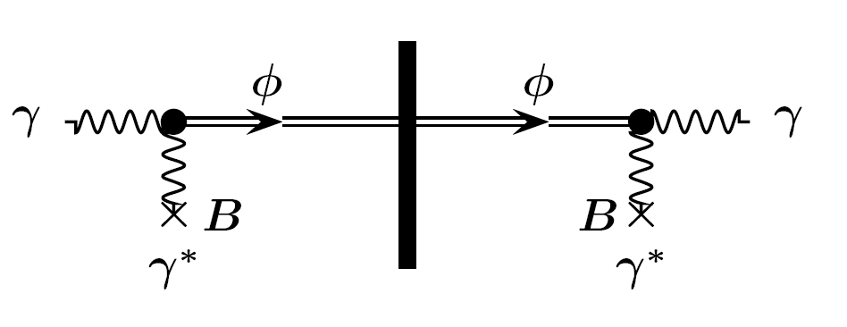
Introduction to axions and axion-like particles (ALPs)
How to look: exploiting photon couplings
From conversion in a magnetic field …
Primakoff-like effect (Sikivie ‘83) B=1
… to light-shining-through-a-wall ALPS II: P(γ→a→γ) ≈ 10⁻³⁶
a
a
a
a

Slide 5
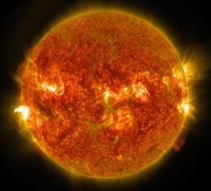
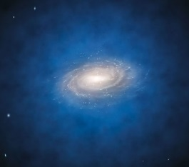
Introduction to axions and axion-like particles (ALPs)
How to look: three kinds of approaches
a
a
Purely laboratory experiments
“light-shining-through-walls”, optical photons,
generation of ALPs in the lab.
Helioscopes
ALPs emitted by the sun, X-rays,
Haloscopes
looking for dark matter constituents, microwaves.
a
a
a
a

Slide 6
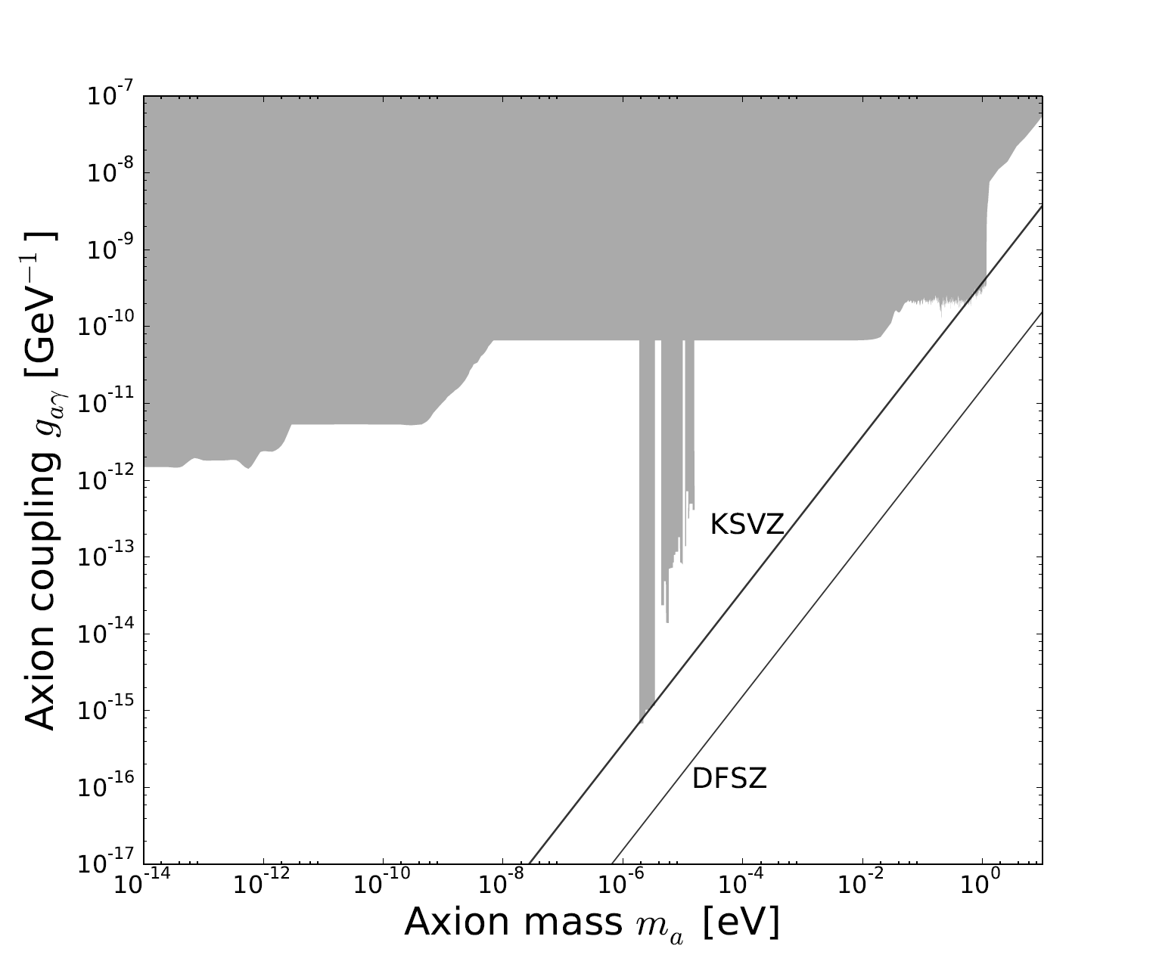
Introduction to axions and axion-like particles (ALPs)
Where to look: hot spots in parameter space
Three main regions of interest:
Axion-like particles:
TeV transparency, stellar evolution,
m_{a} < 10⁻⁷eV, g_{aγ} = O(10⁻¹¹GeV⁻¹)
QCD axions:
CP, stellar evolution, (dark matter),
m_{a} = O(10⁻³eV), g_{aγ} = O(10⁻¹¹GeV⁻¹)
QCD axions:
CP, dark matter,
m_{a} = O(10⁻⁴eV), g_{aγ} = O(10⁻¹⁴GeV⁻¹)
Two-photon-coupling

Slide 7
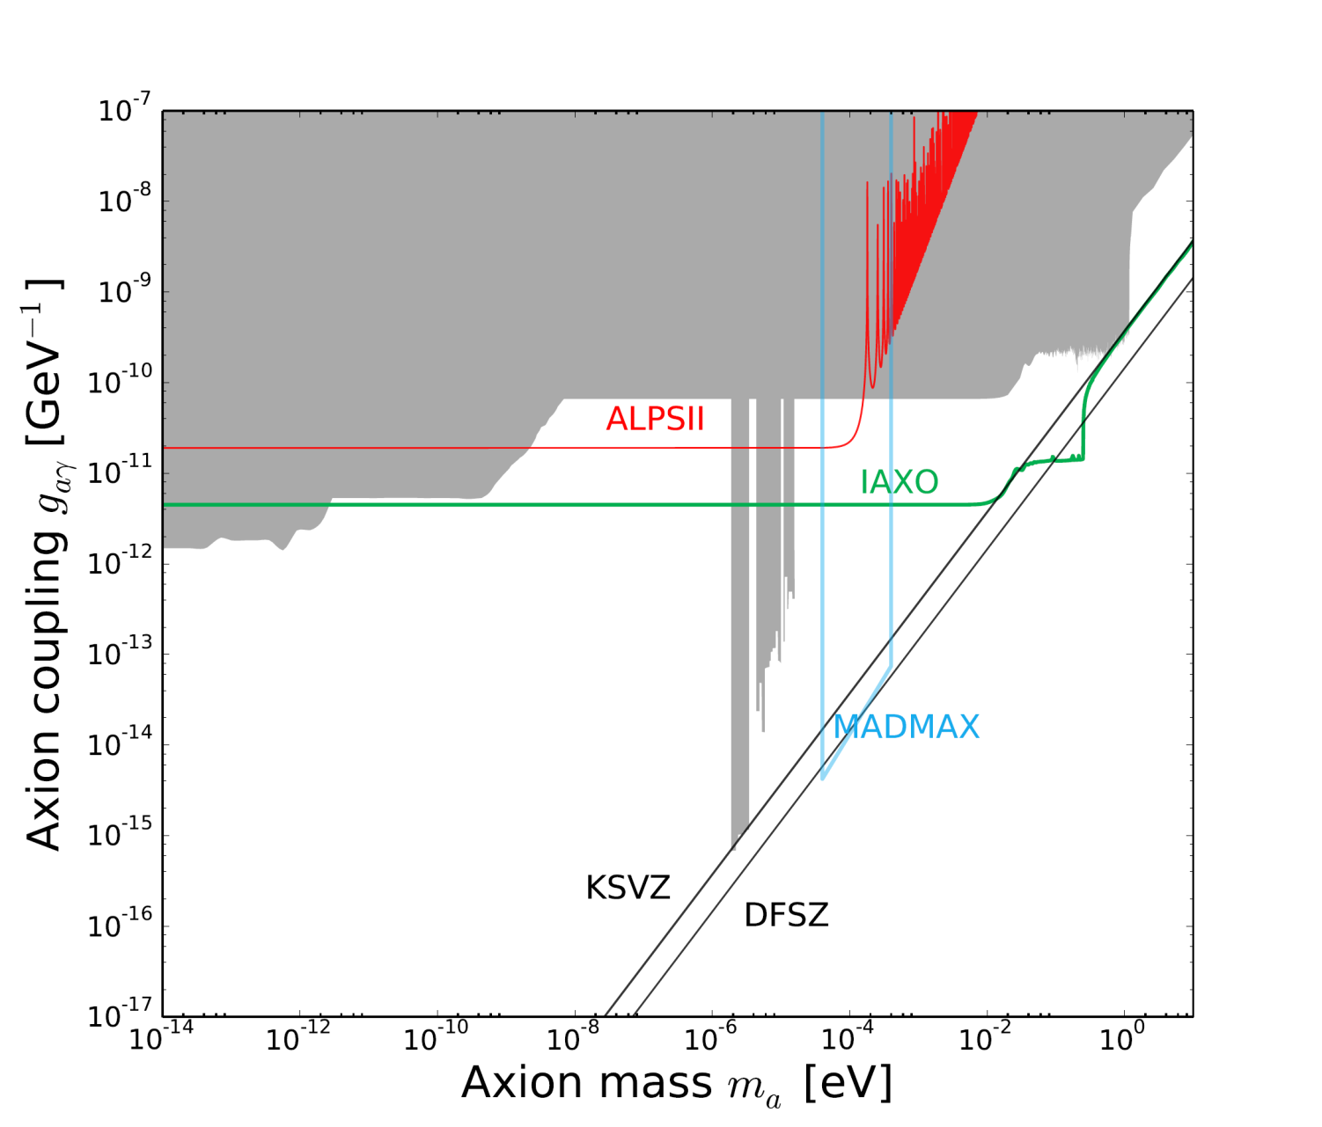
Introduction to axions and axion-like particles (ALPs)
Where to look: hot spots in parameter space
Three main regions of interest:
Axion-like particles:
TeV transparency, stellar evolution,
m_{a} < 10⁻⁷eV, g_{aγ} = O(10⁻¹¹GeV⁻¹),
ALPS II.
QCD axions:
CP, stellar evolution, (dark matter),
m_{a} = O(10⁻³eV), g_{aγ} = O(10⁻¹¹GeV⁻¹),
IAXO.
QCD axions:
CP, dark matter,
m_{a} = O(10⁻⁴eV), g_{aγ} = O(10⁻¹⁴GeV⁻¹),
MADMAX.
a
a
Two-photon-coupling

Slide 8
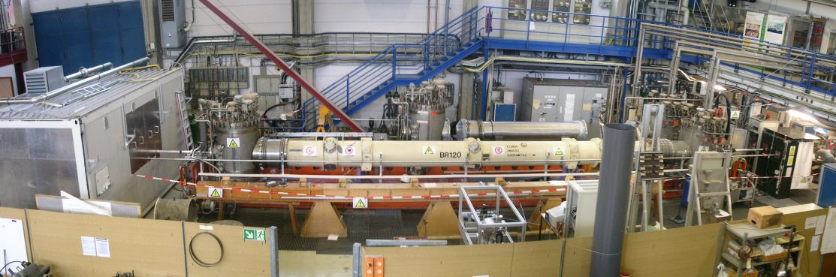
Any Light Particle Searches @ DESY in Hamburg
From ALPS I to ALPS II
ALPS I
based on one HERA proton accelerator dipole magnet,
initiated 2006 by theory, exp. particle physics and administration,
approved 2007 and concluded 2010,
most sensitive ALP search experiment in the lab up to 2014.
Basis of success:
combine forces with LIGO community
(long optical resonators)
to implement an optical resonator
in the magnet bore.

Slide 9
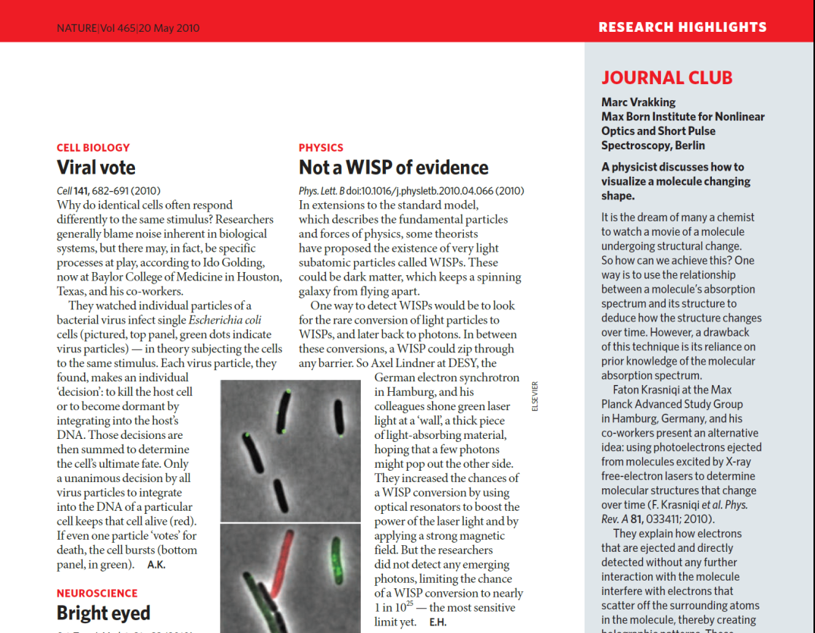
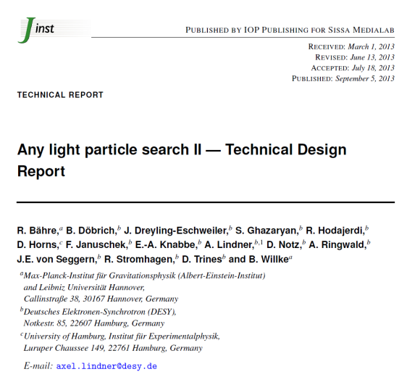
Any Light Particle Searches @ DESY in Hamburg
From ALPS I to ALPS II
ALPS I
based on one HERA proton accelerator dipole magnet,
initiated 2006 by theory, exp. particle physics and administration,
approved 2007 and concluded 2010,
most sensitive ALP search experiment in the lab up to 2014.
ALPS II
proposed 2011,
TDR evaluated in 2012,
directorate decided to continue with the preparatory phase,
construction phase started in 2017.
Main goal:
increase sensitivity on g_{aγ} by > 10³ to probe for axion-like particles motivated by astrophysics.
R Bähre et al 2013 JINST 8 T09001

Slide 10
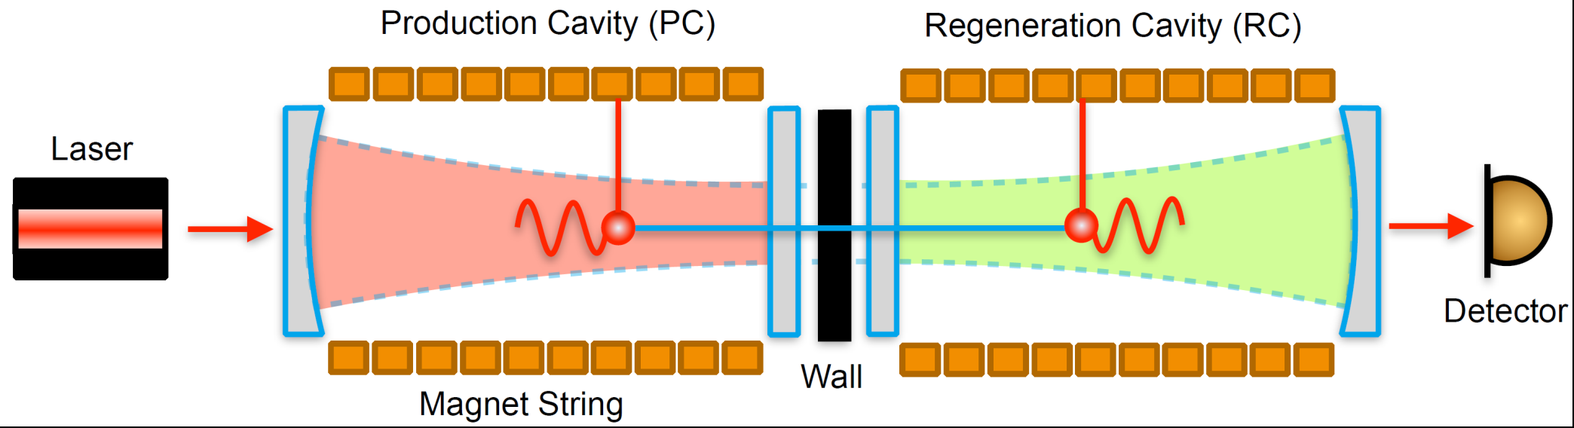
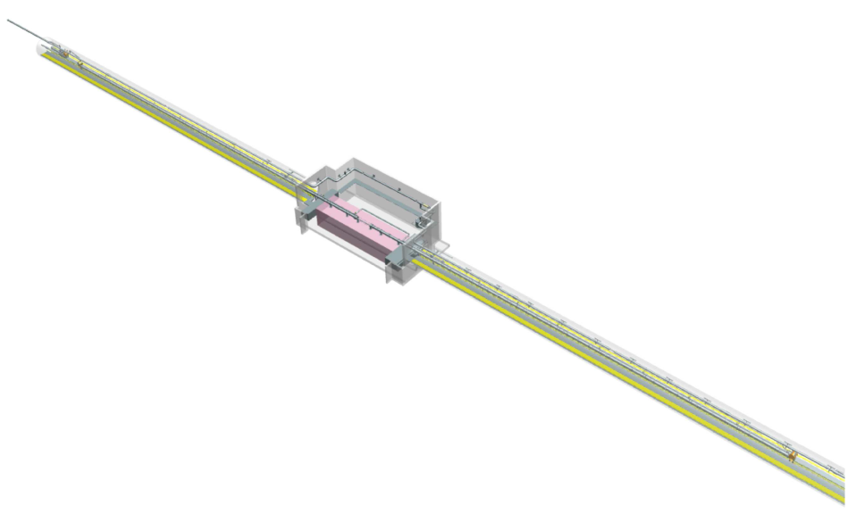
ALPS II @ DESY in Hamburg
Main components
5 cm
200 m
Planned ALPS II installation
in the HERA tunnel
10+10 straightened dipole magnets from the HERA proton accelerator
Production Cavity and Regeneration Cavity, mode matched

Slide 11
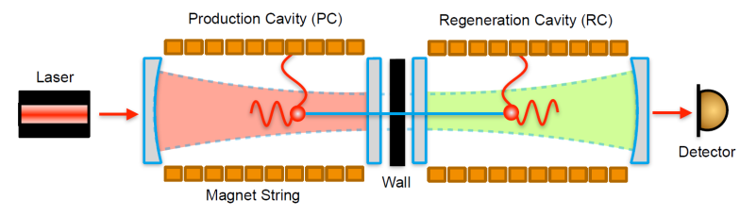
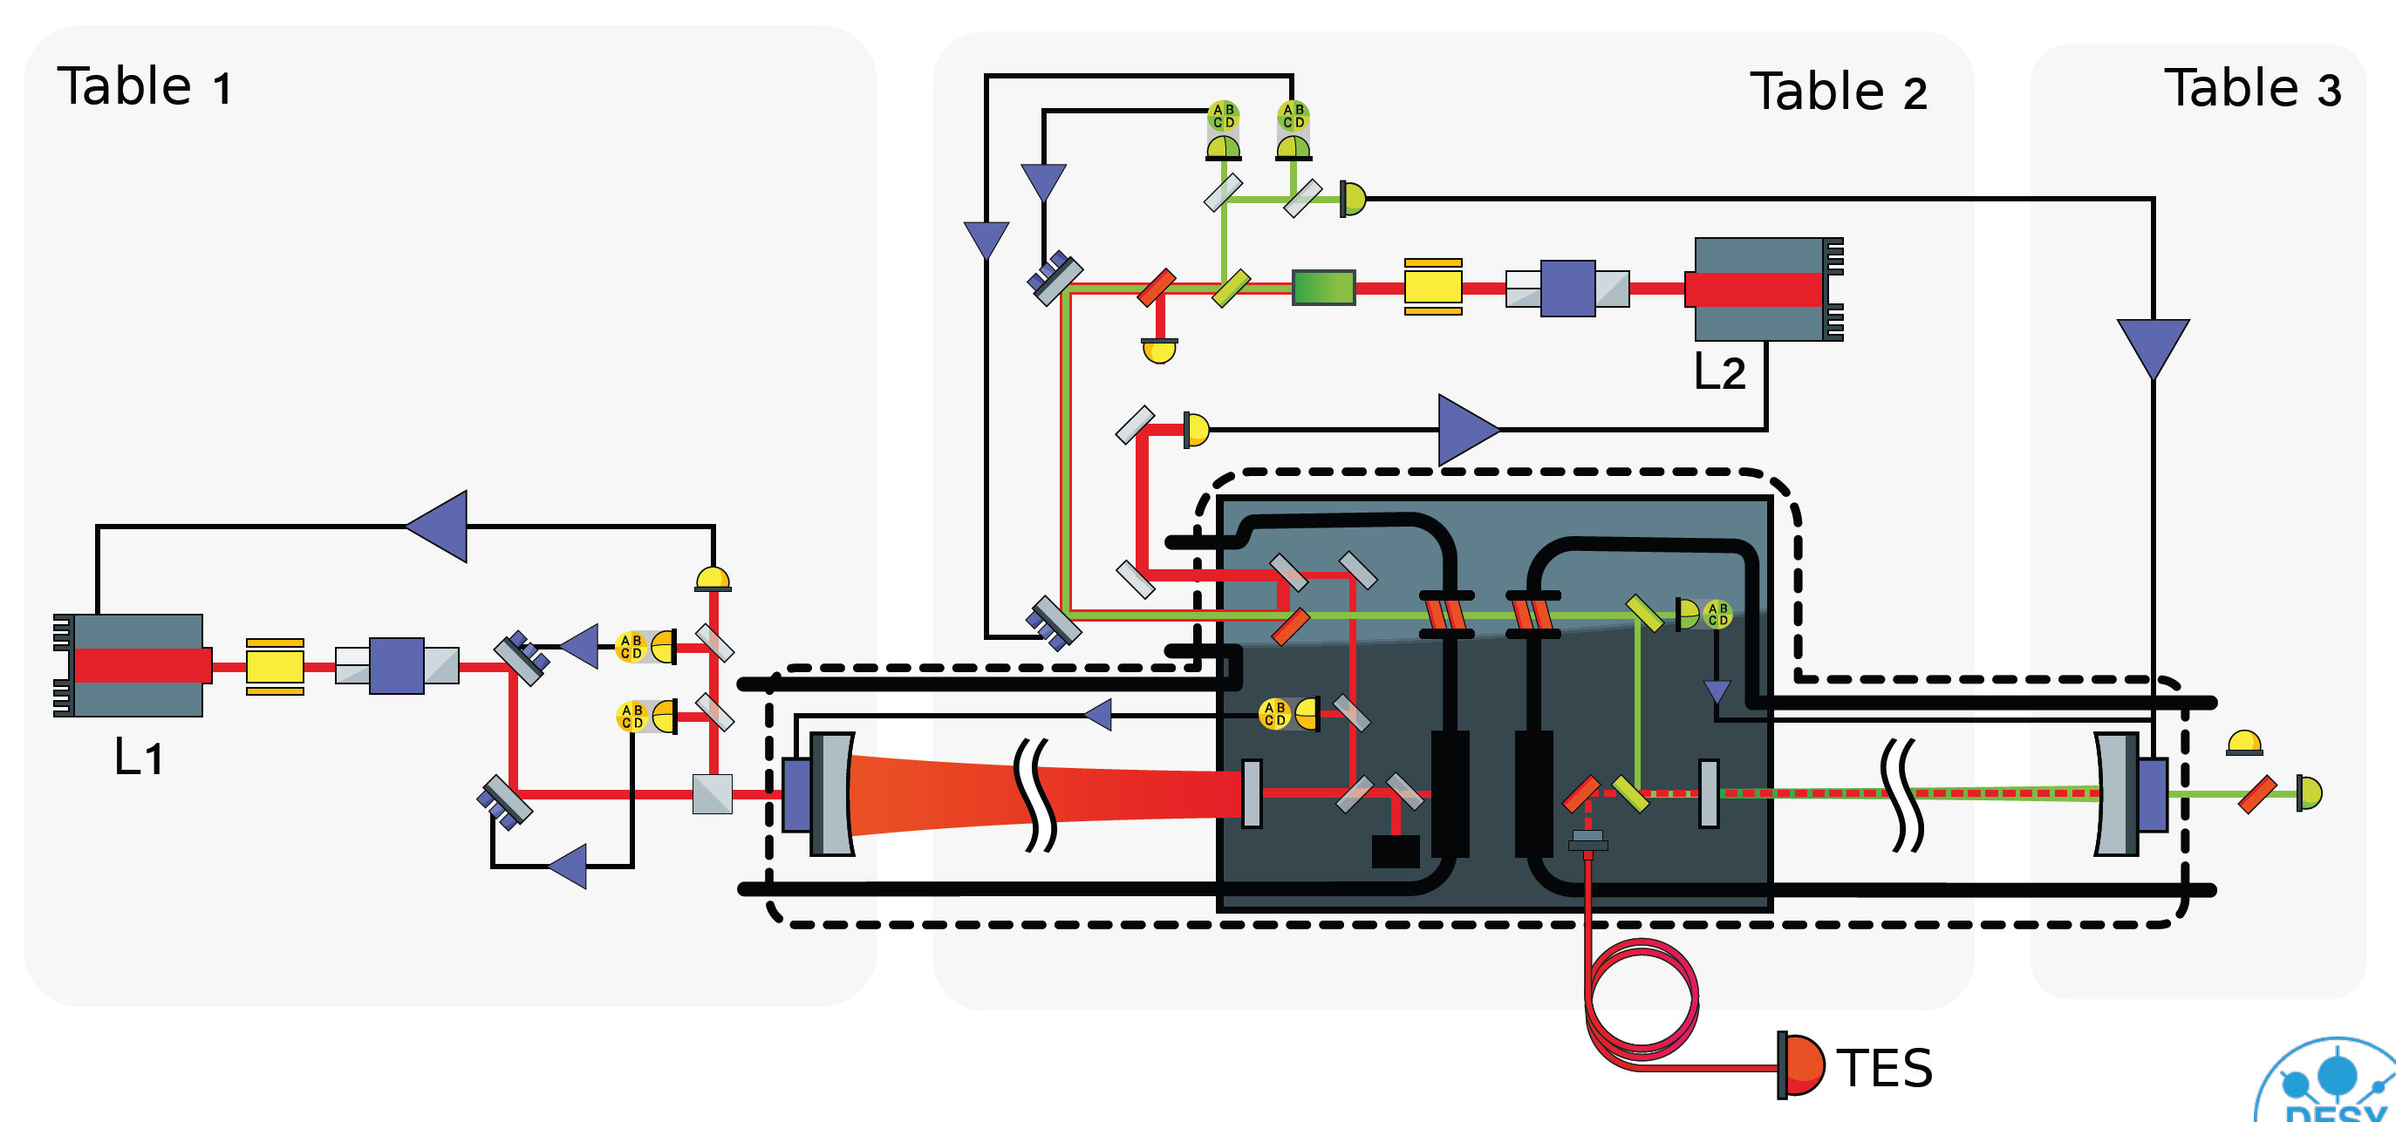
ALPS II @ DESY in Hamburg
Main components: optics
Laser, 1064 nm
Production cavity
Wall and shutter
Regeneration cavity

Slide 12
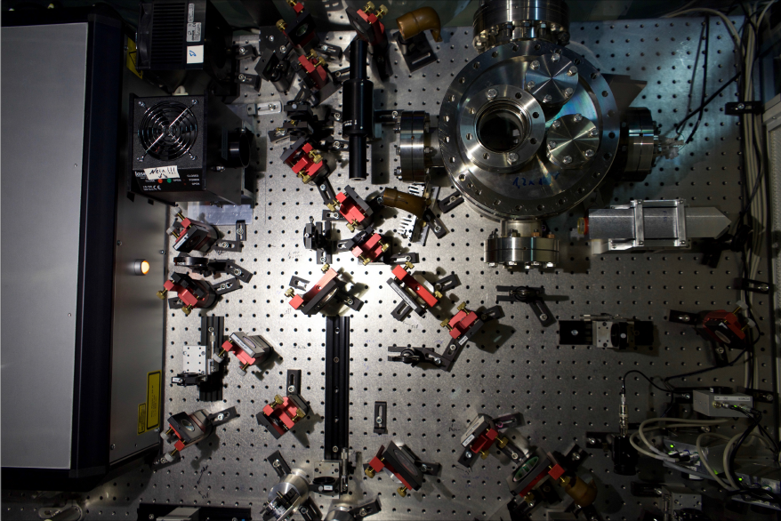
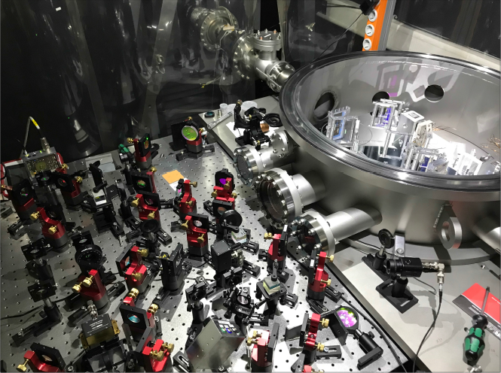
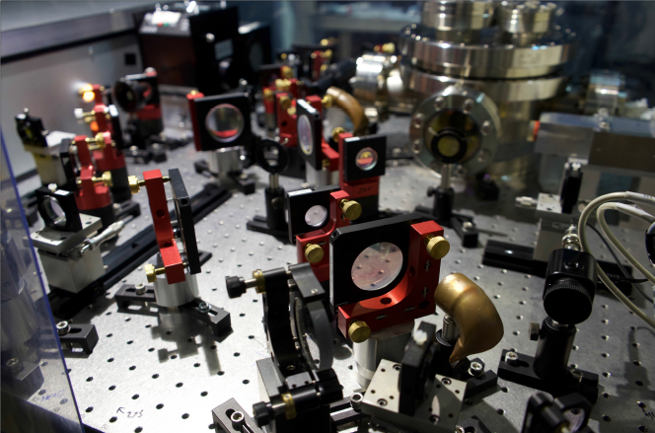
ALPS II @ DESY in Hamburg
Main components: optics in the 20 m long prototype
Be invited for a lab-tour!

Slide 13
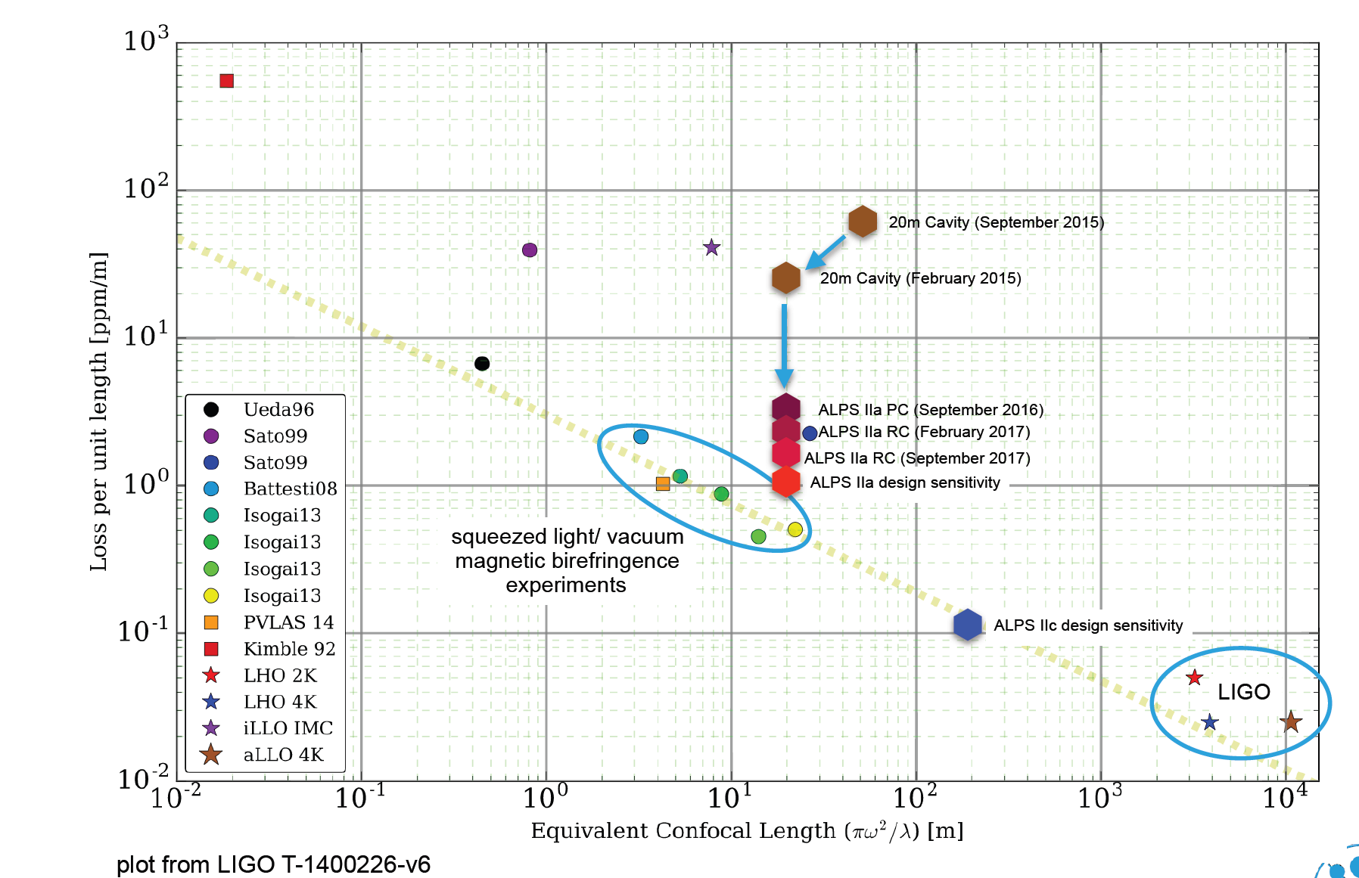
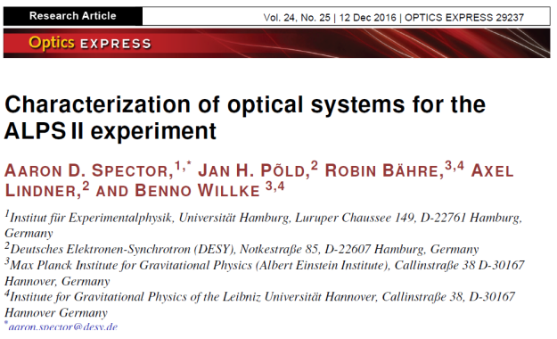
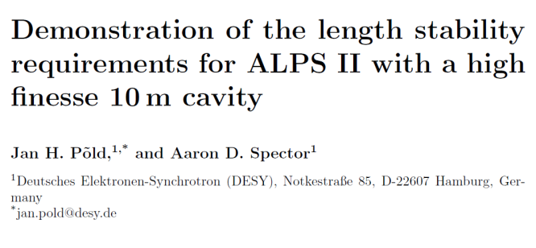
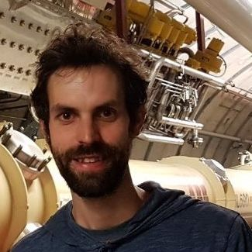
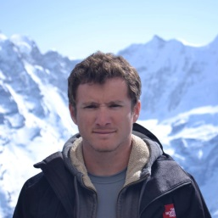
ALPS II @ DESY in Hamburg
Main components: optics achievements in the 20 m long prototype
Long baseline optical resonators: ALPS II optics becomes cutting edge
https://arxiv.org/abs/1710.06634

Slide 14
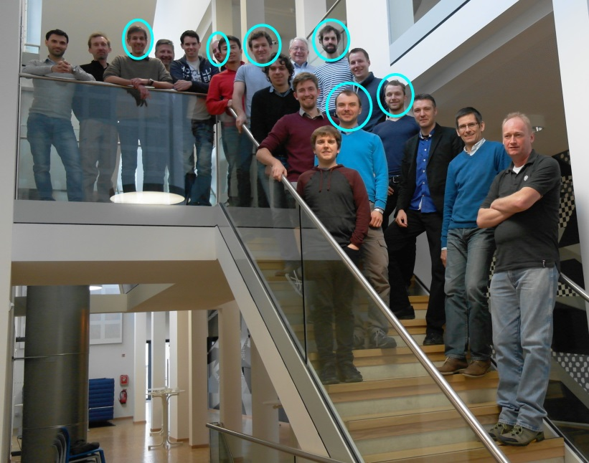





ALPS II @ DESY in Hamburg
Collaboration
ALPS II main contributions
Partner | Magnets | Optics | Detectors | Infrastructure
DESY* | X | X | X | X
AEI Hannover |  | X
U. Florida |  | X | X | X
U. Mainz |  |  | X
*: theory, experimental particle physics, accelerator division
Significant funding support also by the

Slide 15
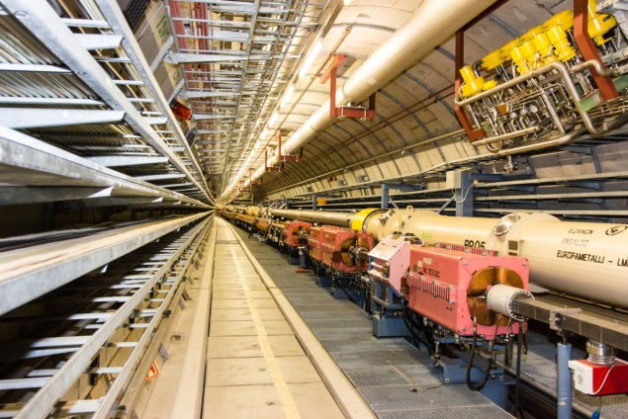
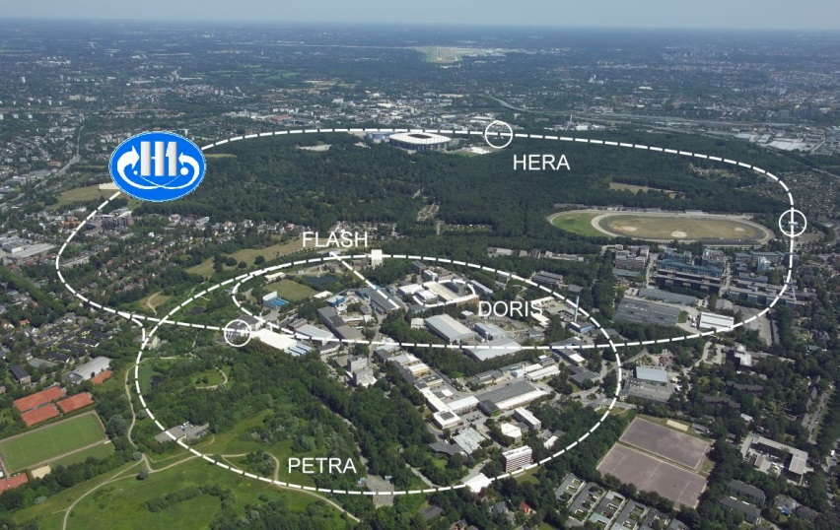
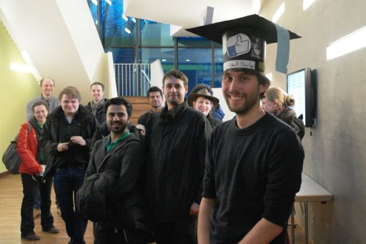
ALPS II @ DESY in Hamburg
Results and schedule
Results:
Axions and ALPs:
none (no data run yet …)
Publications:
5 on optics and detector developments;
several conference contributions.
People (since 2012):
6 Ph.D. theses completed,
about 8 to come,
4 postdocs left for a next career step.
Schedule:
Start data taking in the HERA tunnel in early 2020.
25 x 25 µm²
DESY around the year 2000
HERA hall North
(former H1 experiment at HERA)

Slide 16
On-site experiments
A timeline
2012:
ALPS II
R&D
2017:
ALPS II
construction
2020:
ALPS II
data run
Future options:
2021:
Prototypes MADMAX, IAXO ?
2022: LUXE ?

Slide 17
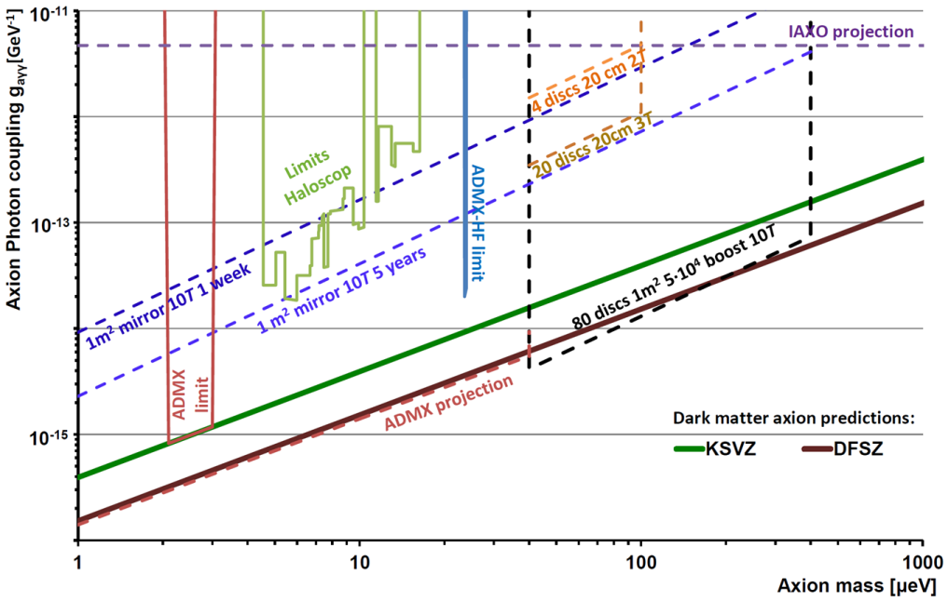
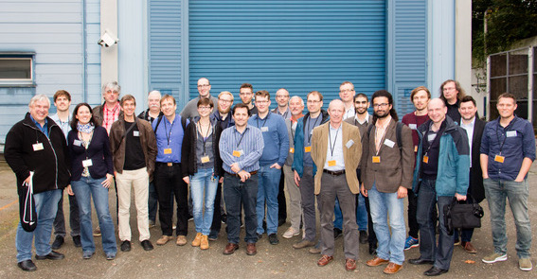
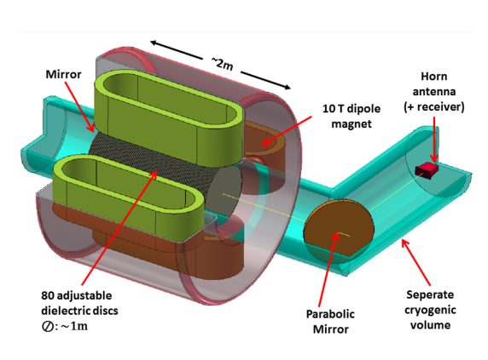







Future option I: MAgnetized Disc and Mirror Axion eXperiment
Direct dark matter search with MADMAX
Experiment:
Motivation:
look for well motivated axion dark matter (for example “SMASH”) in a mass region not accessible by present techniques.
Approach:
install a tunable “booster” of 80 dielectric disks inside a 2 m long dipole magnet providing
B²·A = 100 T²m².
Timeline:
prototype ready in 2021.
Location:
next to ALPS II in HERA North, funding proposal for infrastructure approved by Helmholtz.
Collaboration:
8 Institutes from 3 countries.
Formal collaboration founding
20 October 2017 at DESY.
.
.
MADMAX

Slide 18
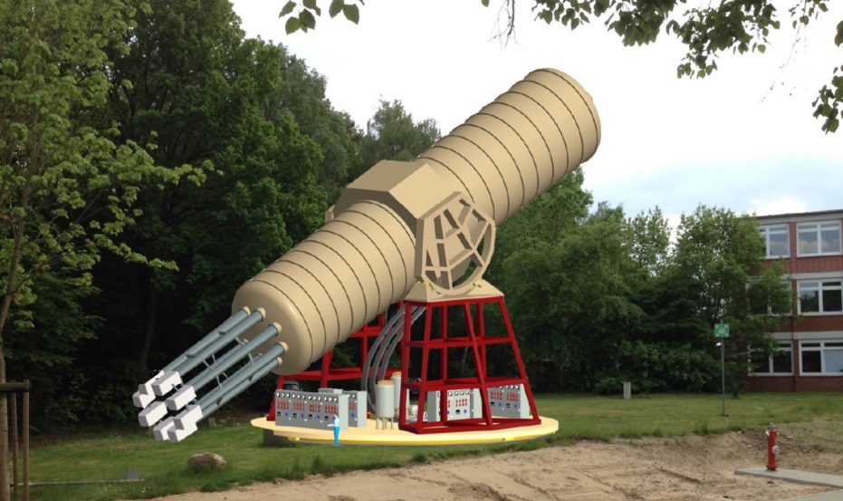
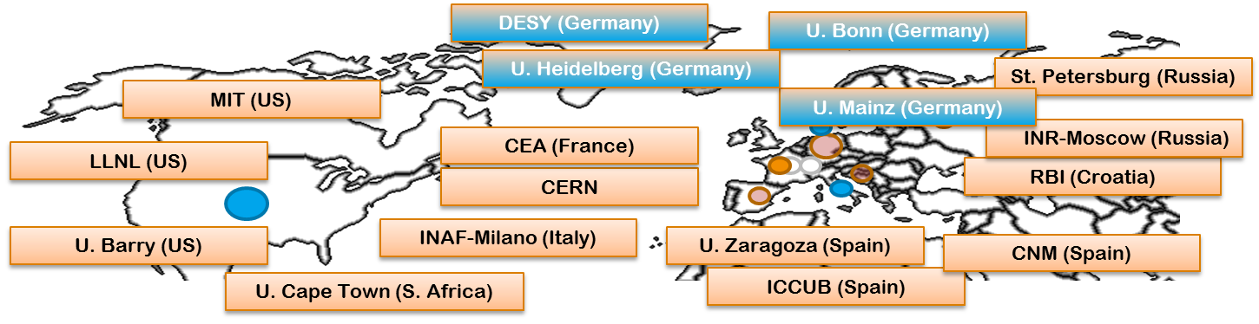

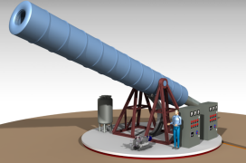
Future option II: International AXion Observatory
Searching for solar axions with IAXO
Collaboration:
17 Institutes from 8 countries.
Formal collaboration founding
03 July 2017 at DESY.
DESY has offered to host IAXO.
.
.
Experiment:
Motivation:
explore a well motivated axion parameter region (for example stellar evolutions) not accessible by other techniques.
Approach:
use experience gained at CAST (CERN) to optimize solar axion searches with dedicated magnets, X-ray optics and detectors.
Timeline:
prototype ready in 2021.
Location:
several options at DESY in Hamburg.
Free bore [m] | 0.6
Magnetic length [m] | 10
Field in bore [T] | 2.5
Stored energy [MJ] | 27
Peak field [T] | 4.1

Slide 19
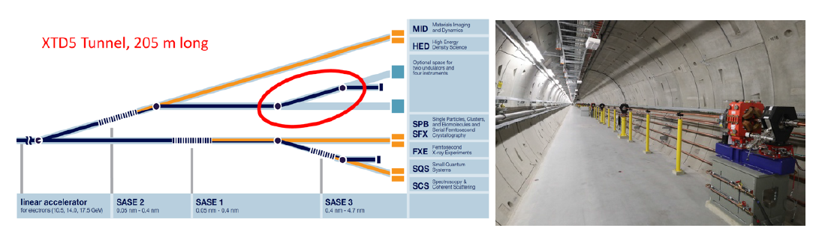

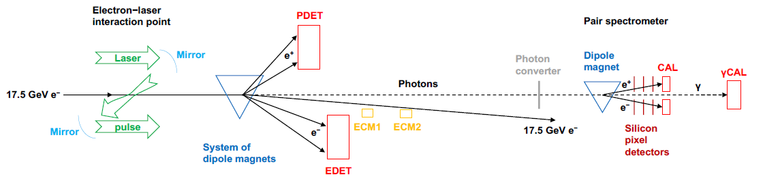





Future option III: Laser Und XFEL Experiment
Probing nonperturbative QED with LUXE
Physics:
Probe the strong field regime of QED around
.
Might be relevant also for astrophysics (neutron stars) and atomic/molecular physics.
Goal: extend the parameter range of
E144 (SLAC 1999) by an order of magnitude.
Technique:
Collide the European XFEL electron beam
(17.5 GeV) with a laser providing
10²¹ W/cm² at 500 nm.
Measure the rate of e⁻+nω → e⁻ e⁺e⁻ and compare its asymptotic value to QED predictions.
Possible layout:
Status:
First discussions on feasibility ongoing:
Supported by the DESY Strategy Fund.

Slide 20

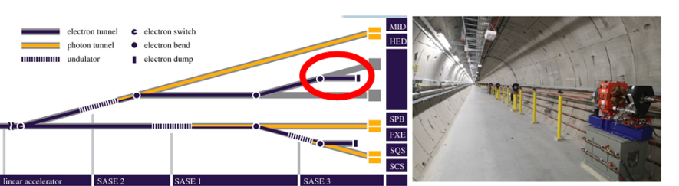
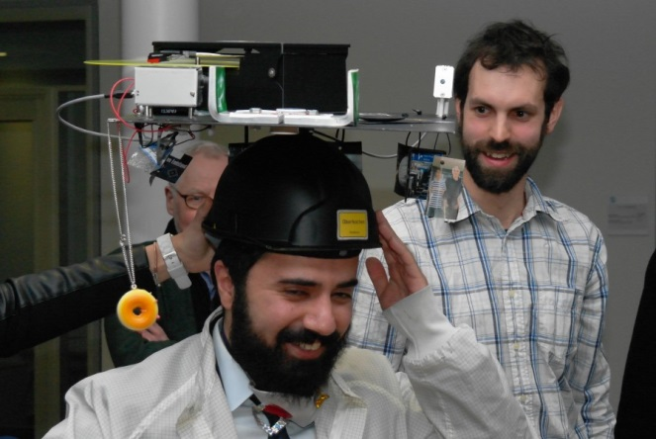
Summary
Experimental particle physics on-site
Axion / axion-like particle experiments:
DESY expertise and infrastructure in collaboration with strong partners
provide excellent opportunities for a break-through in hidden sector searches.
ALPS II is under construction, DESY contributes to the preparation of MADMAX and IAXO. All three will be world-leading.
New collaboration among different communities have formed, for example
ALPS II: particle physics and gravitational waves
Probing nonperturbative QED with LUXE:
Opportunities for particle physics with the unique electron beam of the European XFEL are being explored.
ALPS II and future particle physics on-site experiments at DESY in Hamburg
(re-) use DESY’s unique infrastructure and capabilities,
perfectly complement DESY’s engagement in remote experiments,
offer a unique environment for the development of young people.
R. Hodajerdi,
ALPS II

Slide 21
Supplements

Slide 22
Axions
CP conservation of QCD and the neutron’s EDM
Text

Slide 23
Axions
Indications from astrophysics
Text

Slide 24
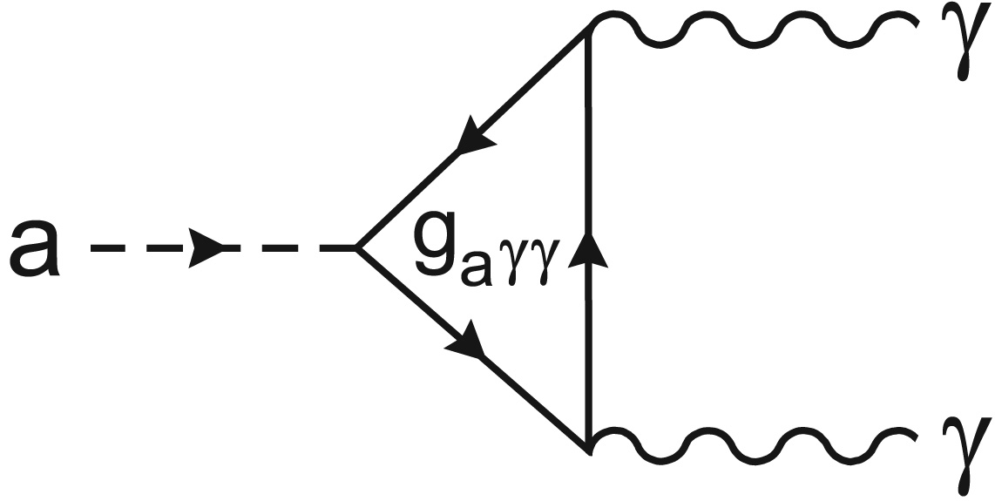
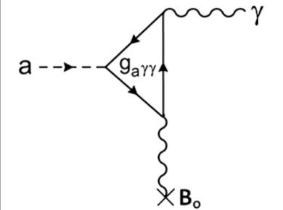
Introduction to axions and axion-like particles (ALPs)
How to look: exploiting photon couplings
Decay to photons
Not observable in the parameter region addressed here. Axion lifetime: τ(m=1eV) = 10¹⁶ yr
Conversion in a magnetic field
Primakoff-like effect (Sikivie ‘83) B=10T, l=10m P(a→γ) ≈ 10⁻¹⁸

Slide 25
Axions and ALPs
Three different approaches
Pros and Cons of LSW, Helio, Halo

Slide 26
Axions
LSW in the lab
Summary of proposals and three independent inventions.

Slide 27
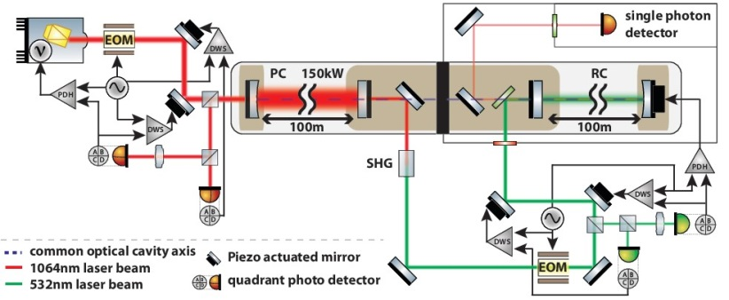
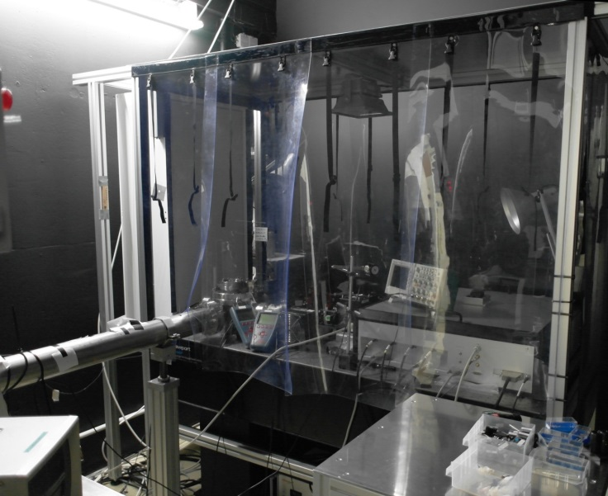
ALPS II @ DESY in Hamburg
Main components: optics
Laser:
developed for LIGO,
based on 2 W NPRO by Innolight/Mephisto
(Nd:YAG, neodymium-doped yttrium aluminium garnet),
1064 nm, 35 W, M²<1.1
Cavities
Production cavity, infrared
Wall
Regeneration cavity

Slide 28
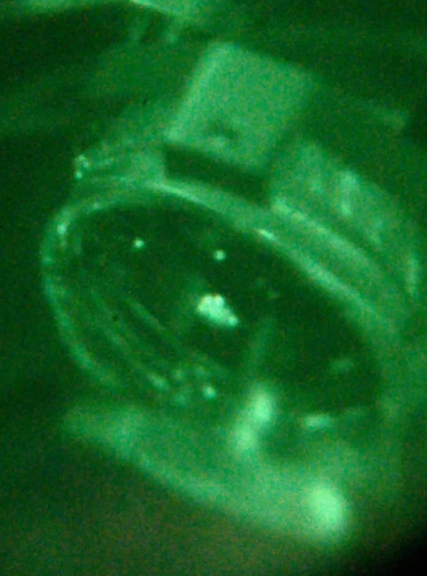
ALPS II @ DESY in Hamburg
Main components: optics achievements in the 20 m long prototype
Cavities in the 20 m ALPS IIa laboratory
 | Requirement | Status
PC circulating power | 150 kW | 50 kW
RC power buildup factor | 40,000 | 23,000
CBB mirror alignment | < 5 μrad | < 1 μrad
Spatial overlap | > 95% | work ongoing
RC length stabilization | < 0.5 pm | < 0.3 pm
Probably caused by micro-roughness of the mirror substrates.

Slide 29
MADMAX
Comparison to other experiments

Slide 30
LUXE
Alternative approaches
Comparison E144
Comparison FACET, ELI

