Slide 1
Advanced Interconnects
In-house Bump Bonding
Helmholtz Program: Matter and Technologies
PoF III Topic: Detector Technologies and Systems
DESY Research Unit: Detector Developments
Karsten Hansen
Center Evaluation DESY, 5 – 9 February 2018

Slide 2
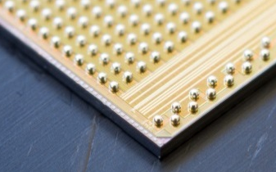
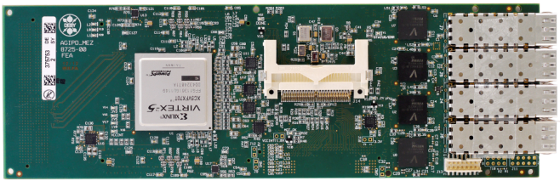
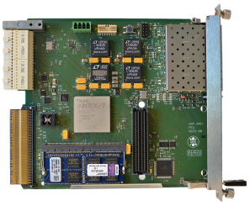
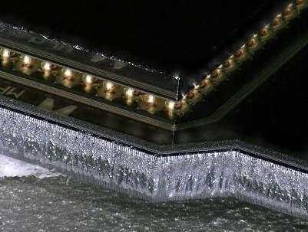
Introduction
Essential Parts of a Detector System
Sensor
Readout
Interface
Data Acquisition
ASIC
Hybrid
PCB with 10-GE Link
HGF-AMC
  Scope of this Talk
  1. DESY Bump Bonding Facility
2. Future Aspects
ASIC
higher Granularity
higher Integration Density
increased Bandwidth
Process Extension
Bump
Sensor
(see previous Talks)

Slide 3
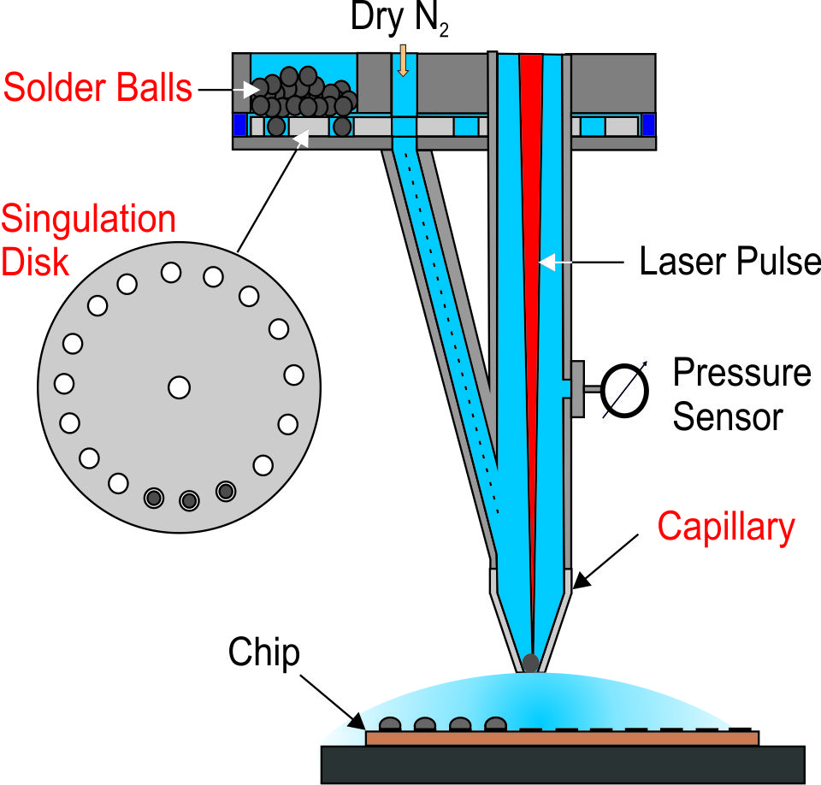
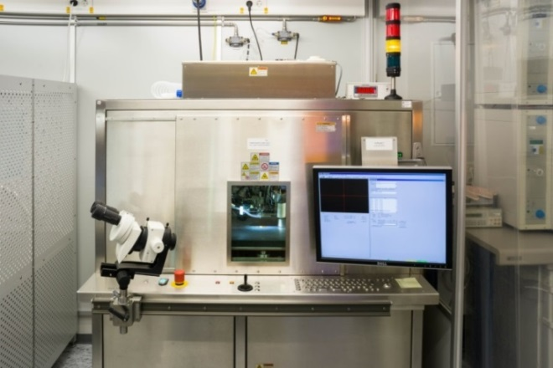
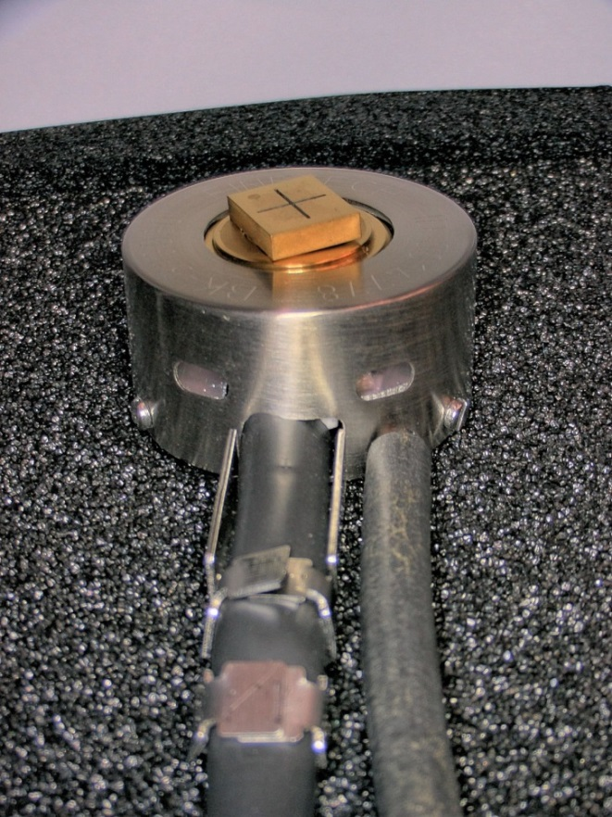
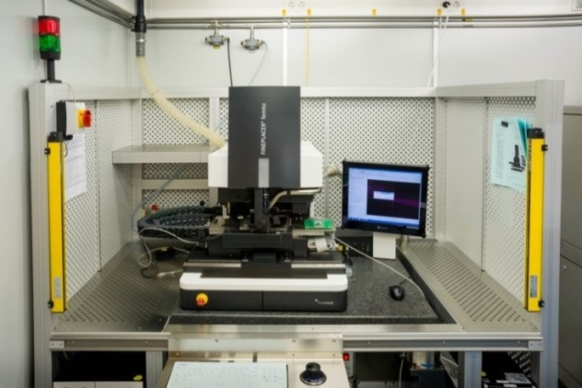
In-house Bump Bonding
DESY Process with two Machines
1. Solder-Ball Placement (SB²-Jet)
Solder Balls
Singulation Disk
Capillary
2. ASIC Placement (FEMTO)
  Formic-Acid Cleaning
  Ball Reflow
  Module Reflow
Special Pick & Place Tool
Chip-to-Chip
DESY has both Chip-Level Processes (Bumping & Bonding) In-House
small Number of additional Tools → Equipment is very flexible also for Prototyping

Slide 4
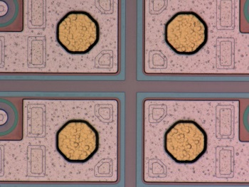
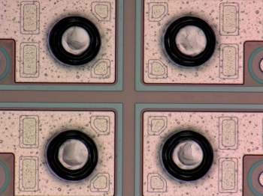
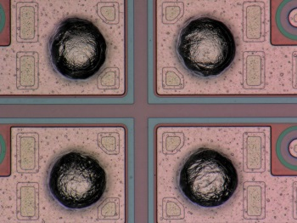
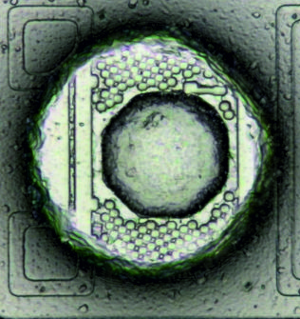
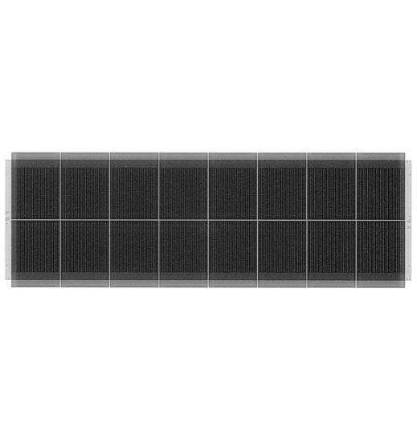
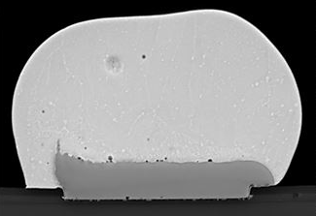
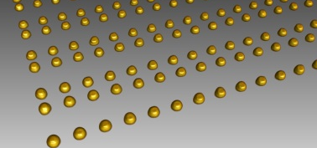
In-house Bump Bonding
Process Steps
external
Ball Placement
ASIC Placement
external X-Ray CT
1. Under-Bump Metaliz.
2. Bumping
3. Ball Reflow
4. Bonding
Bare Module
40 µm
Imprint
100 µm
5. Module Reflow
uniform Contact Array
Pd / Au Finish
Ni
Lead-free
40-µm Balls
1.2-µm Accuracy (1-σ)
≤ 4.5 Bumps per Second
18.9 mΩ per Bump
16 cN per Bump
We can run the full Assembly Chain from Ball Placement to the complete Module in a reliable Way.

Slide 5
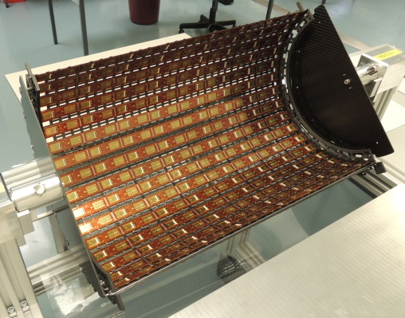
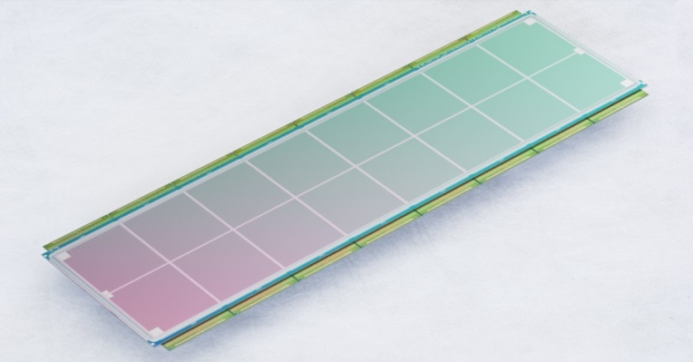
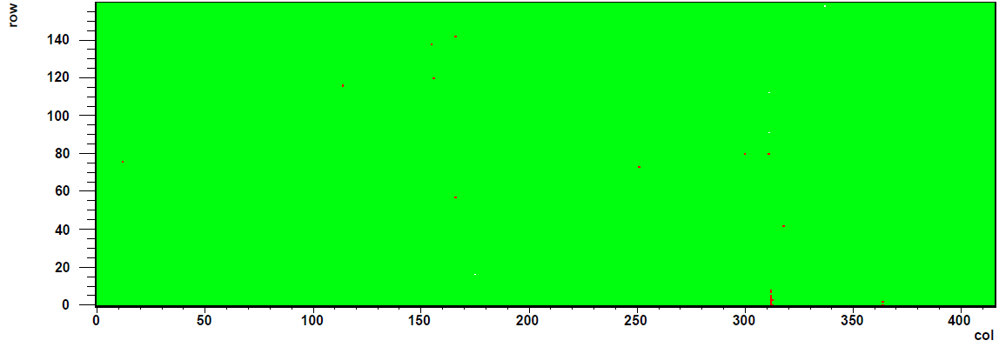
In-house Bump Bonding
CMS Pixel Detector Upgrade Phase I
½ Barrel Layer 4 (0.32 m²)
Bare Module with 66,592 Bumps
Connectivity Map of a Class-A Module
Sensor (6.7x1.9 cm²)
256 x
32 cm
16 ASICs
: missing Connection
Volume 418 Modules with 6,688 ASICs
Rate 6.7 Modules per Week
Connectivity Yield ≥ 99.96% best 256 Modules
Module Yield Loss
  missing Connections 1.2%
  high Sensor Leakage 3.3%
  ASIC Failures 1% after Repair
Five Production Sites:
DESY
Yield Span
84%
96%

Slide 6
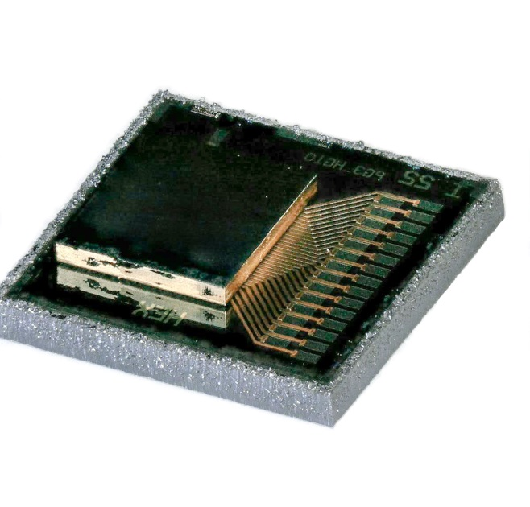
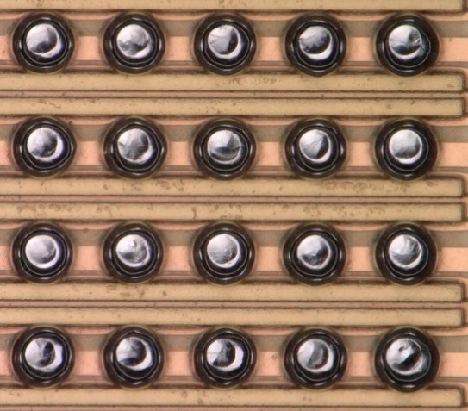
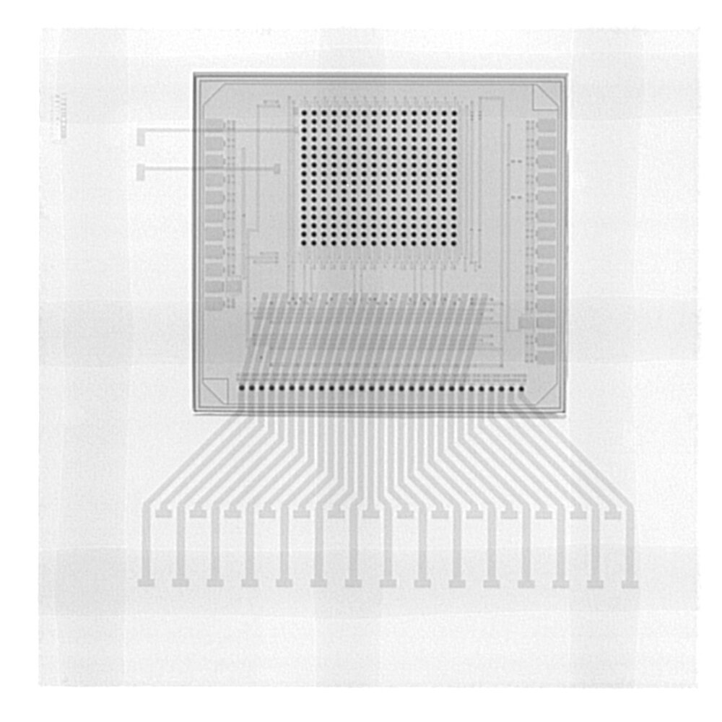
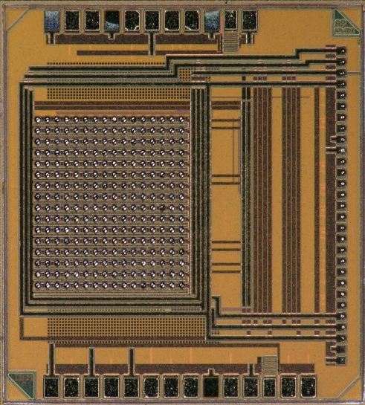
In-house Bump Bonding
Towards smaller Pitches and Copper Metallization for SiPMs
Feasibility of 30-µm Balls at 50-µm Pitch: common Activity with Industry & Semiconductor Lab of MPG
ASIC (16x16 Pixel)
Ball Placement
ASIC Placement
X-Ray
SiPM Sensor
Cu-RDL
ASIC
50 µm
The Process can also be applied for a higher Pixel Granularity.
50-µm Pitch is currently State-of-the-Art in our Community.
Quality is comparable to conventional Wafer-Level Processes.

Slide 7
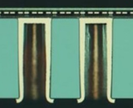
Future Aspects
Higher Pixel Granularity → more Functionality → higher Integration Density & Bandwidth
Density: Si Interposer
Bandwidth: Si-Photonics IC
Redistribution Layers
ASIC
Laser
ASIC
Fiber
Photonic Layer
Through Silicon Vias
active CMOS Layer
Waveguide
Modulator
Detector
Coupler
TSV Example
PIC Example
excellent Platform for multi-Chip Integration towards the 3rd Dimension
additional active Functions in Interposer & Photonics IC
DESY’s Bump Bonding Process is applicable
independent of specific IC Technologies
KIT’s & CERN’s Si Photonics Activities
IZM/DESY
Courtesy of KIT

Slide 8
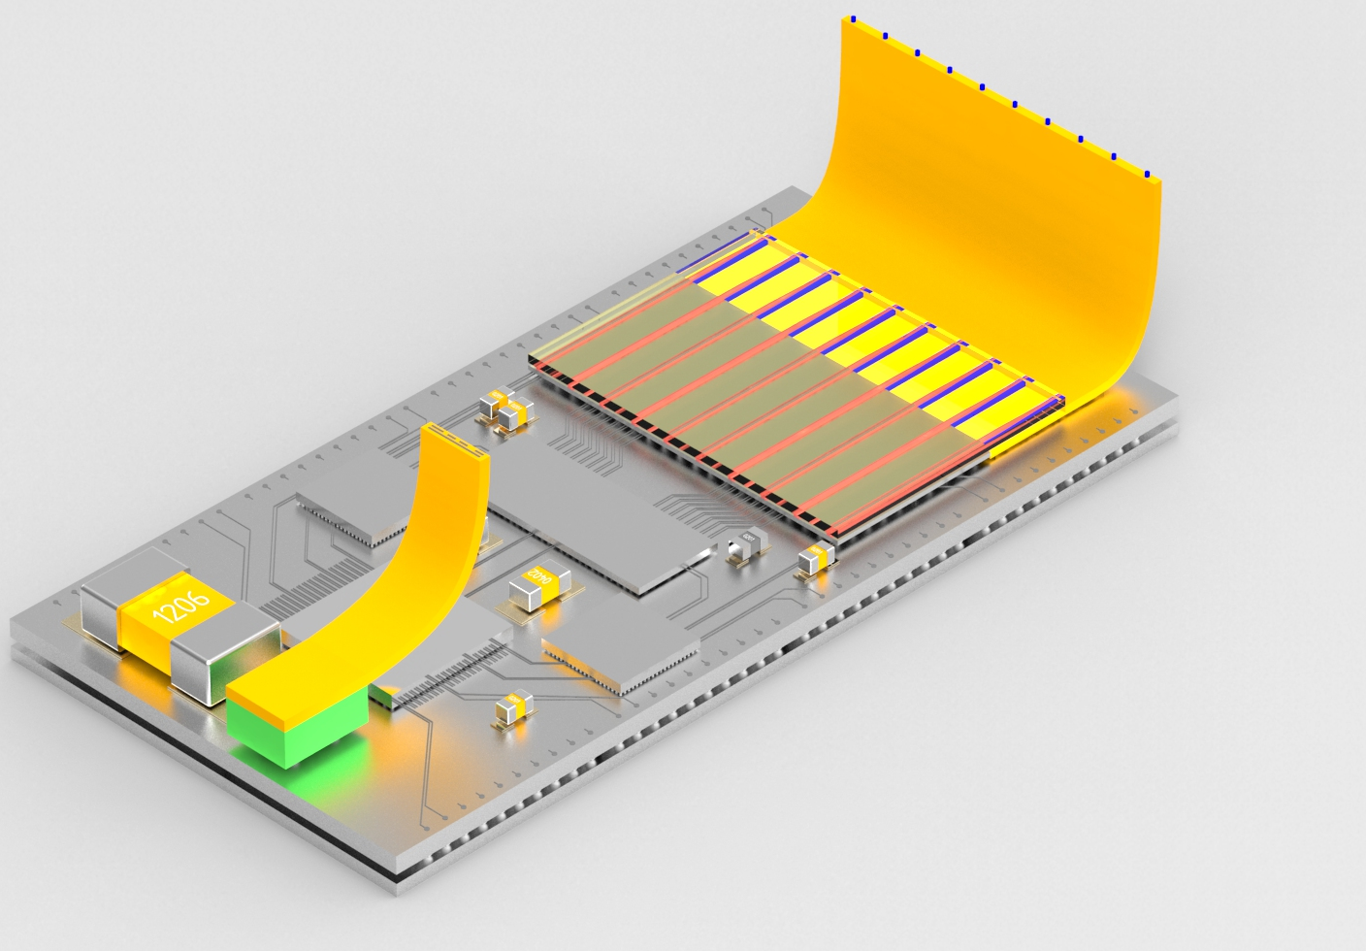
Summary & Outlook
We successfully applied the DESY Process for a Series Production with 100-µm Pitch
We demonstrated the Feasibility of 50-µm Pitch and Cu UBM
Our process can be applied for the Assembly of Interposers and Photonics ICs
optical Uplink
Interconnects
electrical
optical
Polymer Waveguide
Photonic IC
Compact Integration
ASICs
Sensor
Readout
Interface w/ optical I/Os
Interposer with TSV
Flex Cable
Sensor-ASIC Stack bump connected to Interposer

