Slide 1
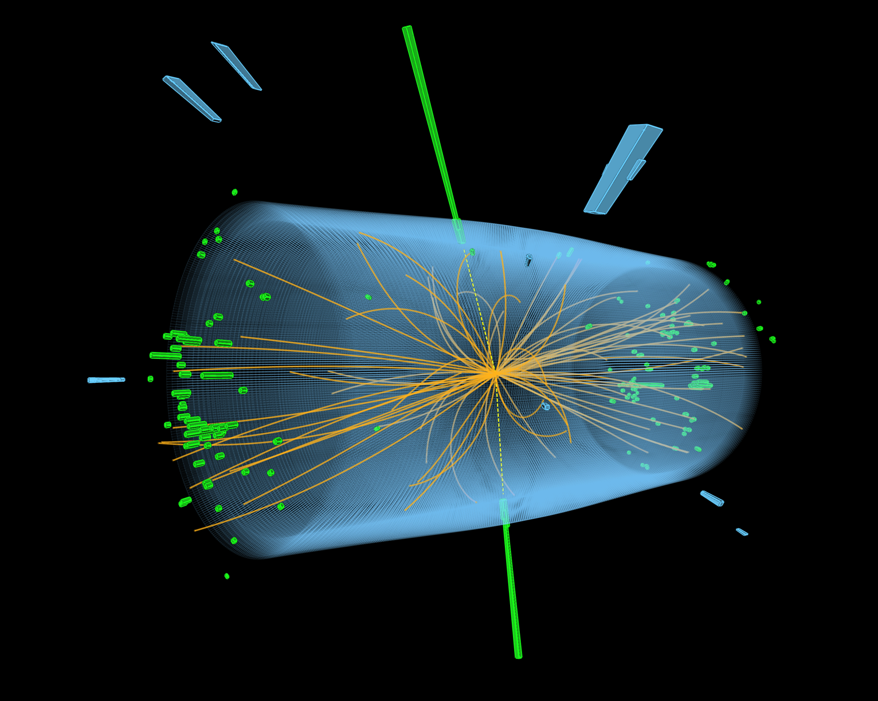
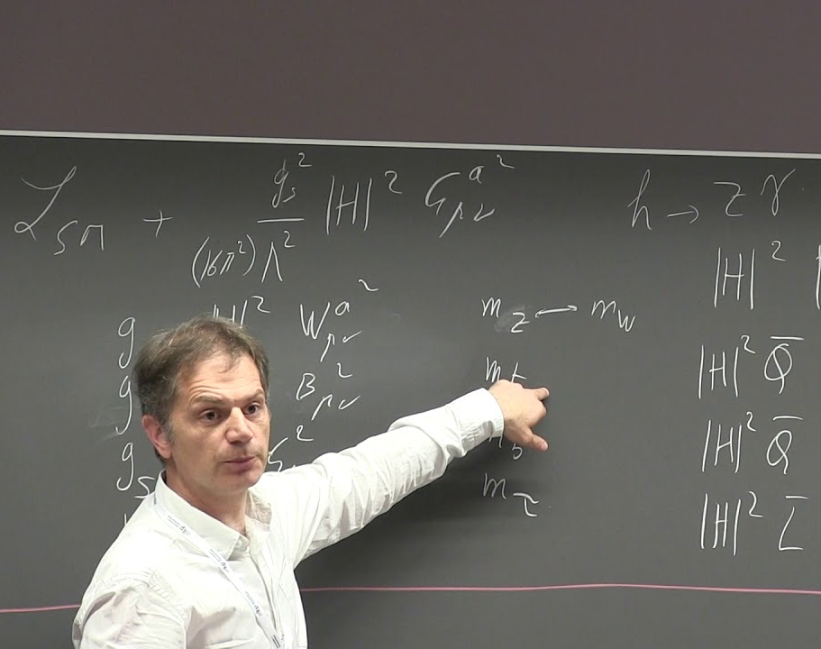
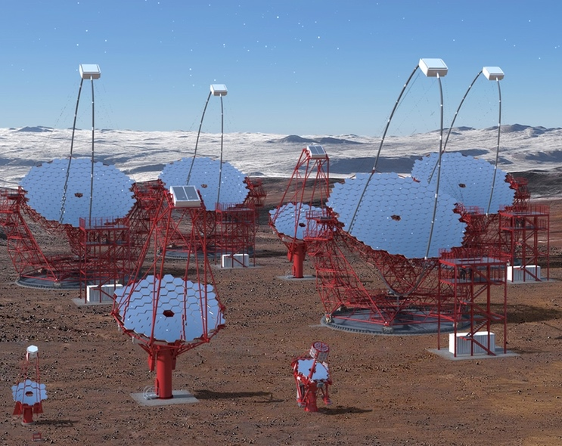
Parallel Session
Matter and the Universe
Elementary Particle and Astroparticle Physics at DESY
Helmholtz Program: Matter and the Universe (MU)
PoF III Topics: Fundamental Particles and Forces, Matter and Radiation from the Universe
DESY Research Units: Experimental Particle Physics, Theoretical Particle Physics, Astroparticle Physics
Joachim Mnich
Center Evaluation DESY, 5 – 9 February 2018

Slide 2
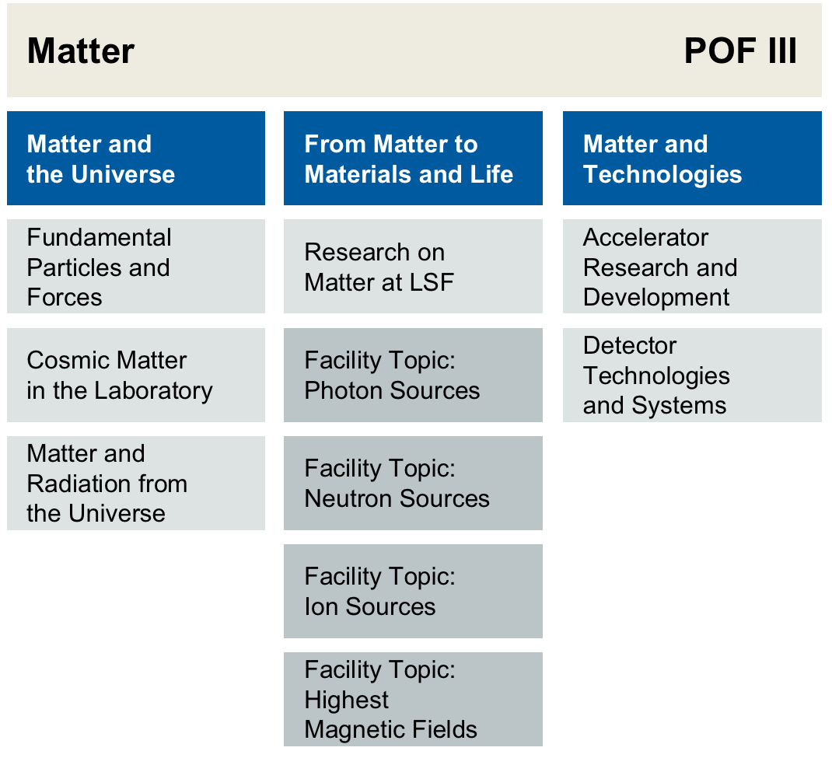
The Program Matter and the Universe
At the Helmholtz Center DESY
Research
Unit
Experimental Particle Physics
Theoretical Particle Physics
Astroparticle Physics
TIER-2 Center

Slide 3
Today’s Agenda
For the Matter and the Universe parallel session
Physics at the LHC: ATLAS and CMS (E. Gallo)
ATLAS and CMS: operations and upgrade (I. Gregor)
Belle and Belle II (C. Niebuhr)
ILC and future accelerator projects (F. Sefkow)
ALPS and other future on-site experiments (A. Lindner)
Collider phenomenology (C. Grojean)
Particle cosmology (G. Servant)
String theory and mathematical physics (V. Schomerus)
Lattice gauge theory (K. Jansen)
The LK2 facility TIER-2 center (V. Gülzow)
Gamma-ray astronomy (D. Berge)
Neutrino astronomy (A. Franckowiak)
Astroparticle physics theory (M. Pohl)
Outlook (J. Mnich)
EPP
TPP
TIER-2 Center
APP

