Slide 1
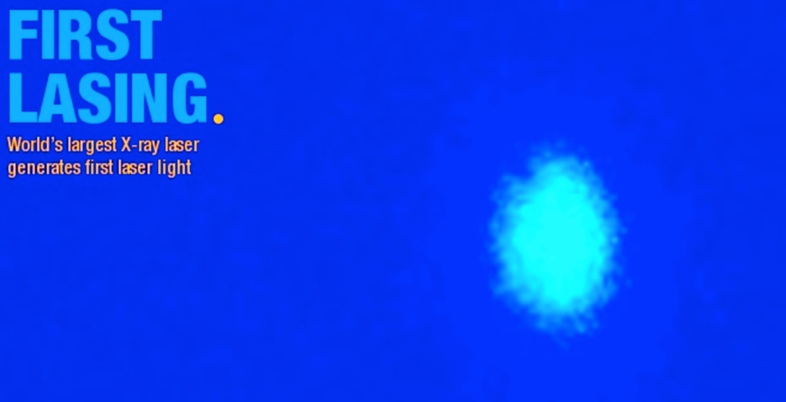

European XFEL –
Results from 1 year of commissioning and operation
Marie-Kristin Czwalinna, Winni Decking, Nina Golubeva, Raimund Kammering, Shan Liu
for the European XFEL commissioning team

Slide 2
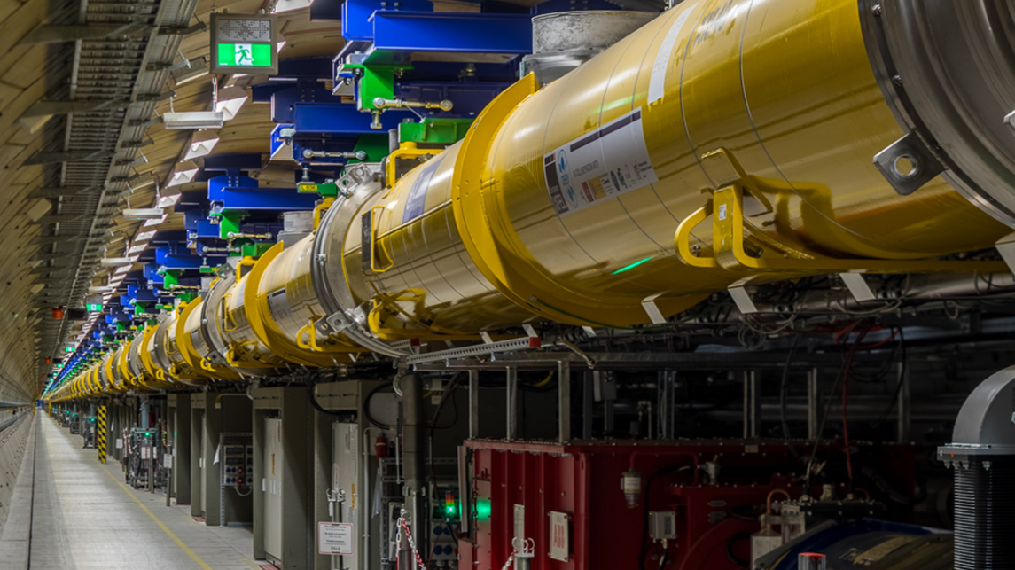
View along the linear accelerator

Slide 3
View along the linear accelerator
Magnets | 103 Dipoles, 495 Quads, 59 Multipoles, 403 Correctors, 103 Quad-Movers, 2 Solenoids
Modules | 101 x 1.3 GHz, 1 x 3.9 GHz, 27 RF Stations
Diagnostics | 457 BPMs, 64 Imaging Stations, 36 Toroids, 9 Dark Current Monitors, 7 Beam Arrival Monitors, 4 Beam Halo Monitors, 4 Bunch Compression Monitors, 4 Elector Optical Monitors, 3 Coherent Radiation Detectors, 3 Faraday Cups
Fast Devices | 34 Kicker Magnets, 3 Transverse Deflecting Structure
Undulator | 1 Laser Heater Undulator, 91 SASE Undulator Segments
Vacuum | About 4200 m of cold & warm beam vacuum, Collimators, Beam Stops, …
And many more …………………

Slide 4
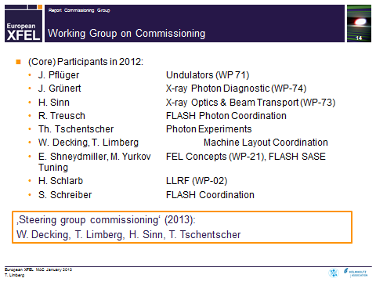
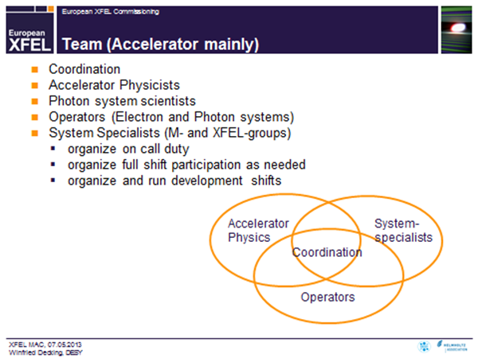
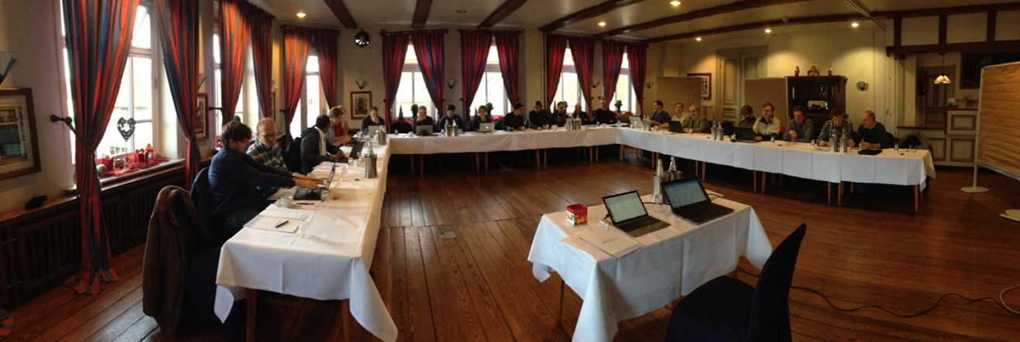
Form a team …

Slide 5
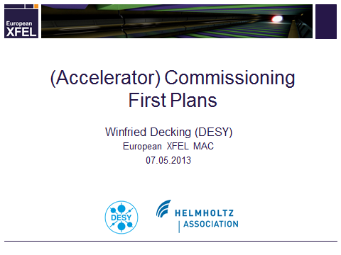
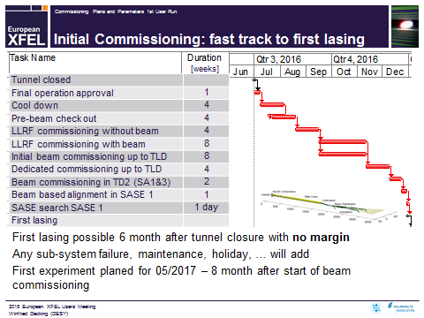
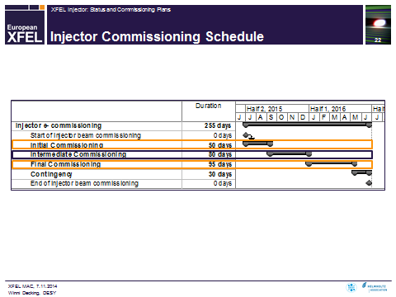
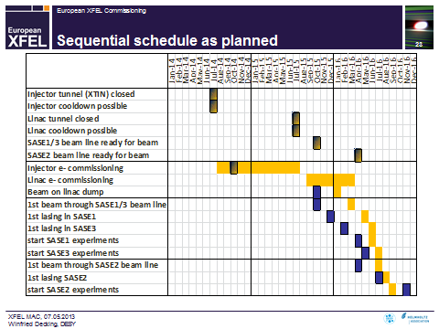
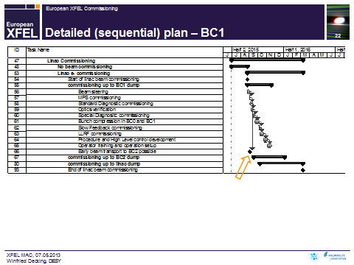
Make a plan …

Slide 6
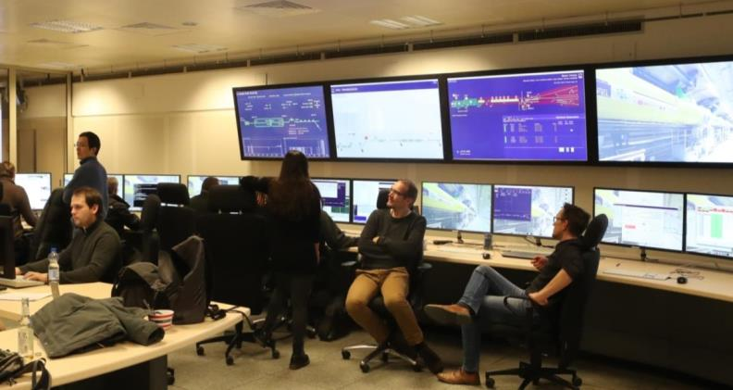
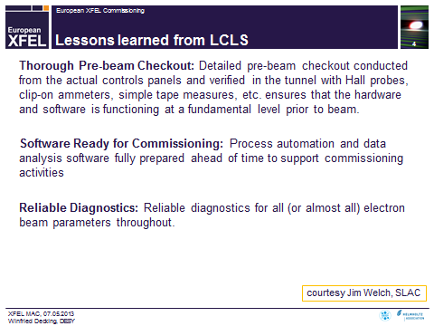



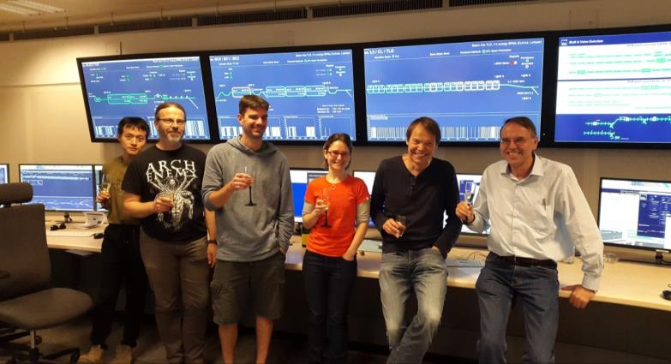

Get help …

Slide 7
Commissioning - Challenges
Was the assembly okay ?
  Cool-down
Does the injector perform ?
  Injector commissioning in parallel to accelerator installation
Can we transport the beam ?
  Beam optics and model -> Nina Golubeva
Do all the sc modules work ?
  RF commissioning
How does the beam look like ?
  Arrival time -> Marie Kristin Czwalinna
  Beam Halo -> Shan Liu
Does it lase?
  First lasing results
  User run
Can we operate it?
  Organization
  Operation and automatization -> Raimund Kammering
What‘s next?
  European XFEL R&D program

Slide 8
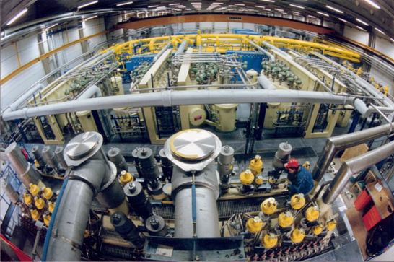
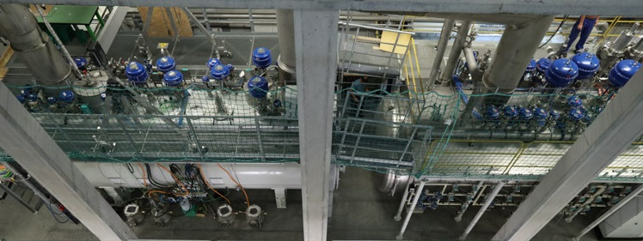
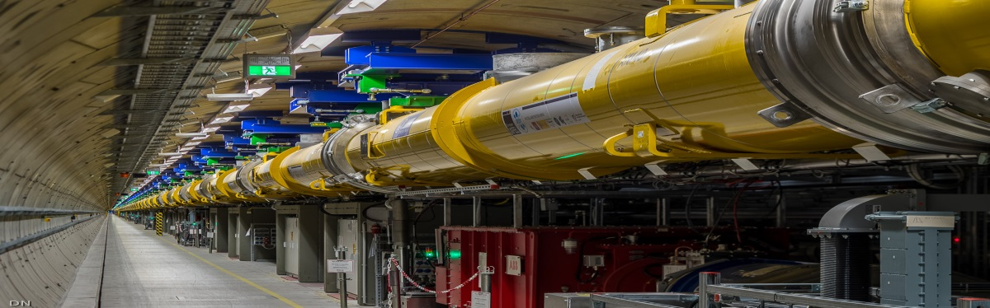
Cool-Down: the cryo-system
Cryo plant with cold compressors and extended distribution system
Cooling capacity:
  2K : >1.9 kW
  5/8K : 4 kW
  40/80K : 24 kW
Linac is one 1.5 km long cryo-string
Cryo Plant
Cold Compressors He Distribution
Linac

Slide 9
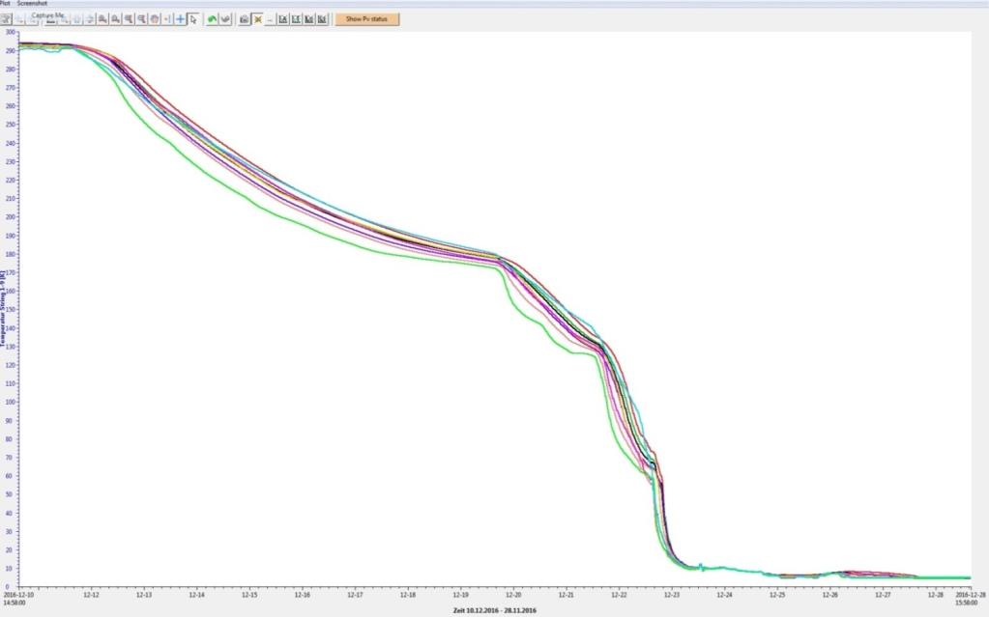

Cool-Down: the cool down
T [K]
300
Temperature at 9 positions along the linac versus time
Cooldown with one coldbox
Start asymmetrical operation of two cold boxes to speed up cooldown
200
No cold leaks !
Fast cooldown at temperatures below liquid nitrogen (no more thermal stress)
100
Recovery of cold return flows in cold boxes to enhance cryogenic capacity
Reached 4K
0
10.12.2016
27.12.2016

Slide 10
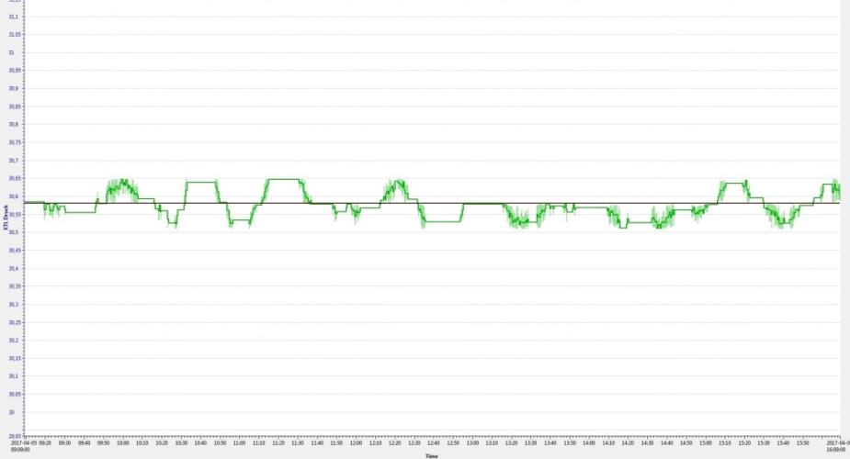
Cool-Down: cryo-system status after only 12 month of operation
2 K pressure stability < 0.3% reached (specification < 1%) after tedious adjustment of regulation loops
Stability can also be maintained during extreme dynamic load changes due to inner system heaters
  2K pressure
  [mbar]
  30.9
2K pressure
  30.6
± 1%
  30.3
Sudden shutdown of 18 RF stations
Linac pressure (2K)
7 hours

Slide 11
Injector
1.3 GHz module
≈ 150 MeV
3.9 GHz 3rd harm.
≈ 25 MeV
L1
4 modules
(1 RF station)
L2
12 modules
(3 RF stations)
L3
80 modules
(20 RF stations)
K_{SASE1/2} = 3.9 – 1.65
K_{SASE3} = 9 – 4
SASE2
300 kW
1 Module
A2
A3
A4
A5
A6
A25
A1
AH1
0.24 kW
5 kW
SASE1
9 kW
300 kW
SASE3
n.c.Gun
1.3 GHz
6 MeV
LH, Dogleg, BC0
130 MeV
BC1
600 MeV
BC2
2.4 GeV
Collimation
6 to 17.5 GeV
300 kW
0 m
40 m
240 m
470 m
1460 m
2130 m
2440 m
3100 m
3300 m
# of bunches/second | 27000 in ten 600 μs bursts/s
bunch charge | 0.02 – 1 nC
electron bunch length after compression | 2 – 180 fs (FWHM)
normalized slice emittance* | 0.4 - 1.0 mm mrad
beam power | 500 kW

Slide 12
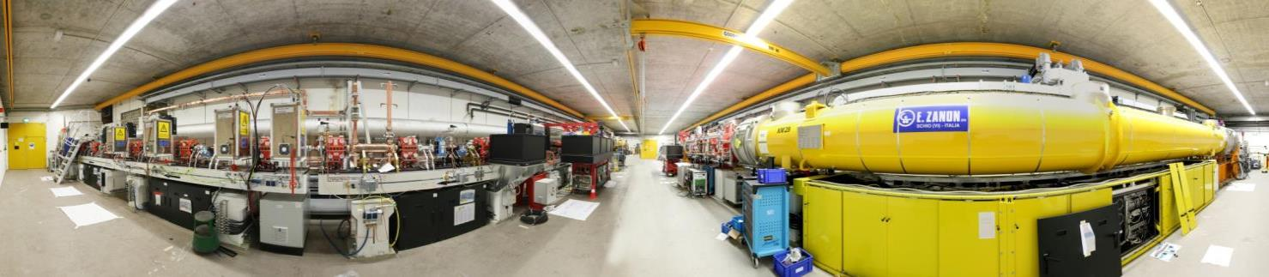
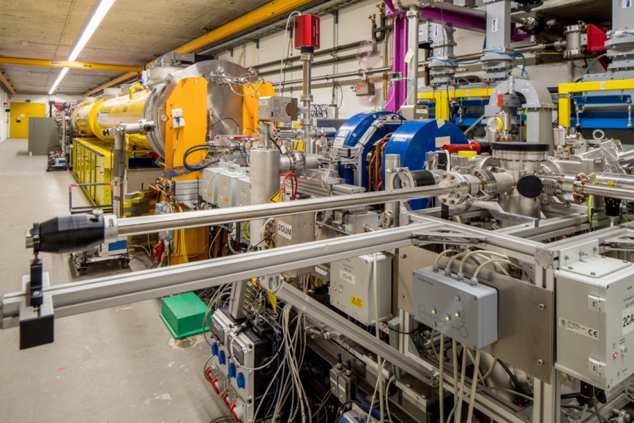
Injector commissioning
Dump Transverse Deflecting Structure
Spectrometer Diagnostic Section Laser Heater 3.9 GHz Module 1.3 GHz Module Gun
Photoinjector conditioned and characterized at PITZ, DESY-Zeuthen
Injector cool-down 12/2015, first beam on 18/12/2015 - commissioning till Q2/2016
Full bunch train length (27000 bunches/s) reached for 20pC-1000pC bunch charges
  Photocathode laser (Yb:YAG laser from Max-Born Institute Berlin 257 nm ≤ 4 μJ; 3 ps) with excellent up-time

Slide 13
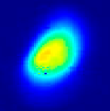
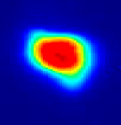
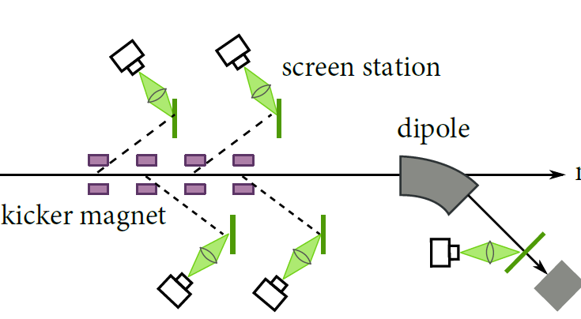
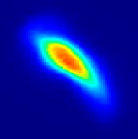
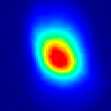
Injector Commissioning: projected emittance
Scheme of the XFEL injector diagnostic section
Emittance optimization mainly at 500 pC and reduced gun gradient (≈ 52 MV/m)
 | Design | Achieved
Normalized proj. emittance [mm mrad] | < 1.5 | 1.2
Normalized slice emittance [mm mrad] | 0.6 | 0.6
Fast kickers kick single bunches out of the trains to off-axis screens
“Semi-parasitic” diagnostics
Together with transverse deflecting system also used for slice diagnostics

Slide 14
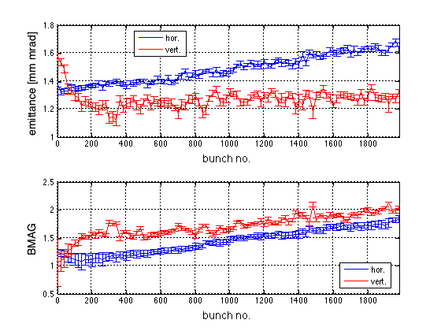
Injector Commissioning: projected emittance
Nina Golubeva, DESY
Scheme of the XFEL injector diagnostic section
Projected emittance along bunch train
Optics mismatch along bunch train
Up to a factor 2 with respect to design beta functions
Matched to design optics
Fast kickers kick single bunches out of the trains to off-axis screens
“Semi-parasitic” diagnostics
Together with transverse deflecting system also used for slice diagnostics
Variations along the train can be monitored
Corrections to provide uniform conditions along train

Slide 15
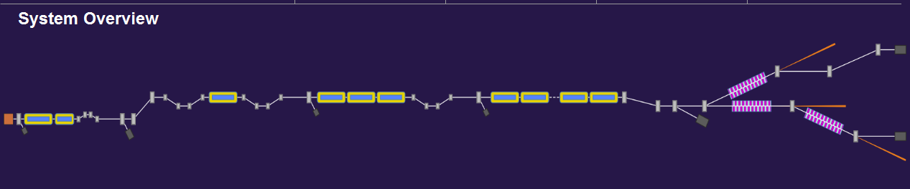
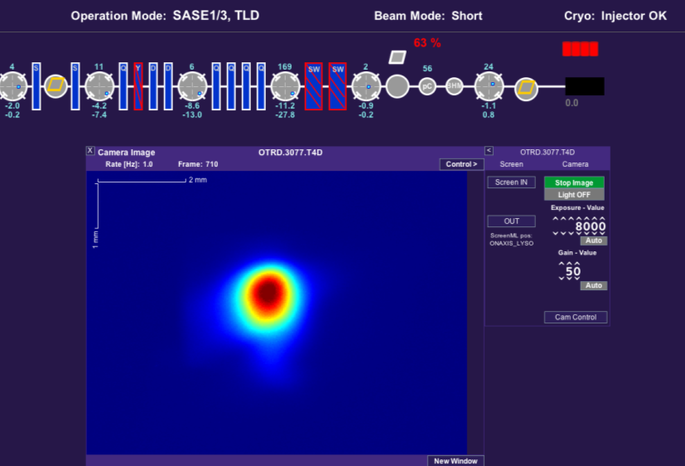
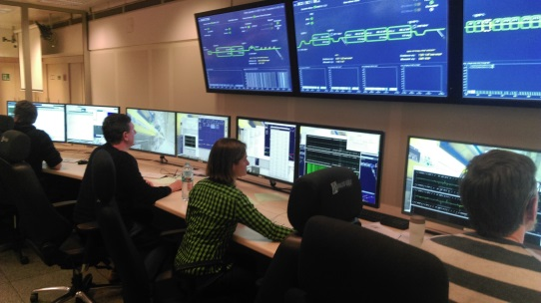
Beam Optics: beam transport till 5/17
L1
L2
L3
0m 30m 230m 480m 1430m 2100m 3100m
13/01*
15/01 @ 130 MeV
19/01 @ 600 MeV
* Beam permission on 13/01
02/02 @ 600 MeV
22/02 @ 2.5 GeV
27/04 Beam spot before dump
25/02 @ 2.5 GeV
19/03 @ 6 GeV
08/04 @ 12 GeV
27/04 First e⁻Beam *
* Beam permission on 26/04

Slide 16
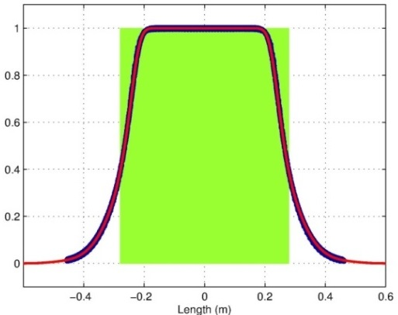
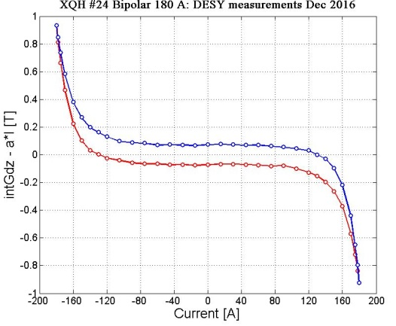
Beam Optics: model for magnets
Nina Golubeva, DESY
Large total number of magnets (around 1000), more than 30 types of magnets
From magnet measurement data → ? to magnet beam dynamical model
Approach: Create an accurate magnet model for beam optics
Requirements for magnetic measurements:
A. Longitudinal field profiles to get
− Traditional effective length for most of magnets
− And more precise model for quadrupole magnets
B. Excitation curves:
− Full magnetic loops (important for the magnet scaling
at changing the energy profile)
− According the cycling procedure used for each magnet
(bipolar, unipolar power supply, different maximal currents)
L_eff
Z [m]
Dipole XBB. Scaled measured data (blue dots),
interpolation function (red curve).
Various accurate magnetic measurements have been done
at Efremov Institute (Saint-Petersburg) and
Budker Institute of Nuclear Physics (Novosibirsk) in Russia,
and at DESY − in accordance with requirements
Quadrupole XQH.
Bipolar hysteresis loop.
Notes:
Before you start editing the slides of your talk change to the Master Slide view:
Menu button “View”, Master, Slide Master:
Edit the following 2 items in the 1st slide:
1) 1st row in the violet header:
Delete the existent text and write the title of your talk into this text field
2) The 2 rows in the footer area: Delete the text and write the information
regarding your talk (same as on the Title Slide) into this text field.
If you want to use more partner logos position them left
beside the DESY logo in the footer area
Close Master View

Slide 17
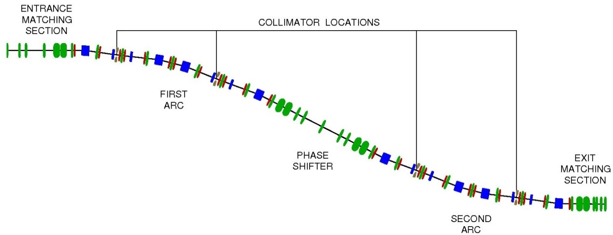
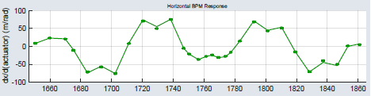

Beam Optics: beam measurements
Different types of magnet lattices (FODO transport, chicanes, doglegs, 2D deflection arcs)
Example: Collimation section
Two types of dipoles
Two quadrupole types
One type of sextupoles
− model
• measured
There is very good agreement between
the prediction of these magnet models
and measurements of beam optics ‼
Design optics can be used in operations
(the beam has to matched to the optics
in the beginning of the beamline)
Response matrix measurement. Response to horizontal corrector.
Notes:
Before you start editing the slides of your talk change to the Master Slide view:
Menu button “View”, Master, Slide Master:
Edit the following 2 items in the 1st slide:
1) 1st row in the violet header:
Delete the existent text and write the title of your talk into this text field
2) The 2 rows in the footer area: Delete the text and write the information
regarding your talk (same as on the Title Slide) into this text field.
If you want to use more partner logos position them left
beside the DESY logo in the footer area
Close Master View

Slide 18
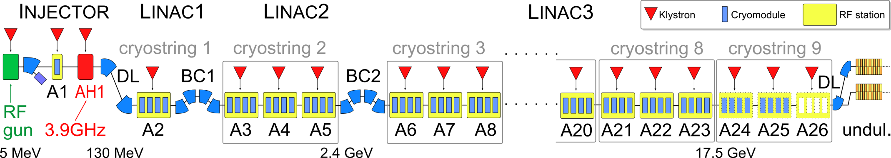
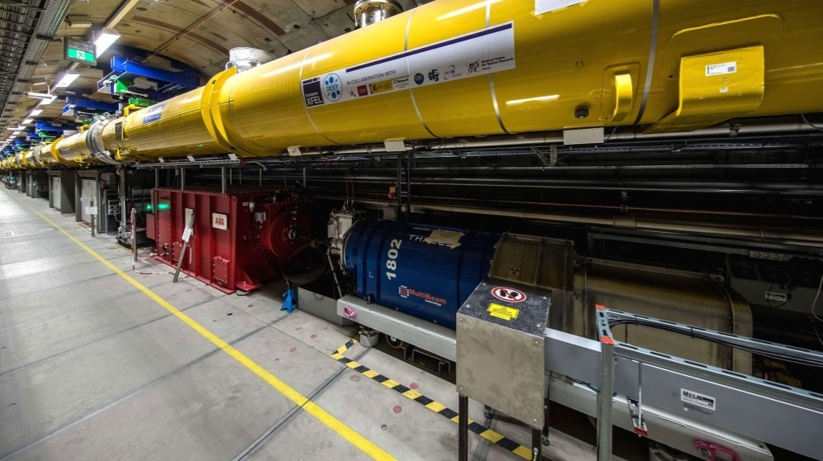
RF Commissioning: XFEL rf system
Cryo Plant
Cryo Plant
CM1 (8 cav.)
CM2 (8 cav.)
CM3 (8 cav.)
CM4 (8cav.)
KLYSTRON
HV Modulators in surface hall
Connected to pulse transformer via up to 2km long pulse cables
Klystron and modulator
below module

Slide 19
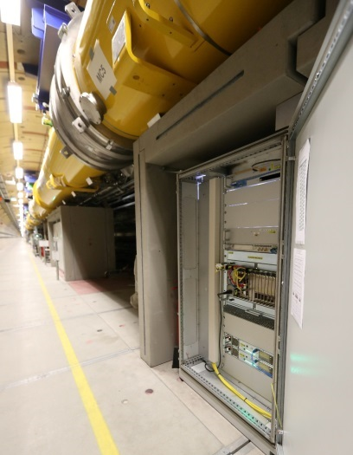
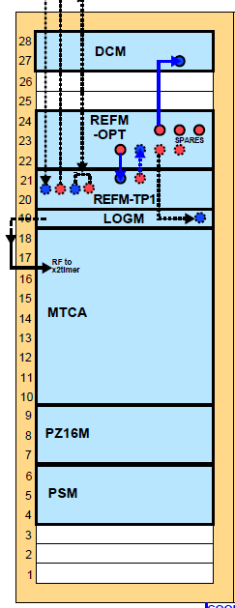
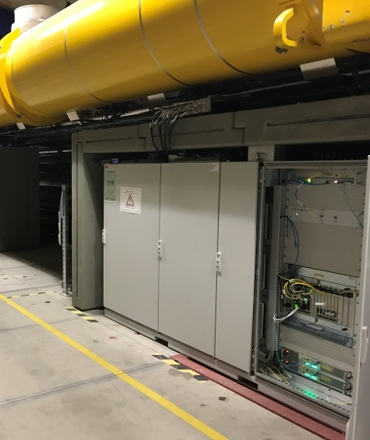
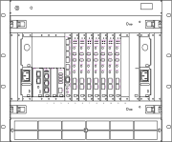
RF Commissioning: XFEL llrf system
CM1 (8 cav.)
CM2 (8 cav.)
CM3 (8 cav.)
CM4 (8cav.)
KLYSTRON
LLRF master
LLRF slave
Drift compensation
Reference synchr. + distr.
Clocks + local oscillator
Main controller crate (MicroTCA)
LLRF master
Piezo*
LLRF slave
Power supplies

Slide 20
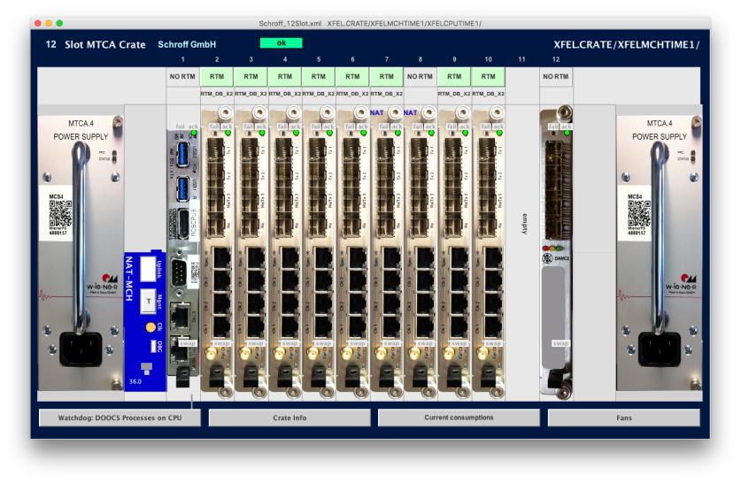
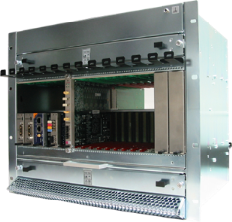
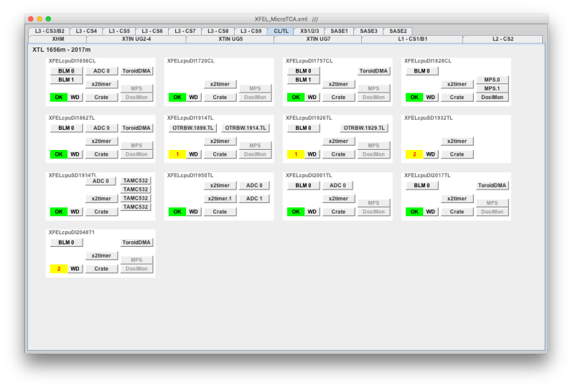
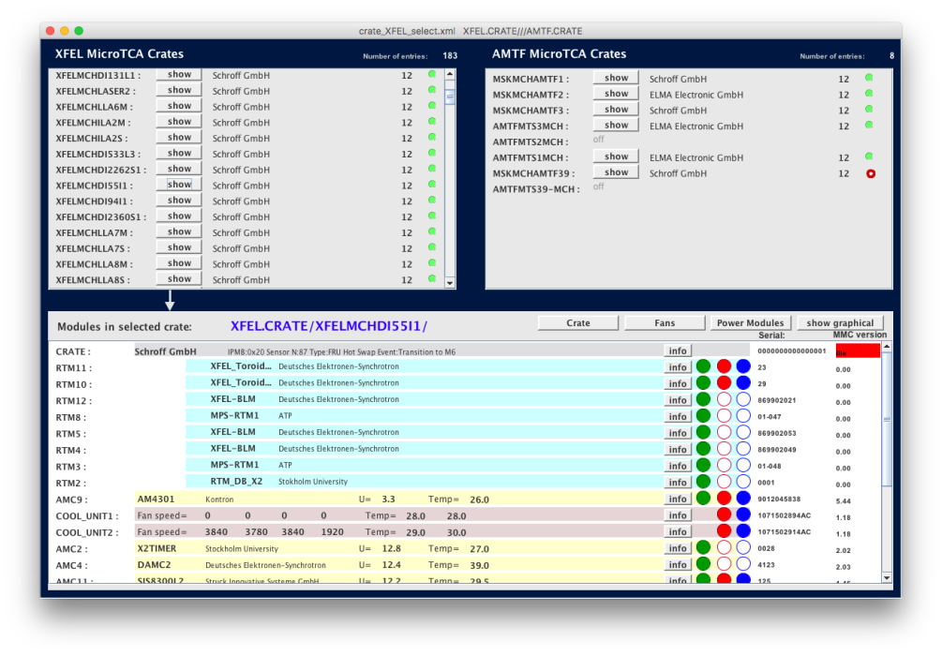
Reminder: MicroTCA.4 for accelerator controls
MicroTCA.4-based components used as standard hardware platform (LLRF, Diagnostics, Vacuum, HPRF, Magnets, Timing, ….)
About 200 systems installed, serving more than 7.000.000 control parameters
Operational from day 1 of deployment

Slide 21
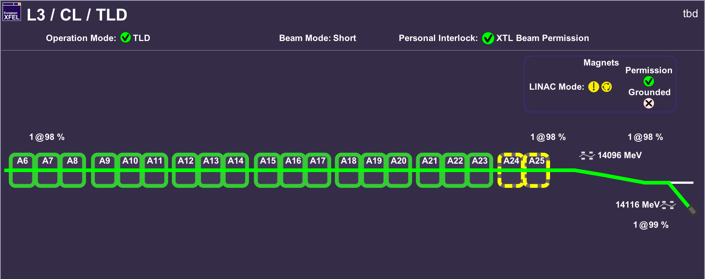
RF Commissiong: process and results
About 3.5 month total commissioning time with and without beam in parallel to beam commissioning
23 out of 25 RF stations initially commissioned
Operation automized; energy goal for 2017/2018 reached with 1-2 stations in reserve
Inner loop RF stability <0.01 deg, < 0.01% (exceed specs)
Preliminary measurements of beam energy jitter ≈ 10⁻⁴

Slide 22
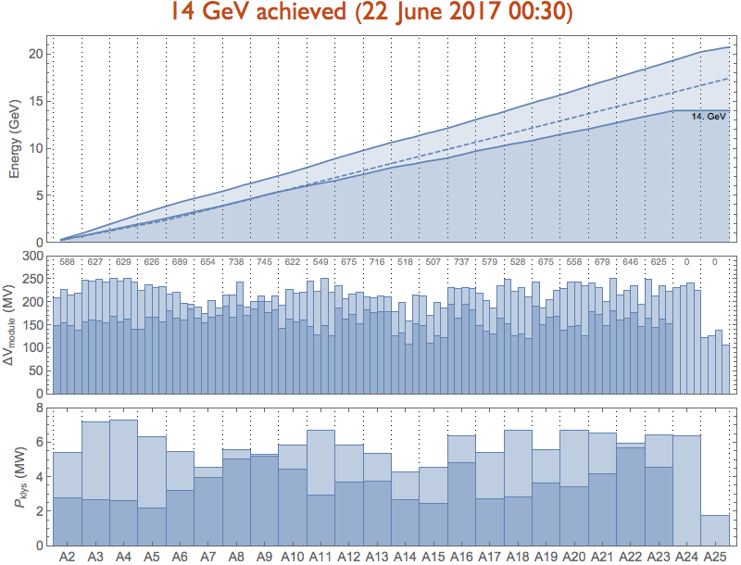
RF Commissioning: energy reach of European XFEL modules
maximum energy reach
  after tunnel installation and
  according to accelerator module test
the maximum energy during FEL operation needs to respect the bunch compressor (BC) working points
  2.4 GeV nominal BC2 energy
  leads to approx. 19.5 GeV
  higher BC2 energy (e.g. 3.3 GeV)
  allows for > 20 GeV
increased max. energy assures higher availability
17.5 GeV
14.9 GeV
24/10/17
23.6 MV/m
1
CS2
CS3
CS4
CS5
CS6
CS7
CS8
CS9
BC1
BC2
2.4 GeV 15.1 17.9 19.5

Slide 23
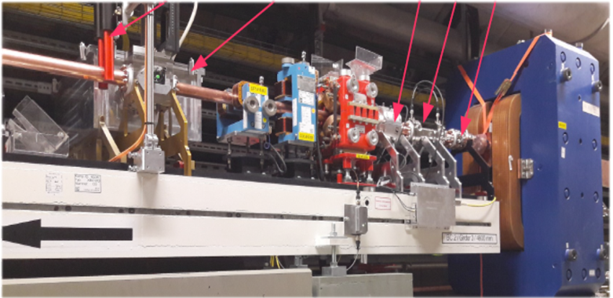
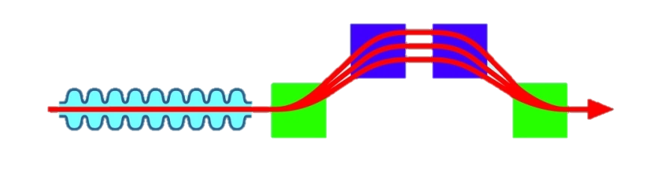
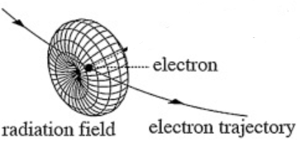
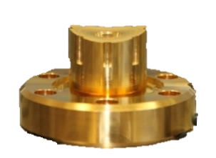

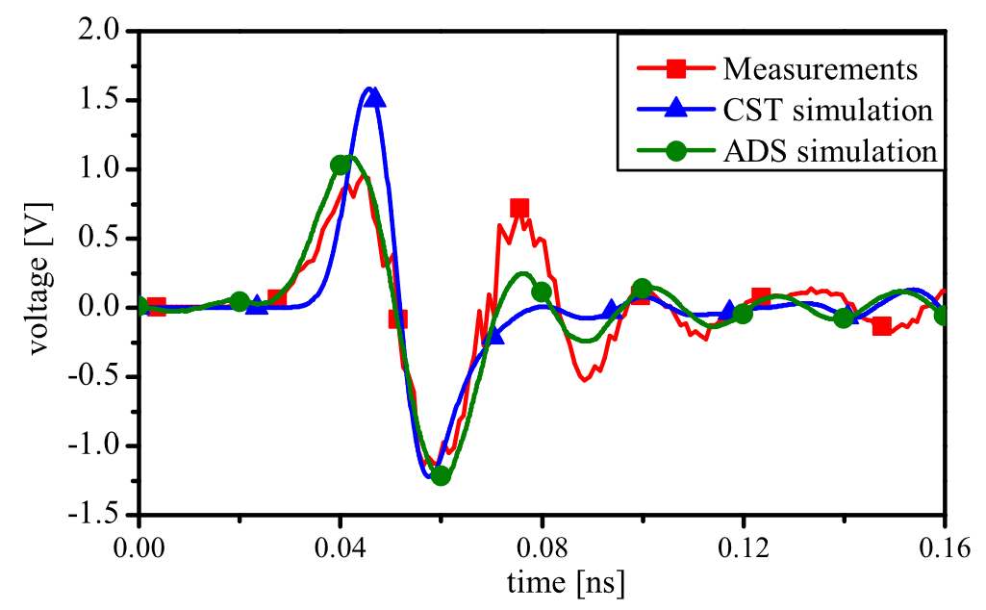

Beam Arrival Time: monitor system
European XFEL Commissioning and Operation
Marie Kristin Czwalinna, DESY
Toroid
BPM
BLM
BAM
BCM
Low Energy
Beam Arrival Monitor System – Principle of Operation
High Energy
Image:http://photon-science.desy.de/facilities/flash/the_free_electron_laser/how_it_works/bunch_compression/index_eng.html
Ultra-relativistic Electron Bunch
Measurement of the Electron Bunch Arrival Time.
(relative to an optical time reference)
Central RF component:
New 40GHz
Pickup design
Electro-Optical Method,
Optical Sampling of 40GHz RF Signal In Time Domain
Translates into
Successful collaboration
RF Phase
Changes
Laser Amplitude
Modulation
BAM RF Signal
Central optical component: Commercial, Telecom
Electro-Optical Modulator
( EOM)
10 - 15ps

Slide 24




Beam Arrival Time: measurements, conclusion & outlook
Marie Kristin Czwalinna, DESY
Arrival time jitter [fs]
Arrival Time Measurement
Resolution 10 fs,
General functionality is quite good,
but identified possible ways for optimisation:
Improvements on hardware side:
  shorter RF cables. different RF components (next Upgrade)
  Improved electronics (next Upgrade)
120 fs
100 fs
INJ
80 fs
60 fs
BC0
40 fs
BC1
20 fs
>3 days history of
first bunch timing jitter, usually 30fs (rms)
Outlook
Beam Energy Jitter
Fast Feedback
Arrival Time Jitter
Jitter can be further improved
by a (fast) beam-based feedback system
(long-term more sophisticated Upgrade)

Slide 25







Beam Halo: collimation principle
Shan Liu, DESY
180 m
MAIN COLLIMATOR LOCATIONS
L3
Phase space before collimator
± 50 σ_{x,x’}
after 2nd collimator
2.4 m
• w/o collimators
* with 2mm collimators
after 4th collimator
end of collimator section
• w/o collimators
* with 2mm collimators
• w/o collimators
* with 2mm collimators
± 20 σ_{x,x’}

Slide 26










Beam Halo: measurements
Shan Liu, DESY
WSD
BLM
before
WS. L3
1597
L3
BLM
1660
WS. TL
after
1899
WS. TL
1929
BLM
1982
halo
90° phase advance
±20σ_{x}
±20σ_{x}
±20σ_{x}

Slide 27



First Lasing Results
1st lasing at about 1.6 keV (02/05)
Undulator trajectory alignment (23/05)
1st lasing at about 6.2 keV (24/05)
Photon beam transport (26/05)
First photons in hutches (26/06)

Slide 28

First Lasing Results: undulator trajectory alignment is key
Beam Based Alignment Results
Needs excellent diagnostics
800 µm
30 µm

Slide 29



First Lasing Results: 1200 X-Ray pulses / second
Starting Point: Well tuned machine 30 bunches
RF and IBFB behaved well ☺
Stable Operation over hours ☺

Slide 30


User Run: facility performance
Recording of SASE level
1000 µJ
Missteering event
1 month shutdown & development
X-ray mirror replacement
Block 1 Block 2 Block 3 Block 4 Block 5 Block 6 Block 7
Seven 5 day user blocks starting 14/09
Availability (= SASE delivery above threshold) between 10% (Block 4) and 97% (Block 6&7)
Little tuning needed (because of limited flexibility offered), but frequent small wavelength changes and variation of bunch number (1-30)

Slide 31



Controls and Automation
Raimund Kammering, DESY
XFELs small brother: FLASH
All relevant hardware (e.g. uTCA, timing system) and software (DOOCS, TINE, …) already in operation
BUT: magnitude higher number of components!
Need for ‘data reduction’ is essential!
➔ Automation
x 20 at FLASH
x 200 at XFEL

Slide 32


Controls and Automation
Raimund Kammering, DESY
Data throughput tested on ’virtual’ XFEL
  can safely cope with XFEL producing data rates in the 1-2 GBs range
  now we are maintaining 9 billion system variables
Very high degree of automation from first hours on
  Fully automated recovery of RF stations, many feedback loops (transversal + longitudinal), automatic optimization procedures, …
Machine can be operated by single person with just at ‘few tools’

Slide 33

Accelerator Operation Organization: operation packages

Slide 34

Accelerator Operation Organization: DESY Machine division matrix

Slide 35
Accelerator R&D
From the accelerator operation agreement: “The Parties (European XFEL GmbH and DESY) give high priority to the scientific and technical evolution of the European XFEL facility. An R&D budget will be assigned as part of the annual budget. DESY will propose an R&D program based on this and conduct it after coordination with European XFEL GmbH.”
Accelerator R&D organized in 4 tiers
  IMP: Improvement of operational stability and efficiency
  CW: Continuous Wave (CW) operation of XFEL
  EXT: Extension of the facilities parameters and performance range
  OPEN: Open short term R&D

Slide 36
Improvement of operational stability and efficiency
Continuous R&D to improve operational stability and efficiency of the existing facility. The direction of these activities might alter during operation, emphasis will be given to the following fields
Improved diagnostic capabilities: Studies for implementation of an X-band deflector
Improved feedback systems: Development of faster and more accurate pick-ups and actuators for feedback systems
Subsystems stability and reliability: new concepts in addition to improvements that are part of maintenance and repair
Automatization: applying novel methods from computer and controls science

Slide 37
CW operation of the European XFEL
Several R&D topics to be pursued both by DESY and European XFEL with the goal for a credible proposal for an upgrade to the European XFEL. Common interest with DESYs ARD program, FLASH 2020.
Superconducting accelerator: cavity and module design, RF source, LLRF
Electron Source: reliable low emittance SC RF CW gun, Cathode & laser development, SC and NC source development and characterization
Accelerator Subsystems: beam diagnostics, DAQ and controls, MPS, beam switch yard, undulators
Overall Facility Layout: adopting the facilities parameter space to obtain an integrated design

Slide 38
Extension of the performance range
Electron source: smaller emittances, shorter pulses, variation of parameters within bunch train; high duty cycle cold gun with improved reliability.
Electron bunch manipulations: Manipulations of the electron bunches to influence the spectral bandwidth or temporal bandwidth
Novel diagnostics: New electron bunch parameters (charge, length, temporal stability …) require novel diagnostic schemes
Novel radiation source schemes: investigations of novel source schemes (FEL, tapering, seeding, oscillator); concepts for the empty tunnels T3 and T5

Slide 39


Summary: Accelerator Status
Accelerator has been commissioned according to schedule and towards expected parameters, about 6400 h of scheduled beam time, always being very close to the commissioning schedule
23 out of 25 RF stations commissioned
Maximum potential final energy obtained during dedicated LLRF studies 16.1 GeV, maximum beam energy 14.9 GeV, user operation with 14.0 GeV
Routine operation with 300 bunches/second in user mode, test operation in linac mode with 3000 bunches/second (≈ 18 kW beam power)
User operation with SASE1, 9.3 keV, up to 1 mJ

Slide 40
Plans for next year
SASE1: About 1600 h user operation
SASE2: First e-beam in March, first lasing in May
  Commission laser and photon systems parallel to user runs
  Installation of Self-Seeding Chicanes (December)
  SASE3: First lasing in February, Eventually user operation late autumn
    photon systems commissioning influences SASE1 operation
Accelerator:
  17.5 GeV by July (continue high gradient task force & CS9 installation and commissioning)
  3000 bunches/second lasing in SASE1 by mid of the year (Possible limitation: dose rate in undulators)
  27000 bunches in XTL by December

Slide 41
Outlook: 2018 E-beam Parameters
Quantity |  | Project Goal | Achieved | Routine | 2018 Goal
electron energy | GeV | 8,12.5,14,17.5 | 6-14.9 | 14 | 8/12.5/14/17.5 GeV
bunch charge | pC | 20 – 1000 | 100, 500 | 500 | 100, 500
electron bunch length after compression | fs (FWHM) | 2 – 180 | 20, 90 | 90 | 20, 90
slice emittance | mm mrad | 0.4 - 1.0 | <1.0 | <1.0 | <1.0
beam power | kW | 500 kW | 18 kW | 1.8 kW | 50 kW
undulators in operation (lasing) |  | SASE1-3 | SASE1 | SASE1 | SASE1-3
photon energy | keV | 0.25 - 25 | 1,6,9 | 9-9.5 | 6-15
photon pulses / s / undulator |  | 27000 | 60 | 30 | 300
saturation power (@ 14 GeV, 500 pC, 9 keV) | mJ | 1 | 1 | 0.4 | 1

