Slide 1

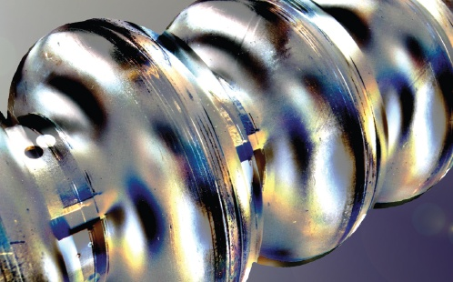
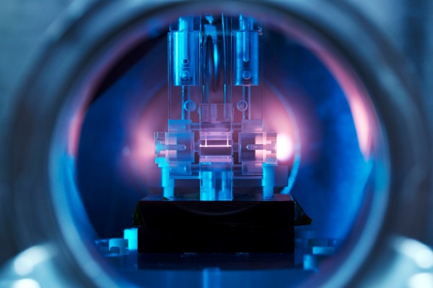
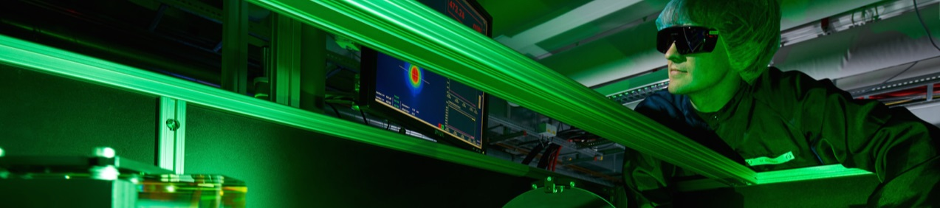
ARD
Infrastructures
Brains and Facilities
Helmholtz Program: Matter & Technology (MT)
PoF III Topic: Accelerator Research & Development (ARD)
Hans Weise
Center Evaluation DESY, 5 – 9 February 2018

Slide 2
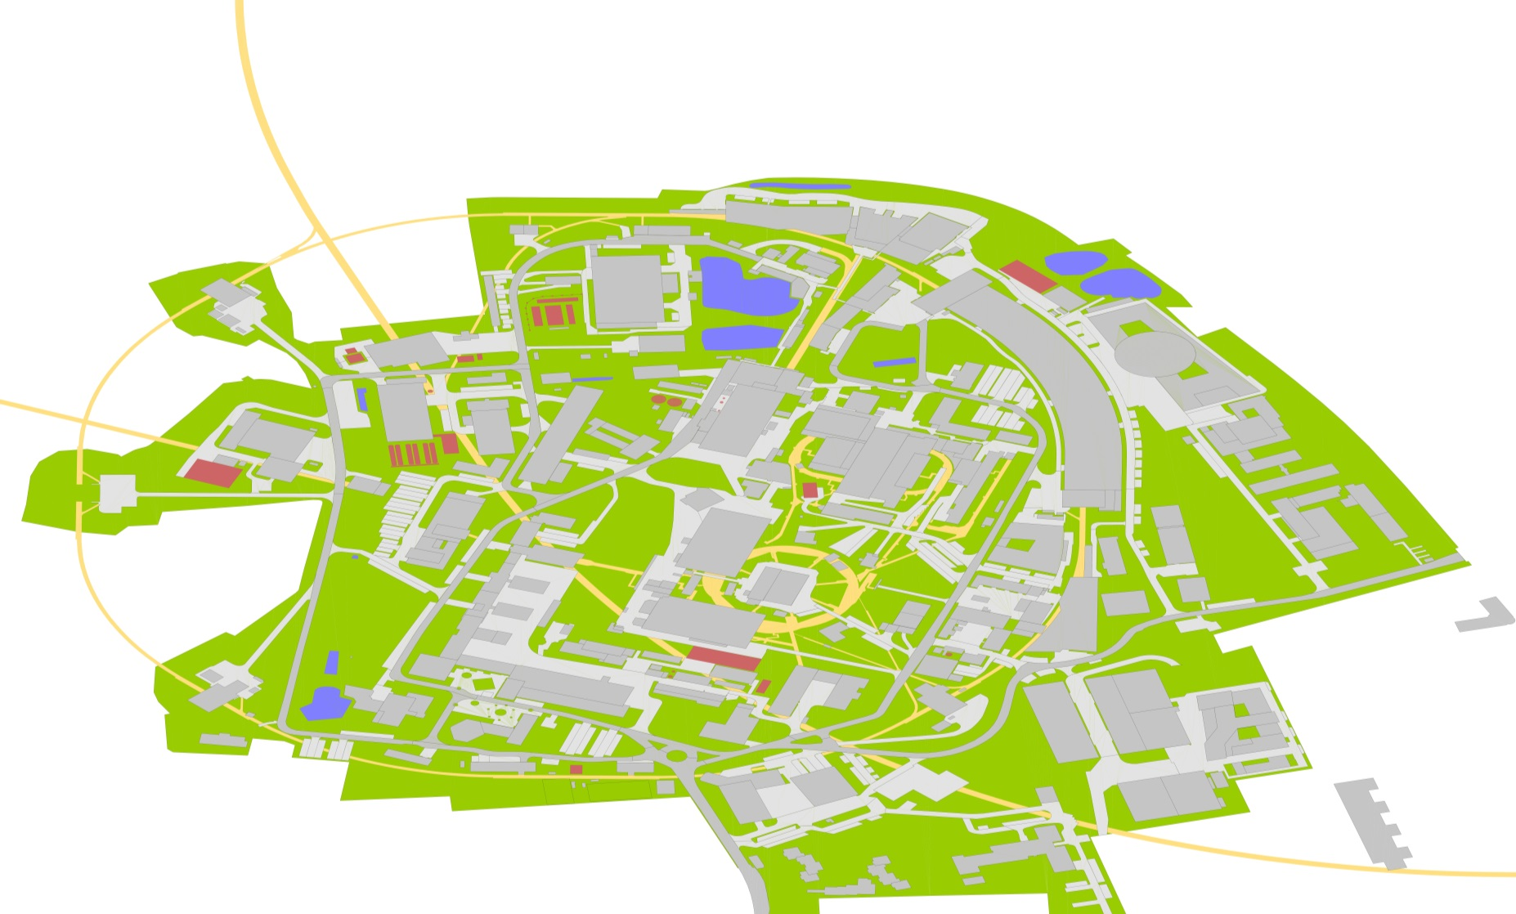
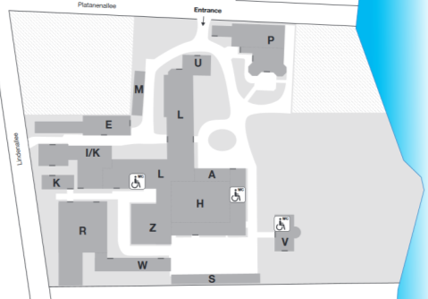
Accelerator Research at DESY
Ultra-short bunches & novel accelerators
ARD ST3 & ST4
  ps & fs electron/photon beams
  FEL seeding
  SINBAD: ARES & AXSIS
  beam and laser-driven plasma acceleration
  prototype compact FELs
R&D needs infrastructure
SRF Technology
ARD ST1
  niobium
  material analysis
  cavities / modules
  SRF gun
FLASH1 & 2
FLASHForward
SINBAD
AXSIS
LUX
REGAE
PITZ
DESY, Zeuthen

Slide 3
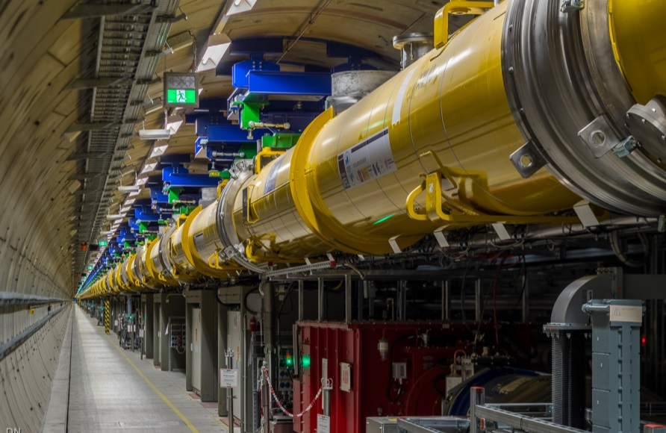
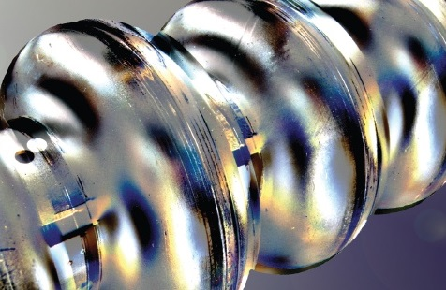
Superconducting Technology
ARD ST1 emphasizes SRF cavities operated continuous wave
European XFEL high energy linac section
Superconducting radiofrequency (SRF) accelerators are a figurehead of DESY‘s engagement in the design, construction and operation of accelerators for science.
The European XFEL is the longest SRF linac worldwide.
The fully successful technology transfer to industry reached a point where other worldwide projects (LCLS-II, ESS, new SRF based FELs at e.g. SINAP, China) are profiting greatly from DESY efforts.
The ARD ST1 goal is to keep both expertise and top-ranking position in SRF technology.
Continuous wave (cw) SRF is of special interest. The time structure of cw FEL photon pulses is adopted to the needs of photon beam users. Almost any macro pulse structure can be offered.
    Due to beam dynamic requirements the first sections of the European XFEL linac would need cw accelerator modules operated around 25 MV/m.
    cw cavities – installed in the low-energy sections - at sufficiently high gradient would offer highest flexibility. The European XFEL would operate in pulsed / long pulse / cw mode.

Slide 4
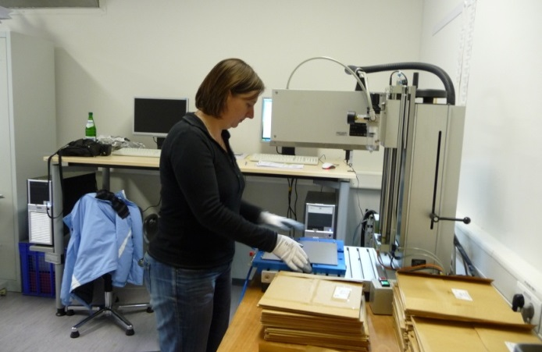
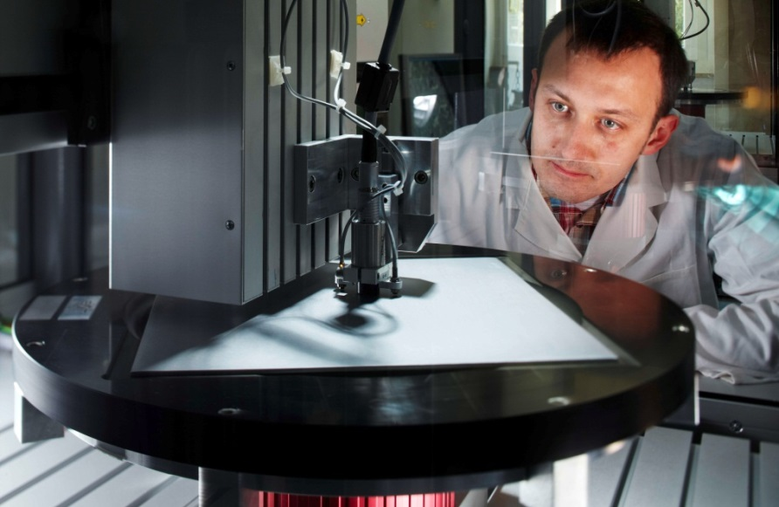
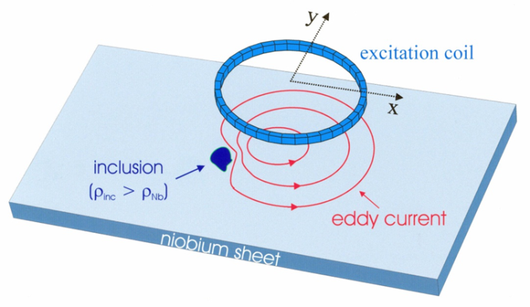
SRF Cavity Production
Niobium scanning and surface analysis
Detailed examination of niobium sheets is a sine qua non condition for large series production of superconducting cavities.
DESY operates a specially developed eddy current device to search for inclusions. For the European XFEL more than 16,000 sheets were scanned. Different vendors were qualified.
DESY’s ARD program aims for high performance and highest quality factor SRF cavities. Cavity production starts with the niobium specification.
Being active member in the worldwide SRF community DESY has taken over the scanning QC for the complete production of LCLS-II cavities. ESS cavity material is next.
The achieved visible sheet’s depth is approximately 500 µm, and the minimal detectable inclusion size is about 80 µm. The scanning result is used to decide on the RF active surface i.e. the later inner side of the accelerating structure.
Identified defects are studied in a well equipped metallurgy laboratory at DESY.

Slide 5
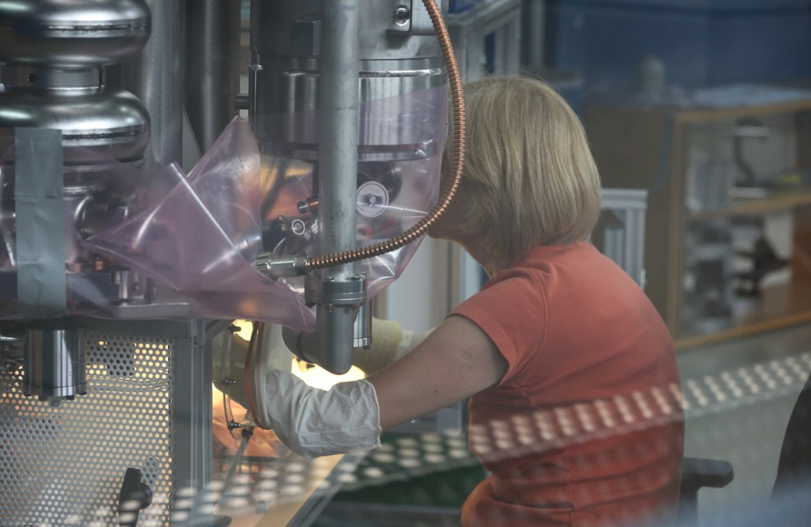
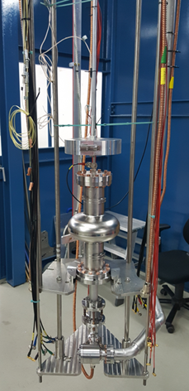
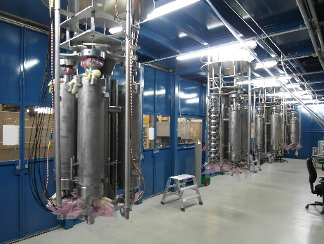
SRF Cavity Testing
RF testing after surface treatment
DESY operates several vertical test stands / dewars to characterize cavities. In total 6 inserts are used to take either up to 4 standard 1.3 GHz cavities, or other structures like SRF guns into the cryostat.
ARD ST1 profits strongly from the cavity test infrastructure. All DESY developed cavities were and are tested here.
For the European XFEL over 1200 cavity tests were carried out. Now DESY supports LCLS-II, ESS and others.
Meanwhile inserts
  are adaptive for different cavity types, and
  usually have an adjustable RF antenna.
  We measure Q(E) incl. pass-band and locate quenches using second-sound and temperature map.
  Sensors checking radiation caused by field emission and magnetic flux complete the picture.

Slide 6
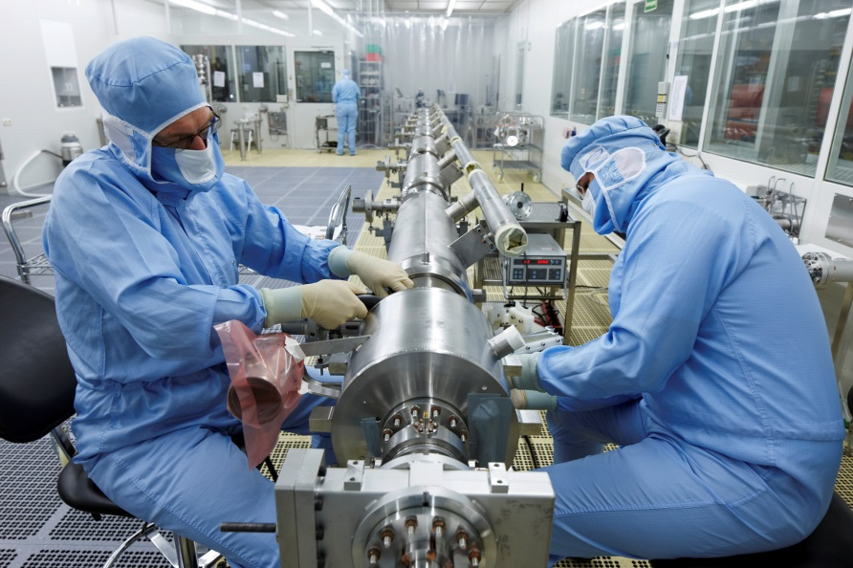
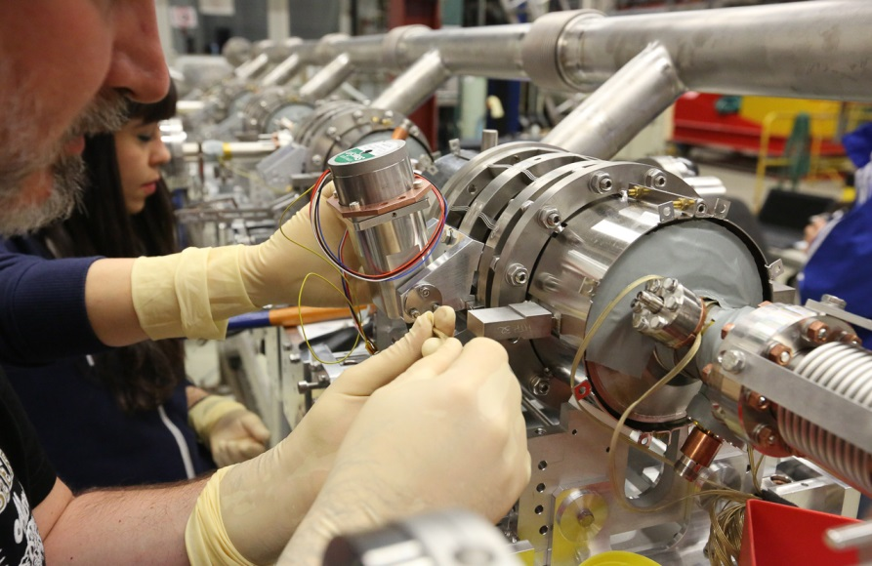
Accelerator Module Assembly
From the cavity string to the finished module
At DESY dedicated assembly infrastructure for the assembly / dis-assembly and repair of superconducting accelerator modules is available.
ARD related R&D like CW tests of improved standard XFEL modules is only possible due to this infrastructure and the related expertise of many colleagues.
DESY has developed the respective infrastructure and uses it for standard European XFEL or FLASH modules. Other infrastructures worldwide e.g. at CE Saclay but also Fermilab and KEK mimic the DESY facilities.
While the string of accelerating cavities is assembled in ISO4 clean rooms, the further assembly of the closed vacuum system to the so-called cold mass which is the inner structure of the cryostat is done in dedicated assembly areas.
The outside clean room assembly work includes installation of frequency tuners, magnetic shields and others.
Skilled teams are responsible for all work.

Slide 7
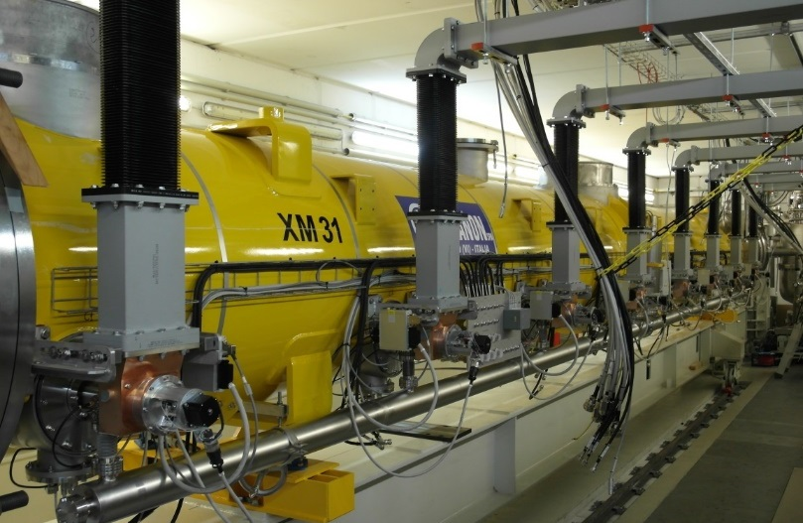
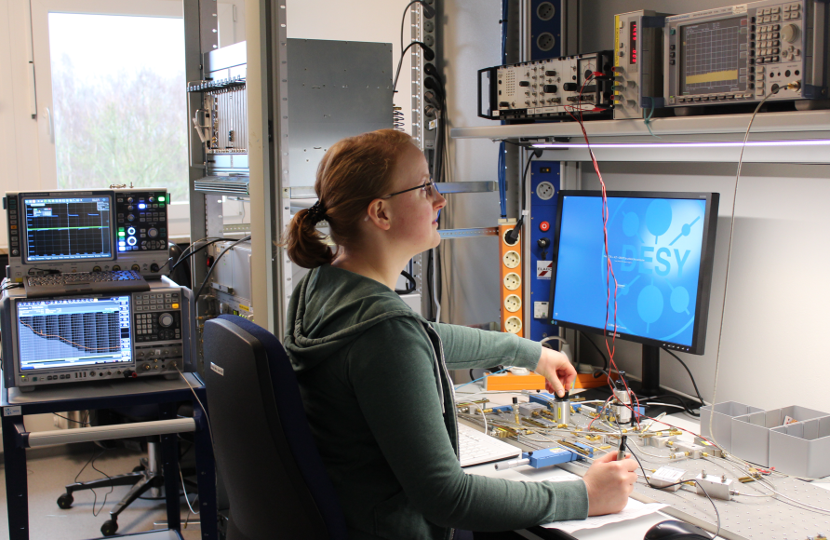
Accelerator Module Testing
Module R&D includes extensive testing
Several horizontal test stands are available for the characterization of completely assembled superconducting accelerator modules. Three test stands were used for the European XFEL series testing.
The ARD ST1 program uses all test stands plus one additional test stand for more sophisticated studies including long pulse or even continuous wave operation.
Precise amplitude and phase control culminates in atto-second LLRF R&D.
CW asks for RF power coupler development (tuning range and copper thickness).
  Established test procedures start with the initial incoming inspection of the modules.
  Vacuum and cryogenic system of the test stand which is installed in a shielding enclosure are attached.
  Waveguides connect to the radio frequency supply.

Slide 8
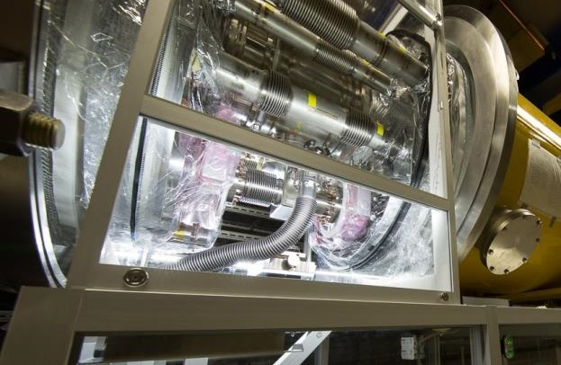
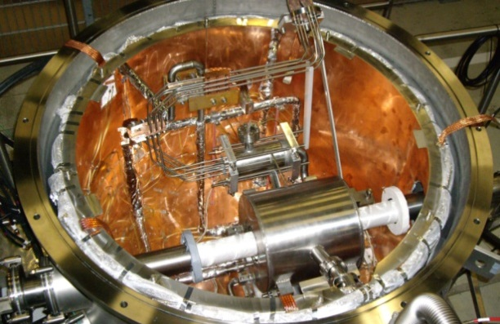
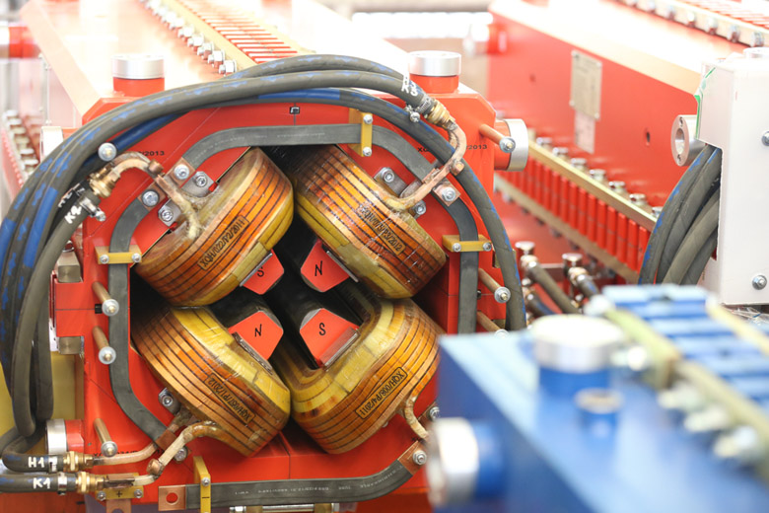
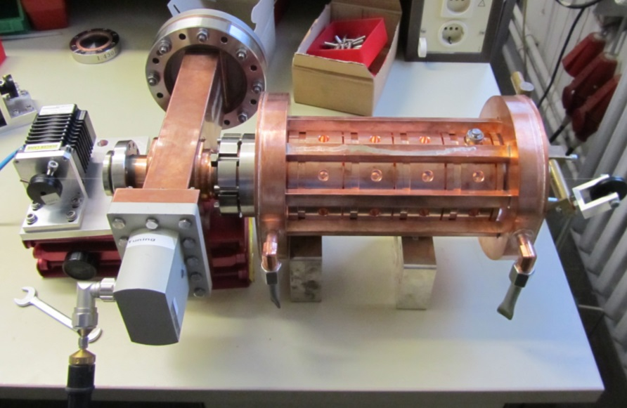
General DESY Infrastructure & Expertise
Highly developed infrastructure enables high-tech
Particle-clean vacuum is indispensable for the success of SRF technology.
All DESY vacuum systems benefit.
  Superconducting magnets are measured in dedicated test stands.
  XFEL series of 103 magnets.
Normal-conducting magnets are specified and measured at DESY.
Fabrication usually at partner labs.
  RF laboratories can handle sophisticated power systems
  RF guns, bunchers, transverse deflecting systems.

Slide 9
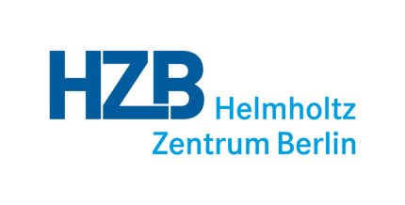
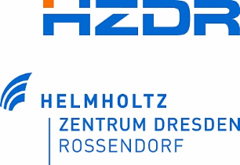

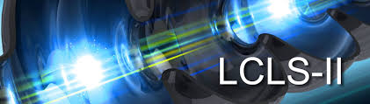

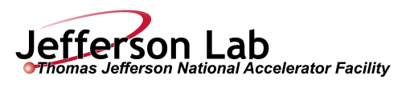







Sustainable Infrastructure
Collaborative use of ARD ST1 related infrastructure
Highly developed infrastructure is operated by skilled teams to the benefit of
  ARD (DESY and partner laboratories e.g. HZDR, HZB, HIM Mainz)
  European XFEL and DESY‘s FLASH facility
  Major research facilities worldwide (LCLS-II, ESS, new FELs)
Access to DESY infrastructure guarantees
  Sharing of expertise
  Participation in new and recent developments
  Sustainability by keeping a highly motivated team
  support many SRF community members
  DESY as brand name
  discretionary budget due to service contracts

Slide 10
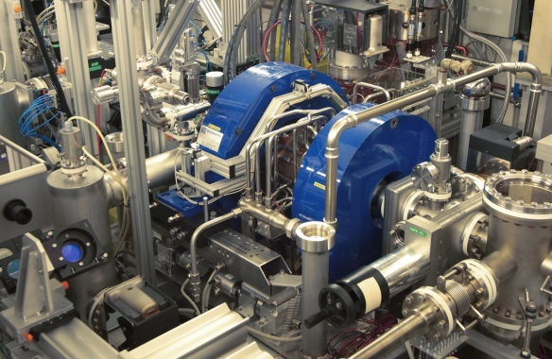
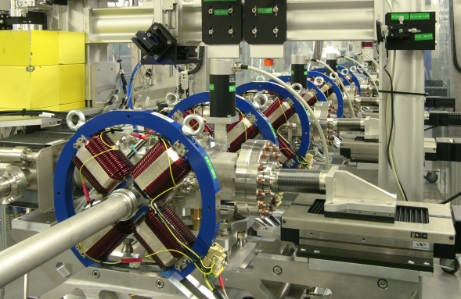
The Photo Injector Test Facility in Zeuthen (PITZ)
More than 15 years of experience in photo injector R&D with advanced diagnostics
PITZ is a test facility for RF guns, lasers, RF and diagnostic components
All RF guns for FLASH & XFEL were conditioned and characterized at PITZ.
  dedicated diagnostics for in-depth electron beam characterization and optimization for a wide bunch charge range
  new developments, e.g. most advanced photo cathode laser systems,
  plasma acceleration, THz, micro-bunch shaping with dielectric structures, …
ARD activities aim for
ultimate beams for short wavelength FELs + applications, e.g.
  beam quality (3D gun laser shaping)
  stability and reliability (gun system design)
basic studies on beam-driven plasma acceleration for particle and astro-particle physics, e.g.
  self-modulation of long particle beams, high transformer ratios, laboratory astrophysics

Slide 11
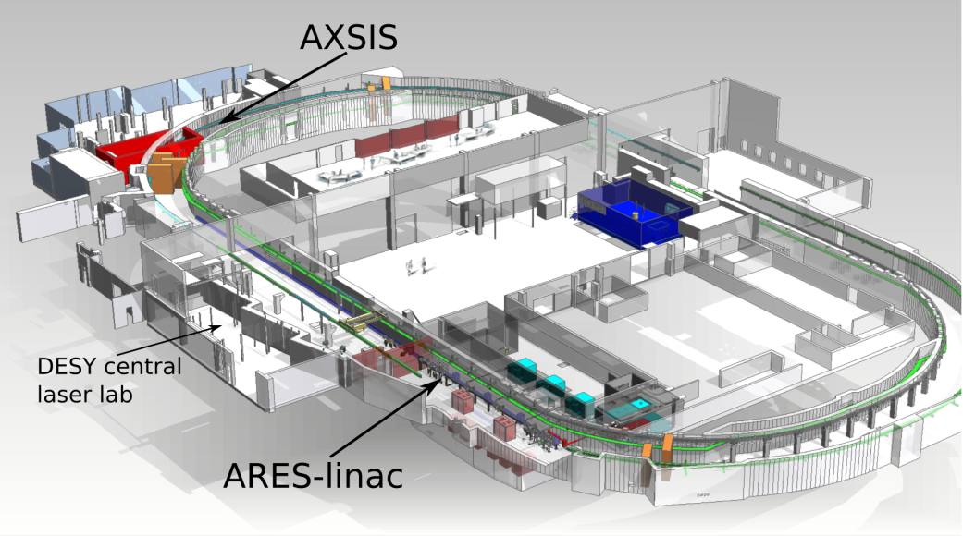



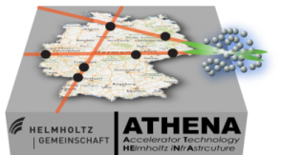
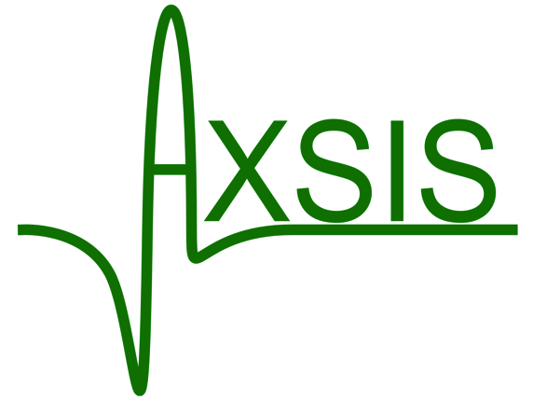

SINBAD (Short INnovative Bunches and Accelerators at DESY)
The upcoming, long-term dedicated accelerator R&D facility at DESY
Dedicated accelerator R&D infrastructure currently under construction (reusing the old DORIS tunnel)
Main science cases:
  ultra-fast science (fs to as-regime electron pulses)
  various laser-driven approaches aiming for high gradient acceleration with external or internal electron beam injection
100 MeV ARES linac for ultra short bunches (fs)
  Study high brightness from RF photo injectors and ultra-short bunch production
  Inject into various laser-driven approaches e.g. DLA
  Start beam commissioning in spring 2019
  Upgrade with high power laser for LWFA in planning via ATHENA
Attosecond X-ray Science: Imaging and Spectroscopy (AXSIS)
  ERC-funded collaboration on acceleration in dielectric loaded waveguides using THz lasers

Slide 12
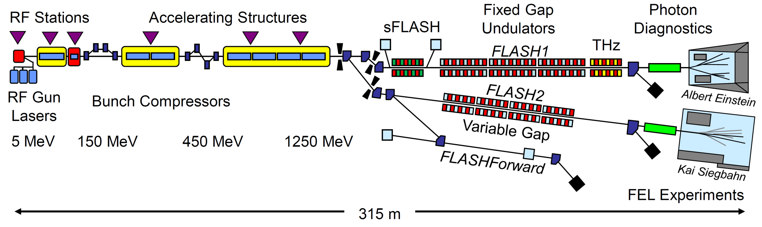
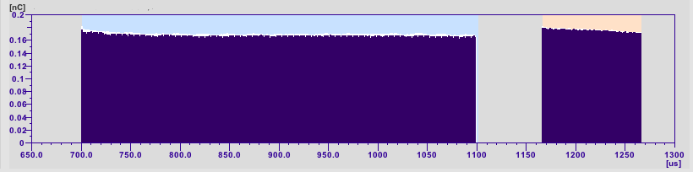
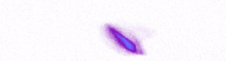
FLASH
User facility with dedicated accelerator R&D and FEL study blocks
A common accelerator part and three electron beamlines
  FLASH1 & FLASH2: undulator beamlines with subsequent photon beamlines
  FLASHForward a pioneering research plasma-wakefield acceleration experiment
FLASH1
FLASH2
The total available beam time is distributed:
  photon user experiments (60%), parallel operation of FLASH1 and FLASH2
  FLASH studies (30%) - machine and photon beamline development - this includes user preparation, but also improvement of diagnostics, optimization of FEL performance like single-spike operation, test of lasing schemes like frequency doubler and harmonic lasing self-seeding
  general accelerator R&D (10%) - this includes seeding development, plasma-wakefield acceleration research
Multi beamline operation
first beam in FLASHForward - August 31, 2017

Slide 13
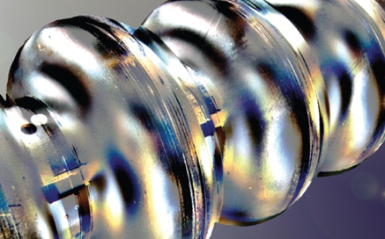
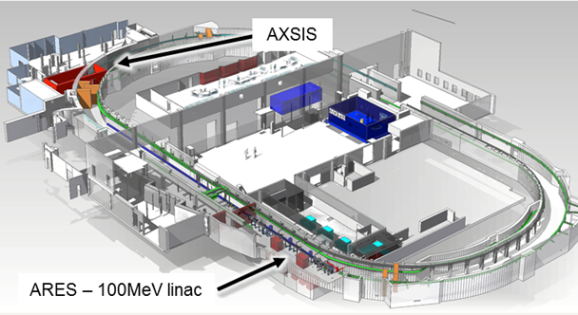
Summary
Brains and facilities
At DESY, accelerator design, construction and operation has a long tradition.
Consolidated knowledge is the basis for new R&D ideas.
Highly motivated teams operate existing and create new R&D infrastructures.
The healthy ARD environment includes
  Enthusiastic brains – old stagers and young scientists
  Technical platforms – material studies and component development
  Facilities – treatment, testing and beam
We are all looking forward to seeing excellent results supporting the recently developed DESY strategy.

